Slide 1
AI Updates
December 29, 2023
New York Times Sues OpenAI & MSFT
Turing Test Passed in 2023 ?
Bigger Network is NOT the Answer
AI Dominates Investors Interest
2023 at a Glance
LoRA and QLoRA
The AI Race - Companies and Tools
Hugging Face LLM Leaderboard
Crowd-sourced "Arena" leaderboard
Mistral Medium in Early Access
PromptBench - Evaluate LLMs
Bill Gates - Notes, Predictions
World Gets Better

Slide 2
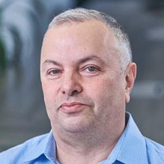

About the Speaker
Lev Selector, Ph.D.
40+ years of software engineering, data science, and building teams (hiring, training, and managing)
Ph.D. in mathematical modeling and computer simulations
Interests:
Generative AI, Using LLM with your data
Local AI for Local Private Data
Cloud architecture, fin-tech, application security
Find/connect: Linkedin, GitHub, YouTube, Google
https://eais.ai

Slide 3

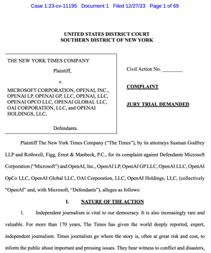
The New York Times (NYT) has sued
OpenAI and Microsoft
The New York Times (NYT) has sued OpenAI and Microsoft for illegal use of their copyrighted material to train ChatGPT. They claim that this is hurting the NYT's business. https://nytco-assets.nytimes.com/2023/12/NYT_Complaint_Dec2023.pdf - 69 pages legal doc
https://www.youtube.com/watch?v=iyGQLRzsUrQ - good video review
Elon Musk has stated that OpenAI was lying about not using copyrighted data. NYT is the single biggest proprietary data set in Common Crawl used to train GPT.
NYT describes how difficult and expensive it is to create high quality materials, and that OpenAI and Microsoft are just using them without paying anything back.
NYT claims that OpenAI has trained their models on NYT materials, and even gave them more attention because of their good quality.
GPT can even recite whole NYT articles verbatim, thus people don't have to go to the original articles, and NYT is losing visitors, subscribers, and money.
OpenAI was removing the copyright info from articles before using them for training
OpenAI and Microsoft has included their models in all their apps and systems, building trillions of dollars in value based on NYT materials, and profiting from it.
AI hallucinate articles - and attribute them to NYT. This includes misinformation related to health recommendations, buying recommendations, etc.
"Fair Use" Doctrine - allows the use of copyrighted material in some cases
Midjourney will most probably be sued by Disney. Midjourney can generated copies of Disney characters, frame by frame.

Slide 4
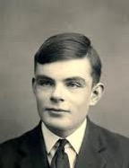
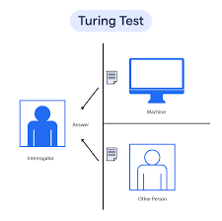
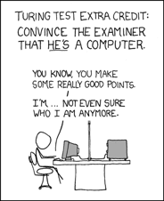
Turing Test Passed in 2023 ?
https://isturingtestpassed.github.io NO
The Turing Test was proposed by Alan Turing in 1950
A human evaluator interacts via messages with an unseen counterpart
The counterpart may be either a machine or a human
The machine passes the test if the human evaluator cannot reliably tell the machine from the human
Some people think that this level is already reached (the machine can imitate a stupid human or a child)
Alan Turing

Slide 5

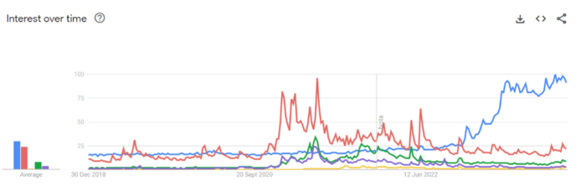
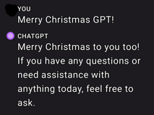
Bigger Network is NOT the Answer
https://twitter.com/Sentdex/status/1738238419300429948
""Make the network bigger" and "throw more data at it" can only go so far with the current architectures and we're already seeing significant diminishing returns for this behavior." - Harrison Kinsley
"Google wanted to blow GPT-4 out of the water with Gemini. If they could've done it by throwing more data and compute at it, they would've." - Ben Rosmine
Data curation can help. But solution is probably in new models and methods of optimization.
AI Dominates Investors Interest in 2023:
Bitcoin and Crypto Surpassed in Searches and Funding
https://www.ccn.com/news/ai-dominates-investors-interest-2023-bitcoin-crypto/
Sama Claus
https://twitter.com/mezaoptimizer/status/1739340176776699945

Slide 6
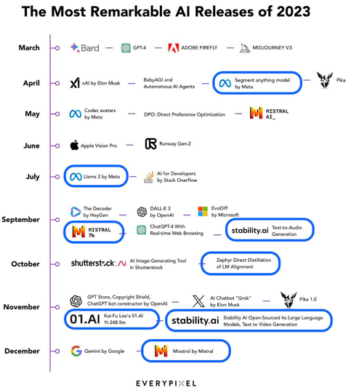
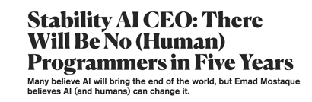
2023 at a Glance
https://twitter.com/Thom_Wolf/status/1739208822575530023
The progressive rise of open (source/access) AI models back from the ashes in 2023
By next year, the GPU in your pocket (phone) will have a local GPT3.5
I wonder why Apple vision pro is in there
Why is SD-XL not on the list?
Data from GitHub reveals that
"41% of all code right now is AI generated,"
- Emad Mostaque, Stability AI CEO, July 2023

Slide 7

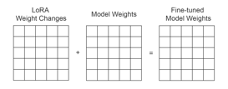
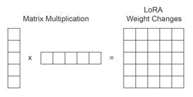
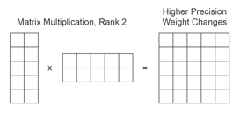
LoRA and QLoRA
Low-rank Adaptation: LoRA Fine-tuning & QLoRA Explained In-Depth
https://www.entrypointai.com/blog/lora-fine-tuning/
https://youtu.be/t1caDsMzWBk?si=IY0ox-PyPvBvFM8D
LoRA (2021, cmu.edu, Microsoft) https://arxiv.org/abs/2106.09685
https://github.com/microsoft/LoRA
QLoRA (May 2023, washington.edu) https://arxiv.org/pdf/2305.14314.pdf
https://github.com/artidoro/qlora
Mark Hennings
https://www.entrypointai.com
https://www.linkedin.com/in/markhennings/
https://www.youtube.com/@EntryPointAI/videos
matrix
decomposition
Rank | 7B | 13B | 70B | 180B
1 | 0.00% | 0.00% | 0.00% | 0.00%
2 | 0.01% | 0.00% | 0.00% | 0.00%
4 | 0.01% | 0.01% | 0.00% | 0.00%
8 | 0.02% | 0.01% | 0.01% | 0.00%
16 | 0.04% | 0.03% | 0.01% | 0.01%
64 | 0.16% | 0.11% | 0.05% | 0.03%
512 | 1.22% | 0.90% | 0.39% | 0.24%
1,024 | 2.45% | 1.80% | 0.77% | 0.48%
8,192 | 19.58% | 14.37% | 6.19% | 3.86%
16,384 | 39.17% | 28.74% | 12.39% | 7.72%
QLoRA team created a special datatype called a NormalFloat that allows a normal distribution of weights to be compressed from 16-bit floats into 4-bits and then restored back at the end with minimal loss in accuracy.
In QLoRA paper:
.. train all layers
.. there is very little statistical difference between ranks of 8 and 256.

Slide 8
The AI Race
Cloud Platforms:
.. Microsoft, Azure
.. Hugging Face
.. Amazon Bedrock
.. AWS EC2
.. Google Vertex AI
.. Google CoLab
.. IBM Watson
.. Nvidia
.. cloud.vast.ai
.. paperspace.com
.. LambdaLabs
.. brev.dev
Tools:
.. RAG tools: Vector DBs, Graph DBs, PostgreSQL
.. AutoGen
.. TaskWeaver
.. MemGPT
.. vLLM + AutoAWQ
Model Safety:
.. Meta Purple Llama
Nov 30, 2022 - ChatGPT release
has pushed many companies to completely change their agenda and to re-organize around AI
2023 - year of discoveries, POCs
2024 - year of deployments
Front-End Dev:
.. LangChain Studio
.. Windows AI Studio
.. Streamlit, Flask, Gradio
.. voiceflow.com
AI Coding Tools:
.. GPT Pilot in VS Code
.. GitHub Copilot
.. Google’s Duet AI
.. JetBrains AI IDEs
Model Training, Fine-tuning:
.. HuggingFace
.. Axolotl
.. LoRA, QLoRA, S-LoRA
.. wandb.ai (weights & biases)
.. fast.ai
Chats:
.. ChatGPT
.. Bard
.. Claude
.. labs.perplexity.ai
.. llama2.ai
.. pi.ai
AI Research:
.. Berkeley, Carnegie
Mellon, MIT, ...
.. OpenAI
.. Microsoft
.. Meta
.. Mistral.ai
.. Stability.ai
.. Anthropic
.. Google DeepMind
.. 01.ai
.. X.ai
.. Inflection.ai
.. IBM
Datasets:
.. HuggingFace
.. Orca2, Open Orca
.. Dolphin
.. scale.com
Software:
.. Python, PyTorch, JAX
.. Rust Candle
.. Nvidia CUDA, cuDNN, TensorRT
SDK, DeepStream SDK, ...
.. HuggingFace python modules (datasets, transformers) models, datasets, ...
.. LangChain, LlamaIndex
.. Apple MLX
Local Apps:
.. Ollama
.. LMStudio
.. GPT4All
.. MLC LLM
.. PrivateGPT
.. h2oGPT
AI Chips:
.. Nvidia
.. Google TPUs
.. Microsoft
.. OpenAI
.. Meta
.. Apple
.. Rain NPU
.. Cerebras
Cloud App Dev:
.. Hugging Face
.. platform.openai.com
.. Cohere.com
.. RunPod.io
.. replit.com
+ voiceflow.com
.. chatbase.co

Slide 9
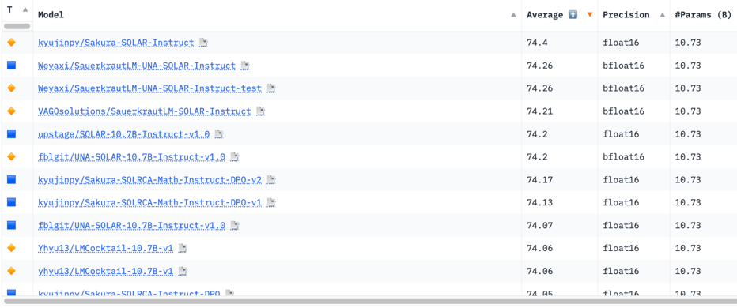
Hugging Face LLM Leaderboard
https://huggingface.co/spaces/HuggingFaceH4/open_llm_leaderboard
https://huggingface.co/datasets/open-llm-leaderboard/results
https://huggingface.co/spaces/felixz/open_llm_leaderboard
https://huggingface.co/spaces/felixz/meta_open_llm_leaderboard
https://github.com/lselector/ai/blob/master/llm_leaderboard.py
First 14 models are all fine-tuned LlaMa 10.7B
December 29, 2023

Slide 10
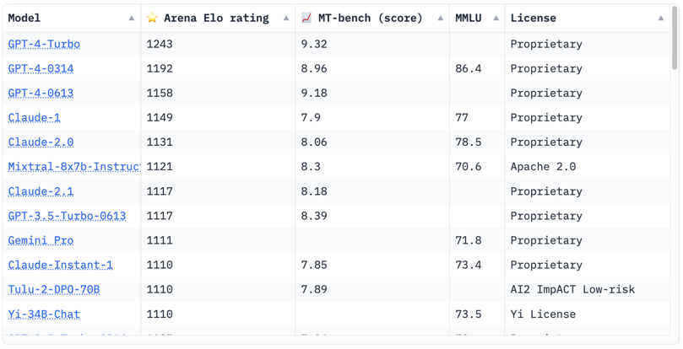
Crowd-sourced "Arena" leaderboard
https://huggingface.co/spaces/lmsys/chatbot-arena-leaderboard
December 20, 2023
Starting Elo rating for each model is set at 1000 Currently 65 models, 130K+ votes

Slide 11
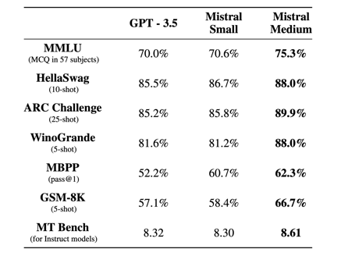
Mistral Medium in Early Access
Mistral Medium VS OpenAI GPT-4 Showdown + Flowise Deployment (Part 2)
https://www.youtube.com/watch?v=pYqEMz5zkhU
Both Mixtral 8x7 and Mistral medium is better than GPT-3.5
Mistral Medium is better, closer to GPT-4

Slide 12
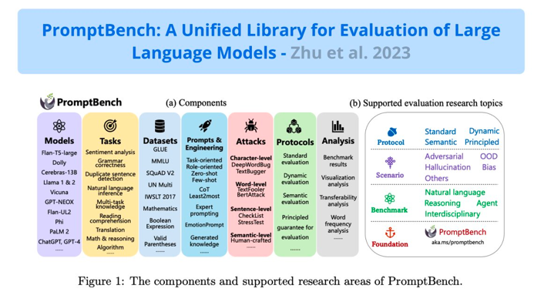
PromptBench - Unified Library for Evaluating LLMs
PromptBench: A Unified Library for Evaluation of Large Language Models - https://arxiv.org/abs/2312.07910v1
GitHub - https://github.com/microsoft/promptbench

Slide 13
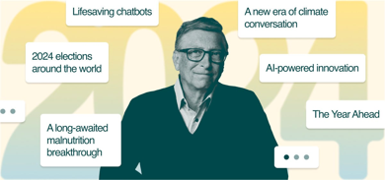
Bill Gates - Notes, Predictions
AI is about to completely change how you use computers
- By Bill Gates| November 09, 2023
https://www.gatesnotes.com/AI-agents
https://www.youtube.com/watch?v=k63-eElwz2k
https://www.gatesnotes.com/The-Year-Ahead-2024
A personal assistant for everyone
Health care, drug discovery, combat antibiotic resistance, treat high-risk pregnancies
Developing new foods to save millions of lives from malnutrition
Education - personalized
Productivity
Entertainment and shopping
"To create a new app or service, you'll just tell your agent what you want."
“If your agent needs to check in with you, it will speak to you or show up on your phone.”
Privacy and other big questions (data ownership)

Slide 14
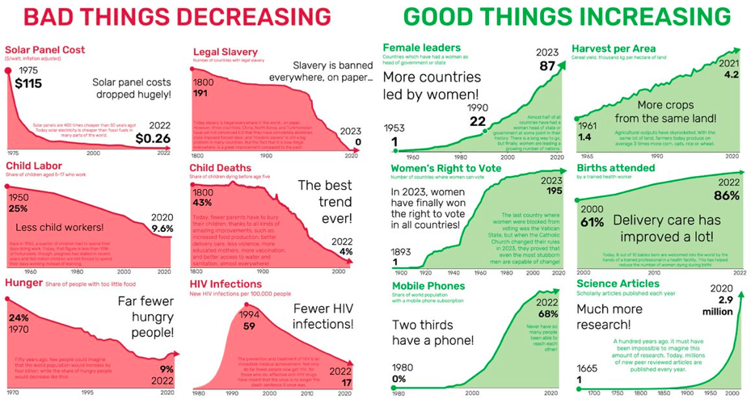
World Gets Better
https://www.gapminder.org/facts/improvements/

Slide 15
Thank You!

