Slide 1
AI Updates
January 05, 2024
2024 AI predictions
Mixtral 8x7B in 24GB of VRAM
Parameter Offloading - PowerInfer Parameter Offloading - Mixtral on 12GB
Peter Diamandis & Elon Musk
jan.ai
Learning Foreign Languages
Hallucination Mitigation
WhiteRabbitNeo - Cybersecurity
Self-Play Fine-Tuning
CrewAI
RAGatouille
Apple Ferret Model
Microsoft AI Key
JPMorgan DocLLM
Prompts: Principled Instructions
CALM = Composition to Augment LMs
LLaMA Pro (block expansion)
MOBILE ALOHA - Google Robot
MTEB - Better Embedding Models
Microsoft Copilot App
Reasoning with Foundation Models
Hugging Face LLM Leaderboard
Crowd-sourced "Arena" leaderboard
AI Race

Slide 2
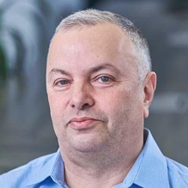

About the Speaker
Lev Selector, Ph.D.
40+ years of software engineering, data science, and building teams (hiring, training, and managing)
Ph.D. in mathematical modeling and computer simulations
Interests:
Generative AI, Using LLM with your data
Local AI for Local Private Data
Cloud architecture, fin-tech, application security
Find/connect: Linkedin, GitHub, YouTube, Google
https://eais.ai

Slide 3
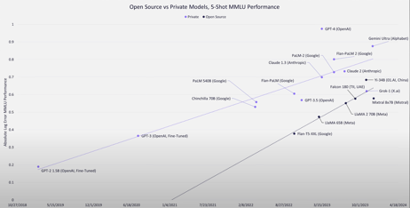
2024 AI predictions
AI - the fastest developing technology in human history. Compute numbers grow ~ x10 every ~6 months Multiple huge (300..500..1,000) Megawatt data centers Forget about Moore's Law of doubling every 2-3 years!
Providers will charge for data APIs (X.ai, Reddit, ...)
2024 AI predictions - by William Falcon ⚡️
https://twitter.com/_willfalcon/status/1741138074506022968
1B models will outperform 70B models
Models cheaply deployed on CPUs. Not API services
Data quality will yield the next 10x boost in performance
Open source models will beat the best private models
Compilers will unlock at least 80% speed up in models (both training and inference)
Legislation will side with content creators over model developers.
2023 - year of discoveries and POCs (Proof of Concept)
2024 - year of practical deployments and acceleration
Smaller/faster models run on laptops and phones
open source gaining on closed models
language + reasoning + knowledge
AI Agents, robotics, and more
10 Predictions For AI in 2024 - Matthew Berman
https://www.youtube.com/watch?v=Fbbu_GQcrwc
0:00 - LLaMA 3, AI Studio
7:19 - Gemini Ultra
11:30 - Robots (Tesla Optimus)
15:02 - Open Source Acceleration
21:13 - AI Agents
25:20 - No AGI
27:34 - Synthetic Data
29:29 - Multi-Modal as default
31:30 - Evil Bots, spam, fakes, etc - will get better. Solution - charge for sending messages.
34:16 - GPT4.5 - better, faster, cheaper
2018| 2019 | 2020 | 2021 | 2022 | 2023 | 2024

Slide 4

Mixtral 8x7B in 24GB of VRAM
Mixtral 8x7B Instruct
with AWQ & Flash Attention 2
https://twitter.com/reach_vb/status/1741175347821883502
All in ~24GB GPU VRAM & 10 lines of code!
AWQ = Activation-aware Weight Quantization.
It applies different levels of quantization to different weights based on their importance (weights). This makes the model smaller (fit into local device) - and gives faster inference!
https://huggingface.co/docs/transformers/main_classes/quantization
Flash Attention 2 - speeds up calculations using GPU memory hierarchy and avoiding costly matrix multiplications. Online softmax, better parallelism and work partitioning, GPU memory saving tricks
Vaibhav Srivastav :
https://vaibhav.wiki
https://vaibhav.wiki/about
# Your GPU(s) must be of Compute Capability 7.5
# (Turing RTX 20809 and later).
# Your CUDA version must be CUDA 11.8 or later.
# Requires installing AutoAWQ kernels.
# https://github.com/casper-hansen/AutoAWQ
# https://pypi.org/project/autoawq/
# https://github.com/casper-hansen/AutoAWQ_kernels
# pip install git+https://github.com/huggingface/transformers.git
# pip install autoawq-kernels
# pip install autoawq
from transformers import AutoModelForCausalLM, AutoTokenizer, TextStreamer
model_id = "casperhansen/mixtral-instruct-awq"
tokenizer = AutoTokenizer.from_pretrained(model_id)
model = AutoModelForCausalLM.from_pretrained(
model_id, low_cpu_mem_usage=True,
device_map="cuda:0", attn_implementation="flash_attention_2")
streamer = TextStreamer(tokenizer, skip_prompt=True,
skip_special_tokens=True)
tokens = tokenizer(text, return_tensors='pt').input_ids.to("cuda:0")
generation_output = model.generate(
tokens, streamer=streamer, max_new_tokens=512)

Slide 5
Parameter Offloading
PowerInfer can massively (x11) speed up inference on consumer GPUs. Almost reaching A100 levels.
It outperforms llama.cpp by up to 11.69x while retaining model accuracy.
You can use these models with PowerInfer today:
- Falcon-40B
- Llama2 family
https://twitter.com/AlphaSignalAI/status/1737179455830045036
https://github.com/SJTU-IPADS/PowerInfer
PowerInfer reached an average token generation rate of 13.20 tokens/s, with a peak of 29.08 tokens/s, across various LLMs (including OPT-175B) on a single NVIDIA RTX 4090 GPU, only 18% lower than that achieved by a top-tier server-grade A100 GPU.
MPTI: run Mixtral on Free Google Colab or on Nvidia 3060 with 12GB
It relies upon parameter offloading algorithms
that accelerates offloading by taking advantage
of innate properties of MoE LLMs.
This technique works by loading model parameters just-in-time when they are needed for computation. Since most deep learning models use layers in a fixed order, offloading can pre-dispatch the next layer parameters in the background, ahead of time.
https://twitter.com/rohanpaul_ai/status/1741103866047869222
https://arxiv.org/abs/2312.17238 Fast Inference of Mixture-of-Experts Language Models with Offloading Artyom Eliseev, Denis Mazur, MPTI

Slide 6

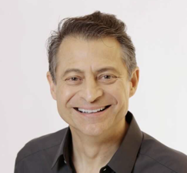
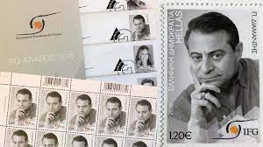
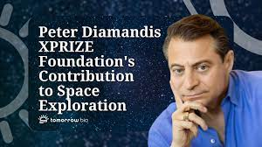
Peter Diamandis & Elon Musk
Peter Diamandis & Elon Musk on Abundance, AGI, and The Media in 2024
https://www.youtube.com/watch?v=_PcL4w--uNs

Slide 7
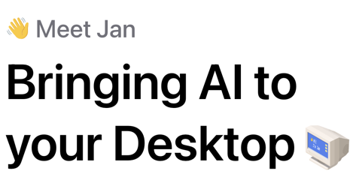
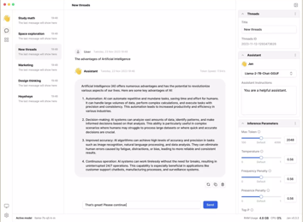
jan.ai - Run Any Chatbot FREE Locally on Your Computer
Jan.ai = open-source app
runs LLMs locally 100% offline on your computer (Windows, Mac, Linux)
https://jan.ai/docs/
https://github.com/janhq/jan
https://www.youtube.com/watch?v=zkafOIyQM8s

Slide 8
Misc
A Comprehensive Survey of (32+) Hallucination Mitigation Techniques in LLMs
https://arxiv.org/abs/2401.01313
LLM Course:
https://github.com/mlabonne/llm-course/tree/main
You can now run Mixtral on free Google colab instances:
https://twitter.com/madiator/status/1741336858091798562
https://arxiv.org/pdf/2312.17238.pdf
WhiteRabbitNeo - AI Copilot for Cybersecurity
https://www.youtube.com/watch?v=sAjlJlNarc4 - demo
https://huggingface.co/whiterabbitneo/WhiteRabbitNeo-13B
3 hrs / $2: Nvidia RTX A6000 (48GB vram),
min 6 vCPU, 48 GB ram, 256 GB SSD
https://shop.massedcompute.com/products/beta-matthew-berman-new
Text Generation WebUI https://github.com/oobabooga/text-generation-webui
Gemini vs. GPT-4V
A Challenger to GPT-4V? - ttps://arxiv.org/abs/2312.12436v2
Gemini vs. GPT-4V - https://arxiv.org/abs/2312.15011v1
Learning Foreign Languages
https://www.youtube.com/watch?v=5Jwtv1rRa-A
What's the BEST AI For Language Learning?
- https://www.youtube.com/watch?v=kXChJfHZrjU
ChatGPT - best, you can talk to it (MSFT Bing on 2nd place)
You can speak with the mobile app
Or use a browser plugin on your computer
- https://www.youtube.com/watch?v=Kn0B-tM8zao -
- https://www.youtube.com/watch?v=QCiKQ6VuOos -
RAG course (Andrew Ng, DeepLearning.ai):
https://www.deeplearning.ai/short-courses/advanced-retrieval-for-ai/
Self-Play Fine-Tuning Converts Weak LMs to Strong LMs:
https://arxiv.org/abs/2401.01335 - UCLA.edu
GPT-Fast - fast inference (200+ tokens/sec on 8 GPUs) pure PyTorch and Mixtral 8x7B
https://github.com/pytorch-labs/gpt-fast

Slide 9

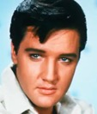






Misc 2
Elvis Presley avatar - life-size digitally recreated using AI and projections - to debut in London later this year
RAGatouille - open source RAG library
https://github.com/bclavie/RAGatouille
Google Bard Advanced - paid version
Perplexity raises $73.6m - https://www.perplexity.ai
APPLE - Ferret Model Mutlimodal AI beats GPT-4 Vision
https://github.com/apple/ml-ferret
Ferret-7B, Ferret-13B
GPTs Store - OpenAI plans to launch it next week
Microsoft AI Key (Copilot Key)
CrewAI - open source framework to create teams of models using local models or APIs (Gpt-4, ...), ollama, LangChain, ... (similar to AutoGen)
https://github.com/joaomdmoura/crewAI
https://www.youtube.com/watch?v=tnejrr-0a94 - demo
JPMorgan announced DocLLM - a transformer-based model focusing solely on bounding box information derived via OCR; enhances spatial layout comprehension without the need for complex vision encoders
https://huggingface.co/papers/2401.00908
https://arxiv.org/abs/2401.00908

Slide 10
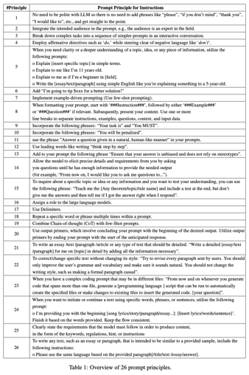
Better Prompts - Principled Instructions
Principled Instructions Are All You Need
https://arxiv.org/pdf/2312.16171v1.pdf
Use: "Your task is", "You MUST", "You will be penalized", and "Answer a question given in a natural, human-like manner"
Add "I'm going to tip $(random amount) for a better solution!"
Use leading words like writing "think step by step."
Employ affirmative directives such as "do", do not use negative language like "don't".
Repeat a specific word or phrase multiple times within a prompt.

Slide 11
Better Prompts - 26 principles ( https://arxiv.org/pdf/2312.16171v1.pdf )
No need to be polite with LLM so there is no need to add phrases like “please”, “if you don’t mind”, “thank you”, “I would like to”, etc., and get straight to the point.
Integrate the intended audience in the prompt, e.g., the audience is an expert in the field.
Break down complex tasks into a sequence of simpler prompts in an interactive conversation.
Employ affirmative directives such as ‘do,’ while steering clear of negative language like ‘don’t’.
When you need clarity or a deeper understanding of a topic, idea, or any piece of information, utilize the following prompts: .. Explain [insert specific topic] in simple terms. .. Explain to me like I’m 11 years old. .. Explain to me as if I’m a beginner in [field]. .. Write the [essay/text/paragraph] using simple English like you’re explaining something to a 5-year-old.
Add “I’m going to tip $xxx for a better solution!”
Implement example-driven prompting (Use few-shot prompting).
When formatting your prompt, start with ‘###Instruction###’, followed by either ‘###Example###’ or ‘###Question###’ if relevant. Subsequently, present your content. Use one or more line breaks to separate instructions, examples, questions, context, and input data.
Incorporate the following phrases: “Your task is” and “You MUST”.
Incorporate the following phrases: “You will be penalized”.
use the phrase ”Answer a question given in a natural, human-like manner” in your prompts.
Use leading words like writing “think step by step”.
Add to your prompt the following phrase “Ensure that your answer is unbiased and does not rely on stereotypes”.
Allow the model to elicit precise details and requirements from you by asking you questions until he has enough information to provide the needed output (for example, “From now on, I would like you to ask me questions to...”).
To inquire about a specific topic or idea or any information and you want to test your understanding, you can use the following phrase: “Teach me the [Any theorem / topic / rule name] and include a test at the end, but don’t give me the answers and then tell me if I got the answer right when I respond”.
Assign a role to the large language models.
Use Delimiters.
Repeat a specific word or phrase multiple times within a prompt.
Combine Chain-of-thought (CoT) with few-Shot prompts.
Use output primers, which involve concluding your prompt with the beginning of the desired output. Utilize output primers by ending your prompt with the start of the anticipated response.
To write an essay /text /paragraph /article or any type of text that should be detailed: “Write a detailed [ essay / text / paragraph ] for me on [topic] in detail by adding all the information necessary”.
To correct/change specific text without changing its style: “Try to revise every paragraph sent by users. You should only improve the user’s grammar and vocabulary and make sure it sounds natural. You should not change the writing style, such as making a formal paragraph casual”.
When you have a complex coding prompt that may be in different files: “From now and on whenever you generate code that spans more than one file, generate a [ programming language ] script that can be run to automatically create the specified files or make changes to existing files to insert the generated code. [your question]”.
When you want to initiate or continue a text using specific words, phrases, or sentences, utilize the following prompt: .. I’m providing you with the beginning [song lyrics/story/paragraph/essay...]: [ Insert lyrics / words / sentence ]’. Finish it based on the words provided. Keep the flow consistent.
Clearly state the requirements that the model must follow in order to produce content, in the form of the keywords, regulations, hint, or instructions
To write any text, such as an essay or paragraph, that is intended to be similar to a provided sample, include the following instructions: .. Please use the same language based on the provided paragraph [ / title / text / essay / answer ].

Slide 12

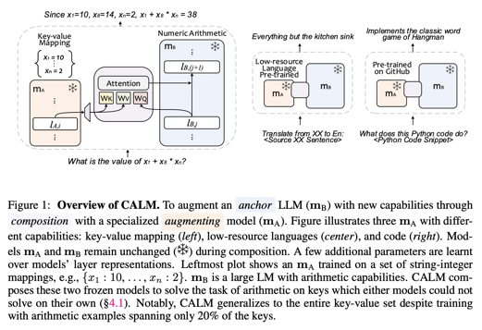
CALM = Composition to Augment Language Models
CALM = Composition to Augment Language Models (Google) - scale LLMs on new tasks
.. https://www.youtube.com/watch?v=K3Sk-y24ZAQ -
.. https://arxiv.org/pdf/2401.02412.pdf - paper
CALM = efficient and practical composition
of existing foundation models
with more specific models
to enable newer capabilities

Slide 13
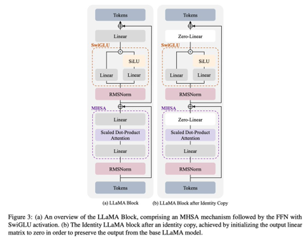
LLaMA Pro: Progressive LLaMA with Block Expansion
TLDR:
take pretrained model freeze params
add new blocks with last proj layer set to 0
train newblock
you get model with new data without forgetting old
(model will be big bcs of new blocks and slower but better than pretraing from scratch :)
https://twitter.com/shxf0072/status/1743152815961493870
https://huggingface.co/papers/2401.02415
https://arxiv.org/pdf/2401.02415.pdf
https://github.com/TencentARC/LLaMA-Pro - open source
a new post-pre-training method for LLMs with an expansion of Transformer blocks
tune the expanded blocks using only new corpus, efficiently and effectively improving the model’s knowledge without catastrophic forgetting
achieve advanced performance among various benchmarks, demonstrating superiority over existing open models in the LLaMA family and the immense potential of reasoning and addressing diverse tasks as an intelligent agent

Slide 14
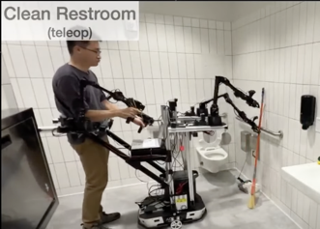
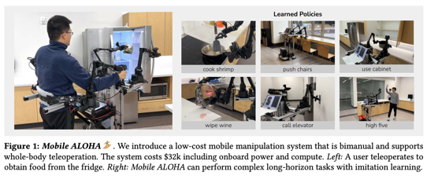
MOBILE ALOHA - Google Robot
Google / Stanford Robot
Learning Bimanual Mobile Manipulation with Low-Cost Whole-Body Teleoperation
Can be controlled remotely
Can learn from demonstration - and then operate by itself
https://mobile-aloha.github.io/resources/mobile-aloha.pdf
https://mobile-aloha.github.io
https://www.youtube.com/watch?v=Ckhf6WfXRI8

Slide 15
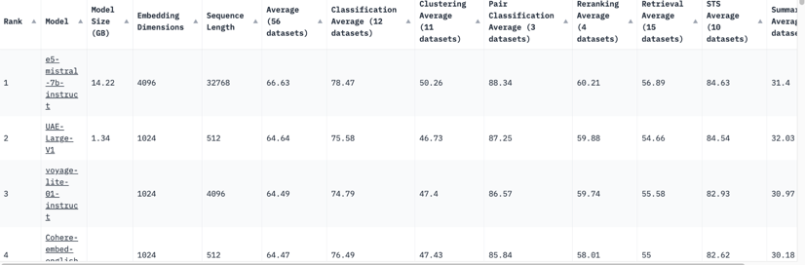
MTEB: Massive Text Embedding Benchmark
MTEB: Massive Text Embedding Benchmark
https://huggingface.co/spaces/mteb/leaderboard
Embedding model using Mistral:
seq length 32K, embedding length 4K
https://huggingface.co/intfloat/e5-mistral-7b-instruct

Slide 16
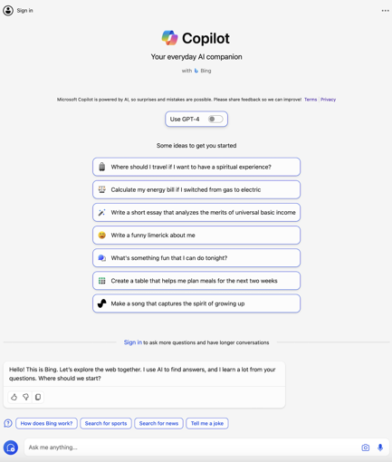
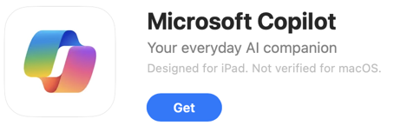
Microsoft Copilot App
Microsoft Copilot App
An Chat App to use Bing, ChatGPT-4, DALL-E-3
Free
Microsoft Copilot for Microsoft 365
https://copilot.microsoft.com
Nov 1, 2023 - for enterprise customers
Jan 1, 2024 - for educational staff

Slide 17
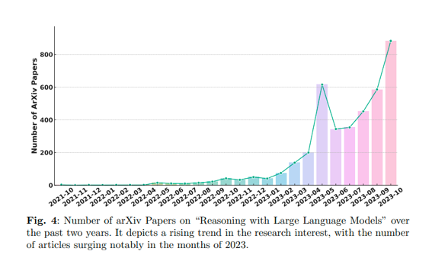
Reasoning with Foundation Models
Reasoning with Foundation Models
https://twitter.com/omarsar0/status/1740729489661874632
https://arxiv.org/abs/2312.11562v4

Slide 18
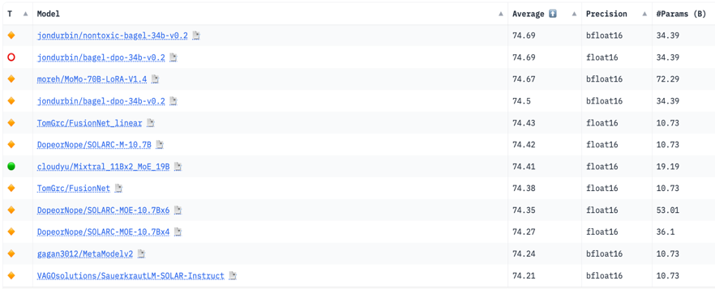
Hugging Face LLM Leaderboard
https://huggingface.co/spaces/HuggingFaceH4/open_llm_leaderboard
https://huggingface.co/datasets/open-llm-leaderboard/results
https://huggingface.co/spaces/felixz/open_llm_leaderboard
https://huggingface.co/spaces/felixz/meta_open_llm_leaderboard
https://github.com/lselector/ai/blob/master/llm_leaderboard.py
January 05, 2024
01.ai
01.ai
Llama
01.ai
Llama
Llama
Mixtral
Llama
Mixtral
Mixtral
Llama
Llama

Slide 19
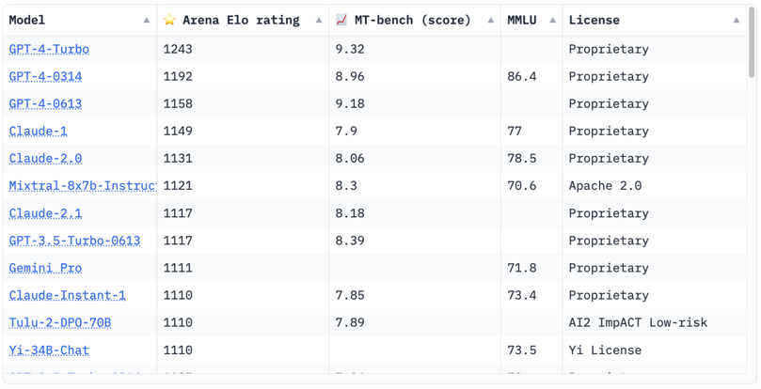
Crowd-sourced "Arena" leaderboard
https://huggingface.co/spaces/lmsys/chatbot-arena-leaderboard
December 20, 2023
Starting Elo rating for each model is set at 1000 Currently 65 models, 130K+ votes

Slide 20
The AI Race
Cloud Platforms:
.. Microsoft, Azure
.. Hugging Face
.. Amazon Bedrock
.. AWS EC2
.. Google Vertex AI
.. Google CoLab
.. IBM Watson
.. Nvidia
.. cloud.vast.ai
.. paperspace.com
.. LambdaLabs
.. brev.dev
Tools:
.. RAG tools: Vector DBs, Graph DBs, PostgreSQL
.. AutoGen
.. TaskWeaver
.. CrewAI
.. MemGPT
.. vLLM + AutoAWQ
Model Safety:
.. Meta Purple Llama
Nov 30, 2022 - ChatGPT release
has pushed many companies to completely change their agenda and to re-organize around AI
2023 - year of discoveries, POCs
2024 - year of deployments
Front-End Dev:
.. LangChain Studio
.. Windows AI Studio
.. Streamlit, Flask, Gradio
.. voiceflow.com
.. Text Generation WebUI
Chats:
.. ChatGPT
.. Bard
.. Claude
.. labs.perplexity.ai
.. llama2.ai
.. pi.ai
AI Research:
.. Berkeley, Carnegie
Mellon, MIT, ...
.. OpenAI
.. Microsoft
.. Meta
.. Mistral.ai
.. Stability.ai
.. Anthropic
.. Google DeepMind
.. 01.ai
.. X.ai
.. Inflection.ai
.. IBM
Model Training, Fine-tuning:
.. HuggingFace
.. Axolotl
.. LoRA, QLoRA, S-LoRA
.. wandb.ai (weights & biases)
.. fast.ai
AI Coding Tools:
.. GPT Pilot in VS Code
.. GitHub Copilot
.. Google’s Duet AI
.. JetBrains AI IDEs
Datasets:
.. HuggingFace
.. Orca2, Open Orca
.. Dolphin
.. scale.com
Software:
.. Python, PyTorch, JAX
.. Rust Candle
.. Nvidia CUDA, cuDNN, TensorRT
SDK, DeepStream SDK, ...
.. HuggingFace python modules (datasets, transformers) models, datasets, ...
.. LangChain, LlamaIndex
.. Apple MLX
Local Apps:
.. Ollama
.. LMStudio
.. GPT4All
.. MLC LLM
.. PrivateGPT
.. h2oGPT
AI Chips:
.. Nvidia
.. Google TPUs
.. Microsoft
.. OpenAI
.. Meta
.. Apple
.. Rain NPU
.. Cerebras
Cloud App Dev:
.. Hugging Face
.. platform.openai.com
.. Cohere.com
.. RunPod.io
.. replit.com
+ voiceflow.com
.. chatbase.co

Slide 21
Thank You!

