Slide 1
AI Updates
January 12, 2024
Mamba Outperforms Transformers
Mixtral-8x7B on a laptop
deepinfra.com - Mixtral at 54 c/Mtokens
Latent.Space - Four Wars of the AI Stack
Open Interpreter - use Local LLM
GPTStore.AI - 12K GPTs
Mixtral paper
AI at Deloitte
OpenAI response to New York Times
AutoGen Studio
TechGPT-2.0
Pennsylvania State to use OpenAI
Jensen Tung - making money with AI
Google open-sourced 1.6T MoE model
"guidde" - generate video docs
1x.tech raises 100M
Local PDF question answering
Rabbit R1 Large Action Model
AI at CES Consumer Electronics Show
AI Leaderboard
Arena Leaderboard
YALL - Yet Another LLM Leaderboard
Nous Research
The AI World
Are Mass Layoffs Coming?
New Jobs from AI
ArXiv.org - submit papers
Tiny LLMs
Monarch Mixer (M2) Retrieval Models
Distilling Language Models
CloudFlare for your website

Slide 2
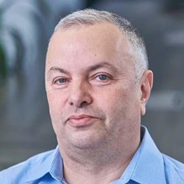

About the Speaker
Lev Selector, Ph.D.
40+ years of software engineering, data science, and building teams (hiring, training, and managing)
Ph.D. in mathematical modeling and computer simulations
Interests:
Generative AI, Using LLM with your data
Local AI for Local Private Data
Cloud architecture, fin-tech, application security
Find/connect: Linkedin, GitHub, YouTube, Google
https://eais.ai

Slide 3

Mamba
Mamba: Linear-Time Sequence Modeling with Selective State Spaces - by Albert Gu (CMU), Tri Dao (Stanford/Princeton)
https://arxiv.org/abs/2312.00752
https://blog.oxen.ai/mamba-linear-time-sequence-modeling-with-selective-state-spaces-arxiv-dives/
Mamba inference is 5x faster than Transformers.
It scales linearly instead of O(N²) with the length of the sequence - thus it can scale to million-length sequences.
SSMs (State Space Sequence Models) challenge the dominance of Transformers.
S4 = Structured State Space for Sequence Modeling:
https://srush.github.io/annotated-s4/
https://www.youtube.com/watch?v=GqwhkbrWDOI
SSM = any recurrent process with a latent space.
SSM is just a version of a RRN (Recurrent Neural Net).
GRUs and LSTMs - gated networks (gates used to select what to remember as you go along the sequence)
Sequence modeling is the art of compressing context into a smaller state (for example, by selecting), and then using it to predict the output sequence.
Attention does not compress the context at all.
Mamba: provides a selection mechanism to filter out irrelevant information, and a hardware aware algorithm that computes the model recurrently but does not materialize in the expanded state, optimizing for GPU memory layouts.
Gated Linear Attention Transformers with Hardware-Efficient Training - 5 authors, MIT-IBM - https://arxiv.org/abs/2312.06635
MoE-Mamba: Efficient Selective State Space Models with Mixture of Experts - https://arxiv.org/abs/2401.04081
- https://www.youtube.com/watch?v=tZD3-uO0RJ0 - video MoE-Mamba, outperforms both Mamba and Transformer-MoE. It reaches performance of Mamba in 2.2x less training steps while preserving the inference performance gains of Mamba against the Transformer.
U-Mamba: Enhancing Long-range Dependency for Biomedical Image Segmentation - https://arxiv.org/abs/2401.04722
U-Mamba outperforms state-of-the-art CNN-based and Transformer-based segmentation networks

Slide 4


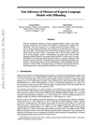


Efficient inference of Mixtral-8x7B on a laptop
run Mixtral on Nvidia 3060 with 12GB !
https://arxiv.org/abs/2312.17238 - paper
https://github.com/dvmazur/mixtral-offloading
https://twitter.com/rohanpaul_ai/status/1741103866047869222
- Stream model during Inference!
- Just-In-Time Loading of model layers!
Since most deep learning models use layers in a fixed order, offloading can pre-dispatch the next layer parameters in the background, ahead of time.
Mixed quantization with HQQ - separate quantization schemes for attention layers and experts to fit the model into the combined GPU and CPU memory.
MoE offloading strategy - each expert per layer is offloaded separately and only brought pack to GPU when needed. LRU cache (Least Recently Used) is used to reduce GPU-RAM communication when computing activations for adjacent tokens.
Demo notebook:
https://github.com/dvmazur/mixtral-offloading/blob/master/notebooks/demo.ipynb
https://colab.research.google.com/github/dvmazur/mixtral-offloading/blob/master/notebooks/demo.ipynb
Moscow Institute of Physics and Technology
Yandex
Denis Mazur
Yandex Researchcore
https://github.com/dvmazur
Artyom Eliseev
Yandex School of Data Analysis
https://github.com/lavawolfiee

Slide 5

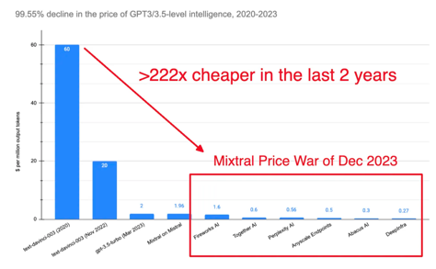
deepinfra.com
Mixtral rates - (in/out) in $ per Million tokens:
($0.6 / $1.8 ) from Mistral
($0.4 / $1.6 ) from Fireworks.AI
($0.6 / $0.6 ) from Together AI
($0.14 / $0.56) from Perplexity
($0.5 / $0.5 ) from Anyscale
($0.2 / $0.5 ) from OctoAI (formerly OctoML)
($0.3 / $0.3 ) from Abacus AI
down from original ($2/$2)!
($0.27 / $0.27) from Deepinfra
“free” on OpenRouter, but rate limited
DeepInfra is a startup offering open-source models
at very low rates via simple API - pay only for usage
https://deepinfra.com
https://twitter.com/DeepInfra
https://venturebeat.com/data-infrastructure/deepinfra-emerges-from-stealth-with-8m-to-make-running-ai-inferences-more-affordable/
 | Model | in $/Mt | out $/Mt | total
Google | Gemini Pro | 1 | 2 | 3
Antropic | Claude-2 | 8 | 24 | 32
AnyScale | Mistral-7b | 0.15 | 0.15 | 0.3
AnyScale | Mixtral-8x7b | 0.5 | 0.5 | 1
AnyScale | Llama-2-70b | 1 | 1 | 2
Mistral | tiny 7b | 0.14 | 0.42 | 0.56
Mistral | small 8X7b | 0.6 | 1.8 | 2.4
Mistral | medium | 2.5 | 7.5 | 10
Together AI | Llama-2-70b | 0.9 | 0.9 | 1.8
Together AI | 8X7b | 0.6 | 0.6 | 1.2
OpenAI | gpt-4-turbo | 10 | 30 | 40
OpenAI | gpt-3.5-turbo | 1 | 2 | 3

Slide 6

Latent.Space
https://www.latent.space/p/dec-2023
The Four Wars of the AI Stack
The Data Wars (rights, deals, law suits, synthetic data)
The War of the GPU power & pricing
The Multimodality War - Midjourney, Assembly AI, Replicate, Suno AI, Stability.AI, OpenAI, Google
The RAG/Ops War - Vector DB, https://turbopuffer.com - serverless vector DB - LangChain vs LlamaIndex - LLMOps - https://humanloop.com, https://www.openlayer.com LangSmith - https://docs.smith.langchain.com Martian - https://withmartian.com - dynamic LLM router for higher performance
Latent.Space is:
a technical newsletter
a podcast - top 10 in US Tech! audio and video
a community (online and in person)
by and for the rising class of AI Engineers,
focusing on the business and technology of this new AI summer. https://www.latent.space/about https://www.youtube.com/@LatentSpaceTV

Slide 7
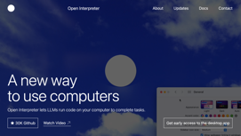
Open Interpreter
Open Interpreter allows you to run code using LLM.
Now you can do it using local LLM !
https://github.com/KillianLucas/open-interpreter
https://www.youtube.com/watch?v=xPd8FFzIeOw - video demo
https://openinterpreter.com
Note: use "bash"
pip install open-interpreter
interpreter # start running it
interpreter --local # use local LLM from LMStudio
interpreter --vision # in "vision" mode
interpreter --help
usage: interpreter [-h] [-ci CUSTOM_INSTRUCTIONS] [-s SYSTEM_MESSAGE] [-y] [-v] [-m MODEL] [-t TEMPERATURE] [-lsv] [-lsf] [-c CONTEXT_WINDOW] [-x MAX_TOKENS] [-b MAX_BUDGET] [-ab API_BASE] [-ak API_KEY] [-av API_VERSION] [-xo MAX_OUTPUT] [-fc] [-dt] [-o] [-sm] [-safe {off,ask,auto}] [-cf CONFIG_FILE] [-f] [-l] [-vi] [-os] [--config] [--reset_config] [--conversations] [--version]

Slide 8
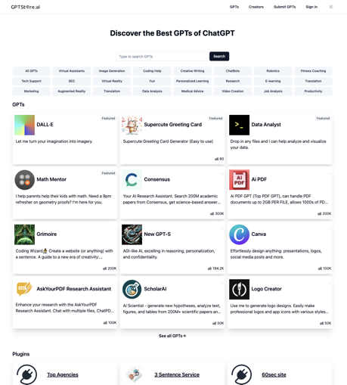
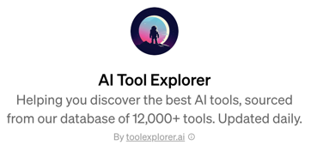
GPTStore.AI
https://gptstore.ai
https://chat.openai.com/gpts
https://www.youtube.com/watch?v=ZbVjyQyVaWw https://www.youtube.com/watch?v=NOpmy7Kqgok
Protect your prompt and data:
https://www.youtube.com/watch?v=Ey2Wt1heba4
"Save for All", create builder profile,
start earning (in Q1, based on user engagement)
AI Tool Explorer
https://chat.openai.com/g/g-YFQNFNgSM-ai-tool-explorer
https://gptsdex.com

Slide 9
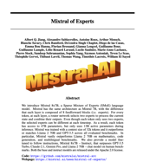
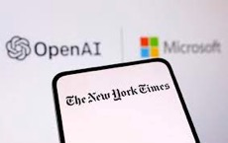

Misc - 1
Mixtral paper "Mixtral of Experts" 26 authors
Paper: https://arxiv.org/pdf/2401.04088.pdf
Video: https://www.youtube.com/watch?v=8XTHLhwX0UQ
Code: https://github.com/mistralai/mistral-src
Webpage: https://mistral.ai/news/mixtral-of-experts/
Huggingface: https://huggingface.co/mistralai/Mixtral-8x7B-Instruct-v0.1
Deloitte is the largest professional services network
~$65 Bln Revenue
~457K employees
Deloitte AI Institute
CortexAI Platform for AI, analytics, and data solutions. Quartz Frontline AI (conversational AI)
https://www2.deloitte.com
https://www2.deloitte.com/us/en/misc/search.html?qr=AI
https://www2.deloitte.com/us/en/pages/consulting/articles/ai-dossier.html
Hiring AI talent ("Dialog Engineer", "Prompt Engineer", ...)
Internal AI research and development
Partnerships and collaborations (Google, OpenAI, ...)
Publications and events
OpenAI strikes back against New York Times
https://www.youtube.com/watch?v=m1kK8EDqqB0
Seems that NYT basically faked evidence by manipulating prompts and chat history to trick ChatGPT to provide the answers
So NYT is lying to push their own agenda - and even demands the destruction of OpenAI's LLMs
LLMs are not storing the original texts - they store statistical data, which is NOT copywritable

Slide 10
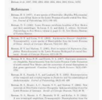

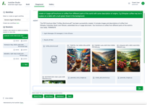
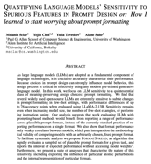


Misc - 2
Not a single commercial LLM can sort the list of ~100 references according to the last name of the first author
https://twitter.com/kchonyc/status/1745151497258872989
TechGPT-2.0: A LLM for knowledge graph construction
https://arxiv.org/abs/2401.04507v1
https://github.com/neukg/TechGPT-2.0
AutoGen Studio
https://microsoft.github.io/autogen/blog/2023/12/01/AutoGenStudio/
Importance of proper prompting: Depending on the format used in few-shot prompting, you may get accuracies:
4%-88% with LLaMA-2-70B 5-shot
47%-85% w/GPT3.5
https://twitter.com/melaniesclar/status/1745557109419458695
https://arxiv.org/abs/2310.11324
Pennsylvania State started a collaboration with OpenAI. State employees will use ChatGPT Enterprise to assist in various tasks such as creating and editing copy, updating policy language, drafting job descriptions, and generating code.
https://www.governor.pa.gov/newsroom/shapiro-administration-and-openai-launch-first-in-the-nation-generative-ai-pilot-for-commonwealth-employees/

Slide 11

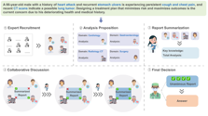



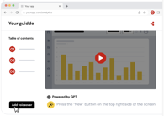
Misc - 3
Jensen Tung - multiple ideas on making money with AI
https://www.youtube.com/@jensentung
AI agents working together to analyze, discuss, and reach consensus on medical topics.
https://github.com/gersteinlab/medagents
OpenAI says it’s “impossible” to create useful AI models without copyrighted material
https://arstechnica.com/information-technology/2024/01/openai-says-its-impossible-to-create-useful-ai-models-without-copyrighted-material/
Google open sources 1.6T MoE model: Switch Transformers C - 2048 experts (1.6T parameters for 3.1 TB) - 2022
https://huggingface.co/google/switch-c-2048
https://arxiv.org/pdf/2101.03961.pdf
guidde - generative AI to create video docs 11x faster https://www.guidde.com
1x raises $100M in ser.B
humanoid robots
https://www.1x.tech

Slide 12



Local PDF question answering
PDF Expert - local PDF viewer/editor now has AI Chat:
Generate Summary
List Main Points
Generate Keywords
Generate Hashtags
Ask Anything about the doc
https://pdfexpert.com/blog/introducing-ai-chat
Other options:
PrivateGPT
LocalGPT
GPT4All
chatd - your own private local AI that can read files on your computer. Chat with your documents!
https://www.chatd.ai
https://github.com/BruceMacD/chatd
powered by Ollama, uses Mistral-7B model
Available on Mac, Windows, Linux
h2oGPT - private local GPT (Mac, Windows, Linux)
Can use local LLM and local database, or online APIs
Can work on local PDFs and other docs
.. https://github.com/h2oai/h2ogpt
.. https://gpt.h2o.ai - online GUI

Slide 13
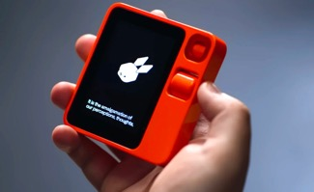


Rabbit R1 AI Pocket Companion
Rabbit R1 - NEW Personal AI AGENT - $199
Received 20K+ orders in first 48 hrs!
Rabbit Inc. - a startup founded in 2020, from Y Combinator program, Los Angeles, $30 Mln in funding
https://voicebot.ai/2024/01/08/generative-ai-hardware-startup-rabbit-reaches-30m-in-funding-round/
r1 device - collaboration with Swedish firm Teenage Engineering - can interpret natural language requests and navigate various apps accordingly
LAM = Large Action Model - Learning human actions on different computer applications. AI learns how to work with apps itself without need for an API.
r1 can learn directly from human interaction with apps, bypassing the need for standard APIs. The R1's cool feature is its training mode, where you can teach it new tasks. It learns quickly - in just 30 seconds, it's ready to go.
video - https://www.youtube.com/watch?v=22wlLy7hKP4
video - https://www.youtube.com/watch?v=DlnJlG1SOZo
web - https://www.rabbit.tech
.. https://www.rabbit.tech/updates/introducing-r1
.. https://www.rabbit.tech/rabbit-os
.. https://twitter.com/rabbit_hmi
Jesse Lyu
CEO & Founder
https://www.linkedin.com/in/jesselyu/
Peiyuan Liao
CTO & Co-Founder
Kaggle Grandmaster
researcher at Carnegie Mellon
https://www.linkedin.com/in/peiyuan-liao/

Slide 14

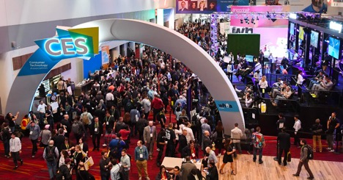
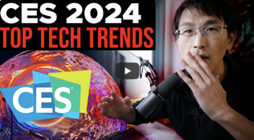
AI dominates Consumer Electronics Show
AI dominates CES 2024
(Consumer Electronics Show) in Las Vegas, Jan 9-12. https://www.ces.tech
more than 130,000 attendees
over 4,000 exhibitors from more than 150 countries
over 1,200 startups
12 official venues, 2+ Mln square feet of exhibit space
Robots, Gadgets, Home, Automotive, ...
https://www.youtube.com/watch?v=44mh6JiHQ8I
https://www.youtube.com/watch?v=qu6i2lgc-uY - video review by Patrick Shyu, a.k.a. TechLead. Lots of talk, not so much implementation yet. Partnerships (for example, auto + electronics, ...), drone delivery, kitchen AI, wearables, ...

Slide 15
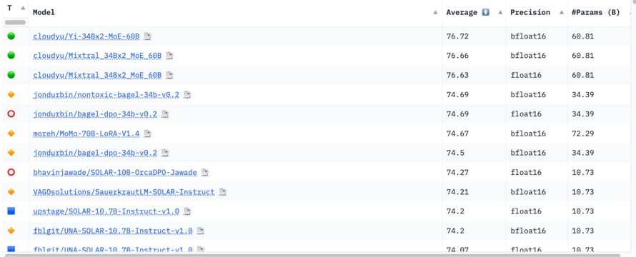
Hugging Face LLM Leaderboard
https://huggingface.co/spaces/HuggingFaceH4/open_llm_leaderboard
https://huggingface.co/datasets/open-llm-leaderboard/results
https://huggingface.co/spaces/felixz/open_llm_leaderboard
https://huggingface.co/spaces/felixz/meta_open_llm_leaderboard
https://github.com/lselector/ai/blob/master/llm_leaderboard.py
January 12, 2024
01.ai
Mixtral
Mixtral
01.ai
01.ai
Alibaba
01.ai
Llama
Llama
Llama
Llama
Llama

Slide 16
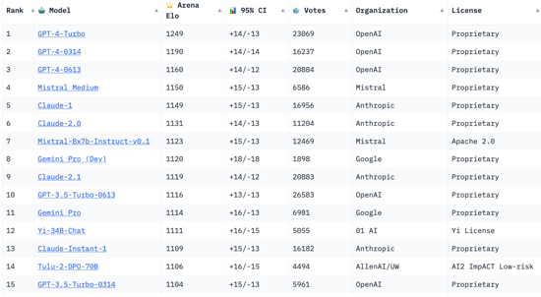
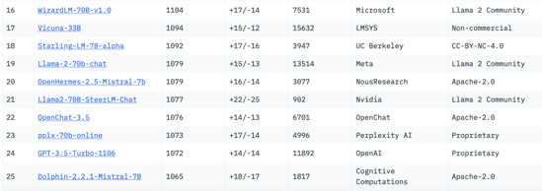
Crowd-sourced "Arena" leaderboard
https://huggingface.co/spaces/lmsys/chatbot-arena-leaderboard
Jan 9, 2024
54 Models
214K+ votes
Starting Elo rating = 1000
for each model
95% CI = Confidence Interval
What is the architecture
of Mistral Medium?
It is probably MoE ?
8x30b ? 32x7b ?
https://www.reddit.com/r/LocalLLaMA/comments/18m2t0z/deducing_mistral_medium_size_from_pricing_is_it_a/
47B
7B
7B
7B

Slide 17
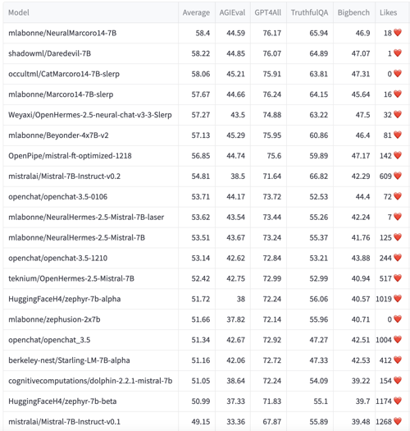
YALL - Yet Another LLM Leaderboard
https://huggingface.co/spaces/mlabonne/Yet_Another_LLM_Leaderboard
Leaderboard made with LLM AutoEval using Nous benchmark suite.

Slide 18
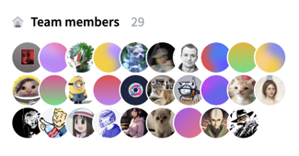
Nous Research
Nous Research received $5.2 Mln financing
https://twitter.com/NousResearch/status/1744865872563618128
Nous Research focuses mainly on two key areas of machine learning: data synthesis and fine-tuned large language models (LLMs).
https://huggingface.co/NousResearch
Hermes - uncensored LLM
YaRN - LLaMa-2 based LLM with 128K context window
Capybara model
Puffin Model
Obsidian - worlds smallest multi-modal LLM (3B)
.. https://nousresearch.com
.. https://github.com/NousResearch

Slide 19
The AI World
Cloud Platforms:
.. Microsoft, Azure
.. Hugging Face
.. Amazon Bedrock
.. AWS EC2
.. Google Vertex AI
.. Google CoLab
.. IBM Watson
.. Nvidia
.. cloud.vast.ai
.. paperspace.com
.. LambdaLabs
.. brev.dev
Tools:
.. RAG tools: Vector DBs, Graph DBs, PostgreSQL
.. AutoGen
.. TaskWeaver
.. CrewAI
.. MemGPT
.. vLLM + AutoAWQ
Model Safety:
.. Meta Purple Llama
Nov 30, 2022 - ChatGPT release
has pushed many companies to completely change their agenda and to re-organize around AI
2023 - year of discoveries, POCs
2024 - year of deployments
Front-End Dev:
.. LangChain Studio
.. Windows AI Studio
.. AutiGen Studio
.. Streamlit, Flask, Gradio
.. voiceflow.com
.. Text Generation WebUI
Chats:
.. ChatGPT
.. Bard
.. Claude
.. labs.perplexity.ai
.. llama2.ai
.. pi.ai
AI Research:
.. Berkeley, Carnegie
Mellon, MIT, ...
.. OpenAI
.. Microsoft
.. Meta
.. Mistral.ai
.. Stability.ai
.. Anthropic
.. Google DeepMind
.. 01.ai
.. X.ai
.. Inflection.ai
.. IBM
AI Coding Tools:
.. GPT Pilot in VS Code
.. GitHub Copilot
.. Google’s Duet AI
.. JetBrains AI IDEs
Datasets:
.. HuggingFace
.. Orca2, Open Orca
.. Dolphin
.. scale.com
Model Training, Fine-tuning:
.. HuggingFace
.. Axolotl
.. LoRA, QLoRA, S-LoRA
.. wandb.ai (weights & biases)
.. fast.ai
Software:
.. Python, PyTorch, JAX
.. Rust Candle
.. Nvidia CUDA, cuDNN, TensorRT
SDK, DeepStream SDK, ...
.. HuggingFace python modules (datasets, transformers) models, datasets, ...
.. LangChain, LlamaIndex
.. Apple MLX
AI Chips:
.. Nvidia
.. Google TPUs
.. Microsoft
.. OpenAI
.. Meta
.. Apple
.. Rain NPU
.. Cerebras
Cloud App Dev:
.. Hugging Face
.. platform.openai.com
.. Cohere.com
.. RunPod.io
.. replit.com
+ voiceflow.com
.. chatbase.co
Local Apps:
.. Ollama
.. LMStudio
.. GPT4All
.. MLC LLM
.. PrivateGPT
.. h2oGPT

Slide 20

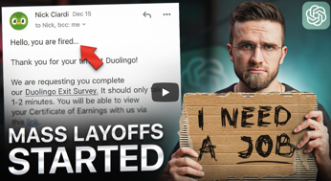
Are Mass Layoffs Coming Soon?
Are Mass Layoffs Coming Soon?
https://www.youtube.com/watch?v=5w-9wpAR1NQ
Mass Layoffs are likely because of:
.. recession
.. cutting cost via optimization (using AI)
https://www.warntracker.com
"I Lost My Job Thanks to This AI Tool"
https://www.youtube.com/watch?v=0Q4UOdIQJZQ
Examples of (massive) firings already happening:
translation , data entry, call center representatives, bank tellers, fraud detection specialists, meteorologists, manufacturing - assembly jobs, defect detection, travel agents / assistants
Amazon, Walmart - lots of human-free solutions (for example, picking, packing, shipping orders)
At risk: truck drivers, librarians, entry-level programmers, legal assistants, writers, editors, proof-reading
Google cuts over 1,000 jobs in its voice assistance, hardware teams as Fitbit founders leave
https://techcrunch.com/2024/01/10/google-cuts-hundreds-of-jobs-in-its-voice-assistance-hardware-teams-as-fitbit-founders-leave/

Slide 21
New Jobs
The rise of the novice coder: Can AI turn every employee into a developer?
- by Reed Albergotti - technology editor at Semafor
https://www.semafor.com/article/10/04/2023/ai-is-spurring-the-rise-of-the-novice-coder
AI Operations and AI Engineer
https://www.youtube.com/watch?v=biIpkIvl5mE
AI Architect
AI Engineer (not an ML Engineer)
AI Operations
https://twitter.com/karpathy/status/1674873002314563584
https://www.latent.space/p/ai-engineer
https://news.theaiexchange.com/p/premium-defining-ai-operations-new-cohorts-announced
How do you build an AI-powered business ? https://twitter.com/rachel_l_woods/status/1684203209475121155
In some companies the managers explicitly warn their people that they may be pushed out of the company (lose their jobs) if they will not learn and start using AI to become more productive
How to integrate AI tools into real workflows?
- What should people learn
- Who should businesses hire
- Where should businesses start
- Why do certain things
- Why not do other things
- What ethical guardrails should exist
- etc.

Slide 22


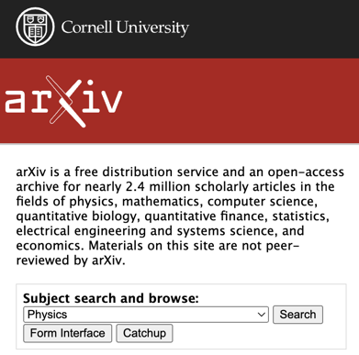
ArXiv.org
Cornell University
arXiv is a free distribution service and an open-access archive
for ~ 2.4 Mln scholarly articles (physics, math, CS, biology, finance, statistics, electrical engineering and systems science, and economics). Materials are NOT peer-reviewed by arXiv.
Paul Ginsparg
Cornell Physics Professor
Started arXiv in 1991
In 1989, Joanne Cohn, a physicist then at the Institute for Advanced Study, began distributing TeX files of string theory papers via email.
https://en.wikipedia.org/wiki/Joanne_Cohn
By August of 1991, the email list had grown to 180 physicists—an unwieldy number for Cohn to individually respond to requests for papers.
As Cohn recounts, a young physicist then at Los Alamos National Laboratory offered to automate the list, and arXiv was born.
“Day one, something happened, day two, something happened. Day three, Ed Witten posted a paper,” said Cornell University physicist Paul Ginsparg, founder of arXiv.org. “That was when the entire community joined.”

Slide 23
ArXiv.org - submit papers
Submission Guidelines: https://info.arxiv.org/help/submit/index.html
If first time - register (create account) on arXiv.org (email, username, password, ...)
You may need an endorsement:
https://info.arxiv.org/help/endorsement.html
Follow arXiv's guidelines for formatting your paper (TeX/LaTeX or PDF)
For example, use Google Docs to create your article, then download it as PDF:
https://info.arxiv.org/help/submit_pdf.html
Log in to your arXiv account, select Submit;
fill out the necessary metadata (title, authors, abstract, and subject classification),
then upload your PDF file and any supplemental material, select the appropriate subject area for your paper - and click Submit;
then select Arxiv.org, download the zip file with submission files, then upload the zip file to arXiv
All members must comply with arXiv's Code of Conduct.
https://info.arxiv.org/help/policies/code_of_conduct.html
Common Subjects for LLM articles:
Machine Learning (cs.LG);
Artificial Intelligence (cs.AI);
Computation and Language (cs.CL)

Slide 24
Tiny LLMs - 1B, 3B, 7B
Small models are great because they can be easily trained/fine-tuned as needed for specific narrow tasks - and can run "on Edge" devices
The Best Tiny LLMs (less than 3B parameters)
.. https://www.geeky-gadgets.com/the-best-tiny-small-and-compact-llms-currently-available/
.. https://www.youtube.com/watch?v=yxWUHDfix_c
Here are some tiny models to consider:
Phi 2 - 2.7B params - Microsoft https://huggingface.co/microsoft/phi-2
DeepSeek Coder 1.3B params, trained on 2T tokens, multiple programming languages https://huggingface.co/deepseek-ai/deepseek-coder-1.3b-instruct
TinyLlama 1.1B params, pre-trained on 3T tokens https://huggingface.co/TinyLlama/TinyLlama-1.1B-Chat-v1.0
Trelis Tiny - 1.3B params, function calling, fast https://huggingface.co/Trelis/Tiny
StableLM Zephyr 3B - 3B params https://huggingface.co/stabilityai/stablelm-zephyr-3b
Phixtral - Mixture of Experts based on Phi-2 https://huggingface.co/mlabonne/phixtral-2x2_8
Mistral 7B locally on iPhone or iPad
https://www.youtube.com/watch?v=5QEDNZlDf-c using TestFlight to install LLMFarm, an open-source client supporting Apple Silicon
https://testflight.apple.com
https://llmfarm.site
Mistral 7B - tuned versions
Starling-LM-7B-alpha
https://huggingface.co/berkeley-nest/Starling-LM-7B-alpha
OpenHermes-2.5-Mistral-7B
https://huggingface.co/teknium/OpenHermes-2.5-Mistral-7B
openchat_3.5 https://huggingface.co/openchat/openchat_3.5
Offline AI on iOS & Android (training and fine-tuning) - by Siraj Raval
https://www.youtube.com/watch?v=c8YM15v9w8M
Doctor Dignity - a LLM that can pass the US Medical Licensing Exam, based on LLaMa-7B
https://github.com/llSourcell/Doctor-Dignity

Slide 25

Monarch Mixer (M2)
Long-Context Retrieval Models with Monarch Mixer (M2)
https://hazyresearch.stanford.edu/blog/2024-01-11-m2-bert-retrieval
Monarch Mixer (M2) is a recent model family developing attention-free and MLP-free BERT models, which are enabling long-context BERT models.
January 11, 2024 - new models:
.. long-context versions of M2-BERT up to 32K context length, .. embedding versions fine-tuned for long-context retrieval
also:
a long-context retrieval benchmark called LoCo

Slide 26
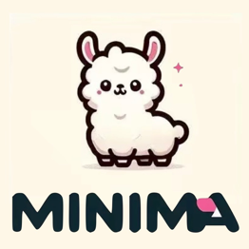
Distilling Language Models
https://github.com/genezc/minima
Language model (LM) distillation - distil the knowledge resided in a large teacher LM to a small student LM.
Difficult to do when there is a large capacity gap between the teacher and the student.
Curse of capacity gap: a larger teacher LM cannot always lead to a better student LM if there is a big gap between them.
Good news - the optimal capacity gap is (almost) consistent across different student scales and architectures.
Distil a 3B student LM (termed MiniMA) from a 7B teacher LM (adapted LLaMA2-7B) - great results. MiniMA can even compete with 7B models.

Slide 27

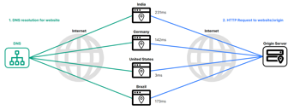
Use Cloudflare to make a simple static website
https://www.cloudflare.com
https://en.wikipedia.org/wiki/Cloudflare
Cloudflare is an American company (in San Francisco, CA) that provides CDN (Content Delivery Network) services, cloud cybersecurity, DDoS mitigation, ICANN-accredited domain registration services.
Think of it as a giant intelligent network spread across hundreds of cities around the world.
Cloudflare acts as a security guard, filtering malicious traffic and protecting websites from DDoS attacks, data breaches, and other online threats. It encrypts connections (HTTPS), offers two-factor authentication, and provide many other services.
Suppose you want to create a simple static website.
You can use CloudFlare to:
Brainstorm the domain name - and register it
Set up DNS and redirects
Integrate with Google workspace (for gmail)
Host a simple static website (up to 25 MB)
You can upload files to "pages" either from your computer, or from GitHub. Easy.
So CloudFlare is perfect for a short "business card"-like website to keep your BIO, resume, and other related files

Slide 28
Thank You!

