Slide 1
AI Updates
January 26, 2024
How to Run Mixtral on Laptop
or on Google Colab Free Tier
Denis Mazur & Artyom Eliseev

Slide 2


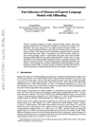
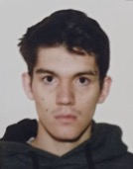

Efficient inference of Mixtral-8x7B on a laptop
Run Mixtral on Nvidia 3060 with 12GB !
https://arxiv.org/abs/2312.17238 - paper
https://github.com/dvmazur/mixtral-offloading
https://twitter.com/rohanpaul_ai/status/1741103866047869222
- Stream model during Inference!
- Just-In-Time Loading of model layers!
Since most deep learning models use layers in a fixed order, offloading can pre-dispatch the next layer parameters in the background, ahead of time.
Mixed quantization with HQQ - separate quantization schemes for attention layers and experts to fit the model into the combined GPU and CPU memory.
MoE offloading strategy - each expert per layer is offloaded separately and only brought pack to GPU when needed. LRU cache (Least Recently Used) is used to reduce GPU-RAM communication when computing activations for adjacent tokens.
Demo notebook:
https://github.com/dvmazur/mixtral-offloading/blob/master/notebooks/demo.ipynb
https://colab.research.google.com/github/dvmazur/mixtral-offloading/blob/master/notebooks/demo.ipynb
Moscow Institute of Physics and Technology
Yandex
Denis Mazur
Yandex Researchcore
https://github.com/dvmazur
Artyom Eliseev
Yandex School of Data Analysis
https://github.com/lavawolfiee

Slide 3
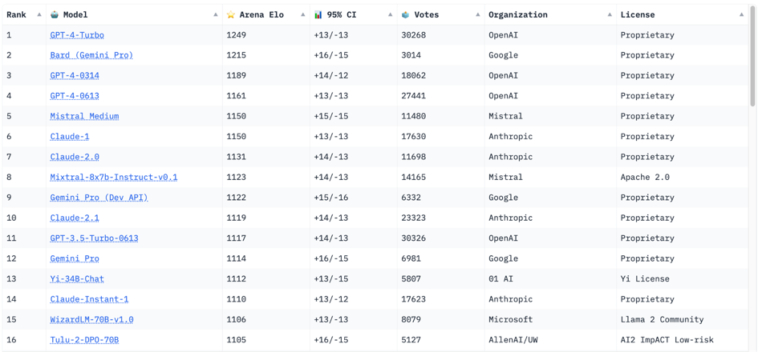
Crowd-sourced "Arena" leaderboard
https://huggingface.co/spaces/lmsys/chatbot-arena-leaderboard
Jan 26, 2024 : 56 Models, 244K votes
Starting Elo rating = 1000 for each model
95% CI = Confidence Interval

Slide 4
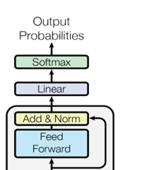
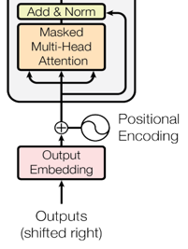
LLMs and Transformers
LLM (Large Language Model) is typically a multi-layer model following the "decoder" part of the standard "transformer" architecture.
It accepts a sequence of tokens, converts them into sequence of embeddings (vectors), transforms them over multiple "decoder" layers, and generates the text token, which is then added to the input.
xN
Each layer consists of two parts: Self-Attention and Feed-Forward
Notes:
A sequence of tokens is converted into a sequence of vectors (embeddings) which are then transformed by multiple decoder layers. The resulting vector for the last token goes through a linear layer (lm head) to generate the next token which is then added to the input and the process repeats. Each decoder layer consists of two parts: Self-Attention and Feed Forward. During Self-Attention each token “looks” at other tokens in the sentence with an attention mechanism, gathers context, and updates the previous representation of "self". After that, a model uses a Feed Forward block to “process” this new information.

Slide 5
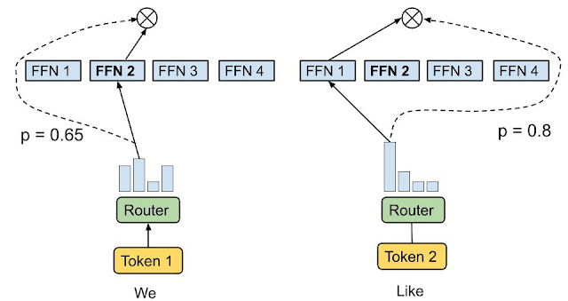
MoE
Notes:
A sequence of tokens is converted into a sequence of vectors (embeddings) which are then transformed by multiple decoder layers. The resulting vector for the last token goes through a linear layer (lm head) to generate the next token which is then added to the input and the process repeats. Each decoder layer consists of two parts: Self-Attention and Feed Forward. During Self-Attention each token “looks” at other tokens in the sentence with an attention mechanism, gathers context, and updates the previous representation of "self". After that, a model uses a Feed Forward block to “process” this new information.
(should we talk about how attention works in details?)

Slide 6
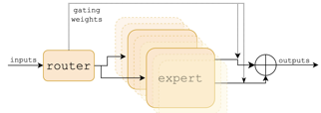
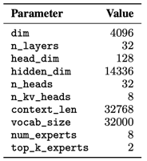
Mixtral - how it works
Feed-Forward Sub-Layers have this structure with router, experts, and aggregation outputs.
Mixtral of Experts paper - https://arxiv.org/abs/2401.04088
Mixtral 8x7B is a Sparse Mixture of Experts (SMoE) language model.
Mixtral has the same architecture as Mistral 7B, with the difference that each layer has 8 feedforward blocks (i.e. experts).
For every token, at each layer, a router network selects two experts to process the current state and combine their outputs.
Even though each token only sees two experts, the selected experts can be different at each timestep. As a result, each token has access to 47B parameters, but only uses 13B active parameters during inference.
Mixtral was trained with a context size of 32k tokens and it outperforms or matches Llama 2 70B and GPT-3.5 across all evaluated benchmarks.
In particular, Mixtral vastly outperforms Llama 2 70B on mathematics, code generation, and multilingual benchmarks.
We also provide a model fine-tuned to follow instructions, Mixtral 8x7B - Instruct, that surpasses GPT-3.5 Turbo, Claude-2.1, Gemini Pro, and Llama 2 70B - chat model on human benchmarks.
Both the base and instruct models are released under the Apache 2.0 license.
The aggregation at the output of each layer is implemented by taking the softmax over the Top-K logits of a linear layer of experts in this layer
=4096/n_heads
dim_MLP
Understanding Mixtral-8x7b - https://huggingface.co/blog/vtabbott/mixtral
Google 2022 review of sparse expert models - https://arxiv.org/pdf/2209.01667.pdf
https://github.com/huggingface/transformers/blob/main/src/transformers/models/mixtral/configuration_mixtral.py
https://github.com/huggingface/transformers/blob/main/src/transformers/models/mistral/configuration_mistral.py
https://arxiv.org/abs/2305.13245 - group attention mechanism
group attention
Notes:
For those of you who don’t know, Mixtral is a 48B parameter mixture-of-experts model. It’s the state of the art open source model on multiple language understanding benchmarks, including MMLU. If that doesn’t make you want to run it - I don’t know what will. The problem is that despite it being open source, it takes a god-awful amount of resources to run. In fp16 precision the model won’t fit into a single A100 GPU, not mentioning consumer-grade devices. This problem can be tackled at different angles, but our work focuses on two: quantization and offloading.

Slide 7
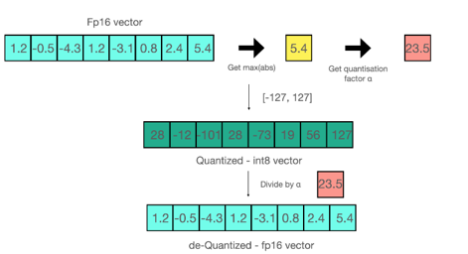
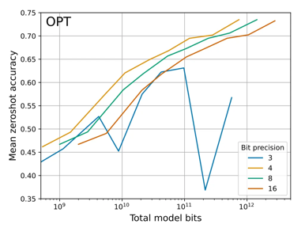
Quantization
In LLMs, quantization reduces parameter precision to save memory and speed up inference, but it might lower accuracy.
https://arxiv.org/pdf/2212.09720.pdf
Notes:
Quantization represents the weights and activations with low-precision data types like int8 instead of fp16 which saves memory and speeds up inference. So why don’t we just quantize the whole model in 2 bits? Because quantization also comes with the cost of reduced accuracy. 2bits is actually so extreme that it’s usually better to quantize model with half the number of parameters to 4bits (say smth smart about pareto because I didn’t really get you :D).
Instead we experiment with quantizing experts and attention layers in different precision. We found that quantizing experts in 2 or 3bits while keeping attention in 4bits and everything else in fp16 gives the best tradeoff between memory usage and model quality. That’s because experts constitute a huge 97% of all weights, so we can compress them hard and generously give more bits to the most sensitive parts - attention, lm head, etc.
We used HQQ for quantization because it has a decent 2 bits quality and is easy to use.

Slide 8
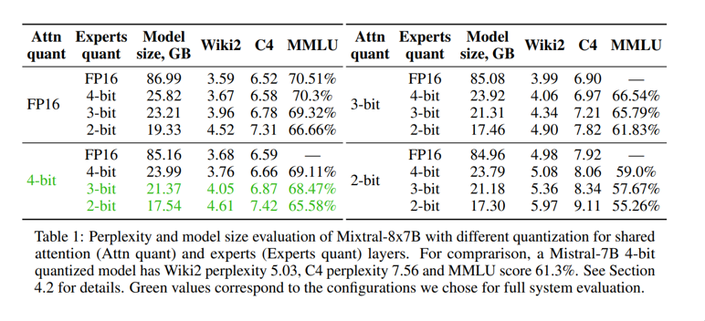
Mixed Quantization & our setup
HQQ = Half-Quadratic Quantization https://github.com/mobiusml/hqq
Notes:
So why don’t we just quantize the whole model in 2 bits? Because quantization also comes with the cost of reduced accuracy. 2bits is actually so extreme that it’s usually better to quantize model with half the number of parameters to 4bits (say smth smart about pareto because I didn’t really get you :D).
Instead we experiment with quantizing experts and attention layers in different precision. We found that quantizing experts in 2 or 3bits while keeping attention in 4bits and everything else in fp16 gives the best tradeoff between memory usage and model quality. That’s because experts constitute a huge 97% of all weights, so we can compress them hard and generously give more bits to the most sensitive parts - attention, lm head, etc.
We used HQQ for quantization because it has a decent 2 bits quality and is easy to use.

Slide 9
Offloading
LLM often don’t fit into GPU memory. Sometimes neither in full precision, nor quantized
Only part of a model’s parameters are used at the same time while computing activations. Why not put them into RAM?
Moving data between RAM and VRAM is quite expensive
Decoder Block_{i -1}
D. Block in GPU mem.
Decoder Block_{i}
D. Block in CPU mem.
D. Block being inferenced
Decoder Block_{i+1}
Decoder Block_{i+2}
Notes:
Offloading is a method for inferencing models when they don’t fit into your accelerator’s (GPU’s) memory. The idea is quite simple: keep the inactive parameters of your model in CPU memory and load them only when computing forward/backward passes using them. For most transformer models offloading is straightforward: fetch the parameters for the i-th layer when computing it, perform a forward pass and offload them back to CPU. Repeat until the output for a token is complete. In practice, this strategy can be a bit more complicated: for example, you can prefetch the weights for the (i + 1)-th layer while computing the i-th one, but by now you should get the gist of the method.
The primary cost you pay for offloading is CPU-GPU communication. Time spent computing attention and ffn activations becomes insignificant, compared to the time you spend sending memory between CPU and GPU. Gladly, in the context of MoE, there are a couple of things that make things easier.

Slide 10
Idea: only keep experts you need in GPU memory
FFN₁
FFN₂
FFN₃
FFN₄
Expert in GPU mem.
Expert in CPU mem.
Expert selected for inference
Gating layer_{i}
Notes:
So why don’t we just quantize the whole model in 2 bits? Because quantization also comes with the cost of reduced accuracy. 2bits is actually so extreme that it’s usually better to quantize model with half the number of parameters to 4bits (say smth smart about pareto because I didn’t really get you :D).
Instead we experiment with quantizing experts and attention layers in different precision. We found that quantizing experts in 2 or 3bits while keeping attention in 4bits and everything else in fp16 gives the best tradeoff between memory usage and model quality. That’s because experts constitute a huge 97% of all weights, so we can compress them hard and generously give more bits to the most sensitive parts - attention, lm head, etc.
We used HQQ for quantization because it has a decent 2 bits quality and is easy to use.

Slide 11
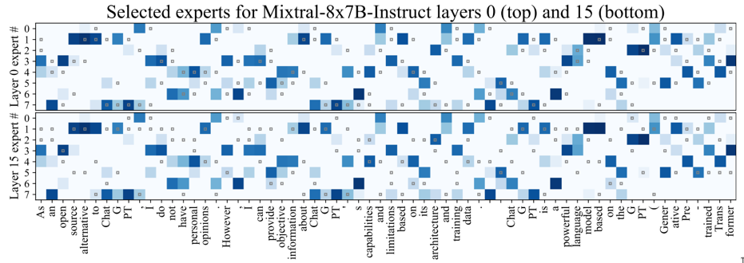
Offloading and caching
Experts are very often reused between adjacent tokens
An LRU Cache can be used to store hot tokens in GPU memory to mitigate the need of moving them between devices
LRU Cache (Least Recently Used) - remove the least used items first when the cache is full
Notes:
In the context of offloading, one thing you need to note about MoE is that: while inferencing the i-th layer you not only don’t need the parameters from the following ones - you also don’t need 3/4 of experts on your current layer. So why not offload them to CPU too? The problem is that you never know which experts you will need in the future.
Let’s take a look at the following figure <fig. 1 from mixtral’s paper>. Notice anything interesting? More often than not, the same expert is used to compute activations for adjacent tokens. We can leverage this feature of MoE and keep a least recently used cache for the experts. This way we pay much less for moving memory around.
<how much does this speed up inference>

Slide 12
Caching in action
Before gating
Expert₁
Expert₂
Expert₃
Expert₄
Expert in GPU cache
Expert in CPU mem.
Expert selected for inference
After gating
Expert₁
Expert₂
Expert₃
Expert₄
Notes:
<Decsribe the slide in details>

Slide 13
Speculative prefetching
Caching still doesn't solve the problem of not knowing which experts will be used ahead of time
Due to residual streams, the output of a decoder layer doesn’t differ too much from it’s input
Next layer’s gating function can be applied current hidden states to approximate which experts will be chosen in the future
This creates a 33% speedup on top of expert-caching on Colab hardware
FFN₁
…
FFN₈
FFN₁
…
FFN₈
Gating layer_{i}
Gating layer_{i + 1}
Multi Head Attn_{i}
Notes:
We can get a decent inference speedup by keeping “hot” expert parameters in GPU memory, but this still doesn’t solve the problem with the uncertainty of experts that will be loaded.
There’s a neat property of transformer models that help to tackle this issue. Specifically, the residual nature of decoder (encoder) blocks. Activations, computed on a given layer, are added back to the features fed into to the layer. Consequently, outputs and inputs of a given layer are quite similar. So why not try guessing the experts on the (i+1)-st layer using activations from the i-th?
<how much does this speed up inference>

Slide 14
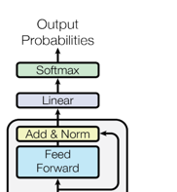
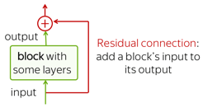

Zooming into transformers: residual streams
Notes:
A sequence of tokens is converted into a sequence of vectors (embeddings) which are then transformed by multiple decoder layers. The resulting vector for the last token goes through a linear layer (lm head) to generate the next token which is then added to the input and the process repeats. Each decoder layer consists of two parts: Self-Attention and Feed Forward. During Self-Attention each token “looks” at other tokens in the sentence with an attention mechanism, gathers context, and updates the previous representation of "self". After that, a model uses a Feed Forward block to “process” this new information.
(should we talk about how attention works in details?)

Slide 15
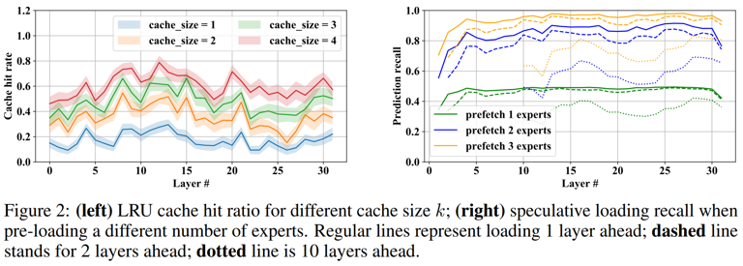
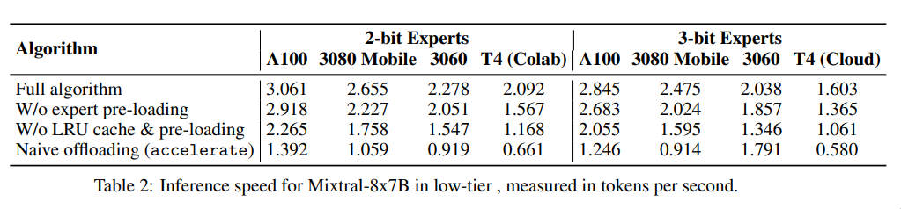
Experiments and results
Notes:
- almost x4 speed up
- 65% cache hit rate, decent prediction accuracy

Slide 16

Thank You!

