Slide 1

AI Updates
February 02, 2024
CodeLlama-70B
DeepSeek-Coder
SQLCoder
cody.dev and continue.dev
LLM for coding - Leaderboards
Google Bard Upgrades
Rabbit R1 uses Cloud-based models
Meta to do Open-Source
Open Source: Linux over Unix
Miqu-70 - old Mistral model
ollama-python & ollama-js
jan.ai - LLM on your desktop
Mamba Hermes 2.8B
Embeddings, ColBERT
The Rise and Rise of AI LLMs
AI as a Baby
LLM Primitive as a Worm
How quantized 4bit models run
Why Do LLM Hallucinate ?
Attention = Facilitation & Inhibition
Misc. news
Layoffs
Leaderboards

Slide 2
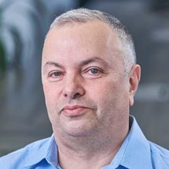

About the Speaker
Lev Selector, Ph.D.
40+ years of software engineering, data science, and building teams (hiring, training, and managing)
Ph.D. in mathematical modeling and computer simulations
Interests:
Generative AI, Using LLM with your data
Local AI for Local Private Data
Cloud architecture, fin-tech, application security
Find/connect: Linkedin, GitHub, YouTube, Google
https://eais.ai

Slide 3
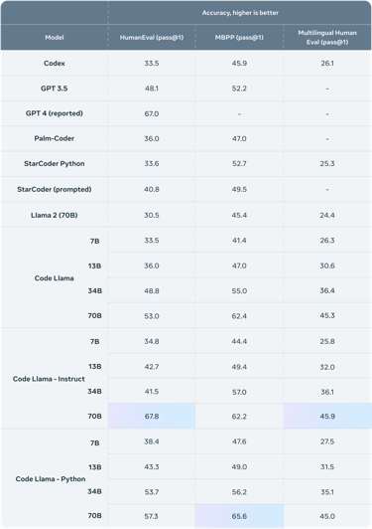
LLM for coding - Code Llama
Code Llama - Open-source, can use for business https://ai.meta.com/blog/code-llama-large-language-model-coding/ https://twitter.com/AIatMeta/status/1752013879532782075 August 2023 - 7B, 13B and 34B January 29, 2024 - 70B
Notably, CodeLlama-34B outperforms larger models such as CodeGen-Multi or StarCoder, and is on par with OpenAI Codex - https://openai.com/blog/openai-codex
Model on Huggingface - https://huggingface.co/codellama/CodeLlama-70b-hf
Request to download https://ai.meta.com/resources/models-and-libraries/llama-downloads/
Run full model https://www.youtube.com/watch?v=ClOQ0BnJNcs
Run locally using Ollama: ollama run codellama:70b https://www.youtube.com/watch?v=JLtA3l9SEwA
Run locally in VS Code using Cody and Ollama https://www.youtube.com/watch?v=gY_E3QBZ-NE
use CodeLlama here: https://labs.perplexity.ai, https://huggingface.co/chat

Slide 4
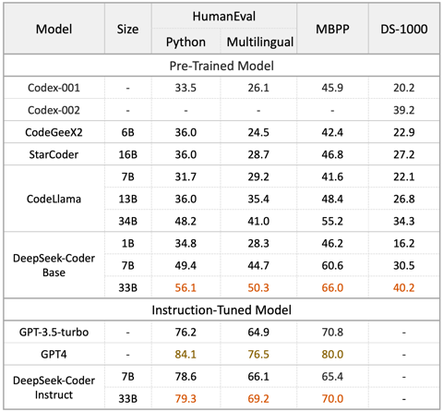
LLM for coding - DeepSeek-Coder
DeepSeek-Coder https://deepseekcoder.github.io
1.3B, 5.7B, 6.7B and 33B sizes
Pretrained on 2 T tokens
More than 80 programming languages
16k window size
Run locally with Ollama: ollama run deepseek-coder:33b
WizardCoder

Slide 5
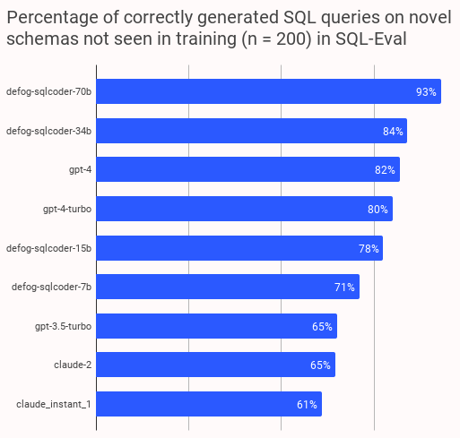
LLM for coding - SQLCoder
Defog SQLCoder
https://github.com/defog-ai/sqlcoder
https://twitter.com/rishdotblog/status/1752329471867371659
https://huggingface.co/defog/sqlcoder-70b-alpha
SQLCoder is a LLM family that outperforms GPT-4 for SQL generation tasks on our sql-eval framework, and significantly outperform all popular open-source models.
SQLCoder-70B and SQLCoder-34B are fine-tuned on a base CodeLlama model.

Slide 6
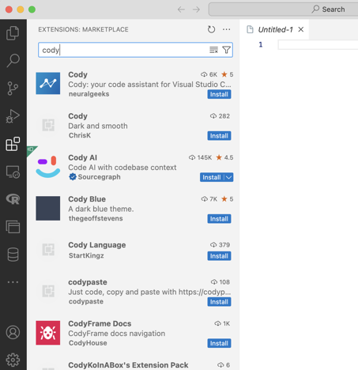
cody.dev
Cody is a coding AI assistant
https://code.dev
https://sourcegraph.com/cody
You can run it as VS Code extension
By default it uses GPT-4 Free (limited bandwidth or $9/mo paid)
But you can also use it with a local model, for example Ollama running CodeLlama ( ollama run codellama:7b-code )
Go to extension settings
"Cody > Autocomplete > Advanced: Provider"
and select "unstable-ollama" from the drop-down list.
Very good step-by-step demo: installation and usage
https://www.youtube.com/watch?v=gY_E3QBZ-NE
In your code you can write comments on the code - and Cody will write the code for you. Or you can click on the yellow circle "Asl Cody to Generate" - and type your instructions.
Writing code, Autocomplete, Generating unit tests, chat (with online LLMs), write comments, documentation, descriptions, follow instructions to edit code, etc. etc.

Slide 7
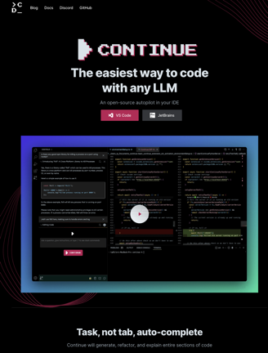
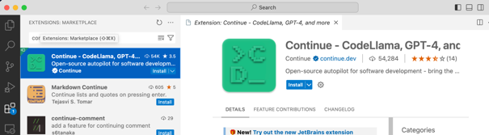
continue.dev
https://continue.dev
https://www.youtube.com/watch?v=F1bXfnrzAxM - video demo
Continue is the open-source extension for VS Code and JetBrains
Allows to use ChatGPT or local LLM to write code
Choose any LLM - GPT-4, Code LLama, Claude 2, Phind-CodeLlama, PaLM 2, ...
Use local LLM (Ollama, LM Studio, ...), in your cloud (vLLM, TGI, ...), or with SaaS (Together, OpenAI API, ...)
Your codebase as context
Customize your workflows (custom commands, providers, ...)
Use your dev. data, Deploy for your team

Slide 8
LLM for coding - Leaderboards
https://huggingface.co/spaces/mike-ravkine/can-ai-code-results - updated
https://evalplus.github.io/leaderboard.html - good leaderboard
https://huggingface.co/spaces/bigcode/bigcode-models-leaderboard - not maintained any longer (since November 2023)
https://huggingface.co/spaces/mlabonne/Yet_Another_LLM_Leaderboard - Leaderboard made with LLM AutoEval using Nous benchmark suite.
https://evalplus.github.io/leaderboard.html - Other - EvalPlus Leaderboard - good source of Coding LLMs
Curious to compare:
CodeLlama-70b-Instruct
DeepSeek-Coder-33B--Instruct
OpenAI Codex - https://openai.com/blog/openai-codex
Google DeepMind AlphaCode https://analyticsindiamag.com/copilot-vs-alphacode-the-race-for-coding-supremacy/ https://github.com/google-deepmind/code_contests
Salesforce CodeGen - https://github.com/salesforce/CodeGen

Slide 9
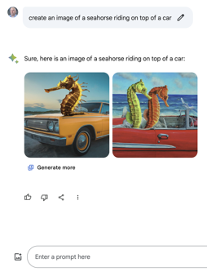
Google Bard Upgrades
https://bard.google.com/chat
Bard has moved to 2nd place on the Crowd-sourced "Arena" leaderboard! Maybe because it has access to the Internet ?
Bard is now running on Gemini Pro instead of the previous LaMDA and PaLM models. Better reasoning. Better language abilities.
Bard uses Imagen-2 model for text-to-image
Conversational search comes to Google Maps
MusicFX text-to-music tool builds on MusicLM, (up to 70 sec)

Slide 10


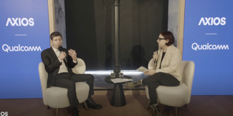
Misc 1
Rabbit R1 :
LAM (Large Action Model) does NOT run on device. It runs on the cloud. Device will get access to all your private accounts you will be using. Your private info will be sent to the cloud. But ... no subscription fee for cloud services ?
R1 will use Perplexity via online API - with subscription fee.
Not clear whether speech-to-text runs on device?
https://www.youtube.com/watch?v=8NjcYdLrjFk - good review
OpenAI's Sam Altman: investors to build AI Chip Factories (in US ?)
Axios' Ina Fried in conversation with Open AI's Sam Altman
https://www.youtube.com/watch?v=QFXp_TU-bO8
Models getting much smarter.
Access to training data, synthetic data, regulations, Politics - election security.
Support for military.
OpenAI ~800 people.
Censorship in different countries, global standards.
GPTs may be customized down to a government level, or even down to a user.

Slide 11
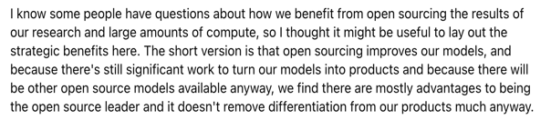

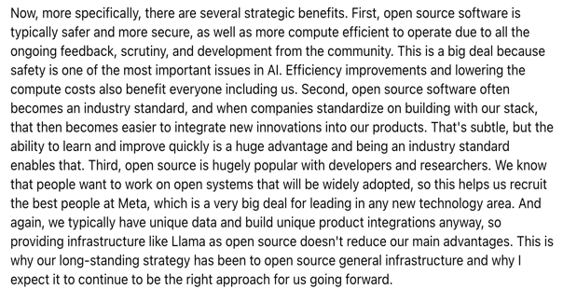

It is Profitable for Meta to do Open-Source
https://twitter.com/soumithchintala/status/1753181120068304989
A clear answer in Meta's earnings call today from Mark Zuckerberg
Yann LeCun - AI at Meta: 350k H100s by the end of the year, open source AI software infrastructure, new data centers with custom chips for AI inference serving hundreds of millions of users of AI tools - https://twitter.com/ylecun/status/1753431180861419947

Slide 12
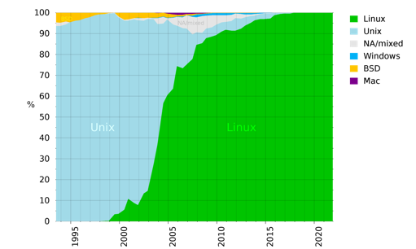
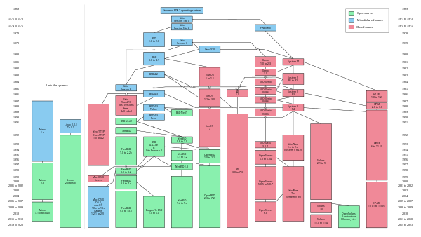
Open Source Wins: Linux vs Unix
https://en.wikipedia.org/wiki/History_of_Unix

Slide 13
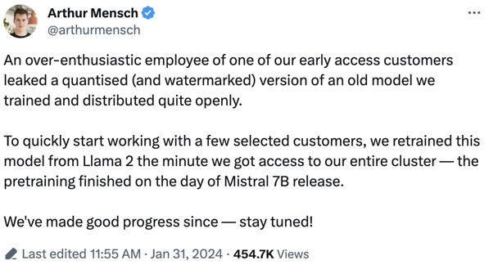
Miqu-70 - old Mistral model
 | Mistral-7b | Mixtral-8x7b | llama-7b | llama-70b | Miqu-70B
hidden_size | 4096 | 4096 | 4096 | 8192 | 8192
intermediate_size | 14336 | 14336 | 11008 | 28672 | 28672
num_attention_heads | 32 | 32 | 32 | 64 | 64
num_hidden_layers | 32 | 32 | 32 | 80 | 80
num_key_value_heads | 8 | 8 | 32 | 8 | 8
num_experts | 1 | 8 | 1 | 1 | 1
Mistral 70b ? https://huggingface.co/miqudev/miqu-1-70b
MIQU -> Mistral Quantized
Mistral has retrained this model from Llama-70B.
It was in Sept 2023 when Mistral-7B was released.
See twitter post:
https://twitter.com/arthurmensch/status/1752737462663684344

Slide 14

ollama-python & ollama-js
From: Ollama Maintainers <hello@ollama.ai>
Date: January 24, 2024 at 6:51 PM
Subject: Ollama - Introducing Python & JavaScript Libraries
https://github.com/ollama/ollama-python
pip install ollama
https://github.com/ollama/ollama-js
npm install ollama
ollama -v # 0.1.20 - download to update
Ollama - Run LLMs locally
import ollama
stream = ollama.chat(
model='dolphin2.2-mistral:latest',
messages=[{'role': 'user',
'content': 'why sky is blue?'}],
stream=True,
)
for chunk in stream:
if 'message' in chunk:
print(chunk['message']['content'],
end='', flush=True)
in iPython: ollama.<tab>
AsyncClient list()
chat() Message
ChatResponse Options
Client ProgressResponse
copy() pull()
create() push()
delete() RequestError
embeddings() ResponseError
generate() show()
GenerateResponse

Slide 15

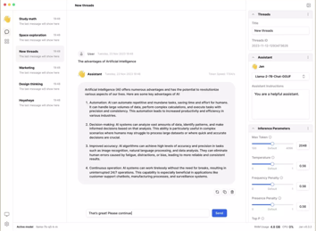
jan.ai - Run Any Chatbot FREE Locally on Your Computer
Jan.ai = open-source app
runs LLMs locally 100% offline on your computer (Windows, Mac, Linux)
https://jan.ai/docs/
https://github.com/janhq/jan
https://github.com/orgs/janhq/projects/5/views/31
https://www.youtube.com/watch?v=zkafOIyQM8s

Slide 16
Mamba Hermes 2.8B
"""Mamba is a POC (Proof of Concept) LLM using architecture called S6 instead of Transformer. Mamba is better than transformer based LLMs in every measurable way. It train faster, run faster, use less VRAM, result in lower perplexity and better benchmark scores with the same exact training data."""
https://arxiv.org/abs/2312.00752 - Mamba original paper, Dec 1, 2023
https://news.ycombinator.com/item?id=38708730 - discussion about Mamba
https://github.com/state-spaces/mamba - Model code and pre-trained checkpoints. Trained on Pile dataset - https://huggingface.co/datasets/EleutherAI/pile Largest model has 2.8B params, 64 layers
https://huggingface.co/state-spaces - pretrained models
Mamba Hermes 2.8B - open-source mamba model fine-tuned on OpenHermes dataset composed of 242,000 entries of primarily GPT-4 generated data
https://www.youtube.com/watch?v=GDhcKNIuKP4
https://colab.research.google.com/drive/18LesI-SoCVCT52ptoM1MskE4Y_rsYjL_?usp=sharing
https://huggingface.co/clibrain/mamba-2.8b-instruct-openhermes
pip install torch==2.1.0 transformers==4.35.0 causal-conv1d==1.0.0 mamba-ssm==1.0.1

Slide 17
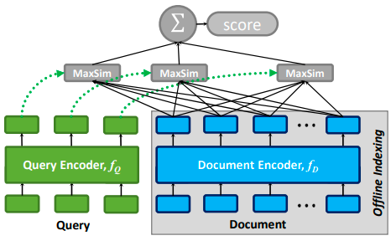
Embeddings, ColBERT
ColBERT is designed to scale to large document collections and can handle millions of docs efficiently. It uses Efficient indexing & retrieval (top-k most similar documents)
ColBERT is good for ad-hoc retrieval, but not as good for question answering, summarization, and text classification
Late Interaction: first encode the query and doc, then compute the similarity between the embeddings at the token level (MaxSim scoring). The final similarity score is the sum of the token-wise similarities.
OpenAI new models and pricing https://openai.com/blog/new-embedding-models-and-api-updates
Embedding V3 models (small & large) .. text-embedding-3-small - dim 512, 1536; price $0.02 / 1 Mln tokens .. text-embedding-3-large - dim 256,1024, 3072; price $0.13 / 1M tokens
gpt-4-0125-preview , gpt-3.5-turbo-0125
OpenAI embeddings: cheap, good, no GPU needed, but not as good as multi-vector ColBERT.
https://twitter.com/marktenenholtz/status/1751406680535883869
ColBERT: Efficient and Effective Passage Search via Contextualized Late Interaction over BERT
https://people.eecs.berkeley.edu/~matei/papers/2020/sigir_colbert.pdf
ColBERT (Contrastive Retrieval of Neural Passages) - a retrieval model that approximates nearest neighbor search (accurate & efficient information retrieval, especially in large document collections.
RAGatouille - Easily use & train SOT retrieval methods in any RAG pipeline (using ColBERT).
https://github.com/bclavie/RAGatouille
https://til.simonwillison.net/llms/colbert-ragatouille

Slide 18
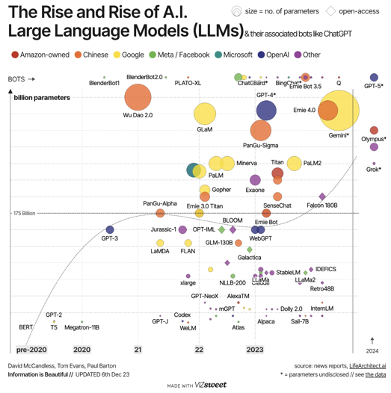
The Rise and Rise of AI LLMs
The Rise and Rise of A.I.
Large Language Models (LLMs)
Beautiful Interactive Dashboard
Last updated in December 2023
Unfortunately not complete - doesn't even have Mistral & Mixtral
https://informationisbeautiful.net/visualizations/the-rise-of-generative-ai-large-language-models-llms-like-chatgpt/
https://www.vizsweet.com
Businesses powered by AI don’t just lead; they dominate. Don't let your business be the one that gets left behind...
https://www.imagineai.live

Slide 19

AI as a Baby
Kindergartens (Universities ?) :
Berkeley, Carnegie Mellon, MIT, ...
OpenAI, Microsoft
Google DeepMind
Meta
Mistral.ai
Stability.ai
Anthropic
01.ai
X.ai
Inflection.ai
IBM
. . .
Baby AI
Mama Humanity

Slide 20


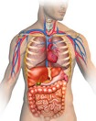
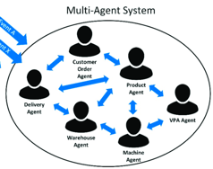
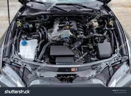

LLM is Primitive as a Worm
Real Systems Have Many Different Parts
Multi-Agent Systems
Next Token
LLM
Writer
LLM
Editor
Brain parts
32 Layers
Next
token
Body organs
Encode
Car engine
worm

Slide 21
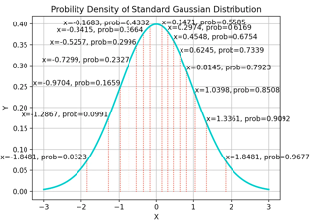
How quantized 4bit models run?
Absmax Quantization to 8 bit
If M = max(abs(your data)), c = (127/M),
then x -> c*x will project float numbers (x) into range (-127,+127)
Suppose that weights are stored as 4bit.
Embedding vectors and activations are typically kept at higher precision (8bit or 16bit).
Ways to do multiplication:
Full Conversion to higher precision. Both weights and activations are temporarily converted to a higher precision (e.g., 16-bit or 32-bit) before multiplication.
Partial Conversion with scaling. Weights remain in 4-bit format, activations converted to a higher precision (e.g., 8-bit) but scaled down before multiplication (to avoid overflow while maintaining some dynamic range). Drawback - reduced accuracy.
Native Low-Bit Multiplication (if supported by hardware): both weights and activations keep their accuracy (4bit and 8bit).
Quantile Quantization to 4 bit
Sort your data points in ascending order and divide them into 16 parts (quantiles) containing equal number of points. This maps original values to 16 4-bit values. But it is a slow (sorting, finding levels).
Normalized float4 (NF4) quantization - a Quantile Quantization using pre-calculated quantiles (for Gaussian distribution) https://ai.plainenglish.io/qlora-key-quantization-and-fine-tuning-techniques-in-the-era-of-large-language-models-0fa05a961d27
NF4 is used only for storage.
You need to de-quantize values before using them.

Slide 22
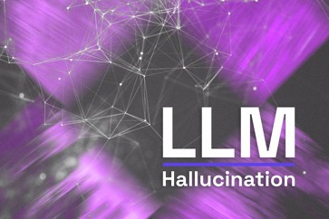
Why Do LLM Hallucinate ?
Why Do LLM Hallucinate ?
LLM predicts the next token
based on statistics of training data.
LLM doesn't have brains.
LLM doesn't have judgement.
If the right data was not available
in training, or if training data was noisy,
LLM will try to select from what it has,
and it may go in a completely wrong
direction. This is hallucination.
LLM does not understand, it simply
follows contextual patterns.
Good prompts may help to avoid hallucinations. You can also use separate LLM Agent(s).
LLM Hallucinations in RAG QA https://www.youtube.com/watch?v=lsZCVmCBRlc
https://www.holisticai.com/blog/types-of-llm-hallucinations

Slide 23
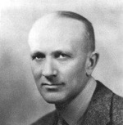
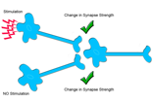
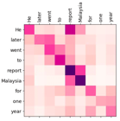



Attention = Facilitation and Inhibition
Attention in Transformer architecture implements both facilitation (Attention Matrix) and lateral Inhibition (Softmax normalization).
Similar mechanisms exist in the brain.
"Neurons that fire together, wire together" is a quote by neuropsychologist Donald Hebb. Hebb first used the phrase in 1949 to describe how brain pathways are formed and reinforced through repetition. - https://en.wikipedia.org/wiki/Neural_facilitation
Lateral Inhibition - the ability of an excited neuron to reduce the activity of its neighbors. It prevents the lateral spread of neuronal activity, which creates an increased contrast in excitation between neighboring neurons. This allows better sensory acuity. - https://en.wikipedia.org/wiki/Lateral_inhibition
Attention in Psychology, Neuroscience, and Machine Learning
https://www.ncbi.nlm.nih.gov/pmc/articles/PMC7177153/
Donald Hebb
Airy Disk (George Biddell Airy)
Point spread functions
Softmax function a.k.a. normalized exponential function

Slide 24
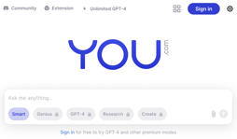

Misc 2
https://you.com will be a default browser option for EU countries on iOS 17.4 (March 2024 ?)
Prompt Design And Engineering - https://arxiv.org/pdf/2401.14423.pdf
Prompt Engineering Guide - https://github.com/dair-ai/Prompt-Engineering-Guide
https://twitter.com/venturetwins/status/1753119305762222200
This guy trained a bot to swipe on Tinder profiles based on his preferences, and then used ChatGPT to message them and set up dates. He communicated with 5,200+ women, and one year later, he's now engaged to one of them (after ChatGPT suggested he propose).
OLMO = Open Language Model - completely open details of training LLM (data, framework, all details)
https://allenai.org/olmo/olmo-paper.pdf
Niklaus Wirth, creator of Pascal programming language, has died in January 2024 (~ 90 y.old) https://en.wikipedia.org/wiki/Niklaus_Wirth
Neuralink implants chip in its first human brain
Open source (Mixral, Miqu) nearing GPT-4 performance
Chinese Xinghuo 3.5 AI model at GPT-4 level
100 congressional offices use AI

Slide 25
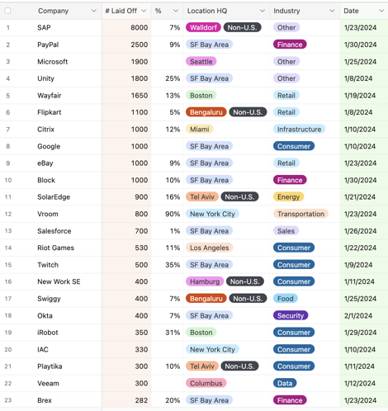
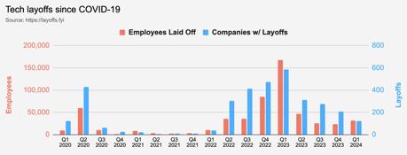
Layoffs are not too big
Layoffs - https://layoffs.fyi
2020 2021 2022 2023 2024

Slide 26
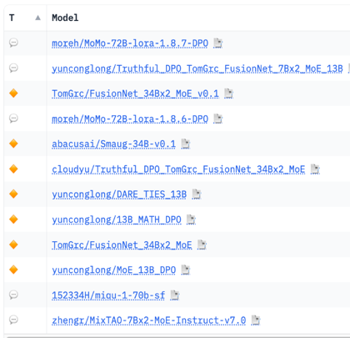
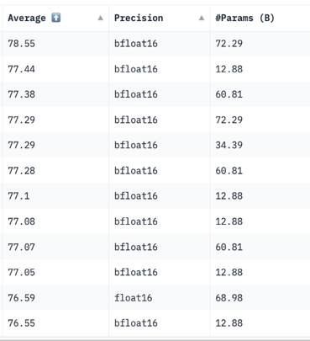
Hugging Face LLM Leaderboard
https://huggingface.co/spaces/HuggingFaceH4/open_llm_leaderboard
https://huggingface.co/datasets/open-llm-leaderboard/results
https://huggingface.co/spaces/felixz/open_llm_leaderboard
https://huggingface.co/spaces/felixz/meta_open_llm_leaderboard
https://github.com/lselector/ai/blob/master/llm_leaderboard.py
January 26, 2024

Slide 27
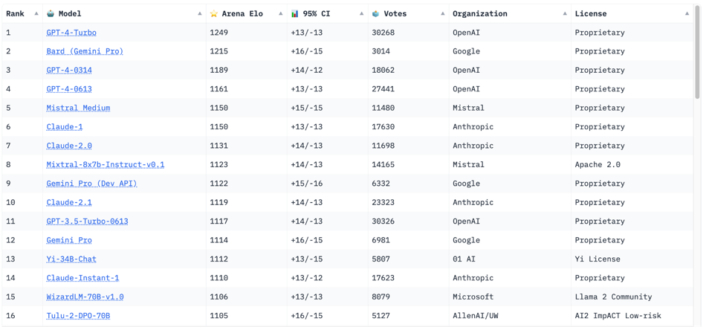
Crowd-sourced "Arena" leaderboard
https://huggingface.co/spaces/lmsys/chatbot-arena-leaderboard
Jan 26, 2024 : 56 Models, 244K votes
Starting Elo rating = 1000 for each model
95% CI = Confidence Interval

Slide 28
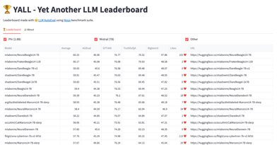
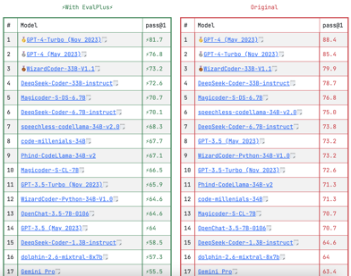
YALL - Yet Another LLM Leaderboard
https://huggingface.co/spaces/mlabonne/Yet_Another_LLM_Leaderboard
Leaderboard made with LLM AutoEval using Nous benchmark suite.
Other - EvalPlus Leaderboard - good source of Coding LLMs
https://evalplus.github.io/leaderboard.html

Slide 29
Thank You!

