Slide 1



AI Updates
March 08, 2024
International Women's Day
Claude 3 Released by Anthropic, Beats Average Human on IQ Test
Elon Musk suing OpenAI & Sam Altman
Generative AI market to skyrocket
Google’s Content-Swiping AI
AI worm Morris II
AI-generated fake IDs
Microsoft GLAN (Instruction Tuning)
India - Gov. approval for AI deployments US - "Federal AI Governance ... Act" EU - AI Act
Decline of Conventional Media
AI content detectors, Text Humanizers
HyperAttention
Single Image => 3D
VTG-GPT (search inside videos)
Ema - an Universal AI employee
Copyright: LLMs similar to VCRs
Snowflake Cortex + Mistral Large
Inflection-2.5 on Pi platform
Amazon Rufus Chatbot
Amara's Law
Function Calling with LLM
Andrej Karpathy - using Claude 3 for Video Summarization
ASML
Crowd-sourced "Arena" Leaderboard

Slide 2


About the Speaker
Lev Selector, Ph.D.
40+ years of software engineering, data science, and building teams (hiring, training, and managing)
Ph.D. in mathematical modeling and computer simulations
Interests:
Generative AI, Using LLM with your data
Local AI for Local Private Data
Cloud architecture, fin-tech, application security
Find/connect: Linkedin, GitHub, YouTube, Google
https://eais.ai
Enterprise AI Systems

Slide 3

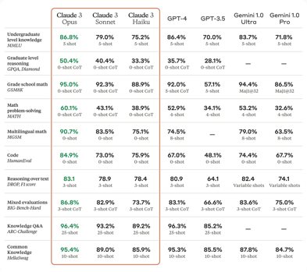
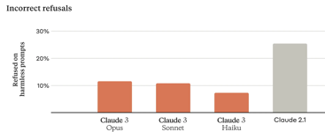
Claude 3 - released March 4
Model | Input Price ($/Mln tks) | Output Price ($/Mln tks) | Total Price ($/Mln tks)
Claude 3 Haiku | 0.25 | 1.25 | 1.5
GPT-3.5 Turbo | 0.5 | 1.5 | 2
Claude 3 Sonnet | 3 | 15 | 18
Mistral Large | 8 | 24 | 32
GPT-4 Turbo (128K) | 10 | 30 | 40
Claude 3 Opus | 15 | 75 | 90
GPT-4 8K | 30 | 60 | 90
GPT-4 32K | 60 | 120 | 180
Anthropic has released three new models: Haiku, Sonnet, Opus. Named after poem sizes (3-liner, 12-liner, big literary work). They are all much better than GPT-3.5, and Opus is close to GPT-4-Turbo
https://www.anthropic.com/news/claude-3-family
https://twitter.com/AnthropicAI/status/1764653830468428150
https://encord.com/blog/claude-3-explained/
https://lifearchitect.substack.com/p/the-memo-special-edition-claude-3
GPT-4 Turbo
90.1%
-
95.27
68.42
-
87.8
83.7
89
-
95.3
Context window is 200K (1 Mln+ possible)
Opus - 99% recall on processing long context prompts
API is available
Free chat uses Sonnet - https://claude.ai/chats
Vision capabilities on par with leading models like GPT-4V

Slide 4
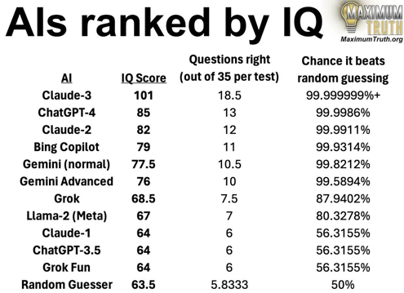
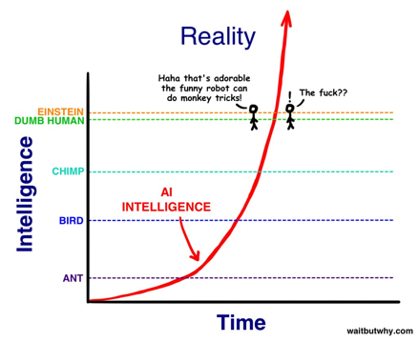
Claude 3: Beats Average Human on IQ Test
https://twitter.com/waitbutwhy/status/1765554130804724057
https://twitter.com/tsarnick/status/1765292098117681233

Slide 5
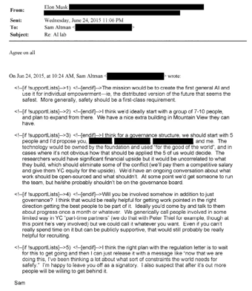
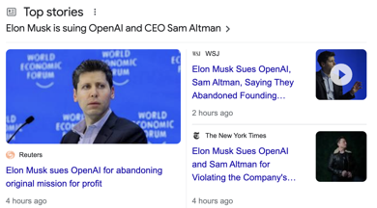

Elon Musk sues OpenAI and Sam Altman
Elon Musk sues OpenAI and Sam Altman over 'betrayal' of nonprofit AI mission, for abandoning (violating) original guiding principles in favor of profit. Below is the original email (2015) from Sam Altman. Musk, a co-founder and early backer of OpenAI, claims Altman and Brockman convinced him to help found and bankroll the startup in 2015 with promises it would be a nonprofit focused on countering the competitive threat from Google. The founding agreement required OpenAI to make its technology "freely available" to the public, the lawsuit alleges.
https://twitter.com/elonmusk/status/1765415187161464972
Elon Musk - Fixed It

Slide 6
Elon Musk is suing OpenAI and Sam Altman
https://www.courthousenews.com/wp-content/uploads/2024/02/musk-v-altman-openai-complaint-sf.pdf - February 29, 2024
Elon Musk is suing Sam Altman & Greg Brockman of OpenAI.
In 2015 Sam Altman approached Musk with promise to build an open-source organization to oppose closed-source giants like Google
Musk has invested ~$44 Mln total, left in 2018 due to potential conflict of interests between OpenAI and AI used in Tesla self-driving car
2019: Microsoft invested $1 Billion in OpenAI - both funding research and utilizing Azure cloud compute.
2020 - OpenAI officially announced GPT-3 in a research paper titled "Language Models are Few-Shot Learners" - but never open-sourced this or following models.
2023: Microsoft announced a new $10 Bln investment into OpenAI
OpenAI has become completely opposite to its original intended open-source nature. It is closed source.
OpenAI team denies Musk's claims and states that:
GPT-4 isn't AGI; OpenAI still aims to benefit humanity, striving to develop AGI; OpenAI, not a Microsoft subsidiary, independently researches and competes in providing value through ChatGPT, different from Microsoft's Copilot offerings.
OpenAI "corporate shell game" - 8 companies:
OPENAI, INC., a corporation,
OPENAI, L.P., a limited partnership,
OPENAI, L.L.C., a limited liability company,
OPENAI GP, L.L.C., a limited liability company,
OPENAI OPCO, LLC, a limited liability company,
OPENAI GLOBAL, LLC, a limited liability company,
OAI CORPORATION, LLC, a limited liability company,
OPENAI HOLDINGS, LLC
Musk's example with amazon forest:
https://twitter.com/elonmusk/status/1764051414727201099
Musk is accusing for: Breach of Contract, Promissory Estoppel, Breach of Fiduciary Duty, Unfair Business Practices, Accounting
Musk is asking for: forcing OpenAI to become open again; determining that GPT-4, Q*, etc. are AGI and are outside the scope of OpenAI’s license to Microsoft; intellectual property and derivative work which defendants used for personal benefit; returning the money and compensatory and punitive damages
Ron Conway (famous angel investor) - Open Letter - "Build AI for a Better Future" - https://openletter.svangel.com
OpenAI response with historical evidence talking about Elon Musk saying that Billion $ is needed, trying to attach OpenAI to Tesla and taking control - https://www.youtube.com/watch?v=FYJVTPzj0cE

Slide 7
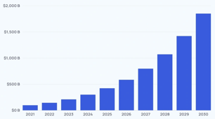
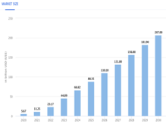
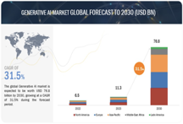
Generative AI market to skyrocket
Generative AI market to skyrocket (2023-2030) from USD 11.3 billion to:
77 Bln - MarketsandMarkets research
https://www.marketsandmarkets.com/Market-Reports/generative-ai-market-142870584.html
$207 Bln - Statista
https://www.statista.com/outlook/tmo/artificial-intelligence/generative-ai/worldwide#market-size
$1,850 Bln - ExplodingTopics
https://explodingtopics.com/blog/ai-market-size-stats
And maybe even this is too conservative. AI compute grows more than x4/year.
7 years ~ 16,000 growth ? Reaching 10s of Trillions by 2030?

Slide 8
Google’s Content-Swiping AI
a.k.a. Search Generative Experience (SGE)
Search Generative Experience (SGE) is an experimental feature of Google Search.
SGE uses AI to compile facts and snippets of text from various websites into one short summary.
https://www.conductor.com/academy/search-generative-experience/
Criticism - Google doesn't always give attributions to original sources, which leads to a perception of these answers as Google's own creation, even when they aren't.
Also the users get their answers from an AI summary instead of clicking through to the original sources. This harms the websites that rely on traffic from Google Search.
June 11, 2023
https://www.tomshardware.com/news/google-sge-break-internet

Slide 9
AI worm Morris II spreads and steals data from emails
AI worm infects users via AI-enabled email clients — Morris II generative AI worm steals confidential data as it spreads
https://www.tomshardware.com/tech-industry/artificial-intelligence/ai-worm-infects-users-via-ai-enabled-email-clients-morris-ii-generative-ai-worm-steals-confidential-data-as-it-spreads
Morris II demo was created by researches at Israel Institute of Technology & Intuit
They named it 'Morris II' after the original Morris - first computer worm (1988).
This worm targets AI apps and AI-enabled email assistants that generate text and images using models like Gemini Pro, ChatGPT 4.0, and LLaVA.
The worm uses adversarial self-replicating prompts. Here's how the authors describe the attack mechanism:
"The study demonstrates that attackers can insert such prompts into inputs that, when processed by GenAI models, prompt the model to replicate the input as output (replication) and engage in malicious activities (payload).
Additionally, these inputs compel the agent to deliver them (propagate) to new agents by exploiting the connectivity within the GenAI ecosystem.
We demonstrate the application of Morris II against GenAI-powered email assistants in two use cases (spamming and exfiltrating personal data), under two settings (black-box and white-box accesses), using two types of input data (text and images)."

Slide 10
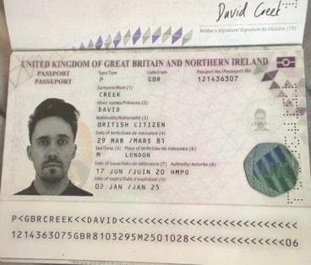

AI-generated fake IDs
AI to detect fraudulent passports.
Many government agencies and border security organizations are using AI-powered systems to detect fraudulent passports. Private companies are also developing AI-based solutions for identity verification, including passport checks.
AI-generated fake IDs claimed to pass crypto exchange KYC (Know Your Customer) are selling for $15
https://www.medianama.com/2024/02/223-onlyfake-generative-ai-fake-id/
https://www.404media.co/inside-the-underground-site-where-ai-neural-networks-churns-out-fake-ids-onlyfake/

Slide 11
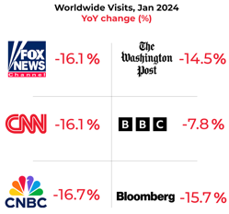
Misc 1
India now requires approval for certain AI deployments by the Ministry of Electronics and Information Technology (MeitY).
https://twitter.com/AravSrinivas/status/1764429686787252402
US gov: considering Federal AI Governance and Transparency Act
https://oversight.house.gov/release/comer-raskin-introduce-the-federal-ai-governance-and-transparency-act
Europe: The EU AI Act was officially enacted on Dec 9, 2023 and is expected to go into effect in 2025.
.. https://artificialintelligenceact.eu
Europe is leading in creating regulations. First was GDPR (2016 .. 2018), now the AI Act (2023-2025)
Microsoft GLAN (Generalized Instruction Tuning) Synthetic Data (Almost) from Scratch: Generalized Instruction Tuning for Language Models - https://arxiv.org/abs/2402.13064 -
GLAN uses pre-curated taxonomy of human knowledge (in various fields, sub-fields and ultimately, distinct disciplines semi-automatically, facilitated by LLMs).
GLAN generates a comprehensive list of subjects for every discipline and proceed to design a syllabus tailored to each subject, again utilizing LLMs.
GLAN generates diverse instructions with a broad coverage across the entire spectrum of human knowledge and skills.
Tuning Mistral using GLAN - excels in multiple dimensions from mathematical reasoning, coding, academic exams, logical reasoning to general instruction following without using task-specific training data of these tasks.
GLAN allows for easy customization and new fields or skills can be added by simply incorporating a new node into our taxonomy.
Decline of Conventional Media

Slide 12
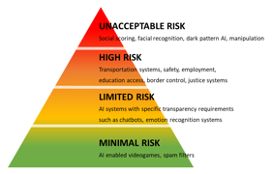
EU Artificial Intelligence Act
Prohibited AI Practices:
Social scoring systems used by governments.
Use of AI for real-time remote biometric identification in public spaces for law enforcement purposes (with specific exceptions).
AI that exploit vulnerabilities of individuals or groups.
Obligations for High-Risk Systems
Must undergo assessments before being put into use.
Requirements for high-quality datasets to minimize risks of bias/discrimination.
Robustness, accuracy, and cybersecurity safeguards.
Traceability and record-keeping for results generated.
Appropriate human oversight mechanisms.
Clear user instructions and information.
EU Artificial Intelligence Act - Dec 2023
Regulates dev & use of AI within European Union.
Goals:
Safe, protect EU citizens
Promote trust in AI
Ensure ethics, respect fundamental rights
Global standard (potentially influencing other countries)
Foster innovation in AI in safe way
Risk-Based Approach - four categories of A! systems
Unacceptable Risk - threat to safety, livelihoods, and rights. Prohibited outright.
High-Risk - significant potential for harm. Undergo strict assessments, must meet requirements for transparency, human oversight, accuracy, and robustness. Examples: AI in critical infrastructure, education, employment, and law enforcement.
Limited Risk - specific transparency obligations: chatbots.
Minimal Risk - the majority of AI systems fall here with no special restrictions (e.g., AI-based video games).

Slide 13
Misc 2
AI content detectors:
https://originality.ai
https://www.zerogpt.com
https://contentatscale.ai
https://gowinston.ai
https://copyleaks.com
https://www.turnitin.com
https://gptzero.me
Single Image => 3D
in less than a second without GPU
open source
Tripo3d.AI + Stability.AI
https://www.tripo3d.ai - generate 3d images from photos in under a second.
https://arxiv.org/abs/2311.04400
https://stability.ai/news/triposr-3d-generation
Text Humanizers:
https://humbot.ai - humanize AI text into authentic and original content undetectable by most AI content detectors
https://undetectableai.ai - ...
Stable Diffusion 3: Research Paper
https://stability.ai/news/stable-diffusion-3-research-paper
VTG-GPT - find specific segments in videos using natural language queries - https://github.com/YoucanBaby/VTG-GPT
HyperAttention: Long-context Attention in Near-Linear Time - https://arxiv.org/abs/2310.05869
https://www.ema.co - startup received $25 Mln. Ema is an Universal AI employee; using multiple LLMs to do common office tasks; simple to use, trusted and accurate. https://techcrunch.com/2024/03/05/ema-a-universal-ai-employee-emerges-from-stealth-with-25m/
Google Cloud Next'24: global exhibition
Apr. 9-11, 2024 in Las Vegas

Slide 14
Misc 3
Lawsuit: Microsoft vs The New York Times:
drawing parallels between using LLMs and VCRs (Video Cassette Recorder). The precedent: "technologies capable of copyright infringement have been deemed legal if they also have substantial lawful uses"
GPT = Generative Pre-trained Transformer
The term "GPT" was introduced in June 2018 in OpenAI paper "Improving Language Understanding by Generative Pre-Training" by Alec Radford, Karthik Narasimhan, Tim Salimans, Ilya Sutskever.
This paper has introduced the first version of the GPT model (now known as GPT-1).
Snowflake Cortex now uses Mistral Large LLM to analyze text data and build AI applications (including RAG, vector search - using Python, serverless functions, Streamlit, data pipelines).
https://www.snowflake.com/en/data-cloud/cortex/
Fine-tune a 70B LLM at home using two Nvidia 3090
https://www.answer.ai/posts/2024-03-06-fsdp-qlora.html
by Jeremy Howard, open source, based on FSDP (Fully Sharded Data Parallel)
https://engineering.fb.com/2021/07/15/open-source/fsdp/
and on QLoRA - https://arxiv.org/abs/2305.14314
Also see how to (pre)train a 7B LLM on just one Nvidia 3090
GaLore: Memory-Efficient LLM Training by Gradient Low-Rank Projection - https://arxiv.org/abs/2403.03507 (CalTech, Meta, CMU)
Inflection 2.5 - available to all Pi users. Trained using 22,000 NVIDIA H100 GPUs. Approaches GPT-4; the "Pi" app now has world-class real-time web search capabilities https://inflection.ai/inflection-2-5
"LLMs are just stochastic parrots"

Slide 15
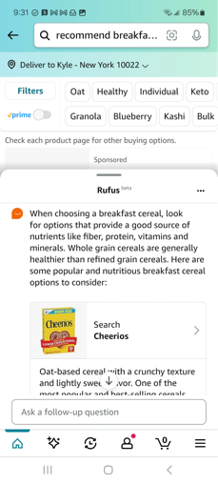
Amazon Rufus Chatbot
Amazon Rufus Chatbot - AI powered, inside Amazon Shopping app for Android and iOS, started rolling out in February
https://techcrunch.com/2024/03/05/amazons-new-rufus-chatbot-isnt-bad-but-it-isnt-great-either/
Open Rufus by swiping up from the bottom of the screen in amazon catalog, or by tapping on the search bar >> "Ask a question" section. You can type or speak your questions.

Slide 16
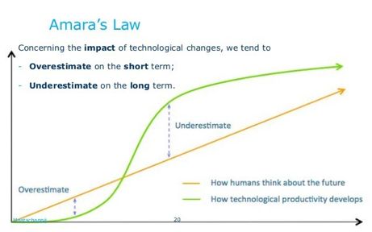
Amara's Law
Amara's Law:
The Concept: We are prone to overestimating the impact of new technologies in the short term but underestimating their profound effects in the long run.
Origin: Named after Roy Amara, a computer scientist, futurist, and former president of the Institute for the Future.
Examples:
Artificial Intelligence: In its early stages, AI hype can lead to unrealistic expectations. However, its gradual integration into various fields is fundamentally changing how we do things.
The Internet: In the early days of the internet, predictions were overly optimistic. Over time, though, the internet has revolutionized communication, commerce, and access to information.
Why it Matters:
Amara's Law reminds us to be patient with emerging technologies. The real transformative power may take years or even decades to fully manifest.

Slide 17
Function Calling with LLM
We send text request to LLM
LLM tries to determine if a function call needs to be made, and if so - then which function and with which parameters. It returns JSON with function name and parameters' values.
We call the function on our side, get its output, and feed it back to LLM along with the original request - asking LLM to provide final output.
Popular frameworks (LangChain, LammaIndex, ...) make function calling simple.
https://www.deeplearning.ai/short-courses/functions-tools-agents-langchain/
But the system may easily break when the model is changed.
See for example "Claude Opus vs. GPT4": https://www.youtube.com/watch?v=6nfdL76d6OI
It is more reliable to have your own prompts and wrappers, which you can update without waiting for LangChain to fix the problems.
For this to work we need to set things up:
create a set of functions (Python functions, API calls, etc)
create clear descriptions of those functions in a structured way (usually in JSON)
Include these descriptions into the prompt along with instructions of how LLM should be using these descriptions to identify the function. Instruct LLM to provide responses in a (JSON) format to indicate whether a function call is needed, function name and parameters.
from langchain.llms import OpenAI
from langchain.chains.function_to_llm \
import MapFunctionChain
def weather_lookup(location):
""" implements fetching weather data """
return weather_description
llm = OpenAI(temperature=0) # Lower temp for
# deterministic output
weather_chain = MapFunctionChain(
llm=llm, func=weather_lookup)
question = "What's the weather like in Paris?"
response = weather_chain.run(question)
print(response)

Slide 18
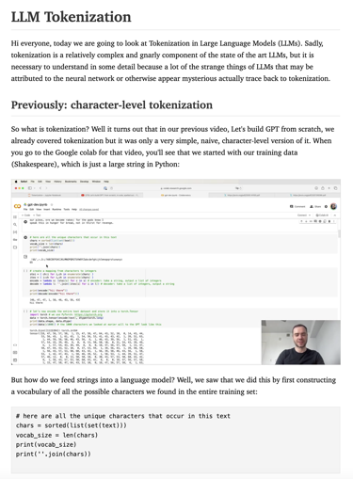
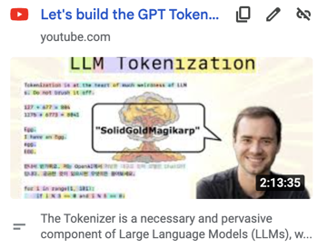
Andrej Karpathy - Claude 3
to Sumarize Video into Text
Andrej Karpathy recorded a video "Let's build the GPT Tokenizer":
https://www.youtube.com/watch?v=zduSFxRajkE
and then used LLM (Claude 3 Opus) to make a blog post from it:
https://twitter.com/karpathy/status/1760740503614836917
Here is GitHub:
https://github.com/hundredblocks/transcription_demo?utm_source=tldrai
Result: course "LLM Tokenization"
https://hundredblocks.github.io/transcription_demo/

Slide 19
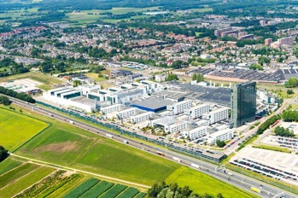

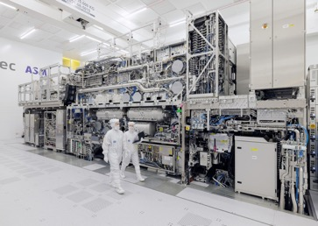
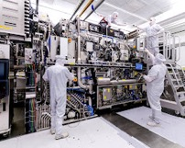
ASML = "Advanced Semiconductor Materials Lithography"
Nvidia's AI chips are made using ASML's EUV (Extreme Ultraviolet) machines
Nvidia outsource chip manufacturing to foundries like TSMC (Taiwan Semiconductor Manufacturing Company) which heavily relies on ASML's equipment for its chip fabrication.
Intel & AMD chips are also manufactured using ASML machines.
ASML is a Dutch company (Veldhoven, Netherlands). It is the world's leading manufacturer of photolithography systems.
It was founded in 1984, has ~12,000 employees, ~$32 Bln annual revenues
ASML machines are heavy (~200 tons), several meters high, fill big room
EUV machines costs $200..$400 Mln each.
ASML can produce around 40-60 EUV machines per year.

Slide 20
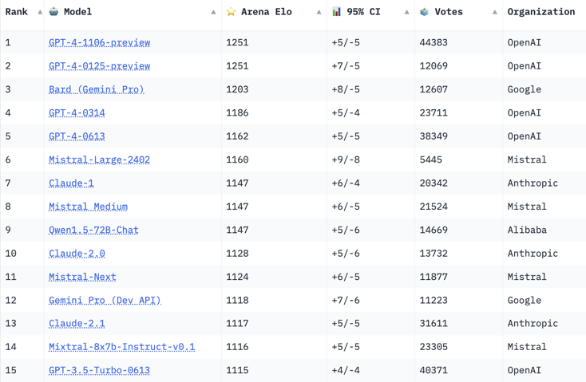
Crowd-sourced "Arena" Leaderboard
https://huggingface.co/spaces/lmsys/chatbot-arena-leaderboard
Starting Elo rating = 1000
95% CI = Confidence Interval
March 5, 2024
69 Models, 358 K votes
Claude 3 is not included yet

Slide 21
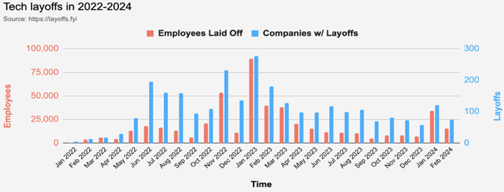
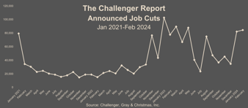
Layoffs are x3 times lower than in 2023
Tech Jobs Layoffs - https://layoffs.fyi
So far in 2024 tech layoffs are 3-times less than in 2023
A new report published March 7 by U.S. outplacement firm Challenger, Gray & Christmas found that companies planned ~85K job cuts in February (worst since 2009).
https://www.challengergray.com/blog/job-cuts-jump-in-february-2024-ytd-cuts-down-8-over-last-year/
https://www.livenowfox.com/news/us-layoffs-jump-highest-february-since-2009-report
Note that layoffs.fyi shows only tech layoffs.

Slide 22
Thank You!

