Slide 1
AI Updates
March 22, 2024
Nvidia GTC, Blackwell B200
Success to iterative Agent's workflows
Multi-Agent Software Development
Microsoft AutoDev
GPT-4 - Celebrating 1 year !
X.ai Grok-1 - open-sourced
Open-source AI is thriving
Apple MM1 multimodal LLMs
NeuroPrompts - automating prompt' tuning
Apple acquired DarwinAI
rerankers - open-source
Agentic RAG
Microsoft Mustafa Suleyman from Inflection
Google partners with Samsung and Apple to bring Gemini to mobile phones
Google - Gemini 1.5 Pro API is available
NLX - enterprise conversational AI
RankPrompt - self-ranking, reasoning
Open-Sora 1.0 ( vs OpenAI Sora)
Meta - Reality Labs Research SceneScript
Run LLMs locally
Neuralink paralized patient controls computer with his mind
maisa.ai - Mesa KPU
OpenAI GPT-5 is expected in June
AWS Kendra
Quiet-STaR (Stanford)
Joint Embedding Predictive Architecture
Rag 2.0 from contextual.ai
Tech Layoffs is lower this year

Slide 2
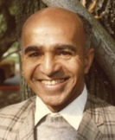
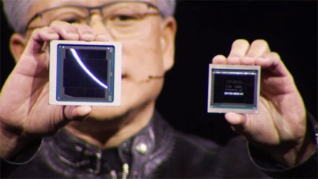
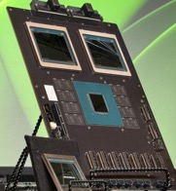

Nvidia GTC March 18-21
Nvidia GTC = GPU Technology Conference
March 18-21
San Jose McEnery Convention Center, San Jose, CA
Blackwell B200 chip vs Hopper:
Blackwell has 208 Bln transistors, can do 20 petaFLOPS per GPU.
It can run LLMs with trillion parameters 25 times faster than before.
New NVLink - delivers 1.8 TBytes per second to each GPU.
GB200 - a board that combines two B200 with a single Grace CPU. It offers x30 times the performance for LLM inference. It “reduces cost and energy consumption by up to 25x” over an H100
David Harold Blackwell
(1919 – 2010)
American statistician and mathematician,
UC Berkeley (1954-88)
GB200

Slide 3
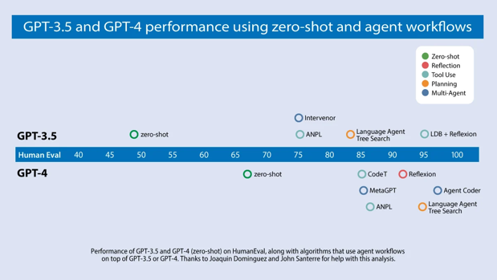
Success to iterative Agent's workflows
GPT-3.5 (zero shot) was 48.1% correct.
GPT-4 (zero shot) does better at 67.0%.
... wrapped in an agent loop, GPT-3.5 achieves up to 95.1%.
https://info.deeplearning.ai/robots-talk-back-ai-security-risks-political-deepfakes-pretrained-models-on-the-cheap
Reflection: LLM examines its own work
Tool use: web search, run code, ...
Planning: LLM creates multi-step plans
Multi-agent collaboration

Slide 4
Multi-Agent Software Development
Microsoft AutoDev - a fully automated AI-driven software development framework. You tell it what to do - and it builds software. 91.5% and 87.8% for code/test generation https://arxiv.org/pdf/2403.08299.pdf
Compare with Microsoft AutoGen - https://github.com/microsoft/autogen
crewAI - open-source Multi-Agent Automations
https://www.crewai.com
https://github.com/joaomdmoura/crewAI
https://docs.crewai.com
MetaGPT - open-source Multi-Agent Framework, Data Science Agent
https://github.com/geekan/MetaGPT
https://arxiv.org/abs/2402.18679
GPT-Pilot (now Pythagora) - open-source, VSCode extension
https://www.pythagora.ai
https://github.com/Pythagora-io/gpt-pilot - open source
https://marketplace.visualstudio.com/items?itemName=PythagoraTechnologies.gpt-pilot-vs-code
SuperAGI - open-source, autonomous agents
https://github.com/TransformerOptimus/SuperAGI
https://superagi.com/open-source
Devin from Cognition AI
https://www.youtube.com/@Cognition-Labs
https://www.cognition-labs.com/blog
https://preview.devin.ai
https://www.youtube.com/watch?v=G0qvYJVpgc0 - Scott Wu is really good at math :)
GitHub Copilot - VS Code Extension
https://blog.stackademic.com/using-github-copilot-in-vscode-and-xcode-ff9f3d951544
AutoGen - open source - build LLM apps using multiple agents
https://github.com/microsoft/autogen
OpenDevin - just started
https://github.com/OpenDevin/OpenDevin
More:
GenWorlds - https://genworlds.com
AutoGPT - https://github.com/Significant-Gravitas/AutoGPT
LoopGPT - https://github.com/farizrahman4u/loopgpt/tree/main
BabyAIG - https://github.com/yoheinakajima/babyagi
ShortGPT - https://github.com/RayVentura/ShortGPT
ChatDev - https://github.com/OpenBMB/ChatDev
Camel - https://github.com/camel-ai/camel
JARVIS - https://github.com/microsoft/JARVIS
Tabnine - https://www.ourcrowd.com/companies/tabnine
SWE-Bench - a dataset that tests systems' ability to solve GitHub issues automatically. The dataset collects 2,294 Issue-Pull Request pairs from 12 popular Python repositories. Evaluation is performed by unit test verification using post-PR behavior as the reference solution.
https://www.swebench.com
https://arxiv.org/abs/2310.06770

Slide 5
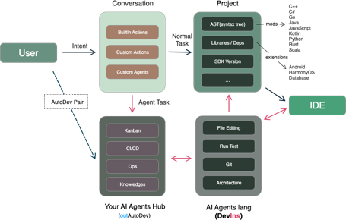
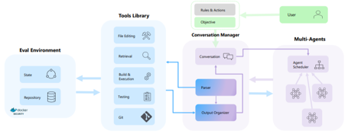
Microsoft AutoDev
Microsoft AutoDev - a fully automated AI-driven software development framework. You tell it what to do - and it builds software. It uses multiple Agents running in a docker container to do coding, file manipulation, testing, git operations, etc.
91.5% and 87.8% for code/test generation
https://arxiv.org/pdf/2403.08299.pdf
https://www.marktechpost.com/2024/03/19/microsoft-introduces-autodev-a-fully-automated-artificial-intelligence-driven-software-development-framework/
Note - there is also a separate open-source (not Microsoft) project from China since April 2023 with the same name AutoDev which already has 1,400 stars: https://github.com/unit-mesh/auto-dev
I think Microsoft should’ve used a different name or at least give credit

Slide 6

GPT-4 - Celebrating 1 year !
OpenAI GPT-4 was released on March 14, 2023
José Gregorio Argomedo found a fun and elegant way to celebrate 1-year anniversary
He wrote a python script using LangChain agents and GPT-4 to generate an article about this event:
https://www.linkedin.com/pulse/celebrating-gpt-4s-first-anniversary-ai-generated-article-argomedo-fnzrf/
And also shared the Jupyter notebook with the code:
https://github.com/rsmchile/technology-experiments-multi-agent-create-blog-post/tree/main
José Gregorio Argomedo
https://www.linkedin.com/in/jose-gregorio-argomedo/

Slide 7
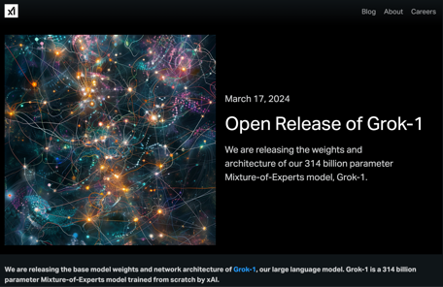
X.ai Grok-1 - open-sourced
grok-1
Elon Musk has promised to make X.ai Grok model open-source.
So - here it is. Apache 2.0 license. March 17, 2024
blog: https://x.ai/blog/grok-os
code: https://github.com/xai-org/grok-1
Huggingface: https://huggingface.co/xai-org/grok-1
314B params, 8K tokens context window, 8-bit precision
Mixture-of-Experts : 8 experts, 2 experts active per token
64 layers, 48 attention heads, 6,144-dim internal embeddings
SentencePiece tokenizer with 131,072 tokens
Activation Caching
RoPE (Rotary Positional Embeddings)
Base model not fine-tuned for any particular task.
Trained from scratch by xAI using a custom training stack on top of JAX and Rust in October 2023
GitHub contains the torrent magnetic link to download the weights, also python code to download and run the model.
The model uses 8bit precision, so 314B parameters means ~296GB size of the download (checkpoint) containing 773 files.
Make sure to download the checkpoint and place ckpt-0 directory in checkpoint. Then, run
pip install -r requirements.txt
python run.py
The script loads the checkpoint and samples from the model on a test input. Model is big (314 Bln params), need a big multi-GPU computer to run it.

Slide 8
Misc 1
Open-source AI is thriving
https://twitter.com/chiefaioffice/status/1768973268445274302
$8B+ invested in open-source AI over the last 2 years
GitHub witnessed 148% YOY growth in contributors
248% YOY growth in the total number of Gen AI projects
400K+ models on Huggingface
NeuroPrompts - Automatic tuning the prompts
https://spectrum.ieee.org/prompt-engineering-is-dead
https://arxiv.org/abs/2311.12229
Apple acquired Canada-based company DarwinAI which specializes in creating small efficient AI systems
https://www.macrumors.com/2024/03/14/apple-acquires-darwinai/
Apple MM1, a family of multimodal LLMs
text, image, video, audio
small - up to 30B parameters
SoTA in pre-training metrics
perform competitively after fine-tuning.
https://arxiv.org/abs/2403.09611
https://www.youtube.com/watch?v=QB5cSqrESlE
rerankers provide a simple API for all popular rerankers
https://github.com/AnswerDotAI/rerankers/
Initial retrieval in a RAG system is usually done using vector similarity. It is fast and cheap, but not good quality.
The retrieved docs are scored for relevancy - and sorted based on scores. The top of the prioritized list is fed to LLM.
There are multiple ways to do the scoring.
Cross-Encoders (specifically trained Neural Networks) are good. You can also use feature-based ML methods. Or even an LLM.
Logits of API-Protected LLMs Leak Proprietary Information
https://arxiv.org/abs/2403.09539 It is possible to learn a surprisingly large amount of non-public information about an API-protected LLM from a relatively small number of API queries. Most modern LLMs suffer from a softmax bottleneck, which restricts the model outputs to a linear subspace of the full output space. This unlocks several capabilities. For example, we estimate the embedding size of OpenAI's gpt-3.5-turbo to be about 4,096, and number of params ~7 Bln .
Agentic RAG - https://cobusgreyling.medium.com/agentic-rag-context-augmented-openai-agents-578e96212bc0
Designing RAG - https://towardsdatascience.com/designing-rags-dbb9a7c1d729
RAG using Knowledge Graph - https://pub.towardsai.net/how-to-do-rag-without-vector-databases-45fd4f6ced06
RAG with Knowledge Graph - https://medium.com/@rajib76.gcp/rag-recipe-needs-a-knowledge-graph-feb263bdcb62

Slide 9

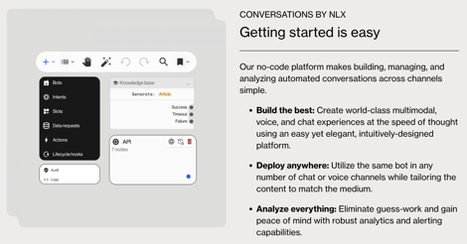
Misc 2
Microsoft has hired Mustafa Suleyman, the cofounder of $4 billion AI startup Inflection, to run Microsoft's AI operations. Karén Simonyan, another Inflection cofounder, is also joining Microsoft. Microsoft is paying $650 to Inflection.
Google - deals with Samsung and iPhone - integrating Gemini AI
into smartphone
Google - Gemini 1.5 Pro API is available https://medium.com/@manojpn/how-to-get-gemini-1-5-pro-api-key-bba09c46437e
NLX - enterprise conversational AI platform - raised additional $15 Mln - https://nlx.ai
Microsoft CEO Satya Nadella
Mustafa Suleyman
RankPrompt: Step-by-Step Comparisons Make Language Models Better Reasoners - (China) - https://arxiv.org/pdf/2403.12373.pdf
RankPrompt is a new method for LLMs to self-rank their responses without additional resources. The ranking problem is plit into a series of comparisons among diverse responses,
leveraging the inherent capabilities of LLMs to generate chains of comparison as contextual exemplars.
RankPrompt significantly enhances the reasoning performance of ChatGPT and GPT-4, with improvements of up to 13%.

Slide 10
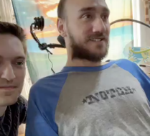
Misc 3
Open-Sora 1.0 - https://github.com/hpcaitech/Open-Sora
Can produce 2 sec 512x512 videos
Note: Original OpenAI Sora https://openai.com/sora can makes 60 sec videos at good resolution
Meta - Reality Labs Research is announcing SceneScript, a novel method of generating scene layouts and representing scenes using language.
https://ai.meta.com/blog/scenescript-3d-scene-reconstruction-reality-labs-research/
Neuralink
Paralized patient plays chess on computer with his mind
https://twitter.com/thekitze/status/1770711281508536421
Run LLMs locally - many no-code / low-code ways to do it:
Ollama - https://ollama.com
LMStudio - https://lmstudio.ai
TextGen WebUI - https://github.com/oobabooga/text-generation-webui
GPT4All - https://gpt4all.io
MLC LLM - https://github.com/mlc-ai/mlc-llm
PrivateGPT - https://github.com/zylon-ai/private-gpt
h2oGPT - https://github.com/h2oai/h2ogpt
Jan - https://github.com/janhq/jan
https://maisa.ai - Mesa KPU (Knowledge Processing Unit)
https://www.linkedin.com/pulse/ai-reasoning-breakthrough-mesas-kpu-decimates-gpt-4-timmy-vanheel-lrq1e/
Mesa claims the KPU achieved impressive results:
96.9% accuracy (zero-shot) GSM8K (math word problems):
86.2% accuracy (zero-shot) DROP (reading comprehension):
100% on multi-step arithmetic problems (vs 4% for GPT-4)
OpenAI GPT-5 is expected in June
https://www.firstpost.com/tech/openai-to-launch-gpt-5-in-a-few-months-will-be-the-closest-thing-to-agi-we-have-seen-yet-13751450.html

Slide 11
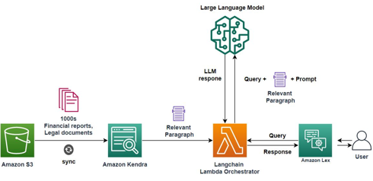
AWS Kendra
AWS Kendra
Indexing S3 bucket from Python: https://docs.aws.amazon.com/kendra/latest/dg/gs-python.html
Query API - https://docs.aws.amazon.com/kendra/latest/dg/searching-example.html
Query API - https://docs.aws.amazon.com/kendra/latest/APIReference/API_Query.html
Kendra has its own re-ranking. And it offers plugin to rerunk results of OpenSearch: https://docs.aws.amazon.com/kendra/latest/dg/opensearch-rerank.html
AWS Comprehend may be used to "enrich" queries and improve the search results. It is used to preprocess user queries and extract entities (people, places, organizations, dates, etc.) and key phrases, and then add them into query.
Example: A user query "Show me contracts with Acme Corp."
Comprehend extracts "Acme Corp" as an organization, providing an additional search signal for Kendra.
Comprehend can also detect positive or negative Sentiment - and prioritize the results accordingly. It can also perform custom NLP Tasks, for example, industry-specific terminology.

Slide 12
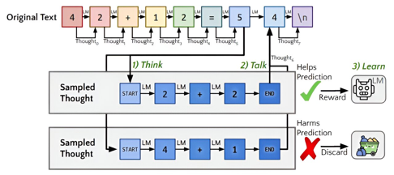
Self-Reflection
Agent with self-reflection
Quiet-STaR: Language Models Can Teach Themselves to
Think Before Speaking (Stanford)
Paper - https://arxiv.org/pdf/2403.09629.pdf
Video summary - https://www.youtube.com/watch?v=A_NE3ouBAUI
GitHub: https://github.com/ezelikman/quiet-star
Quiet-STaR, a generalization of STaR in which LMs learn to
generate rationales at each token to explain future text, improving their predictions.
We address key challenges, including
1) the computational cost of generating continuations,
2) the fact that the LM does not initially know how to generate or use internal thoughts, and
3) the need to predict beyond individual next tokens.
To resolve these, we propose a token-wise parallel sampling algorithm, using learnable tokens indicating a thought’s start and end, and an extended teacher-forcing technique. Encouragingly, generated rationales disproportionately help model difficult-to-predict tokens and improve the LM’s ability to directly answer difficult questions.
In particular, after continued pretraining of an LM on a corpus of internet text with
Quiet-STaR, we find zero-shot improvements on GSM8K (5.9%→10.9%) and CommonsenseQA (36.3%→47.2%) and observe a perplexity improvement of difficult tokens in natural text. Crucially, these improvements require no fine-tuning on these tasks. Quiet-STaR marks a step towards LMs that can learn to reason in a more general and scalable way.

Slide 13

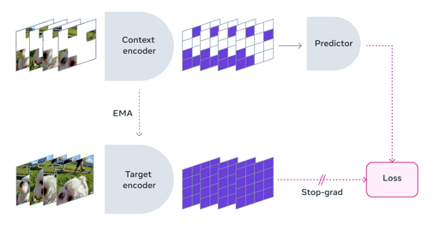
V-JEPA
Video Joint Embedding Predictive Architecture (V-JEPA) model
https://ai.meta.com/blog/v-jepa-yann-lecun-ai-model-video-joint-embedding-predictive-architecture/
Yann LeCun has proposed the original Joint Embedding Predictive Architectures (JEPA) in 2022.
https://www.youtube.com/watch?v=bMoad-Fd9LI
Yann interview with Lex Fridman
Hierarchical Planning
Scaling
Bias, freedom of speech, open source is the answer

Slide 14

contextual.ai
contextual.ai - startup
https://contextual.ai
building foundation models to run on your stack
customizable, trustworthy, privacy-aware AI
secure by default
RAG 2.0 - https://contextual.ai/introducing-rag2/
A typical RAG is a "Frankenstein’s monster" using:
a frozen off-the-shelf model for embeddings
a vector database for retrieval
a black-box LLM for generation
The RAG 2.0 approach pretrains, fine-tunes, and aligns all components as a single integrated system, backpropagating through both the language model and the retriever to maximize performance
Founders: Amanpreet Singh (CTO), Douwe Kiela (CEO)
Microsoft Research, Meta/Facebook AI Research, Hugging Face, Cambridge, NYU, Stanford
worked in foundation models (RAG, FLAVA, UniT, Bloom), dense retrieval (Hallucination reduction, MDR, Unsupervised QA), evaluation (SentEval, GLUE, SuperGLUE, Dynabench, Eval on the Hub), multimodality (Hateful Memes, Winoground, TextVQA, MMF) and representation learning (InferSent, GroundSent, Poincare embeddings).

Slide 15
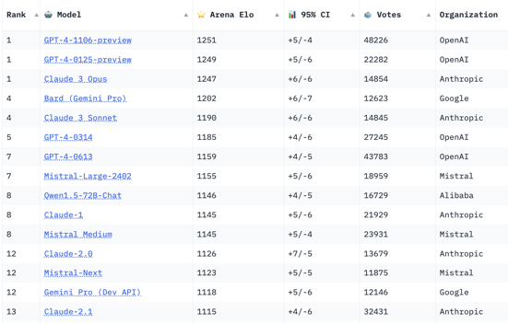
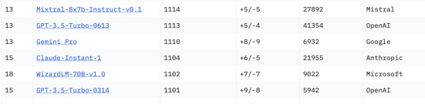
Crowd-sourced "Arena" Leaderboard
https://huggingface.co/spaces/lmsys/chatbot-arena-leaderboard
Starting Elo rating = 1000
95% CI = Confidence Interval
models: 73
votes: 408,144
March 13, 2024
open source
open source
open source

Slide 16
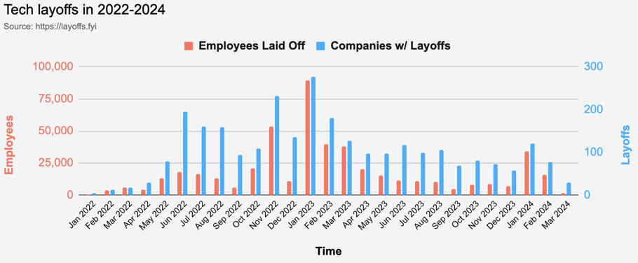
Tech Layoffs are x3 times lower than in 2023
Layoffs - https://layoffs.fyi
Salaries for AI engineers rose 12% from the third to fourth quarter last year
The average salary for a senior AI engineer nationally is more than $190,000, according to Comprehensive.io.

Slide 17


About the Speaker
Lev Selector, Ph.D.
40+ years of software engineering, data science, and building teams (hiring, training, and managing)
Ph.D. in mathematical modeling and computer simulations
Interests:
Generative AI, Using LLM with your data
Local AI for Local Private Data
Cloud architecture, fin-tech, application security
Find/connect: Linkedin, GitHub, YouTube, Google
https://eais.ai
Enterprise AI Systems

Slide 18
Thank You!

