Slide 1
AI Updates
April 05, 2024
LambdaLabs - Nvidia GH200
April 1st - celebrated for 400+ years
Why Emad Mostaque Left Stability.ai
the craziest talent war
Red Teaming LLM applications
Most Impactful AI Workflows
Naive RAG has poor performance
Apple's ReALM improves Siri's
OpenUI - build UI from description
OpenAI GPT without account for free
$100 Bln data center with "Stargate"
OpenAI clone voice from just 15 sec
Applicant Tracking System (ATS)
Claude-Author - write a novel from one prompt
SWE-agent - open source bug fixer
Stability AI just released Stable Audio 2.0
Crowd-sourced "Arena" Leaderboard
Tech Layoffs are x3 times lower than in 2023

Slide 2
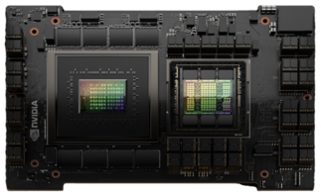



LambdaLabs - Nvidia GH200
LambdaLabs expansion
https://lambdalabs.com - another $500 Mln to expand GPU cloud, in addition to the $230 Mln Series C earlier this year.
Grace CPU + Hopper GPU
What is Coherent Memory?
GH200 has 576 GB of "Coherent memory"
Coherent memory creates a single, unified memory space accessible by both the CPU and GPU.
Both CPU and GPU can see and operate on the same data without the need for explicit memory transfers.
Apple Silicone Unified Memory
Nvidia "Coherent Memory" is very similar to Apple Silicone Mac's Unified Memory.
(128 GB laptops, or 192 GB Studio or Pro) (using Apple’s MLX framework)

Slide 3







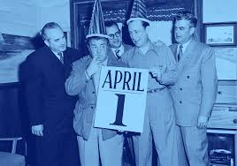



April 1st - celebrated for 400+ years (at least)

Slide 4
Why Emad Mostaque Left Stability.ai
Peter H. Diamandis interviewed Emad Mostaque
https://www.diamandis.com/blog/emad-wisdom-part-1
Emad: "I'm particularly great at taking creatives, developers, researchers, others and achieving their full potential and designing systems. But I should not be dealing with HR and operations and business development and other elements. There are far better people than me to do that."
Emad recounted Elon Musk’s quote about what it's like being CEO: "Staring into the abyss and chewing glass."
... big feeling of relief: "It was tying me down. There's a lot of legacy, technical, organizational, and other debt, especially when you grow so fast...I felt tired, relieved. I felt that now there's a million options.”
... advice to focus on the huge opportunity in AI-generated media
... he also stepped down because he felt an urgency and a responsibility to address broader issues around AI governance and consolidation that very few people are focused on. Emad believes there is a small window of only a year or two to establish proper governance and standards before highly capable AI systems become too consolidated and centralized.
... AI also has the potential to end democracy as we know it if the technology enables perfectly persuasive and emotionally manipulative speech targeted to each individual.
Decentralized AI:
Accessibility: Everyone should be able to access AI technology.
Governance: There needs to be decentralized, democratic governance over the data that trains AI systems, not centralized control by a few companies.
Modular infrastructure: AI systems should be built in a modular way that people can build on top of, rather than monolithic centralized systems.
Emad envisions a future "intelligent internet" - roads, electric grid, schools, ... where "each person, country, and company has their own AI models, and they're all interacting with each other in an optimal way for humanity."

Slide 5
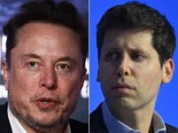
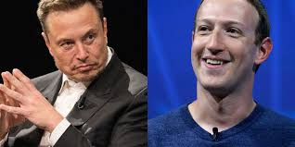
"the craziest talent war"
Elon Musk says competition for AI engineers is 'the craziest talent war I've ever seen!'. Musk said he's raising the salaries of Tesla's AI engineering team.
Musk claimed OpenAI has successfully poached several Tesla engineers, with Tesla increasing AI engineer pay to attempt to fend off threats.
Several Tesla engineers have even been poached by Musk’s own xAI, including ML scientist Ethan Knight, who Musk said was originally set to join OpenAI.
Also making AI talent poaching headlines is Mark Zuckerberg, who reportedly recently emailed several Google DeepMind employees to recruit for Meta.
https://www.businessinsider.com/elon-musk-says-ai-talent-war-is-craziest-hes-seen-2024-4

Slide 6
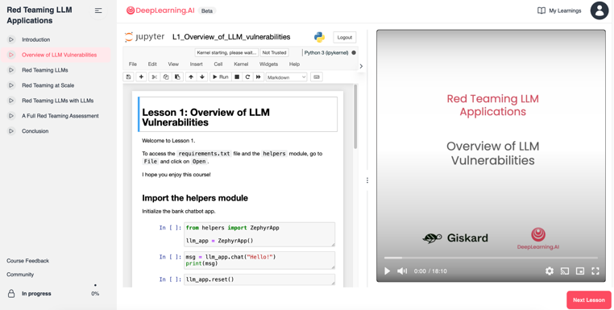
Red Teaming LLM applications
Red Teaming LLM applications
https://learn.deeplearning.ai/courses/red-teaming-llm-applications/lesson/1/introduction

Slide 7
Most Impactful AI Workflows
Customer Service:
AI-Powered Chatbots - 24/7 service, fast (RAG systems)
Sentiment Analysis - social media, emails, and surveys - to track customer satisfaction, identify potential problems, and make proactive improvements.
Personalized Recommendations - boost sales
Operations and Process Automation:
Document Analysis - sorting, classifying, extracting crucial data from documents (like invoices, contracts, reports)
Inventory Management - forecast demand and optimize stock levels, minimize waste and ensure adequate inventory
Fraud Detection - AI analyzes patterns in transactions and flags suspicious activity to prevent fraud, protect from losses
Marketing and Sales:
Predictive Lead Scoring - prioritize sales efforts, increase conversion rates
Targeted Ad Campaigns - highly personalized ads
Sales Forecasting - analyze trends, predict sales, improve planning and resource allocation
Writing - posts, articles, newsletters
Human Resources:
Candidate Sourcing and Screening - identify good potential candidates from huge resume pools
Employee Training - AI can offer personalized training plans to support employee growth and skill development.
Predictive Analytics for Attrition - identify patterns that could lead to employee turnover.

Slide 8
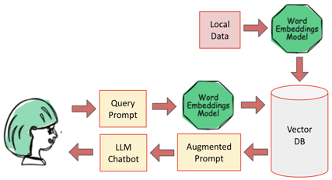
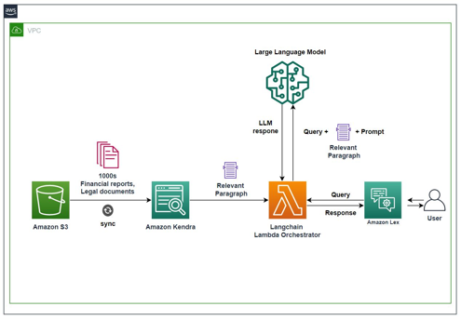
Naive RAG - poor performance
Amazon simple naive RAG (Retrieval Augmented Generation) using Kendra indexing and Bedrock LLM works very poorly, mostly because of bad retrieval.
Data preprocessing MUST be added for better results.

Slide 9
Misc
Apple has developed a new system called ReALM (Reference Resolution As Language Modeling) that improves Siri's ability to understand context by considering on-screen, conversational, and background entities. It outperforms ChatGPT 4.0 in some benchmarks.
https://9to5mac.com/2024/04/01/apple-ai-gpt-4/
https://arxiv.org/pdf/2403.20329.pdf - paper
Applicant Tracking System (ATS) software scans and analyses your resume or application and rejects it if it is not a good match. - https://twitter.com/deadlyjackflash/status/1774739901784920551
Claude-Author - write a novel using one-prompt description
open-source
saves book as a real e-book
complete w/ cover art
a chain of many Claude 3 Haiku/Opus and Stable Diffusion API calls that work together
https://github.com/mshumer/gpt-author/
https://twitter.com/mattshumer_/status/1775543642561597821
OpenUI - describe UI - and it gets automatically created using HTML, React, Svelte, Web Components, etc.
https://github.com/wandb/openui
Microsoft "Generative AI for Beginners" v.2 course
https://github.com/microsoft/generative-ai-for-beginners
SWE-agent - open source, can fix bugs and issues in real GitHub repositories - https://github.com/princeton-nlp/SWE-agent
OpenAI now provides ChatGPT for free without the need to sign-up.
Stability AI just released Stable Audio 2.0 - create high-quality songs up to 3 min from a single text prompt.
https://stability.ai/news/stable-audio-2-0
Microsoft and OpenAI are planning a new data center: in 2028, $100 Bln, AI supercomputer called "Stargate".
OpenAI can clone voice from just 15 sec of audio
https://decrypt.co/224165/open-ai-voice-engine-clone-speech
https://openai.com/blog/navigating-the-challenges-and-opportunities-of-synthetic-voices

Slide 10
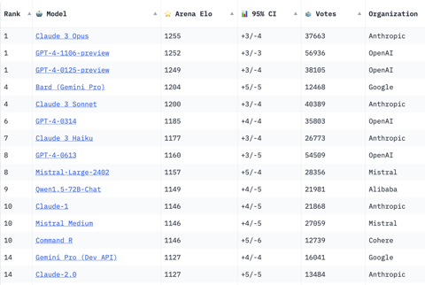
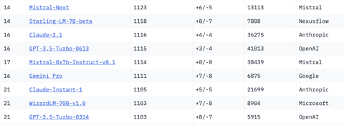
Crowd-sourced "Arena" Leaderboard
https://huggingface.co/spaces/lmsys/chatbot-arena-leaderboard
Starting Elo rating = 1000
95% CI = Confidence Interval
models: 76
votes: 511252
March 29, 2024
open source
open source
open source

Slide 11
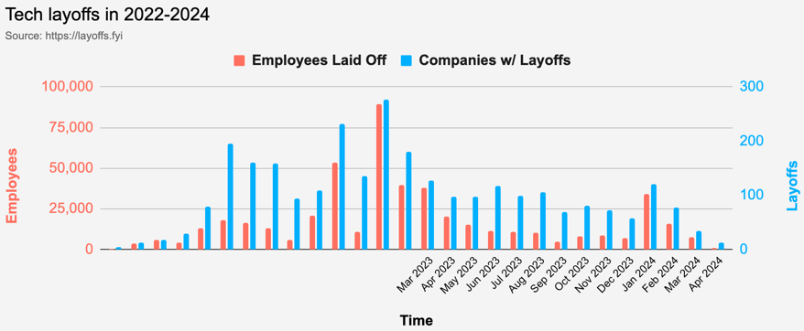
Tech Layoffs are x3 times lower than in 2023
Layoffs - https://layoffs.fyi
Salaries for AI engineers rose 12% from the third to fourth quarter last year
The average salary for a senior AI engineer nationally is more than $190,000, according to Comprehensive.io.
AI has a talent shortage, meaning $1 Mln salary job offers! Even during tech layoffs https://qz.com/tech-layoffs-high-ai-struggling-find-talent-1851368861

Slide 12
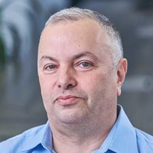

About the Speaker
Lev Selector, Ph.D.
40+ years of software engineering, data science, and building teams (hiring, training, and managing)
Ph.D. in mathematical modeling and computer simulations
Interests:
Generative AI, Using LLM with your data
Local AI for Local Private Data
Cloud architecture, fin-tech, application security
Find/connect: Linkedin, GitHub, YouTube, Google
https://eais.ai
Enterprise AI Systems

Slide 13
Thank You!

