Slide 1
AI Updates
April 12, 2024
Google Cloud AI Agents - Google Cloud Next 2024
Nvidia AI Accelerators - GH200, GB200
Intel AI Accelerator - Gaudi 3 Chip
Meta AI Accelerator
Microsoft Azure AI Chips
Groq AI Accelerator - fast Inference
Mixtral 8x22B
$1 Bln to design new AI phone
OpenAI GPT-4 trained on 1+ Mln hrs of YouTube
Text-to-Code usage grows
100+ toks/sec on a Mac
Google CodeGemma
Llama-3 to be release in a month
Google Imagen-2 Animated Images
Google Vertex AI Agent Builder
EMO: Emote Portrait Alive
UDIO new music generator
OpenAI GPT-4 Turbo with Vision
Google DeepMind - Griffin & Hawk
Chief AI Officers in US Government
AI fake girlfriend/boyfriend industry
llm.c from Andrej Karpathy
RAG Success Story
Make RAG Better
Ollama & Embedding Models
AIOS: LLM Agent Operating System
3Blue1Brown YouTube Deep Learning Tutorials
Crowd-sourced "Arena" Leaderboard
Tech Layoffs are x3 times lower than in 2023

Slide 2

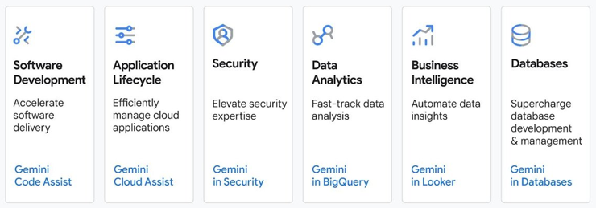
Google Cloud Next 2024 - AI Agents
Google Cloud Next 2024 Event (Las Vegas April 9-11):
New AI Hypercomputer architecture (TPU v5p)
Gemini 1.5 Pro
Imagen 2.0
Vertex AI Agent Builder
Gemini Assistants for Google Cloud (developers, services, applications): Gemini Cloud Assist, Gemini in Security, Gemini Code Assist, Gemini in BigQuery, Gemini in Looker, Gemini in Databases
Google Axion Processors
Google Workspace, Google Vids
Google Vertex AI Agent Builder
https://cloud.google.com/products/agent-builder
https://cloud.google.com/vertex-ai
Build conversational AI agents
Ground your apps in Google Search
Use Vertex AI search for RAG
Use search component APIs
Vector search (embeddings)
Use LangChain on Vertex AI

Slide 3



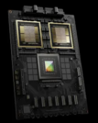





Nvidia AI Accelerators
Motherboard + several GPUs
Accelerated compute trays:
GB200 NVL72 rack: 36 Grace CPUs and 72 Blackwell GPUs
estimated price $3.5 Mln
GH200 Grace CPU
Hopper GPU
576 .. 624 GB of
unified memory
starts at $3.99/hr
A100 Ampere GPU
80GB GPU memory
8 per server,
starts at $1.29/hr
H100 Hopper GPU
80GB GPU memory
available with
AMD EPYC 9004 CPU
starts at $1.99/hr
H200
Hopper GPU
128 .. 141 GB GPU Memory
(still expected ...)
GB200 Grace CPU
2 Blackwell GPU
~ 850 GB
GB200
compute tray
2 Grace CPUs
4 Blackwell GPUs
1.7 TB Memory
80 petaflops

Slide 4


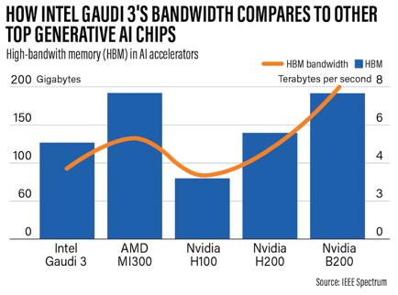


Intel AI Accelerator - Gaudi 3 Chip
Intel claims that their new Gaudi 3 AI Accelerator Chips are better than Nvidia H100s in speed and cost and comparable with Nvidia Blackwell !
https://wccftech.com/intel-gaudi-3-ai-accelerator-5nm-128-gb-hbm2e-900w-50-percent-faster-nvidia-h100/
Antoni Gaudí i Cornet (1852-1926) was a Catalan architect and designer from Spain. Most of his work are located in Barcelona, including his main work, the church of the Sagrada Família.
Universal board with 8 Gaudi 3 chips
Typical server contains dual Xeon CPU and 8 Gaudi GPUs

Slide 5


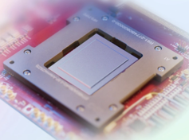
Meta AI Accelerator: Inference & Training
Microsoft Azure AI Chips
Meta Training and Inference Accelerator
https://ai.meta.com/blog/next-generation-meta-training-inference-accelerator-AI-MTIA/
TSMC 5nm, Freq 1.35GHz, 2.35B gates,
Area 25.6mm x 16.4mm, Package: 50mm x 40mm
Power: 0.85V, 90W
On-chip memory: 256 MB
Off-chip LPDDR5: 128 GB
Memory Bandwidth
Local memory: 1 TB/s per PE
On-chip memory: 2.7 TB/s
Off-chip LPDDR5: 204.8 GB/s
Microsoft Azure AI chips:
GPU - Azure Maia 100 (a.k.a. Athena or M100)
CPU - Cobalt 100 - 128-core Arm lower power
Google New AI Chip
Google new TPU v5 chip
The new TPU v5p chip is built to run in pods of 8,960 chips, and can double the performance of the prior generation of TPUs.
The Axion chip offers 30% better performance than "general-purpose Arm chips, and 50% better performance than current generation x86 chips produced by Intel
https://www.reuters.com/technology/google-unveils-arm-based-data-center-processor-new-ai-chip-2024-04-09/

Slide 6
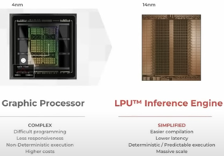

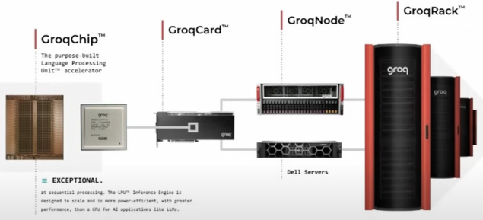
Groq AI Accelerator - fast Inference
GROQ - Super fast LPU Inference Engine
LPU = Language Processing Unit
Up to 500 tokens/sec, x100 - x600 faster than GPUs
https://www.youtube.com/watch?v=gmzd8dhlc0g
https://www.youtube.com/watch?v=fv69M1M_fXw
https://www.youtube.com/watch?v=WQDMKTEgQnY
https://groq.com
https://console.groq.com/docs/quickstart
Groq's LPU card cost $20K,
which is much cheaper than $35K for Nvidia's H100
Jonathan Ross* is Groq’s founder and CEO. He has began Google’s TPU effort as a 20% project,
and became a member of Google X’s Rapid Eval Team (Moonshots factory).

Slide 7

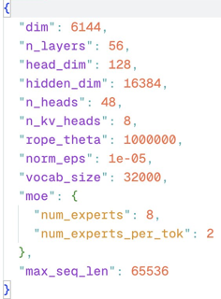
Mixtral 8x22B
Mistral has released a bigger Mixtral model
https://twitter.com/MistralAI/status/1777869263778291896
https://huggingface.co/v2ray/Mixtral-8x22B-v0.1
https://huggingface.co/mlx-community/Mixtral-8x22B-4bit
Play with it: https://labs.perplexity.ai
x3 times bigger than 8x7B
176B parameters
torrent download 261 GB
VRAM 260 GB in fp16
VRAM 73 GB in 4bits
65K tokens sequence length
32000 vocab size
8 experts, 2 experts/token
tokeniser similar to 7b model
6K dim
from transformers import AutoModelForCausalLM, AutoTokenizer
model_id = "v2ray/Mixtral-8x22B-v0.1"
Model | ARC C (25-shot) | Hellaswag (10-shot) | MMLU (5-shot) | TruthfulQA
Mixtral 8x22B - Base | 70.5 | 88.9 | 77.3 | 52.3
Cohere Command R+ | 70.99 | 88.56 | 75.73 | 56.3
Mixtral 8x7B-Base | 66.38 | 86.46 | 71.88 | 46.81
Owen1.5-728-Base | 65.87 | 85.99 | 77.2 | 59.61
LLAMA-2-70B-Base | 87.1 | 69.9 | 44.7 | 83.2
mistral-large | 89.2 | 81.2 | 50.5 | 86.7
mistral-medium | 88 | 75.3 | 47 | 88
mistral-small | 86.9 | 72.2 | 51.7 | 84.7
GPT-3.5 | 85.5 | 70 | 81.6 | -
GPT-4 | 95.3 | 86.4 | - | 87.5
Claude 3 Opus | 95.4 | 86.8 | - | 88.5
Claude 3 Sonet | 89 | 79 | 75.1 | -
Claude 3 Haiku | 85.9 | 75.2 | 74.2 | -
Gemini 1.0 Pro | 84.7 | 71.8 | - | 86.5 (Maj1@32)
Gemini 1.0 Ultra | 87.8 | 83.7 | - | 94.4 (Maj1@32)
Gemini 1.5 Pro | 92.5 | 81.9 | - | 91.7 (11)
ARC (Abstraction and Reasoning Corpus) - a dataset by Francois Chollet
HellaSwag - a dataset to test for grounded common sense inference
MMLU = Massive Multitask Language Understanding (math, science, medicine, finance, ...)

Slide 8
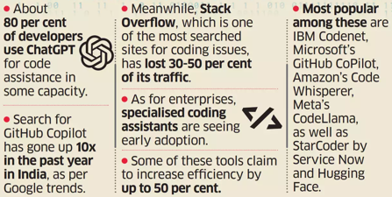


Misc 1
Former Apple Chief Design Officer Jony Ive
and OpenAI CEO Sam Altman
have raised ~$1 Bln from Masayoshi Son’s Softbank
to design the new kind of smartphone device
https://finance.yahoo.com/news/report-jony-ive-openai-ceo-134000931.html
Text-to-Code usage grows
https://economictimes.indiatimes.com/tech/technology/prompt-in-progress-genai-text-to-code-tools-boost-productivity/articleshow/109093288.cms
OpenAI developed its Whisper audio transcription model and used it to transcribe over a million hours of YouTube videos to train GPT-4. Company knew this was legally questionable but believed it to be fair use.
https://www.theverge.com/2024/4/6/24122915/openai-youtube-transcripts-gpt-4-training-data-google
Mac is great: 103.5 toks-per-sec
Apple Studio Ultra M2 192 GB memory
MLX framework
4-bit Mistral 7B
https://twitter.com/awnihannun/status/1777072588633882741
Google Gemma 1.1 Instruct 2B and “7B” are out!
Elon Musk Announces Tesla's Robotaxi Unveiling in August
https://twitter.com/elonmusk/status/1776351450542768368

Slide 9



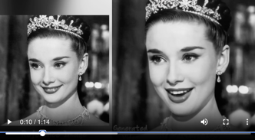
Misc 2
UDIO - new music generator
Udio AI Music Raises $10 Million
https://www.udio.com
Google open-sources CodeGemma models based on Gemma architecture and uploaded pre-quantized 4-bit models for 4x faster downloading
https://huggingface.co/blog/codegemma
https://ai.google.dev/gemma/docs/codegemma
OpenAI GPT-4 Turbo with Vision available to developers. It allows to combine text and images in one model. Still 128K-token window, and still knowledge cutoff Dec 2023.
https://www.zdnet.com/article/openai-makes-gpt-4-turbo-with-vision-available-for-developers/
At an event in London on Tuesday, Meta confirmed that it plans an initial release of Llama 3 within the next month.
Google’s Imagen 2 can now create 4 sec animated images
https://www.youtube.com/watch?v=XQU9Agg2MrU
https://venturebeat.com/ai/google-imagen-2-creates-four-second-animated-images/?utm_source=substack&utm_medium=email
EMO: Emote Portrait Alive
Portrait + Audio => animated video
https://humanaigc.github.io/emote-portrait-alive/
https://github.com/HumanAIGC

Slide 10
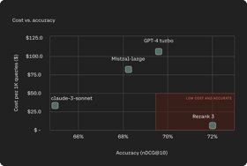

Misc 3
A New Massive Multilingual Dataset
for High-Performance Language Technologies (HPLT): 75 languages with ~5.6 trillion word tokens and 18 English-centric parallel language pairs
https://hplt-project.org
Federal Government Ramps Up Commitment to Fairness, Equity in Use of AI
White House Issues Policy to Reduce Risk, Enhance Benefits of AI
White House Orders All Federal Agencies to Name Chief AI Officers to oversee the federal government’s various approaches to AI and manage the risks that the rapidly evolving technologies might pose.
https://www.shrm.org/topics-tools/news/inclusion-equity-diversity/federal-government-commits-to-ai-fairness
Cohere Rerank 3: semantic re-ranking to improve RAG. Receives output of search, reranks it - and sends the top items to LLM for generating output. Available via API on Cohere and AWS, low latency (less than 3 sec)
https://txt.cohere.com/rerank-3/
Essay Grading at Texas Public Schools will be done by AI
Preprocessing Unstructured Data for LLM Applications
by DeepLearning.ai (Andrew Ng)
https://learn.deeplearning.ai/courses/preprocessing-unstructured-data-for-llm-applications/lesson/1/introduction
Amazon Adds AI Expert Andrew Ng To Board (Stanford ML Course, Google, Baidu, Coursera, DeepLearning.ai)

Slide 11
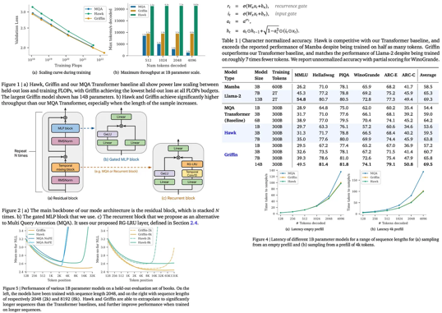
Griffin & Hawk
Google DeepMind - Griffin & Hawk
https://arxiv.org/abs/2402.19427 - paper
Hawk and Griffin are new RNNs by DeepMind.
Hawk - high performance (faster than Mamba) using gated linear recurrences
Griffin - matches Llama-2’s performance with significantly less training data. Griffin is a hybrid combining gated linear recurrences and local attention.
Griffin - handles long sequences (longer than seen during training).
Both models are as hardware efficient as Transformers, but offer lower latency and higher throughput during inference.
Griffin is scaled to 14 billion parameters.
https://artgor.medium.com/paper-review-griffin-mixing-gated-linear-recurrences-with-local-attention-for-efficient-language-75e5a86b1b24
https://medium.com/@bnjmn_marie/griffin-and-hawk-local-attention-for-efficient-language-models-7856fbb6bb32

Slide 12


AI fake girlfriend/boyfriend industry
Andrew Ng: https://twitter.com/AndrewYNg/status/1776737961243218134
The Financial Times has a great article on Renate Nyborg's work speaking about the dangers of the AI fake girlfriend/boyfriend industry and the risk of this leading to greater loneliness.
Renate says "Men didn’t want to meet girls because they had virtual girlfriends who said exactly what they wanted to hear."
To regulators wondering what are the risky applications of AI, I would urge taking a look at the fake gf/bf industry!
In contrast, Meeno ( https://meeno.com ) gives advice for human relationships, and is working to bring people together. Working to reduce human loneliness is a wonderful goal!

Slide 13

llm.c from Andrej Karpathy
Pure C training of GPT-2 with 124 Mln params in a single file with less than 1000 Lines of simple pure C.
There is no need for 245MB of PyTorch or 107MB of cPython.
It compiles and runs instantly, and exactly matches the PyTorch reference implementation.
https://github.com/karpathy/llm.c
Next steps:
direct CUDA implementation
speed up the CPU version with SIMD instructions, AVX2 on x86 / NEON on ARM (e.g. Apple Silicon).
more modern architectures, e.g. Llama2, Gemma, etc.
Andrej Karpathy

Slide 14
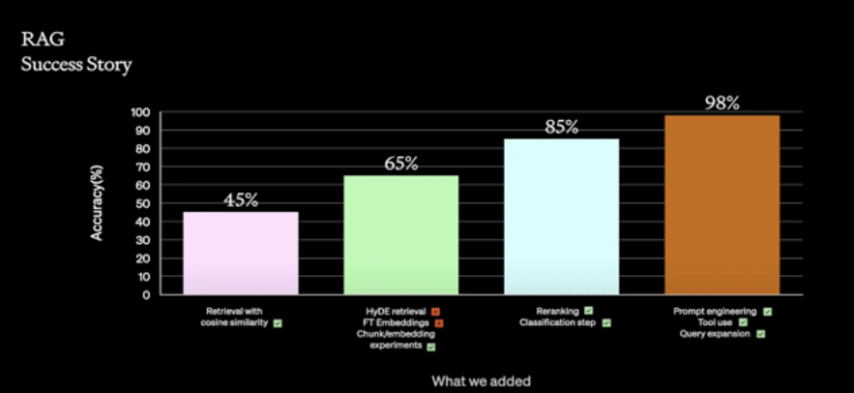
A Practical Guide to RAG Pipeline Evaluation (Part 1 & 2)
Original RAG paper (2021, FAIR)
https://arxiv.org/pdf/2005.11401.pdf
https://medium.com/@yisz
https://medium.com/relari/a-practical-guide-to-rag-pipeline-evaluation-part-1-27a472b09893
https://medium.com/relari/a-practical-guide-to-rag-evaluation-part-2-generation-c79b1bde0f5d
https://github.com/relari-ai/continuous-eval

Slide 15


Make RAG Better
One problem with RAG is that the questions and answers don't have to be semantically similar. One way of solving it is to do the search in the space of questions.
Text vector indexing:
split text into text chunks,
generate embedding vectors from those text chunks,
index them as (vector_from_text, text)
Question vector indexing:
split text into big chunks - chapters.
for each chapter generate multiple "exam" questions
generate embedding vectors from questions
index them as (vector_from_question, text)
You can also use hybrid approach using both methods together
LLM Agent Classifier,
may ask to refine question
LLM Agent question
rewriter,
embedding
Request
LLM Agent summarizer
LLM Agent semantic re-runking
Response
Semantic re-runking:
You send question and the chunk of text to LLM - and ask it to rank the relevancy of the text to the question.
If your search found 10 text chunks - you can make 10 separate queries to LLM, get 10 ranks - and sort them to select the best match.
You can make those 10 queries in parallel (for speed).
Any good LLM can be used (Mixtral, for example).
You can program agents using LangChain or LlamaIndex
Some good techniques to use:
classification step
query expansion
re-ranking
prompt engineering
tool use

Slide 16

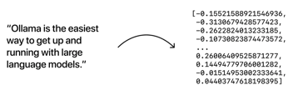
Ollama & Embedding Models
Ollama supports embedding models
https://ollama.com/blog/embedding-models
for example:
mxbai-embed-large (334M parameters)
nomic-embed-text (137M parameters)
all-minilm (23M parameters)
So you can use Ollama for RAG (both embedding and LLM)
# ollama pull mxbai-embed-large
## REST API
curl http://localhost:11434/api/embeddings -d '{
"model": "mxbai-embed-large",
"prompt": "some text to convert"
}'
## Python Library
ollama.embeddings(
model='mxbai-embed-large',
prompt='some text to convert',
)
## JavaScript Library
ollama.embeddings({
model: 'mxbai-embed-large',
prompt: 'some text to convert',
})

Slide 17
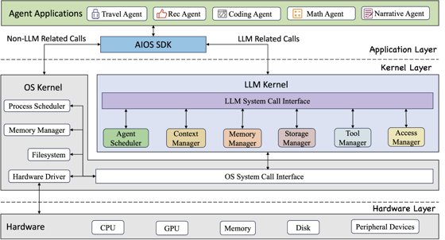
AIOS: LLM Agent Operating System
AIOS = AI OS (AI Operating System)
open source LLM Agent operating system
embeds large language model into Operating Systems (OS) as the brain of the OS
enables an operating system "with soul"
It is an important step towards AGI.
AIOS is designed to:
optimize resource allocation,
facilitate context switch across agents,
enable concurrent execution of agents,
provide tool service for agents,
maintain access control for agents,
provide a rich set of toolkits for developers
https://github.com/agiresearch/AIOS

Slide 18
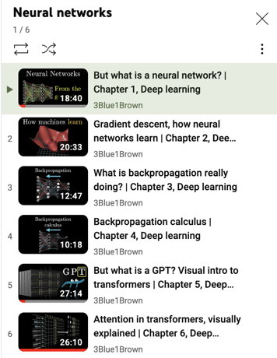



3Blue1Brown YouTube Deep Learning Tutorials
https://www.youtube.com/watch?v=aircAruvnKk&list=PLZHQObOWTQDNU6R1_67000Dx_ZCJB-3pi
Excellent animated tutorials about deep learning.
You may start with #5 and #6 explaining GPT and Transformers.
Grant Sanderson's eyes are mostly blue with a distinct brown section
Grant Sanderson
https://www.3blue1brown.com
https://www.youtube.com/@3blue1brown
https://twitter.com/3blue1brown
https://en.wikipedia.org/wiki/3Blue1Brown
https://www.youtube.com/watch?v=U_lKUK2MCsg - interview with Lex Fridman

Slide 19
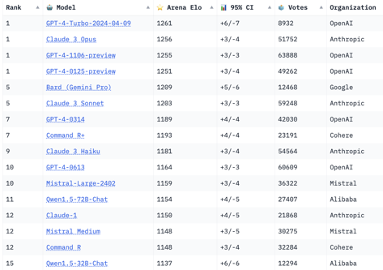
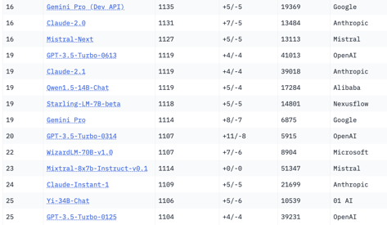
Crowd-sourced "Arena" Leaderboard
https://huggingface.co/spaces/lmsys/chatbot-arena-leaderboard
models: 82
votes: 652,743
April 11, 2024
Starting Elo rating = 1000
95% CI = Confidence Interval
o.s.
o.s.
o.s.
o.s.
o.s.
o.s.
o.s.

Slide 20
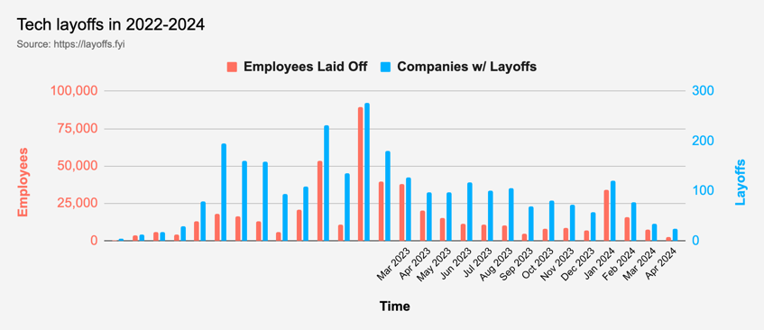
Tech Layoffs are lower than in 2023
Layoffs - https://layoffs.fyi
Salaries for AI engineers rose 12% from the third to fourth quarter last year
The average salary for a senior AI engineer nationally is more than $190,000, according to Comprehensive.io.
AI has a talent shortage, meaning $1 Mln salary job offers! Even during tech layoffs https://qz.com/tech-layoffs-high-ai-struggling-find-talent-1851368861

Slide 21


About the Speaker
Lev Selector, Ph.D.
40+ years of software engineering, data science, and building teams (hiring, training, and managing)
Ph.D. in mathematical modeling and computer simulations
Interests:
Generative AI, Using LLM with your data
Local AI for Local Private Data
Cloud architecture, fin-tech, application security
Find/connect: Linkedin, GitHub, YouTube, Google
https://eais.ai
Enterprise AI Systems

Slide 22
Thank You!

