Slide 1
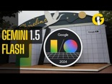

AI Updates
May 17, 2024
OpenAI GPT-4o
Google I/O - new models, apps, and more
Crowd-sourced "Arena" Leaderboard
Model Comparison - Graphs
AnthropicAI prompt generator
How To Beat Conch AI Detector, StealthGPT
WebLlama
John Wiley & Sons closing 19 journals (due to AI)
Apple + OpenAI
Ilya Sutskever is leaving OpenAI
When LLM is bigger than memory ...
Which model to use for an Agent?
Berkeley Function-Calling Leaderboard
Coding Assistants
Tech Layoffs were lower than in 2023

Slide 2
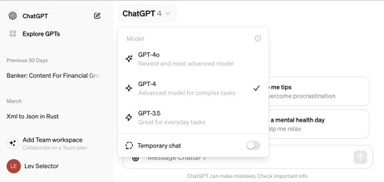
OpenAI announcement - Monday May 13
GPT-4o: A new AI model with improved capabilities in text, video, and audio processing. It is faster and more powerful than previous versions, offering enhanced performance and features.
Desktop version of ChatGPT: A dedicated desktop application for ChatGPT, providing a streamlined and user-friendly experience for interacting with the AI chatbot.
GPT-4 for all users: GPT-4, previously available only to paid subscribers, is now accessible to all ChatGPT users, including those using the free version.
Enhanced user interface: An updated user interface for ChatGPT, focusing on improved usability and accessibility.
GPT-4o is available for paid users
Pricing (per 1 Mln tokens)
https://openai.com/api/pricing/
gpt-4 : $10 in, $30 out
gpt-4o: $5 in, $15 out
Note: Google Gemini 1.5 Flash is > 10-times cheaper:
Flash : $0.35 in, 0.53 out
voice features - not released yet
flirtatious and engaging voice style (default voice has a "California Valley Girl" tone)

Slide 3
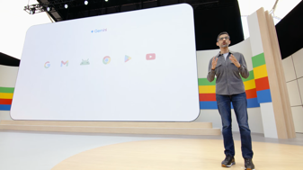
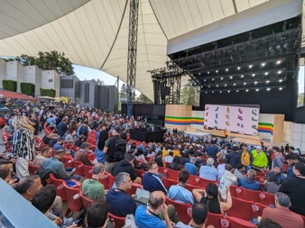
Google I/O 2024 - May 14, 2024
Gemini models - family of models, multimodal (images, audio, video), 1 Mln tokens context length (or 2M), fast, efficient, scalable.
Gemini Advanced subscription now includes the latest model.
Gemini Nano integrated into Chrome!
Imagen 3 - image generation model, available in Imagen FX. https://aitestkitchen.withgoogle.com/tools/image-fx
MusicFX - https://aitestkitchen.withgoogle.com/tools/music-fx
Veo - in VideoFX - creating short 1080p videos from text https://aitestkitchen.withgoogle.com/tools/video-fx https://deepmind.google/technologies/veo/
AI Scam Protection in Android - using Gemini Nano
Firebase Genkit: An open-source framework for building AI-powered applications.
Gemini in Android Studio: An AI coding companion with multimodal input support coming soon.
Astra - newest assistant - universal AI agent that can see AND hear what you do live in real-time, and take action on your behalf. https://twitter.com/rowancheung/status/1790437573694996667
Google Search AI Overviews - https://blog.google/products/search/generative-ai-google-search-may-2024/
https://ai.google.dev/pricing
Gemini 1.0 Pro (33k tokens), Gemini 1.5 Pro (1 Mln tokens), Gemini 1.5 Flash (1 Mln tokens) - light, fast, cheap https://deepmind.google/technologies/gemini/flash/ 1,500 Request per day for FREE
Flash Pricing: ($0.35+0.53 / 1 Mt (for prompts up to 128Kt)

Slide 4
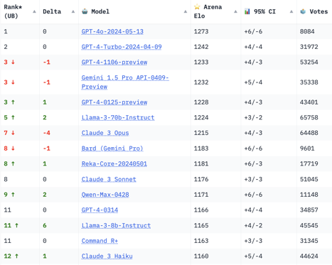
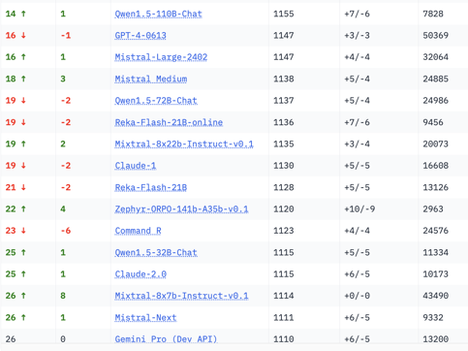
Crowd-sourced "Arena" Leaderboard
Total #models: 97.
Total #votes: 1,131,288.
Last updated: 2024-05-16
Starting Elo rating = 1000
95% CI = Confidence Interval
https://chat.lmsys.org/?leaderboard
English-only queries

Slide 5

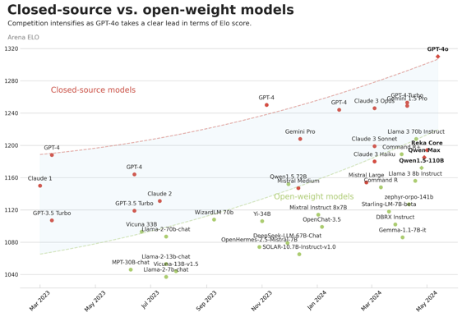
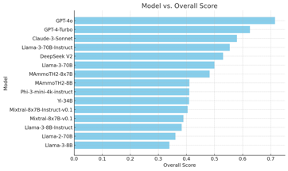
Model Comparisons - Graphs
Maxime Labonne tweets:
https://twitter.com/maximelabonne/status/1790676962974867724
https://twitter.com/maximelabonne/status/1790519226677026831
Maxime Labonne
Staff ML Scientist @ Liquid AI
London, UK

Slide 6
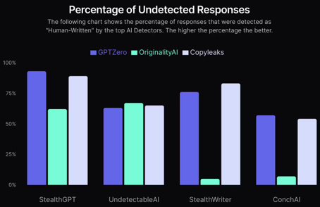
Misc 1
AnthropicAI prompt generator.
(also accepts variables to easily inject external data).
https://docs.anthropic.com/en/docs/prompt-generator
WebLlama - browse the web by following instructions and talking to you - https://github.com/McGill-NLP/webllama
John Wiley & Sons, Inc., a 200+ years old publishing company is closing 19 journals. They had to retract more than 11,300 papers recently "that appeared compromised" as generative AI makes it easier for paper mills to peddle fake research.
How To Beat Conch AI Detector
https://www.stealthgpt.ai/blog/how-to-beat-conch-ai-detector
Humanize content with StealthGPT: This is the easiest and most effective method. https://www.stealthgpt.ai
Write content manually: Conch AI has a low rate of false positives, so human-written content usually scores well.
Use Conch AI’s Humanizing Tool: This is a paid option and may not be effective against other AI detectors.
Introduce variety into content: Avoid repetitive sentence structures and phrases. This method can be challenging if you lack experience with AI content.
Train the AI model in your writing voice: Provide the AI with samples of your writing to make the generated content more personal. This method may not be effective for neutral or informative writing styles.
Tell a story: AI struggles with authentic storytelling, so adding personal anecdotes can help bypass detection.

Slide 7


Misc 2
Apple + OpenAI
SiriPro with OpenAI
Free ChatGPT for Mac
https://www.youtube.com/watch?v=ya2bxqbM3Yw
https://siri-pro.com/en/
Stability AI is facing a cash crunch and is exploring a sale

Slide 8
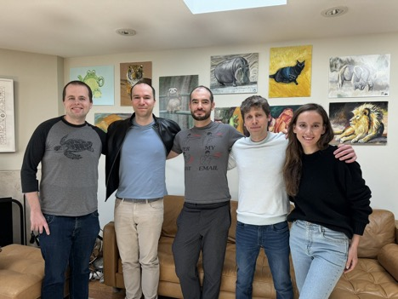



Ilya Sutskever is leaving OpenAI
Ilya Sutskever is leaving OpenAI.
https://twitter.com/ilyasut/status/1790517455628198322
Ilya is a co-founder and chief scientist.
He helped lead the coup against Sam Altman
He later changed his mind.
His employment status had been ambiguous since the ouster.
Jakub Pachocki, the company's director of research, will be OpenAI's new chief scientist.
-->> Jakub Pachocki, Greg Brockman,
Ilya Sutskever, Sam Altman, Mira Murati
Ilya Sutskever
Jan Leike
Jakub Pachocki
Jan Leike has also resigned. He was a co-lead of the Sutskever’s superalignment group. The news follows months of departures largely coming from OpenAI’s superalignment and safety teams.

Slide 9
When LLM is bigger than memory ...
I used my standard prompt asking to list 10 presidents
on my M1 32GB MacBook Pro
using ollama llama3-70b 4-bit model (~40GB size).
40GB > 32GB, so the model couldn't fit into memory.
It took 1 hour and 20 minutes to generate the answer !!!
The prompt was:
Please make a numbered chronological list of the last ten (10) US presidents in reverse order. The list should start like this: 1. Joe Biden (2021-present); 2. Donald Trump (2017-2021); 3. Barack Obama (2009-2017); the list should contain 10 rows. Important - make a fresh list. Disregard the chat history. Output only the list itself, nothing else. Output each list element on a separate line.
Here is the output and stats:
1.⁠ ⁠Joe Biden (2021-present)
2.⁠ ⁠Donald Trump (2017-2021)
3.⁠ ⁠Barack Obama (2009-2017)
4.⁠ ⁠George W. Bush (2001-2009)
5.⁠ ⁠Bill Clinton (1993-2001)
6.⁠ ⁠George H.W. Bush (1989-1993)
7.⁠ ⁠Ronald Reagan (1981-1989)
8.⁠ ⁠Jimmy Carter (1977-1981)
9.⁠ ⁠Gerald Ford (1974-1977)
10.⁠ ⁠Richard Nixon (1969-1974)
total duration: 1h 21m 35s
load duration: 40s
prompt eval count: 281 token(s)
prompt eval duration: 1m 53s
prompt eval rate: 2.48 tokens/s
eval count: 114 token(s)
eval duration: 1h 19m 2s
eval rate: 0.02 tokens/s

Slide 10
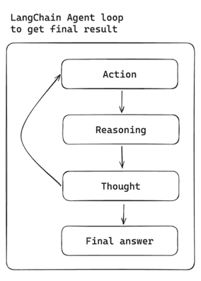


Which model to use for an Agent?
An agent has an internal loop, it can iterate, adjusting the approach.
Agent can send internal messages, using LLM and functions (tools).
You can also create a multi-agent solutions, where agents send the messages to each other. And can get into loops as well.
The model in agent has to be good. And it should be good at function calling. You should NOT use gpt-3.5-turbo, or mistral-7b, or llama3-8b. Because if you do, the agents may be making errors and getting into never-resolving loops.
Remember how a year ago you would ask ChatGPT to write code. You would try to run it - it crushed. you ask the model to fix it. Over and over again. The model couldn't figure things out and get out of this loop.
Today we have much better models. You should try to use the best LLM you can afford. Do NOT use GPT-3.5. Use GPT-4 or GPT-4o (especially with LangChain)
LangChain framework started in October of 2022 with the release of OpenAI GPT-3. it is by far the most popular framework, and well tested with OpenAI models
Some other options - LlamaIndex from Meta/Facebook, CrewAI, AutoGen
GPT-3.5
GPT-4

Slide 11
Berkeley Function-Calling Leaderboard
https://gorilla.cs.berkeley.edu/leaderboard.html
Rank 🔼 | Overall Acc | Model | Cost ($) | Mean | SD
1 | 87 | GPT-4-0125-Preview (Prompt) | 5.25 | 1.97 | 1.31
2 | 86.47 | Claude-3-Opus-20240229 (Prompt) | 10.84 | 4.61 | 1.53
3 | 84.35 | GPT-4-1106-Preview (FC) | 5.07 | 5.97 | 6.31
4 | 84.24 | GPT-4-turbo-2024-04-09 (Prompt) | 5.25 | 2.57 | 2.2
5 | 83.29 | Gorilla-OpenFunctions-v2 (FC) | 0.31 | 0.05 | N/A
6 | 83.12 | GPT-4-0125-Preview (FC) | 4.83 | 4.72 | 5.76
7 | 82.12 | Meta-Llama-3-70B-Instruct (Prompt) | 1.1 | 0.18 | N/A
8 | 81.24 | GPT-4-turbo-2024-04-09 (FC) | 4.78 | 5.48 | 6.37
9 | 81.06 | Claude-3-Sonnet-20240229 (Prompt) | 2.13 | 1.95 | 1.16
10 | 80.24 | Mistral-Medium-2312 (Prompt) | 1.76 | 2.75 | 2.15
11 | 79.06 | Command-R-Plus (Prompt) (Optimized) | 1.9 | 1.27 | 0.93
12 | 79 | Command-R-Plus (Prompt) (Original) | 1.9 | 1.32 | 0.94
13 | 79 | Functionary-Medium-v2.4 (FC) | N/A | 2.49 | 2.69
14 | 78.47 | Functionary-Small-v2.4 (FC) | N/A | 2.43 | 2.55
15 | 78.12 | Command-R-Plus (FC) (Optimized) | 1.06 | 1.9 | 1.34
16 | 76.47 | Claude-3-Opus-20240229 (FC tools-2024-04-04) | 30.87 | 12.92 | 3.95
17 | 75.24 | Claude-instant-1.2 (Prompt) | 0.95 | 1.21 | 0.69
18 | 73.29 | Claude-3-Haiku-20240307 (Prompt) | 0.18 | 1 | 0.49
19 | 70.29 | Claude-2.1 (Prompt) | 6.61 | 3.27 | 2.13
20 | 69.47 | Command-R-Plus (FC) (Original) | 1.07 | 1.9 | 0.99
21 | 67.59 | Mistral-large-2402 (FC Auto) | 4.95 | 3.02 | 2.94
22 | 64.88 | DBRX-Instruct (Prompt) | 1.25 | 0.64 | 0.41
GPT-4 & Claude3-Opus are on top
Llama3-70b is good (on 7th place)
GPT-3.5 is on 25th place,
Llama3-8b is on 28th place

Slide 12
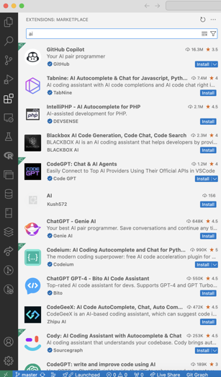





Coding Assistants
tabnine - local or remote LLMs
https://www.tabnine.com
Codeium (formerly Cody) - local or remote LLMs
https://codeium.com
GitHub Copilot
https://github.com/features/copilot
Snyk Code (code security)
https://snyk.io/product/snyk-code/
Cursor - https://cursor.sh - AI-first editor, a fork of VS Code, uses OpenAI models.
One-click migration from VSCode
Cursor is essentially VSCode enhanced with AI capabilities to boost productivity and improve the coding experience

Slide 13
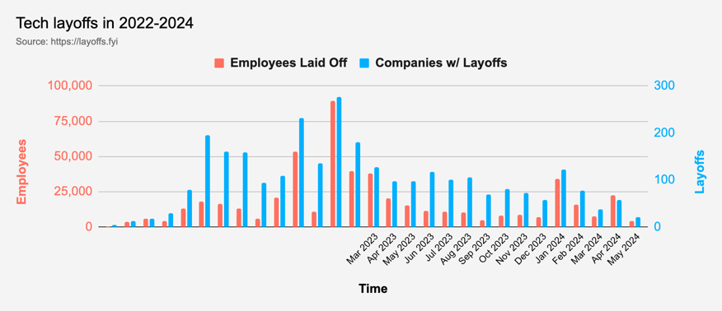
Tech Layoffs were lower than in 2023
Layoffs - https://layoffs.fyi
Salaries for AI engineers rose 12% from the third to fourth quarter last year
The average salary for a senior AI engineer nationally is more than $190,000, according to Comprehensive.io.
AI has a talent shortage, meaning $1 Mln salary job offers! Even during tech layoffs

Slide 14


About the Speaker
Lev Selector, Ph.D.
40+ years of software engineering, data science, and building teams (hiring, training, and managing)
Ph.D. in mathematical modeling and computer simulations
Interests:
Generative AI, Using LLM with your data
Local AI for Local Private Data
Cloud architecture, fin-tech, application security
Find/connect: Linkedin, GitHub, YouTube, Google
https://eais.ai
Enterprise AI Systems

Slide 15
Thank You!

