Slide 1
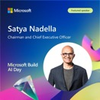


AI Updates
May 24, 2024
Microsoft Build
TinyBox
Memorial Day
AI at Microsoft Build 2024
LM Studio, Server, lms CLI
LM Studio from Python
Streaming chat: LM Studio Server from Python
Create Ollama models
Smaug-Llama-3-70B
NVIDIA Growth
TinyBox / TinyGrad - AMD or NVIDIA
Try ChatGPT-4o
Benchmarks running Llama3
Qualcomm Snapdragon X Elite
Hanna Berji - selection of AI apps
Google Firebase Genkit - AI apps
Grant Sanderson (3Blue1Brown) Great Speech
OpenAI and News Corp
Axolotl fine-tuning
Bland.AI - calling apps at scale
Microsoft Phi-3-Medium-128K-Instruct
Scarlett Johansson vs. OpenAI
Apple partnering with OpenAI
Meta's Chameleon "Early-fusion" model
Fine-Tuning LLMs Encourage Hallucinations?
Cognition Devin on Azure
Eric Schmidt - powerful AI on military bases
Crowd-sourced "Arena" Leaderboard
Tech Layoffs were lower than in 2023

Slide 2
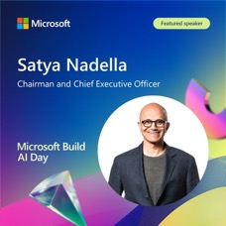

AI at Microsoft Build 2024
Microsoft Build is an annual developer conference. May 21-23, 2024, Seattle
This event is all about AI integration and AI enabling.
Copilot - personal assistant for Microsoft 365 and Teams users. Chatbot, agenda management, note-taking, chat moderation, contextual question-answering. You can assign tasks to Copilot. Custom copilots and agents - later in 2024.
AI laptops (Copilot+ PCs) - after june 18th. On-device AI. Surface Pro (tablet+keyboard), Surface Laptop, ASUS, Dell, Samsung, Acer, Lenovo, HP, ... Chips from Intel, Qualcomm (Snapdragon), AMD. Comparable with MacBook Air M3.
Phi-3-Silica model - optimized for Neural Processing Units in Copilot+ PCs.
Recall - remembers what you were doing (AI-powered photographic memory). Privacy?
Windows Semantic Index tool - used for Recall.
Cocreator tool - works with Adobe Photoshop, DaVinci Resolve, CapCut, etc.
Phi-3-vision 4.2b model in preview. Visual reasoning. 28K context. Can transcribe text from images, describe tables and graphs.
Snapdragon Dev Kit from Qualcomm (small computer like Mac Mini)
Microsoft File Explorer integration with Git
Microsoft’s partnerships with OpenAI, Meta, Hugging Face, Khan Academy, ...
Snapdragon Dev Kit from Qualicomm
SoC – Snapdragon X Elite (X1E-00-1DE) (CPU + GPU + NPU)
32GB System Memory, 512GB SSD
HDMI port, 3 x USB4-C ports, 2x USB 3.2 Gen 2 Type-A ports, 3.5mm audio jack, Ethernet RJ45 port, Power button, WiFi & Bluetooth,
size (mm): 199 x 175 x 35 mm, Weight – 970 grams, price $900

Slide 3
LM Studio, server, lms CLI - run models locally
You can now start and use LM Studio server from terminal or python. "lms" CLI is added for admin tasks. Start by downloading and installing LM Studio app on your computer - https://lmstudio.ai
Then follow these instructions to bootstrap and run the lms application in Terminal - https://lmstudio.ai/blog/lms or https://github.com/lmstudio-ai/lms
Here are docs on how to start and use the server: https://lmstudio.ai/docs/local-server
# Mac / Linux:
~/.cache/lm-studio/bin/lms bootstrap
# lms uses lmstudio.js to interact with LM Studio.
# In new terminal:
lms --help
lms status
lms server start # stop, status
lms ls # List all downloaded models
lms ps # List all loaded models
lms load mymodel # Load a model
lms unload mymodel
lms unload --all
lms create # new project
lms log stream
lms version
lms bootstrap
Example asking question from CMD:
curl http://localhost:1234/v1/chat/completions \
-H "Content-Type: application/json" \
-d '{
"messages": [
{ "role": "system",
"content": "You are a helpful coding assistant." },
{ "role": "user",
"content": "Whys is the sky blue?" }
],
"temperature": 0.7,
"max_tokens": -1,
"stream": true
}'
The response is a series of JSON messages containing individual words / tokens:
data: {"id":"chatcmpl-us3308g6gahcu0wo1j0xm", "object":"chat.completion.chunk", "created":1716417847, "model":"PrunaAI/abacusai-Llama-3-Smaug-8B-GGUF-smashed/Llama-3-Smaug-8B.Q8_0.gguf:2", "choices":[{"index":0,"delta":{"role":"assistant", "content":"To"}, "finish_reason":null}]}
data: {"id":"chatcmpl-us3308g6gahcu0wo1j0xm", "object":"chat.completion.chunk", "created":1716417847, "model":"PrunaAI/abacusai-Llama-3-Smaug-8B-GGUF-smashed/Llama-3-Smaug-8B.Q8_0.gguf:2", "choices":[{"index":0, "delta":{"role":"assistant", "content":" work"},"finish_reason":null}]}

Slide 4
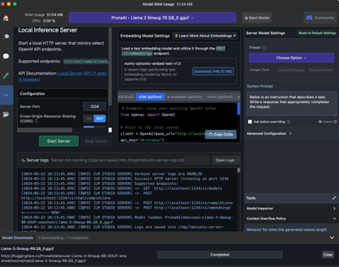
Use LM Studio Server from Python
You can use LLMs via LM Studio Server from Python:
https://www.youtube.com/watch?v=Z-EofFFnOus
The code examples are actually provided right inside LM Studio
# res = subprocess.run(
# ["lms","server", "start"],
# capture_output=True, text=True)
from openai import OpenAI
client = OpenAI(base_url="http://localhost:1234/v1",
api_key="not-needed")
response = client.chat.completions.create(
model = "local_model",
messages = [
{"role": "system",
"content": "You are a helpful assistant."},
{"role": "user",
"content": "why is the sky blue?"},
],
temperature=0.5,
)
print(response.choices[0].message.content)
The response:
The sky appears blue because of a phenomenon called Rayleigh scattering, named after Lord Rayleigh who first described it in the late 19th century. Essentially, when sunlight enters Earth's atmosphere, it encounters tiny molecules of gases such as nitrogen and oxygen. These small molecules scatter shorter (blue) wavelengths much more than longer (red) wavelengths due to their size compared to the wavelength of light. This scattering effect gives the sky its blue color during the daytime. The color can vary depending on atmospheric conditions like pollution or dust, but generally, it's that beautiful shade of blue we see!

Slide 5
Streaming chat using LM Studio Server from Python
lms server start
lms ls
lms load PrunaAI/abacusai-Llama-3-Smaug-8B-GGUF-smashed
from openai import OpenAI
client = OpenAI(base_url="http://localhost:1234/v1",
api_key="not-needed")
response = client.chat.completions.create(
model = "local_model",
messages = [
{"role": "system",
"content": "You are a helpful assistant."},
{"role": "user",
"content": "why is the sky blue?"},
],
temperature=0.5,
stream=True,
)
for chunk in response:
content = chunk.choices[0].delta.content or ""
print(content, end="", flush=True)

Slide 6
Create ollama models from models on HuggingFace
Ollama: How To Create Custom Models From HuggingFace ( GGUF )
https://www.youtube.com/watch?v=TFwYvHZV6j0
https://www.youtube.com/watch?v=7BH4C6-HP14
https://www.youtube.com/watch?v=0ou51l-MLCo
download model from HuggingFace, for example: https://huggingface.co/PrunaAI/abacusai-Llama-3-Smaug-8B-GGUF-smashed/blob/main/Llama-3-Smaug-8B.Q8_0.gguf
Manually create file "Modelfile" using model description templates from HuggingFace model page or running "ollama show" command for a similar model
To see examples of Modelfiles, you can run the ollama show command, for example:
ollama show llama3-gradient --modelfile
To create the model, run this command:
ollama create dragon8b -f Modelfile
That's it!
Run it:
ollama run dragon8b
Modelfile
FROM ./Llama-3-Smaug-8B.Q8_0.gguf
TEMPLATE "{{ if .System }}<|start_header_id|>system<|end_header_id|>
{{ .System }}<|eot_id|>{{ end }}{{ if .Prompt }}<|start_header_id|>user<|end_header_id|>
{{ .Prompt }}<|eot_id|>{{ end }}<|start_header_id|>assistant<|end_header_id|>
{{ .Response }}<|eot_id|>"
PARAMETER stop <|start_header_id|>
PARAMETER stop <|end_header_id|>
PARAMETER stop <|eot_id|>

Slide 7
Mistral 7B Instruct V3
The Mistral-7B-Instruct-v0.3 is an instruct fine-tuned version of the Mistral-7B-v0.3.
It has extended context length (32K) and improved performance.
Supports v3 Tokenizer.
Supports function calling.
https://huggingface.co/mistralai/Mistral-7B-Instruct-v0.3
pip install mistral_inference
mistral-chat $HOME/mistral_models/7B-Instruct-v0.3 --instruct --max_tokens 256
ollama run mistral:7b-instruct-v0.3-q5_K_M

Slide 8

Smaug-Llama-3-70B-Instruct
Abacus.ai Smaug-Llama-3-70B-Instruct
and PrunaAI Abacus Llama3 Smaug 8b
Model is on par with GPT-4
The small 8b model Q8 is amazing
https://www.youtube.com/watch?v=0OvT7kWXWvQ
https://huggingface.co/abacusai/Llama-3-Smaug-8B
https://huggingface.co/abacusai/Smaug-Llama-3-70B-Instruct
https://huggingface.co/PrunaAI/abacusai-Llama-3-Smaug-8B-GGUF-smashed https://huggingface.co/PrunaAI/abacusai-Llama-3-Smaug-8B-GGUF-smashed/tree/main - download https://huggingface.co/PrunaAI/abacusai-Llama-3-Smaug-8B-GGUF-smashed/blob/main/Llama-3-Smaug-8B.Q8_0.gguf
Smaug is a dragon and the main antagonist in J. R. R. Tolkien's 1937 novel The Hobbit, his treasure and the mountain he lives in being the goal of the quest.

Slide 9
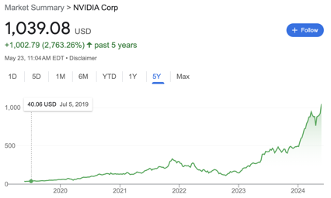
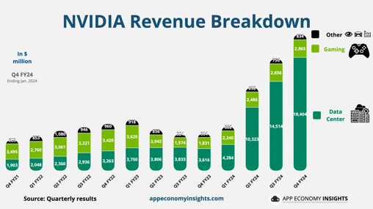
NVIDIA Growth
NVIDIA fiscal year: Feb - Jan
In the fiscal year ending January 28, 2024, NVIDIA had annual revenue of ~ $61B with 125.85% growth. ~ 30,000 employees
Market Cap $2,374 Bln

Slide 10

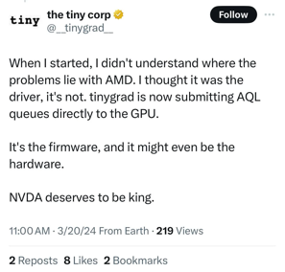
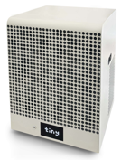
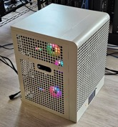
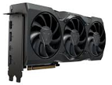
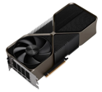
TinyBox / TinyGrad
In 2023 George Hotz was working on creating a tinybox computer.
Estimated Price - $15K
1600W x 2 (two 120V outlets)
Six (6) GPUs (6 x 24GB = 144 GB VRAM total) AMD 7900 XTXs or Nvidia 4090
CPU - AMD EPYC 32 cores
128 GB RAM
738 .. 991 FP16 TFLOPS
https://tinygrad.org
https://www.youtube.com/watch?v=GKRu3Txc0sk - July 2023
George Hotz
Recently (Spring 2024) he is considering switching from AMD to Nvidia 4090.
https://www.reddit.com/r/AMD_Stock/comments/1bjkob4/the_tiny_corp_nvda_deserves_to_be_king/
https://en.wikipedia.org/wiki/George_Hotz
Price options: $15K or $25K
AMD 7900 XTX 24GB
AMD 7900 XTX 24GB

Slide 11
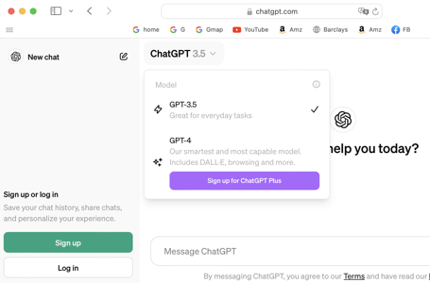
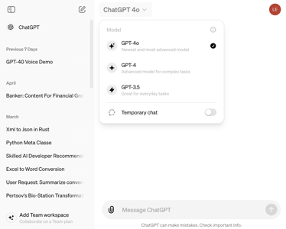
How to Access ChatGPT-4 and ChatGPT-4o
The "o" in GPT-4o stands for "omni" - ability to be "omni-processing" (text, voice, images, video).
https://chatgpt.com = https://chat.openai.com
https://www.youtube.com/watch?v=TFhIVfR1XjM
"4o" is available for free - but limited (approx 8 answers per 3 hours). Tends to time out.
Microsoft Copilot
Microsoft Bing
OpenAI Playground - https://platform.openai.com/playground
Overview - https://platform.openai.com/overview
Merlin (browser extension) - https://www.getmerlin.in/feature/access-gpt-4-for-free

Slide 12
Benchmarks running Llama3
Groq
Model | tok/sec | $/1M tokens (in/out)
Llama 3 70B (8K) | ~300 | $0.59/$0.79
Mixtral 8x7B SMoE (32K) | ~480 | $0.24/$0.24
Llama 3 8B (8K) | ~870 | $0.05/$0.10
Gemma 7B (8K) | ~820 | $0.10/$0.10
Whisper Large V3 | ~140x speed-up | $0.0654 / hour transcribed
Nvidia vs Mac
Model | H100 | A100 | RTX-3090 | dual RTX-3090 | RTX-4090 | 2 x RTX-4090 | Mac M3 128GB
ollama Llama 3 70B | -- | --
ollama Llama 3 8B | -- | --

Slide 13

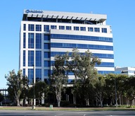
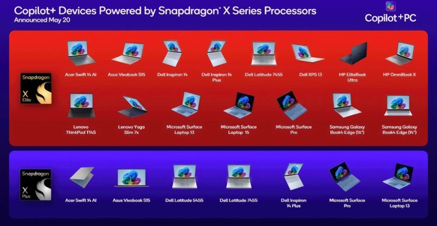

Qualcomm Snapdragon X Elite
Qualcomm Snapdragon - system-on-a-chip (SoC) chips for mobile devices (and for Laptops). Competing with Apple Silicone!
Qualcomm Snapdragon X Elite has:
CPU 12-core
GPU Adreno
NPU (Neural Processing Unit) Hexagon
up to 64 GB of Unified Memory
The X Elite comes in three variants:
X1E-84-100
X1E-80-100
X1E-78-100
Qualcomm Inc. - an American multinational corporation headquartered in San Diego, CA since 1985. It creates semiconductors, software, and services related to wireless technology. - https://en.wikipedia.org/wiki/Qualcomm
New Laptops with Qualcomm Snapdragon X Elite: Microsoft Surface, Lenovo, Dell, Asus, ...

Slide 14

Selection of AI Apps
10 Best Neuro-Network Apps
https://www.youtube.com/watch?v=zmv8k5LXIuQ - in English https://www.youtube.com/watch?v=AxgDdBN-UJA - in Russian
https://noisee.ai - melodies into music videos
https://www.coze.com - create and publish ChatBots
https://piktochart.com - AI maker for infographic, poster, banner
https://mindtrip.ai - plan your travel
https://autoshorts.ai - create videos with avatars
https://goodsnooze.gumroad.com/l/macwhisper - transcribe audio and video to text on Mac at x30 speed
https://huggingface.co/spaces/sanchit-gandhi/whisper-jax - transcribe your voice online
https://ai-icon.top - AI icon generator
https://toolbaz.com - online AI writing tools
https://product.supertone.ai/shift - Real-time Voice Changer
Hanna Berji
San Mateo, CA She is quite amazing.
She has graduated from
Draper University in San Mateo.
And in 2022 she started her company “Zeroweb”.
https://www.youtube.com/@Web3nity
https://twitter.com/web3nity
https://www.linkedin.com/in/hanna-berji-6a8434224/
https://t.me/+dPw_AwlCXA05Mzcy

Slide 15


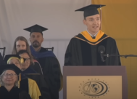

Misc 1
Google Firebase Genkit - a new open-source framework to build, deploy and monitor production-ready AI-powered apps.
https://firebase.google.com/docs/genkit/plugins/ollama
https://firebase.google.com
Google Firebase is a cloud-based platform for developers to build, deploy, and scale web and mobile apps and games.
Mostly Javascript based.
npm i -g genkit
ollama pull gemma
OpenAI and News Corp (which includes WSJ, NYP, The Times, and other publishers) agreed to bring its news content to OpenAI's platform! https://openai.com/index/news-corp-and-openai-sign-landmark-multi-year-global-partnership/
Axolotl - a go-to tool for fine-tuning AI models like Llama and Mistral, with Docker setups making it easy to use.
Supports full finetune, lora, qlora, relora, gptq.
https://github.com/OpenAccess-AI-Collective/axolotl
Bland.AI - building AI phone calling apps at scale. Can handle Million phone calls simultaneously - https://www.bland.ai
Microsoft Phi-3-Medium-128K-Instruct - context length 128K, performs on par with Command R 104B https://huggingface.co/microsoft/Phi-3-medium-128k-instruct
Grant Sanderson. Great Speech. 3Blue1Brown
https://www.youtube.com/watch?v=W3I3kAg2J7w
Scarlett Johansson vs. OpenAI
OpenAI showcased a new voice for ChatGPT called "Sky".
Many people, including Scarlett Johansson, found this voice similar to voice of Johansson's AI character in the movie "Her."
Johansson, who had previously declined to voice ChatGPT, hired legal counsel and demanded an explanation from OpenAI.
In response, OpenAI paused Sky's use and clarified that Sky's voice belonged to a different actress.

Slide 16
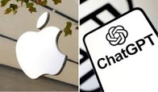
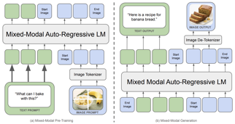

Misc 2
Apple is shifting from its device-based processing to integrating cloud-based AI services, using high-end Mac chips in its data centers.
Apple partnering with OpenAI to integrate it into iOS 18.
https://arxiv.org/abs/2405.05904
Does Fine-Tuning LLMs on New Knowledge Encourage Hallucinations? (Technion - Israel Institute of Technology Google Research)
https://x.com/omarsar0/status/1793292346978623812
LLMs struggle to acquire factual knowledge through fine-tuning.
When examples with new knowledge are eventually learned they linearly increase the LLM's tendency to hallucinate.
Cognition Devin (software agent) will be powered by Azure - new Microsoft and Cognition partnership.
Ex-Google CEO Eric Schmidt predicts that the most powerful AI systems will be housed on military bases in the US and China, protected by armed guards, due to their potential to absorb knowledge at an unprecedented rate and collaborate autonomously. https://nypost.com/2024/05/23/business/ex-google-ceo-eric-schmidt-predicts-ai-data-centers-will-be-on-military-bases/
Meta's Chameleon - an "Early-fusion" model.
The model from the start learns from an interwoven combination of images, code, text and other inputs. Similar to Gemini.
https://arxiv.org/abs/2405.09818v1

Slide 17
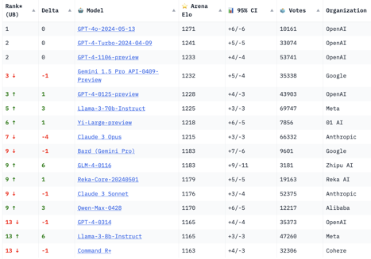
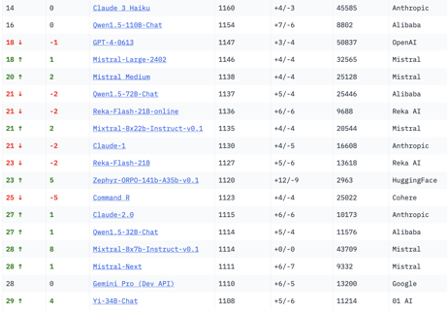
Crowd-sourced "Arena" Leaderboard
Total #models: 99.
Total #votes: 1,170,955.
Last updated: 2024-05-20.
Starting Elo rating = 1000
95% CI = Confidence Interval
https://chat.lmsys.org/?leaderboard
English-only queries

Slide 18
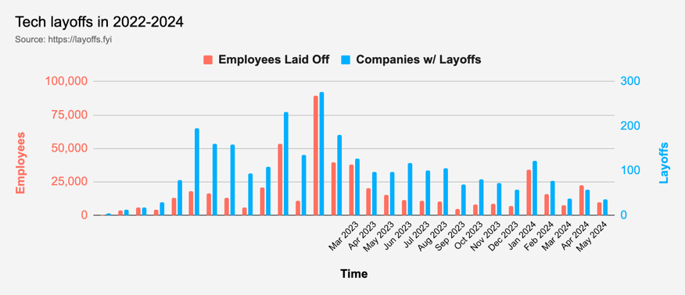
Tech Layoffs were lower than in 2023
Layoffs - https://layoffs.fyi
Salaries for AI engineers rose 12% from the third to fourth quarter last year
The average salary for a senior AI engineer nationally is more than $190,000, according to Comprehensive.io.
AI has a talent shortage, meaning $1 Mln salary job offers! Even during tech layoffs

Slide 19
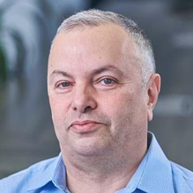

About the Speaker
Lev Selector, Ph.D.
40+ years of software engineering, data science, and building teams (hiring, training, and managing)
Ph.D. in mathematical modeling and computer simulations
Interests:
Generative AI, Using LLM with your data
Local AI for Local Private Data
Cloud architecture, fin-tech, application security
Find/connect: Linkedin, GitHub, YouTube, Google
https://eais.ai
Enterprise AI Systems

Slide 20
Thank You!

