Slide 1
AI Updates
June 07, 2024
Nvidia - Jensen Huang - COMPUTEX 2024
(Local) Models with Long Context
Gemma 2B with 10M context
Amazon’s Project PI (Private Investigator)
Asana AI Teammates
Andrew Ng - fact checking agents
Yann LeCun - Advanced Machine Intelligence
Grok: Socrates & DEI modes
OpenAI - GPT-4o available via API
Google AI Overviews
Meta's NLLB (No Language Left Behind) Model
AI Agents in LangGraph - Andrew Ng course
Thought-Augmented Reasoning with LLMs
Scalable MatMul-free Language Modeling
Claude tools
Milvus Lite
DSPy instead of Prompt Engineering
Right to Warn
Qwen2 from Alibaba
Automated Knowledge Graph Built with LLMs
Architectures in Agentic Systems
Crowd-sourced "Arena" Leaderboard
Tech Layoffs were lower than in 2023

Slide 2
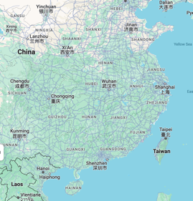
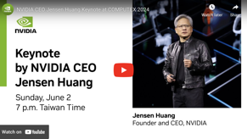

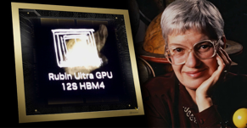
Nvidia - Jensen Huang
COMPUTEX 2024, Taiwan, June 4–7
GeForce RTX - A Gamer's GPU now used for AI.
RTX stands for Ray Tracing Texel eXtreme - real-time ray tracing for realistic lighting, reflections, and shadows.
Project G-Assist AI Assistant - context-aware help for PC games and apps.
NVIDIA ACE (Avatar Cloud Engine) - generative AI microservices in the cloud for "digital humans" - customer service, gaming, healthcare, ...
NVIDIA NIM (Neural Inference Microservices) is a set of optimized inference microservices
SFF (Small Form Factor) PCs
Gaming - Star Wars™ Outlaws Adds DLSS 3.5, ComfyUI Acceleration
https://www.youtube.com/watch?v=pKXDVsWZmUU
Jensen Huang Net Worth ~ $106 Bln
Vera Rubin platform (2026):
Vera CPU + Rubin GPU
Vera Florence Cooper Rubin (1928–2016) was an American astronomer
https://www.nvidia.com/en-us/events/computex/
Nvidia’s market cap surpassed Apple:
Microsoft - $3.16 trillion
Nvidia - $3.012
Apple - $3.003
Amazon - $1.93
Google - $2.18

Slide 3
(Local) Models with Long Context
Context Length = input + output
x
x
Local models with long context
https://www.reddit.com/r/LocalLLaMA/comments/1bk8bga/best_open_source_llm_for_large_context_length/
https://www.reddit.com/r/LocalLLaMA/comments/1d21o5b/are_there_any_long_context_open_source_models/
Mistral-7B-v0. 1 has 32k context (ollama run mistral)
Gemma 2B with 10M context (make model for ollama)
Nous-Capybara-34b - 200K (up to 40K green)
Yi-34b for 100K
C4AI Command-R - 128K - https://huggingface.co/CohereForAI/c4ai-command-r-v01
Faro Yi 9B DPO - 200K (quantized at 8bpw). It's "smart" enough to understand even a full 200K context, and it all fits in around 16GB VRAM at 200K: https://huggingface.co/wenbopan/Faro-Yi-9B-DPO
Beta-35B
Llama3-instruct-gradient - (crushes) https://huggingface.co/gradientai/Llama-3-8B-Instruct-Gradient-1048k
x
x
x
x
x
x
x
x
x
x
x
x
x
x
x
x
x
x
x
x
x
x
x
x
x
x
x
x
x
x
Comparison of Models:
https://artificialanalysis.ai/models
x
x
Input
Output
Model | In (KT) | Out (KT)
gpt-4o | 128k | 4k
gpt-4 | 8k | 8k
gpt-4-Turbo | 128k | 4k
gpt-4-32k | 32k | 32k
Claude3 (Opus, Sonnet, Haiku) | 200k | 4k
Gemini 1.5 Pro | 1,000K | 8k
gpt-3.5-turbo-16k | 16k | 16k
gpt-3.5-turbo | 16k | 4k
Llama3-8b & 70b | 8k | remaining
Mistral-7B-v0.3 | 32k (was 8k) | 8k
Mixtral-8x7B | 32
Mixtral-8x22B | 64
Qwen2 (Alibaba) | 130
gemma-2B-10M | 10,000K
Codestral-22B | 32K
A lot of the inspiration for our ideas comes from the Transformer-XL paper.
https://twitter.com/rohanpaul_ai/status/1796137219712754118
https://github.com/mustafaaljadery/gemma-2B-10M

Slide 4
Misc 1
Andrew Ng
A barrier to faster progress in generative AI is evaluations (evals).
Would adding a fact-checking agent improve the results?
https://twitter.com/AndrewYNg/status/1796206876805489105
https://www.deeplearning.ai/the-batch/issue-251/
Gemma 2B with 10M context runs in less than 32GB memory
The largest bottleneck (in terms of memory) for LLMs is the KV cache. It grows quadratically in multi-head attention
The "InfiniAttention" splits the attention in local attention blocks. Those local attention blocks are taken and apply recurrence to the local attention blocks for the final result of 10M context global attention.
A lot of the inspiration for our ideas comes from the Transformer-XL paper.
https://twitter.com/rohanpaul_ai/status/1796137219712754118
https://github.com/mustafaaljadery/gemma-2B-10M
Yann LeCun
What I and many (most) people at FAIR have working is no mystery. We call it AMI (Advanced Machine Intelligence). Objective-Driven AI, JEPA, world models, planning/reasoning is part of that. - https://twitter.com/ylecun/status/1794249923329720415
Xai (owned by Elon Musk) is working on new modes for its chatbot Grok: Socrates & DEI (Diversity Equity and Inclusion).
Amazon’s Project PI (Private Investigator) - AI + computer vision.
It is used to flag damaged products before shipping.
OpenAI - GPT-4o available via API
Google AI Overviews = AI-generated answers - are now appearing in around 11% of queries (down from around 27% when the feature was launched last month.
AI is creating a golden age for scammers - with deepfakes and genAI, scams are more difficult to recognize.
Asana AI Teammates - https://asana.com
Asana is a project management software, similar to Jira. https://sousabrothers.medium.com/asana-unveils-ai-teammates-to-collaborate-with-employees-at-work-af702cbd32f2
Meta's NLLB (No Language Left Behind) Model
published in Nature,
high-quality translations between 200 languages
AI Agents in LangGraph - Andrew Ng course
https://learn.deeplearning.ai/courses/ai-agents-in-langgraph/lesson/1/introduction

Slide 5
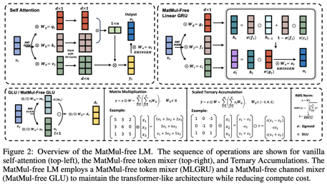
Misc 2
Thought-Augmented Reasoning with LLMs
Buffer of Thoughts - containing high-level thoughts distilled from problem-solving processes. Using this buffer enhances the accuracy, efficiency, and robustness of LLM-based reasoning.
It demonstrates SOTA performance on 10 challenging tasks while requiring 12% of the cost of multi-query prompting methods like Tree-of-Thoughts.
https://twitter.com/omarsar0/status/1799113545696567416
https://arxiv.org/abs/2406.04271
Claude can now use tools
https://www.anthropic.com/news/tool-use-ga
Scalable MatMul-free Language Modeling
https://arxiv.org/abs/2406.02528
MatMul (Matrix Multiplication) operations can be completely eliminated from LLMs while maintaining strong performance
MatMul-free models achieve performance on-par with state-of-the-art Transformers
We provide a GPU-efficient implementation of this model which reduces memory usage
A custom hardware solution on an FPGA used to process billion-parameter scale models at 13W beyond human readable throughput, moving LLMs closer to brain-like efficiency

Slide 6
Milvus Lite - Easy to Use Local Vector DB
DSPy: Prompt Engineering Is Dead
Milvus Lite
https://milvus.io/docs/milvus_lite.md
# pip install "pymilvus>=2.4.2"
from pymilvus import MilvusClient
client = MilvusClient("mydb_file.db")
Till a few months ago, Prompt Engineering was all the hype. The entire job market was filled with the role of prompt engineers, but not so anymore.
People even wrote books/blogs like the Top 50 prompts to get the best of GPT, so on and so forth.
But large-scale experiments have clearly shown that there is no single prompt or strategy that works for all kinds of problems, it’s just some prompts appear to be better in isolation but are a hit-and-miss when analyzed comprehensively.
DSPy (Declarative Self-Improving Pipelines) is a framework developed by Stanford University that aims to simplify and streamline the process of building language model (LLM) pipelines.
https://medium.com/aiguys/prompt-engineering-is-dead-dspy-is-new-paradigm-for-prompting-c80ba3fc4896
DSPy - express LLM tasks in a high-level, declarative manner, similar to PyTorch.
Self-Improving Pipelines - automatically optimize LLM calls over time
Modularity - LLMs are treated as modules
Easy to use, Pythonic syntax and intuitive APIs.
import dspy
turbo = dspy.OpenAI(model='gpt-3.5-turbo')
colbertv2_wiki17_abstracts = dspy.ColBERTv2(url='http://somedomain/wiki17_abstracts')
dspy.settings.configure(lm=turbo, rm=colbertv2_wiki17_abstracts)
# ...

Slide 7

Right to Warn
Qwen2
AI researchers demand "Right to Warn"
Current and former employees from top AI labs, including OpenAI, Anthropic, and DeepMind just published an open letter
This letter was also supported by Yoshua Bengio, Geoffrey Hinton, and Stuart Russell
They push AI companies to provide whistleblower protection so that workers can warn about potential AI dangers without fear of retaliation.
Eliminating non-disparagement clauses concerning AI risk
Establishing and facilitating anonymous channels for raising concerns
Expanding whistleblower protections and anti-retaliation measures
Qwen2 from Alibaba Cloud
5 sizes (0.5B, 1.5B, 7B, 57B-14B MoE, 72B)
Base & Instruct versions
Open source (Apache 2.0) except 72B.
Models are multilingual in 29 languages
https://github.com/QwenLM/Qwen2
https://huggingface.co/spaces/Qwen/Qwen2-72B-Instruct
https://qwenlm.github.io/blog/qwen2/
https://ollama.com/library/qwen2
Models achieve SOTA performance on academic and chat benchmarks
Qwen2-72B: MMLU 82.3, IFEval 77.6, MT-Bench 9.12, HumanEval 86.0
Qwen2-7B: MMLU 70.5, MT-Bench 8.41, HumanEval 79.9.
On MMLU-PRO, Qwen2 scored 64.4, outperforming Llama 3's 56.2.

Slide 8
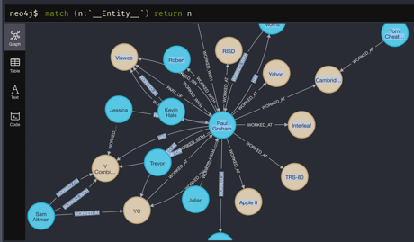
Automated Knowledge Graph Construction with LLMs
Automating knowledge graph construction with LLMs
Knowledge graphs are networks that represent data in a graphical format. Difficulties of constructing them include the time and cost, as well as the fact that different graphs are needed for different domains.
LLMs can be used to extract knowledge from text.
Researchers are exploring ways to combine LLMs and knowledge graphs. This could improve the accuracy of both knowledge graphs and LLMs.
https://medium.com/@researchgraph/automated-knowledge-graph-construction-with-large-language-models-150512d1bc22
LlamaIndex - Property Graph Index: A Powerful New Way to Build Knowledge Graphs with LLMs
https://www.llamaindex.ai/blog/introducing-the-property-graph-index-a-powerful-new-way-to-build-knowledge-graphs-with-llms
from llama_index.indices.property_graph \
import SchemaLLMPathExtractor
entities = Literal["PERSON", "PLACE", "THING"]
relations = Literal["PART_OF", "HAS", "IS_A"]
schema = {"PERSON": ["PART_OF", "HAS", "IS_A"],
"PLACE": ["PART_OF", "HAS"],
"THING": ["IS_A"]}
kg_extractor = SchemaLLMPathExtractor(
llm=llm,
possible_entities=entities,
possible_relations=relations,
kg_validation_schema=schema,
strict=True)

Slide 9
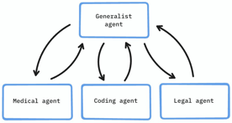

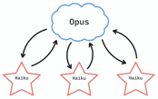
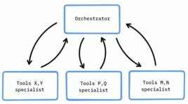
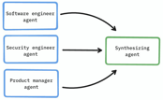
Architectures in Agentic Systems
Specialization: A generalist agent orchestrates, while specialists execute tasks.
Architectures in Agentic Systems https://x.com/alexalbert__/status/1796211969432887331
Delegation: Use cheaper, faster models for cost and speed gains. Example: Opus delegates to Haiku.
Parallelization: Cut latency (but not cost) by running agents in parallel.
Tool Suite Experts: When using 100s or 1000s of tools, specialize agents in tool subsets.
Debate: Multiple agents with different roles engage in discussion to reach better decisions. Example - software engineer, security engineer, product manager, final agent

Slide 10
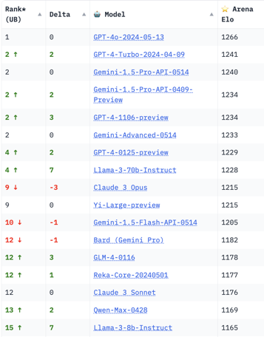
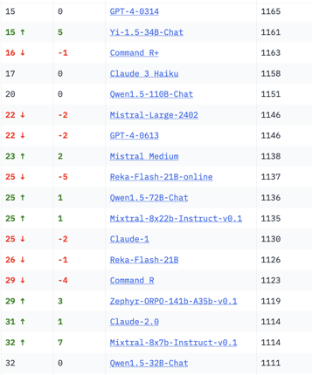
Crowd-sourced "Arena" Leaderboard
Total #models: 105
Total #votes: 1,205,934
Last updated: 2024-06-02
Starting Elo rating = 1000
95% CI = Confidence Interval
https://chat.lmsys.org/?leaderboard
English-only queries

Slide 11
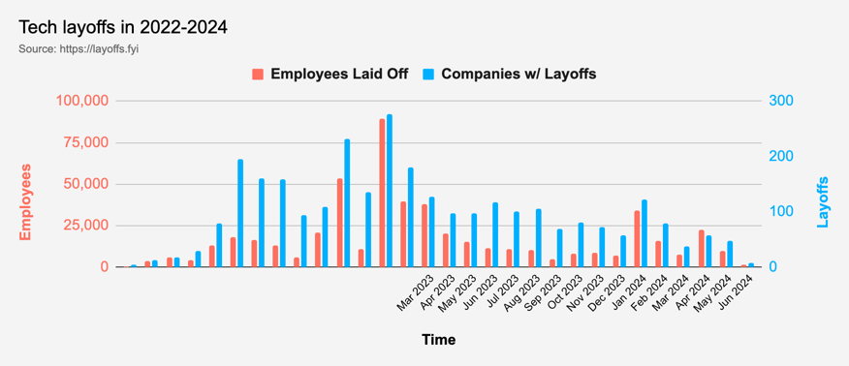
Tech Layoffs were lower than in 2023
Layoffs - https://layoffs.fyi
Salaries for AI engineers rose 12% from the third to fourth quarter last year
The average salary for a senior AI engineer nationally is more than $190,000, according to Comprehensive.io.
AI has a talent shortage, meaning $1 Mln salary job offers! Even during tech layoffs

Slide 12
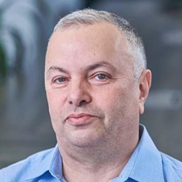

About the Speaker
Lev Selector, Ph.D.
40+ years of software engineering, data science, and building teams (hiring, training, and managing)
Ph.D. in mathematical modeling and computer simulations
Interests:
Generative AI, Using LLM with your data
Local AI for Local Private Data
Cloud architecture, fin-tech, application security
Find/connect: Linkedin, GitHub, YouTube, Google
https://eais.ai
Enterprise AI Systems

Slide 13
Thank You!

