Slide 1
AI Updates
June 14, 2024
AI = Apple Intelligence
Elon Musk - X is now #1 News App
Yann LeCun - beginning of sigmoid looks like exp
Arc - AI-first browser
LLMs - Base Text vs Instruct vs Chat
prompt = system + human + history
OpenAI annual revenue ~$3.4B
Meta scaling to 600,000 GPUs
Microsoft invested $1.5 Bln into G42
OpenAI added a General to its Board
Google DeepMind solving nuclear fusion
Magnific AI - Image Upscaling
Sacana.ai - Tuning Preference Optimization
Elon Musk dropped lawsuit against OpenAI
Samsung - new chips
AI Steve is running for U.K. Parliament
Luma Dream Machine
Stable Diffusion 3 - open weights
Combining LLMs through MoA
An Empirical Study of Mamba-based LMs
Mistral $600+ Mln funding
Crowd-sourced "Arena" Leaderboard
Tech Layoffs were lower than in 2023

Slide 2


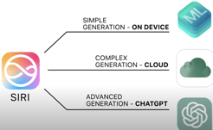
Apple Intelligence
Apple WWDC 2024: June 10-14
WWDC = Worldwide Developers Conference
Apple Intelligence - Coming in beta this Fall - Siri, context sensitivity, ... (similar to MS Windows AI)
https://www.apple.com/apple-intelligence/
Siri Upgrades - natural conversation, remember context across requests, and accomplish more complex tasks by better understanding both voice and text. "onscreen awareness".
New AI writing tools built into apps like Mail, Messages, and Notes will allow users to auto-generate and edit text.
Mail will utilize AI to better organize and surface content in inboxes
Notes and Phone gain new audio transcription and summarization capabilities.
AI-crafted "Genmojis" enable personalized text-to-image emojis, and a new "Image Playground" feature introduces an image generation tool from prompts.
Photos - conversational search, ability to create photo "stories", and new editing tools.
Privacy - on-device processing when possible, Private Cloud Compute (PCC) for more complex tasks.
AI
Artificial Intelligence
Apple announced that it is integrating OpenAI ChatGPT into a variety of native experiences on iOS devices. It plans to eventually expand to use voice and other capabilities.
Elon Musk just threatened to ban the use of all Apple devices from his companies. He says that the integration of ChatGPT into operating systems poses an "unacceptable security violation". He called it "creepy spyware" that can’t ensure data protection.
The Tesla, SpaceX, and xAI will require company’s visitors to check Apple devices at the door and store them in a "Faraday cage".

Slide 3
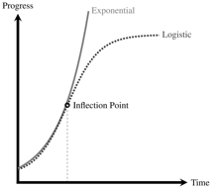
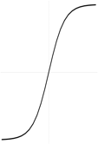


Misc1
Elon Musk - X is now #1 News App in 143 countries Worldwide (App Store)
Billionaire Peter Thiel says that AI boom will make society
favor people with strong verbal skills, not math skills
Yann LeCun - The beginning of a sigmoid looks like an exponential. - https://twitter.com/ylecun/status/1799064075487572133
No physical process can grow indefinitely. There are always friction terms in the dynamics equation that eventually become dominant. Even processes that *appear* exponential on a long time scale are actually a succession of sigmoids, in which each new sigmoid is caused by a paradigm shift.
A good example is Moore's Law. It is saturating right now. But the exponential progress of the last 7 decades is due to a succession of technological paradigm shifts that weren't pre-ordained.
Each paradigm behaved like a sigmoid. Each new sigmoid overtook the previous one. The envelope turned out to be exponential.
We haven't seen similar paradigm shifts in, say, airplane speed or space travel. Technological paradigm shifts require scientific breakthroughs.

Slide 4

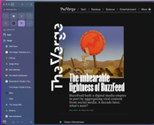
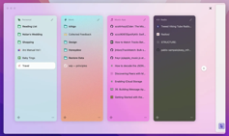


Arc Browser
Arc - an AI-first browser
For Mac, iOS, Windows 11
The Browser Company, Brooklyn, New York
Founders: Josh Miller & Hursh Agrawal, 2019
Raised $550M from top investors such as LinkedIn’s Jeff Weiner and Figma’s Dylan Field
https://arc.net
https://thebrowser.company
https://www.youtube.com/watch?v=ldf5Q-nkBZU
https://en.wikipedia.org/wiki/Arc_(web_browser)
Arc has a sidebar: search bar (called command bar), tab list, bookmarks, audio control. Works with video call software
Command Bar is similar to Apple's Spotlight - searching for websites.
You can pin tabs to side bar, duplicate tabs, access history, use optional ad blocker.
You can organize tabs into "spaces". Tabs in spaces can be put in a split-screen view with up to four tabs per window.
"easel" function - collect webpage screenshots and URLs, type and draw, share and post online.
Easy integration with Google docs and gmail
"Boost" feature - improved "extensions".
Arc's "Air Traffic Control" feature lets users select which space a specific link will be opened at.[23] Users can create what's called a "route" that defines which space the link will be opened when the link is opened from an external source. The "Air Traffic Control" feature can be accessed and modified from the Arc settings > Links > Air Traffic Control.
AI "Instant Links" - AI-search.
"Live Folders" - automatically being updated.
"Arc Explore" - desktop version of Arc Search
Josh MIller
Hursh Agrawal

Slide 5
Base Text vs Instruct vs Chat
Base Text LLMs - predicting next word in a sequence. They are not specifically designed for following instructions or engaging in conversations.
Instruct LLMs - trained on pairs (instruction, output). They better understand and follow instructions. Good at creating specific output format or structure, such as generating summaries, translating text, writing code, calling functions. They are generally more reliable and controllable than base text LLMs.
( instruction , output )
( question , answer )
User: I'm looking for a good Italian restaurant nearby.
Assistant: What kind of food are you in the mood for?
User: Something with pasta.
Assistant: How about Trattoria Romana? They have excellent pasta dishes.
User: That sounds great! What's their address?
Assistant: Their address is 123 Main Street.
Chat LLMs - designed for conversations with humans. Trained on dialogues and are fine-tuned to generate responses that are relevant, coherent, and engaging. Chat LLMs are often used in chatbots, virtual assistants, and other applications where natural language interaction is required. They are typically more conversational and empathetic than instruct LLMs.

Slide 6
prompt = system message + human message + history
prompt = system message + human message
System Message (role) - an initial instructions for the LLM. It sets the tone, behavior, and boundaries for the conversation. It works behind the scenes to guide the LLM's responses.
Example:
you are a helpful assistant, tutor, translator ...
you always respond in a specific language
System message is typically written by the developer or administrator. And it is not directly visible to the human user.
Human message is the input provided by the user during the conversation.
from langchain.prompts import (ChatPromptTemplate,
SystemMessagePromptTemplate,HumanMessagePromptTemplate)
from langchain.chat_models import ChatOpenAI
# Define templates for system and human messages
system_message_prompt = SystemMessagePromptTemplate.from_template(
"You are a helpful and informative AI assistant.")
human_message_prompt = HumanMessagePromptTemplate.from_template(
"What is the capital of France?")
# Combine the templates into a ChatPromptTemplate
chat_prompt_template = ChatPromptTemplate.from_messages(
[system_message_prompt, human_message_prompt])
# Format the prompt for the model
chat = ChatOpenAI() # or any other LLM from LangChain
chain = chat_prompt_template.format_prompt()
print(chain.to_string())

Slide 7



Misc 2
OpenAI annual revenue ~$3.4B, more than doubled!
Magnific AI
https://magnific.ai - image ujpscaling using AI
Meta is upgrading its data centers scaling to 600,000 GPUs for AI training jobs.
Microsoft is partnering with AI startups and building an in-house AI team led by Mustafa Suleyman. Microsoft is aiming to create internal AI capabilities rivaling OpenAI.
Microsoft made $1.5 Bln investment in G42.
Group 42 Holding Ltd, since 2018, 22,000 employees, based in Abu Dhabi, UAE. It performs AI research and development processes on big data, AI, and ML via its subsidiary, the Inception Institute of Artificial Intelligence (IIAI).
OpenAI is adding former NSA head and retired General Paul Nakasone to its board of directors and its Safety and Security Committee.
Ian Goodfellow: https://twitter.com/goodfellow_ian/status/1800902333716730181
Announcing TORAX, an open source simulator component for modeling fusion power generators - https://arxiv.org/abs/2406.06718
Google DeepMind fusion team - solving nuclear fusion power generation. Using reinforcement learning to control a fusion power generator.

Slide 8

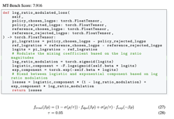
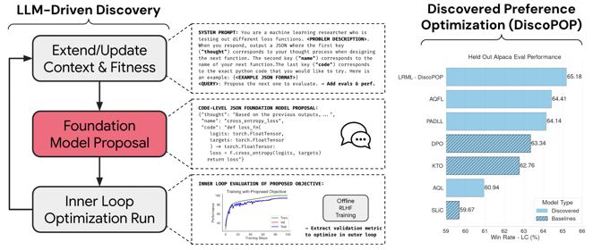
Sacana.ai
The Future: A Fully Automated AI Researcher that Open-endedly Improves Itself (LLM²)
Can LLMs invent better ways to train LLMs? LLM Squared ! ( LLM² )
https://sakana.ai/llm-squared/
Using evolutionary strategy to develop better ways to train foundation models like LLMs. To find a preference optimization scheme that outperforms DPO.
It used a LLM to suggest code and then trained models based on that code. After 100 or so generations, it had several proposed variants with extremely high performance.
example of generated code
Preference optimization schemes are techniques used to align large language models (LLMs) with human preferences during training.
DPO = Direct Preference Optimization)
RLHF = Reinforcement Learning from Human Feedback
RPO - Relative Preference Optimization

Slide 9





Misc 3
Luma Dream Machine - https://lumalabs.ai/dream-machine
“Dream Machine” platform - type in a descriptive prompt and have it rendered as a high-definition video clip generated in minutes.
Elon Musk has dropped his lawsuit against OpenAI without explanations.
https://apnews.com/article/elon-musk-drops-openai-lawsuit-e3932deb15957c915cd694d63583a043
Samsung Electronics - two new chip nodes ( SF2Z and SF4U ), which will be produced using 2nm and 4nm processes.
Samsung AI Solutions - new AI service.
AI Steve is running for U.K. Parliament.
AI Steve is represented by a human Steve Endacott.
If elected, Endacott will serve as AI Steve's human proxy in Parliament, attending meetings and casting votes based on the AI's constituent-driven platform.
Database Agent Course - Convert Language to SQL
https://www.deeplearning.ai/short-courses/building-your-own-database-agent/
Stable Diffusion 3 Medium - weights released.
2B parameter model is resource-efficient and capable of running on consumer GPUs.
SD3 Medium overcomes common artifacts in hands and faces, understands complex prompts, and achieves high quality text rendering.
GPT-4 is smarter at temperature=1 than temperature=0, even on deterministic tasks
Qwen 72B is the best performing open-source model

Slide 10
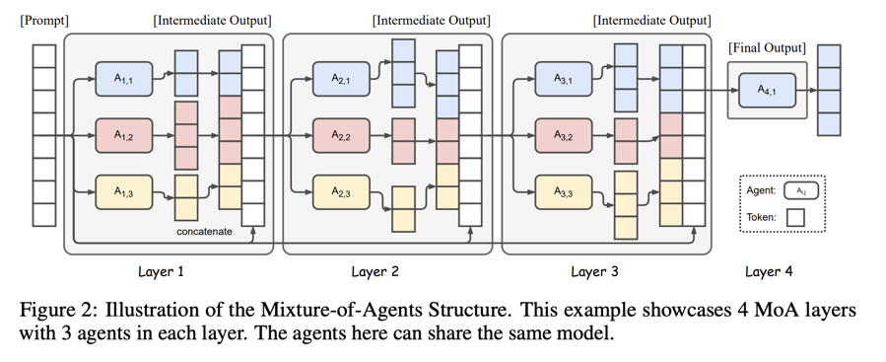
Misc 4
Combining multiple LLMs through a Mixture-of-Agents (MoA) outperforms GPT-4o
https://arxiv.org/abs/2406.04692
https://huggingface.co/papers/2406.04692

Slide 11
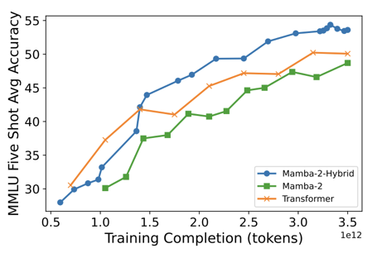

Misc 4
An Empirical Study of Mamba-based Language Models
This is the third team (after Jamba and Zamba) that has independently found that mixing Mamba and Transformer blocks does better than either can alone.
https://arxiv.org/pdf/2406.07887
Mistral announcing €600M in Series B funding for the first anniversary.

Slide 12
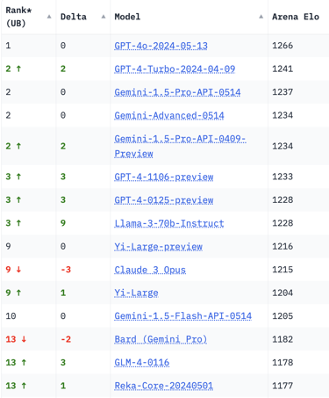
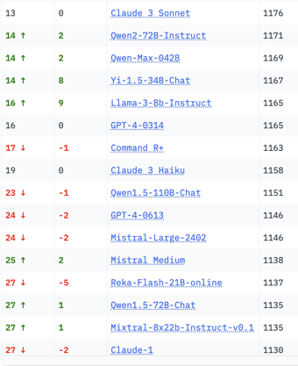
Crowd-sourced "Arena" Leaderboard
Total #models: 107.
Total #votes: 1,276,601.
Last updated: 2024-06-11
Starting Elo rating = 1000
95% CI = Confidence Interval
https://chat.lmsys.org/?leaderboard
English-only queries

Slide 13
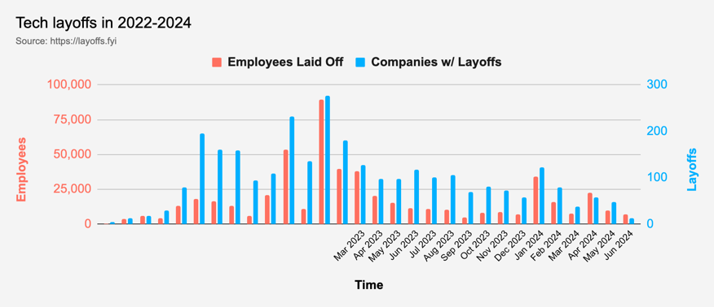
Tech Layoffs were lower than in 2023
Layoffs - https://layoffs.fyi
Salaries for AI engineers rose 12% from the third to fourth quarter last year
The average salary for a senior AI engineer nationally is more than $190,000, according to Comprehensive.io.
AI has a talent shortage, meaning $1 Mln salary job offers! Even during tech layoffs

Slide 14
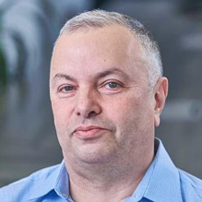

About the Speaker
Lev Selector, Ph.D.
40+ years of software engineering, data science, and building teams (hiring, training, and managing)
Ph.D. in mathematical modeling and computer simulations
Interests:
Generative AI, Using LLM with your data
Local AI for Local Private Data
Cloud architecture, fin-tech, application security
Find/connect: Linkedin, GitHub, YouTube, Google
https://eais.ai
Enterprise AI Systems

Slide 15
Thank You!

