Slide 1
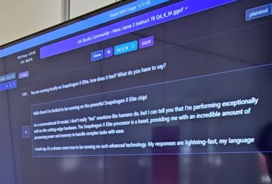



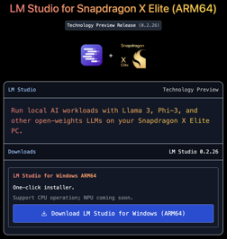



LLM on Snapdragon
LM Studio for snapdragon - https://lmstudio.ai/snapdragon
Windows Laptops with new Snapdragon X Elite chips will be able to run LLMs effectively using on-chip NPU and fast memory.
They are affordable ($1K .. $2K).
LM Studio - has already created a version for Snapdragon - and demonstrated 20 tokens/sec for Llama-7b-q4 on CPU. NPU support is pending - waiting for llama.cpp support.
Both LM Studio and Ollama are using llama.cpp https://github.com/ggerganov/llama.cpp
Ollama - waiting ( https://github.com/ollama/ollama ).
Yagil Burowski
LM Studio founder, Brooklyn, NY
https://www.linkedin.com/in/yagil-burowski/
https://x.com/yagilb
Order Windows laptop with Snapdraon X Elite with 64GB memory and small 13-14" screen:
https://www.lenovo.com/us/en/p/laptops/thinkpad/thinkpadx/thinkpad--x13s-(13-inch-snapdragon)/len101t0019
https://www.dell.com/en-us/shop/laptops/13-new/spd/xps-13-9345-laptop/usexchcto9345qcm02
https://www.microsoft.com/en-us/d/surface-laptop-6-for-business/8pz3fvs57qcv

