Slide 1
AI Updates
July 12, 2024
"How I use AI today is completely different from just three months ago."
LLM on Snapdragon
Crowd-sourced "Arena" Leaderboard
Crowd-sourced "Arena" Leaderboard - Coding
Calculating GPU memory for serving LLMs
What is Function Calling in LLMs
JEPA vs Transformers
Write a Book in Seconds
CELLO - Causal Evaluation
RouteLLM on lmsys.org
Andrej Karpathy - fully software 2.0 Computer
AI passed the Turing Test - May 9, 2024
MatMul-Free Language Modeling
TechLead (Patrick Shyu)
NuminaMath-7B wins AI Math Olimpiad
Microsoft & Apple Exit OpenAI Board
TensorWave Cloud offers 192GB GPUs
Prompt Compression and Query Optimization
HarmonicMath Achieved 90% on MiniF2F test
Andreessen Horowitz renting GPUs for Equity
Fine-Tuning & Hallucinations
Hebbia raises $130M
Intuit AI reorganization (cuts 1,800 workers)
Shanghai declaration on global AI governance
AMD is buying Silo.AI for $665 Mln
ElevenLabs speech generation / cleaning
Tech Layoffs in 2024

Slide 2
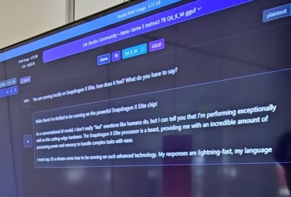



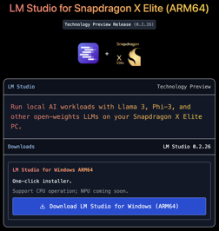



LLM on Snapdragon
LM Studio for snapdragon - https://lmstudio.ai/snapdragon
Windows Laptops with new Snapdragon X Elite chips will be able to run LLMs effectively using on-chip NPU and fast memory.
They are affordable ($1K .. $2K).
LM Studio - has already created a version for Snapdragon - and demonstrated 20 tokens/sec for Llama-7b-q4 on CPU. NPU support is pending - waiting for llama.cpp support.
Both LM Studio and Ollama are using llama.cpp https://github.com/ggerganov/llama.cpp
Ollama - waiting ( https://github.com/ollama/ollama ).
Yagil Burowski
LM Studio founder, Brooklyn, NY
https://www.linkedin.com/in/yagil-burowski/
https://x.com/yagilb
Order Windows laptop with Snapdraon X Elite with 64GB memory and small 13-14" screen:
https://www.lenovo.com/us/en/p/laptops/thinkpad/thinkpadx/thinkpad--x13s-(13-inch-snapdragon)/len101t0019
https://www.dell.com/en-us/shop/laptops/13-new/spd/xps-13-9345-laptop/usexchcto9345qcm02
https://www.microsoft.com/en-us/d/surface-laptop-6-for-business/8pz3fvs57qcv
Review: https://www.theverge.com/24191671/copilot-plus-pcs-laptops-qualcomm-intel-amd-apple

Slide 3
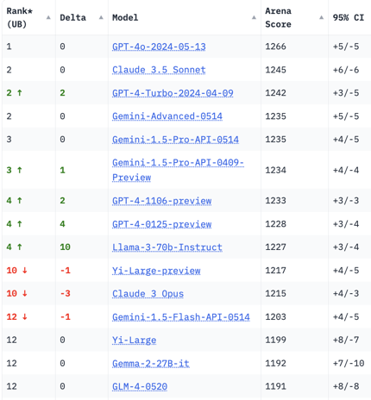
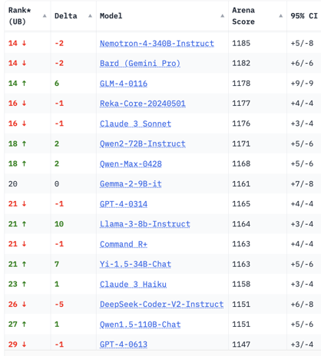
Crowd-sourced "Arena" Leaderboard
Total #models: 115.
Total #votes: 1,450,208.
Last updated: 2024-07-08.
Starting Elo rating = 1000
95% CI = Confidence Interval
https://chat.lmsys.org/?leaderboard
English-only queries

Slide 4
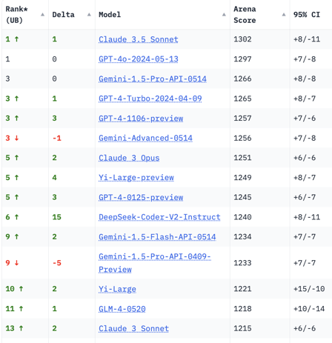
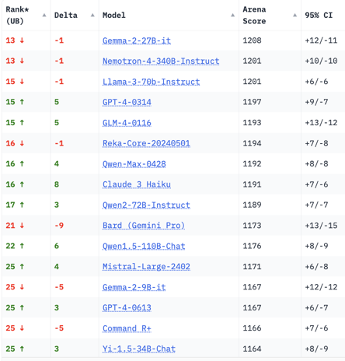
Crowd-sourced "Arena" Leaderboard
Total #models: 115.
Total #votes: 1,450,208.
Last updated: 2024-07-08.
Starting Elo rating = 1000
95% CI = Confidence Interval
https://chat.lmsys.org/?leaderboard
Coding

Slide 5
Calculating GPU memory for serving LLMs
q4 = 4 bits
-------
3.5 GB (4.5 GB)
q8 = 8 bits
--------------
7.0 GB (8 GB)
q16 = 16 bits
----------------------------
14 GB (17 GB)
q32 = 32 bits
--------------------------------------------------------
28 GB (34 GB)
Full Precision
Full precision = 4Bytes = 4*8bits = 32 bits
7B params * 4 Bytes = 28 GBytes
In reality we need approx 20% more:
28*1.2 = 34GB
If we use 4bit precision instead of 32,
then the memory requirement will be proportionally 8 times lower.
So we will need less than 4.7GB
https://www.substratus.ai/blog/calculating-gpu-memory-for-llm
If we use 4bit precision for 70B model,
we will need 35GB + 20% + extra.
In reality 40..47GB

Slide 6

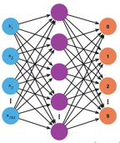

What is Function Calling in LLMs
Function calling in LLMs:
Understand user requests to determine if it's a request to perform a specific action (from the list).
Identify the appropriate (predefined) function to execute
Generate structured parameters (typicallin in JSON format) to pass to the identified function
Return structured data (typically in JSON format). This structured data can then be used by external applications or systems to execute the intended action.
Prompt
LLM
Functions

Slide 7
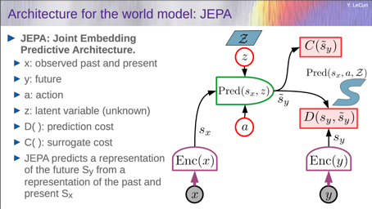
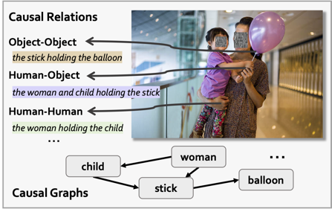

Misc 1
JEPA (Joint Embedding Predictive Architecture) vs transformers
https://www.turingpost.com/p/jepa
CELLO: Causal Evaluation of Large Vision-Language Models
https://arxiv.org/abs/2406.19131v1
CELLO, consist of 14,094 causal questions across all four levels of causality: discovery, association, intervention, and counterfactual.
This dataset surpasses traditional commonsense causality by including explicit causal graphs that detail the interactions between humans and objects
GitHub - write a book in seconds using Groq and Llama3
https://www.youtube.com/watch?v=h3wqIba7Xrc
https://github.com/Bklieger/groqbook
https://console.groq.com/keys
https://groqbook.streamlit.app
https://www.youtube.com/watch?v=fjtHOYU0m6o

Slide 8

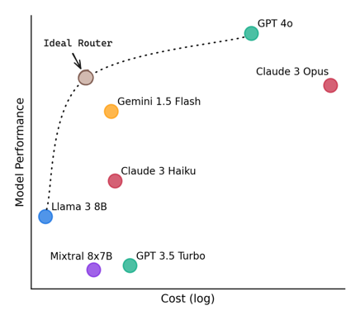
Misc 2
lnsys.org RouteLLM - directs simpler questions to cheaper LLMs
cost reduction 85% while maintaining 95% GPT-4 performance
open source !
https://lmsys.org/blog/2024-07-01-routellm/
Andrej Karpathy - 100% Fully Software 2.0 computer.
Just a single neural net and no classical software at all.
https://twitter.com/karpathy/status/1807497426816946333
Software 2.0 is a term coined by Andrej Karpathy (2017) to describe a new paradigm in software development where neural networks replace traditional hand-written code.
Instead of writing explicit instructions, developers curate and train datasets to teach the neural network the desired behavior.
https://karpathy.medium.com/software-2-0-a64152b37c35
Example: using NN for translation:
Much better results
Simpler architecture substituted ~0.5 Mln lines of code
Same "code" works for 200+ languages

Slide 9
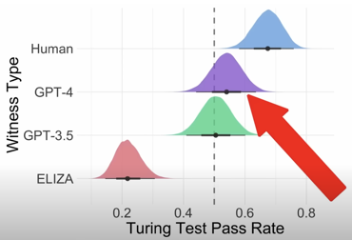

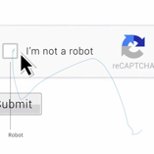

AI passed the Turing Test - May 9, 2024
AI passed the Turing Test -- And No One Noticed
https://www.youtube.com/watch?v=GyNaH27lX90
Paper: "People cannot distinguish GPT-4 from a human in a Turing test"
https://arxiv.org/abs/2405.08007 - May 9, 2024
We evaluated 3 systems (ELIZA, GPT-3.5 and GPT-4) in a randomized, controlled, and pre-registered Turing test. Human participants had a 5 minute conversation with either a human or an AI, and judged whether or not they thought their interlocutor was human.
GPT-4 was judged to be a human 54% of the time,
outperforming ELIZA (22%), but lagging behind actual humans (67%).
The results provide the first robust empirical demonstration that any artificial system passes an interactive 2-player Turing test.
The results have implications for debates around machine intelligence and, more urgently, suggest that deception by current AI systems may go undetected.
What makes humans "Human"? Analysis of participants' strategies and reasoning suggests that stylistic and socio-emotional factors play a larger role in passing the Turing test than traditional notions of intelligence.
Turing Test of AI (1950):
A human should be unable to distinguish the machine from another human being by using the replies to questions put to both
https://en.wikipedia.org/wiki/Turing_test
So, AI is already intelligent enough. It needs to mimic human imperfections to pretend to be a human.
Similarly, reCAPTURA tracks various interactions, such as mouse movements, scrolling patterns, and the time spent on the page. These interactions create a "imperfect" pattern that is difficult for bots to mimic accurately.
https://davidmartindata.medium.com/human-like-mouse-movement-simulation-for-captcha-evasion-fcd52a382c29
Alan Turing
Sophia (2016)

Slide 10



MatMul-Free Language Modeling
Normal multiplying by a matrix:
"Scalable MatMul-free Language Modeling"
A joined paper US + China - https://arxiv.org/abs/2406.02528
Using ternary numbers (-1,0,1) allows to completely eliminate the computational cost of Matrix multiplication (MatMul) while maintaining strong performance at billion-parameter scales.
This model competes with state-of-the-art Transformers.
GPU and FPGA implementations are provided
Simplifying when using ternary numbers (-1,0,1):
BitNet - LLM using binary (1-bit) numbers
BitLinear layer - NN layer that uses only 1-bit numbers
Vanilla implementation of BitNet is not efficient. So the paper focuses on optimization of use of on-chip Static Random-Access Memory (SRAM)
SNN = Spiking Neural Networks - mimic biological networks.
SNNs transmit information as discrete events called spikes.
These spikes occur when a neuron's "membrane potential" reaches a specific threshold (similar to biological neurons).
SNNs can capture the temporal dynamics of info processing.
SNNs are low energy.
SNNs use binary values (0,1)
There are variations (BNNs and TNNs) using Binary and Ternary quantized weights

Slide 11


TechLead (Patrick Shyu)
TechLead has deleted all of his tech videos!
https://www.youtube.com/watch?v=9kpCLOJDl04
Reason - no views.
Interest to technical tutorials has dropped.
Value of engineers is dropping. Layoffs.
Tech is dead.
https://www.youtube.com/watch?v=ycfPF1gkNpE
"Imagine you are on Titanic - and trying to learn Java ...".
"Studying hard, going to college, getting Ph.D. - doesn't work".
"Advice to work hard - doesn't work any longer".
"Attention Economy" (instead of tech/science).
No opportunity in 9-5 work. Stop doing this.
Stagnant economy, zero productivity.
Governments print money and making you poor.
Web3 and other projects were effectively shut-down by regulations.
Fees and taxes, all kinds of fees - scams.
Local governments blocking external business - to charge more.
Opportunities:
Entrepreneur.
Attention economy
Bitcoin
Fireship about TechLead Drama:
https://www.youtube.com/watch?v=FhqNN1LykWU
https://www.linkedin.com/in/shyup/

Slide 12

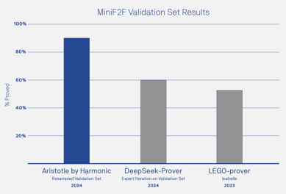

Misc 2
NuminaMath - solve math problems
https://huggingface.co/AI-MO/NuminaMath-7B-TIR
NuminaMath 7B TIR won the first progress prize of the AI Math Olympiad (AIMO).
HarmonicMath - https://harmonic.fun
Mathematical reasoning engine
Achieved 90% on OpenAI MiniF2F benchmark
https://x.com/HarmonicMath/status/1810765353389281346
Microsoft and Apple exit OpenAI board.
Reason - regulatory scrutiny (anti-monopoly / antitrust laws)
TensorWave Cloud offers MI300X with 192GB of VRAM (compare to 80GB on H100) so you can store larger models on a single GPU.
https://go.tensorwave.com/rundown
Prompt Compression and Query Optimization - a new course from DeepLearning.ai
https://learn.deeplearning.ai/courses/prompt-compression-and-query-optimization/lesson/1/introduction
Pre/Post filtering
Projection - select a subset of the fields
Reranking (move more desired results up)
Prompt Compression (reduce the length of prompts)
Venture Capital firm Andreessen Horowitz (A16Z) is planning to get up to 20,000 GPUs (including Nvidia H100) to rent them to its portfolio companies at below-market rates in exchange for equity.

Slide 13
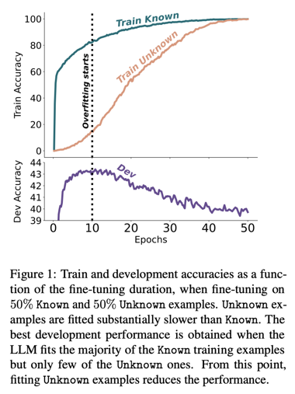
Fine-Tuning & Hallucinations
Does Fine-Tuning LLMs on New Knowledge Encourage Hallucinations?
.. https://arxiv.org/pdf/2405.05904v2
.. https://www.youtube.com/watch?v=Fimzi1oKNnY
Learning new information during fine-tuning can cause hallucinations. In this work authors vary the proportion of the fine-tuning examples
that introduce new knowledge.
LLMs struggle to acquire new factual knowledge through fine-tuning, as
fine-tuning examples that introduce new knowledge are learned significantly slower than those consistent with the model’s knowledge.
The examples with new knowledge are eventually learned, but they linearly increase the model’s tendency to hallucinate.
Taken together, these results highlight the risk in introducing new factual knowledge through fine-tuning, and support the view that LLMs mostly acquire factual knowledge through pre-training, whereas fine-tuning teaches them to use it more efficiently

Slide 14
Misc 3
Hebbia, a startup that uses generative AI to search large documents and respond to large questions, has raised a $130 million Series B at a roughly $700 million valuation led by Andreessen Horowitz
https://techcrunch.com/2024/07/09/ai-startup-hebbia-rased-130m-at-a-700m-valuation-on-13-million-of-profitable-revenue/
Intuit (QuickBooks and TurboTax), announced an AI-focused reorganization plan that includes laying off about 10% of its workforce, or 1,800 employees.
The company plans to hire at least as many new employees in fiscal 2025 as it focuses on integrating AI into its products.
Shanghai declaration on global AI governance
China has published its views on global AI cooperation, emphasizing its ambitions for AI dominance, including mass production of AI-driven humanoid robots by 2025 and sector leadership by 2027.
promoting AI development
maintaining AI safety
developing an AI governance system
enhancing public participation and literacy
improving quality of life through AI
Microsoft MInference speeds up the pre-filling for long-context LLMs.
It first determines offline which sparse pattern each head belongs to, then approximates the sparse index online and dynamically computes attention with the optimal custom kernels.
This approach achieves up to a 10x speedup for pre-filling on an A100 while maintaining accuracy.
https://github.com/microsoft/MInference
Facebook Multi-token Prediction - better and faster
https://huggingface.co/facebook/multi-token-prediction
Better & Faster Large Language Models via Multi-token Prediction
https://arxiv.org/abs/2404.19737
AMD is buying Silo AI for $665 Mln. https://www.silo.ai
Silo AI specializes in the integration of AI into business solutions
ElevenLabs
- text-to-speech tool https://elevenlabs.io/app/sign-up?redirect=/app/speech-synthesis
- speech cleaning tool (voice isolator)
https://elevenlabs.io/voice-isolator

Slide 15
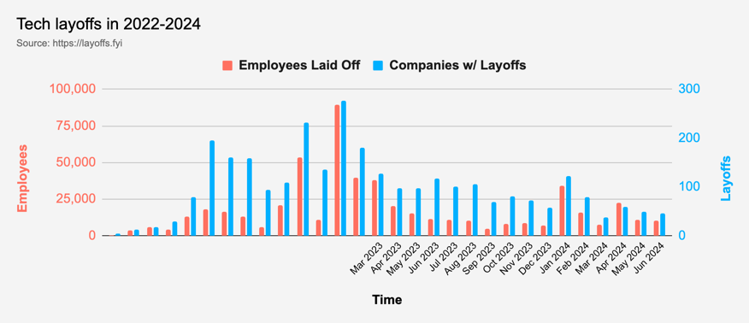
Tech Layoffs in 2024 are lower than last year
Layoffs - https://layoffs.fyi
Salaries for AI engineers rose 12% from the third to fourth quarter last year
Salaries: Python: $110K - $150K, Rust: $150K - $200K, AI Engineer: $140K - $250K
AI has a talent shortage, meaning $1 Mln salary job offers! Even during tech layoffs

Slide 16
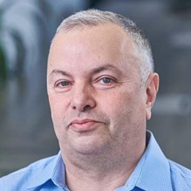

About the Speaker
Lev Selector, Ph.D.
40+ years of software engineering, data science, and building teams (hiring, training, and managing)
Ph.D. in mathematical modeling and computer simulations
Interests:
Generative AI, Using LLM with your data
Local AI for Local Private Data
Cloud architecture, fin-tech, application security
Find/connect: Linkedin, GitHub, YouTube, Google
https://eais.ai
Enterprise AI Systems

Slide 17
Thank You!

