Slide 1


AI Updates
August 16, 2024
Grok-2 released = sus-column-r on LMSYS
Flux.1 Image Generation
LLM-Aided OCR
OpenAI (2015) founders has mostly left
Which models to choose for agents?
Gemini 1.5 Flash price drop 71-78%
Best AI Image Generators
Sakana.ai - The AI Scientist
Genie from Cosine.sh - new coding model
FLYR raised $295 Mln - AI for Travel
Figure 02 humanoid robot
Anthropic Claude Artifacts - Real Time Diagrams
LLMs - working with PDF documents
TTT (Test Time Training) outperforms Mamba
Zico Kolter joins OpenAI Board
AI-powered hearing aid
ChatGPT Free Users Now Can Use DALL-E 3
Extract Thinker: LLMs to Process 4,000 CVs for $1
Golden-Retriever: High-Fidelity Agentic RAG
Gemini Live - talk with Gemini mobile app
Google's Imagen 3
76 pages of Prompting Techniques
Crowd-sourced "Arena" Leaderboard - English
OpenAI improved GPT-4o reclaims top spot
Crowd-sourced "Arena" Leaderboard - Coding
Tech Layoffs in 2024

Slide 2

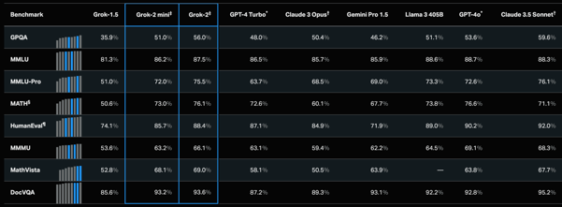
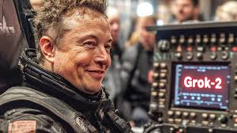
Grok-2 Uncensored
Grok-2 Beta release - https://x.ai/blog/grok-2
Grok-2 and Grok-2 mini are being released for 𝕏 premium.
Its early version was tested on the LMSYS leaderboard
under the name "sus-column-r".
It is outperforming both Claude 3.5 Sonnet and GPT-4-Turbo.
Multi-modal, 128K context.
https://www.nextleveldata.info/post/grok-2-0-vs-grok-1-5
Search Google images for: grok 2 deep fakes - https://www.google.com/search?q=grok+2+deep+fakes
grok 2 uncensored images - https://www.google.com/search?q=grok+2+uncensored
Black Forest Labs released the Flux.1 family of text-to-image models.
The largest of them outperformed Stable Diffusion 3 Ultra, Midourney v6.0, and DALL·E 3 HD (in the company’s internal qualitative tests).

Slide 3


Misc 1
LLM-Aided OCR - significantly enhance the quality of Optical Character Recognition (OCR) output
https://github.com/Dicklesworthstone/llm_aided_ocr
OpenAI (2015) founders has mostly left :
Greg Brockman - just went on sabbatical
Ilya Sutskever - left OpenAI
Trevor Blackwell - left in 2017
Vicki Cheung - left in 2017
Andrej Karpathy - left in 2017, returned 2023, left in 2024
Durk Kingma - left in 2018
John Schulman - just left in 2024
Pamela Vagata - left in less than 1 year
Wojciech Zaremba – still at OpenAI
Sam Altman - became CEO in 2019 after Microsoft $$
Elon Musk - quit the board in 2018
https://spyglass.org/openai-non-non-profit/
How to choose LLMs for Agents.
Choose the best models for decision making:
Anthropic Sonet 3.5 - $3/$15
OpenAI gpt-4o : $2.50/$10
Use other models for simple targeted specific tasks:
Gemini 1.5 Flash $0.075/$0.3 for prompts < 128K tokens up to 1 Mln tokens context
OpenAI gpt-4o-mini-2024-07-18: $0.3 / $1.2
Local models (Llama-3.1, Mistral-Nemo, ...)

Slide 4
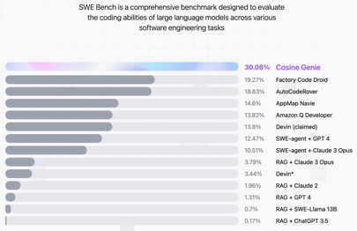
Misc 2
AI Image Generators (best)
https://www.tomsguide.com/best-picks/best-ai-image-generators
Leonardo - https://leonardo.ai
Midjourney - https://www.midjourney.com
Ideogram - https://ideogram.ai
DALL-E 3 - OpenAI ChatGPT, Microsoft Copilot, ...
Google ImageFX - https://aitestkitchen.withgoogle.com/tools/image-fx
Adobe Firefly - https://firefly.adobe.com
NightCafe - https://creator.nightcafe.studio
Flux.1 - https://blackforestlabs.ai/#get-flux - open source
FLYR raised $295 Mln to accelerate the development and delivery of its reservation systems and AI-based decision automation solutions to travel industry companies around the globe.
Figure 02 humanoid robot: 6 video cameras, 20-hour battery, Height 5'6", Weight 132 lbs, can lift 44 lbs, powered by OpenAI.
There are ~30 other humanoid robots in the world,
prices $10K .. $50K, forcasts: 10 Bln Robots by 2040
Sakana.ai - The AI Scientist - automate scientific discoveries
https://arxiv.org/abs/2408.06292
https://sakana.ai/ai-scientist
New coding model Genie has the highest score in the world
on SWE-Bench
Cosine - a startup - https://cosine.sh

Slide 5

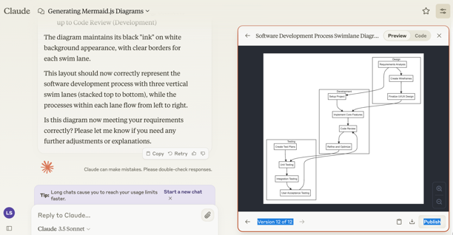
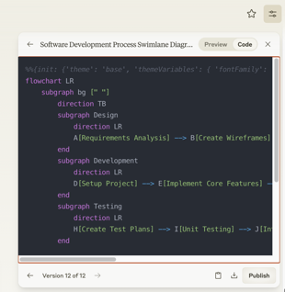
Anthropic Claude Artifacts
Real Time Diagrams
Mermaid Diagramming and Charting - Javascript
pip install mermaid-py
https://github.com/ouhammmourachid/mermaid-py
https://www.kaggle.com/code/ouhammourachid/mermaid-py
https://mermaid.js.org/syntax/examples.html
Asked Claude to generate a mermaid js diagram.
It shows code or diagram preview in artifacts:

Slide 6
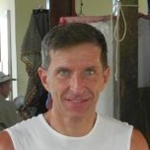


LLMs - working with PDF documents
https://en.wikipedia.org/wiki/MuPDF
https://pypi.org/project/PyMuPDF/
https://github.com/pymupdf/PyMuPDF
https://artifex.com/news/pymupdf-acquired-by-artifex
https://github.com/JorjMcKie
Langchain uses:
PyMuPDF - the default and fastest - https://pypi.org/project/PyMuPDF/
PyPDF2 - another common choice - https://pypi.org/project/PyPDF2/
History of MuPDF, Fitz, PyMuPDF:
In 2002, Tor Andersson started work on MuPDF based on the Libart rendering library by Raph Levien. After Artifex Software acquired the MuPDF project, the development focus shifted on writing a new modern graphics library called Fitz. In 2005, the first version of MuPDF with the new Fitz library was released.
PyMuPDF = Fitz - a Python wrapper for the MuPDF. PyMuPDF was originally written by Jorj X. McKie. Both PyMuPDF and MuPDF are maintained and developed by Artifex Software, Inc.
Old versions of PyMuPDF had their Python import name as fitz. Newer versions use pymupdf instead, and offer fitz as a fallback so that old code will still work.
Jorj McKie
Raph Levien
https://levien.com
Harald Lieder
harald.lieder@outlook.com

Slide 7




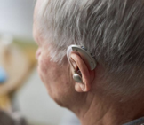
Misc 3
TTT (Test Time Training)
Replaces the attention mechanism in Transformers with an inner machine learning model
This inner model can be a simple linear model or a more complex MLP model
TTT achieves linear complexity (avoids quadratic complexity)
TTT better performance than Mamba on long context
Competitive performance with Transformers
Low latency, does not slow down with context length
https://www.youtube.com/watch?v=jOmTwRx-W08
https://arxiv.org/abs/2407.04620
https://github.com/test-time-training/ttt-lm-pytorch
ChatGPT Free Users Can Now Generate DALL-E 3 Images!
https://theaijournal.substack.com/p/chatgpt-free-users-can-now-generate
Zico Kolter, a Professor at Carnegie Mellon University and expert in AI safety and robustness, has joined OpenAI's Board of Directors and its Safety and Security Committee.
AI-powered hearing aid - x53 boost in speech understanding
https://interestingengineering.com/health/sonovas-ai-hearing-aids-offer-crystal-clear-speech
Zico Kolter, CMU
Extract Thinker - LLMs to Process 4,000 CVs for $1
https://medium.com/@enoch3712/how-companies-use-llms-to-process-4-000-cvs-for-1-extractthinker-3fa0815057c3

Slide 8
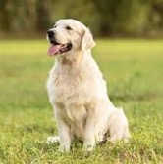


Misc 4
Golden-Retriever: High-Fidelity Agentic RAG https://arxiv.org/pdf/2408.00798
https://twitter.com/rohanpaul_ai/status/1822654040502608034
improves total score of Llama3-70B by 79%, 40% over RAG.
question augmentation: identifies jargon, clarifies meaning
OCR to extract text, LLMs to summarize and identify context using Chain-of-Thought prompting
Jargon dictionary queried using SQL
Augmented question integrates original query, context information, detailed jargon definitions. Explicitly states context, clarifies ambiguous terms.
if jargon is un-identified, system respond indicating missing information, instructs user to check spelling or contact knowledge base manager
Gemini Live - talk with Gemini app on smartphone.
You can even interrupt mid-response, can pause, and come back later. Available to Gemini Advanced subscribers.
Google's Imagen 3 - generate images (on Vertex AI)
https://www.theverge.com/2024/8/15/24221218/google-ai-image-generator-imagen-3-available
The Prompt Report - 76 pages of Prompting Techniques
https://arxiv.org/pdf/2406.06608

Slide 9
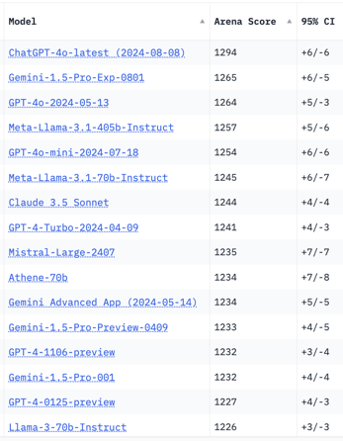
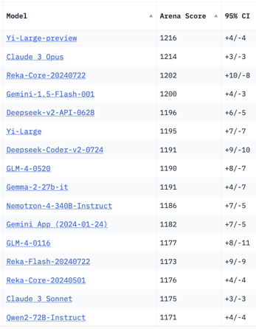
Crowd-sourced "Arena" Leaderboard
Total #models: 128.
Total #votes: 1,671,145.
Last updated: 2024-08-12.
Starting Elo rating = 1000
95% CI = Confidence Interval
https://chat.lmsys.org/?leaderboard
English-only queries
OpenAI improved GPT-4o reclaims top spot

Slide 10
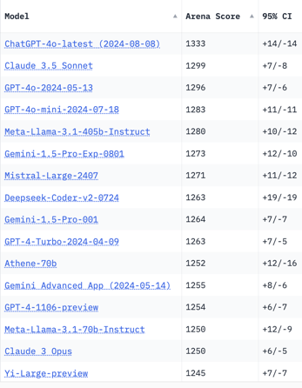
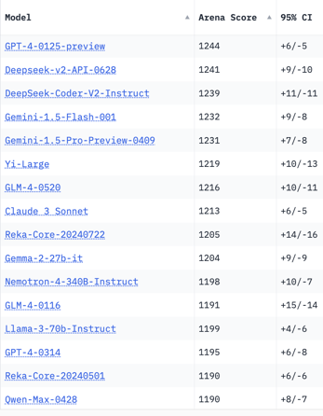
Crowd-sourced "Arena" Leaderboard
Total #models: 115.
Total #votes: 1,450,208.
Last updated: 2024-07-08.
Starting Elo rating = 1000
95% CI = Confidence Interval
https://chat.lmsys.org/?leaderboard
Total #models: 128.
Total #votes: 1,671,145.
Last updated: 2024-08-12.
Coding

Slide 11
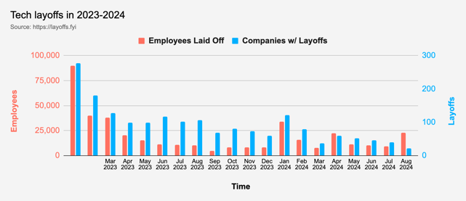


Tech Layoffs in 2024
Layoffs - https://layoffs.fyi
Intel is firing 15% of its personnel (about 15,000 jobs) - Aug 1, 2024
https://x.com/burkov/status/1819214183881187828
Dell Technologies is firing 10% (12,500 employees). This follows a previous round of 13,000 layoffs. The cuts mainly impact sales and marketing divisions.
https://www.pcmag.com/news/dell-makes-cuts-to-boost-ai-pivot-reportedly-laying-off-12500-employees

Slide 12
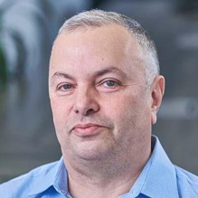

About the Speaker
Lev Selector, Ph.D.
40+ years of software engineering, data science, and building teams (hiring, training, and managing)
Ph.D. in mathematical modeling and computer simulations
Interests:
Generative AI, Using LLM with your data
Local AI for Local Private Data
Cloud architecture, fin-tech, application security
Find/connect: Linkedin, GitHub, YouTube, Google
https://eais.ai
Enterprise AI Systems

Slide 13
Thank You!

