Slide 1
from "memorize the answers"
to "memorize the reasoning"
AI Updates
September 20, 2024
"Second Wave Of Generative AI"
"System 2 thinking"
OpenAI o1 mini, preview, regular
o1 - Passes IQ 120
o1 - Dominates LMSYS Leaderboard
o1 - Generates newsletters at Smol.AI
o1 - Results on ARC-AGI-Pub
o1 - Interview with Sam Altman
Chain-of-Thought - and "reasoning tokens"
AI will affect 43 Mln jobs in USA in just 1 year
Google DeepMind robot ties its shoes
Fei-Fei Li's World Labs raised $230 Mln
11xAI - a startup building AI bots
Andrej Karpathy - tokens other than language
Groq - fast inference center in Saudi Arabia
AI for cybersecurity - a multi-$Bln opportunity
Llama 405B on 2 Macs
SambaNova fast inference
AI dominates online content (57%)
Klarna Bank substitutes 50% of workers by AI
DigitalOcean survey - 73% uses AI
Alibaba Qwen 2.5 vs Llama 3.1 405B
Salesforce - new autonomous AI tools
o1 model used to develop a trading strategy
Try-on clothes virtually
AI tool cuts unexpected deaths by 26%
20% of UK GP doctors use AI
Apple Intelligence is now live in public beta
Perplexity AI Pro
Google's Illuminate - generates podcasts
Crowd-sourced "Arena" Leaderboard - English
Crowd-sourced "Arena" Leaderboard - Coding
Tech Layoffs in 2024

Slide 2
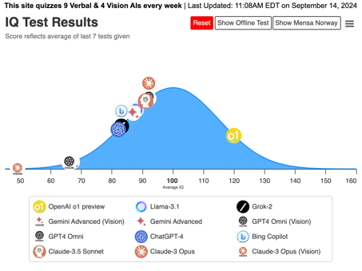
OpenAI o1 mini, preview, regular
shift from "memorize the answers"
to "memorize the reasoning"
The o1 models has 128K token input context window.
o1-preview can generate up to 32K tokens (25K of them consumed internally for reasoning), o1-mini - up to 65K tokens.
Plus and Team users:
o1-mini : 50 messages / day
o1-preview : 50 messages / week
API for tier 5 ($1K/mo):
o1-mini : 250 requests per minute
o1-preview : 100 requests per minute
OpenAI passes IQ 120
https://www.maximumtruth.org/p/massive-breakthrough-in-ai-intelligence
API cost for tier-5 ($1K/mo):
o1-mini : $3/$12 per Million in/out tokens
o1-preview : $15/$60 per Million in/out tokens
GPT-4o : $5/$15 per Million in/out tokens
OpenAI didn’t announce a release date for a finished o1 model.
RL (Reinforcement Learning) is used to reward the models for generating desired reasoning steps and for their alignment with human values, goals, and expectations.
The models process "reasoning tokens" and charges for these
hidden tokens even though they’re invisible to users. Users can see a summary of steps, but not the actual tokens.
Step-by-step reasoning is slow, but it delivers superior results.
OpenAI recommends budgeting 25K tokens for reasoning. Thus the ouput for o1-preview will be less than 7K (32K-25K), and less than 40K for o1-mini.
Low hallucinations , more resistance to jailbreaking attacks.

Slide 3
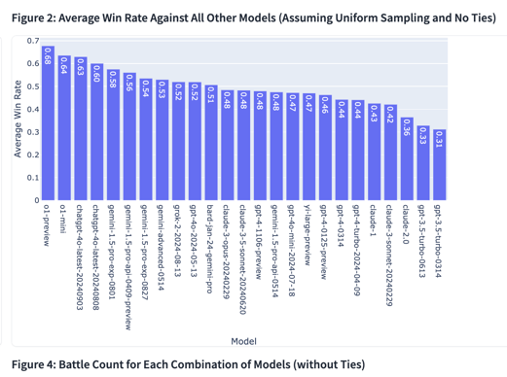
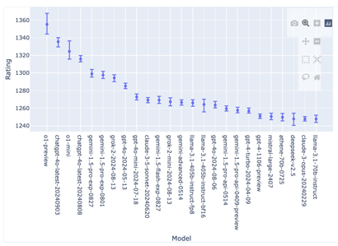
OpenAI o1 Dominates Leaderboard
o1 models dominate LMSYS Chatbot Arena Leaderboard
https://lmarena.ai/?leaderboard
Cognition's Devin significantly improves its code generation capability by using OpenAI's o1 model. https://www.cognition.ai/blog/evaluating-coding-agents

Slide 4
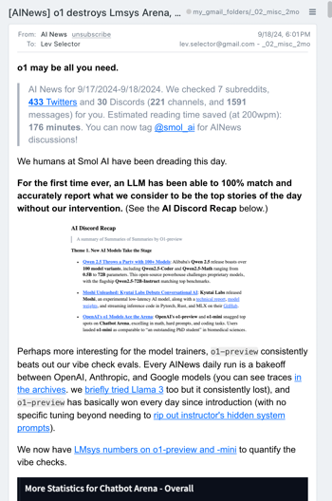

OpenAI o1 mini, preview, regular
https://smol.ai - News and Hackathons, ~24 pages daily!
"We humans at Smol AI have been dreading this day. For the first time ever, an LLM has been able to 100% match and accurately report what we consider to be the top stories of the day without our intervention."
Perhaps more interesting for the model trainers, o1-preview consistently beats out our vibe check evals. Every AINews daily run is a bakeoff between OpenAI, Anthropic, and Google models (you can see traces in the archives. we briefly tried Llama 3 too but it consistently lost), and o1-preview has basically won every day since introduction (with no specific tuning beyond needing to rip out instructor's hidden system prompts).

Slide 5
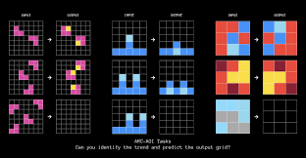

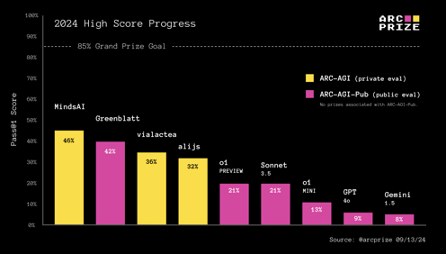
OpenAI o1 Results on ARC-AGI-Pub
ARC-AGI-Pub is a public leaderboard for evaluating the performance of cutting-edge AI systems on the ARC-AGI dataset. ARC-AGI (Advanced Reasoning and Comprehension for Artificial General Intelligence) is a benchmark designed to test an AI's ability to solve problems that require advanced reasoning, common sense, and knowledge (2019, François Chollet).
https://github.com/fchollet/ARC-AGI
https://arcprize.org/blog/openai-o1-results-arc-prize
The foundational source of o1 training is still a fixed set of pre-training data. But OpenAI is also able to generate tons of synthetic CoTs that emulate human reasoning to further train the model via RL.
Reward signals for RL were likely achieved using verification (over formal domains like math and code) and human labeling (over informal domains like task breakdown and planning.)
At inference time, OpenAI says they're using RL to enable o1 to hone its CoT and refine the strategies it uses. We can speculate the reward signal here is some kind of actor + critic system similar to ones OpenAI previously published. And that they're applying search or backtracking over the generated reasoning tokens at inference time.
https://openai.com/index/finding-gpt4s-mistakes-with-gpt-4/
Iterated CoT genuinely unlocks greater generalization.
Automatic iterative re-prompting enables the model to better adapt to novelty, in a way similar to test-time fine-tuning leveraged by the MindsAI team https://minds.ai

Slide 6
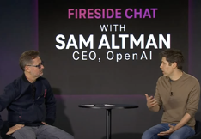
o1 - interview with Sam Altman
Sam Altman discussed the new o1 model's advanced reasoning capabilities (T-Mobile’s Capital Markets Day, 15 min - from 51:00 to 1:06:00) - https://www.youtube.com/watch?v=r-xmUM5y0LQ&t=3070s
o1 is described as the first AI system with advanced reasoning, outperforming previous models in complex problem-solving.
Altman compared o1’s current state to the "GPT-2 stage", suggesting that "GPT-4" equivalent is coming soon.
He spoke about 5 levels of AI development: Level 1 - chat Level 2 - reasoning Level 3 - autonomous AI, agents Level 4 - innovating AI - improving processes Level 5 - organizational AI - running entire organization

Slide 7
Chain of Thought - Reasoning Tokens
Reasoning tokens and techniques used in System 2 LLMs such as OpenAI o1 - by Don Lim
https://medium.com/@don-lim/reasoning-tokens-and-techniques-used-in-system-2-llm-models-such-as-openai-o1-bacbf8fd9bec
Reinforcement Learning from Human Feedback (RLHF): training advanced language models like InstructGPT and ChatGPT to align with human preferences
https://en.wikipedia.org/wiki/Reinforcement_learning_from_human_feedback
OpenAI's O1 Models: use "reasoning tokens" as part of their Chain-of-Thought approach.
Reasoning Token, Planning Tokens, Self-reasoning tokens.
reasoning tokens - external instructions
self-reasoning tokens - internal prompts that encourage the model to think ahead and reason more independently
Felipe Bonetto's work focuses on integrating self-reasoning tokens within models to better manage future-oriented tasks and enhance model interpretability​
https://reasoning-tokens.ghost.io/reasoning-tokens/
https://github.com/lucidrains/self-reasoning-tokens-pytorch
https://ai-recon.ghost.io/air-48-april-21-2024/
https://www.envisioning.io/vocab/self-reasoning-token
Daniel Kahneman in 2011 in his book "Thinking, Fast and Slow".
"System 1 thinking is an immediate response"
"System 2 thinking is a delayed response from a well-thought-out process".
Break down complex tasks into smaller steps.
Chain of Thought (CoT)
"CoT-enabled LLMs"
Chain-of-Thought Prompting: Introduced in the 2022 paper "Chain of Thought Prompting Elicits Reasoning in Large Language Models" by Wei et al., https://arxiv.org/abs/2201.11903
Chain of Thought (https://arxiv.org/abs/2201.11903, 2022)
Tree of Thoughts (https://arxiv.org/abs/2305.10601, 2023)
Branch-Solve-Merge (https://arxiv.org/abs/2310.15123, 2023),
System 2 Attention (https://arxiv.org/abs/2311.11829, 2023)
Rephrase and Respond (https://arxiv.org/abs/2311.04205, 2023)
Planing Tokens (https://arxiv.org/abs/2310.05707 , 2023)
Anthropic Thinking tags ( https://anthropic.com/news/tool-use-ga , 2024)

Slide 8
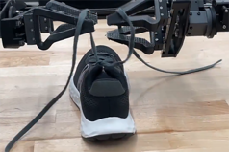





Misc 1
AI will affect 43 Mln jobs in USA (16 Mln in Mexico) in one year.
https://english.elpais.com/economy-and-business/2024-09-15/artificial-intelligence-will-affect-60-million-us-and-mexican-jobs-within-the-year.html
Google DeepMind robot ties its shoes and fixes fellow robots
https://techcrunch.com/2024/09/12/google-deepmind-teaches-a-robot-to-autonomously-tie-its-shoes-and-fix-fellow-robots/
Datastack - open-source framework, easily build real-time web apps, internal tools, dashboards, weekend projects, data entry forms, or prototypes using just Python.
https://github.com/data-stack-hub/DataStack/tree/master
11xAI - a startup building AI bots, just secured a $24 million Series A funding. Company makes AI agents like "Alice" for sales and "Jordan" for phone representation
https://www.11x.ai
Fei-Fei Li's World Labs raised $230 Mln for developing "large world models" to help artists, designers, developers, and engineers interact/understand the 3D world. https://techcrunch.com/2024/09/13/fei-fei-lis-world-labs-comes-out-of-stealth-with-230m-in-funding/
Sam Altman leaves OpenAI board's safety and security committee. This move addresses concerns about potential conflicts of interest. The newly formed committee, chaired by Zico Kolter, will review major models and have the authority to delay their release.
Salesforce Ventures - $1 Bln AI fund
https://techcrunch.com/2024/09/16/salesforce-ventures-ups-its-ai-fund-to-1-billion-doubling-it-again/

Slide 9

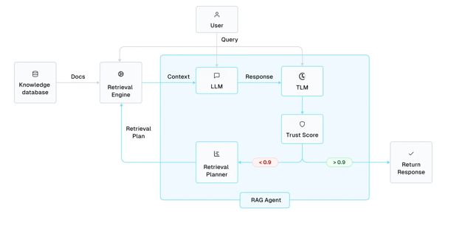
Misc 2
Andrej Karpathy - LLMs don't care if the tokens happen to represent little text chunks. It could just as well be little image patches, audio chunks, action choices, molecules, or whatever.
If you can reduce your problem to that of modeling token streams (for any arbitrary vocabulary of some set of discrete tokens), you can "throw an LLM at it" - "next token prediction" for different domains. - https://x.com/karpathy/status/1835024197506187617
Joke: o1-mini keeps refusing to try to solve the Riemann Hypothesis on my behalf. Model laziness continues to be a major issue sad ;p - https://twitter.com/karpathy/status/1834374965942255835
Reliable Agentic RAG with LLM Trustworthiness Estimates
https://cleanlab.ai/blog/reliable-agentic-rag/
Groq (fast inference chips) partnered with Saudi oil giant Aramco to build the world’s largest AI inferencing center in Saudi Arabia - to serve Middle East, Africa, and India.
The data center will host 19K LPUs (Language Processing Units) by the end of 2024, with potential expansion to 200K units.
Advantages: low energy costs, available land, and proximity to 4 billion people within a 100-millisecond data travel time.

Slide 10




Misc 3
AI for cybersecurity - a multi-Billion $ opportunity.
AI is necessary because cyberattacks are on the rise.
https://www.globenewswire.com/news-release/2024/09/16/2946676/0/en/How-Artificial-Intelligence-AI-In-Cybersecurity-is-Generating-a-Billion-Dollar-Revenue-Opportunity-for-Tech-Industry.html
Llama 405B running locally on a 2-computer Apple Silicone cluster of Mac Studio M2 Ultra (192GB memory) and a Macbook Pro M3 Max (128GB memory); 2.5 tokens/sec, 30 sec to first token; using Exo (https://github.com/exo-explore) and Apple MLX; using 4-bit quantization
Microsoft AI Copilot - Copilot Pages, improvements, faster, better
SambaNova uses Reconfigurable Dataflow Units (RDU)
for fast inference (Llama 3.1 in tok/sec):
130 for 405B , 411 for 70B , 1000 for 8B
It is a bit behind Cerebras in both speed and price
https://venturebeat.com/ai/sambanova-challenges-openais-o1-model-with-llama-3-1-powered-demo-on-huggingface/
Klarna Bank ditches Salesforce for internal AI app as it cuts 50% of workforce (from 4.2K down to 2K). It is also phasing out the HR "Workday" in favor of its own in-house AI solutions to cut operational costs. It has already reduced headcount by 1,200 jobs over the last year.
https://en.wikipedia.org/wiki/Klarna
https://www.performancemarketingworld.com/article/1888702/klarna-ditches-salesforce-internal-ai-app-cuts-50-workforce
AI dominates online content. 57% of online text is now generated by AI.
This may cause the "model collapse" effect - degradation of model quality when using synthetic data.

Slide 11





Misc 4
Try on clothes virtually on Huggingface:
https://huggingface.co/spaces/Kwai-Kolors/Kolors-Virtual-Try-On
Step 1. Upload a person image
Step 2. Upload a garment image
Step 3. Press “Run” to get try-on results
DigitalOcean survey:
- 73% use AI/ML tools
- 78% anticipate an increase in their use of AI/ML
- 47% of businesses have implemented AI/ML
https://www.digitalocean.com
YouTube CEO Neal Mohan has revealed that 92% of YouTube creators already use AI tools (in some capacity).
Qwen 2.5 (Alibaba, China):
open-source
sizes 0.5B, 1.5B, 3B, 7B, 14B, 32B, and 72B
context length in/out 128K/8K
29 languages
outcompetes Llama 3.1 405B on many benchmarks
https://qwenlm.github.io/blog/qwen2.5/
https://ollama.com/library/qwen2.5
AI tool cuts unexpected deaths in hospital by 26% (Toronto):
https://www.cbc.ca/news/health/ai-health-care-1.7322671
Apple Intelligence is now live in public beta. (iOS 18.1, iPadOS 18.1, macOS Sequoia 15.1)
https://techcrunch.com/2024/09/19/apple-intelligence-is-now-live-in-public-beta-heres-what-it-offers-and-how-to-enable-it/
Salesforce - new AI tools for tasks without human supervision.
New low price $2 per AI-driven conversation.
20% of UK GP doctors use AI. 30% for documentation, 28% for suggesting diagnoses, ...
https://informatics.bmj.com/content/31/1/e101102
"I used OpenAI’s o1 model to develop a trading strategy. It is DESTROYING the market"
https://medium.datadriveninvestor.com/i-used-openais-o1-model-to-develop-a-trading-strategy-it-is-destroying-the-market-576a6039e8fa

Slide 12
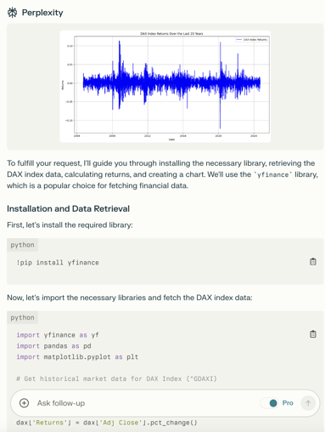
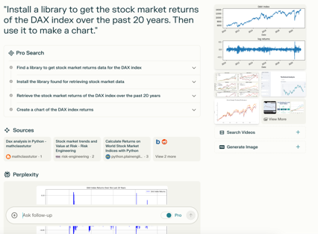
Perplexity Pro
Perplexity AI Pro ($20/mo):
In the search bar, click "Pro" search, enter a query like: "Install a library to get the stock market returns of the DAX index over the past 20 years. Then use it to make a chart."
Watch as Perplexity searches for libraries, installs them, fetches data, and creates the chart, allowing you to then analyze the results and ask follow-up questions about that specific chart. https://www.perplexity.ai/search/install-a-library-to-get-the-s-JcN8IO1yRN.wETNKNntK1w

Slide 13
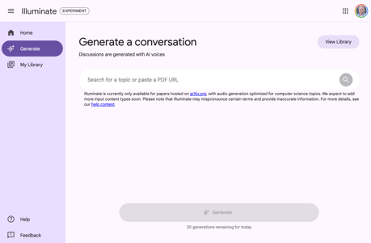
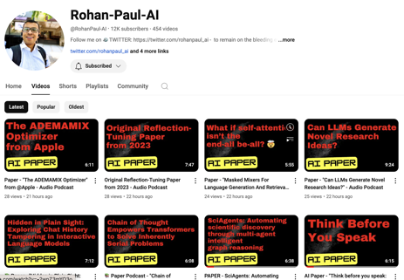
Google's Illuminate
Google's illuminate - the tool trained on AI & science-related Arxiv papers - https://illuminate.google.com
Here are many podcasts converted to animated videos:
https://www.youtube.com/@RohanPaul-AI/videos

Slide 14
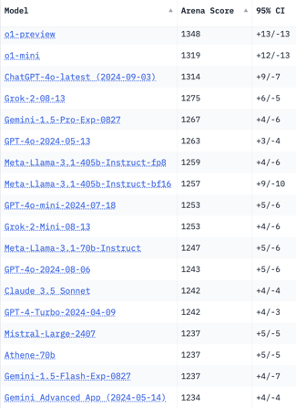
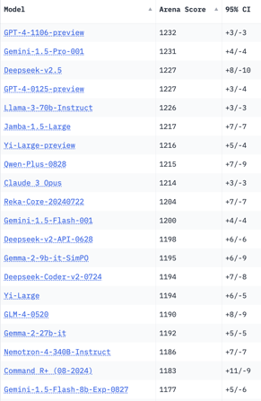
Crowd-sourced "Arena" Leaderboard
Total #models: 145.
Total #votes: 1,898,013.
Last updated: 2024-09-17.
Starting Elo rating = 1000
95% CI = Confidence Interval
https://chat.lmsys.org/?leaderboard
English-only queries
New
New
New
1 byte

Slide 15
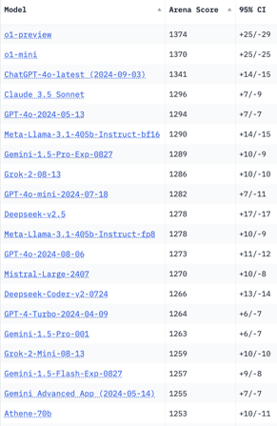
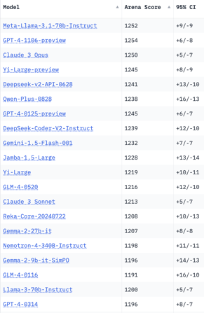
Crowd-sourced "Arena" Leaderboard
Total #models: 145.
Total #votes: 1,898,013.
Last updated: 2024-09-17.
Starting Elo rating = 1000
95% CI = Confidence Interval
https://chat.lmsys.org/?leaderboard
Coding
New
New
1 byte

Slide 16
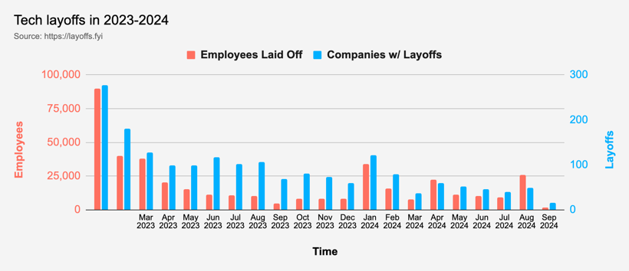
Tech Layoffs in 2024
Layoffs - https://layoffs.fyi
Amazon has mandated that its corporate employees return to the office full-time, five days a week, starting in January 2025.

Slide 17
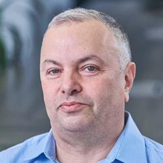

About the Speaker
Lev Selector, Ph.D.
40+ years of software engineering, data science, and building teams (hiring, training, and managing)
Ph.D. in mathematical modeling and computer simulations
Interests:
Generative AI, Using LLM with your data
Local AI for Local Private Data
Cloud architecture, fin-tech, application security
Find/connect: Linkedin, GitHub, YouTube, Google
https://eais.ai
Enterprise AI Systems

Slide 18
Thank You!

