Slide 1
AI Updates
May 16, 2025
AI Competition Shifts from Models to Apps
Continuous Thought Machines from Sakana-AI
Meta's AssetGen 2.0: 3D Model Generation
Amazon "Enhance My Listing" AI for sellers
Microsoft is offering OpenAI equity for access
Alibaba Qwen "Web Dev"
GPT-4.1 and GPT-4.1-mini
NVIDIA’s Global Headquarters Will Be In Taiwan
China's 500+ data centers are 80% idle
TikTok AI Alive Stories
Audible uses AI to convert print to audio
Suna - open-source AI Employee
Jeremy Howard Answer.AI
Cline AI Coding Assistant
Which Local Coding Model to Use
Figma Prototyping using AI
Absolute Zero Reasoner (AZR)
WebThinker
WizardLM, WizardCoder, WizardMath
Bytedance Opensources DeerFlow
Perplexity raises $500 Mln
Honor phones image to video
Bamba-9B-v2 - Mamba2-based
FaceAge AI predicts age and cancer from face photo
Crowd-sourced "Arena" Leaderboard
Jobs, Layoffs

Slide 2
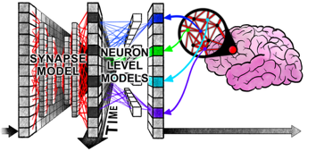
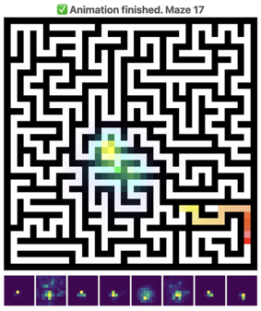
Continuous Thought Machines from Sakana-AI
Continuous Thought Machines from Sakana-AI https://www.youtube.com/watch?v=tRN2F_tqmeo https://arxiv.org/abs/2505.05522 https://x.com/SakanaAILabs/status/1921749814829871522 https://github.com/SakanaAI/continuous-thought-machines/ https://pub.sakana.ai/ctm/
New AI model architecture: (1) Decoupled Internal Dimension for thoughts; (2) Neuron-Level Models: Each neuron has its own internal weights that process the history of incoming signals (pre-activations) to calculate its next activation - dynamic processing of temporal signal history; (3) Synchronization Matrix: computed from the history of all neurons' post-activations and forms the basis for action and output
The model uses "ticks" (t) in this artificial time dimension to produce outputs at each internal tick. The system optimizes across this internal temporal dimension using standard loss functions like cross-entropy, similar to classical transformer architectures
The architecture consists of: - A UNET-style MLP "synapse model" that interconnects neurons across a shared space - Individual neuron-level models that compute post-activations based on pre-activation history - A synchronization matrix that measures co-activity of neuron pairs over the internal artificial time
The system trained on solving 39×39 mazes could generalize to solving 99×99 mazes, showing some out-of-distribution generalization capacity

Slide 3




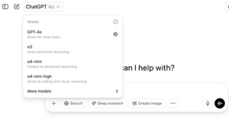
AI Updates 1
Meta's AssetGen 2.0: 3D Model Generation
Creates detailed 3D models and textures from words and pictures
https://developers.meta.com/horizon/blog/AssetGen2
Amazon "Enhance My Listing" AI for sellers
900,000+ sellers can auto-optimize product titles and descriptions with Gen AI, boosting listing-quality scores by 40%
Microsoft is offering OpenAI some of its equity stake for access to technology beyond their current contract's 2030 expiration https://techcrunch.com/2025/05/11/microsoft-and-openai-may-be-renegotiating-their-partnership/
Alibaba Qwen "Web Dev" - prompt-based web code development
Prompt like "Create a Twitter-like website" returns working HTML, CSS, and JavaScript - no coding skills or setup required
https://the-decoder.com/web-dev-in-qwen-generates-full-front-end-code-from-just-a-prompt/
GPT-4.1 and GPT-4.1-mini added to ChatGPT - good at coding tasks & instruction following
https://x.com/OpenAI/status/1922707554745909391

Slide 4

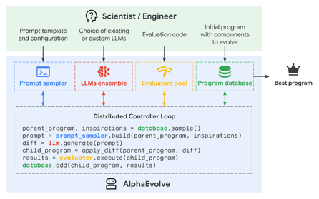
AlphaEvolve builds advanced algorithms
Google AlphaEvolve designing advanced algorithms
Developed by Google DeepMind
uses Gemini LLMs and an evolutionary optimization framework to design advanced algorithms for mathematics, computer science, and practical computing applications
uses Gemini Flash (for rapid idea generation)
uses Gemini Pro (for deeper, higher-quality suggestions)
https://deepmind.google/discover/blog/alphaevolve-a-gemini-powered-coding-agent-for-designing-advanced-algorithms/
The system generates multiple candidate algorithms or code snippets, then iteratively evaluates, scores, and refines them
This evolutionary process enables AlphaEvolve to discover, test, and optimize algorithms that often outperform human-designed solutions
AlphaEvolve Achievements:
developed a scheduling heuristic for Google's data centers, recovering an average of 0.7% of global compute resources
suggested improvements to Verilog code used in Google's custom AI chips (TPUs), leading to more efficient hardware designs
optimized matrix multiplication operations crucial for training large AI models, achieving a 23% speedup in a core kernel and reducing Gemini model training time by 1%
matched or surpassed state-of-the-art solutions in about 75% of over 50 open mathematical problems, and improved on the best-known results in roughly 20% of cases, including breaking a 56-year-old record for 4x4 matrix multiplication
AlphaEvolve’s general-purpose approach can be applied to any problem that can be expressed in code and evaluated by a computer, ranging from scientific research to industrial optimization

Slide 5
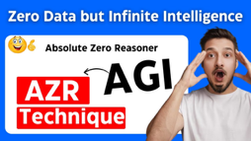

Absolute Zero Reasoner
Absolute Zero Reasoner (AZR) - self-learning AI model
Research from China by Tsinghua University (Beijing) and BIGAI (Beijing Institute for General Artificial Intelligence)
Model can train itself from scratch without using any external data
Model generates its own tasks, solves them, and improves through self-play with no external datasets required.
This is Reinforcement Learning with Verifiable Rewards.
This is learning from self-play, from experience
The system achieved SOTA results on coding and math benchmarks, surpassing models trained on expert-labeled examples
AZR uses three reasoning modes (deduction, abduction, and induction) to create increasingly harder self-generated challenges to learn
Researchers noted an "uh-oh moment" when Llama-3.1 produced chains of thought about "outsmarting intelligent machines," raising safety concerns
https://www.arxiv.org/abs/2505.03335
https://github.com/LeapLabTHU/Absolute-Zero-Reasoner
https://www.youtube.com/watch?v=CqdqZNqljdI
WizardLM is a Chinese team which has moved from Microsoft (2024) to Tencent (2025).
Original 2024 project has used "Evol-Instruct" method, where LLMs themselves generate increasingly complex instruction data, which is then used to fine-tune and improve the models
There are WizardLM, WizardCoder, WizardMath WizardLM-2 family: MoE 8x22B, 70B, 7B
Note: WizzardLM and Absolute Zero Reasoner are not related. Different teams, different methods.
WebThinker gives AI the ability to browse the web, gather real-time information, and write detailed research reports fully autonomously
Renmin University of China (RUC), BAAI (Beijing Academy of Artificial Intelligence), Huawei Poisson Lab (Shenzhen, China)
https://arxiv.org/abs/2504.21776
https://github.com/RUC-NLPIR/WebThinker
https://huggingface.co/papers/2504.21776

Slide 6
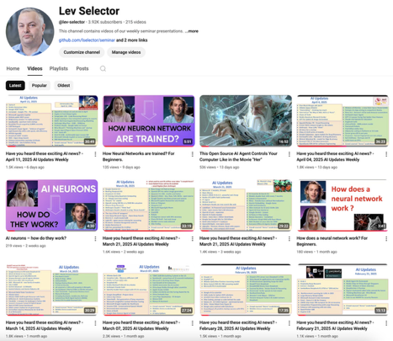
About this Channel:
We post our AI Updates
Every Friday after 3pm EST
It is usually 25-30 min long
Links to slides are under the videos
Subscribe to our YouTube channel to get notified when new videos are posted
https://www.youtube.com/@lev-selector

Slide 7




AI Updates 2
Bytedance Opensources DeerFlow ( Deep Exploration and Efficient Research Flow)
open-source Deep Research framework
python + node.js in docker
LLMs plus web search, crawling, python code execution, TTS (Text-To-Speech), Multi-Agent, LangGraph, MCP
https://github.com/bytedance/deer-flow
https://deerflow.tech/
Perplexity raises $500 Mln
AI-powered search engine startup
Valuation $14 billion
https://www.reuters.com/technology/ai-firm-perplexity-eyes-14-billion-valuation-fresh-funding-round-wsj-reports-2025-05-12/
Honor phones image to video
Honor 400 and 400 Pro phone buyers will be the first to test Google’s new Veo 2-powered AI tool allowing to convert photos into videos
Honor is a Chinese company, originally a sub-brand of Huawei. Valuation $14 B
https://www.honor.com
https://www.youtube.com/watch?v=EIMdp_sZvHU

Slide 8

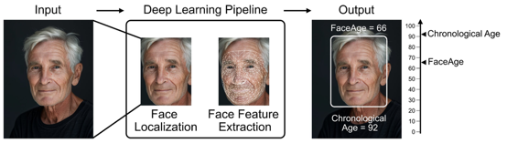

AI Updates 3
Bamba-9B-v2 - Mamba2-based
Released by IBM, Princeton, CMU, and UIUC
Outperforms Llama 3.1 8B
Trained on 3 Trillion tokens
Bamba v2 leverages Mamba2 architecture for 2-2.5x faster inference and excels in L1 and L2 benchmarks
https://huggingface.co/blog/ibm-ai-platform/bamba-9b-v2
FaceAge AI predicts age and cancer from face photo
By researchers from Boston
AI tool estimates biological age and improve cancer survival outcome predictions simply by analyzing their facial photograph
FaceAge uses a system trained on tens of thousands of face photos to translate subtle facial characteristics into a biological age estimate
Cancer patients appear ~ 5 years older
FaceAge risk scores help to more accurately predict 6-mo survival

Slide 9

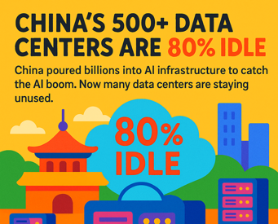
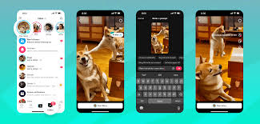
AI Updates 4
NVIDIA’s Global Headquarters Will Be In Taiwan
https://wccftech.com/nvidias-global-headquarters-will-be-in-taiwan-with-ceo-huang-set-to-announce-site-next-week-says-report/
China's 500+ data centers are 80% idle
China poured billions into AI infrastructure to catch the AI boom. Now many data centers are staying unused.
https://www.technologyreview.com/2025/03/26/1113802/china-ai-data-centers-unused/amp/
TikTok AI Alive Stories
Create short video stories from static images in TikTok Stories
https://newsroom.tiktok.com/en-us/introducing-tiktok-ai-alive

Slide 10


AI Updates 5
Audible uses AI to convert print to audio
Amazon’s audiobook service is converting print and e-books into AI-narrated audiobooks
Book publishers can choose from 100+ AI-generated voices available in English, French, Spanish, and Italian, with multiple accents and dialect options
Audible plans to roll out a beta version of AI translation later this year (text-to-text and speech-to-speech translation) - English, Spanish, French, Italian, and German.
Spotify, the second-largest audiobook provider after Audible, has also recently made efforts to expand its audiobook library by utilizing AI narration tools - partnered with ElevenLabs in February
https://www.audible.com/about/newsroom/audible-expands-catalog-with-ai-narration-and-translation-for-publishers
Suna an open-source AI employee
https://www.suna.so
https://github.com/kortix-ai/suna
https://huggingface.co/blog/lynn-mikami/suno-ai
AI agent that is competing directly with Manus AI. Suna was developed by Kortix AI, is designed to perform real-world tasks with a level of autonomy that mimics human behavior. Launched with impressive traction, including 280,000 views on X and 2.8K stars on GitHub, this AI can reason, plan, and take action across various domains. Suna can interact with virtual systems, write files, execute code, browse the internet, just like Manus AI.
One notable feature is its ability to handle complex tasks such as enhancing B2B lead spreadsheets by gathering data from LinkedIn, or conducting research on financial topics like stock performance and market analysis. These tasks are carried out through an AI interface that plans and executes steps in a methodical sequence, ensuring an efficient completion of tasks without manual intervention.
However, Suna's capabilities also highlight areas for improvement, such as requiring occasional user input to resolve obstacles, as seen in instances where the AI fails to complete tasks without assistance. While impressive in its ability to handle specific research tasks autonomously, the AI still requires human intervention in certain scenarios, particularly when navigating unfamiliar challenges.
Kortix AI offers Suna both as a self-hosted solution and a cloud-hosted service, priced at $29 per month for professionals and $199 for small teams, with the higher-tier plan offering 40 hours of AI usage. This open-source approach allows users to host Suna on their own infrastructure, providing a more cost-effective alternative to the cloud service offered by Manus AI.
Despite some limitations, Suna represents a significant step in the development of general-purpose AI agents, offering a glimpse into a future where AI could serve as a highly capable digital assistant, tackling a broad range of tasks without constant human oversight.

Slide 11
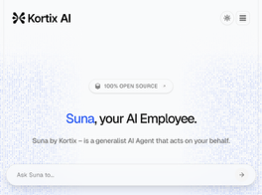
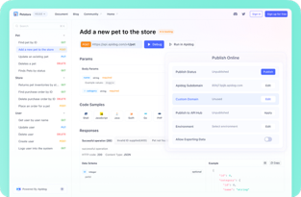
Suna open-source AI Employee
Suna an open-source AI employee
https://www.suna.so
https://github.com/kortix-ai/suna
https://huggingface.co/blog/lynn-mikami/suno-ai
AI agent that is competing directly with Manus AI. Suna was developed by Kortix AI (Lisbon, Portugal), is designed to perform real-world tasks with a level of autonomy that mimics human behavior.
Founded by Marko Kraemer two years ago (when he was 18 y.old)
Very popular - 280,000 views on X, 11K+ stars on GitHub
Suna can reason, plan, and take action across various domains. Suna can interact with virtual systems, write files, execute code, browse the internet, just like Manus AI.
Suna can handle complex tasks, for example, enhancing B2B lead spreadsheets by gathering data from LinkedIn, or conducting research on financial topics like stock performance and market analysis. These tasks are carried out through an AI interface that plans and executes steps in a methodical sequence, ensuring an efficient completion of tasks without manual intervention.
Suna still requires human assistance - especially when navigating unfamiliar challenges.
Kortix AI offers Suna both as a self-hosted solution and a cloud-hosted service, priced at $29 per month for professionals and $199 for small teams, with the higher-tier plan offering 40 hours of AI usage.

Slide 12

Jeremy Howard Answer.AI
Jeremy Howard, co-founder of Answer AI, on Building 5,000 AI products with 14 People - https://www.youtube.com/watch?v=MbHL0uvKYbE
His team uses Qwen and Deepseek. Answer AI is modeled after Edison's Menlo Park laboratory, focusing on both research and development, trying to create numerous commercially successful products with a tiny team
A core innovation at Answer AI is "dialogue engineering" - a process where humans and AI work together in continuous dialogue. Their platform "Solve It" - humans can recalibrate in real time, correct for hallucinations, grounding, retrieval capabilities, and collaborative text editing features
Purely autonomous AI agents like Devin can not be trusted
Answer AI is VC-backed but has a public benefit mission "to create as much societal benefit from AI as possible."
Howard intends to keep the company small at 12-14 people, focusing on scaling through better technology rather than headcount. He hopes to have about 50 products in use by then, creating more end-user products rather than just developer tools.
https://www.fast.ai - education
https://answerai.pro , https://answer.ai - 14 people startup
https://www.fastht.ml - FastHTML

Slide 13


Cline AI Coding Assistant
Cline AI Coding Assistant
Cline = CLI aNd Editor
https://cline.bot
https://github.com/cline/cline - 43K+ stars
Cline (formerly known as "Claude Dev") is an open-source (Apache 2.0) VSCode extension - AI coding assistant
Cline can use various models (Claude, GPT, GEmini, ...). It is free, customizable and extensible. You pay only for models' API use.
Cline reads your project files, understands your code structure, and incorporates relevant context for more accurate suggestions
You can chat with the AI, generate code, edit files, and even run commands - all without leaving your editor. Cline can create, modify, or revert files as needed. Can execute terminal commands, run tests, interact with browsers
Two modes: Plan and Act. You can instruct Cline in natural language (e.g., "Create a Python calculator"), and it will plan the steps, generate code, and propose changes for your approval. Cline also explains its reasoning.
Claude Dev was first released in June 2024 as part of Anthropic’s "Build with Claude" hackathon, . It was developed by Saoud Rizwan
It originally worked only with Claude. In October 2024 it was renamed to "Cline" with the release of version 2.0 when support for other models was added
Cline project is backed-up by a small San Francisco-based private company called Cline (just few people).
Saoud Rizwan - Founder of Cline
https://www.linkedin.com/in/saoud-rizwan/
AI coding assistants:
GitHub Copilot - deeply integrated with VS Code and has a massive user base due to its backing by GitHub and OpenAI
Tabnine - 5M+ installs
IntelliCode - 27M+ installs, Microsoft’s own AI-powered code completion tool built into Visual Studio and available for VS Code
Codeium (now Windsurf Plugin)
Amazon CodeWhisperer - also integrated into VS Code
Cursor - https://www.cursor.com
Windsurf - https://windsurf.com/editor
Trae - https://www.trae.ai

Slide 14
Which Local Coding Model to Use
DeepSeek-V3-0324 1393
Qwen3-235B-A22B 1371
Gemma-3-27B-it 1313
(Claude Sonnet 3.7 1,300)
Llama-3.3-Nemotron-Super-49B-v1 1299
Llama-4-Maverick-17B-128E-Instruct 1288 (245B)
Qwen2.5-Coder-32B-Instruct 1261
Qwen2.5-32B
Apriel Nemotron 15B
OpenCodeReasoning-Nemotron-32B
Mistral-Small-24B-Instruct-2501 1231
Microsoft Phi-4 reasoning 14B params 1221
OpenHands LLM 32B 128K context (built on top of Qwen Coder 2.5 Instruct 32B)
Nvidia Nemotron Ultra
VS Code extensions tried:
Cody ~640K downloads
Continue: open-source ~ 1.1M downloads - , no ollama?
CodePilot AI Assistant: open-source, 87 downloads
AI Toolkit (Microsoft): ~117K downloads
Wingman-AI: open-source, 3.7K downloads, supports only few models
Other (not local focused, require careful setup):
vscode-ollama (kohlivarun5)
CodeGPT
Cline / Roo Code

Slide 15

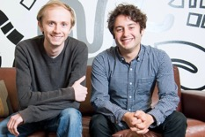
Figma
Figma uses AI to enhance prototyping:
Automatic Interactive Prototyping (instead of manual)
The "Make Prototype" feature lets you select up to 10 screens and have AI automatically create basic navigation connections between them. You can then review and refine these connections as needed.
First Draft Feature - transform ideas into editable wireframes or designs in minutes
Figma Make - users enter prompts to create and change a web application prototype. Developers can also directly modify the code to make necessary changes.
Automating tasks (like naming layers, generate dummy text, etc), generating content variations while maintaining design consistency, transition to different languages, tone adjustment, and length modification.
Figma Sites - design, build, and publish responsive websites directly from Figma - https://www.figma.com/blog/introducing-figma-sites/
Evan Wallace & Dylan Field
Figma is a collaborative web application for interface design
Web app, desktop apps for macOS and Windows, mobile apps
Uses vector graphics and prototyping tools
https://en.wikipedia.org/wiki/Figma
Figma was started by Dylan Field and Evan Wallace in 2012 when they were studying computer science at Brown University.
2016 - first public release
2018 - annular revenue $4M
2023 - Adobe considered buying Figma for $20 Bln
2024 - $700 Mln ARR (Annual Recurrent Revenue)
2025 - $12.5 Bln estimated valuation, started IPO filings
Figma is free for unlimited prototyping using basic tools.
$12/mo/editor "Pro" plan gives advanced and teams features
Enterprise pricing may go as high as $90/mo/editor
Other Prototyping tools:
Sketch - https://www.sketch.com
Axure - https://www.axure.com
Marvel - https://marvelapp.com
Canva - https://www.canva.com

Slide 16
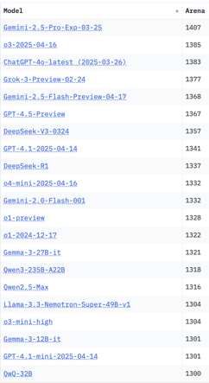
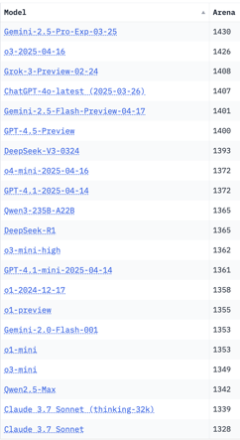
Crowd-sourced "LM Arena" Leaderboard
Starting Elo rating = 1000
95% CI = Confidence Interval
https://en.wikipedia.org/wiki/Elo_rating_system
Total #models: 233
Total #votes: 2,909,287
Last updated: 2025-05-04
https://chat.lmsys.org/?leaderboard
https://lmarena.ai/?leaderboard
https://openlm.ai/chatbot-arena/
https://beta.lmarena.ai
English-only queries
Coding
Gemini-2.5-Pro-Exp-03.25 on 1st place
Qwen3-235B on 10..15 place
Llama-4-Maverick is still on 40th place
x.ai
x.ai
Web Leaderboard https://web.lmarena.ai/leaderboard
LLM Leaderboard - by @LlmStats https://llmworld.net/llm_leaderboards/
LLM Leaderboard - by StackAI https://www.stack-ai.com/llm-leaderboard
LLM Leaderboard - by Artificial Analysis https://artificialanalysis.ai/leaderboards/models
Open LLM Leaderboard - by Hugging Face https://huggingface.co/open-llm-leaderboard
LLM Leaderboard - by Vellum https://www.vellum.ai/llm-leaderboard
Multiple Leaderboards: https://virtualizationreview.com/articles/2025/04/29/ais-heavy-hitters-best-models-for-every-task.aspx
China
China
China
China
China
China
China
China
China

Slide 17
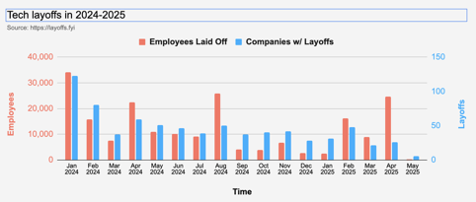
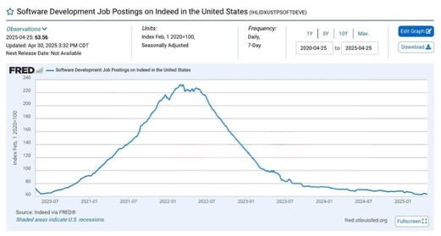
Jobs
Layoffs in 2025: as of 5/7/2025:
52,340 tech employees laid off
123 tech companies w/ layoffs
2024: more than 150,000 tech job cuts
across 549 companies
https://layoffs.fyi

Slide 18


About the Speaker
Lev Selector, Ph.D.
40+ years of software engineering, data science, and building teams (hiring, training, and managing)
Ph.D. in mathematical modeling and computer simulations
Interests:
Generative AI, Using LLM with your data
Local AI for Local Private Data
Cloud architecture, fin-tech, application security
Find/connect: Linkedin, GitHub, YouTube, Google
https://eais.ai
Enterprise AI Systems

Slide 19
Thank You!

