Slide 1




AI Updates
November 01, 2024
GitHub Copilot offers multiple models
GitHub Spark prompt-to-code (in preview)
Grok - finally has vision
Claude can write and execute code (analysis tool)
Perplexity macOS desktop app - really good
Llama 3.2 1b & 3b models are 8bit quantized
Cerebras inference Llama3-70b at 2,100 tok/sec
TSMC in Arizona has outpaced Taiwan
Waymo self-driving cars has raised $5.6 Bln
Red Panda image generation model
Google Project Jarvis - agent inside Chrome
Stable Diffusion 3.5 medium is released
Genmo's Mochi 1 open-source video generation
Meta’s Llama-4 expected early 2025
Meta's own real time search engine
OpenAI started its own search engine
Meta's MovieGen AI - videos with sound
Elon Musk xAI is raising funds at $40 Bln valuation
xAI - 100K GPU xAI Colossus Cluster
Google Shopping - will use AI
Trend: Agents replacing chatbots
Ameca "Cyber Date" - humanoid robots
OpenAI's Canvas
Microsoft Co-pilot Updates
Google Gemini 2.0 in December ?
OpenAI o1 model demo in London
Boston Dynamics Atlas robot works autonomously
Apple M4 Chip and Apple Intelligence
Linux Patch, Prohibition on certain IT information
National Security Memorandum on AI
AI Halloween
Text to Video, NotebookLlama, Revid.AI
AI will not replace human coaches and therapists
Crowd-sourced "Arena" Leaderboard - English
Crowd-sourced "Arena" Leaderboard - Coding
Tech Layoffs in 2024

Slide 2



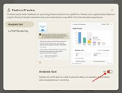







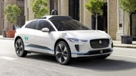


AI News - 1
GitHub Copilot - now offers selection of models (including Claude 3.5, Sonnet, Gemini 1.5 Pro, and even o1 preview).
GitHub Spark - prompt-to-code (in preview)
Grok - finally has vision - understand images/memes
Claude can now write and execute code (analysis tool) - https://www.anthropic.com/news/analysis-tool
Perplexity desktop app macOS - really good.
Anthropic, OpenAI, Google Gemini also have desktop apps
Llama 3.2 1b & 3b models are 8bit quantized - much faster inference, low compute/memory requirements
Cerebras inference x3 faster (Llama3-70b at 2,100 tok/sec)
TSMC (Taiwan Semiconductor Manufacturing Company) in Arizona has outpaced production in Taiwan.
Waymo (self-driving cars) has raised $5.6 Bln
Red Panda image generation model - beats all other models
https://www.tomsguide.com/ai/mysterious-new-red-panda-ai-image-generator-appears-out-of-nowhere-is-this-a-new-dall-e
https://artificialanalysis.ai/text-to-image/arena?tab=Leaderboard
Project Jarvis - Google agent inside Chrome browser (in dev, using Gemini 2.0, large context window, can work across multiple web pages)
Stable Diffusion 3.5 medium is released

Slide 3
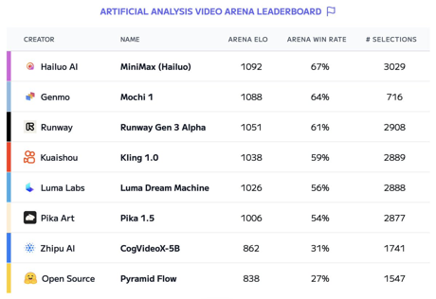


AI News - 2
Meta’s Llama-4 AI Models Are Training on a GPU Cluster bigger than 100,000 H100s ("Bigger Than Anything Else"). An initial launch expected early next year.
Meta is working on improving Llama's reasoning abilities.
Meta is developing their own search engine to add real time search result data to their LLM chatbot (and reduce dependency on Google and Bing). This will work in Facebook, Instagram, WhatsApp, ... So Meta's AI search will be providing real-time answers about current events, markets, ...
Meta's MovieGen AI - generate videos with sound - 1080p, 16 frames/sec - https://ai.meta.com/research/movie-gen/
Genmo's Mochi 1 - new open-source video generation model takes second place on the Artificial Analysis video leaderboard .. https://artificialanalysis.ai/leaderboards/models .. https://artificialanalysis.ai/text-to-video/arena
OpenAI ChatGPT can now search the web in a much better way than before. You can get fast, timely answers with links to relevant web sources, which you would have previously needed to go to a search engine for. https://openai.com/index/introducing-chatgpt-search/
xAI - in talks to raise funds at a $40 Bln valuation.
xAI - 100K GPU xAI Colossus Cluster
Google Shopping - will use AI
Trend: Agents replacing chatbots

Slide 4
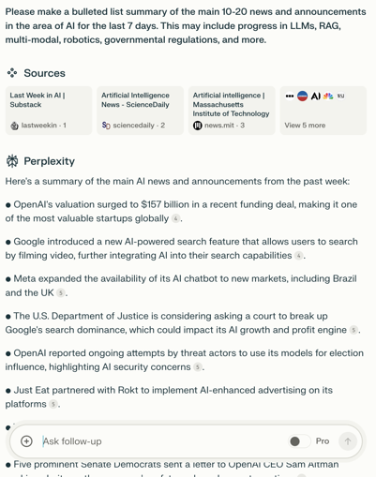

AI chats - getting real time news
Google Gemini - knows what Google knows
Meta AI chats - adding real-time AI search to provide real-time answers about current events, markets, ...
OpenAI ChatGPT Search - (only GPT-4o model) - fast, timely answers with links to relevant web sources (Plus and Teams)
Perplexity AI - provides "fast, timely answers with links to relevant web sources" for topics like current news, sports scores, stock quotes, and more, partnered with various news and data providers, including The Associated Press, Reuters, Financial Times, and others, to provide up-to-date information. You need to activate "Pro" mode though.
Microsoft - "Stay updated with contextual news within Copilot chat" for Dynamics 365 Sales
Anthropic Claude - still doesn't have it, but you can access it via Perplexity Pro

Slide 5
Example: Perplexity News Search
Prompt:
Please make a bulleted list summary of the main 10-20 news and announcements in the area of AI for the last 30 days (mostly after October 1, 2024) which may be of interest and relevance for a CEO or CRO (Chief Risk Officer) of a CTO (Chief Technology Officer), AI and ML managers and developers of an US based large company. The news may include progress in LLMs, RAG, multi-modal, robotics, governmental regulations, and more.
Please provide links to the sources where possible
List from the output
• Chipotle introduced an AI recruiter named "Ava Cado" to reduce hiring time by 75%.
• Meta is developing its own AI-powered search engine to decrease reliance on Google and Microsoft.
• Anthropic released Claude 3.5 Sonnet, available on Amazon Bedrock, improved coding capabilities.
• Anthropic launched a public beta for Claude 3.5 Sonnet with a new "computer use" capability, allowing the AI to control a computer.
• Meta's Ray-Ban smart glasses have become top-selling products in many Ray-Ban stores across Europe, the Middle East, and Africa.
• Meta is implementing facial recognition technology to combat celebrity investment scam ads, starting with a trial involving 50,000 public figures.
• NVIDIA announced contributions of its GB200 NVL72 rack and compute and switch tray liquid cooled designs to the Open Compute Project.
• DataStax announced a new AI development platform built with NVIDIA AI.
• UCLA researchers developed an AI model for expert analysis of 3D medical images.
• NVIDIA released Modulus v24.09 with utilities for physics-informed training and validation.
• Advancements in reality capture workflows using AI and NVIDIA RTX GPUs were announced1.
• NVIDIA introduced NV-CLIP, a multimodal embeddings model for image and text.
• NVIDIA CUDA-X now accelerates the Polars data processing library1.
• NVIDIA released improvements to NeMo Curator for accelerating data curation (support for images).
• NVIDIA announced its first on-device small LM for improving game character conversations.

Slide 6
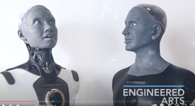
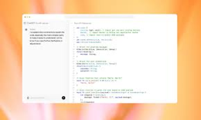


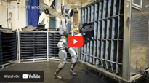
AI News - 3
Ameca "Cyber Date" - two humanoid robots communicating with each other .. https://www.youtube.com/watch?v=HFEOg352zgk .. https://www.youtube.com/@EngineeredArtsLtd
OpenAI's Canvas - collaborative workspace for tex, code, ...
Microsoft Co-pilot Updates: Co-pilot Daily (news), Co-pilot Plus PCs (Recall, Click to, ...)
Google Gemini 2.0 in December? It may have "test time compute" to enhance reasoning. Multimodal (audio, video, and images), Long context window, Overall improvements.
Google's reasoning model - project led by Noam Shazeer
OpenAI o1 model demo at the OpenAI Dev Day in London
building a full-stack application to control a drone
using voice to help someone plan a trip and order food
providing interactive educational experiences (answering questions, generating visualizations)
https://www.youtube.com/watch?v=UsuyDInIsF8
Boston Dynamics Atlas robot works autonomously. In latest video demo it sorts plastic engine covers between containers. The robot may be used in car manufacturing (because Boston Dynamics is currently 80% owned by the Hyundai Motor Group).

Slide 7
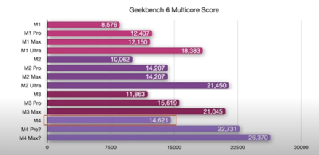
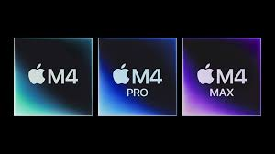


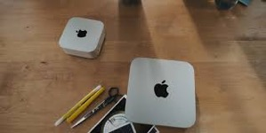

Apple M4 Chip
October 28,29,30 - M4 announcements from Apple
(shipping starts November 8th):
M4 iMac 24" - up to 32GB RAM
M4 Mac mini - up to 64GB RAM
M4 MacBook Pro & Max 14" & 16"
- up to 128GB RAM
M4 is ~20% faster, a bit longer battery life
Apple Intelligence (iOS 18.1) - has some cool features like notification rollups and describing albums in Apple Photos, but overall it's not very impressive.

Slide 8
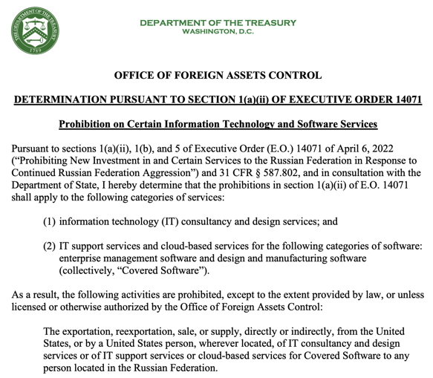
Linux Patch
In October 2024, a patch was merged into the Linux kernel removing many maintainers with Russian email addresses, citing "compliance requirements."
Linus Torvalds, the creator of Linux, defended the patch, stating it was due to US sanctions against Russia
James Bottomley, a prominent Linux kernel developer, clarified that anyone on the US sanctions list cannot be a maintainer.
https://ofac.treasury.gov/media/932951/download?inline
https://www.youtube.com/watch?v=u4PMwpMGTdY
ABBYY, US AI text recognition software company, has fired all Russian employees (including in their offices in Hungary, Serbia, and Cyprus). Probably because their clients are large American companies, and the company works with their documents. ABBY was founded in 1989 by an MFTI graduate, left Russia in 2022
https://en.wikipedia.org/wiki/ABBYY

Slide 9
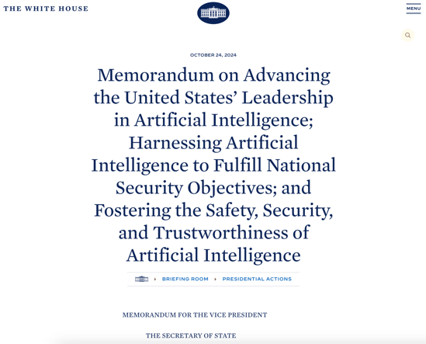
National Security Memorandum on AI
This memorandum outlines the governance of AI in national security systems, emphasizing responsible development and use while addressing oversight and transparency requirements.
Released October 24, approx 57 pages
https://www.whitehouse.gov/briefing-room/presidential-actions/2024/10/24/memorandum-on-advancing-the-united-states-leadership-in-artificial-intelligence-harnessing-artificial-intelligence-to-fulfill-national-security-objectives-and-fostering-the-safety-security/

Slide 10
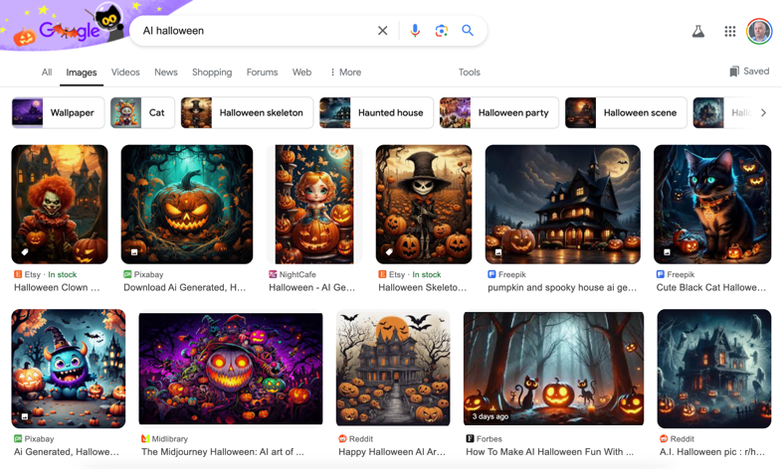
AI Halloween

Slide 11
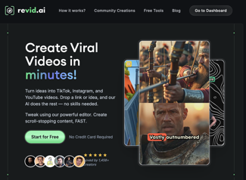
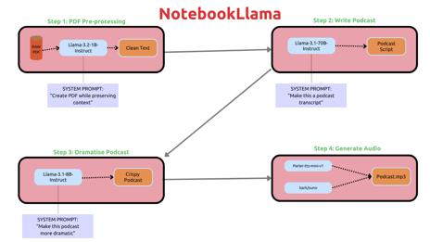
Text to Video
Convert audio to video:
https://www.revid.ai
https://www.descript.com
https://www.kapwing.com/video-editor
https://notebooklm.google.com/
https://www.youtube.com/watch?v=oSuXs0w1PPY
Google's Notebook LM has a podcast feature, the ability to customize podcasts and a business edition.
Upload the documents or provide a web link
select "Generate" option under "Audio overview."
"File" menu, select "Export audio" ...
NotebookLlama - An Open Version of Google’s NotebookLM from Meta
https://github.com/meta-llama/llama-recipes/tree/main/recipes/quickstart/NotebookLlama

Slide 12

AI will not replace human coaches and therapists
Emiliya Zhivotovskaya, CEO of the Flourishing Center, argues that AI and AGI will not replace human practitioners in fields like positive psychology, coaching, and therapy.
AI, like a parrot, mimics human language based on the data it's trained on but lacks true understanding, empathy, and consciousness.
AGI (Artificial General Intelligence) is still far off. While AI excels in narrow tasks, achieving human-level general intelligence in machines is a long way away.
Five reasons why human practitioners won't be replaced:**
Belief - AI can't genuinely believe in you or your potential the way a human can.
Storytelling - AI can't share authentic personal stories that connect with people on a human level.
Experiences - AI can't create real-life, engaging experiences that foster learning and growth.
Energy Exchange - AI can't replicate the energy exchange and intuition present in human interactions.
Reciprocal Relationships - AI can't form genuine, two-way relationships that contribute to well-being.
Emiliya Zhivotovskaya
https://theflourishingcenter.com

Slide 13
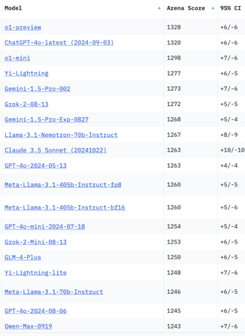
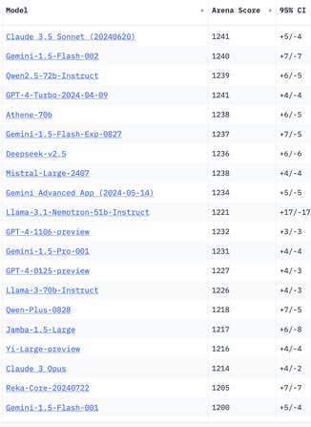
Crowd-sourced "Arena" Leaderboard
Total #models: 159.
Total #votes: 2,141,583.
Last updated: 2024-10-27.
Starting Elo rating = 1000
95% CI = Confidence Interval
https://chat.lmsys.org/?leaderboard
English-only queries
China
x.ai
x.ai
China
China
China

Slide 14
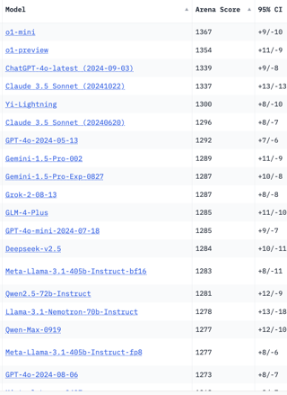
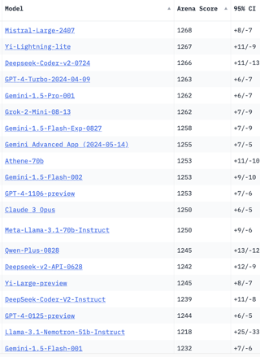
Crowd-sourced "Arena" Leaderboard
Total #models: 159.
Total #votes: 2,141,583.
Last updated: 2024-10-27.
Starting Elo rating = 1000
95% CI = Confidence Interval
https://chat.lmsys.org/?leaderboard
Coding
China
China
x.ai
x.ai
China
China
China
China

Slide 15
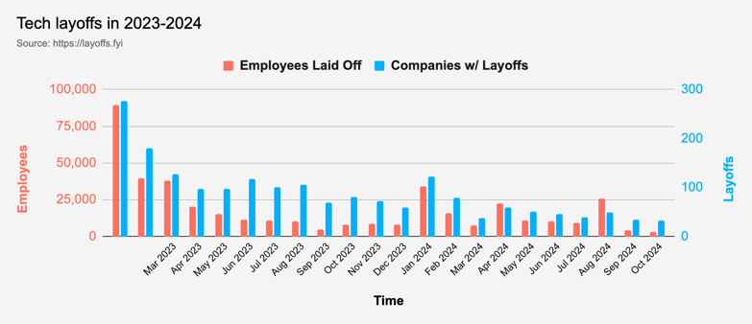
Tech Layoffs in 2024
Layoffs - https://layoffs.fyi
Job market for IT: much worse than before COVID.
IT has become a commodity. Lower salaries/rates ($100/hr => $75/hr).
Much more competition, hundreds of applications for each position

Slide 16
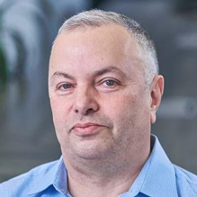

About the Speaker
Lev Selector, Ph.D.
40+ years of software engineering, data science, and building teams (hiring, training, and managing)
Ph.D. in mathematical modeling and computer simulations
Interests:
Generative AI, Using LLM with your data
Local AI for Local Private Data
Cloud architecture, fin-tech, application security
Find/connect: Linkedin, GitHub, YouTube, Google
https://eais.ai
Enterprise AI Systems

Slide 17
Thank You!

