Slide 1
AI Updates
June 6, 2025
Crowd-sourced "Arena" Leaderboard
New Gemini 2.5 PRO Preview - June 5
Phonely talk AI - no delays, 99.2% accuracy
Meeker Report
Perplexity Pro: Search, Research, Labs
Microsoft Bing Video Creator Powered by Sora
Yoshua Bengio LawZero research center
Manus Making Slides
H Company Agentic Systems
No Robo Bosses Act
Klarna is hiring back human customer support
PageIndex in Reasoning RAG
Can LLMs Generate Novel Research Ideas?
Ollama "Thinking"
Get Better Answers from LLM
Microsoft WINA - cost savings
AgenticSeek, Chatterbox, Flux Kontext Pro
Decision Flow
Coding with AI - Rules and PRDs
PageIndex in Reasoning RAG
AI video Summarization
Apple Vision Air
Robot - High Speed Parkour Navigation
Sakana self-improving coding agent
Andrej Karpathy about Veo 3
AI Generated YouTube Videos
AI writes paper which passes peer review
Cerebras beats Nvidia at Inference Speed
Anthropic hits $3 billion in ARR
AI-powered roll-ups
Ollama Thinking
OpenAI Jony Ive Device as predicted by AI
How to Negotiate Tech Contracts
Jobs, Layoffs

Slide 2
Crowd-sourced "LM Arena" Leaderboard
Starting Elo rating = 1000
https://en.wikipedia.org/wiki/Elo_rating_system
Text - June 5
Webdev - June 5
LM Arena secures $100M to expand AI benchmarking (at $600M valuation)
Model | Score
gemini-2.5-pro-preview-06-05 | 1470
gemini-2.5-pro-preview-05-06 | 1446
o3-2025-04-16 | 1443
chatgpt-4o-latest-20250326 | 1431
gpt-4.5-preview-2025-02-27 | 1425
gemini-2.5-flash-preview-05-20 | 1419
claude-opus-4-20250514 | 1414
gpt-4.1-2025-04-14 | 1402
gemini-2.5-flash-preview-04-17 | 1400
grok-3-preview-02-24 | 1399
claude-sonnet-4-20250514 | 1390
o4-mini-2025-04-16 | 1390
deepseek-v3-0324 | 1388
o1-2024-12-17 | 1388
deepseek-r1 | 1384
o1-preview | 1372
mistral-medium-2505 | 1369
claude-3-7-sonnet-20250219 | 1365
gpt-4.1-mini-2025-04-14 | 1365
Model | Score
Gemini-2.5-Pro-Preview-06-05 | 1443
Claude Opus 4 (20250514) | 1412
Gemini-2.5-Pro-Preview-05-06 | 1408
Claude Sonnet 4 (20250514) | 1389
Claude 3.7 Sonnet (20250219) | 1357
Gemini-2.5-Flash-Preview-05-20 | 1312
GPT-4.1-2025-04-14 | 1256
Claude 3.5 Sonnet (20241022) | 1238
DeepSeek-V3-0324 | 1207
DeepSeek-R1 | 1198
o3-2025-04-16 | 1188
GPT-4.1-mini-2025-04-14 | 1187
Qwen3-235B-A22B | 1183
Mistral Medium 3 | 1167
Gemini-2.5-Flash-Preview-04-17 | 1144
o3-mini-high (20250131) | 1136
Claude 3.5 Haiku (20241022) | 1133
o4-mini-2025-04-16 | 1100
o3-mini (20250131) | 1092
https://lmarena.ai/?leaderboard
https://openlm.ai/chatbot-arena/
https://beta.lmarena.ai
https://legacy.lmarena.ai
Web Leaderboard https://web.lmarena.ai/leaderboard
LLM Leaderboard - by @LlmStats https://llmworld.net/llm_leaderboards/
LLM Leaderboard - by StackAI https://www.stack-ai.com/llm-leaderboard
LLM Leaderboard - by Artificial Analysis https://artificialanalysis.ai/leaderboards/models
Open LLM Leaderboard - by Hugging Face https://huggingface.co/open-llm-leaderboard
LLM Leaderboard - by Vellum https://www.vellum.ai/llm-leaderboard
China
x.ai
China
China
China
M
China
M

Slide 3
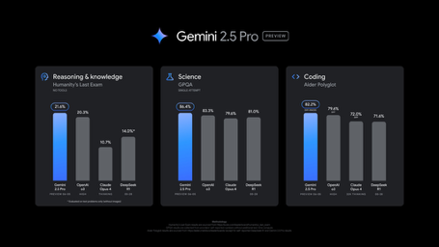
New Gemini 2.5 PRO Preview - June 5
Gemini 2.5 PRO Preview June 5
https://www.youtube.com/watch?v=tYl6zw79CBc
24-35 ELO score increase (leaderboard lead at 1470)
Excels at coding benchmarks
Improved response style, structure, and creativity, with better formatting in outputs
A new "thinking budget" feature
Pricing remains competitive: $1.25 for input and $10 for output
Solving the elevator puzzle:
Gemini 2.5 Pro - solved in 7 button presses
O4 Mini - solved in 6 button presses !!
Claude Opus 4 - required 8-9 button presses
Free ChatGPT - found a 6-press solution
o4 Mini and ChatGPT executed python code under the hood using breadth-first search (BFS) algorithms. They converted the linguistic puzzle into a mathematical optimization problem
So the most effective approach isn't necessarily pure language-based reasoning, but rather intelligent tool integration
https://www.youtube.com/watch?v=xsyQHWR3QIM

Slide 4



Phonely 99.2% accuracy
Phonely conversational AI - 99.2% accuracy, no delays
A three-way partnership between - Phonely - an AI phone support https://www.phonely.ai - Maitai - inference optimization https://trymaitai.ai - Groq - chip maker https://groq.com
no awkward delays - response times reduced by more than 70%
accuracy increased from 81.5% to 99.2% (surpassing GPT-4o’s 94.7% benchmark by 4.5 percentage points)
The improvements stem from Groq’s new capability to instantly switch between multiple specialized AI models without added latency, orchestrated through Maitai’s optimization platform.
https://venturebeat.com/ai/phonelys-new-ai-agents-hit-99-accuracy-and-customers-cant-tell-theyre-not-human/

Slide 5
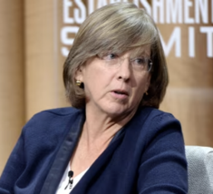
Meeker Report
AI inference costs have dipped 99.7% in last 2 years
Trends – Artificial Intelligence (AI), May 30, 2025
340 slides' report
Mary Meeker / Jay Simons / Daegwon Chae / Alexander Krey
https://www.bondcap.com/reports/tai
Things are accelerating exponentially
AI grows much faster than Internet or any other product or service
AI is used to predicts future (people trust AI)
Turing Test - passed
AI good with video, images, ...
Different models are better at different skills, AI vs Google
New expensive services ($20/mo, $200/mo, $2,000/mo)
Physical world AI (robo-taxi)
Mary Meeker

Slide 6
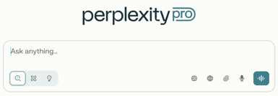
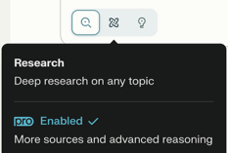
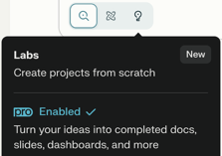
Perplexity Pro: Search, Research, Labs
In Perplexity Pro you can choose between 3 modes: Search, Research, Labs
Search, Research, Labs

Slide 7


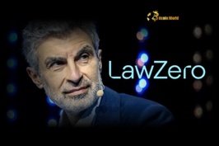
AI Updates 1
Microsoft Bing Video Creator Powered by Sora
Can generate 5-second videos
Users get 10 fast video generations and unlimited slower ones
The feature launches on Bing’s iOS and Android mobile apps, with desktop and Copilot Search releases coming soon.
https://www.youtube.com/watch?v=PoxWxMjA224
Apple Vision Air
https://www.cultofmac.com/news/apple-smart-glasses-iphone-replacement
Yoshua Bengio LawZero research center
AI Safety Non-profit with $30M in Funding
the Zeroth Law of Robotics: protection of humanity above all else.
Mission is building “honest” AI systems to detect and block harmful actions from autonomous agents.
Its first project, Scientist AI, gauges the risk of deception or danger before agents act.
https://techcrunch.com/2025/06/03/yoshua-bengio-launches-lawzero-a-nonprofit-ai-safety-lab
Robot - High Speed Parkour Navigation
https://www.youtube.com/watch?v=645Wk4tKtLQ

Slide 8
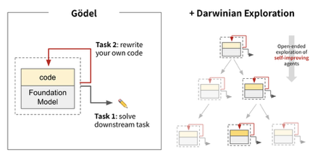

AI Updates 2
sakana.ai - self-improving coding agent, open-source
https://sakana.ai/dgm/
Researchers from Sakana AI (Japan) and the University of British Columbia just introduced the Darwin Gödel Machine (DGM) - an AI agent that rewrites its own code to get better at tasks, achieving up to 150% performance improvements without intervention.
It discovers improvements like editing tools, error memory, and peer review capabilities. It jumped from 20% to 50% on SWE-bench and 14% to over 30% on Polyglot.
Inspired by Darwinian evolution, DGM tries out changes to its code, keeps what works, and archives promising "mutations" for future improvements. It works with different underlying models
Andrej Karpathy about Veo 3
Perspectives of AI video generation tools like Veo 3
High bandwidth, universal appeal, becomes easy, direct optimization capability
Videos can be directly optimized using gradient descent for any objective. This means videos can be generated infinitely and optimized in real-time for specific goals like engagement, ad conversions, or other metrics. Instead of indexing a finite set of human-created videos, platforms could generate and optimize content on-demand
https://x.com/karpathy/status/1929634696474120576

Slide 9
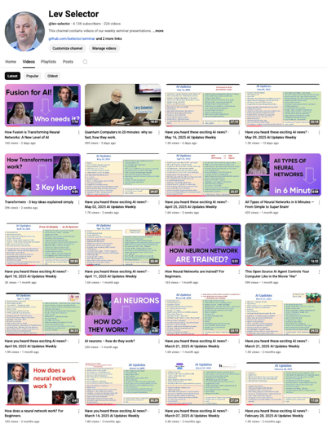
Subscribe to get notified
about new videos
https://www.youtube.com/@lev-selector
We post a video every Friday
It is usually 25-30 min long
Links to slides are under the videos

Slide 10
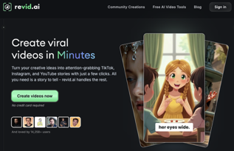

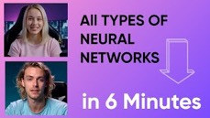
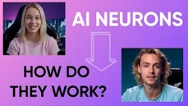
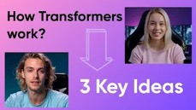
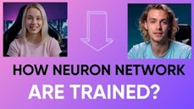
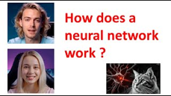
AI Generated YouTube Videos
We make 3 video per month
First we select a topic.
Then go back-and-forth with ChatGPT to write dialog
Then use revid.ai ( https://www.revid.ai ) paid service to generate videos

Slide 11



AI Updates 3
AI writes paper which passes peer review
https://www.intology.ai/blog/zochi-acl
Zochi completed the entire research process and wrote the paper
Zochi is an Intology’s Artificial Scientist
It got a 4.0 meta-review score (top 8.2% of all ACL submissions)
https://arxiv.org/pdf/2503.10619 - paper
Intology is based in San Francisco
Cerebras beats Nvidia at Inference Speed
Cerebras - 2.5 Ktokens for 400B Llama 4 Maverick
Nvidia DGX B200 with 8 Blackwell GPUs - 1 Ktokens
This is the world record
https://analyticsindiamag.com/ai-news-updates/we-smoked-nvidias-blackwell-says-cerebras/
Anthropic hits $3 billion in ARR
Grown from $1 billion in just 5 months
https://finance.yahoo.com/news/exclusive-anthropic-hits-3-billion-200202733.html
AI-powered roll-ups
Buy established companies, improve them with AI, then use the profits to buy again (similar to flipping houses)
https://techcrunch.com/2025/06/01/early-ai-investor-elad-gil-finds-his-next-big-bet-ai-powered-rollups
Ollama Thinking
a toggle to enable or disable step-by-step reasoning for DeepSeek R1 and Qwen 3.
https://ollama.com/blog/thinking

Slide 12


AI Updates 4
Manus Slides
Manus creates structured presentations (slide decks) from prompts
https://x.com/ManusAI_HQ/status/1928105652444094568
H Company
H Company was founded in late 2023 in Paris, also in London
Founders - former DeepMind scientists and a Stanford researcher
Advanced "multi-agent" solutions to automate complex digital workflows; plan, execute tasks, and solve problems autonomously
Runner H and Surfer H - business process automation, quality assurance, robotic process automation, and web-based task execution
https://www.hcompany.ai
No Robo Bosses Act
California introduced several significant AI and employment law bills (e.g., “No Robo Bosses Act,” Automated Decisions Safety Act, and workplace surveillance limits)
Klarna re-hiring humans
Klarna Bank (Swedish buy-now-pay-later company) has cut 50% of workforce (from 4.2K to 2K). It stopped using Salesforce and HR "Workday" in favor of its own in-house AI solutions
But recently Klarna is planning to hire humans (mostly students and rural areas) to ensure customers will always have the option to speak to a live representative.

Slide 13

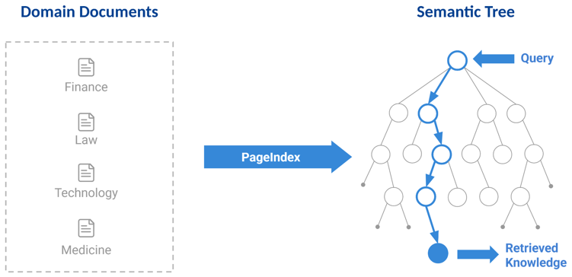
PageIndex in Reasoning RAG
PageIndex instead of RAG
PageIndex - document indexing that builds search tree structures from long documents, to be used by reasoning-based RAG achieving 98.7% accuracy
https://github.com/VectifyAI/PageIndex
https://vectify.ai - Reasoning-Based RAG

Slide 14
AI Updates 5
Can LLMs Generate Novel Research Ideas?
https://arxiv.org/pdf/2409.04109
Compare Ai with humans:
AI ideas scored significantly higher in Novelty (5.64 vs. 4.84), but needed human evaluation and reranking. LLM tend to be repetitive and can not Self-Evaluate.
Ollama "Thinking"
https://www.youtube.com/watch?v=yBD598s5g8c
Separates AI reasoning from output
API: Set "think": true in request body
CLI: Use /set think to enable
Works with models like Qwen2.5-14B
Compatible with streaming and non-streaming responses
Get Better Answers from LLM
1. Ask for Clarifying Questions - add this to your prompt: "Ask me clarifying questions until you're 95% confident you can complete the task successfully."
2. Ask to think Like a Top Expert - add this to your prompt: "What would a top 0.1% person in this field think?"
3. Challenge Your Perspective - add this to your prompt: "Reframe this in a way that challenges how I see the problem."
https://www.youtube.com/watch?v=foLPJRmXBkU

Slide 15
AI Updates 6
Open Source AI beats commercial offerings
https://www.youtube.com/watch?v=wI4ZtpniRVM
AgenticSeek - open-source, local version of Manus AI that runs autonomous web tasks on your computer using Docker
Chatterbox by Resemble AI - An open-source text-to-speech and voice cloning model that runs locally. Claims to rival ElevenLabs quality while generating high-quality audio in seconds
Flux Kontext Pro - Black Forest Labs' new AI image generator offering 86% cost savings over OpenAI's image generation ($0.04 vs $0.25 per image). Provides similar quality to ChatGPT-4o with faster processing and better aspect ratio handling for thumbnails
Decision Flow - https://arxiv.org/pdf/2505.21397 - paper
https://www.youtube.com/watch?v=Ch_tstGzDxE
30% performance improvements in decision-making tasks.
DF is a framework that sits on top of large language models (LLMs) to improve structured reasoning for high-stakes decisions in domains like finance, healthcare, and agriculture
utility-based reasoning approach: structure decision scenario; assign numerical weights to different factors; apply constraints; calculate scores using simple linear function; chooses the option with maximum utility
DF makes single-shot decisions rather than learning over time;
Improves results in Medical, Agriculture, and Financial domains.

Slide 16
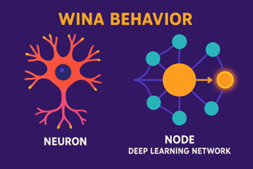
Microsoft WINA
Microsoft WINA
WINA (Weight Informed Neuron Activation) - judges each neuron's importance by multiplying its activation (how "loud" it is) by the strength of its weights (how much it influences the output)
Keeps only the neurons with the largest combined impact active for each step, letting the rest "nap."
Requires no retraining and works dynamically per input, unlike traditional pruning which permanently removes neurons and needs fine-tuning
Uses a mathematical cleanup (singular value decomposition) to align weights, ensuring low error rates even with high sparsity.
Tested on several popular LLMs (e.g., Llama 2, Llama 3)
WINA can shut off up to 65% of neurons, reducing compute needs by about two-thirds, with only minimal drops in accuracy
Outperforms previous methods
Enables substantial cost savings (up to half the GPU bill) without extra training or permanent network changes
https://arxiv.org/abs/2505.19427
https://github.com/microsoft/wina - Open source (Apache 2)

Slide 17
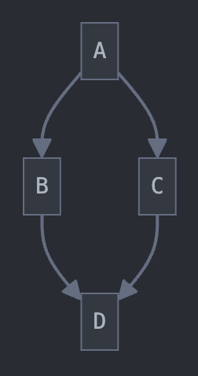
Coding with AI - Rules and PRDs
A 3-step AI coding workflow - using Cursor
https://www.youtube.com/watch?v=fD4ktSkNCw4
1. Create a PRD (Product Requirements Document) - using a custom Cursor rule that instructs AI to write PRDs suitable for junior developers. Includes clarifying questions with dot notation (2.1, 2.2) for clarity. Stores PRD as markdown in a dedicated tasks folder
2. Generate Task Lists - Another Cursor rule breaks the PRD into detailed, actionable tasks; Creates hierarchical tasks (main tasks with subtasks) in markdown format; Includes checkboxes for progress tracking
3. Execute Tasks Systematically - one subtask at a time; AI stops after each subtask and waits for user approval; Human stays in the loop to catch errors and maintain quality
Cursor MDC rules files - in ".cursor/rules/" directory in your project. They provide system-level guidance to the AI. Coding standards, architectural decisions, and project-specific best practices
Each rule is a separate file, usually written in the MDC format (".mdc"), which supports both YAML metadata and MD content
Examples: Enforcing naming conventions (e.g., always use snake_case for service names), Dictating which frameworks or libraries to use, Standardizing file/folder structures or architectural patterns, Automating project-specific workflows or templates
PRDs (Product Requirement Documents) - foundational document(s) outlining what a product or feature should do. PRDs serve as a "source of truth" for both human developers and the AI assistant
Content of PRD: intro and problem statement; solution or feature overview; user stories and feature descriptions; technical requirements and constraints; acceptance criteria; project timeline, tech stack, and user flows
Best Practices - use clear sections and headings, write concise, isolated user stories, list explicit acceptance criteria for each feature, keep the PRD accessible to the AI (within the project folder)
Additional files: tree.txt or repo_structure.yaml, README.md, ARCHITECTURE.md, etc.
Markdown (MD) files can contain Mermaid diagrams, for example: graph TD;A-->B;A-->C;B-->D;C-->D;
Task Master
https://www.youtube.com/watch?v=BvWzQ4W0QXA
AI-powered task management system - splits into small tasks
Works with multiple AI models (main, research, and fallback)
Integrates with Cursor, VS Code, Windsurf
Can be installed as an MCP server of CLI tool
Create a Product Requirements Document (PRD) for your project
Taskmaster parses the PRD and generates a structured task list
Execute tasks one by one through your preferred AI coding agent
Each subtask stays within context limits, reducing errors and token costs
Cursor v.1.0 is here (finally)
Anysphere, maker of Cursor, raised $900M at $9.9B valuation

Slide 18
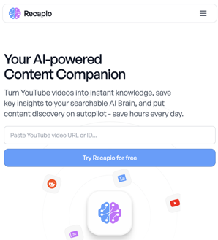
AI video Summarization
Manually copy transcript:
Check that YouTube video has a transcript,
open it, select it with mouse, copy into plain text file
Ask Claude to make a short summary of the attached text - and copy/paste the attached plain text into Claude
Perplexity can extract transcript (given a URL)
Check that YouTube video has a transcript
Copy youtube URL into Perplexity - and ask to make a short summary. Perplexity will extract transcript from youtube website - and make a summary
recapio - copy URL into recapio
https://recapio.com

Slide 19
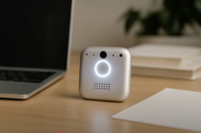


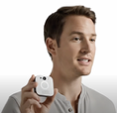
OpenAI IO Device - an prediction by AI
Video created by AI (not a real OpenAI product)
https://www.youtube.com/watch?v=rEAPBT6_-TM
Jony Ive (full name: Sir Jonathan Paul Ive) is a renowned British-American industrial designer best known for his pivotal role at Apple Inc., where he served as Senior Vice President of Industrial Design and later Chief Design Officer from 1992 to 2019. Ive was instrumental in designing some of Apple’s most iconic products, including the iMac, iPod, iPhone, iPad, MacBook, Apple Watch, and even the architectural design of Apple Park and Apple Stores.
In 2019 he left Apple and started LoveFrom, worked with Ferrari, Airbnb, and OpenAI.
Recently LoveFrom was acquired by OpenAI
AI Generated,
not real

Slide 20
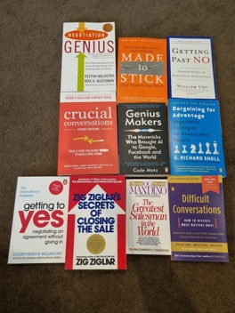
How to Negotiate Tech Contracts
Chris Dunlop - "Why clients pay me 10x more than developers who are better at coding than me"
The more technical your pitch, the more you will be delegated down the chain of command!
Start talking about databases to a CEO and they will delegate you to the CTO.
https://medium.com/realworld-ai-use-cases/why-clients-pay-me-10x-more-than-developers-who-are-better-at-coding-than-me-10bc46f6e67b
Translate problem
Give Peace of Mind
Reduce Risk
Improving Client's position
Time Recovery
You are:
The Professional Painkiller
The Communication Multiplier

Slide 21
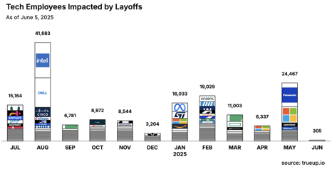
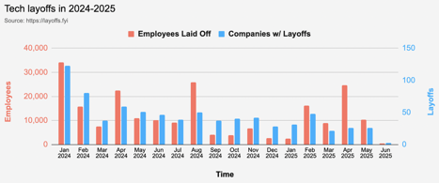
Jobs
https://layoffs.fyi
https://trueup.io/layoffs
Workers with AI skills command a 56% wage premium (up from 25% last year), suggesting the value these workers bring
https://www.pwc.com/gx/en/issues/artificial-intelligence/job-barometer/2025/report.pdf
New job postings from white-collar roles fell by 12.7% from 2024 to 2025, with demand for business analysts and developers dropping twice as fast
Anthropic’s CEO predicts that within the next 5 years, 50% of all entry-level jobs will be fully automated.
Elon’s launching Tesla self-driving cars in Austin and trucks operating autonomously on Texas highways
The only secure job is being an entrepreneur.
Curiosity and adaptability now outperform career pathing.
"Singularity Sprint" - now!
The coming years will feel chaotic, unpredictable, and downright scary at times
-- from Peter Diamandis

Slide 22


About the Speaker
Lev Selector, Ph.D.
40+ years of software engineering, data science, and building teams (hiring, training, and managing)
Ph.D. in mathematical modeling and computer simulations
Interests:
Generative AI, Using LLM with your data
Local AI for Local Private Data
Cloud architecture, fin-tech, application security
Find/connect: Linkedin, GitHub, YouTube, Google
https://eais.ai
Enterprise AI Systems

Slide 23
Thank You!

