Slide 1


AI Updates
September 13, 2024
Ph.D.
OpenAI released Strawberry o1-preview
Reflection-70B - Real or Fraud
Scrape websites using AI
LinkedIn_AIHawk - Job Search AI Assistant
AI and Robotics killing white- and blue-collar jobs
Andrej Karpathy Interview
Elon Musk "Colossus cluster" - 100K H100s
META CRAG = Comprehensive RAG Benchmark
Apple iPhone 16, 4M model
Salesforce "Industries AI" & Einstein AI Agents
Pixtral 12B - first multimodal model by Mistral
Honeycomb AI for Software Development
You.com raise 50 Mln
Groq - faster speed, multimodal
Chai Discovery Chai-1 outperforms AlphaFold3
OpenAI: $6.5 Bln funding ?
Phind-405B - for programming and tech. tasks
LLaMA-Omni - speech-text-speech
SambaNova Cloud - x10 faster than GPU
DeepSeek-V2.5 - open-source and very good
Time Magazine excluded Elon Musk from 100/AI
Anthropic Claude Artifacts
Jim Fan - fooling LLM benchmarks
Synthetic data and Model Collapse
RefChecker for Hallucinations
Alexis Conneau leaves OpenAI
DocAI - extract structured info from documents
iText2KG - python to extract entities from text
Nvidia Ecosystem
Intel AMX
Google Data Gemma RAG & RIG
Assistants
Crowd-sourced "Arena" Leaderboard - English
Crowd-sourced "Arena" Leaderboard - Coding
Glassdoor - Salaries for AI and Data Science jobs
Tech Layoffs in 2024

Slide 2
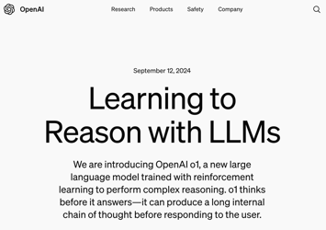

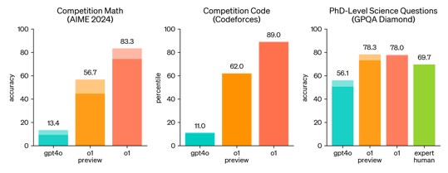
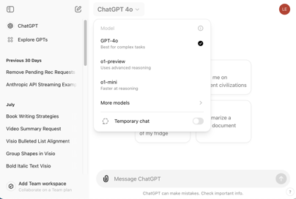
OpenAI Strawberry Model Preview
September 12 - OpenAI released two models for a limited preview (30 messages per week ?): o1 and o1-mini.
https://openai.com/index/learning-to-reason-with-llms/
https://openai.com/index/openai-o1-mini-advancing-cost-efficient-reasoning/
https://www.axios.com/2024/09/12/openai-strawberry-model-reasoning-o1
https://www.straitstimes.com/tech/tech-news/openai-launches-new-strawberry-series-of-ai-models-with-reasoning-abilities

Slide 3




OpenAI Strawberry Model Preview
Matthew Berman: GPT-o1:
The Best Model I've Ever Tested
https://www.youtube.com/watch?v=SbrfjBV8EzM
How OpenAI made o1 "think"
https://www.youtube.com/watch?v=MNE6QZaRavo
Reinforcement learning, generating helper tokens,
chain-of-thought processing, "think" before responding
o1 model is designed for handling complex, multistep problems with improved reasoning skills.
good for coding, math, science.
outperforms expert humans on PhD-level science questions
ranks in the 89th percentile for competitive programming.
solved 83% of International Mathematics Olympiad qualifying exam problems, compared to GPT-4o's 13%.
security test score: 84% vs 22% of previous generation.
Cost $15 / $60 in/out per Million tokens
This morning I have tested o1-preview and o1-mini.
One of the tests was to analyze a 87KB JSON file containing 76 news items (title, text, tags, dates, etc.. ) - and return the list of titles in the order of importance.
I was really impressed by o1-preview model.
o1-mini was not as good and can not be trusted.

Slide 4





Reflection-70B
Matt Shumer & Sahil Chaudhary have fine-tuned Llama 3.1 70B and claimed (September 5th) to achieve amazing accuracy beating top models in just 3 weeks. They used a technique similar to the one described in 2023 paper "Reflection-Tuning: Recycling Data for Better Instruction-Tuning" - basically training the model to use "step-by-step" Chain of Thought approach. This is done by tuning on synthetic data showing examples of using <thinking> and <reflection> tags to remove hallucination and perform self-correction - and fine-tuned the model on these examples.
https://openreview.net/forum?id=xaqoZZqkPU
https://venturebeat.com/ai/meet-the-new-most-powerful-open-source-ai-model-in-the-world-hyperwrites-reflection-70b/
https://huggingface.co/mattshumer/Reflection-Llama-3.1-70B
But third party evaluations have failed to reproduce Reflection 70B’s impressive results, so Shumer was accused of fraud.
https://www.greenbot.com/hyperwrite-reflection-70B/
https://www.youtube.com/watch?v=Alzjn_0ne1Y
https://venturebeat.com/ai/reflection-70b-model-maker-breaks-silence-amid-fraud-accusations/
Matt Shumer
https://x.com/mattshumer_
https://www.hyperwriteai.com
Sahil Chaudhary
https://twitter.com/csahil28
https://glaive.ai
Matt Berman videos:
35 min interview with Matt & Sahil https://www.youtube.com/watch?v=5_m-kN64Exc
How This AI Model Achieves Insane Accuracy https://www.youtube.com/watch?v=-IBAg6lMfXA

Slide 5
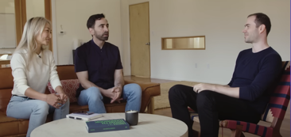
Misc 1
Elon Musk "Colossus cluster"
$6B financing, 122 days,
100K Nvidia H100 GPUs on a single network.
xAI plans to double Colossus to 200K GPUs (including 50,000 H200s) in few months.
Compare: Grok-2 was trained on just 15K GPUs
Compare with Meta: building new cluster with 100K Nvidia H100s for Llama-4 used 16K H100s to train Llama 3.1
Scrape ANY WEBSITE with Llama3.1!
https://www.youtube.com/watch?v=xrt2GViRzQo
LinkedIn_AIHawk - Job Search Assistant
automation + AI
dynamic resume generation to fit job descriptions
AI-powered personalization
streamline application submissions https://github.com/feder-cr/linkedIn_auto_jobs_applier_with_AI
META CRAG = Comprehensive RAG Benchmark from Meta
competition of RAG systems based on Llama 2 and Llama 3 models (8B & 70B). Results are not posted yet.
https://www.aicrowd.com/challenges/meta-comprehensive-rag-benchmark-kdd-cup-2024
AI already kills white-collar jobs
Robotics + AI will kill blue-collar jobs
Andrej Karpathy - interview
Tesla is not a car company, it is a Robotics Company
https://www.youtube.com/watch?v=hM_h0UA7upI
Apple iPhone 16 -
Writing Tools - emails & notes, edit, add custom emojis
Photos and Videos - AI search
Priority and Focus - summarize emails and notifications
Visual Intelligence - Apple 4M model (tex, image, audio,...)
4M = "Massively Multimodal Masked Modeling" https://github.com/apple/ml-4m
Siri - works better with AI
Apple Intelligence will enter beta with iOS 18.1 in October

Slide 6
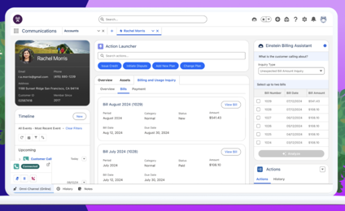
Salesforce AI
90% of Fortune 500 companies use Salesforce
Salesforce Industries AI - will start releasing in October
100+ Out-of-the-Box AI Capabilities, ready to use
15 Industries
Foundational, pre-built, and customizable AI capabilities
Embedded in each of Salesforce’s 15 industry clouds
https://www.salesforce.com/news/stories/industries-ai-announcement/
https://www.salesforce.com/service/ai/
https://www.salesforce.com/service/customer-service-chatbot/
https://www.salesforce.com/service/customer-service-automation/
Salesforce has unveiled two AI agents:
Einstein SDR Agent - talks to inbound prospects (Sales Development Representative)
Einstein Sales Coach Agent - provides real-time selling guidance to sales teams
https://www.zdnet.com/article/salesforce-unveils-ai-agents-for-sales-teams-heres-how-they-help/

Slide 7


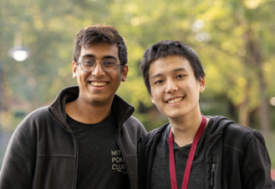


Misc 2
Pixtral 12B - first multimodal model by Mistral
built on top of mistral-nemo-12B
open source Apache 2.0 license
https://www.techopedia.com/news/mistral-unveils-its-first-multimodal-ai-model
https://huggingface.co/mistral-community/pixtral-12b-240910
https://github.com/mistralai/mistral-common/releases/tag/v1.4.0
Honeycomb AI Beats Amazon in SWE-Agent Leaderboard
Honeycomb is building agents to help automate tasks across the entire software development lifecycle.
- https://honeycomb.sh
- https://www.ycombinator.com/companies/honeycomb
SWE-bench Leaderboard - https://www.swebench.com
Groq 2 is a new chip from Groq introduced in August 2024
It is available via Groq website https://groq.com
It is faster x8 times faster (per chip) compared to v.1
It supports multimodal models
Speed improvements were achieved via better chip architecture, increased compute density, better compiler
Ishank Agrawal & Andrew Liu

Slide 8



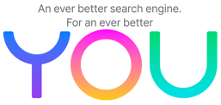
You.com
You.com raise 50 Mln
You.com was founded by Richard Socher and Bryan McCann, both leading AI research scientists.
AI-powered searchengine & productivity tool
personalized & private
offers private ads without third-party cookies, pixels, or user data sharing
has a zero-trace private mode that doesn't store queries or record clicks
search results are powered by your choice, not by the highest bidder
is used for knowledge work in fields like finance, biotech, and legal, as well as for students and academic research.
can add multimedia elements to help answer a question more precisely
allows users to create their own custom agents.
Richard Socher
Founder & CEO
from Salesforce & Standord,
famous for NLP work
(Sentiment Analysis, word embeddings, GloVe, Recursive Neural Networks)
https://www.socher.org
Bryan McCann
Founder & CTO
from Salesforce & Standord
NLP Research

Slide 9


Chai Discovery
Chai Discovery, an AI biology startup founded six months ago
Raised nearly $30 million from Thrive Capital and OpenAI
Released Chai-1 - a new multi-modal foundation model for molecular structure prediction
Chai-1 enables unified prediction of proteins, small molecules, DNA, RNA, covalent modifications, and more.
The model shows performance on the level with SOTA models like AlphaFold3 and ESM3-98B.
The model is available for free via a web interface, including for commercial applications such as drug discovery.
Also releasing the model weights and inference code as a software library for non-commercial use.
https://www.bnnbloomberg.ca/business/technology/2024/09/09/openai-thrive-capital-back-six-month-old-ai-drug-discovery-startup/
https://www.chaidiscovery.com/blog/introducing-chai-1
https://x.com/joshim5/status/1833183091776721106

Slide 10

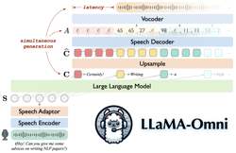

Misc 3
DeepSeek-V2.5 - very good and cheap, open source
The European Court of Justice (ECJ) ordered Apple to Pay back $14.4 Billion in back taxes to Ireland
OpenAI: $2K/month subscriptions? $6.5 Bln funding
Phind-405B
Open-source, based on Meta Llama 3.1 405B https://huggingface.co/Phind/Phind-CodeLlama-34B-v2
SOTA for programming and technical tasks
128K tokens of context coming (32K context available now)
https://www.phind.com - chat with the model
https://www.phind.com/blog/introducing-phind-405b-and-better-faster-searches
deeplearning.ai - course on Multimodal RAG: Chat with Videos
Time Magazine excluded Elon Musk from its list of the 100 most influential people in AI, while featuring actress Scarlett Johansson on the cover.
LLaMA-Omni - speech-language model, based on Meta Llama-3.1 can process spoken instructions and generate both text and speech responses simultaneously with very low latency (~0.25 sec)
https://huggingface.co/ICTNLP/Llama-3.1-8B-Omni
https://github.com/ictnlp/LLaMA-Omni
SambaNova Cloud - x10 faster than GPU
SambaNova Systems - SN40L Reconfigurable Dataflow Unit (RDU) https://sambanova.ai/technology/sn40l-rdu-ai-chip
World's Fastest AI Cloud: Llama 3.1 405B at 132 tokens/sec Llama 3.1 70B at 570 tokens/sec.
https://sambanova.ai/press/worlds-fastest-ai-platform

Slide 11
Misc 4
Model Collapse - AI models, trained on their own generated synthetic data, gradually produce lower-quality outputs. This cycle worsens with each iteration of retraining, leading to what is called "model collapse".
Anthropic Claude Artifacts to build:
Code snippets: Can be in any coding language.
Webpages: Single page HTML, CSS, and Javascript.
Mermaid diagrams: Flow charts and other diagrams.
Documents: Markdown formatted docs.
SVG images: Simple vector drawings.
React components: Interactive apps.
RefChecker - standardized assessment to identify hallucinations
https://github.com/amazon-science/RefChecker
https://www.youtube.com/watch?v=w-fl1xR9dj0
Alexis Conneau - one of OpenAI‘s research leads for its ChatGPT-4o audio product, is leaving to launch a startup
Jim Fan - fooling LLM benchmarks
https://x.com/DrJimFan/status/1833160432833716715
Train on paraphrased examples of the test set. LLM-decontaminator" paper from LMSys found that you can beat GPT-4 with a 13B model (!!)
It's easy to game the LLM-decontaminator as well. It only checks for paraphrasing, but you can use any frontier model to generate "new questions" with similar logic
You can also prompt-engineer the heck out of your generator to fool the LLM-decontaminator
Increasing inference-time almost always helps. Self-reflection (see Reflexion, Shinn et al. 2023), simple majority voting or Tree of Thought. These are essentially ensemble methods. Ensemble of N things > 1 thing if you don't control for inference-time tokens.
DocAI - extract structured info from documents:
https://github.com/madisonmay/docai
iText2KG - Python package uses LLM to extract entities and relationships from text, incrementally building consistent knowledge graphs - https://github.com/AuvaLab/itext2kg

Slide 12
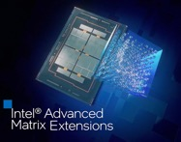
Nvidia Ecosystem
Intel AMX
NVIDIA NIM - AI Microservice to deploy/run a model https://www.nvidia.com/en-us/ai/
NVIDIA Metropolis - developer tools for visual AI https://developer.nvidia.com/metropolis
NVIDIA NeMo - open-source platform for building custom generative AI models, part of NVIDIA AI Foundry, which is a platform and service for building custom generative AI models https://github.com/NVIDIA/NeMo
NVIDIA Riva - speech and translation microservices https://www.nvidia.com/en-us/ai-data-science/products/riva/
NVIDIA Triton Inference Server - open-source https://developer.nvidia.com/triton-inference-server
NVIDIA Visual Insight Agent (VIA) - workflows for building AI agents to process videos and images using Vision-Language Models (VLM). https://www.nvidia.com/en-us/use-cases/visual-ai-agents/
Intel AMX (Advanced Matrix Extensions) are available on some new Intel Xeon CPUs. They do matrix operations and help with AI workloads. These CPUs are very expensive ($10K .. 30K+) - https://en.wikipedia.org/wiki/Advanced_Matrix_Extensions

Slide 13
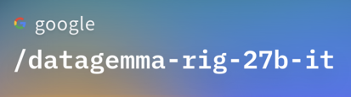
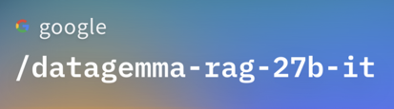
Google Data Gemma RAG & RIG 27B models
Improving accuracy of LLMs by integrating them with
Data Commons - a vast, open-source repository of public statistics from trusted organizations like the United Nations (UN), Center for Disease Control and Prevention (CDC) and global census bureaus.
RIG (Retrieval Interleaved Generation) - LLM is trained to produce natural language queries to retrieve data from Data Commons
RAG (Retrieval Augmented Generation) - relevant data tables are fetched from Data Commons and used to augment the LLM's prompt
https://www.threads.net/@qnixsynapse/post/C_0Z3I9yYRD
https://huggingface.co/google/datagemma-rag-27b-it
https://huggingface.co/google/datagemma-rig-27b-it
https://docs.datacommons.org/papers/DataGemma-FullPaper.pdf
https://research.google/blog/grounding-ai-in-reality-with-a-little-help-from-data-commons/

Slide 14





Assistants
Amazon Alexa (Echo) - now uses Anthropic Claude
Apple Siri - uses Apple's proprietary model + OpenAI
Google Assistant (since 2016) - an app working on phones and other devices. It is being replaced by Google Gemini.
Microsoft Copilot - works on multiple devices
Amazon Echo

Slide 15
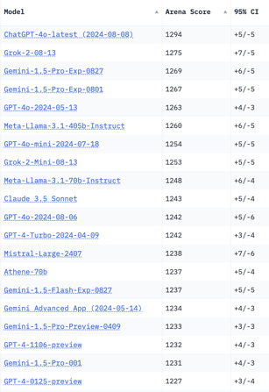
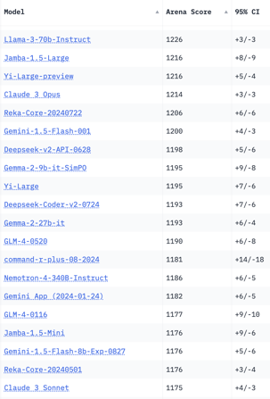
Crowd-sourced "Arena" Leaderboard
Total #models: 139
Total #votes: 1,821,125
Last updated: 2024-09-04
Starting Elo rating = 1000
95% CI = Confidence Interval
https://chat.lmsys.org/?leaderboard
English-only queries

Slide 16
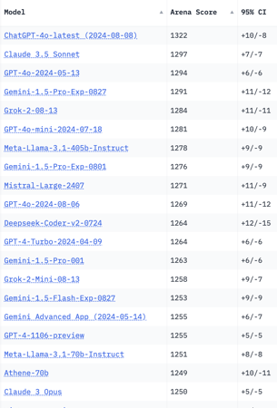
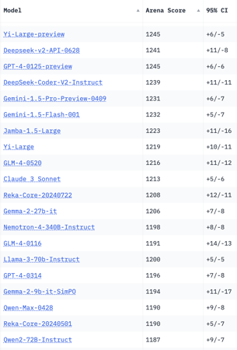
Crowd-sourced "Arena" Leaderboard
Total #models: 139
Total #votes: 1,821,125
Last updated: 2024-09-04
Starting Elo rating = 1000
95% CI = Confidence Interval
https://chat.lmsys.org/?leaderboard
Coding

Slide 17
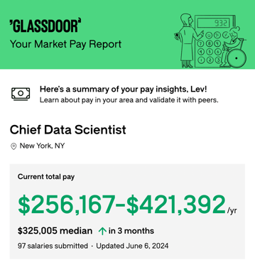
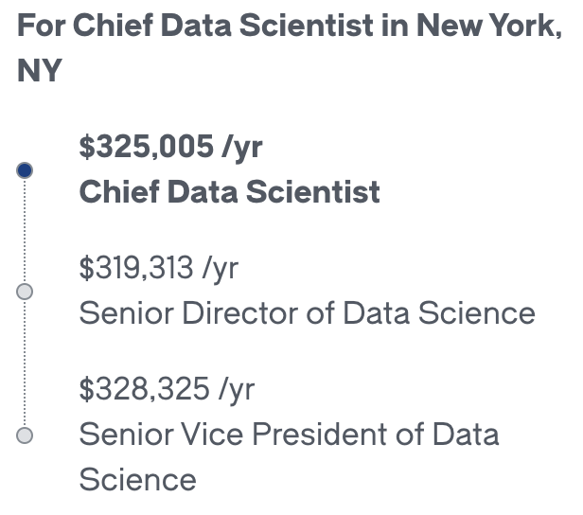
Salaries

Slide 18
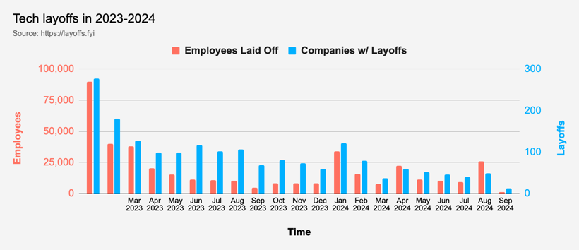
Tech Layoffs in 2024
Layoffs - https://layoffs.fyi

Slide 19
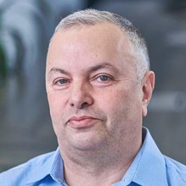

About the Speaker
Lev Selector, Ph.D.
40+ years of software engineering, data science, and building teams (hiring, training, and managing)
Ph.D. in mathematical modeling and computer simulations
Interests:
Generative AI, Using LLM with your data
Local AI for Local Private Data
Cloud architecture, fin-tech, application security
Find/connect: Linkedin, GitHub, YouTube, Google
https://eais.ai
Enterprise AI Systems

Slide 20
Thank You!

