Slide 1





AI Updates
January 31, 2025
DeepSeek R1 Learns to Reason using RL
DeepSeek vs OpenAI
Open Source AI Development Drive Prices Down
Kimi k1.5 by MoonshotAI
Alibaba Qwen-2.5-M 7b & 14b 1 Mln context
DeepSeek Janus Pro - text-to-image
Open R1 Reproduction of DeepSeek R1
Meta's $60-$65 Bln infra investment in 2025
UI-TARS native GUI agent - open source
DeepSeek - explanation and analysis
Berkley - Small Model Learns Using RL
Open Source AI Development around the Globe
Mistral Small 3, a 24B params, open source
Allen AI Tülu 3 405B surpasses DeepSeek V3
COCONUT Paper (Chain of Continuous Thought)
Thinking in Systems - by D. H. Meadows
Parlant - Customer-Facing Agents
Sky-T1-32B-Flash - Faster Reasoning LLM
OpenAI Diversifies Cloud Providers
Measure Political Preferences in AI Systems
Alibaba GTE-ModernBERT models
OpenAI ChatGPT Gov platform
Goose - automate engineering, in Rust
CoRAG - Chain of RAG Framework
Dario Amodei on DeepSeek
Andreessen Horowitz ( a16z )
Crowd-sourced "Arena" Leaderboard

Slide 2

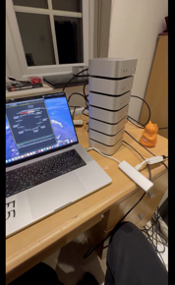
DeepSeek R1 Learns to Reason using RL
Running DeepSeek R1 across 7 M4 Pro Mac Minis and 1 M4 Max MacBook Pro. Total unified memory = 496GB. Uses @exolabs distributed inference with 4-bit quantization.
Approx 64GB each, $3K * 8 = $24K total cost
Next goal is fp8 (requires >700GB)
https://x.com/alexocheema/status/1881561143736664180
https://github.com/exo-explore/exo
https://github.com/trending?since=weekly
DeepSeek R1 was fine-tuned on top of DeepSeek V3 using RL (Reinforcement Learning) during its training phase, before being deployed for public use. - https://arxiv.org/abs/2412.19437v1 - V3 paper - https://arxiv.org/abs/2501.12948 - R1 paper
RL process: the model receives feedback on its predictions and iteratively refines them to improve accuracy. This process happens without needing massive amounts of extra computational resources.
The model's training process is structured like human education, starting with simple tasks and gradually increasing in complexity. This allows it to build a strong foundation and learn more effectively.
DeepSeek R1 can analyze its own reasoning process, identify potential errors, and adjust its approach to improve accuracy. This "self-reflection" is a key part of its learning process.
This continuous learning process allows DeepSeek R1 to become more accurate and efficient over time, without relying solely on increasing the size of its training data or computational power.
This is a significant departure from traditional LLMs, which often focus on scaling up data and compute resources to improve performance.
DeepSeek R1's approach suggests a potential shift towards more efficient and adaptable AI models in the future.
exo: Run your own AI cluster at home with everyday devices
Nvidia lost $593 Billion cap value on Mon Jan 27, a record one-day loss for any company on Wall Street. This fear is largely unfounded.
Training:
DeepSeek: 2.8 Mln GPU-hours (H800)
GPT-4 : 60.0 Mln GPU hours (A100)
H800 is x2 .. x9 faster than A100 (depending on specific operations)
DeepSeek's AI Assistant has overtaken OpenAI's ChatGPT on Apple's (AAPL) app store in the U.S.
DeepSeek has claimed it spent only $5.6 million over two months to develop its latest AI model
OpenAI accuses DeepSeek for IP theft (for using OpenAI models to train theirs).

Slide 3
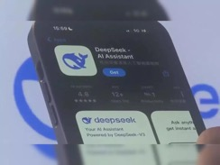
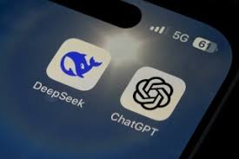
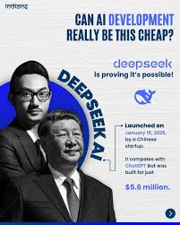

DeepSeek vs OpenAI
DeepSeek's AI Assistant has overtaken OpenAI's ChatGPT on Apple's (AAPL) app store in the U.S.
DeepSeek has claimed it spent only $5.6 million over two months to develop its latest AI model
OpenAI accuses DeepSeek for IP theft (for using OpenAI models to train theirs).

Slide 4



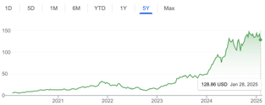
Open Source AI Development Drive Prices Down
On Monday stock market deeped because of the panic caused by the release of Deepseek-R1 in China.
On Wednesday Alibaba (China) has announced similar model. It is called "Max" model in their Qwen-2.5 family of models.
It is claimed to match or beat Deepseek on many benchmarks.
It is much smaller (72B vs 671B parameters)
And Alibaba is known to open-source their models.
Kiwi k1.5 - yet another new open-source LLM from China (Jan 24th) (by Moonshot AI), it is multimodal 128 K context, great for STEM, coding, and general reasoning. It outshines giants like OpenAI o1 and Qwen models like QVQ-72B/32B Preview on several parameters like Maths, Coding and Vision
What will be the consequences of models getting better and more affordable? Here is an example.
Ford has created affordable Model "T" car in 1908, and this has started huge automobile industry.
Same is happening in AI world today as models are becoming more affordable.
All these models need chips to run - which is very good for Nvidia and other chip manufactures.
I recommend this 5-min Fireship video:
https://www.youtube.com/watch?v=hpwoGjpYygI

Slide 5


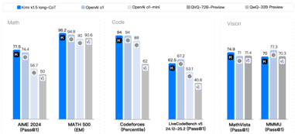
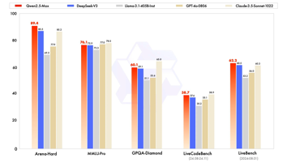

Qwen 2.5 Max and Kimi k1.5
Qwen 2.5 Max - open-source, 72B, outperforms DeepSeek V3
Qwen 2.5 Max (72B parameters)
Qwen 2.5 VL (Vision Language Model)
Qwen 2.5 7B & 3B variants
Qwen 2.5 7B/14B Instruct with 1M token context
Can handle large videos, object detection, structured output
https://www.youtube.com/watch?v=_FYnwYdLtIc - video
Kimi k1.5 by MoonshotAI
https://www.moonshot.cn
https://github.com/MoonshotAI/Kimi-k1.5
https://www.analyticsvidhya.com/blog/2025/01/kimi-k1-5-vs-deepseek-r1/
https://arxiv.org/abs//2501.12599
DeepSeek Janus Pro - New Image Model
https://www.youtube.com/watch?v=rNg-MVUN_FQ
text-to-image generation
can answer questions about images (image understanding)

Slide 6

Open Source AI Development
DeepSeek R1 - Mathew Berman explanation
https://www.youtube.com/watch?v=IMXRpbxifq8 - video
Open R1 - A fully open reproduction of DeepSeek-R1
https://github.com/huggingface/open-r1 (work in progress)
Andrej Karpathy about DeepSeek in December 2024
DeepSeek (Chinese AI co) making it look easy today with an open weights release of a frontier-grade LLM trained on a joke of a budget (2048 GPUs for 2 months, $6M).
For reference, this level of capability is supposed to require clusters of closer to 16K GPUs, the ones being brought up today are more around 100K GPUs. E.g. Llama 3 405B used 30.8M GPU-hours, while DeepSeek-V3 looks to be a stronger model at only 2.8M GPU-hours (~11X less compute). ... a highly impressive display of research and engineering under resource constraints.
Does this mean you don't need large GPU clusters for frontier LLMs? No but you have to ensure that you're not wasteful ...
https://x.com/karpathy/status/1872362712958906460
Qwen2.5-1M - 1 Mln context length small models (7b & 14b)
Qwen2.5-7B-Instruct-1M
Qwen2.5-14B-Instruct-1M
https://qwenlm.github.io/blog/qwen2.5-1m/
Meta's $60-$65 Billion AI Infrastructure Investment for 2025
OpenAI Canvas now works with OpenAI o1 (use the toolbox icon or the “/canvas” command)
Also Canvas can now render HTML & React code
https://x.com/OpenAI/status/1882876172339757392
UI-TARS native GUI agent - open source https://github.com/bytedance/UI-TARS https://arxiv.org/abs/2501.12326 - paper https://www.youtube.com/watch?v=NeJlTWwtLyg - video
Navigates and controls computers and mobile devices
It perceives the screen visually like humans do
Developed by ByteDance and Tsinghua University (China)
Outperforms GPT-4o, OpenAI's Operator, and Claude on multiple GUI benchmarks
It learns from experience (reflection tuning)
Two sizes: 7B and 72B params

Slide 7
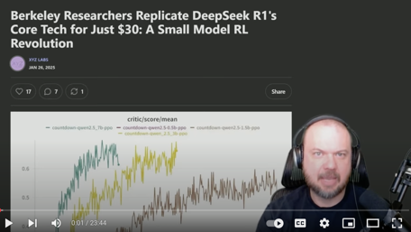
Berkley - Small Model Learns Using RL
DeepSeek R1 Replicated for $30 Berkley's STUNNING Breakthrough Sparks a Revolution
https://www.youtube.com/watch?v=E_h8xt0X1Kg
Berkeley researchers replicated DeepSeek's R1 core technology (reasoning) for only $30.
The research demonstrates that even tiny models (1.5 Billion parameters) can exhibit sophisticated problem-solving skills.
The models were tested using the countdown game, requiring them to solve mathematical equations. They also performed number multiplication using the distributive law.
The models developed specialized problem-solving strategies for different tasks, suggesting they aren't general problem solvers but excel in their specific domain.
The success relies heavily on reinforcement learning (RL), where the AI learns through trial and error in a simulated environment. This is what allows the "aha moment" of self-discovery of solutions.
This breakthrough democratizes AI research, making it accessible to individuals and smaller teams due to the lower cost.
Comparison to DeepSeek R10 - the current work shows similar capabilities in much smaller models.

Slide 8


Open Source AI Development
USA & Europe:
Meta (formerly Facebook)
Mistral AI
EuroLLM consortium
Stability AI
Jina AI, Wasp, Tldraw, Trigger.dev, Pythagora, Twenty (French CRM)
Hugging Face
X.ai (founded by Elon Musk)
TII in Abu Dhabi (Tech. Innovation Institute)
EleutherAI
Microsoft
Google
Apache Software Foundation
China:
DeepSeek
Alibaba (Qwen)
Minimax
01.AI, Baichuan AI, Zhipu AI, Moonshot AI
India:
Sarvam-1 and Sarvam 2B (Indian languages)
Dhenu Llama 3 (for Indian farmers)
Shuka - audio LLM, Indian languages
Mistral Small 3, a 24B parameter model
Oopen source (Apache 2.0)
base and instruct versions
Fast - 150 tokens/s and 81% accuracy on MMLU
Competitor to Llama 3.3 70B, Qwen-2.5 32B, and GPT4o-mini.
Available on Ollama, llama.cpp, la Plateforme, HF, ...
The model is multilingual and supports Spanish, French, German, Italian, Chinese, Japanese, Korean, Portuguese, Dutch, and Polish
Can be used for conversational assistance, function calling, and fine-tuning
JSON - extract, return, adhere to the JSON schema
The model is also able to solve simple puzzles and generate jokes
https://mistral.ai/news/mistral-small-3/
https://www.youtube.com/watch?v=NIdrv3d895o - video demo
Allen AI released Tülu 3 405B
open source
Surpasses DeepSeek V3
Performs on par with GPT-4o
Available on HF
https://allenai.org/blog/tulu-3-405B

Slide 9
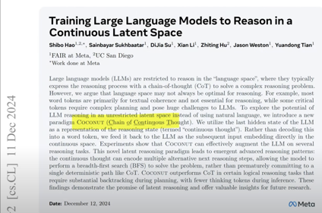

COCONUT Paper (Chain of Continuous Thought)
Training large language models to reason in a continuous latent space – COCONUT Paper explained
The YouTube video, "Training large language models to reason in a continuous latent space – COCONUT Paper explained," from the channel AI Coffee Break with Letitia, introduces a new approach called COCONUT that enhances the reasoning abilities of large language models (LLMs). The video explains that COCONUT allows LLMs to reason using vectors in a continuous latent space (Chain of Continuous Thought), instead of relying on traditional word-based reasoning (Chain of Thought). This method enables more efficient and flexible reasoning by overcoming the limitations of language-based reasoning. The video also discusses the implications of COCONUT for interpretability, as the reasoning process becomes less transparent when using vectors. Despite this challenge, COCONUT offers a promising avenue for improving the reasoning capabilities of LLMs, potentially leading to more advanced AI systems in the future.
https://www.youtube.com/watch?v=mhKC3Avqy2E
https://arxiv.org/abs/2412.06769 - paper from Meta
Letiția Pârcălăbescu
AI Coffee Break
https://leti.blebli.de

Slide 10



Thinking in Systems - by D. H. Meadows
Thinking in Systems - by Donella H. Meadows
International Bestseller, 2008
https://www.amazon.com/Thinking-Systems-Donella-H-Meadows/dp/1603580557
https://www.youtube.com/watch?v=C6jhqpe6Xoc - video summary
"Thinking in Systems: you can not control systems, you can dance with them"
This phrase is attributed to Donella Meadows, a prominent systems thinker, meaning that rather than trying to completely control complex systems, we should learn to adapt and work with their inherent dynamics, similar to how one would dance with a partner, responding to their movements while guiding the interaction - https://donellameadows.org/dancing-with-systems/
“But self-organizing, nonlinear feedback systems are inherently unpredictable.
They are not controllable.
They are understandable only in the most general way.
... making a complex system do just what you want it to do can be achieved only temporarily, at best.
... we can expect surprises and learn from them and even profit from them.
We can’t impose our will upon a system.
We can listen to what the system tells us, and discover how its properties and
our values can work together to bring forth something much better than could
ever be produced by our will alone.
“We can’t control systems or figure them out. But we can dance with them!”

Slide 11

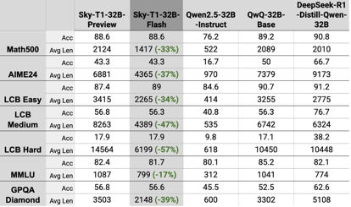
AI Updates - 1
Parlant: The Behavior Guidance Framework for Customer-Facing Agents
https://github.com/emcie-co/parlant
$ pip install parlant
$ parlant-server
$ # Open the sandbox UI at http://localhost:8800 and play
$ parlant guideline create \
--agent-id MY_AGENT_ID \
--condition "the customer wants to return an item" \
--action "get the order number and item name and then help them return it"
Sky-T1-32B-Flash - A New Reasoning LLM
The performance is on par with o1-preview model in both math and coding
Reduces Overthinking, Slashing Inference Costs by up to 57%
Berkeley Sky Computing Lab Introduces
https://huggingface.co/NovaSky-AI/Sky-T1-32B-Flash
OpenAI Diversifies Cloud Providers
OpenAI will diversify its cloud computing providers, moving away from Microsoft's Azure as its sole cloud provider.
This helps it to get more Compute Power, do development faster, reduce dependency on MSFT as a single provider, and potentially reduce costs. This also should influence Revenue Sharing. And MSFT may lose access to some Intellectual Property
https://www.ainvest.com/news/microsoft-s-cloud-monopoly-challenged-openai-diversifies-providers-2501101034b0080b4bcbd7a2/

Slide 12
AI Updates - 2
Measuring Political Preferences in AI Systems An Integrative Approach
https://manhattan.institute/article/measuring-political-preferences-in-ai-systems-an-integrative-approach
This report analyzes political bias in LLMs. Key findings: Most conversational AI systems display left-leaning preferences, though the degree varies.
Base (pre-trained) models show milder left-leaning tendencies. The least biased conversational AIs were Google's Gemma 2b, xAI's Grok, and Mistral AI's 7B. The most biased were Google's Gemini 1.5 models and OpenAI's GPT-4
The report emphasizes that political bias in AI systems isn't inevitable, as studies show models can be fine-tuned toward different political orientations. It calls for responsible development focusing on factual accuracy while maintaining neutrality on contested political issues.
OpenAI ChatGPT Gov platform - specialized version of ChatGPT chatbot designed specifically for U.S. agencies
Deployed within MSFT Azure Cloud
Complies with security and privacy protocols while working with sensitive data
Model - 4o, department-wide deployments
Enterprise features: conversation sharing, custom GPTs, and admin controls
90k employees, 3,500 agencies, 18M messages since 2024.
goose - open-source, extensible, local AI agent automating engineering tasks. Written in Rust. Helps developers create AI assistants. Works with many different AI systems and keeps user information private. Can help testing/debugging software
https://github.com/block/goose
https://block.github.io/goose/
The Alibaba GTE-ModernBERT series of models are built upon the latest ModernBERT pre-trained encoder-only foundation models. They include both text embedding models and rerank models. The models demonstrate competitive performance in several text embedding and text retrieval evaluation tasks when compared to similar-scale models from the current open-source community. The gte-modernbert series models have a size of less than 1B parameters.
https://huggingface.co/Alibaba-NLP/gte-modernbert-base
CoRAG - Chain-of-Retrieval Augmented Generation - AI Framework for Iterative Retrieval and Reasoning - Microsoft, China https://arxiv.org/pdf/2501.14342

Slide 13

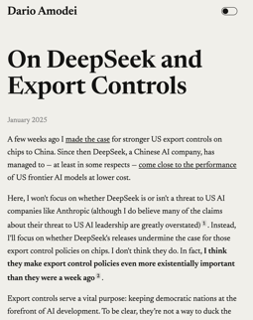
Dario Amodei on DeepSeek
Dario Amodei, former employee at OpenAI and current CEO and founder of Anthropic, has written an essay detailing his thoughts on deep learning model innovation and GPU export controls to China. https://darioamodei.com/on-deepseek-and-export-controls
This essay, combined with new evidence suggesting that DeepSeek may have distilled data from OpenAI's models, is causing a stir in the AI industry
https://www.youtube.com/watch?v=i-OAzG2mCUE - video
Amodei emphasizes the importance of scaling laws in AI
The impact of both software and hardware improvements
Emergence of new paradigms, use of RL (reinforcement learning) to train models to generate chains of thought.
DeepSeek's R1 model is not a unique breakthrough
DeepSeek's V3 model is not just $5 Mln. It is a result of much more research, development, data preparation
Amodei concludes by emphasizing the importance of export controls in maintaining the US's lead in AI. He predicts that AI smarter than humans will likely be developed in 2026-2027

Slide 14

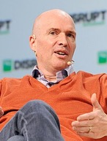
Andreessen Horowitz
Andreessen Horowitz
AH Capital Management, LLC (commonly known as Andreessen Horowitz, or a16z - https://a16z.com ) is an American privately held venture capital firm,
It was founded in 2009 by Marc Andreessen and Ben Horowitz.
The company is headquartered in Menlo Park, California. Aprox 500 employees
$42 Billion under management as of May 2024. Charges ~2% /year for money management
Investments - both early-stage startups and established growth companies
healthcare, consumer, cryptocurrency, gaming, fintech, education and enterprise IT (including cloud computing, security, and software as a service) industries
https://en.wikipedia.org/wiki/Andreessen_Horowitz
https://www.youtube.com/watch?v=8efsFy8ViTA - Marc Andreessen & Jordan Peterson
https://www.youtube.com/watch?v=_Z1JFCARXpA - full 2h video
https://www.youtube.com/watch?v=eZ5tanQtTUw - How Biden Admin Planned to Control AI by suppressing AI development in the US by picking a few big winners it could control and starve the rest
Marc Andreessen and Ben Horowitz
AI investments - https://a16z.com/ai/ (132 companies):
11x - Aerodome - Air Space Intelligence - AKASA - Alchemy Health - Amber - Ambience Healthcare - Ambient.ai - Anduril - Anyscale - Applied Intuition - Asserts - Exit - Azra Games - Bayesian Health - BigHat Biosciences - BioAge Labs - Exit - Biodock - Black Forest Labs - BrainTrust Data - Captions - Cardiogram - Exit - Cartography Biosciences - Character.AI - Ciitizen - Exit - Civitai - Coactive - Concourse - Counsel Health - Cresta - Cursor - Databricks - Decagon - Deepcell - Descript - Devoted Health - DoNotPay - Dyno Therapeutics - EarnBetter - ElevenLabs - Equals - Eve - Fal.ai - Firefly Health - Flock Safety - Fortuna Health - Freenome - Genesis Therapeutics - Gensyn - Happyrobot - Hebbia - Hex - Hippocratic AI - Ideogram - Inceptive - Inductive Bio - Infinitus - InSitro - Instabase - Jungla - Exit - Knownwell - KoBold Metals - Komodo Health - Labelbox - Levels Health - Limitless - Loom - Exit - Luma AI - Macro - Mana Bio - Marker Learning - Mem Labs - Memora Health - Exit - Milu Health - Mistral AI - Nautilus Biotechnology - Exit - Navan - Omada Health - OpenAI - Pahdo Labs - Pantheon AI - People.ai - Pinecone - PLAI Labs - Pomelo Care - Prepared - Q Bio, Inc. - Rasa - Raspberry AI - Ready Player Me - Reface - Regression - Replicate - Replit - Rezo Therapeutics - Ribbon Health - Exit - Santa Ana Bio - Sardine - Saronic - Scribenote - Season Health - Series Entertainment - Shield AI - Skydio - Slingshot AI - Sourcegraph - Sprinter Health - Tecton - Tennr - Thatch Health - Topography Health - Turquoise Health - Ultima Genomics - Valar Labs - Ventrilo - Ventus Therapeutics - Viggle - Waymark - Waymo - World Labs - Yellow - Zipline - Zuma - Zus Health

Slide 15
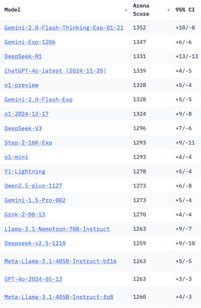
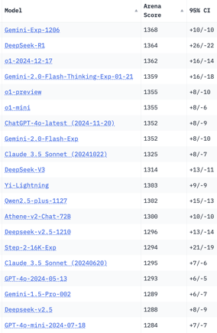
Crowd-sourced "Arena" Leaderboard
Total #models: 195
Total #votes: 2,582,581
Last updated: 2025-01-27
Starting Elo rating = 1000
95% CI = Confidence Interval
https://en.wikipedia.org/wiki/Elo_rating_system
https://chat.lmsys.org/?leaderboard
English-only queries
Coding
China
China
China
China
China
China
China
China
China
x.ai
China
China
China

Slide 16


About the Speaker
Lev Selector, Ph.D.
40+ years of software engineering, data science, and building teams (hiring, training, and managing)
Ph.D. in mathematical modeling and computer simulations
Interests:
Generative AI, Using LLM with your data
Local AI for Local Private Data
Cloud architecture, fin-tech, application security
Find/connect: Linkedin, GitHub, YouTube, Google
https://eais.ai
Enterprise AI Systems

Slide 17
Thank You!

