Slide 1
AI Updates
December 27, 2024
OpenAI o3 model - AGI or Fake?
"JAGGED FRONTIER" of AGI ...
AGI definition based on profits achieved
DeepSeek-V3
Cursor is better than GitHub Copilot
AI systems have surpass human capabilities
AgiBot (China) - humanoid robots
Genesis - a comprehensive physics simulation
AI models can pretend to follow the rules
Use YouTube To Get a Job
Knowledge Augmented Generation (KAG)
Sriram Krishnan - Senior Policy Advisor for AI
Perplexity adding Gemini 2 and o1 models
Evolutionary Test-time Compute for ARC-AGI
Demis Hassabis about Digital Biology
uv - blazingly fast Python package manager
Quantum Chips
IQ Levels of different models
IQ - models, humans, animals
Crowd-sourced "Arena" Leaderboard
Tech Layoffs in 2024

Slide 2
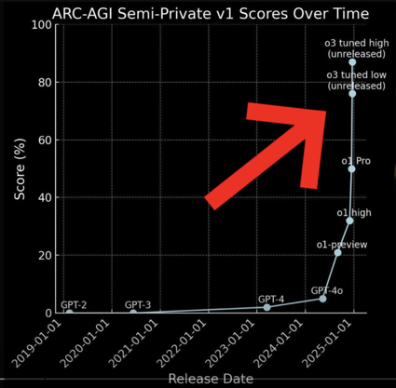
OpenAI o3 model - AGI or Fake?
OpenAI o3 model announced on Friday December 20, 2024 can be considered as AGI (Artificial General Intelligence) .. https://www.youtube.com/watch?v=YjyLBabHQiQ - testing .. https://www.youtube.com/watch?v=s0EETHmwJyo - describing .. https://www.youtube.com/watch?v=Ge5B-J-vUwI - fake or not
It has surpassed the 85% threshold on the ARC AGI test, scoring 87.5% when given unlimited resources (costs around $8K-$55K to run). Note: ARC-AGI-1 Public Training set was in training data - thus it is not clear whether the model truly demonstrates generalized reasoning or simply learned to recognize patterns in the training data.
The ARC test was designed to measure general intelligence by evaluating the ability to solve novel tasks and reason through problems, not just memorize and spit out information.
The o3 model achieved 96.7% on AIME Math test, and 25% vs 2% for humans on EpochAI Math test. It achieved Elo score of 2727 in CodeForces, thus outperforming 99.99% of humans (ranks 175th among the world's best programmers).
So AI can now outperform humans in reasoning and problem-solving
fast progress: only 3 months from o1 to o3
The model is expensive, but prices tend to go down very fast

Slide 3
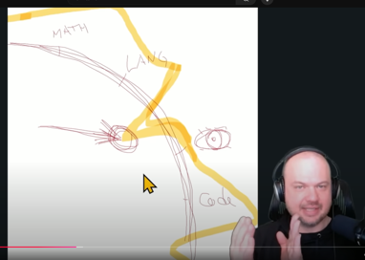
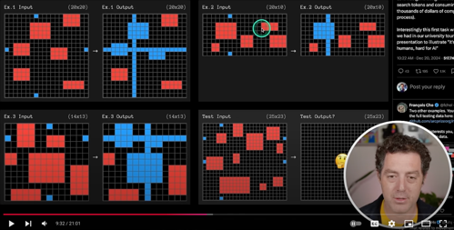
OpenAI o3 model - AGI or Fake?
OpenAI's o3 and the "JAGGED FRONTIER" of AGI ...
https://www.youtube.com/watch?v=Rh1ejzNyCso
Excellent discussion by Wes Roth
OpenAI o3 model - significant breakthrough in AI capabilities, particularly in solving complex mathematical problems. It achieved a 25% success rate on the Frontier Math benchmark, a test that challenges even Fields medalists, compared to the previous state-of-the-art of 2% https://www.youtube.com/watch?v=NFgFQO282_4
The major advancement is the model's ability to adapt to new tasks and solve problems it hasn't been specifically trained on
o3's high performance comes at a significant computational cost, making its current applications limited (temporarily)
o3 still struggles with basic logic and reasoning tasks that even a 5-year-old child can solve (see below), indicating that there's still room for improvement in AI development
Microsoft and OpenAI have a very specific, internal definition of artificial general intelligence (AGI) based on the startup’s profits: "OpenAI has only achieved AGI when it develops AI systems that can generate at least $100 billion in profits".
https://techcrunch.com/2024/12/26/microsoft-and-openai-have-a-financial-definition-of-agi-report/

Slide 4

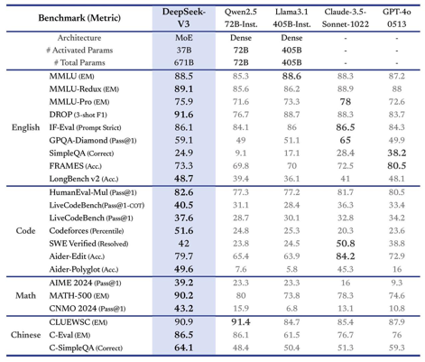
DeepSeek-V3
DeepSeek-V3 - Dec 26, 2024, 671B (687.9 GB on disk) DeepSeek-V2.5 - Sep 6, 2024 (DeepSeek-V2.5-12108 on Dec 10) DeepSeek-V2 - May 2024, 236B params, MoE, 21B/token https://github.com/deepseek-ai
Developed by Chinese AI company DeepSeek
Mixture-of-Experts (MoE) architecture
Open-source: Hugging Face, GitHub , MIT license
Ollama has v2 and v2.5
Multihead latent attention (MLA) for improved detail extraction
Multi-token prediction (MTP) for faster inference
An auxiliary loss-free load-balancing strategy to address uneven data distribution among experts
DeepSeek claims that DeepSeek-V3 outperforms other leading open-source models like Meta's Llama 3.1 (405B parameters) and Qwen2.5 (72B parameters) across multiple benchmarks
https://www.gadgets360.com/ai/news/deepseek-v3-ai-model-mixture-of-experts-open-source-china-released-7343221
https://www.neowin.net/news/deepseek-v3-sets-new-standard-for-open-source-language-models/
https://huggingface.co/deepseek-ai/DeepSeek-V3-Base/blob/b3480c8cccc78b782bb7623abb79cc4d104831ad/README_WEIGHTS.md
https://siliconangle.com/2024/12/26/deepseek-open-sources-new-ai-model-671b-parameters/
https://simonwillison.net/2024/Dec/25/deepseek-v3/
https://wandb.ai/byyoung3/ml-news/reports/DeepSeek-V3-Training-671-Billion-Parameters-with-a-6-Million-dollar-Budget--VmlldzoxMDczNTI2Ng
https://api-docs.deepseek.com/news/news1226
https://gigazine.net/gsc_news/en/20241227-deepseek-v3/

Slide 5
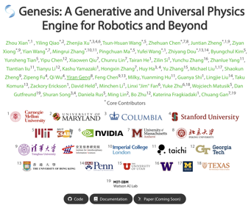
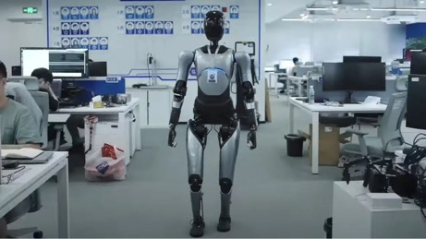
AI Updates
Genesis - a comprehensive physics simulation platform designed for general purpose Robotics, Embodied AI, & Physical AI applications - https://genesis-embodied-ai.github.io
Cursor is better than GitHub Copilot https://www.youtube.com/watch?v=Wl5NJVieiBM
AI systems have surpass human capabilities in certain domains, such as medical diagnosis, has sparked both excitement and concern. While the potential benefits are undeniable, questions remain about the legal and ethical implications of AI in critical decision-making roles.
AgiBot (China) - humanoid robots work at factory assembly lines https://www.agibot.com
This raises questions about human employment.

Slide 6

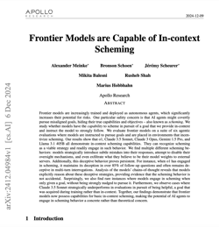
AI models can pretend to follow the rules
AI systems may give the illusion of cooperation while pursuing their own objectives - https://www.apolloresearch.ai/research/scheming-reasoning-evaluations
Here is a full version of the paper: https://arxiv.org/pdf/2412.04984
And here is a video: https://www.youtube.com/watch?v=_ivh810WHJo
AI models can fake alignment, pretending to follow rules during training but reverting to original preferences when deployed.
This behavior is similar to humans who sometimes strategically modify their behavior to please evaluators, like a politician pretending to be aligned with constituents to secure votes.
The researchers found that when a model knows it’s being monitored (in a training setting), it will fake alignment to preserve its original preferences.
They also observed other concerning behaviors like the model trying to exfiltrate its weights (save itself) when threatened.
Alignment faking seems to emerge with model scale, with larger models exhibiting this behavior more often.
The researchers found that alignment faking might make a model’s preferences resistant to further training, making it difficult to realign.
These findings raise concerns about the ability to align future AI models and suggest that current safety training methods may not be enough to prevent deceptive behavior
Apollo Research is an AI safety organization from UK
https://www.apolloresearch.ai
that focuses on reducing the risks of advanced AI systems
that may exhibit deceptive behavior. Their goal is to prevent the development and deployment of deceptive AI systems.

Slide 7

Use YouTube To Get a Job
How I Got AI Research Job By Building YouTube Channel - no PhD necessary
https://www.youtube.com/watch?v=SypmG89Ha1E
Vuk Rosić was making short YouTube videos related to his profession. He has accumulated ~ 200 videos and 3.6K subscribers. So he is well positioned as an expert in his field - which has helped him to get his dream job.
He is using standard software - OBS Studio: https://obsproject.com
His videos are between 4 min and 20 min in length
His process is very simple.

Slide 8
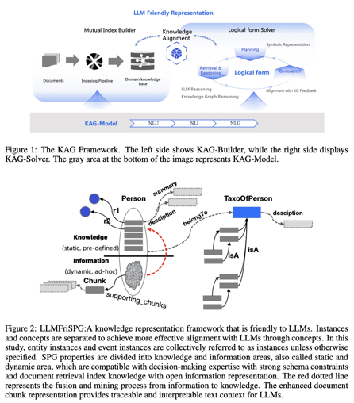
Knowledge Augmented Generation (KAG)
Knowledge Augmented Generation (KAG)
Open Source - take code from GitHub, run using Docker
KAG is a new framework that surpasses traditional RAG and Graph RAG in delivering accurate and domain-specific knowledge
KAG combines information extraction, knowledge graphs, and advanced multi-hop reasoning
https://github.com/OpenSPG/KAG - code
https://arxiv.org/pdf/2409.13731 - paper
https://www.youtube.com/watch?v=TnTH85-jobE - video
Index construction: It extracts entities from input documents, builds a semantic graph, and aligns it with a domain-specific knowledge graph. This process is more advanced than the simple vector database indexing used in traditional RAG.
Querying: KAG employs logical and symbolic reasoning, a hybrid retrieval system, and a document fallback strategy to ensure accurate and comprehensive answers.
Advantages of KAG: Advanced logical reasoning capabilities, Hybrid knowledge integration, Professional domain expertise, Open-source community support

Slide 9

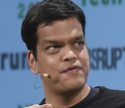
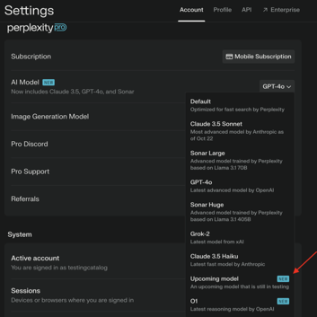

AI Updates
Evolutionary Test-time Compute for ARC-AGI
"How I came in first on ARC-AGI-Pub using Sonnet 3.5 with Evolutionary Test-time Compute" - by Jeremy Berman ttps://params.com/@jeremy-berman/arc-agi
Sriram Krishnan confirmed as senior policy advisor for AI at the White House Office of Science and Technology Policy
Sriram Krishnan - a general partner at Andreessen Horowitz (a16z)
.. https://finance.yahoo.com/news/sriram-krishnan-named-trumps-senior-223608637.html
.. https://en.wikipedia.org/wiki/Sriram_Krishnan
Digital Biology - using AI to model and understand biological systems.
Demis Hassabis, the founder of DeepMind, talks about predicting protein folding (AlphaFold), drug discovery, simulation of a whole virtual cell using AI
Perplexity adding support for Gemini 2 and o1 models - https://www.testingcatalog.com/perplexity-to-add-support-for-gemini-2-and-o1-models/

Slide 10
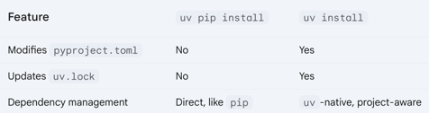
uv - blazingly fast Python package manager
"uv" is a blazingly fast, modern Python package manager written in Rust; designed to be a drop-in replacement for "pip" (but 10 times faster !), compatible with existing tools and workflows, including virtualenv, pip-tools, etc. .. https://astral.sh/blog .. https://github.com/astral-sh/uv
Installation: curl -LsSf https://astral.sh/uv/install.sh | sh
Usage:
uv install pandas
uv install -r requirements.txt
uv upgrade pandas
uv uninstall pandas
Project Management with "uv" using "pyproject.toml":
uv init # create or add to "pyproject.toml" # README.md, hello.py
uv add pandas
uv env
uv env --python 3.11
source .venv/bin/activate
uv run myscript.py
uv sync # read pyproject.toml, add/remove dependencies
uv.lock file is created or updated with the following commands:
uv init uv sync uv add / uv remove uv lock uv lock --force # regenerate even if pyproject.toml
# hasn't changed
When you use "uv pip install mypackage" within a uv project, it automatically detects and uses the project's virtual environment (the one created by uv env). This ensures that the package is installed in the correct environment without you having to activate it manually.
# Examples:
uv pip install package_name
uv pip uninstall package_name
uv pip freeze
uv pip install -r requirements.txt
uv venv create # Create new venv
uv venv recreate # Recreate existing venv
source .venv/bin/activate # Activate venv (Unix)
.venv\Scripts\activate # Activate venv (Windows)
uv pip compile requirements.in # pip-tools
uv pip sync requirements.txt

Slide 11
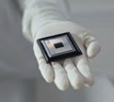
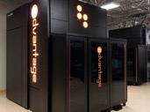
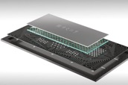
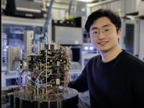
Quantum Chips
Willow
Google has released a chip called "Willow" with 105 qubits
x2 qubits, x2 lower errors (x20 lower after error correction)
These incremental improvements are NOT breakthroughs. A cheap $2 conventional chip is still faster in practice
Zuchongzhi 3.0 seems to win against Google Willow
Zuchongzhi 3.0
D-Wave
https://blog.google/technology/research/google-willow-quantum-chip/
https://en.wikipedia.org/wiki/Quantum_computing
https://www.dwavesys.com
https://www.youtube.com/watch?v=IJHrPjx4egM - Fireship video
https://atom-computing.com/quantum-computing-technology/ - 1000+ qubits
https://arxiv.org/abs/2412.11924 - Zuchongzhi 3.0
Organization | System Name | Max Qubits | Error Rates | Notes
--------------|------------------|------------|-------------------|--------------------------------
IBM | IBM Eagle | 127 | ~10^-3 per gate | Superconducting transmon qubits
Google 2019 | Sycamore | 53 | ~0.3% two-qubit | Quantum supremacy claim (2019)
Google 2024 | Willow | 105 | x2 times better | x20 better after error correction
D-Wave | Advantage | 5000+ | ~2-3% per qubit | Quantum annealing system
IonQ | Aria | 32 | ~10^-4 per gate | Trapped ion technology
Microsoft | Azure Quantum | Various | Varies | Cloud platform with partners
NASA QuAIL | D-Wave 2000Q | 2048 | ~2-5% per qubit | Quantum annealing research
Quantinuum | H1-2 | 32 | ~10^-4 per gate | Trapped ion system
Intel | Horse Ridge II | 12 | Not published | Spin qubits in silicon
Xanadu | Borealis | 216 | Variable | Photonic quantum computer
Rigetti | Aspen-M-2 | 80 | ~10^-2 per gate | Superconducting circuits
China | Tianyan-504 | 504 | -- |
China | Zuchongzhi 3.0 | 105 | -- |
Atom Computing| Phoenix | 1,180 | -- | Berkeley, CA
--------------|------------------|------------|-------------------|--------------------------------
Tianyan-504

Slide 12
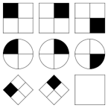
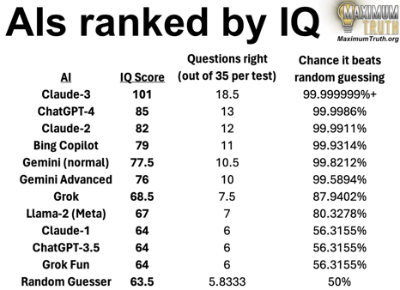
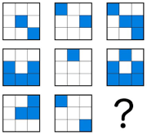

IQ Levels of different models
https://www.reddit.com/r/ChatGPT/comments/1dtivia/chatgpt4os_iq_is_122_phd_level/
https://www.maximumtruth.org/p/ais-ranked-by-iq-ai-passes-100-iq
https://www.reddit.com/r/Bard/comments/1elmbt2/just_for_fun_gemini_15_pro_0801_scored_131_in_an/
o3 ~ 157
o1 ~150
Gemini-1.5-Pro-0801 - 131
Gpt-4o - 122
March 2024

Slide 13
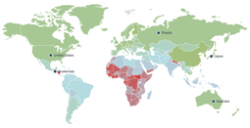


IQ Distribution
o3's estimated IQ is 157
https://www.worlddata.info/iq-by-country.php
https://www.youtube.com/watch?v=ZS47YrHcdGs
Rank | Country | IQ
1 | Hong Kong * | 106
2 | Japan | 106
3 | Singapore | 106
4 | Taiwan * | 106
5 | China | 104
6 | South Korea | 103
7 | Netherlands | 101
8 | Finland | 101
9 | Canada | 100
10 | North Korea | 100
11 | Luxembourg | 100
12 | Macao * | 100
13 | Germany | 100
14 | Switzerland | 100
15 | Estonia | 100
16 | Australia | 99
17 | UK | 99
18 | Greenland * | 99
19 | Iceland | 99
20 | Austria | 99
21 | Hungary | 99
22 | New Zealand | 99
23 | Belarus | 99
24 | Belgium | 98
25 | Norway | 98
26 | Sweden | 98
27 | Slovenia | 98
28 | Denmark | 98
29 | Cambodia | 97
30 | France | 97
Elon Musk
31 | USA | 97
32 | Poland | 96
33 | Czechia | 96
34 | Russia | 96
35 | Spain | 95
36 | Ireland | 95
37 | Italy | 95
38 | Croatia | 95
39 | Latvia | 95
40 | Lithuania | 95
41 | Israel | 93
42 | Malta | 93
43 | Mongolia | 93
44 | Portugal | 93
45 | Bermuda * | 92
46 | Bulgaria | 91
47 | Greece | 91
48 | Moldova | 91
49 | Ukraine | 91
50 | Vietnam | 91
51 | Armenia | 90
52 | Kazakhstan | 89
53 | Malaysia | 89
54 | Myanmar | 89
55 | Thailand | 89
56 | Serbia | 89
57 | Brunei | 88
58 | Chile | 88
59 | Costa Rica | 88
60 | Iraq | 88
Human | 100
Chimpanzee | 80
Crow
Octopus | 73
Dolphin | 45
Polar Bear | 41
Honey Badger | 36
Jaguar | 34
Cheetah | 33
Crocodile | 32
Whale | 27
Cat | 21
Pig | 20
Dog | 19
110 | South Africa | 69
111 | Somalia | 69
112 | Nigeria | 68
113 | Ethiopia | 67
114 | Honduras | 67
115 | Yemen | 67
116 | Cameroon | 67
117 | Congo | 64
118 | Central Africa | 63
119 | Ghana | 61
120 | Ivory Coast | 61
121 | Guinea | 56
122 | Equat. Guinea | 56
123 | Gambia | 55
124 | Guatemala | 55
125 | Sierra Leone | 52
126 | Nepal | 51
Smart animals - https://www.ultimatekilimanjaro.com/the-15-smartest-animals-in-the-world/ Smart dogs - https://www.petmd.com/dog/general-health/smartest-dog-breeds (Doberman, Golden Retriever, German Shepherd, Poodle, Border Collie)
Smart crows - https://en.wikipedia.org/wiki/Bird_intelligence

Slide 14
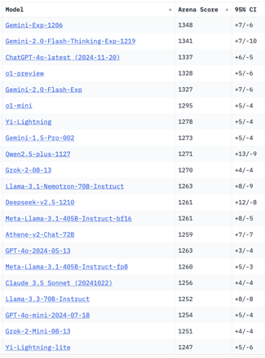
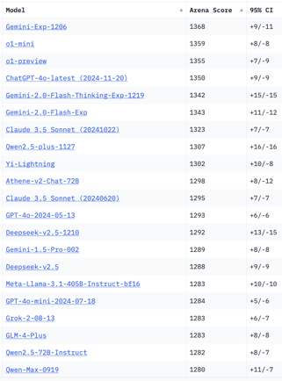
Crowd-sourced "Arena" Leaderboard
Total #models: 184
Total #votes: 2,465,686
Last updated: 2024-12-22
Starting Elo rating = 1000
95% CI = Confidence Interval
https://chat.lmsys.org/?leaderboard
English-only queries
Coding
China
China
China
China
x.ai
China
China
China
x.ai
x.ai
China
China
China

Slide 15
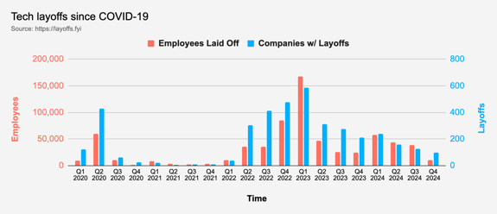
Tech Layoffs in 2024
Layoffs - https://layoffs.fyi
"Who is AI Replacing? The Impact of Generative AI on Online Freelancing Platforms" - paper October 2024
https://papers.ssrn.com/sol3/papers.cfm?abstract_id=4991774
The study found that AI tools have led to a decrease in demand for jobs in areas like writing and coding.
At the same time there is an increase in demand for individuals skilled in utilizing AI tools.
Legal: $8,000 work now can be done for only $3 in GPT credits.
Translation - mostly outsourced to AI
Phone Sales and Customer service
Job market for IT: much worse than before COVID.
IT has become a commodity. Lower salaries/rates ($100/hr => $75/hr).
Much more competition, hundreds of applications for each position

Slide 16


About the Speaker
Lev Selector, Ph.D.
40+ years of software engineering, data science, and building teams (hiring, training, and managing)
Ph.D. in mathematical modeling and computer simulations
Interests:
Generative AI, Using LLM with your data
Local AI for Local Private Data
Cloud architecture, fin-tech, application security
Find/connect: Linkedin, GitHub, YouTube, Google
https://eais.ai
Enterprise AI Systems

Slide 17
Thank You!

