Slide 1
AI Updates
March 28, 2025
what used to cost $5 million now takes "a couple hours"
most Nobel Prizes will be AI-enabled
-- Jared Kaplan from Anthropic
Google Gemini 2.5
Beating Deepseek R1
DeepSeek V3-0324
AI Training Using Quantum Computing
s1 - Simple test-time scaling
Tencent "T1" model
OpenAI raising $40 Bln at a $300 Bln valuation
Ollama Deep Research
Anthropic Claude's "Think Tool"
Anthropic Claude's Search is using "Brave Search"
Reve Image 1.0 Text-to-image
OpenAI GPT-4o native image generation
Qwen2.5-VL-32B - smaller and better
Qwen2.5-Omni - See, Hear, Talk, Write - open source
Google Gemini real-time screen and camera
Microsoft Copilot Researcher and Analyst
Grok on Telegram
Ideogram 3.0
Microsoft Hyperlight Wasm
ARC-AGI-2
Chat2DB
Robots
AI diagnose cancer with 99% accuracy
Chain-Of-Draft - fast and cheap
AlexNet source code released
Vibe Coding
The rise of the AI 'wrappers'
Liner Deep Research Agent, Open Deep Search
Kimi k1.5 - multi-modal LLM
Light-R1 - open-source training for reasoning
R1-Omni - Emotion Recognition with RL
Nvidia Nemotron-H
UAE has committed $1.4 trillion
Microsoft's KBLaM - inject facts into LLM
Crowd-sourced "Arena" Leaderboard
Jobs

Slide 2
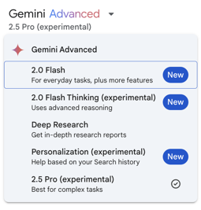
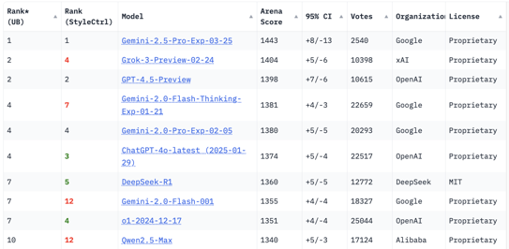
Google Gemini 2.5 Pro (experimental)
Google Gemini 2.5 Pro (experimental) just released
Outperforms other models, No 1 on LMArena by a significant margin
2 Mln tokens context length, training data January 2025, reasoning built-in - fast
natively multimodal - it can process text, images, audio, video, code
https://blog.google/technology/google-deepmind/gemini-model-thinking-updates-march-2025/
https://lmarena.ai/?leaderboard
https://www.rdworldonline.com/googles-gemini-2-5-pro-model-tops-lmarena-by-40-points-outperforms-competitors-in-scientific-reasoning/
https://www.youtube.com/watch?v=RxCZhltR9Cw - video demo

Slide 3
Beating Deepseek R1
DeepSeek R1 (Jan 20, 2025) – Open-Source Reasoning Model, 671B MoE
DeepSeek R1 smaller Distilled Variants (1.5B .. 14B)
Phi-3.5 Mini 3.8B, Phi-3.5 Vision 4.2B, Phi-3.5-MoE 42B
GPT-4o Mini (~8B), GPT-4.5 "Orion", GPT-o3-mini (~ 100B)
Mistral small 3.1
Alibaba Qwen 2.5-Max (72B), QwQ-32B,
Gemini 2.0 Pro (Feb 5, 2025) – Multimodal Reasoner, estimated 600B
xAI Grok-3 (Feb 17, 2025) – “Thinking” Agent Model, estimated 300+B
Anthropic Claude 3.7 “Sonnet” (Feb 24, 2025) – Hybrid Reasoning AI, estimated 200B
Google’s Gemma 3 (27B)
DeepSeek R1 Distill Qwen (14B, 32B)
Mistral small 3.1 24B, outperforms GPT-4o
Baidu's ERNIE X1 & ERNIE 4.5 - comparable to Deepseek R1 but at half the cost
Cohere Command A for enterprise
NVIDIA Llama Nemotron reasoning models Nano (8B) and Super (49B) sizes
AI2 OLMo 32B - outperform GPT-3.5 and GPT-4o mini

Slide 4

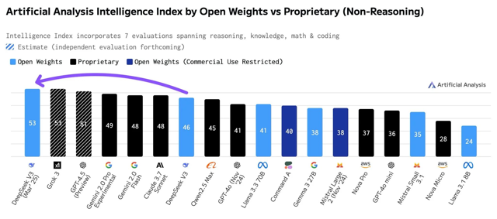
DeepSeek V3-0324 is now the highest scoring non-reasoning model
Open source (MIT-licensed) non-reasoning model
#1 among all non-reasoning models
Released on March 24, 2025
Major improvement over DeepSeek V3
685B parameters (37B active - MoE)
https://huggingface.co/deepseek-ai/DeepSeek-V3-0324
https://huggingface.co/spaces/akhaliq/anychat
https://artificialanalysis.ai/
https://www.reddit.com/r/LocalLLaMA/comments/1jip611/deepseek_releases_new_v3_checkpoint_v30324/
https://venturebeat.com/ai/deepseek-v3-now-runs-at-20-tokens-per-second-on-mac-studio-and-thats-a-nightmare-for-openai/

Slide 5
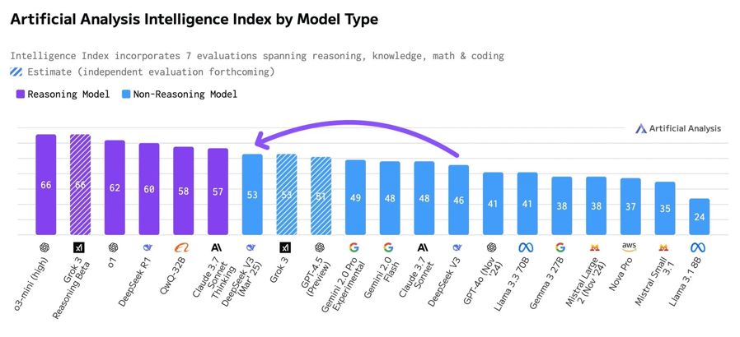
DeepSeek V3-0324 remains behind reasoning models
Non-reasoning AI models are traditional and excel at speed and pattern recognition for tasks like chatbots

Slide 6
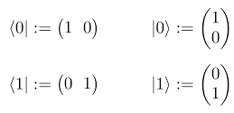
AI Training Using Quantum Computing
Quantum-Enhanced LLM Efficient Fine Tuning
https://arxiv.org/abs/2503.12790v1
Quantum Weighted Tensor Hybrid Network (QWTHN), which reparameterizes pre-trained layers into quantum tensor hybrid architectures.
Origin Quantum - a Chinese company specializing in quantum computing
Their "QCloudService" refers to their cloud-based quantum computing platform
"Origin Wukong" quantum computer is accessible via their cloud services
The parameter count of the Quantum Tensor Hybrid Network (QWTHN), which combines quantum tensor networks and quantum neural networks, is lower than that of classical LoRA, while the training loss is significantly reduced. This leads to improved parameter efficiency.
The Matrix Product Operator (MPO) decomposition introduces the concept of rank, effectively decomposing high-dimensional linear transformations into a series of low-dimensional matrix products
Quantum neural networks process input data using quantum properties (e.g., superposition, entanglement, and parallel computation), potentially generating high-dimensional or nonlinear features. Even though the final output of the QNN is classical data (e.g., probability distributions after measurement), the underlying quantum state evolution process can still extract information that is difficult to obtain using classical methods.
Stochastic nature of neural networks and quantum computers open up potential avenues for their interaction, particularly in the context of LLM training and inference.
The potential for quantum computing to enhance the training of Large Language Models (LLMs) is a very active area of research.
POtential benefits: Faster Training, enhanced NLP, Optimization Problems,
Challenges: Hardware limitations (limited qubit counts and high error rates), Algorithm Development, Integration with classical computers

Slide 7
s1 - Simple test-time scaling
s1 - Simple test-time scaling (model s1-32B, open-source)
https://www.youtube.com/watch?v=XuH2QTAC5yI
https://arxiv.org/pdf/2501.19393 - paper authored by Niklas Muennighoff and colleagues from Stanford University and the University of Washington
1. A carefully curated dataset called "s1K" containing 1,000 questions paired with reasoning traces, selected based on three validated criteria: difficulty, diversity, and quality.
2. A technique called "budget forcing" that controls test-time compute by either terminating the model's thinking process or extending it by appending "Wait" multiple times when the model tries to finish. This forces the model to double-check its answers, often correcting incorrect reasoning steps.
After fine-tuning the Qwen2.5-32B-Instruct language model on their s1K dataset and implementing budget forcing, their model (called s1-32B) exceeded the performance of OpenAI's o1-preview on certain benchmarks.
The model showed clear scaling trends, with performance improving as more computational resources were allocated, allowing it to extrapolate beyond its performance without test-time intervention.
Notably, the researchers achieved these results at a fraction of the cost typically associated with training such models - reportedly for less than $50, demonstrating a cost-effective approach to developing high-performing AI reasoning models.

Slide 8
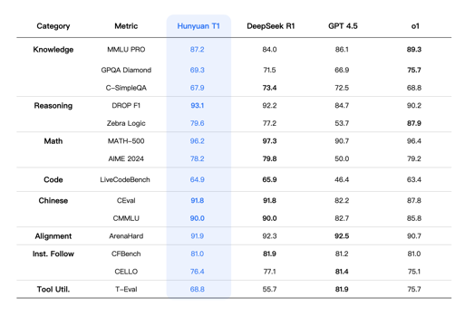

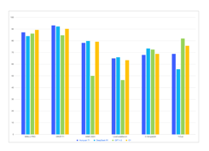

Tencent "T1" model
Tencent’s Hunyuan T1 reasoning model - matching or outperforming OpenAI’s o1 and DeepSeek’s R1
faster responses, improved reasoning
Hybrid-Transformer-Mamba architecture
long-text processing, reduced memory usage, and a powerful reinforcement learning
super aggressive pricing
strong in coding, math, and science tests
Hunyuan T1-Preview was released in February, now official T1
https://tencent.github.io/llm.hunyuan.T1/README_EN.html
Tencent is a Chinese multinational technology conglomerate and holding company, headquartered in Shenzhen, known for its messaging app WeChat, and is a major player in the video game industry, owning stakes in companies like Riot Games (League of Legends) and Epic Games (Fortnite). Public company, more than 100K employees
https://en.wikipedia.org/wiki/Tencent

Slide 9

AI Updates - 1
OpenAI raising $40 Bln at a $300 Bln valuation
led by SoftBank, according to a Bloomberg report
https://www.calcalistech.com/ctechnews/article/bjfztiftjl
Ollama Deep Research, the Open-Source Alternative to OpenAI Deep Researcher - https://apidog.com/blog/ollama-deep-research/
Anthropic Claude's Search is using "Brave Search"
https://search.brave.com
https://en.wikipedia.org/wiki/Brave_Search
Brave Search is a search engine developed by Brave Software, Inc., (San Francisco, CA), and is the default search engine for the Brave web browser in certain countries
https://brave.com/download/ - Brave Browser
Anthropic Claude's "Think Tool" -
Anthropic's "Think Tool" is a new feature introduced for Claude AI that enhances its ability to handle complex, multi-step tasks by providing a dedicated space for structured thinking.
This tool allows Claude to take notes, break down problems, and reason through complex scenarios more effectively.
The Think Tool is implemented as a simple JSON command that allows Claude to record its thoughts without obtaining new information or changing the database.
It's designed to be used during the answer generation process, particularly when Claude needs to process new information from other tools or navigate complex decision-making scenarios.
To use the Think Tool - Add the tool definition to your Claude implementation, Include instructions on when and how to use the tool in the system prompt. Provide domain-specific examples for best results. Monitor Claude's use of the tool and refine prompts as needed.
https://www.anthropic.com/engineering/claude-think-tool
{
"name": "think",
"description": "Use this tool to think about something without obtaining new information or changing the database.",
"input_schema": {
"type": "object",
"properties": {
"thought": {
"type": "string",
"description": "A thought to consider."
}
},
"required": ["thought"]
}
}

Slide 10
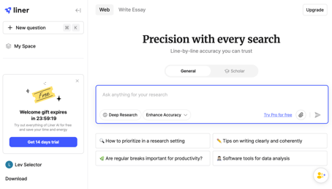
AI Updates - 2
The rise of the AI 'wrappers'
Perplexity is raising funds at $18 Bln valuation
x6 times growth in 1 year
https://www.youtube.com/watch?v=AEOI-y546_4
Liner Deep Research Agent
https://getliner.com
Free. Beats Perplexity, GPT-4.5 & Gemini Deep Research
current best deep research agent on the market
faster, better sources
https://www.youtube.com/watch?v=wG2v2BCBc2I
- It ranks #1 in OpenAI's Simple QA Benchmark
- It offers up to 10 free reports daily (compared to Google's 5)
- It aggregates sources from 50+ trusted academic sources including arXiv, PubMed, and Nature
- Users can evaluate sources based on citation volume to ensure credibility
Multi-agent performance, can see sources for specific sections, can do Follow-up questions, can filter for scholarly articles only, customization options for publication date, citation quantity, and fields, source summarization feature
Open Deep Search (ODS)
Use open-source LLMs, reasoning agents, web search tools
https://arxiv.org/abs/2503.20201

Slide 11




AI Updates - 3
Kimi k1.5 - multi-modal LLM
Developed by Moonshot AI, China, available via API and app
https://kimi.ai
128K context window
good at STEM, coding, and general reasoning.
https://arxiv.org/abs/2501.12599
Estimated 50-150 Bln params
Natively multimodal
Fast and cost-effective
https://merlio.app/blog/kimi-k1-5-ai-outperforms-gpt-4
Nvidia Nemotron-H
Family of Accurate, Efficient Hybrid Mamba-Transformer Models
Nemotron-H-8B Base, Instruct, VLM
Nemotron-H-47B-Base
Nemotron-H-56B Base, VLM
End-to-End FP8 pre-training (on 20T tokens)
https://research.nvidia.com/labs/adlr/nemotronh/?utm_source=tldrai
Light-R1 - open-source training for reasoning
open-source suite for training long reasoning models using reproducible and cost-effective methodology
Light-R1: Curriculum SFT, DPO and RL for Long COT from Scratch and Beyond - https://arxiv.org/abs/2503.10460
curriculum training progressively increases data difficulty, combined with multi-staged post-training
Light-R1-32B model, trained from Qwen2.5-32B-Instruct, outperforms DeepSeek-R1-Distill-Qwen-32B in math reasoning.
The UAE has committed $1.4 trillion over the next decade to "substantially increase… existing investments" in artificial intelligence infrastructure, semiconductors, energy, and manufacturing
https://www.semafor.com/article/03/24/2025/uae-pledges-1-trillion-investment-in-us-artificial-intelligence-semiconductors-energy
R1-Omni - Emotion Recognition with RL
Explainable, Multimodal, with Reinforcement Learning
https://arxiv.org/abs/2503.05379

Slide 12


AI Updates - 4
Microsoft's KBLaM - inject facts into LLM
KBLaM = Knowledge Base Augmented Language Model
A new way to add information directly into LLM that improves how AI handles facts, making it faster and more accurate.
Older methods were either expensive or slow, but KBLaM is efficient and easily adds new information without needing to retrain the entire AI.
It also helps reduce AI's tendency to make things up, providing more reliable answers.
This new approach is better than previous methods because it's faster, uses less memory, and is easier to understand.
https://www.microsoft.com/en-us/research/blog/introducing-kblam-bringing-plug-and-play-external-knowledge-to-llms/
OpenAI GPT-4o native image generation
Finally ! ( OpenAI GPT-4o was first released in May 2024 )
It is not a separate model. Now the whole GPT-4o model is trained to understand text and images at once (it is not separate DALL-E 3 diffusion model). The model also integrates into Sora video.
Benefits: higher quality of images, accurate text in images. Can create signs, menus, invitations, infographics, historical imagery, scientific diagrams, storyboards (consistent characters), various artistic styles and photorealism. You can iterate/refine with text and images.
https://openai.com/index/introducing-4o-image-generation/
Reve Image 1.0 - a new text-to-image AI model that topped global rankings with the codename "Halfmoon"
https://preview.reve.art
Outperforming Google's Imagen 3, Midjourney v6.1, and Recraft V3
Natural language editing, photo uploads, and an ‘explore’ tab to view community prompts and generations
"We saved $350 million last year using AI agents" - Dorit Zilbershot, vice president of AI experiences and innovation at ServiceNow, added that "We use AI in customer service, IT support, HR processes, developer assistance, and marketing, and we are expanding its use to other areas of the company."

Slide 13
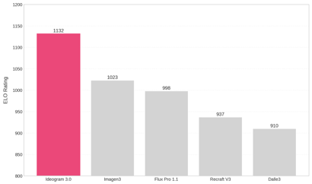
AI Updates - 5
Qwen2.5-VL-32B - surpasses its 72B predecessor in multimodal tasks
https://qwenlm.github.io/blog/qwen2.5-vl-32b/
Grok on Telegram
Elon Musk's AI chatbot, Grok, is now available on Telegram Premium
Offering its sarcastic assistant to over 1 billion users
Qwen2.5-Omni - See, Hear, Talk, Write - open source
https://qwenlm.github.io/blog/qwen2.5-omni/
Ideogram 3.0
ideogram.ai - text-to-image tool, high-quality images
artwork, diagrams, and realistic photos
ideal for artists, marketers, designers, and content creators
stunning realism, creative designs, and consistent styles
https://about.ideogram.ai/3.0
https://artificialanalysis.ai/text-to-image/arena?tab=Leaderboard
Google’s Gemini now offers real-time screen and camera analysis for select Google One AI Premium subscribers.
Powered by “Project Astra,” the new features let Gemini read phone screens and interpret live camera feeds to answer questions instantly.
GitHub Copilot Serves 400 Million Completion Requests a Day
https://www.infoq.com/presentations/github-copilot/
Microsoft Copilot Researcher and Analyst
Microsoft has introduced new features for its Microsoft 365 Copilot, including two advanced “deep reasoning” agents—Researcher and Analyst—as well as enhanced custom AI agent capabilities.
Researcher leverages OpenAI’s deep research model to handle complex, multi-step tasks and integrates data from tools like Salesforce and ServiceNow.
Analyst, based on OpenAI’s o3-mini reasoning model, uses chain-of-thought reasoning to analyze raw data, generate spreadsheets, run Python code, and create detailed reports.

Slide 14

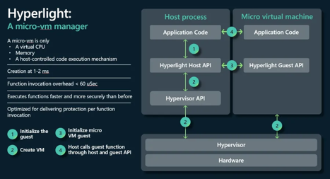
Microsoft Hyperlight Wasm
Microsoft open-sourced Hyperlight Wasm
Hyperlight Wasm is a micro VM for running WebAssembly apps
Written in Rust
Open source, Apache 2.0 license
Various programming languages can target WASM.
Hyperlight Wasm can run on Linux, Windows, and macOS.
https://www.phoronix.com/news/Microsoft-Hyperlight-Wasm
https://github.com/hyperlight-dev/hyperlight
https://opensource.microsoft.com/blog/2024/11/07/introducing-hyperlight-virtual-machine-based-security-for-functions-at-scale/

Slide 15
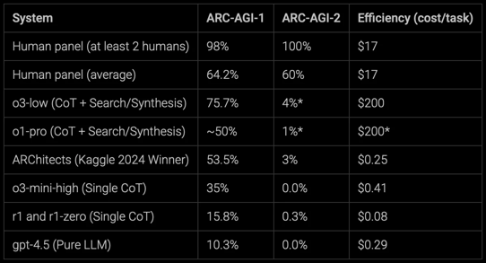
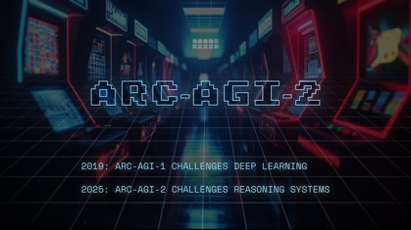

ARC-AGI-2
ARC-AGI-2 by Arc Prize Foundation
https://arcprize.org/blog/announcing-arc-agi-2-and-arc-prize-2025
https://techcrunch.com/2025/03/24/a-new-challenging-agi-test-stumps-most-ai-models/
In 2019, François Chollet - creator of Keras (front-end for TensorFlow used by 2.5 Mln developers), published "On the Measure of Intelligence" where he introduced the "Abstract and Reasoning Corpus for Artificial General Intelligence" (ARC-AGI) benchmark to measure intelligence.
AGI (Artificial General Intelligence) is a system that can efficiently acquire new skills outside of its training data.
Intelligence is measured by the efficiency of skill-acquisition on unknown tasks. Simply, how quickly can you learn new skills?
ARC when scores
ARC2 - now, scores, ! Mln prize

Slide 16
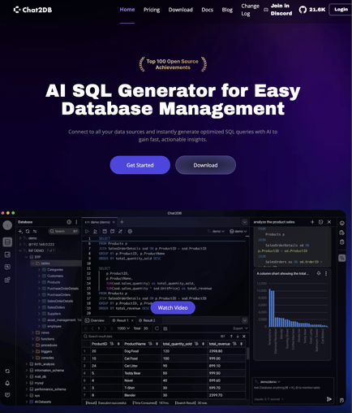
Chat2DB
Chat2DB - https://chat2db.ai - https://github.com/CodePhiliaX/Chat2DB
AI-powered DB management tool and SQL client
open-source
Natural language for table creation, test data generation, SQL query generation, automatic SQL formatting, debugging, query refinement and schema exploration, data visualization, AI-powered BI dashboards and auto-generated charts
integrates AI models like Claude 3.7 Sonnet
MySQL, PostgreSQL, SQLite, BigQuery, ...
AI assistant for natural language interaction for tasks like
https://www.geeky-gadgets.com/chat2db-ai-database-management-tool/
https://www.reddit.com/r/selfhosted/comments/1hhnv3z/i_built_an_aipowered_database_management_tool/
https://www.youtube.com/watch?v=QAOSpMbg7yk
https://www.youtube.com/watch?v=Nmxozp7FyvM
https://www.youtube.com/watch?v=kz3AysTvEYE
https://www.skool.com/data-alchemy/open-source-chat2db-talk-to-your-relational-db

Slide 17


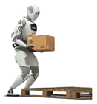






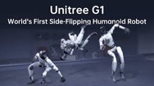
Robots
Robots are About to Have Their iPhone Moment.
Humanoid robots represent one of the largest economic opportunities in human history ($60 Trillion Market).
In 2029 the humanoid robots will be in every home
Price $300/month (40¢ per hour)
Solving the workforce shortages.
New cheaper and better robots every year
Chinese Robots, short robots, back-flips, ... https://www.youtube.com/watch?v=s0s2j35KBWA
Review of several robots: https://www.youtube.com/watch?v=vT-NyxPUrJw
Atlas Robot (can do flips) https://www.youtube.com/watch?v=I44_zbEwz_w https://www.youtube.com/shorts/0QqXQuCd2P0
Apollo Robot working at Mercedes https://www.youtube.com/watch?v=lGugiWNYFVk
Neo Gamma by 1X Technologies (Norway) https://www.youtube.com/shorts/EdIAA1zROiA
Unitree G1 Robot (China: Kungfu, flips, kick-up, ...) https://www.youtube.com/watch?v=0C-LU0cnqB8
Tesla Bot gen 3 ($2,579 !) https://www.youtube.com/watch?v=KTLAHRoH82A
Nvidia Isaac GROOT N1 - a foundation model for humanoid robots https://www.youtube.com/watch?v=BFiBZI3nqhQ
Figure AI Helix - a Vision-Language-Action model https://www.figure.ai/news/helix
Atlas
Apollo
Figure Helix
Neo
Unitree G1
Tesla
Nvidia Isaac GROOT N1
side flip

Slide 18
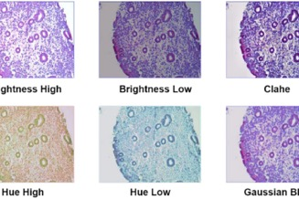
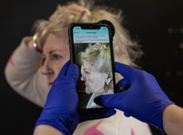
AI diagnose cancer with 99% accuracy
AI diagnose cancer with 99% accuracy
https://www.cdu.edu.au/news/ai-diagnoses-major-cancer-near-perfect-accuracy
Researchers from Daffodil International University in Bangladesh, Charles Darwin University, the University of Calgary and Australian Catholic University developed an AI model which can detect endometrial cancer with 99.26 percent accuracy.
AI model called ECgMLP. It identifies endometrial cancer from microscopic tissue images
Current human diagnostics - ~80% accuracy
Model also performs great for other cancers: colorectal (98.57%), breast (98.20%), and oral (97.34%)
an iPhone app diagnoses skin cancer with 99.9% accuracy
Chelsea and Westminster Hospital in UK uses AI app
Diagnose takes 5 min
Half of patients are discharged immediately without even seeing a doctor
using an iPhone with a magnifying lens to take photos of any suspicious-looking moles, with the image analysed in seconds by an AI app.
https://www.thetimes.com/article/c42e8af0-ddbb-4f63-bda6-2a968915b05d?shareToken=42517e4133440299ffc5b5a166a52cfe

Slide 19
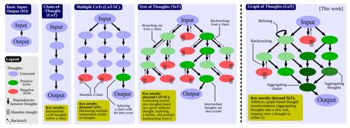
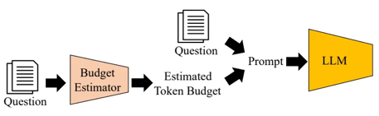
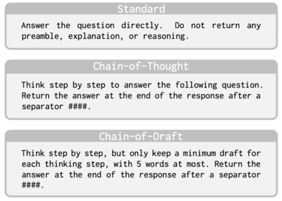
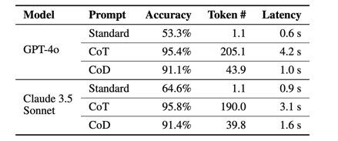
Chain-Of-Draft
Chain-of-Draft (CoD) Is The New King Of Prompting Techniques
Chain-of-Draft (CoD) Prompting simply asks the model to think step-by-step and to limit each reasoning step to five words at most.
We lose some accuracy, but get response 4 times faster and much cheaper
https://levelup.gitconnected.com/chain-of-draft-cod-is-the-new-king-of-prompting-techniques-d9dc17f12051

Slide 20
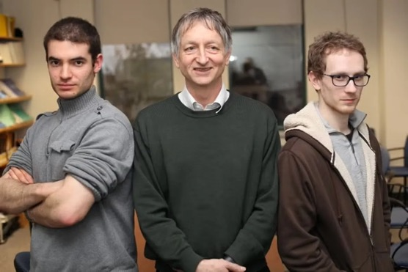
AlexNet source code released
AlexNet source code released
Computer History Museum (CHM) & Google released the AlexNet source code written by University of Toronto graduate student Alex Krizhevsky in 2012 (and sold to Google)
Code is now on GitHub.
It is C++ with CUDA extensions. Also multiple python scripts.
https://github.com/computerhistory/AlexNet-Source-Code
https://github.com/computerhistory/AlexNet-Source-Code/blob/main/README.md
https://www.zdnet.com/article/alexnet-the-ai-model-that-started-it-all-released-in-source-code-form-for-all-to-download/
Ilya Sutskever, Geoffrey Hinton, Alex Krizhevsky
2013

Slide 21

Vibe Coding
Vibe Coding - Revolution and Risks in AI-Assisted Software Development - by José Gregorio Argomedo
https://www.linkedin.com/pulse/vibe-coding-revolutionizing-software-development-what-argomedo-5vt6e/
"vibe coding" - provide natural language high-level instructions to AI models instead of writing code manually.
This term was recently coined by Andrej Karpathy
The workflow becomes conversational, with humans guiding the process through prompts; It allows rapid development, reducing repetitive tasks, easy prototyping, democratizes programming for non-developers; This approach follows the historical trend of raising abstraction levels in programming
Risks: AI hallucinations producing plausible but incorrect code; Security vulnerabilities that novices won't catch; Poor architecture and maintainability leading to technical debt; Potential loss of debugging skills and fundamental programming knowledge; Domain knowledge gaps creating "invisible complexity" issues
Experienced developers benefit - while maintaining oversight
Organizations with strong engineering practices can benefit, while novices are most vulnerable. Teams may become overly dependent on AI, leading to potential loss of skills
Solution - balanced "vibes plus knowledge" approach that combines AI's speed with human expertise and rigorous software engineering practices.
Repo Prompt - app for Mac (Linux/Windows coming)
Repo Prompt can help structure your prompts and apply AI changes for you; send only what’s needed; Select just the files that matter; Cut the noise for sharper answers;
https://repoprompt.com/#pricing
https://www.youtube.com/watch?v=ubWQx8ev4Rw
José Gregorio Argomedo
The paradox of vibe coding: It works best for those
who do not need it - By Tim Anderson
https://devclass.com/2025/03/26/the-paradox-of-vibe-coding-it-works-best-for-those-who-do-not-need-it/
https://en.wikipedia.org/wiki/Vibe_coding - wikipedia page
Models are great at speeding up software engineering work, but they still make a lot of mistakes.
When debugging, the model can rewrite (damage) the good working code.
When code base grows (~3,000 lines of code or more), the models tend to "fall apart" without targeted guidance by a human who understands the code.

Slide 22
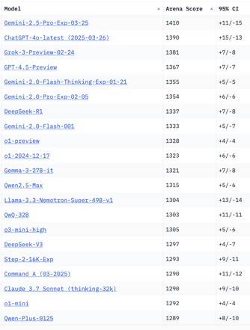
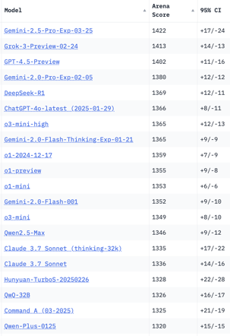
Crowd-sourced "LM Arena" Leaderboard
Total #models: 220
Total #votes: 2,816,680
Last updated: 2025-03-25
Starting Elo rating = 1000
95% CI = Confidence Interval
https://en.wikipedia.org/wiki/Elo_rating_system
https://chat.lmsys.org/?leaderboard
https://lmarena.ai/?leaderboard
English-only queries
Coding
x.ai
x.ai
China
China
China
China
China
China
China
Cohere
China
China
Cohere
China
China

Slide 23


About the Speaker
Lev Selector, Ph.D.
40+ years of software engineering, data science, and building teams (hiring, training, and managing)
Ph.D. in mathematical modeling and computer simulations
Interests:
Generative AI, Using LLM with your data
Local AI for Local Private Data
Cloud architecture, fin-tech, application security
Find/connect: Linkedin, GitHub, YouTube, Google
https://eais.ai
Enterprise AI Systems

Slide 24
Thank You!

