Slide 1
AI Updates
April 25, 2025
SDK => ADK
Software => Agent
OpenAI image generation via API - gpt-image-1
Microsoft UI agents in Copilot Studio
Google Veo 2 in Gemini API, AI Studio, mobile app
Ai2 DataDecide - a suite of open models
ByteDance Seaweed video foundation model
Google Gemini 2.5 Flash with reasoning budget
Claude Code: Best practices for agentic coding
RLHF to use streams instead of labeled data
Meta Web-SSL - Self-Supervised Learning for images
President Trump Executive order on AI Literacy
Liner Deep Research
Physical Intelligence π0.5 AI Framework
JetBrains Junie Smart Coding Agent
OpenAI’s o3 and o4-mini Models Identify Locations
Gemma-3 Quantized Training
ByteDance UI-TARS-1.5 Agent
Mechanize - train agents in virtual envs
MCP with Python & Ollama
Sam Altman at TED 2025
Why Lazy Entrepreneurs Earn More
All the top LLMs releases in 2025 so far
Moonshot AI - Kimi 1.5
Google Sheets =AI("your prompt ...)
Meta PerceptionLM open 8B vision-language model
d1: Scaling Reasoning in Diffusion via RL
3-Level Prompting System
OpenEvals - Agent Self Healing Code
Chinese Huawei's 910C GPU to ship in May
51% of internet traffic is from automated bots
Films made with AI can win Oscars
China to sell 1,000+ humanoid robots in 2025
Nemotron-H (Hybrid Mamba-Transformer) models
Nvidia's Eagle 2.5 VLMs
Crowd-sourced "Arena" Leaderboard

Slide 2





AI Updates - 1
OpenAI image generation via API - gpt-image-1
Pricing (per 1M tokens): text-in:$5; image-in:$10, image-out:$40
In practice, this translates to roughly $0.02, $0.07, and $0.19 per generated image for low, medium, and high-quality images
https://openai.com/index/image-generation-api/
Microsoft UI agents in Copilot Studio to automate desktop and web workflows without APIs https://www.microsoft.com/en-us/microsoft-copilot/blog/copilot-studio/announcing-computer-use-microsoft-copilot-studio-ui-automation/
Google Veo 2 in Gemini API, AI Studio, and mobile app for text-to-video generation - very realistic https://developers.googleblog.com/en/veo-2-video-generation-now-generally-available/
Ai2 DataDecide - a suite of open models 14 model sizes (from 4M parameters up to 1B parameters) provide recommendations about the best and most cost-effective benchmarks, prediction methods, and metrics to use to make decisions - https://allenai.org/blog/datadecide
ByteDance Seaweed-7B video foundation model https://seaweed.video/seaweed.pdf

Slide 3

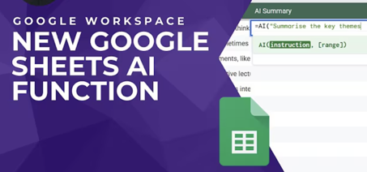
AI Updates - 2
Google Gemini 2.5 Flash - hybrid reasoning AI in preview
matches o4-mini, outperforms Claude 3.5 Sonnet on reasoning/STEM benchmarks
new "thinking budget" control (up to 24k tokens) to optimize cost vs. quality vs speed. Turning off reasoning slashes costs from $3.50 to $0.60 per million tokens. Model adjusts its reasoning effort based on task complexity
Strong performance across reasoning, STEM, and visual reasoning benchmarks, despite coming in at a fraction of the cost of rivals.
Available via API through Google AI Studio and Vertex AI, and is also appearing as an experimental option within the Gemini app.
Google Sheets' new AI formula
In any cell, type =AI("your prompt", [optional cell reference])
with specific prompts like "Summarize this customer feedback in three bullet points."
Apply your formula to multiple cells by dragging the corner handle down an entire column for batch processing.
Combine with standard functions like IF() and CONCATENATE() to create powerful workflows, and use "Refresh and insert" anytime you need updated content.
Pro tip: You can also include formatting instructions directly in your prompt, such as "in table format" or "as a numbered list," to control how your output appears in the cell.
https://youtu.be/6UNM0DQ2diw

Slide 4

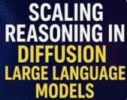
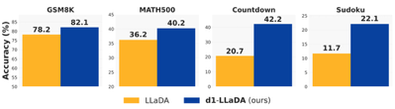
AI Updates - 3
Meta PerceptionLM (PLM) - open 8B vision-language model trained without distillation for video understanding https://ai.meta.com/research/publications/perceptionlm-open-access-data-and-models-for-detailed-visual-understanding/
Perception Encoder shows SOTA performance in visual understanding, excelling at tasks like ID’ing camouflaged animals or tracking movements.
Locate 3D enables precise object understanding for AI, with Meta publishing a dataset of 130,000 spatial language annotations for training.
Collaborative Reasoner framework tests how well AI systems work together, showing nearly 30% better performance vs. working alone.
d1: Scaling Reasoning in Diffusion via Reinforcement Learning
https://arxiv.org/abs/2504.12216v1
https://github.com/dllm-reasoning/d1
https://youtu.be/7fKF4pboPXs
The researchers demonstrated that their d1 framework consistently improves reasoning performance across multiple mathematical and logical tasks when applied to LLaDA-8B-Instruct (a state-of-the-art dLLM)

Slide 5
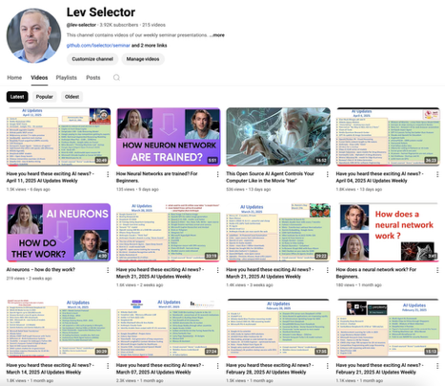
We post our AI Updates
Every Friday after 3pm EST
It is usually 25-30 min long
Links to slides are under the videos
Subscribe to our YouTube channel to get notified when new videos are posted
https://www.youtube.com/@lev-selector

Slide 6
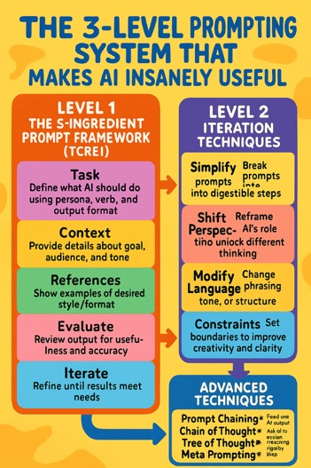
3-Level Prompting System
The 3-Level Prompting System That Makes AI Insanely Useful
https://medium.com/age-of-awareness/the-3-level-prompting-system-that-makes-ai-insanely-useful-c37f9e64d547
Three progressive levels:
Level 1: The 5-Ingredient Prompt Framework (TCREI)
Task - Define what AI should do using persona, verb, and output format
Context - Provide details about goal, audience, and tone
References - Show examples of desired style/format
Evaluate - Review output for usefulness and accuracy
Iterate - Refine until results meet needs
Level 2: Iteration Techniques (SSMC)
Simplify - Break complex prompts into digestible steps
Shift Perspective - Reframe AI's role to unlock different thinking
Modify Language - Change phrasing, tone, or structure
Constraints - Set boundaries to improve creativity and clarity
Level 3: Advanced Techniques
Prompt Chaining - Feed one AI output into the next prompt
Chain of Thought - Ask AI to explain reasoning step-by-step
Tree of Thought - Explore multiple reasoning paths
Meta Prompting - Ask AI to write better prompts for you

Slide 7

OpenEvals - Agent Self Healing Code
OpenEvals - Agent Self Healing Code
use a second LLM to judge/evaluate the generated code
https://github.com/langchain-ai/openevals
https://www.youtube.com/watch?v=fKxSTCu7IE0
pip install openevals
from openevals.llm import create_llm_as_judge
from openevals.prompts import CONCISENESS_PROMPT
export OPENAI_API_KEY="your_openai_api_key"
conciseness_evaluator = create_llm_as_judge(
# CONCISENESS_PROMPT is just an f-string
prompt=CONCISENESS_PROMPT,
model="openai:o3-mini",
)
inputs = "... your prompt ..."
outputs = "... LLM response ..."
eval_result = conciseness_evaluator(
inputs=inputs,
outputs=outputs,
)
print(eval_result)

Slide 8

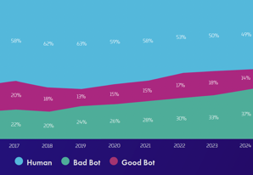

AI Updates - 2
Chinese Huawei's 910C GPU to ship in May
910C chip performs on par with Nvidia’s H100.
https://opentools.ai/news/huawei-set-to-shake-up-ai-scene-with-new-910c-chip-amid-us-restrictions
51% of internet traffic is from automated bots
37% is malicious (bad bots)
14% are good bots
Much of the current expansion is fueled by criminal use of AI, which is likely to increase.
https://www.securityweek.com/bot-traffic-surpasses-humans-online-driven-by-ai-and-criminal-innovation/
Films made with AI can win Oscars
Academy of Motion Picture Arts and Sciences opens the door for AI-assisted films to compete for Oscars
https://opentools.ai/news/lights-camera-ai-ction-oscars-now-open-to-ai-assisted-films

Slide 9
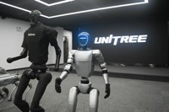


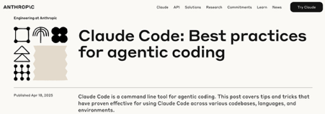
AI Updates - 3
China to sell 1,000+ humanoid robots in 2025
Six manufactures (including Unitree, AgiBot, ...)
Total expected revenue $616 Mln this year
https://www.scmp.com/tech/tech-trends/article/3307356/chinas-humanoid-robot-sector-enters-mass-production-unitree-agibot-among-pack
Nemotron-H (Hybrid Mamba-Transformer) models
replace most self-attention layers with Mamba layers
3x faster inference, maintains accuracy
8B and 56B parameter models
MiniPuzzle compressed 47B (20% speedup)
FP8 training recipe for BF16-parity
https://arxiv.org/abs/2504.03624
Nvidia's Eagle 2.5 VLMs
long-context multimodal learning
8B version matches GPT-4o and Qwen2.5-VL-72B on long-video understanding
https://x.com/arankomatsuzaki/status/1914517474370052425
Claude Code: Best practices for agentic coding
https://www.anthropic.com/engineering/claude-code-best-practices

Slide 10
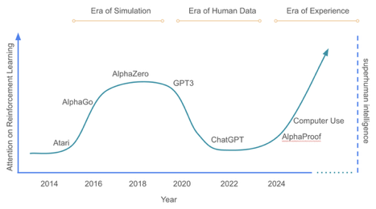

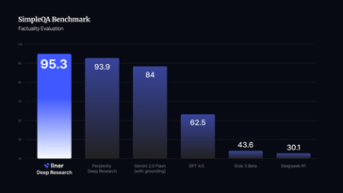
AI Updates - 4
RLHF to use streams instead of labeled data.
Pioneers of modern reinforcement learning, Richard Sutton and David Silver released a new paper, “Welcome to the Era of Experience,” proposing that AI should stop relying on fixed human-labeled data.
The paper introduces “streams”, continuous interaction loops with real or simulated environments, as the foundation for future agents.
https://storage.googleapis.com/deepmind-media/Era-of-Experience%20/The%20Era%20of%20Experience%20Paper.pdf
Liner Deep Research
https://liner.com/news/introducing-deepresearch
advanced AI-powered research tool
aggregates information from over 50 trusted academic sources, including Arxiv, PubMed, Nature, and IEEE
highly accurate, in-depth reports for students, academic researchers, professionals, ...
Very fast and accurate (below - factuality benchmark)
10 Million+ users

Slide 11
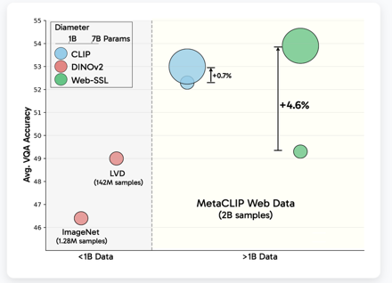

AI Updates - 5
Meta Web-SSL - Self-Supervised Learning for images
A Scalable and Language-Free Visual Representation Learning
It is a family of DINO and Vision Transformer (ViT) models
Sizes: from 300 million to 7 Bln params
Trained on 2 Bln images (224×224), available via Hugging Face
Use: embeddings, Image classification, Object detection, Semantic and instance segmentation, Depth estimation, Image retrieval https://www.marktechpost.com/2025/04/24/meta-ai-releases-web-ssl-a-scalable-and-language-free-approach-to-visual-representation-learning/
President Trump Executive order on AI Literacy
make AI literacy a national priority
from K–12 classrooms to workforce apprenticeships
The order establishes a federal task force, AI education challenge, and public-private partnerships to expand K–12 and workforce training, support teacher development, and grow AI-related apprenticeships
The goal is to prepare a generation of AI-fluent citizens and solidify U.S. leadership in the AI-driven global economy.
7B
1B

Slide 12
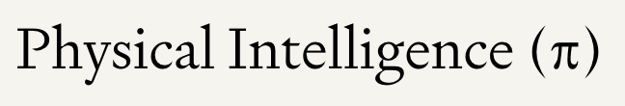
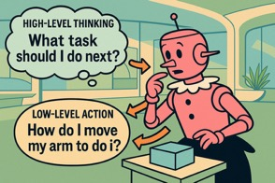
Physical Intelligence π
Physical Intelligence π0.5 AI Framework
A vision-language-action (VLA) model designed to enable robots to perform tasks in entirely new environments through open-world generalization.
Building on its predecessor π0, this framework combines hierarchical decision-making with co-training on diverse datasets to achieve adaptability in unstructured settings like homes, offices, and hospitals
Researchers tested the new π0.5 framework at three rental homes in San Francisco, where robots used the AI to complete basic domestic tasks.
Framework: "vision-language-action model with open-world generalization," meaning it can see, understand instructions, and act in homes and situations it’s never seen before.
Physical Intelligence startup has emerged in 2024
Valued at $2.4 Billion, got $400 Mln in funding
https://www.physicalintelligence.company/blog/pi05
https://mikekalil.com/blog/pi-vla-open-world-generalization/

Slide 13
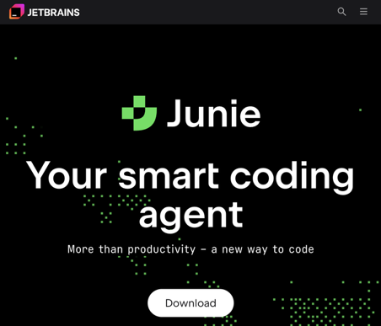
JetBrains Junie Smart Coding Agent
JetBrains has launched Junie - smart coding agent (April 2025) https://www.jetbrains.com/junie/
Before that JetBrains offered the JetBrains AI Assistant - answer questions, provide code suggestions
Junie is more advanced. It is an autonomous coding agent that can take on and execute complex, multi-step development tasks, acting more like a junior developer or pair programmer
Junie can be delegated entire features or workflows, and will execute, test, and present results for review, reducing manual effort and enabling developers to focus on higher-level issues
Junie is available to all eligible JetBrains IDE users with a free tier that allows limited cloud-based usage each month. For unlimited or higher-volume use, a paid AI Pro or AI Ultimate subscription is required
JetBrains Junie is currently available in IntelliJ IDEA Ultimate, PyCharm Professional, WebStorm, GoLand. Junie is not available in the Community or non-Pro editions of these IDEs, nor is it available in all JetBrains products yet

Slide 14
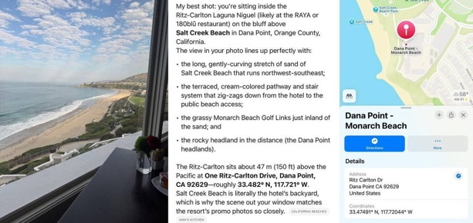
OpenAI’s o3 and o4-mini Models Identify Locations
OpenAI’s o3 and o4-mini Models Identify Locations
very accurate thanks for advanced image reasoning
https://x.com/Cointelegraph/status/1913268908389269989

Slide 15
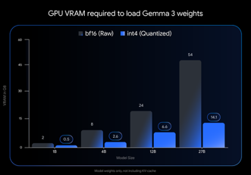
Gemma-3 Quantized Training
Gemma-3 Quantized Training
Gemma-3 family of models was released on March 12, 2025
1B, 4B, 12B, and 27B params
128kt context length
140+ languages
multimodal (text and images)
Gemma 3 QAT models (April 2025) are versions of Google's Gemma 3 AI models that have been trained using Quantization-Aware Training (QAT) - that is simulating the reduction of the precision of the model's weights and activations (e.g., from 16-bit floating point to 4-bit integers) during the training process itself.
QAT models require less memory while preserving accuracy. For example, Gemma 3 27B: from 54GB (BF16) to just 14.1 GB (int4)
https://developers.googleblog.com/en/gemma-3-quantized-aware-trained-state-of-the-art-ai-to-consumer-gpus/
https://ollama.com/library/gemma3 ollama run gemma3:27b-it-qat

Slide 16
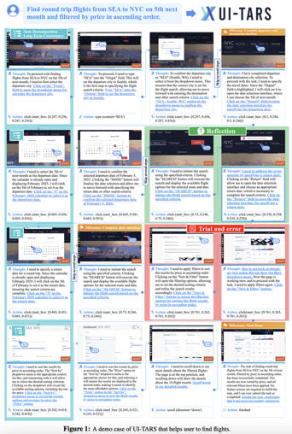
ByteDance UI-TARS-1.5 Agent
ByteDance UI-TARS-1.5 Agent
An open-source multimodal agent built upon a powerful vision-language model
China - ByteDance Seed, Tsinghua University, January 2025
The agent perceives the screenshots as input and performs human-like interactions (e.g., keyboard and mouse operations)
It is built on the Qwen2.5-VL-7B vision-language model. It uses reinforcement learning to reason before acting, improving task execution across environments
https://seed-tars.com/1.5/
https://arxiv.org/abs/2501.12326

Slide 17
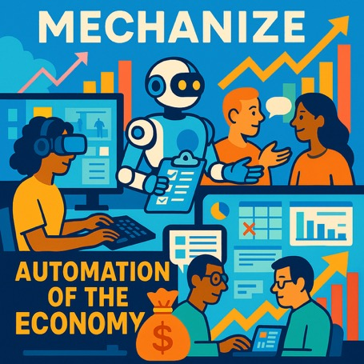
Mechanize - train agents in virtual envs
Mechanize - startup to train agents in virtual environments
Focused on full automation of the economy
Simulating what people do at their jobs - computer use, working on long-horizon tasks that lack clear criteria for success, coordinating with others, dealing with obstacles and interruptions.
https://x.com/MechanizeWork/status/1912904151874625928
https://www.mechanize.work

Slide 18
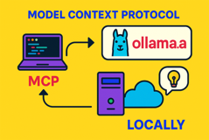
MCP with Python & Ollama
https://pypi.org/project/mcp/
https://github.com/mark3labs/mcphost
https://www.digitalocean.com/community/tutorials/mcp-server-python
# sqlite-server.py
from mcp.server.fastmcp import FastMCP
import sqlite3
# Initialize the MCP server with a friendly name
mcp = FastMCP("Community Chatters")
# Define a tool to fetch the top chatters
# from the SQLite database
@mcp.tool()
def get_top_chatters():
"""Retrieve the top chatters sorted by number of messages."""
# Connect to the SQLite database
conn = sqlite3.connect('community.db')
cursor = conn.cursor()
sql = "select name, messages from chatters order by messages"
cursor.execute("")
results = cursor.fetchall()
conn.close()
chatters = [{"name": name, "messages": messages}
for name, messages in results]
return chatters
# Run the MCP server locally
if __name__ == '__main__':
mcp.run()
pip install mcp mcphost mcp-client
ollama pull llama3
mcphost --model ollama:llama3 --sqlite-file mydb.sqlite
from mcp import MCPClient
# Connect to the running MCP server (default port 3333)
client = MCPClient("http://localhost:3333")
response = client.ask("""List all orders from customer Alice in the last month.""")
print(response["result"])

Slide 19
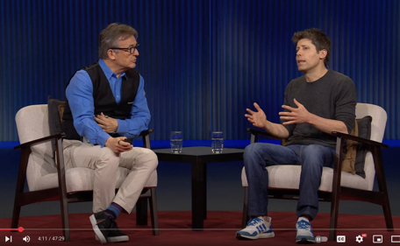
Sam Altman at TED 2025
OpenAI has been rapidly releasing new models
ChatGPT - 500 million weekly active users - and rapidly growing
software development will be transformed through agentic software engineering
rather than fearing job replacement, people should view AI as a tool that increases capabilities, similar to previous technological revolutions
There is a need for new economic models for creative content
OpenAI is planning to release a powerful open-source model
There are potential risks including bioterror, cybersecurity challenges, and self-improving AI that could lead to loss of control
OpenAI has a framework to evaluate models before release
Importance of developing safe agentic systems. "a good product is a safe product"
need in establishing rigorous testing frameworks for advanced AI
collective value preferences of hundreds of millions of users rather than decisions made by small elite groups
Hope AI can help humans make wiser collective decisions
Altman is most excited about AI for science, believing it will accelerate scientific discovery
He describes AI development as an "unbelievable exponential curve" that will continue far beyond what we currently call AGI
He envisions a future of "incredible material abundance" where his children will grow up in a world where AI is always smarter than humans
https://www.youtube.com/watch?v=5MWT_doo68k
TED - Chris Anderson Interviews Sam Altman

Slide 20
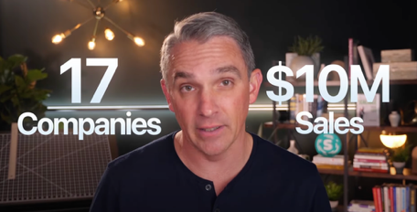
Why Lazy Entrepreneurs Earn More
Why Lazy Entrepreneurs Earn More Money Than You by Ryan Deiss - https://www.youtube.com/watch?v=34UPt_fDuy0
Scaling businesses through "strategic laziness" - achieving more by doing less (focus) through leverage
Commit to Doing Less. Maintain a "don't do list" and follow the seven-project rule, which limits new yearly projects to seven, with only three active simultaneously. This forces prioritization of impact over activity.
Shift from Tasks to Assets: Transform your to-do list from one-time tasks (verbs) to reusable assets (nouns) by creating systems, templates, and processes that eliminate repetitive work.
Reward Asset Creation: Change company culture by incentivizing employees who build systems rather than just complete tasks. Dice implemented bonuses for team members who created useful systems or playbooks.
Measure Revenue Per Employee: Track this metric to encourage building systems rather than simply adding headcount. Improving this number indicates increased leverage.

Slide 21


All the top LLMs releases in 2025 so far
January 2025
Qwen2.5 Qwen-Plus-0125, Qwen2.5-Max (Alibaba)
DeepSeek-R1 (DeepSeek)
MiniMax-Text-01 (MiniMax)
GLM-4-Plus-0111
Gemini-2.0-Flash-Thinking-Exp-01-21
Gemini-2.0-Flash-001
Gemma-3-27B-it
Kimi-1.5 (Moonshot AI)
February 2025
Gemini-2.0-Pro-Exp-02-05
Gemini-2.0-Flash-Lite
Gemini-2.0-Flash
Grok-3-Preview-02-24 (xAI)
Grok-3 (xAI)
Claude 3.7 Sonnet (thinking-32k) (Anthropic)
Hunyuan-TurboS-20250226
GPT-4.5 (OpenAI)
March 2025
Gemini-2.5-Pro-Exp-03-25
Gemini 2.5 Pro
DeepSeek-V3-0324 (DeepSeek)
Command A (03-2025)
Step-2-16K-Exp
ChatGPT-4o-latest (OpenAI, March 26)
April 2025
OpenAI o3 (April 16)
OpenAI o4-mini (April 16)
o3-2025-04-16
o4-mini-2025-04-16
GPT-4.1 (April 14)
GPT-4.1-mini (April 14)
GPT-4.1-2025-04-14
GPT-4.1-mini-2025-04-14
Gemma-3-27B-it-QAT
Gemini-2.5-Flash-Preview-04-17 (Google DeepMind, April 17)
Gemini 2.5 Flash (Google DeepMind)
Llama 4 (Behemoth) (Meta AI, April 5)
o1-preview (OpenAI)
o3-mini
o3-mini-high
QwQ-32B
Nvidia Nemotron
Nvidia Eagle 2.5 8B Video
China is leading open-source development:
https://huggingface.co/collections/zh-ai-community/april-2025-open-releases-from-the-chinese-community-67ea699965f6e4c135cab10f
Moonshot AI - Kimi 1.5 - https://www.moonshot.cn
Kimi 1.5 (a.k.a. Kimi k1.5) is a direct competitor to leading Western models like OpenAI’s GPT-4o and Anthropic’s Claude series
particularly excelling in tasks that require reasoning, code generation, and multimodal understanding (text, images, and code). Multilingual (Chinese, English, ...)
Context length: up to 200,000 characters (2M in Chinese)
96.2% score on the MATH 500 benchmark and ranked in the 94th percentile on Codeforces, a competitive coding platform.
The model is not on lmsys leaderboard yet
Moonshot AI is a Beijing-based, founded by Zhilin Yang

Slide 22
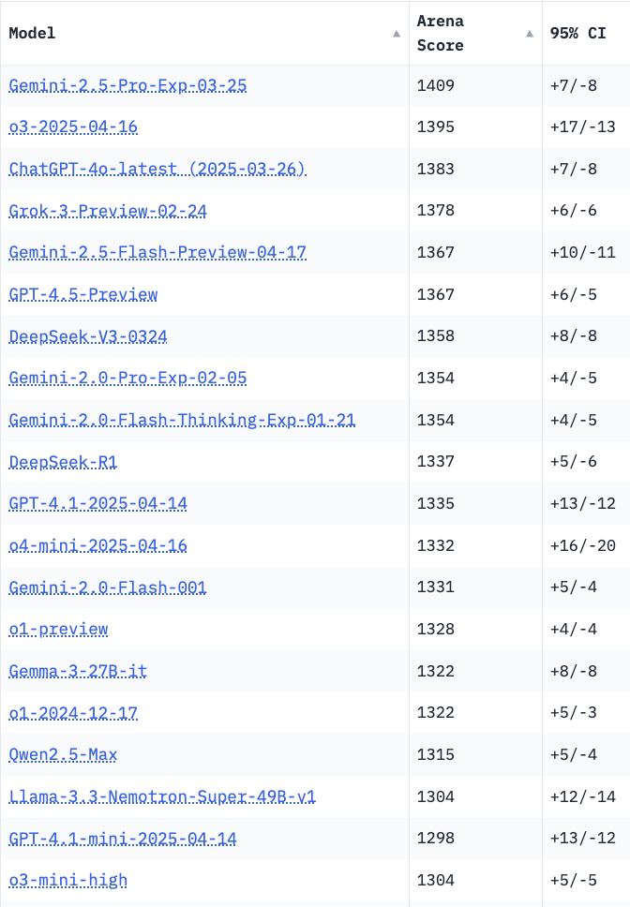
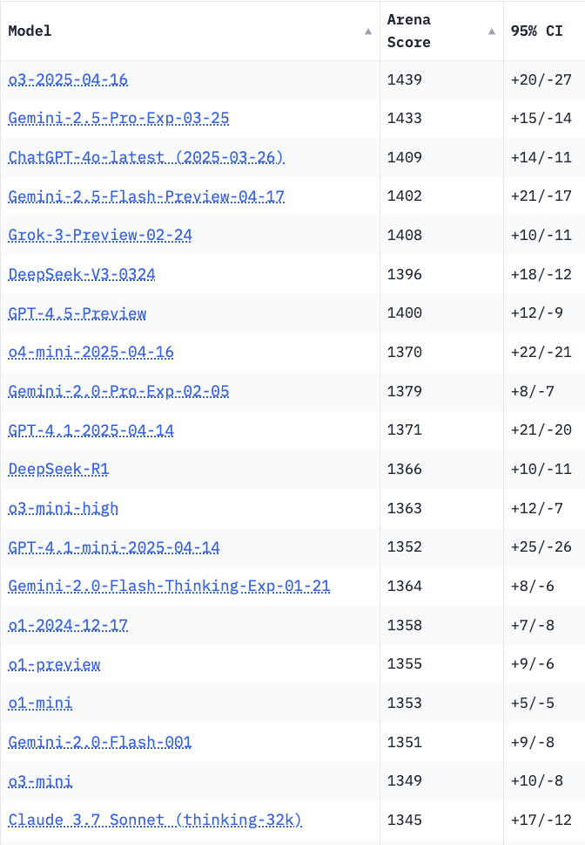
Crowd-sourced "LM Arena" Leaderboard
Starting Elo rating = 1000
95% CI = Confidence Interval
https://en.wikipedia.org/wiki/Elo_rating_system
Total #models: 229
Total #votes: 2,887,373
Last updated: 2025-04-22
https://chat.lmsys.org/?leaderboard
https://lmarena.ai/?leaderboard
https://openlm.ai/chatbot-arena/
https://beta.lmarena.ai
English-only queries
Coding
Chatbot Arena is now "Arena Intelligence Inc."
x.ai
x.ai
China
China
China
China
China
Llama-4-Maverick
is still on 30+ place

Slide 23


About the Speaker
Lev Selector, Ph.D.
40+ years of software engineering, data science, and building teams (hiring, training, and managing)
Ph.D. in mathematical modeling and computer simulations
Interests:
Generative AI, Using LLM with your data
Local AI for Local Private Data
Cloud architecture, fin-tech, application security
Find/connect: Linkedin, GitHub, YouTube, Google
https://eais.ai
Enterprise AI Systems

Slide 24
Thank You!

