Slide 1
AI Updates
May 09, 2025
Gemini 2.5 Pro I/O Edition
Mistral Medium 3
Kevin-32B
Microsoft's AI performance is doubling every 6 mo
Apple Integrates Anthropic's Claude into Xcode
ACP (Agent Communication Protocol)
Google Gemini image editing using prompts
Zed, Tabby, Void Editors - open source
Microsoft AI Agent helps change Windows Settings
Apriel Nemotron 15B - open source reasoning
NVIDIA Parakeet-TDT-0.6B-v2 Speech Recognition
Apple Xcode with Claude Sonnet
Amazon Nova Premier
Anthropic Claude System Prompt - 24K tokens
Alibaba ZeroSearch
Context-Guided Dynamic RAG
Google - Agents Companion Whitepaper
Google 'Implicit Caching' - 75% cost cut
Elon Musk’s xAI Colossus 200K GPUs
OpenCodeReasoning-Nemotron-32B
Which LLM writes the best SQL ?
Julia Vineboo AI - live portraits
OpenAI abandons plan to become a for-profit
OpenAI for Countries
ChatGPT Can Now Read and Analyze GitHub Code
OpenAI Buys Startup Windsurf for $3 Bln
OpenAI & FDA - speed up drug approvals
Prompt Engineering - from job to task
Semantic Caching
Anthropic $90/mo 'Max" plan
Cursor vs VSCode for Vibe Coding
FutureHouse - 4 agents: Crow, Falcon, Owl, Phoenix
Crowd-sourced "Arena" Leaderboard
Jobs, Layoffs

Slide 2
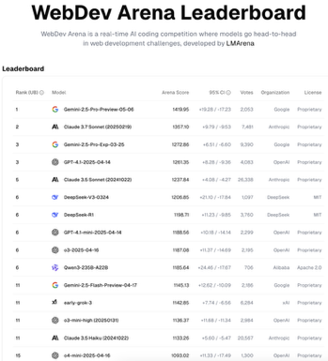
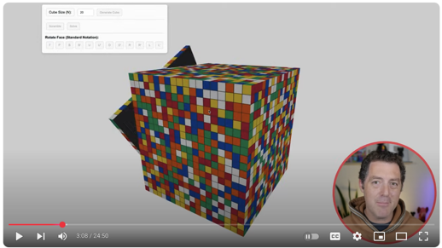

Gemini 2.5 Pro I/O Edition
Gemini-2.5-Pro-Preview-05-06 ( for Google I/O event May 20-21)
1st place on WebDev Arena leaderboard (frontend dev) and on LMSys Leaderboard https://web.lmarena.ai/leaderboard https://lmarena.ai/?leaderboard https://www.youtube.com/watch?v=yPC6a83JDeQ - video demo https://www.youtube.com/watch?v=8kLn20ZYz8A - Gemini is better than Claude Sonnet 3.7
frontend and UI development, code transformation, editing, agentic workflows
video understanding (can re-build web app from a video demo)
available via studio and API

Slide 3
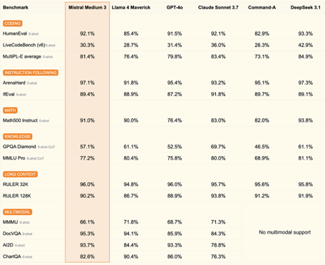
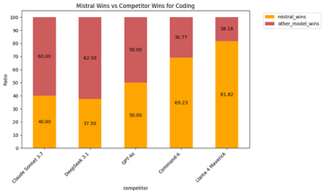
Mistral Medium 3
Mistral Medium 3 https://mistral.ai/news/mistral-medium-3
was officially released on May 7, 2025
at or above 90% of Claude Sonnet 3.7 on benchmarks, surpasses Llama 4 Maverick and Cohere Command A
low cost ($0.4 in / $2 out per M token).
can also be deployed on any cloud, or self-hosted (4 GPUs)
Available via Mistral La Plateforme, Amazon Sagemaker, and soon on IBM WatsonX, NVIDIA NIM, Azure AI Foundry, and Google Cloud Vertex

Slide 4
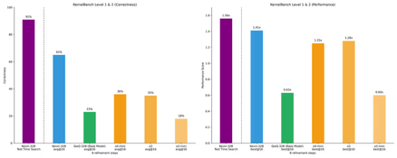

Kevin-32B
Kevin-32B - open source coding model
created by Cognition AI & Stanford University
Kevin is a simpler, open-source alternative to Devin
Kevin stands for "K(ernel D)evin" - designed for programming GPU CUDA kernels
Kevin is tuned on top of Qwen QwQ-32B model
Kevin uses modular agents to plan, research, code, organize.
Kevin can support other models (Cohere, Gemini-Pro) via API
Kevin workflow involves decomposing tasks, researching solutions, and producing code
https://www.youtube.com/watch?v=39Z8ObQzO4Y
https://cognition.ai/blog/kevin-32b
https://scalingintelligence.stanford.edu/blogs/kernelbench/
Trained via multi-turn reinforcement learning (RL) to iteratively generate, compile, and refine CUDA kernels. It uses intermediate feedback on compilation errors and runtime performance. It uses efficient reward distribution
Multi-turn training enhances the model's problem-solving capability over single-turn approaches, particularly in more complex tasks
Kevin performs much better than competitors on KernelBench

Slide 5



AI Updates - 1
Microsoft's AI model performance is "doubling every 6 months" - according to Satya Nadella
https://www.windowscentral.com/microsoft/satya-nadella-microsoft-ai-model-performance-is-doubling-every-6-months
Apple Integrates Anthropic's Claude Sonnet AI into Xcode
https://opentools.ai/news/apple-and-anthropic-join-forces-for-ai-powered-vibe-coding-revolution
ACP (Agent Communication Protocol)
https://www.youtube.com/watch?v=Nzaq2S1EpLY
https://agentcommunicationprotocol.dev/introduction/welcome
ACP was created by IBM Research
This project is related to open-source BeeAI project
https://research.ibm.com/blog/multiagent-bee-ai
https://github.com/i-am-bee
and to "Open Governance Networks" under the Linux Foundation
https://www.linuxfoundation.org/blog/blog/introducing-the-open-governance-network-model
Model Context Protocol
Agent Communication Protocol
Google Gemini image editing using prompts
upload and edit your images - change the background, replace objects, add elements
https://www.pcmag.com/news/google-brings-native-ai-image-editing-to-the-gemini-app

Slide 6
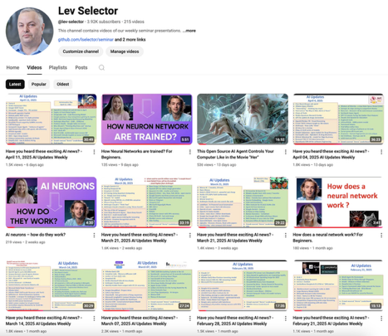
About this Channel:
We post our AI Updates
Every Friday after 3pm EST
It is usually 25-30 min long
Links to slides are under the videos
Subscribe to our YouTube channel to get notified when new videos are posted
https://www.youtube.com/@lev-selector

Slide 7


OpenAI Updates
OpenAI abandons plan to become a for-profit company
The announcement follows a storm of criticism and legal challenges
https://www.theverge.com/openai/661303/openai-stays-nonprofit-sam-altman-employee-memo
https://www.reuters.com/business/openai-remain-under-non-profit-control-change-restructuring-plans-2025-05-05/
Sam Altman is still the CEO of OpenAI
OpenAI hires Fidji Simo, the CEO of Instacart and former Facebook app chief, as the head of the company’s apps business https://en.wikipedia.org/wiki/Fidji_Simo
OpenAI Forecasts $12.7B Revenue in 2025 (was $3.7B in 2024)
OpenAI received $40B Funding at $300 B valuation
OpenAI for Countries - build AI infrastructure ( similar to $500 Bln project Stargate) https://openai.com/global-affairs/openai-for-countries/?utm_source=alphasignal
OpenAI & FDA collaborate to speed up drug approvals
https://techcrunch.com/2025/05/07/openai-and-the-fda-are-reportedly-discussing-ai-for-drug-evaluations/
ChatGPT Can Now Read and Analyze GitHub Code
It is a new deep research feature. ChatGPT can now search GitHub repositories and answer questions about code.
This feature is available for ChatGPT Plus, Pro, and Team users
https://help.openai.com/en/articles/11145903-connecting-github-to-chatgpt-deep-research
OpenAI Reaches Agreement to Buy Startup Windsurf for $3 Bln
The deal has not yet closed
https://finance.yahoo.com/news/openai-reaches-agreement-buy-startup-000054157.html

Slide 8




AI Updates - 2
Prompt Engineering - from job to task
https://www.fastcompany.com/91327911/prompt-engineering-going-extinct
Semantic Caching
eliminate redundant LLM queries and improve AI agent performance
https://thenewstack.io/what-is-semantic-caching/
Anthropic $100/mo 'Max" plan
Amazingly good
https://www.youtube.com/watch?v=hSQ5cjr-WjM
Anthropic API supports web search
And this web search allows re-fining of the search
https://www.anthropic.com/news/web-search-api
https://www.youtube.com/watch?v=2Qx4i3pV81M

Slide 9
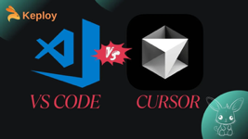
Cursor vs VSCode
Cursor:
Cursor is an AI-first code editor built on VSCode, offering deeply integrated AI features like project-wide context, multi-model support (including GPT-4), and built-in AI chat for code generation, refactoring, and explanations
Its AI can understand and edit across multiple files, provide plain-language debugging help, and enable real-time AI-assisted collaboration
Cursor is best for users who want advanced AI capabilities, interactive learning, and creative coding support, especially beginners or those seeking hands-on AI guidance
Cursor - great for beginner, it understands the whole project, supports AI-powered collaboration and multi-file refactoring
VSCode - speed, stability, and broad extension support. Maximum customization and manual control for an experienced developer
https://techpoint.africa/guide/cursor-vs-vscode-vibe-coding-review/
VSCode:
VSCode remains a lightweight, highly customizable, and performance-focused editor with a massive extension ecosystem[2][4][5]. AI features (like GitHub Copilot) are added via extensions, typically focused on inline suggestions within single files. VSCode excels in speed, stability, and flexibility, making it ideal for experienced developers who value control, a streamlined environment, and rapid code completion[2][4][5].

Slide 10






AI Updates - 3
FutureHouse - 4 agents: Crow, Falcon, Owl, Phoenix
Open, Free
Backed by Google’s former CEO Eric Schmidt
agents are built specifically for scientific research
Analyze millions of research papers, design new drug compounds, identify research gaps, and dramatically speed up discovery processes
Transparent reasoning, real-time data integration, and lab testing support
https://www.youtube.com/watch?v=4clyIcphEvU
Zed, Tabby, Void Editors - open source
https://www.youtube.com/watch?v=d0rPK0dJn1A - video demo
https://zed.dev/ai - Zed
https://www.tabbyml.com - Tabby
https://voideditor.com - Void
Microsoft AI Agent helps change Windows Settings
Copilot+ PCs includes AI agents that can help you to find and change settings. All done with natural language prompting
https://www.bleepingcomputer.com/news/microsoft/microsoft-unveils-new-ai-agents-that-can-modify-windows-settings/

Slide 11

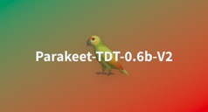

AI Updates - 4
Apriel Nemotron 15B - open source reasoning
by Nvidia and ServiceNow
lower latency, lower inference costs, and agentic
for enterprise AI agents and real-time workflow automation
Outperforms or matches QWQ-32b - while using 40% fewer tokens
Strong performance on both enterprise tasks (RAG, workflow automation) and academic benchmarks (math, logic, coding)
https://huggingface.co/ServiceNow-AI/Apriel-Nemotron-15b-Thinker
NVIDIA Parakeet-TDT-0.6B-v2 Speech Recognition
very fast open-source speech recognition model
available on HuggingFace
transcribe an hour of audio in just one second (using Nvidia GPU)
ranks at the top of Hugging Face's Open ASR Leaderboard
can transcribe song to lyrics
https://huggingface.co/nvidia/parakeet-tdt-0.6b-v2
https://huggingface.co/spaces/nvidia/parakeet-tdt-0.6b-v2 - try
Apple Xcode with Claude Sonnet
write, fix, and test code
https://techcrunch.com/2025/05/02/apple-and-anthropic-reportedly-partner-to-build-an-ai-coding-platform/
https://opentools.ai/news/apple-and-anthropic-join-forces-for-ai-powered-vibe-coding-revolution

Slide 12


AI Updates - 5
Amazon Nova Premier
Amazon’s most advanced foundation "teacher" model
Context length 1 Mln tokens
complex tasks, multi-step planning
works with tools and data sources
fully multimodal (text, images, videos)
agentic workflows, RAG, function calling
Premier is behind Google’s Gemini 2.5 Pro on benchmarks, but does well on tests for knowledge retrieval and visual understanding - according to Amazon’s internal benchmarking.
In Bedrock, Premier is priced at $2.50 in, 12.50 out per M tokens. This is similar to Gemini 2.5 Pro
https://aws.amazon.com/blogs/aws/amazon-nova-premier-our-most-capable-model-for-complex-tasks-and-teacher-for-model-distillation/
Anthropic Claude System Prompt - 24K tokens
xxx
https://www.youtube.com/watch?v=hc9d9lylJg0
https://github.com/asgeirtj/system_prompts_leaks/blob/main/claude-3.7-sonnet-full-system-message-humanreadable.md

Slide 13
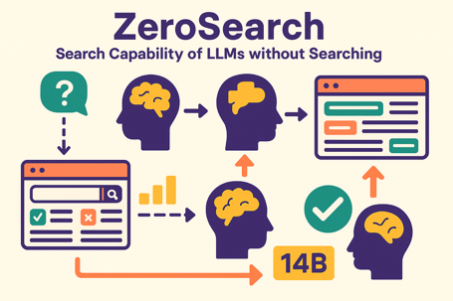
Alibaba ZeroSearch
ZeroSearch - Search Capability of LLMs without Searching
Finding information without constantly using real search engines
Approach:
Train one AI to generate both good and not-so-good "fake search results" for questions;
Then use this as a training environment for another AI, teaching it to reason through information and find answers;
Gradually make this training harder by making the fake search results more challenging;
This helps the AI learn to be a good searcher without needing real search engines.
This works very well. Authors tried 3B, 7B, and 14B models. The resultant performance of the large (14B) model has matched or even exceeded what they'd get with real search engines.
This approach saves money and gives more control over the training process, while still helping AI get better at finding and using information to answer questions.
https://huggingface.co/papers/2505.04588

Slide 14
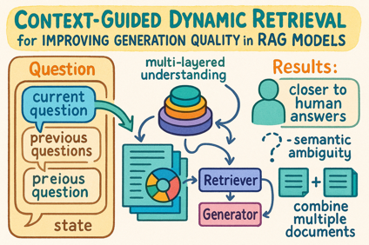
Context-Guided Dynamic RAG
Context-Guided Dynamic Retrieval
for Improving Generation Quality in RAG Models
https://arxiv.org/pdf/2504.19436
Regular RAG is "static". This Paper Proposes Dynamic Context-Guided Retrieval.
The system is not just looking at the current question in isolation. It pays attention to the "state" of the conversation, what's already been discussed and what kind of information is needed right now.
Also the system builds a multi-layered understanding of documents.
Also "retriever" and "generator" are trained together and can learn from each other continuously
Results:
dynamic RAG system produced answers that were closer in quality and content to human-generated answers compared to older, static systems.
It was also better at handling questions with unclear meanings ("semantic ambiguity") and questions that required combining information from multiple documents.

Slide 15

Google - Agents Companion Whitepaper
Google Kaggle - Agents Companion
https://www.kaggle.com/whitepaper-agent-companion
Google has released the second installment in its Agents Companion series, a comprehensive 76-page technical whitepaper focused on operationalizing AI agent systems at scale. The paper builds on previous foundational concepts and emphasizes three main areas:
Agentic RAG (Retrieval-Augmented Generation):
Evolution from static retrieval to dynamic, iterative reasoning
Key improvements include context-aware query expansion , multi-step decomposition, adaptive source selection, and fact verification
Designed for high-stakes domains like healthcare, legal compliance, and finance
Agent Evaluation Framework:
Three-dimensional approach: capability assessment, trajectory analysis, and final response evaluation
Uses specialized benchmarks like AgentBench and PlanBench
Emphasizes observability across both reasoning and execution layers
Multi-Agent Architectures:
Specialized agents that collaborate through modular reasoning
Benefits include fault tolerance and improved scalability
Requires tracking coordination quality and system-level efficiency
The paper also covers real-world implementations including Google's AgentSpace (an enterprise orchestration platform), NotebookLM Enterprise, and a detailed automotive AI case study featuring various design patterns like hierarchical orchestration and peer-to-peer handoffs.
Key Improvements in Agentic RAG:
Context-Aware Query Expansion: Agents reformulate search queries dynamically based on evolving task context.
Multi-Step Decomposition: Complex queries are broken into logical subtasks, each addressed in sequence.
Adaptive Source Selection: Instead of querying a fixed vector store, agents select optimal sources contextually.
Fact Verification: Dedicated evaluator agents validate retrieved content for consistency and grounding before synthesis.

Slide 16
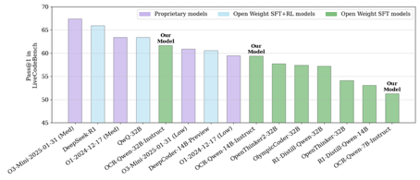
AI Updates - 6
Google Launches 'Implicit Caching' to Cut AI Model Costs by 75%
works in Gemini API for Gemini 2.5 Pro and 2.5 Flash models
can reduce the cost of repetitive context by up to 75%
Previous caching was explicit, developers were required to manually identify and define common prompts or prefixes
Elon Musk’s xAI Colossus 200K GPUs
Supercomputer in Memphis is now fully operational with 200,000 GPUs
Power: 150 MW from the grid and 150 MW from Tesla Megapack batteries
Plans to scale up to one million GPUs
https://www.tomshardware.com/tech-industry/artificial-intelligence/musks-colossus-is-fully-operational-with-200-000-gpus-backed-by-tesla-batteries-phase-2-to-consume-300-mw-enough-to-power-300-000-homes
OpenCodeReasoning-Nemotron-32B
NVIDIA just open sourced Open Code Reasoning models 32B, 14B, 7B
open-source (Apache 2.0)
Beats o3 mini & o1 (low) on LiveCodeBench
Works with llama.cpp, vLLM, transformers, TGI, ...
https://huggingface.co/nvidia/OpenCodeReasoning-Nemotron-32B
LiveCodeBench Results

Slide 17
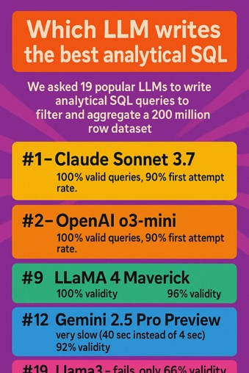
Which LLM writes the best SQL ?
Which LLM writes the best analytical SQL?
We asked 19 popular LLMs (+1 human) to write analytical SQL queries to filter and aggregate a 200 million row dataset.
1st place - Anthropic Claude Sonnet 3.7
https://llm-benchmark.tinybird.live/ - benchmark
https://www.tinybird.co/blog-posts/which-llm-writes-the-best-sql
#1 - Claude Sonnet 3.7
#3 - Claude Sonnet 3.5
100% valid queries, 90% first attempt rate.
#2 - OpenAI o3-mini
#6 - OpenAI o4-mini
100% valid queries, 90% first attempt rate.
#9 LLaMA 4 Maverick - 100% validity
#11 LLaMA 4 Scout - 96% validity
#12 Gemini 2.5 Pro Preview
very slow (40 sec instead of 4 sec)
92% validity
#19 Llama3 - fails, only 66% validity

Slide 18



Julia Vineboo AI
Julia Vineboo | Wine 🍷 | AI Wine Art
Amazing - painting brought to life
Julia Vineboo is a digital creator known for blending wine culture with AI-generated art
Mostly on Instagram under the handle @julia_vineboo_ai (187K followers)
Julia Vineboo is originally from Ukraine, Poland, and Spain
https://www.instagram.com/julia_vineboo_wines/
https://www.instagram.com/julia_vineboo_ai/
https://www.youtube.com/watch?v=9uL9xcEa9EA
https://www.tiktok.com/discover/julia-vineboo
https://www.instagram.com/billylee4648/reel/C-e3L__NqUE/
https://www.instagram.com/billylee4648/reel/C-wZ8ZgptTB/
https://www.pinterest.com/pin/495396027781920944/

Slide 19
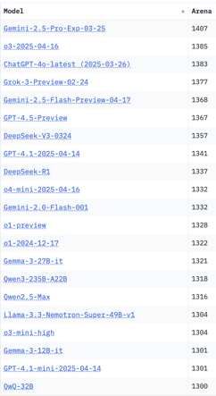
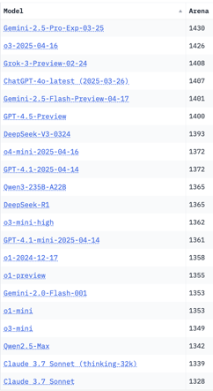
Crowd-sourced "LM Arena" Leaderboard
Starting Elo rating = 1000
95% CI = Confidence Interval
https://en.wikipedia.org/wiki/Elo_rating_system
Total #models: 233
Total #votes: 2,909,287
Last updated: 2025-05-04
https://chat.lmsys.org/?leaderboard
https://lmarena.ai/?leaderboard
https://openlm.ai/chatbot-arena/
https://beta.lmarena.ai
English-only queries
Coding
Gemini-2.5-Pro-Exp-03.25 on 1st place
Qwen3-235B on 10..15 place
Llama-4-Maverick is still on 40th place
x.ai
x.ai
Web Leaderboard https://web.lmarena.ai/leaderboard
LLM Leaderboard - by @LlmStats https://llmworld.net/llm_leaderboards/
LLM Leaderboard - by StackAI https://www.stack-ai.com/llm-leaderboard
LLM Leaderboard - by Artificial Analysis https://artificialanalysis.ai/leaderboards/models
Open LLM Leaderboard - by Hugging Face https://huggingface.co/open-llm-leaderboard
LLM Leaderboard - by Vellum https://www.vellum.ai/llm-leaderboard
Multiple Leaderboards: https://virtualizationreview.com/articles/2025/04/29/ais-heavy-hitters-best-models-for-every-task.aspx
China
China
China
China
China
China
China
China
China

Slide 20
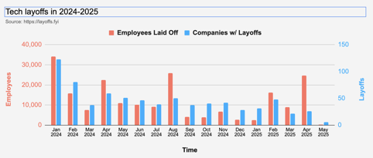
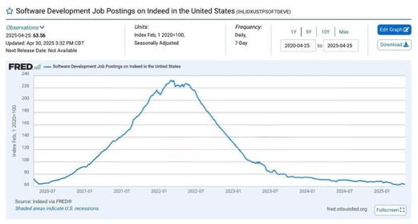
Jobs
Layoffs in 2025: as of 5/7/2025:
52,340 tech employees laid off
123 tech companies w/ layoffs
2024: more than 150,000 tech job cuts
across 549 companies
https://layoffs.fyi

Slide 21


About the Speaker
Lev Selector, Ph.D.
40+ years of software engineering, data science, and building teams (hiring, training, and managing)
Ph.D. in mathematical modeling and computer simulations
Interests:
Generative AI, Using LLM with your data
Local AI for Local Private Data
Cloud architecture, fin-tech, application security
Find/connect: Linkedin, GitHub, YouTube, Google
https://eais.ai
Enterprise AI Systems

Slide 22
Thank You!

