Slide 1
Topic 1
Sea ice and sea ice processes

Slide 2
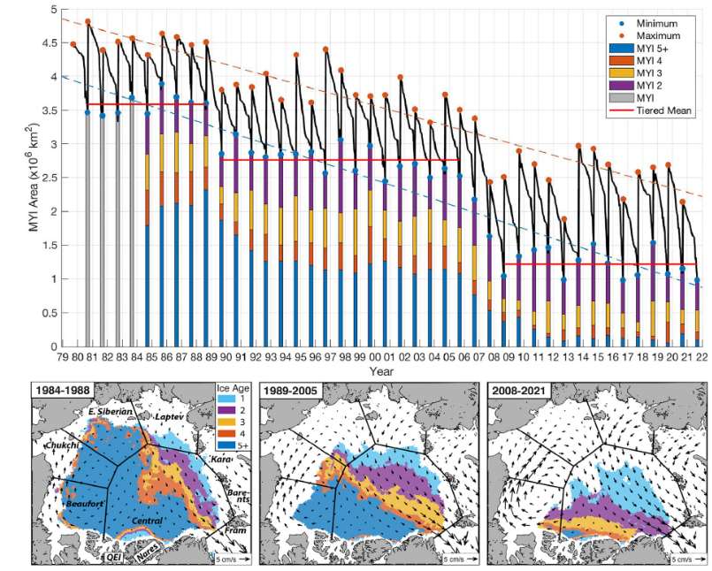
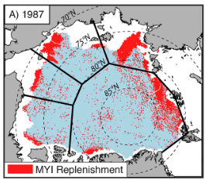
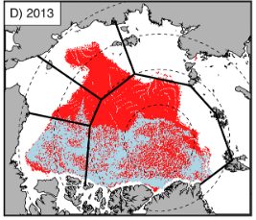
The Stepwise Reduction of Multiyear Sea Ice Area in the Arctic Ocean Since 1980 Babb et al. (2023)
Context/relevance/introduction
MYI is backbone of the Arctic sea ice pack and prognosticator of annual minimum SIE.
End of winter MYI extent was 5.5 x 10⁶ km² in 1950s/1960s and current record min is 1.6 x10⁶ km² in 2017.
MYI budget changes due to export, melt/deformation, and replenishment (FYI →MYI)
Orientation of TPD determines proportion of MYI exported
  Westward shift (AO+ phase) = old ice drawn out of BG
  Eastward shift (AO- phase) = more FYI exported from Russian Seas
  Ricker et al. (2018) – btw 64% and 94% of ice in FS is MYI over 2010-2017
  Nares/QEI export increasing, yet far smaller than FS, but contains oldest ice
    Export is limited by ice arches in these regions
    MYI survival rate in BS went from 93% (1981-2005) to 73% (2006-2010)
      MYI melt in BS quadrupled since 1997-2021 (due to accel. ice-albedo feedback )
      63% variance in MYI replenishment (2000-2006) explained by MDD (summer) and FDD (preceding winter) anomalies – Kwok (2007)
  93% of MYI export through FS, w/ remaining 7% through Nares/QEI/Barents/Kara
    Post-2007, total and MYI export decreased significantly through FS (-6% per decade)
      Increasing melt rate across Arctic since first stepwise reduction – 1/3 of which occurred in BS
      MYI replenishment increased 11,000 km² yr⁻¹ , but not enough to offset melt/export
        Increasing replenishment creates thinner MYI during the following melt season, increasing the area of MYI that melts
        Replenishment increased in Central Arctic, decreased in marginal seas
        Neg feedback → MYI loss compensated by increased MYI replenishment bc more FYI & faster growth of thin ice … but oldest ice lost and MYI increasingly thin/young
Methods
NSIDC EASE-Grid Sea Ice Age which gets LG evolution from PP motion
Grid cell age assigned to oldest parcel within it → MYI overestimates
Beaufort, Chukchi, E. Siberian, Laptev, and Central Arctic (MASIE regions)
  Export calculated across FS, FJL and SZ, Bering Strait, and CAA-Nares Strait gateway
  Concentration from Nimbus-7 SMMR and DMSP SSM/I-SSMIS PMW v2 product
  Replenishment calculated as area of SYI during week after Sept minimum
  Deformation reduces MYI area, despite volume being conserved (ice gets thicker), but this study doesn’t account for this bc they assume the term is small as generally it is FYI that is deforming the most
  PMW too coarse for Nares Strait/QEI – they use synthesis of methods from prev. studies to estimate it (pg. 7)
  2m temps from ERA-5 used for frozen/melting degree days
Conclusions
        High replenishment is reason for stability btw stepwise reductions
        First reduction driven by export, second driven by high export/melt, low replenishment.
        Given decreasing FS export, future MYI losses primarily due to melt and lack of replenishment
Results/Discussion
MYI min/max area declined -72,500 km² yr⁻¹ /-61,000 km² yr⁻¹ over 1980-2022
Loss not cyclical (Comiso 2012) but in two stepwise reductions btw 1988-1989 and 2005-2008
  AO- to AO+ in 1980s led to flushing out MYI out of BG (Pfirman et al. (2004) and conditioned Arctic sea ice pack for 2007 minimum (second reduction; Lindsay et al. 2009)
  MYI5+ decreased 92% and MYI3+ decreased 81%, but SYI remained stable
        No long-term trend in export, increasing melt, increasing replenishment (neg. feedback)
        A future reduction of similar magnitude as prev. two would render Arctic close to MYI-free
Impressions
I think this gives a good overview of the loss of MYI in Arctic, with budgetary components important. Especially considering sea ice export is decreasing overall. No mention of BS export.
SI decline
MYI reduction
Area export

Slide 3
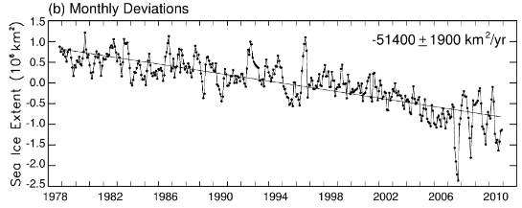
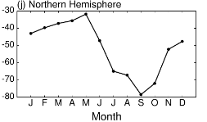
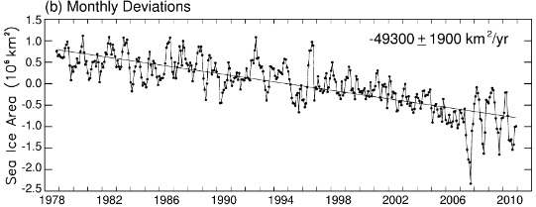
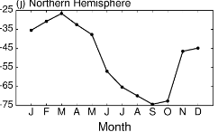
Arctic sea ice variability and trends, 1979-2010 Cavalieri and Parkinson (2012)
Context/relevance/introduction
The main objective of the paper is to compare trends over 1979-2010 (32-yr) and 1979-2006 (28-yr; Parkinson & Cavalieri 2008), but also with 1978-1996 (18-yr; Parkinson et al. 1999)
Methods
PMW observations from: Nimbus 7 SMMR (1978-1987), DMSP SSMI (1987-2007), and DMSP SSMIS (2008-2010)
  Between satellites, they reduced SIE and SIC differences to less than 0.1% and 0.6%, respectively.
Results/Discussion
Sea ice extents
Overall trend is -51.5 ± 4.1 x 10³ km² yr ⁻¹ which is 14% more negative than the 28-yr trend, largely bc of 2007 minimum
Regionally, the Arctic Ocean, Kara/Barents Seas, and Baffin Bay/Labrador Sea had largest declines
  Bering Sea had slightly positive trend over period (Jan-May+)
  Trends were 31% and 20% more negative over summer/autumn compared to 28-yr
  Sea ice areas
  Overall trend is -49.6 ± 4.0 x 10³ km² yr ⁻¹ which is 21% more negative than the 28-yr trend
  Year-to-year variability almost identical to SIE
  Regionally, as with SIE, the Arctic Ocean, Kara/Barents Seas, and Baffin Bay/Labrador Sea had largest declines
  Bering Sea has positive trend over period as well
  Seas of Okhotsk and Japan, Hudson Bay, Baffin Bay/Labrador Sea, and Greenland Sea regions had less negative trends for 32-yr than 28-yr period
    So, was the 2007 minimum not experienced as much here?
  Arctic Ocean & CAA w/+ SIA trends
  As expected, most negative trends in summer/Sep, least negative in winter/Mar
Conclusions
The Arctic Ocean region showed a 50 % increase in the magnitude of the negative SIE trend during summer by extending the 1979–2006 record by just four years.
The corresponding increase for the Northern Hemisphere, overall, was 30 %.
Significant changes in the 32-yr vs. 28-yr trends (and 18-yr) are driven by the 2007 sea ice minimum? They do not discuss this in any detail.
The positive trend in Bering Sea SIE/SIA is interesting… I am curious why this is positive.
Impressions
I think this paper does a good job at quantifying the changes in SIE/SIA over the Arctic and on a regional basis. However, the paper just quantifies and does provide much/any explanation for why the observed changes in trends occur. Instead, they refer readers to Stroeve et al. (2012). I think this paper is useful to refer to in order to see how SIE/SIA has changed in different regions, but it lacks any meaningful insights into why we are observing these changes.
SI decline
PMW
SIA
SIE

Slide 4
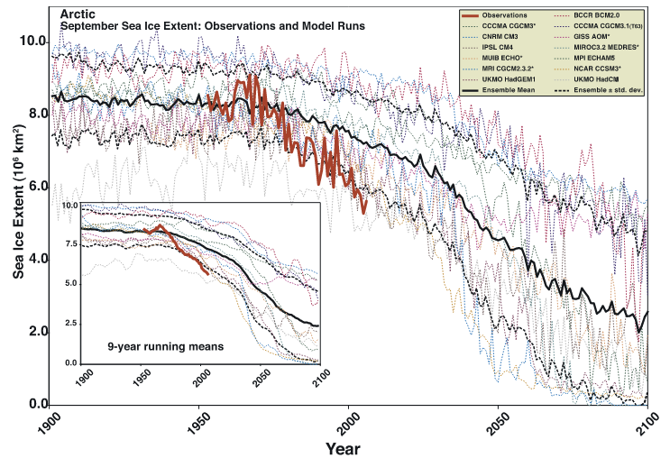
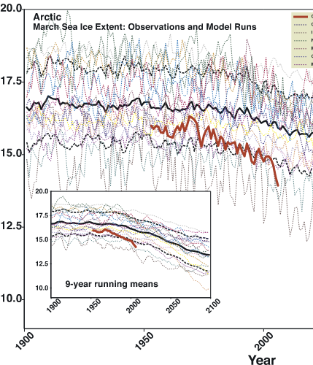
Arctic sea ice decline: Faster than forecast Stroeve et al. (2007)
Context/relevance/introduction
September Arctic sea ice extent decreased -7.8%/decade over 1953-2006
  This is -9.1%/decade over 1979-2006
  March trends are -1.8%/decade and -2.9%/decade over these two periods^
  While it is easy to ascribe these trends to purely GHG loading, natural variability needs to be accounted for
  None of the negative residual trends over 1953-2006 are comparable to observations after removing the forced component which indicates natural variability is underestimated in models.
September
March
Methods
Observations
Before 1979, estimates of SIC from satellite obsv, aircraft, and ship reports
Post 1979 they use PMW from NASA Team algorithm
Models
IPCC AR4 simulations run under “business as usual” (A1B) scenario where CO2 reaches 720 ppm by 2100
Models kept if they were within 20% of mean ice extent of observations
  13 Sep, 18 Mar for Arctic – 12 for Sep and 5 for Mar in Antarctica
Results/Discussion
The observed SIC trend over 1953-2006 is -7.8%/decade, three times larger than the multi-model mean trend of -2.5%/decade
  None of the models or their individual ensemble members have trends as large as observed over this period
    March trends aren’t as significant, but the discrepancies btw observations
    and models remain (SIC recovers in winter, but is thinner overall)
    Two interpretations of why discrepancy occurs: (a) Sep trend is statistically rare, w/natural variability dominating signal and not enough models to capture trend, or (b) models are deficient in their response to GHG forcing
They estimate what part of the observed trend is due to external forcing by (a) dividing multi-model mean by observed trend and (b) computing anomalies of multi-model mean trend, subtract those from observed time series, and recompute the trend from adjusted obsv.
  Calculations show 33-38% (1953-2006) and 47-57% (1979-2006) of observed trend is externally forced – assuming the modeled trend is a true representation of forced changes by GHG
  Observed/modeled trends for Antarctic are small, but models perform poorly over summer which limits meaningful comparison
Conclusions
For the Arctic, minima from observations were 30 years ahead of modeled minima
The evidence suggests models’ response to GHG is too weak, thus it is likely that an even higher percentage of the observed trends are externally forced
  Models do not capture natural variability well enough
  Given the evidence suggests models’ response to GHG forcing is too weak and they don’t capture natural variability well enough, an ice-free Arctic is likely to occur before projections indicate
Impressions
I think this will be key when discussing any questions about the future of the Artic, observations vs. models, and the role(s) of natural variability in the declining Arctic sea ice cover.
SI decline
Observations
Models
Natural variability

Slide 5
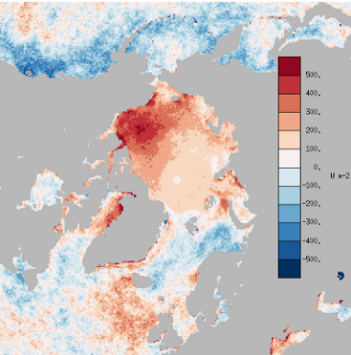
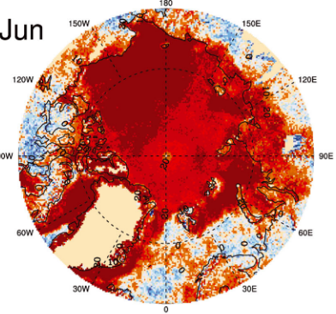
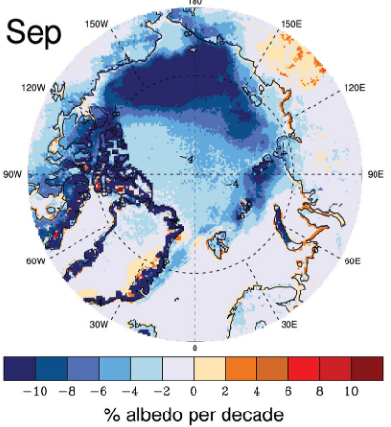

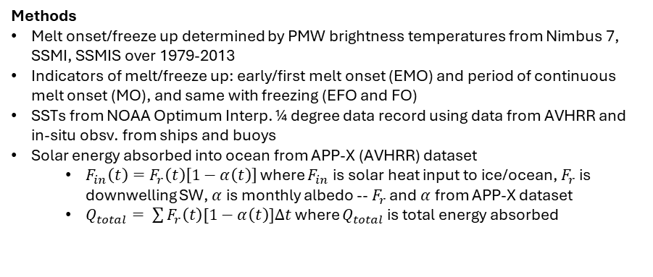
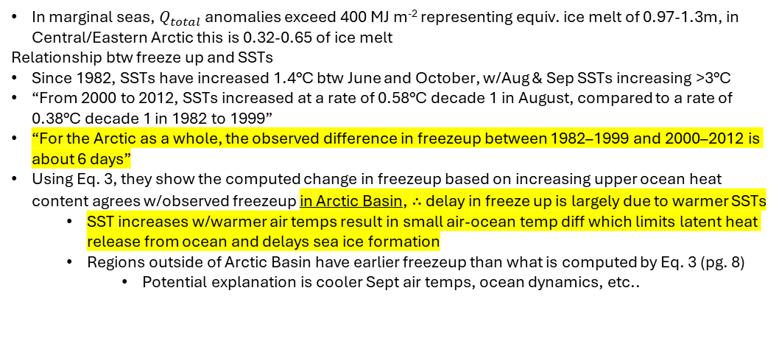
Changes in Arctic melt season and implications for sea ice loss Stroeve et al. (2014)
Context/relevance/introduction
Thermodynamic melt primarily occurs via radiation or melting the underside of ice, as sensible heat flux from atm to ice is much smaller
FYI now 70% of Arctic compared to 38% in 1980s
Goal of paper is to analyze change in melt/freeze season, look at absorbed solar radiation, and examine SSTs
In marginal seas, $Q_{total}$ anomalies exceed 400 MJ m⁻² representing equiv. ice melt of 0.97-1.3m, in Central/Eastern Arctic this is 0.32-0.65 of ice melt
Relationship btw freeze up and SSTs
Since 1982, SSTs have increased 1.4°C btw June and October, w/Aug & Sep SSTs increasing >3°C
“From 2000 to 2012, SSTs increased at a rate of 0.58°C decade 1 in August, compared to a rate of 0.38°C decade 1 in 1982 to 1999”
“For the Arctic as a whole, the observed difference in freezeup between 1982–1999 and 2000–2012 is about 6 days”
Using Eq. 3, they show the computed change in freezeup based on increasing upper ocean heat content agrees w/observed freezeup in Arctic Basin, ∴ delay in freeze up is largely due to warmer SSTs
  SST increases w/warmer air temps result in small air-ocean temp diff which limits latent heat release from ocean and delays sea ice formation
  Regions outside of Arctic Basin have earlier freezeup than what is computed by Eq. 3 (pg. 8)
    Potential explanation is cooler Sept air temps, ocean dynamics, etc..
Methods
Melt onset/freeze up determined by PMW brightness temperatures from Nimbus 7, SSMI, SSMIS over 1979-2013
Indicators of melt/freeze up: early/first melt onset (EMO) and period of continuous melt onset (MO), and same with freezing (EFO and FO)
SSTs from NOAA Optimum Interp. ¼ degree data record using data from AVHRR and in-situ obsv. from ships and buoys
Solar energy absorbed into ocean from APP-X (AVHRR) dataset
  $F_{in}\left(t\right)=F_{r}\left(t\right)\left[1−α\left(t\right)\right]$ where $F_{in}$ is solar heat input to ice/ocean, $F_{r}$ is downwelling SW, $α$ is monthly albedo -- $F_{r}$ and $α$ from APP-X dataset
  $Q_{total}= \sum{F_{r}\left(t\right)[1−α\left(t\right)]∆t}$ where $Q_{total}$ is total energy absorbed
Results/Discussion
Melt season
Trends in days/decade: EMO=-1.9, MO=-2.1, EFO=3.0, FO=2.3
  Consistent across all regions^ except Bering/Sea of Okhotsk which means that the melt season is lengthening on both sides
  Positive trend in Bering Sea consistent with SIE/SIC pos trends from Cavalieri and Parkinson (2012)
  In Arctic Basin, the later autumn freeze up dominates trend of lengthened melt season, w/largest trends of 9-13 days/decade
    Meaning lengthening of melt season by a month over study period
    Similar lengthening in E. Greenland/Barents Seas, sometimes higher
    For the Arctic as a whole, melt season has lengthened 4-5 days/decade
Total absorbed energy
Perovich et al. (2011) showed that solar heating of ice/ocean is more sensitive to timing of melt onset than autumn freeze up as the melt onset lowers the albedo and begins the positive feedback
Neg albedo trends up to -9%/decade in marginal seas of Arctic
Albedo trends max in Sep, but largest trends in total absorbed solar rad are in Jun, reflecting influence of earlier melt onset during the period of peak solar insolation
  Hence, melt onset has larger impact on total absorbed solar rad than timing of freeze-up, in agreement w/Perovich et al. (2011)
Absorbed solar rad anomalies
Conclusions
They mention that diff in MYI/FYI albedo and decline in MYI can allow for huge increase in solar heat absorption equivalent to melting 1.0m ice (Perovich and Polashenski, 2012)
Underscoring importance of interannual variability w/thinner ice cover – ice cover is more sensitive to changes in temps in either direction
Primary takeaways are lengthening of melt season of 1-2 weeks in some regions (4-5 days in Arctic Basin) and albedo trends of -9%/decade in marginal seas
Impressions
I think the comment about thinner ice cover being more vulnerable to natural variability is interesting… w/anomalously cold temps, SIC could rebound quickly due to higher growth rate of thinner ice. Conversely, rapid ice loss could occur w/anomalously warm temps.
SI decline
Melt onset
Freeze up
PMW

Slide 6
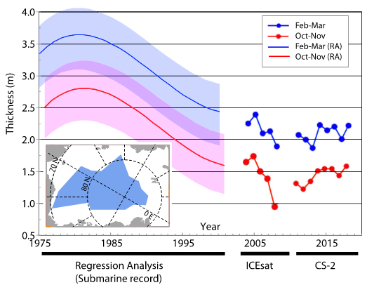
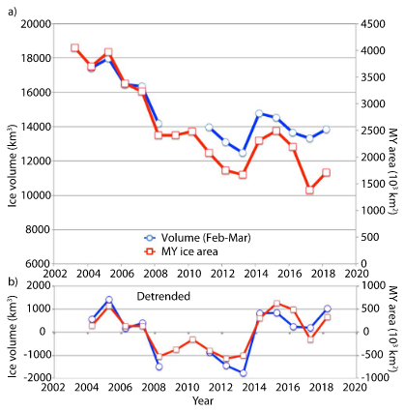
Arctic sea ice thickness, volume, and multiyear ice coverage: losses and coupled variability (1958-2018) Kwok et al. (2018)
Context/relevance/introduction
This paper aims to provide a long-term timeseries of SIT/SIV by stitching together submarine, sonars, satellite altimeters, and satellite scatterometers (1958-2018)
This study updates Kwok and Rothrock (2009) by extending their 1958-2007 timeseries to include the 8 years of CS2 estimates (2011-2018)
Volume during satellite (IS/CS2) period
Steeper SIV decline over IS period than the joint IS-CS2 period due to heavy weighting of 2007 minimum
  12,370 km³/decade vs. 5,130 km³/decade over Oct-Nov, for example
SIT/SIV increase in 2013/2014 due to record extreme convergence north of CAA/Greenland in summer 2013 and cooler September air temperatures (Kwok, 2015)
MYI coverage
Over 2002-2017, Arctic has lost 2x10⁶ km² (>50% decrease) and MYI is now less than 1/3 of Arctic Ocean and primarily in CAA/north Greenland
“MYI advected into the southern Beaufort Sea no longer survives summer melt, and this region has become a significant sink of MYI ice volume.”
Kwok and Cunningham (2010) state BS MYI melt may be comparable to FS MYI outflow
Coupled variability in MYI coverage & SIV -- MYI anomalies explain ~85% of variance in anomalies of Arctic SIV
Methods
US Navy Submarine declassified sonar data from 1958-2000 w/gaps. SIT computed by subtracting 0.29m bias and then multiplying by 1.075 (Rothrock et al. 2008) SIT
IS data over 2003-2008 from 10 data collection campaigns ~33 days in length SIT
  Oct to mid-Nov (2003-2007), late Feb to late Mar (2004-2008)
  Snow from ECMWF fields described in Kwok and Cunningham (2008)
  Monthly CS2 fields on 25km grid w/time varying snow depth from Kwok and Cunningham (2015) SIT
  They compare IS and CS2 SITs by comparing w/BGEP ULS and find differences of 0.14 m and 0.06 m
  MYI coverage from QuikSCAT and ASCAT (active microwave) w/daily coverage SIC
  They examine changes over four periods: pre-1990 submarine (1958-1976), post-1990 submarine (1993-1997), IS (2003-2007) and CS2 (2011-2018)
  They use 29 locations ID’d by Rothrock et al. (1999) where earlier submarine tracks cross or are closely parallel to later (1990s) ones, then assign each of the 29 locations to regions: Chukchi Cap/BS/ Canada Basin/North Pole/Nansen Basin/Eastern Arctic
    They extract monthly thicknesses from IS and CS2 at these 29 locations
    There are also ice draft from submarine sonars that were declassified within a data release area (DRA) – these are from 34 cruises over 1975-2000
      To compare these w/IS&CS2, they use a regression model from Rothrock et al. (2008) to get the annual mean ice draft (see pg. 4 for more info)
Results/Discussion
Thickness changes
SIT decreased from 3.0m to 1.6m (-46%) btw 1958-1976 and 1993-1997, then another 0.2 m (-12%) btw 1993-1997 and 2003-2007, and finally another 0.4m btw 2003-2007 and 2011-2018 → overall decline of 2.0m (66%) over 1958-2018
Regionally, Chukchi Cap is essentially ice-free, w/more seasonal ice in Nansen/Canadian Arctic
Results from regression analysis give decline from peak 3.13 m in 1980 to 2.0m in 2000, we/steepest rate in 1990 and slowing of trend towards end of record
The trend in SIT over the CS2 record is negligible (for winter/fall)
  The significant thinning pre-2008 was largely MYI losses, whereas SIT decline now is less significant as the ice cover is primarily seasonal ice.
Conclusions
Between 1958-1976 and 2011-2018, average SIT decreased by 2.0m (66%) over the six decades
The massive thinning observed in the 1980s/1990s has abated post-2007
Bering Sea as a sink for MYI; convergence event summer 2013 increased SIT/SIV
“The MYI area anomalies explain ∼85% of the variance in the anomalies in Arctic sea ice volume.”
Further emphasis that sea ice will be more vulnerable to climate forcings due to thinner cover
Impressions
My biggest takeaways are that MYI coverage is extremely strongly correlated w/SIV, that the Beaufort Sea is a sink for MYI that may be comparable to FS outflow, and post-2007 the changes in SIV are insignificant
SI decline
SIV/SIT
Submarine
MYI

