Slide 1
AAPL
2024-11-12

Slide 2
Overview
Apple Inc. (ticker symbol AAPL) is one of the world's leading technology companies, known for its innovative products such as the iPhone, iPad, Mac, and Apple Watch. The company was founded in 1976 by Steve Jobs, Steve Wozniak, and Ronald Wayne, and is headquartered in Cupertino, California.
Apple has a diverse product portfolio, including hardware, software, and services. Its flagship products, the iPhone and iPad, account for a significant portion of the company's revenue. Apple also offers a range of services such as the App Store, Apple Music, and iCloud, which have become increasingly important to the company's growth.
In addition to its consumer technology products, Apple also has a strong presence in the enterprise market with its Mac computers and software solutions. The company's ecosystem of products and services allows for seamless integration and a personalized user experience, making it a popular choice among both consumers and businesses.
Apple is known for its commitment to innovation and design, with a strong focus on user experience and premium quality. The company has a loyal customer base and a strong brand reputation, which has helped it maintain a dominant position in the market.

Slide 3
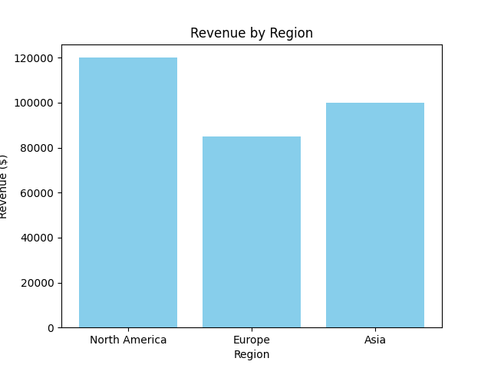
Financials
Financial Table:
Region Revenue Profit
0 North America 120000 20000
1 Europe 85000 15000
2 Asia 100000 18000

Slide 4
Geographic Mix
Geographic Distribution Table:
Region Revenue
0 North America 120000
1 Europe 85000
2 Asia 100000

Slide 5
Management Information
This section could include profiles or key information about the management team.

Slide 6
Recent News
Apple Inc. (AAPL) has been making headlines recently for its potential growth in the fields of artificial intelligence (AI) and augmented reality (AR). Renowned investor Ken Fisher has made a significant investment in the company, confident in its potential for future growth in these areas.
Fisher, founder and chairman of Fisher Investments, has reportedly invested over $2 billion in Apple, making it his third-largest holding. He believes that the company's focus on AI and AR technologies will drive its future growth and make it a strong investment opportunity.
Apple has been actively investing in AI and AR for several years, with CEO Tim Cook stating that these technologies are a top priority for the company. In 2018, Apple acquired AI startup Silk Labs, and in 2019, it acquired AR startup IKinema, signaling its commitment to these areas.
AI and AR have the potential to enhance Apple's products and services, such as the iPhone and Apple Watch, by improving user experience and introducing new features. They also have the potential to open up new revenue streams, such as through the sale of AR glasses or the use of AI in healthcare.

Slide 7
Discounted Cash Flow Analysis
Sample DFC analysis content and calculations.

Slide 8
Leveraged Buyout Analysis
Sample LBO analysis content and calculations.

