Slide 1

Writing games with Python

Slide 2
Available Libraries
Many common game programming libraries have python bindings.
There are many “pure” python libraries for writing games and these can run anywhere you have a python interpreter (like Qpython for Android)
When you can't use one of those mentioned above Python is trivial to use as a scripting language in any C/C++ game project.

Slide 3
Simple Direct Media Layer (SDL)
SDL works on almost every platform known to exist. Even things like gameboy, and 20 or so that you have never heard of.
Pygame (which we will be using for our project) is not only a direct wrapper of SDL it has tons of higher level functionality like collision detection, image and TTF font loading and rendering, and helper methods to access advanced video card features like OpenGL rendering.

Slide 4
Rapid prototyping
With Python there is no edit/build/run/debug cycle. Testing and idea is as simple as rerunning the script.
Bootstraping a pygame application is just a handfull of lines of code so testing ideas is very small investment.

Slide 5
Commercial game companies use and rely on Python everyday.
There are many AAA titles that use Python as the “meat” of their game. Games like Civilization 4/5, the Total War series of games, Eve Online, and Battlefield 2+ just to name a few.
Aside from using it for scripting in a game engine, Python's easy syntax and multi-platform support make it an amazing choice for level editors and content creation tools. One good example is The QUakeArmyKnife (or Quark) which can edit levels and content for 100+ commercial games like Portal and Call of Duty.

Slide 6
Modern Graphics Cards
The functionality of modern graphics cards puts Python back in the running for game development.
Modern methods of 3d graphics takes the burdon 100% away from the CPU by requiring you to send all of the geometry, textures, and lighting info directly to the hardware and control the drawing with a 'shader'.
Shader languages differ by the tools you are using. DirectX uses a language called HLSL, and OpenGL uses GLSL. These two examples are similar to C and can be picked up by most people very quickly.

Slide 7
Speeeeeed
By nature as a very high level language Python is slow at many of the tasks common to game programming like physics, level generation, and any task that relies on raw mathmatics or extreme iteration.
Lots of the situations where speed is a liability can be worked around with smart efficent code that avoids iteration.
Places where you need to do complex calculations can be refactored into small 'drop in' C/C++ modules and imported just like they were normal pure Python files.

Slide 8
Distribution
A commercial game written in Python is a little harder to deploy, but not impossible. There are tools that can not only build a nice exe or .app of your game, but they can also generate the full installers with a single command.
Protecting the source code is hard if not impossible. Python bytecode (like Java) is easy to dissassemble and inspect.

Slide 9
Internet Access
I brought with me a portable hotspot so you can get what you need.
The SSID is 'CODETABAI' the password is 'pancakes'
http://belinux.org Has links to all the stuff we need.
Windows users need to get (if you dont already have it)
  Python 2.7.8: python-2.7.8.msi
  Python 1.9.1: pygame-1.9.1.win32-py2.7.msi
Linux (ubuntu or debian) users need the package 'python-pygame' installed.
If your install was successful you should be able to run the python interpreter and enter the following code without errors:
>>> import pygame
>>> print pygame.__version__
1.9.1release

Slide 10
And so it begins
Create a directory to hold your project files. Mine is called 'shooter'
Download the sprite_sheet.png from http://belinux.org and place it in that folder.
Open for favorite text editor and create the file main.py in the same folder you put the sprite sheet.

Slide 11
Importing pygame and initializing
Before we can use pygame we need to tell python that we want to 'import' it into our namespace.
import pygame
from pygame.locals import *
pygame.init()

Slide 12
Creating a window
In order to draw anything we first need a window to put it in. pygame.display helps us do just that. We will be using the method set_mode and store our window in the variable 'screen'.
screen = pygame.display.set_mode((800,600))

Slide 13
Loading an image
For image loading pygame makes this very simple. We will be using pygame.image which supports almost every image format in existance. We will store our loaded image in the variable 'sheet'.
sheet = pygame.image.load('sprite_sheet.png')

Slide 14
Handle an event
Pygame can handle events from keyboards, mice, joysticks, and gamepads. Here we want to keep the application open until we press a key. First we will need a state variable which we will call 'game_running' with it's initial value to True:
game_running = True

Slide 15
Our game loop
For the loop we will use the while keyword in combination with our game_running variable. In order to get the events currently on the stack we need to use pygame.event:
while game_running:
for event in pygame.event.get():
if event.type == KEYDOWN:
game_running = False

Slide 16
Drawing graphics to the window
The 'screen' variable we made earlier is actually what pygame calls a 'surface'. A surface is just a collection of pixels that make up an image (in this case our screen) with methods and tools to manipulate it. To draw to our screen we are going to use the blit method. The first argument is the surface we want to draw, the second is an 'area' we want to draw in:
screen.fill((0,0,0))
screen.blit(sheet, (0, 0, 0, 0))
pygame.display.flip()

Slide 17
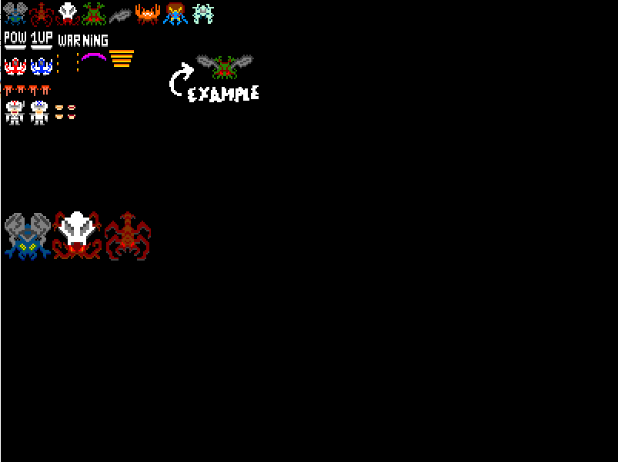
What you should have so far
import pygame
from pygame.locals import *
pygame.init()
screen = pygame.display.set_mode((800,600))
sheet = pygame.image.load('sprite_sheet.png')
game_running = True
while game_running:
for event in pygame.event.get():
if event.type == KEYDOWN:
game_running = False
screen.fill((0,0,0))
screen.blit(sheet, (0, 0, 0, 0))
pygame.display.flip()

Slide 18
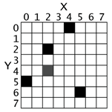
The Screen
The coordinate system is not the same as you remember from geometry class.
Top left is (0,0)
X extends to the right
Y extends down

Slide 19
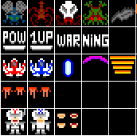
Sub-rectangles
In order to display our sprites individually we need to only draw certain areas of our sheet. Our sprite sheet is 340x340 and each sprite is 34x34 pixels. So we have a total of 10x10 sprites.

Slide 20
Calculating Sub-rectangles
So the ship graphic we want to use is in the first column and the third row of the sprite sheet.
Each sprite is 34x34
To find out where in the sheet the sprite starts we just need to so some simple multiplication. (REMEMBER sequences of numbers in programming usually start with zero so column 1 is 0 and column 4 is 3):
x = col * 34
y = row * 34
So for the ship:
0 * 34 = 0
2 * 34 = 68
So the subrectangle for our ship would be:
(0, 68, 34, 34)

Slide 21
Back to the code
So after the decleration of game_running we will add a few more 'state' variables. These will hold the current status of objects in the game world. Next we will define some constants for our sprite size:
ship_x = screen.get_width() / 2
ship_y = screen.get_height()-40
sprite_width, sprite_height = (34, 34)

Slide 22
Calculating the sub-rect
Now it's time to calculate the ship's rectangle so we can draw it:
ship_rect = (0*sprite_width, 2*sprite_height, sprite_width, sprite_height)
Now we have a sub-rectangle so we only have to draw the ship and not the whole sprite sheet!

Slide 23
Use our subrect for drawing
Now that we have what we need (the location of the ship on the screen, and the basic geometry of where the ship is in the sprite sheet we can modify our blit call to use this information:
screen.blit(sheet, (ship_x, ship_y, 0, 0), ship_rect)

Slide 24
What you should have so far
import pygame
from pygame.locals import *
pygame.init()
screen = pygame.display.set_mode((800,600))
sheet = pygame.image.load('sprite_sheet.png')
game_running = True
ship_x = screen.get_width() / 2
ship_y = screen.get_height()-40
sprite_width, sprite_height = (34, 34)
ship_rect = (0*sprite_width, 2*sprite_height, sprite_width, sprite_height)
while game_running:
for event in pygame.event.get():
if event.type == KEYDOWN:
game_running = False
screen.fill((0,0,0))
screen.blit(sheet, (ship_x, ship_y, 0, 0), ship_rect)
pygame.display.flip()

Slide 25
Making our ship move
We have everything in place to allow our ship to move around based on input from the keyboard. We need to modify our event checking to handle the arrow keys.
for event in pygame.event.get():
if event.type == KEYDOWN:
if event.key == K_ESCAPE:
game_running = False
if event.key == K_LEFT:
ship_x -= 5
if event.key == K_RIGHT:
ship_x += 5

