Slide 1

Let’s OverREACT
A ReactJS Development Primer

Slide 2
Introduction
Chris Wall
Senior Software Architect, Afterman Software
chris@aftermansoftware.com
Previous Experience
5 years at HP as Principal Architect and Development Lead in the Enterprise Cloud Services division
2 years at Avanade as Sr. Solutions Architect in Enterprise Solutions division
Total of 20 years as a developer and architect

Slide 3
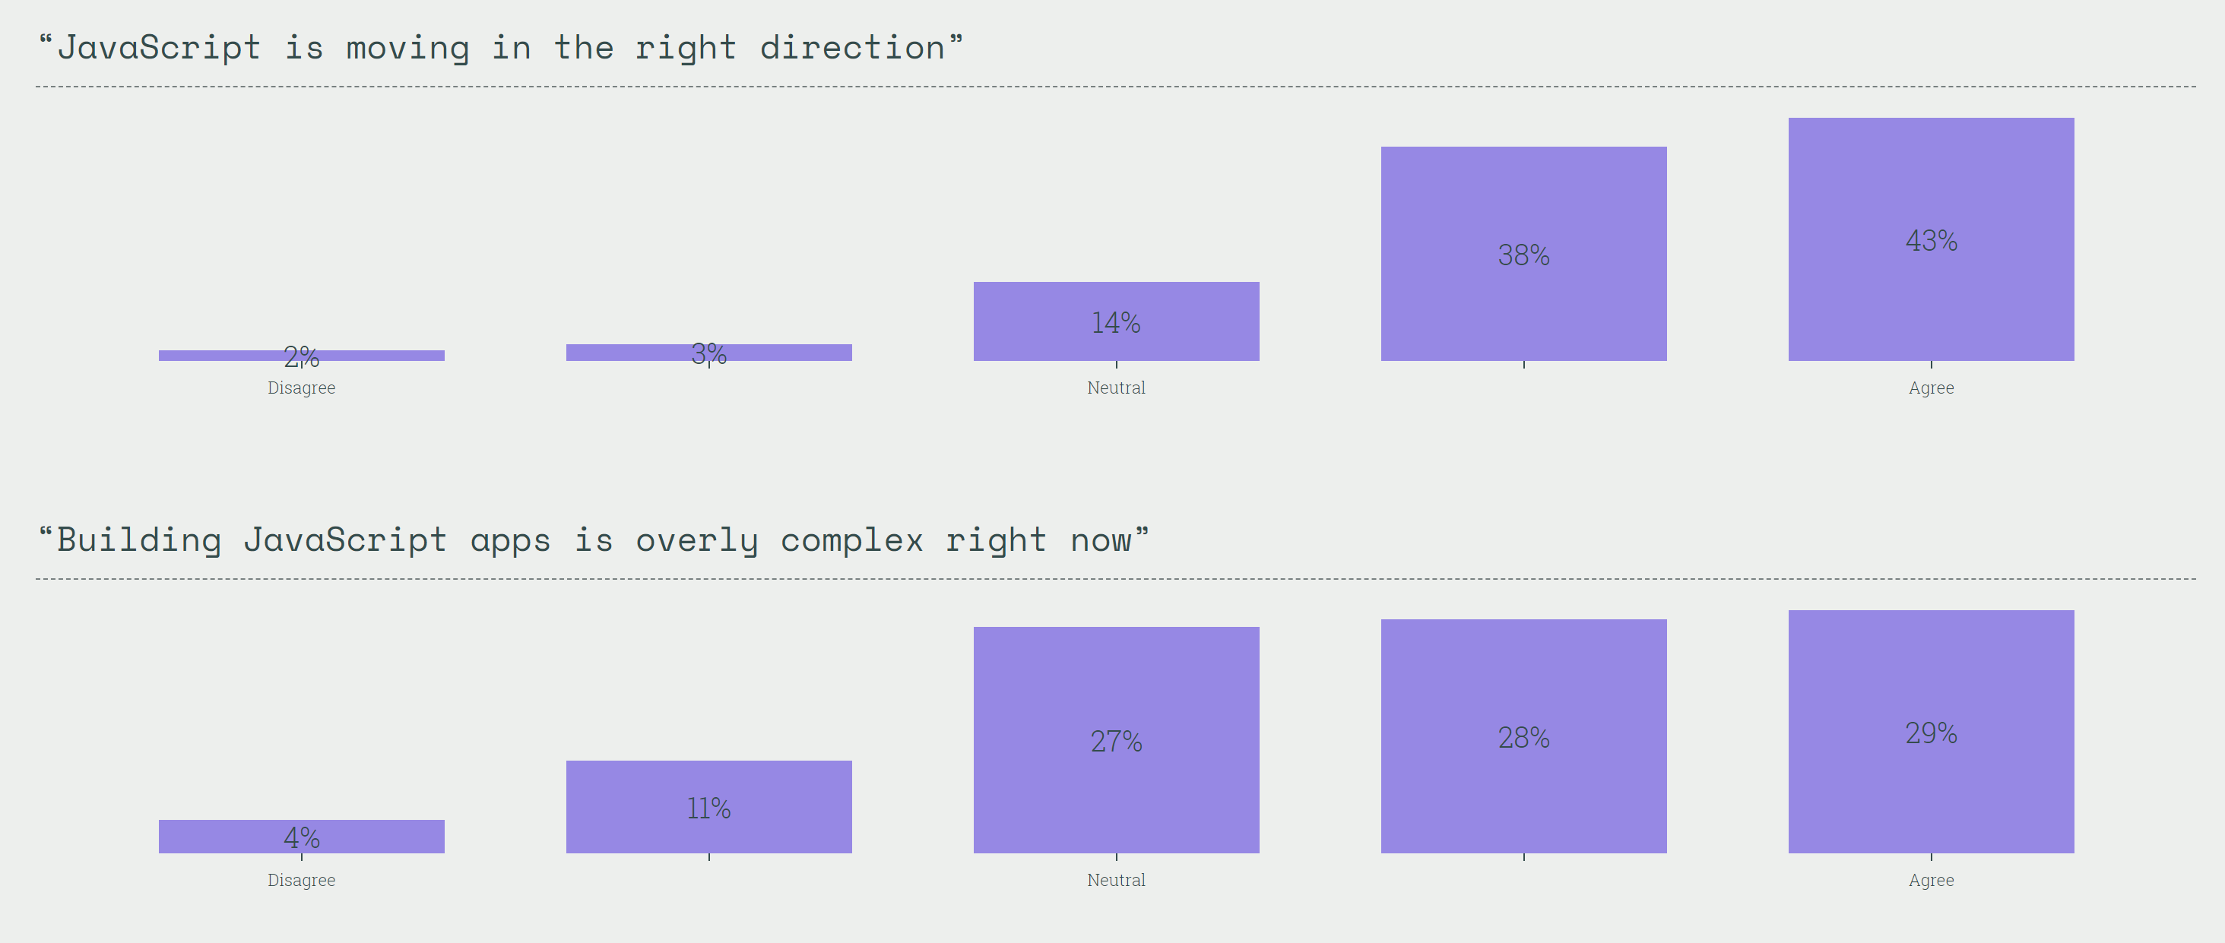
State of the Union
In 2018, JavaScript is a mess
Tooling is strong but fragmented and complex
Standards are adopted at varying rates across browser vendors

Slide 4
Vocabulary
ES2015 is the latest mass-adoption version of JavaScript
ES5 is the JS version necessary for supporting older browsers
Transpiling is the process of converting ES2015+ into ES5
Syntax and language features only
Can I Use is a handy tool for checking functional features (e.g. fetch)
Bundling is the process of combining your transpiled code into packages
Code splitting is separating your app into packages for optimal loading scenarios
Tree shaking is the process that removed unnecessary dependencies

Slide 5
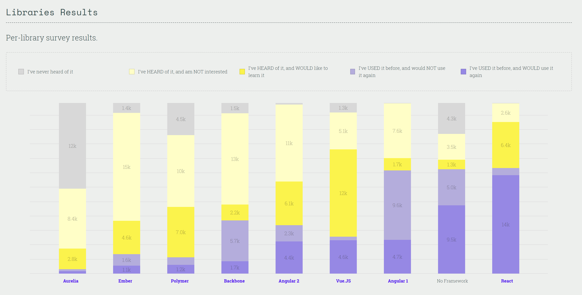
Why ReactJS?

Slide 6

Getting Started

Slide 7
Save the Environment
Best Practice ReactJS development requires Node and NPM
Best Practice ReactJS setup uses transpiler and packager
Common tools necessary are:
Transpiling ES2015 and JSX to ES5 using Babel
Packaging using Webpack, Browserify, etc.
Dependency management using NPM, JSPM, Bower, etc.
Each of these things needs to be configured separately – usually on a project by project basis
These tools must be kept in sync as versions change and different ECMA features become supported

Slide 8

But, you said we’d like React!
Yes, React can be scary.

Slide 9
My Hero!
Create React App is a Node based CLI for quickly scaffolding your React applications and development environment
Found on NPM: `$ npm –i –g create-react-app`
Version locks your environment dependencies
Offers an `eject` command to take off the training wheels

Slide 10
So, what exactly is React?
ReactJS is a view rendering library

Slide 11
React 101
A React UI is composed of components
Components can be created by extending a Component base class or for stateless components a simple JavaScript function will work
Components are authored in an HTML-like language extension called JSX
CSS in JS can be used with the style attribute or regular CSS Styles can be applied using class and id attributes and style sheets
Composition is declarative
React is vanilla JavaScript and can leverage anything you could in plain JS
React encourages one-way data flow
Common Gotchas:
JSX tags cannot use class or for attributes; instead use className and htmlFor
Component classes should bind instance methods to ‘this’ to avoid strange bugs
Controlled components can be a pain and feel like reinventing the wheel

Slide 12

Show me the money!
Enough idle chit-chat;
let’s see React in action!
https://github.com/chris-wall/lets-overreact

Slide 13
Show me the data!
GraphQL API to serve the data (deep dive is outside the scope of this talk)
Data Model:
Driver: represents a person
Name and email fields (both strings)
Driver has a 1:n relationship with Vehicle
Vehicle: represents a car
Vin, year, make, model
Vehicle has a n:1 relationship with Driver

Slide 14
Show me the data (visually)!
The application state uses Redux-Saga and Redux to process side effects and store the API data for use by the application.
Redux coupled with Immutable to enforce one way data flow
ReactJS components to display our API data.
React Router will handle our contextual display state.

Slide 15

Questions and Comments
Ok, what do you got?

