Slide 1
Party-Queue
A Social Party Playlist

Slide 2
The Team
Luke Worley
Bu Sun Kim
Daniel Henderson
Corwin Sheahan

Slide 3
What is Party Queue?

Slide 4
How Did We Create it?

Slide 5
Summary of Tools

Slide 6

VCS
Project Tracker
5/5 star rating
Git is a fantastic VCS

Slide 7

Hosted backend server on Google App Engine
Endpoints API
3.5/5 stars
Great for getting up and running
Hides complexities from the programmer
Code generation
Difficult to unit test

Slide 8


Testing
Python Unittest framework for server-side
Rating 4/5
Junit framework for client side
Rating 4/5

Slide 9

Google Datastore
Rating 5/5 stars
Very easy to use
Great testing environment available

Slide 10

IDE for Frontend development
Rating 4/5

Slide 11

Text editor used for writing backend code.
Rating 5/5 stars
Very efficient
Fast
No frills
Highly customizable

Slide 12

Auto-documenter for Client Side code
Rating 3.5/5

Slide 13
Development Methodology

Slide 14

Employed (Pseudo) Agile development process
Weekly standups
No customers (....yet)
Month-long sprints

Slide 15

Often used pair programming after weekly standups
Helped our team develop a common level of code-base competency
Especially helpful in debugging/easing the pain of environment setup

Slide 16
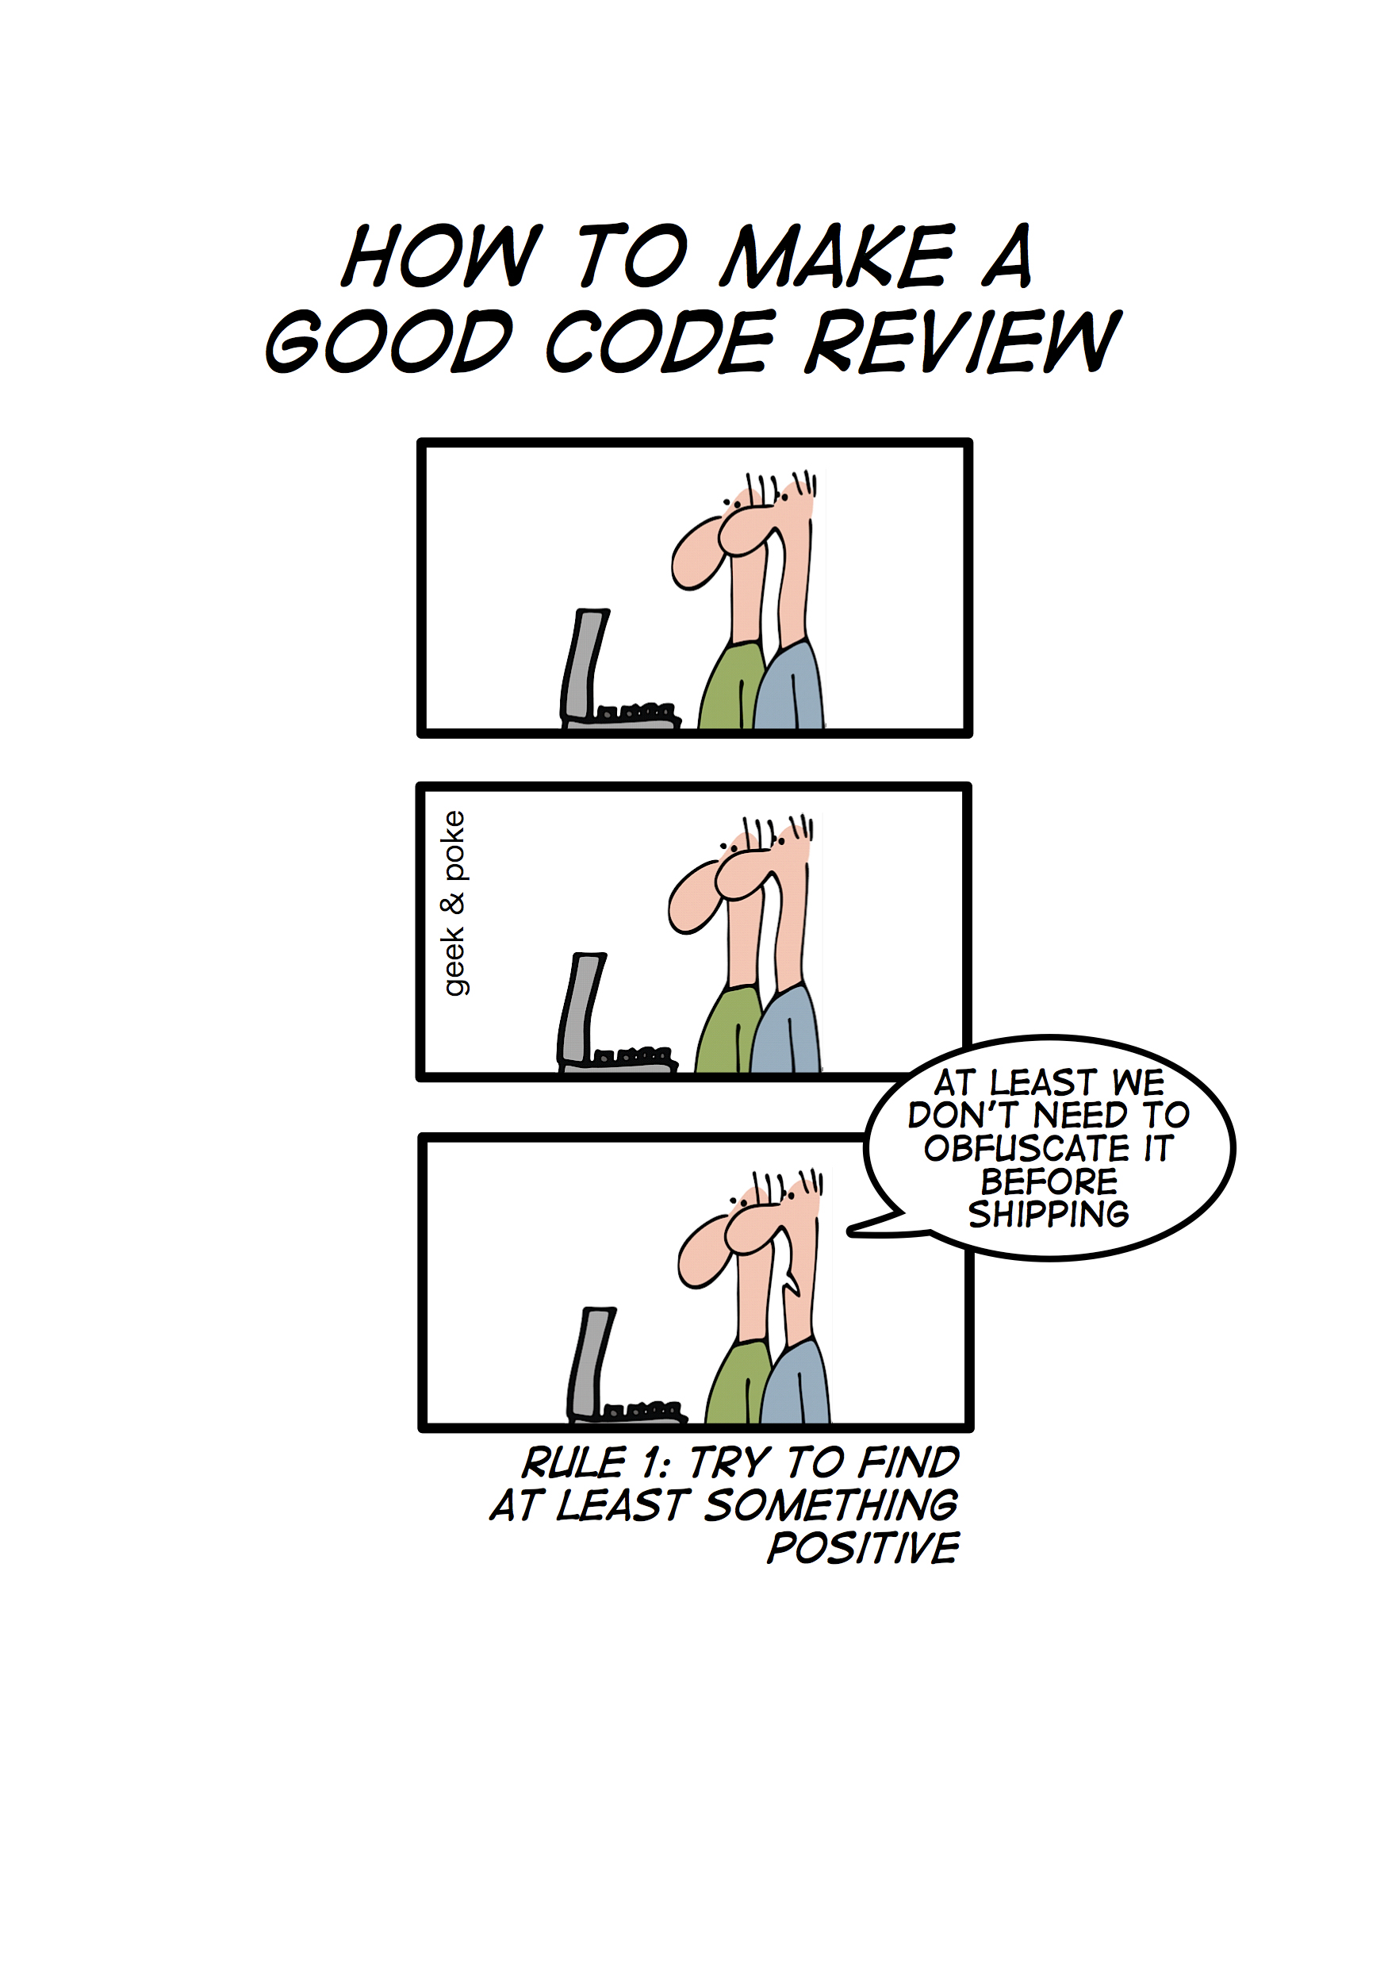
Code review used on every new piece of code.

Slide 17
Challenges

Slide 18

No team experience with GAE
No team experience with Android/Android Studio
Limited experience with Python & Java
Overcame these challenges through persistence
Final product is not as feature-laden as we had planned

Slide 19
Demo!!

Slide 20
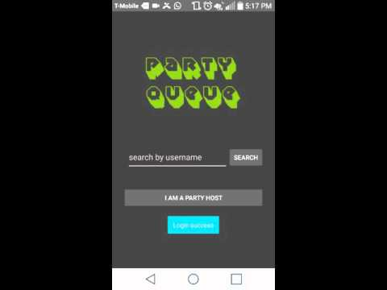

Slide 21
