Slide 1
Chapter 2: Bits and Bytes
Topics
  Why bits?
  Binary Logic
  Representing information as bits
    Binary/Hexadecimal
    Byte representations
      ints, floats, double precision

Slide 2
Announcements
Data Lab is available on the moodle, due Friday Sept 12 by 11:55 pm
  Sign up at moodle.cs.colorado.edu, enrollment key = systems14
No TA recitation next Monday due to Labor Day
  May hold extra office hours
Lecture slides online: ppt’s vs pdf’s
  pdf’s lose animation and notes at bottom of each slide
Essential that you read the textbook in detail & do the practice problems
  Solutions to practice problems are at the end of each chapter
  Read Chapter 2 (2.1-2.3)

Slide 3
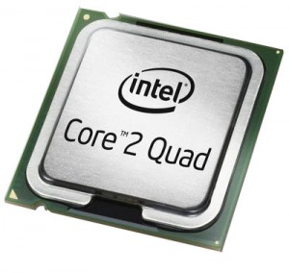
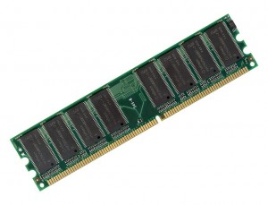
Recap: Systems In a Nutshell
add a,b
sub a,b
move a…
Lines of
Source
code
Pre-processor
&
Compiler
Lines of
Assembly
code
Assembler
&
Linker
Chapter 2
10101010
00001010
10101010
01010111
Lines of
Binary
code &
data
Memory
11101110
00111011
10000111

Slide 4
Decimal Representation
Decimal representation (Base 10) is what we humans naturally gravitate to, given 10 digits (fingers)!
  7126 base 10 = 7126₁₀
  = 7000 + 100 + 20 + 6
  = 7*10³ + 1*10² + 2*10¹ + 6*10⁰
  By convention, we write the most significant digit on the left, followed by the second most significant digit, then the 3rd most significant digit, etc., until we reach the least significant digit

Slide 5
Binary Representation – Why Bits?
0 1 0 1₂ = 0*2³ + 1*2² + 0*2¹ + 1*2⁰
= 0 + 4 + 0 + 1 = 5₁₀
Each binary digit is called a ‘bit’
Base 2 or Binary is easier to represent via electronic circuits than Base 10
  Digital transistor circuits can easily represent a ‘0’ and a ‘1’
    A ‘1’ = +5 volts, a ‘0’ = 0 volts, so only 2 voltage levels
    Don’t have to implement 10 different voltage levels as in base 10
  Easy to implement Base 2 arithmetic
    much of Base 10 arithmetic using Base 2 arithmetic (integers are exact, but floats are approximations)
  Easy to implement digital logic (AND, OR, etc.) with binary
Notes:
Most digital circuits today are based on CMOS (Complementary Metal Oxide Semiconductor) technology.
CMOS typically combines together NMOS and PMOS transistors to form digital logic and arithmetic circuits

Slide 6
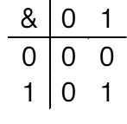
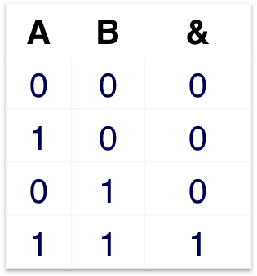
Digital Logic via Boolean Algebra
Developed by George Boole in 19th Century
  Algebraic representation of logic
    Encode “True” as 1 and “False” as 0
And “&”
  A&B = 1 only when both A=1 and B=1
B
A
Truth Tables
(two forms)
Notes:
Now we’re representing variables as TRUE/FALSE Booleans *and* performing *logical* operations on them. In the next subsections, we’ll consider representing variables as integers, and performing *arithmetic* operations on them. Note the above tables are called “truth tables”.

Slide 7
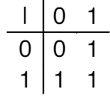
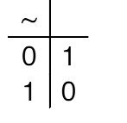
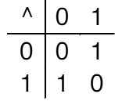
Common Digital Logic Operations
And “&”
  A&B = 1 only when both A=1 and B=1
Or “|”
  A|B = 1 when either A=1 or B=1
B
A
Not “~”
  ~A = 1 only when A=0
Exclusive-Or (Xor) “^”
  A^B = 1 when either A=1 or B=1, but not both
Other operators: NAND (Not AND), NOR (Not OR), etc.
Notes:
Now we’re representing variables as TRUE/FALSE Booleans *and* performing *logical* operations on them. In the next subsections, we’ll consider representing variables as integers, and performing *arithmetic* operations on them. Note the above tables are called “truth tables”.

Slide 8
Implementing Digital Logic
D
Silicon transistor (NMOS)
  Three terminals. Input is the Gate G
  Acts like a simple ON/OFF switch
  Current flows from high voltage to low voltage
G
S
D
  When a high voltage is applied to the input Gate G, then this connects the two terminals D and S, i.e. closes the switch, and current flows between them
G = High
voltage
Current
can flow
S
  When a low voltage is applied to Gate, then the two terminals are disconnected, i.e. opens the switch, and no current flows
D
G = Low
voltage
No
Current
flows
S
Notes:
This is an example of an n-type Metal Oxide Semiconductor (MOS) Field Effect Transistor (FET), or NMOS for short. See MOSFET for more.

Slide 9
Implementing an Inverter or Not “~” Operation
High input connects Output to Ground
Low input means no current flows, so output stay high
An Inverter circuit
Power = +3 or +5 Volts
Power
Power
resistor
R
resistor
R
Voltage drop when current flows
resistor
R
Output
Output
= Low
Output
= High
Input
Input = High
Input = Low
Ground
= 0 Volts
Ground
Ground
  Thus we have an inverter or Not “~” operator:
    Input ‘1’ (High voltage) => output ‘0’ (Low voltage)
    Input ‘0’ (Low voltage) => output ‘1’ (High voltage)
Notes:
See Wikipedia for more.

Slide 10
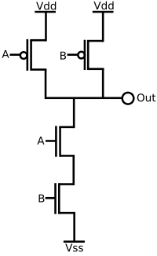
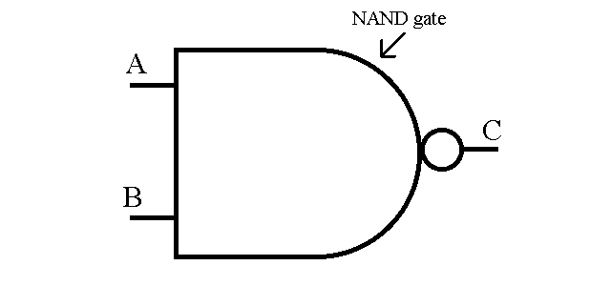
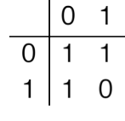
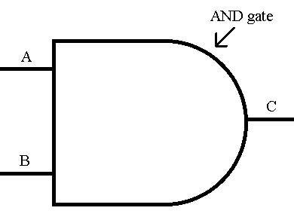
Implementing a NAND operation
Power
NAND = Negative AND
  Output = ~(A AND B)
  Symbol for a NAND gate is:
Pmos transistor
has opposite
behavior of nmos
How do I make an AND gate?
  Concatenate an inverter after a NAND gate!
  AND gate symbol:
B
NAND
A
Ground
Notes:
Top two transistors are pmos, while the bottom two transistors are nmos. Pmos has the opposite behavior of nmos, namely when the input to a pmos transistor is HIGH, then two terminals are disconnected, while when the input is LOW, the two terminals are connected. Mixing nmos and pmos transistors creates Complementary MOS (CMOS) digital logic circuits.

Slide 11
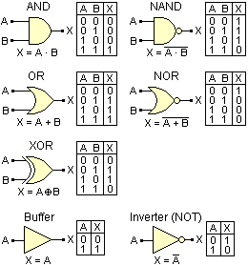
Binary Digital Logic Symbols
Notes:
See Wikipedia for more.

Slide 12
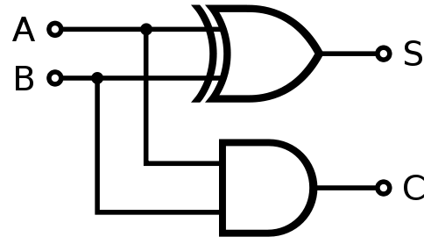
Building a Binary Adder
One-bit Half Adder circuit
  Sum bit S = A XOR B
  Carry bit C = A AND B
One-bit Full Adder circuit extends Half Adder to also account for a bit carried in, not just the bit carried out
Example: an 8-bit Full Adder can be built by concatenating 8 one-bit Full Adders
Bit A | Bit B | Sum S | Carry C
0 | 0 | 0 | 0
0 | 1 | 1 | 0
1 | 0 | 1 | 0
1 | 1 | 0 | 1
One-bit Half Adder Circuit
Notes:
See Wikipedia for more.

Slide 13
Binary Representation (2)
Base 2 vs. Decimal conversion example:
  89 base 10 = 89₁₀ = what in base 2 or binary?
  Find the largest power of 2 that is <= # and then subtract.
  Keep iterating until #=0.
  89₁₀ = 64 + 16 + 8 + 1
  = 2⁶ + 2⁴ + 2³ + 2⁰
  = 0*2⁷ + 1*2⁶ + 0*2⁵ + 1*2⁴ + 1*2³ + 0*2² + 0*2¹ + 1*2⁰
  = 0 1 0 1 1 0 0 1 ₂

Slide 14
Hexadecimal Representation
Hexadecimal (base 16) is more convenient (it’s power of 2) and compact notation for larger binary #’s
  Consider a 32-bit number:
  10101110001100101000101000011001₂
  This is hard to read. So form 4-bit groups.
  = 1010 1110 0011 0010 1000 1010 0001 1001₂
  We then use hexadecimal notation:
  Use characters ‘0’ to ‘9’ and ‘A’ to ‘F’
  = A E 3 2 8 A 1 9 ₁₆
  = 0xAE328A19
  “0x” signifies hexadecimal or just hex. Note lower case 0xae328a19 is also valid.
Decimal
Hex
Binary
0
0
0000
1
1
0001
2
2
0010
3
3
0011
4
4
0100
5
5
0101
6
6
0110
7
7
0111
8
8
1000
9
9
1001
A
10
1010
B
11
1011
C
12
1100
D
13
1101
E
14
1110
F
15
1111
Notes:
32 bits is the standard word size in IA32 architectures.

Slide 15
How We Use These Representations
Since these are just numbers, we can use them to describe anything with numerical value
We’ll use them to describe the numerical values of data stored at various memory locations
  Different data values, like real and integer values, positive and negative
We’ll also use them to describe the addresses of memory locations
Later, our code instructions will be encoded in binary as well

Slide 16
Byte-Addressed Memory
MEMORY
15₁₀
byte 15
14₁₀
byte 14
Byte = 8 bits
  Binary 00000000₂ to 11111111₂
  Decimal: 0₁₀ to 255₁₀
  Hexadecimal 00₁₆ to FF₁₆
.
.
.
.
.
.
.
  Memory addresses are referenced by their byte number
    Example: a 16 byte memory
    Memory address 15₁₀
    = 16th byte (since memory starts at 0)
    = binary address
    00000000000000000000000000001111₂ in bytes
    = hex address 0x0000000F in bytes
    This memory stores how many bits?
    Answer: 8*16 = 128 bits!
8 bits
3₁₀
2₁₀
byte 2
1₁₀
byte 1
0₁₀
byte 0
Memory Address
Notes:
What we’re trying to bring out here is that binary, hex and decimal can be used to describe both the data values/bytes stored *in* memory as well as the addresses *of* the memory.

Slide 17
Machine Words
Each CPU Has “Word Size”
  Nominal size of integer-valued data
    Including addresses
  Early microprocessors were 8-bit CPUs. Today, many embedded microcontrollers are still 8-bit.
  Intel evolved to 16-bit processors, and called these “words”.
  Most machines were 32 bits (4 bytes)
    Limits addresses to 4GB
    Becoming too small for memory-intensive applications
  Most newer systems are 64 bits (8 bytes)
    Potentially address ≈ 1.8 X 10¹⁹ bytes or 18 Exabytes
  Machines support multiple data formats
    Fractions or multiples of word size
    Always integral number of bytes

Slide 18
Word-Oriented Memory Organization
32-bit
Words
64-bit
Words
Memory
(bytes)
Addr.
0015
Addr
=
??
0014
Addresses Specify Byte Locations
  Address of first byte in word
  Addresses of successive words differ by 4 (32-bit) or 8 (64-bit)
0012
0013
Addr
=
??
0012
0008
0011
Addr
=
??
0010
0008
0009
0008
0007
Addr
=
??
0006
0004
0005
Addr
=
??
0004
0000
0003
Addr
=
??
0002
0000
0001
0000

Slide 19
Data Representations
Sizes of C Objects (in Bytes)
  C Data Type Intel_x64 Typical 32-bit Intel IA32
    int 4 4 4
    long int 8 4 4
    char 1 1 1
    short 2 2 2
    float 4 4 4
    double 8 8 8
    long double 10/16 8 10/12
    char * 8 4 4
      Or any other pointer
    A float is a real # like -2.7143*10⁽⁻³⁾. A double just provides more precision than a float, something like 2.71433273882*10⁽⁻³⁾
    A pointer stores an integer–like value that is interpreted as a memory location/address

Slide 20
Storing Data in Memory
Memory
(bytes)
Addr.
IA32 Example:
  Address of int is 0x00000000
  Address of float is 0x00000004
  Address of character = ‘7’ is 0x00000009
  Address of pointer is 0x0000000c
    Note: the pointer points to another memory location, i.e. stores a memory location address
0015
value=
address
0014
pointer
4 bytes
0013
0012
char 1 byte
‘x’
0011
char 1 byte
‘y’
0010
char 1 byte
‘7’
0009
char 1 byte
‘!’
0008
0007
value
0006
    e.g. if pointer = 0x00000004 it means the pointer is pointing to the float! (actually the first byte of the float)
float
4 bytes
0005
0004
0003
int
4 bytes
value
0002
0001
0000

Slide 21
Pointers in C
To declare a pointer to say an integer, here’s some code:
  int x;
  int *p = &x;
  int * p declares the variable p to be a pointer to an integer
  note how it differs from the declaration ‘int p’, which would just declare p to be an integer, not a pointer to an integer
  &x means find the memory location/address of x
  Thus, int *p = &x means initialize the value of the pointer p with the address of integer variable x.

Slide 22
Dereferencing Pointers in C
To find the value of a variable being pointed to, you must dereference a pointer. Here’s some code:
  int x;
  int *p = &x;
  int y = *p;
  p is a pointer to an integer. To get the value of the integer that p is pointing to, you use the dereference operator (*).
  note how * is used first to declare a pointer, and is used later to dereference a pointer to find the value of the variable it is pointing to
  Here, y = x.

Slide 23
Pointer Values
Since the pointer value is an address, then it doesn’t matter what type of variable is being pointed to, the size of the pointer value is always 4 bytes (IA32)
  char c;
  int x;
  double d;
  char *p1 = &c;
  int *p2 = &x;
  double *p3 = &d;
  p1 is a pointer to a one-byte long char, but is 4 bytes long, because the address of the char is 4 bytes long.
  p3 is a pointer to an 8-byte long double, but is 4 bytes long, because the address of the double (lowest byte) is 4 bytes long.

Slide 24
Supplementary Slides

Slide 25
Integer Algebra vs. Boolean Algebra
Integer Arithmetic
  ⟨Z, +, *, –, 0, 1⟩ forms a “ring”
  Addition is “sum” operation
  Multiplication is “product” operation
  – is additive inverse
  0 is identity for sum
  1 is identity for product
Boolean Algebra
  ⟨{0,1}, |, &, ~, 0, 1⟩ forms a “Boolean algebra”
  OR is “sum” operation
  AND is “product” operation
  ~ is “complement” operation (not additive inverse)
  0 is identity for sum
  1 is identity for product

Slide 26
Boolean Algebra ≈ Integer Ring
  Commutativity
  A | B = B | A A + B = B + A
  A & B = B & A A * B = B * A
  Associativity
  (A | B) | C = A | (B | C) (A + B) + C = A + (B + C)
  (A & B) & C = A & (B & C) (A * B) * C = A * (B * C)
  Product distributes over sum
  A & (B | C) = (A & B) | (A & C) A * (B + C) = A * B + A * C
  Sum and product identities
  A | 0 = A A + 0 = A
  A & 1 = A A * 1 = A
  Zero is product annihilator
  A & 0 = 0 A * 0 = 0
  Cancellation of negation
  ~ (~ A) = A – (– A) = A

Slide 27
Boolean Algebra ≠ Integer Ring
  Boolean: Sum distributes over product
  A | (B & C) = (A | B) & (A | C) A + (B * C) ≠ (A + B) * (A + C)
  Boolean: Idempotency
  A | A = A A + A ≠ A
    “A is true” or “A is true” = “A is true”
  A & A = A A * A ≠ A
  Boolean: Absorption
  A | (A & B) = A A + (A * B) ≠ A
    “A is true” or “A is true and B is true” = “A is true”
  A & (A | B) = A A * (A + B) ≠ A
  Boolean: Laws of Complements
  A | ~A = 1 A + –A ≠ 1
    “A is true” or “A is false”
  Ring: Every element has additive inverse
  A | ~A ≠ 0 A + –A = 0

Slide 28
Properties of & and ^
Boolean Ring
  ⟨{0,1}, ^, &, Ι, 0, 1⟩
  Identical to integers mod 2
  Ι is identity operation: Ι (A) = A
    A ^ A = 0
Property Boolean Ring
  Commutative sum A ^ B = B ^ A
  Commutative product A & B = B & A
  Associative sum (A ^ B) ^ C = A ^ (B ^ C)
  Associative product (A & B) & C = A & (B & C)
  Prod. over sum A & (B ^ C) = (A & B) ^ (A & C)
  0 is sum identity A ^ 0 = A
  1 is prod. identity A & 1 = A
  0 is product annihilator A & 0 = 0
  Additive inverse A ^ A = 0

Slide 29
Application of Boolean Algebra
Applied to Digital Systems by Claude Shannon
  1937 MIT Master’s Thesis
  Reason about networks of relay switches
    Encode closed switch as 1, open switch as 0
A&~B
Connection when
A&~B | ~A&B
A
~B
~A
B
~A&B
= A^B

Slide 30
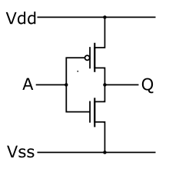
Binary Digital Logic Circuit Example
= +3 V
CMOS inverter circuit
  Vdd = Power = +3 Volts, Vss = Ground = 0 Volts
  Current flows from high voltage to low voltage
  When input A = 0 V (Ground), then nmos transistor is shut off, while the pmos transistor is turned on, so Q is connected to Vdd = +3 V
pmos
= 0 V
~= +3 V
nmos
= 0 V
= +3 V
  When input A = +3 V (Power), then pmos is off and nmos is on, so Q is connected to ground and is pulled down to 0 V
  So Q is the opposite or inverse of A!
  i.e. Q = ~A
  AND, OR, NAND, NOR, ADD, SUBTRACT, etc. are also implemented this way…
pmos
= 3 V
~= 0 V
nmos
= 0 V
Notes:
See Wikipedia for more.

Slide 31
Byte-Oriented Memory Organization
Programs Refer to Virtual Addresses
  Conceptually very large array of bytes
  Actually implemented with hierarchy of different memory types
    SRAM, DRAM, disk
    Only allocate for regions actually used by program
  Address space private to particular “process”
    Program being executed
    Program can clobber its own data, but not that of others
Compiler + Run-Time System Control Allocation
  Where different program objects should be stored
  Multiple mechanisms: static, stack, and heap
  In any case, all allocation within single virtual address space

