Slide 1
Monte Carlo Simulations
Simulate the distribution of the key in the network by randomly connecting nodes with a certain probability p
Only use primitive operations
The simulation makes no assumption about the distribution of p
Simulate over a large sample set
At least 10,000 samples

Slide 2
Monte Carlo Simulation Results
Simulation results match theoretically expected values almost exactly
Comparison of distribution times when p = 0.5
Group Size | Model | Simulation | Difference
5 | 4.4956 | 4.4952 | 0.0004
10 | 6.3174 | 6.3368 | 0.0194
15 | 7.5182 | 7.5361 | 0.0179
20 | 8.456 | 8.456 | 0
25 | 9.1614 | 9.1538 | 0.0076
30 | 9.7729 | 9.7794 | 0.0065

Slide 3
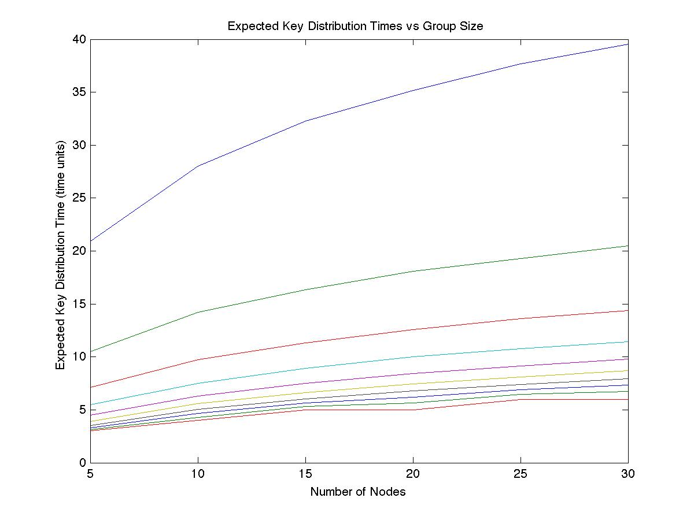
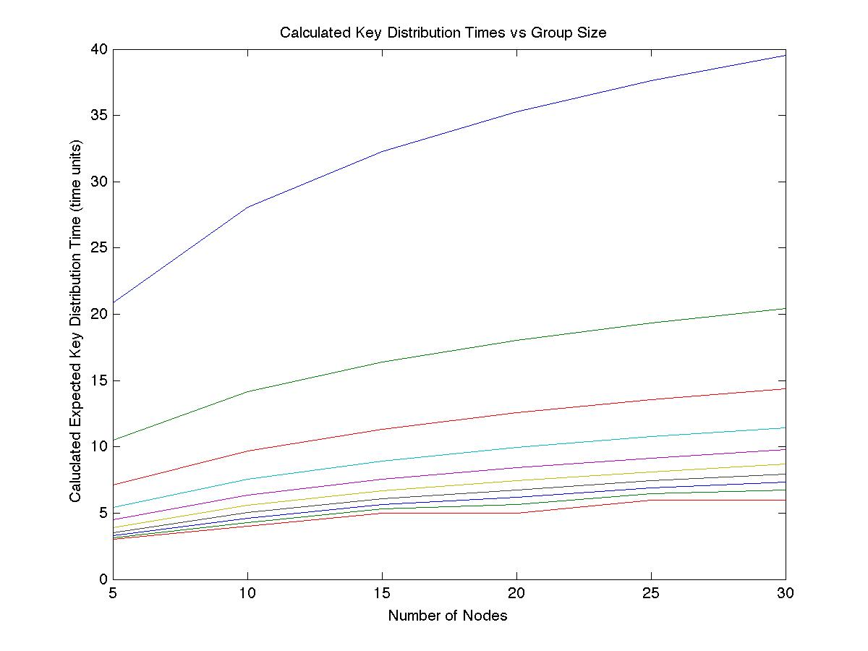
Graphical Comparison
Theoretical Results
Simulation Results

Slide 4
Real-time Measurements
Assume IKE exchanges take ~1.5s to complete.
From direct calculation using channel bandwidth, packet sizes, and estimated computation overhead
Sample real-time values for p = 0.5
Group Size | Expected Time | Real Time
5 | 4.4956 | 6.7434
10 | 6.3174 | 9.4761
15 | 7.5182 | 11.2773
20 | 8.456 | 12.684
25 | 9.1614 | 13.7421
30 | 9.7729 | 14.6593

Slide 5
SMURPH Simulation Framework
C/C++-based simulation framework
Open source, as opposed to other proprietary tools like OPNET
Treats individual nodes in the network as processes that execute concurrently
User-specified discrete indivisible time unit (ITU) used to define accuracy of simulation
Allows simulation parameters (channel bandwidth, node positions, packet sizes, etc) to be parameterized

Slide 6
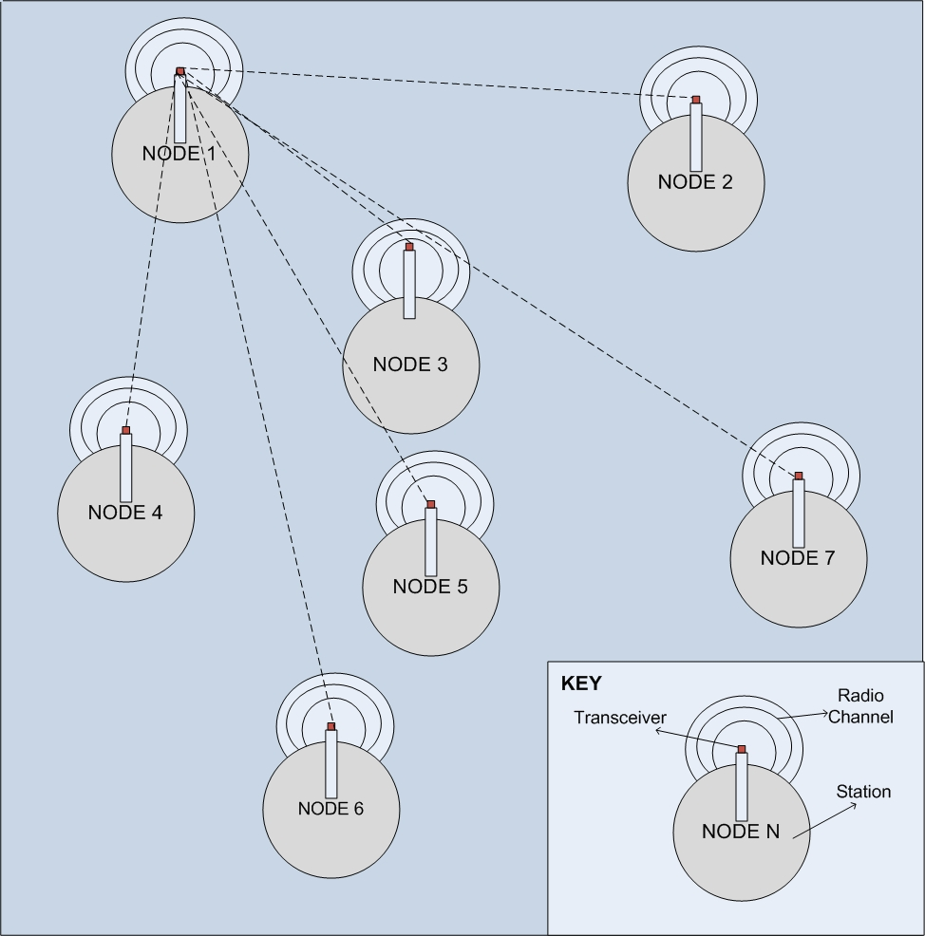
SMURPH Node Structure

Slide 7
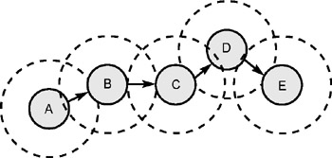
SMURPH Group Orientation
Network size, bandwidth, and packet sizes are fixed for each simulation
Node locations are randomized
Thousands of simulations are run to cover all arbitrarily structured graphs

Slide 8
SMURPH Simulation Features
Failed packets are re-sent to ensure reception
Primitive TDMA scheme was implemented to reduce packet collisions and share the channel
No built-in multicast support – all packets are broadcasted on the channel
Leads to lower SNR and more failed packets
Impossible to specify explicit packet reception probability p

Slide 9
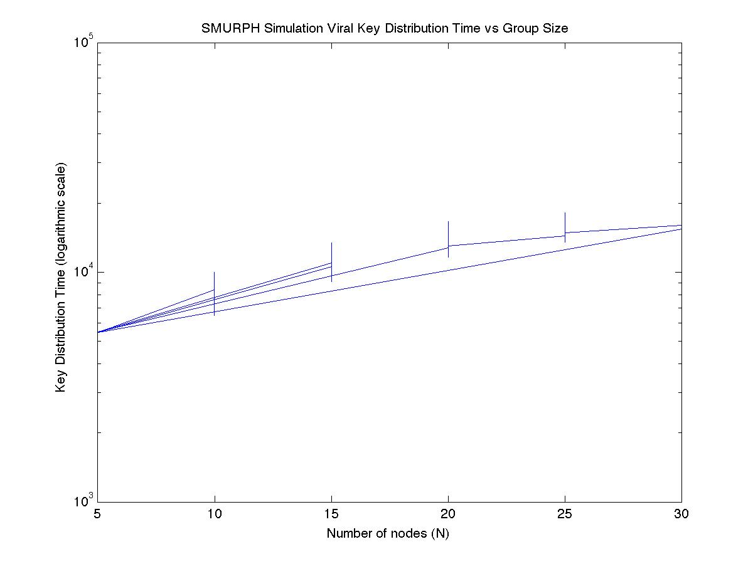
SMURPH Simulation Results

Slide 10
Average Simulation Results
Group Size | Average Key Distribution Time
5 | TODO
10 | TODO
15 | TODO
20 | TODO
25 | TODO
30 | TODO

Slide 11
Summary
SMURPH simulation results provide upper bound on theoretical results

