Slide 1
Coexistence of Heterogeneous Traffic in CSMA/CA Networks
Tamir Husain
Christopher A. Wood

Slide 2
Agenda
Problem statement
Markov model iterations
Simulation overview
Experimental results and observations
Q&A

Slide 3
Traffic Trends
Application traffic is becoming increasingly heterogeneous:
Real-time video streaming (e.g., Netflix)
Web browsing
File downloads
VoIP (e.g., Skype)
New traffic types vary in packet size, interarrival times, burstyness, etc.
Most applications send and receive traffic over wireless PHY mediums – WiFi

Slide 4
Problem Statement
Question 1: How does the performance of CSMA/CA vary with increasingly heterogeneous traffic?
Question 2: Is universal random backoff the best technique technique to handle collisions? Would a deterministic avoidance scheme be better suited for heterogeneous traffic? Or maybe a hybrid approach?
Question 3: Should backoffs be tailored to the type of traffic?

Slide 5
Research Approach
Create Markov models that represent varying types of traffic:
Media streams
Web browsing
File downloads
Compute metrics for each of these models individually, i.e., with a constant conditional collision probability
Compute metrics when different Markov models of these types are superimposed
Analyze the data

Slide 6
802.11 Distributed Control Function
A simplistic random access scheme based on the CSMA/CA protocol.
Failed packets are retried according to a binary exponential backoff rule.
At each packet transmission, the backoff is uniformly in the range (0, w-1)
The window w is set to W_{min} to begin, and upon every failure, the backoff counter is doubled.
The maximum backoff is bounded by W_{max} = 2^{m}W_{min}.
Selections of W_{min} and W_{max}are dependent upon the physical layer specifications in the 802.11 standard

Slide 7
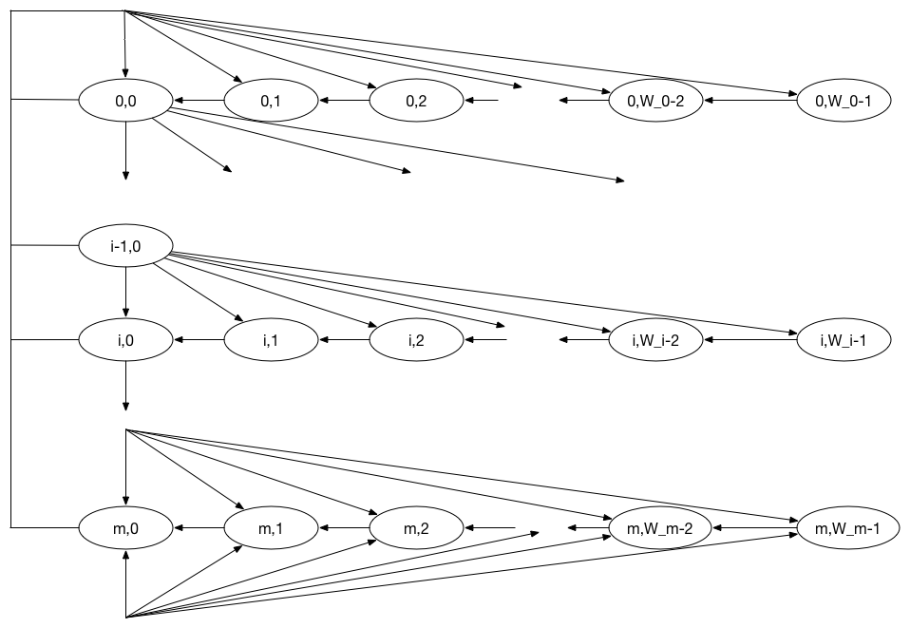
The DCF Model with Saturated Traffic

Slide 8
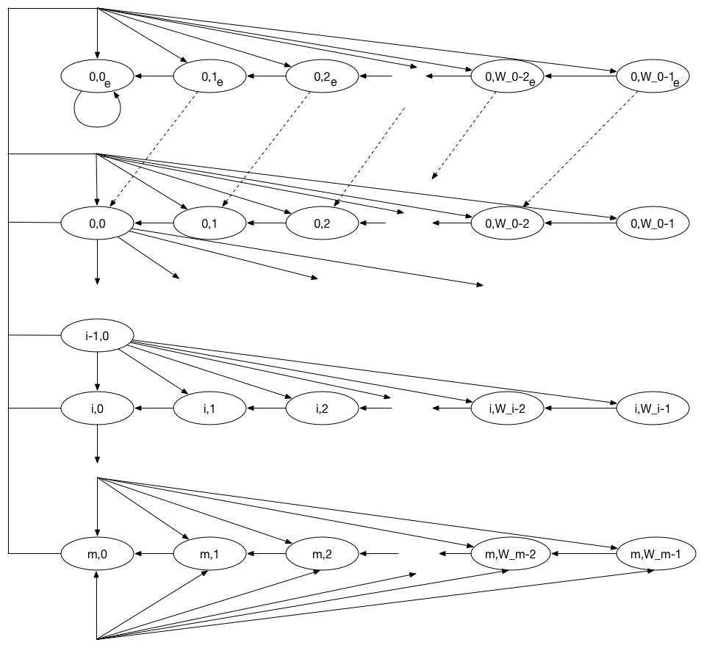
Supporting Unsaturated Traffic

Slide 9
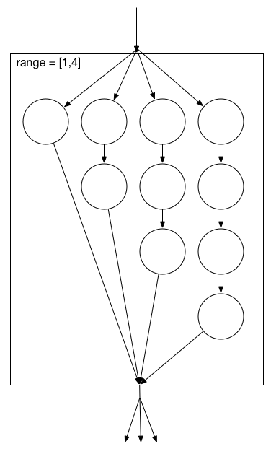
Size Chain Blackbox
Equal probability of entering each chain
n
P(success) = (1 – p)^n
Exit transition probability is a function of the chain length

Slide 10
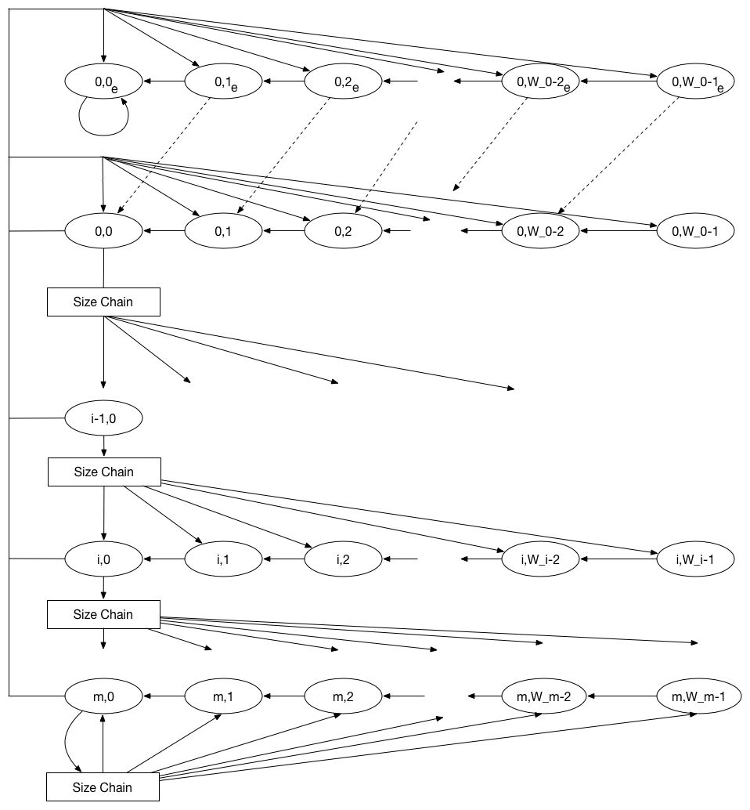
Variable Packet Size

Slide 11
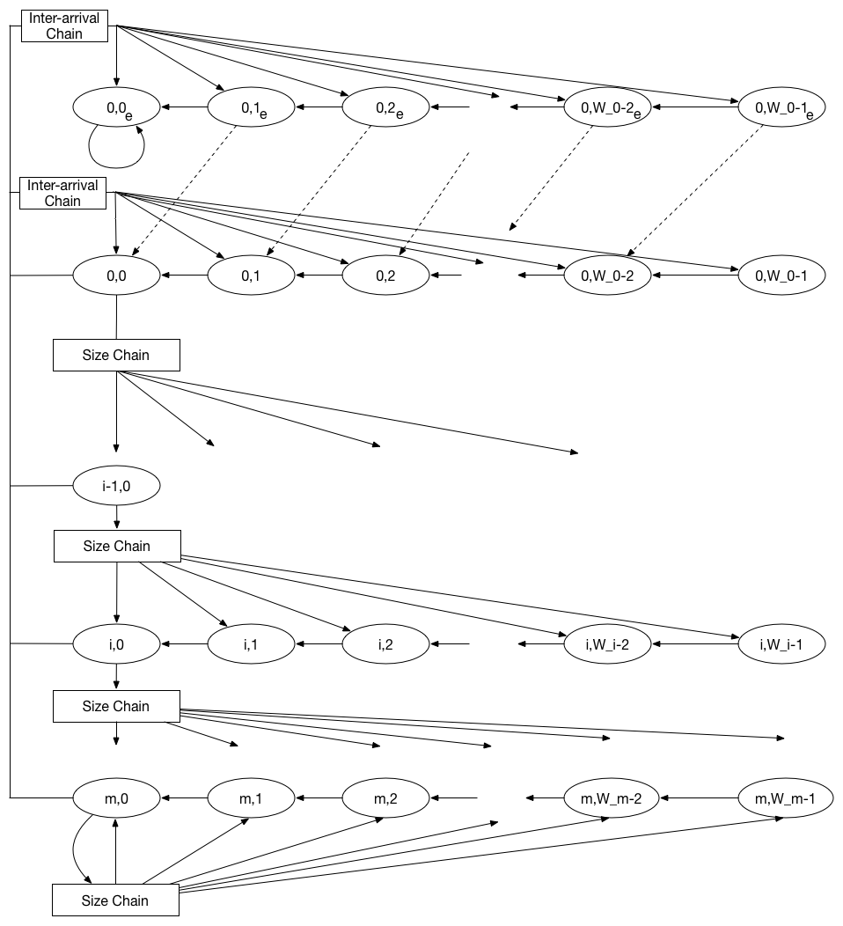
Interarrival Time

Slide 12
Varying Packet Types
Packet types differ in size and frequency of arrival
E.g., video I packets are larger and less frequent than smaller D packets
Each packet type has a “fixed” packet size, decided at the beginning of the lifetime of the packet
Packet type transitions are deterministic

Slide 13
Creating a more complex DCF
Adding features adds new dimensions to the 2D DCF
Packetsize, interarrival, postbackoff, etc…
Create small Markov models
Treat each as a black box
Connect them through instantaneous transitions
Compressible states
Temporary logical states
Probabilities distributed to real states in preprocessing

Slide 14
Compressible States
x1
0.8
a
0.5 * 0.8 = 0.4
a
0.5
0.2
s
b
s
0.5 * 0.2 = 0.1
b
0.25
0.25
c
c
x2
0.25 + 0.25 * 1.0 = 0.5
1.0

Slide 15
Compressible DCF
success
Blue: Original DCF Transmit
Yellow: Original DCF Backoff
Green: Compressible states
transmit
1,1
1,2
failure, 1
2,1
2,2
2,3
2,4
failure, 2

Slide 16
Adding Interarrival
Blue: Original DCF Transmit
Yellow: Original DCF Backoff
Green: Compressible states
Orange: Interarrival
success
transmit
1,1
1,2
interarrival
failure, 1
3
2
1
2,1
2,2
2,3
2,4
failure, 2

Slide 17
Adding Packetsize Chains (a new dimension)
Blue: Original DCF Transmit
Yellow: Original DCF Backoff
Green: Compressible states
Orange: Interarrival
Red: Packet Size
success
interarrival
packet size
calculation
3
2
1

Slide 18
Traffic Models
We focus on three types of traffic
Multimedia
Web browsing
File downloads
Each traffic can be characterized according to
Packet size
Interarrival time and packet queue saturation
Type of packet
Consequence: our model needs to parameterize each of these characteristics to model each type of traffic

Slide 19
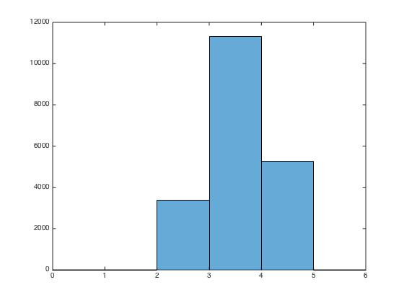
Web Traffic
Primary characteristics
Randomly sized packets
Random interarrival time
Parameters to tune:
Packet size (random)
Interarrival time (random)

Slide 20
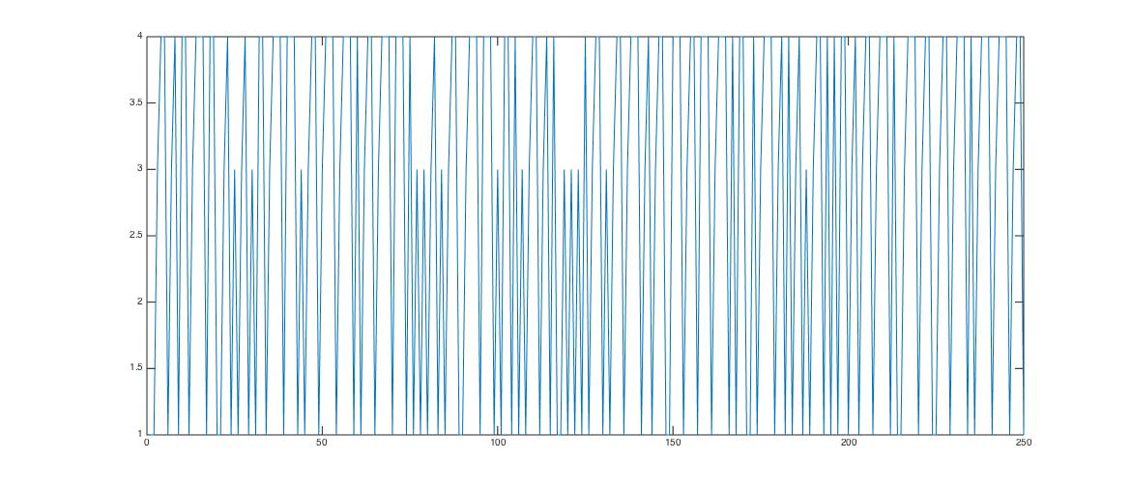
Web Traffic Illustrated
Size Chain
Wait
Fail
Success
time

Slide 21
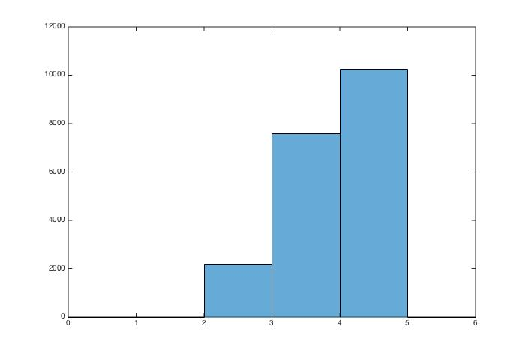
File Downloads
Primary characteristics:
Long periods of activity and long inter-burst time
Usually large packet sizes
Parameters to tune:
Packet size (high)
Queue arrival time (long)
Interarrival time (short)

Slide 22
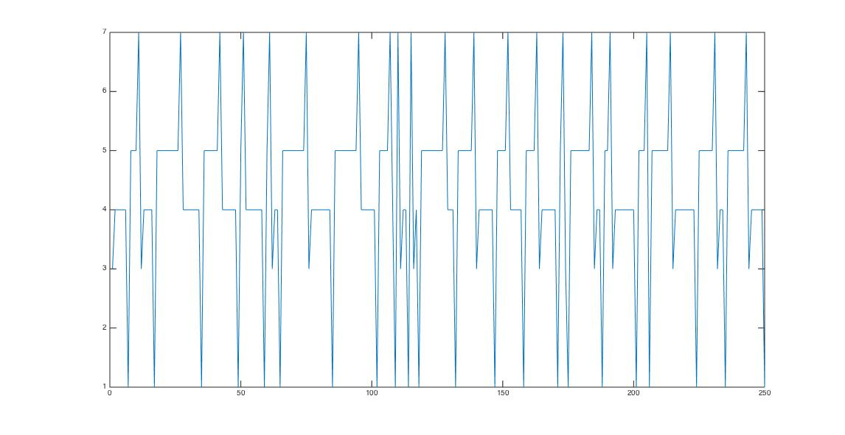
File Downloads Illustrated
Collapsible
Interarrival
Size Chain
Wait
Fail
Success
time

Slide 23
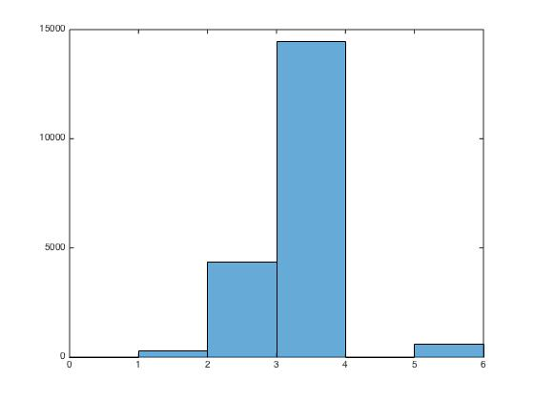
Multimedia Traffic
Primary characteristics:
Streams of different types of packets, each of a different length
E.g., Big I frames (packets) and many small D packets
Parameters to tune:
Packet size
Packet type

Slide 24
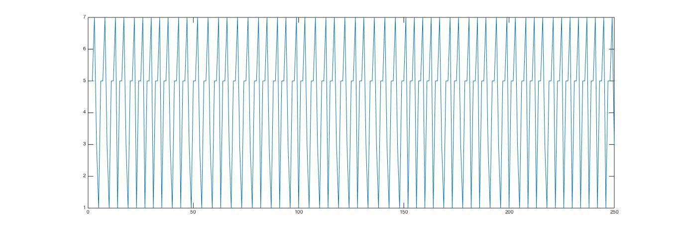
Multimedia Illustrated
Collapsible
Interarrival
Size Chain
Wait
Fail
Success
time

Slide 25
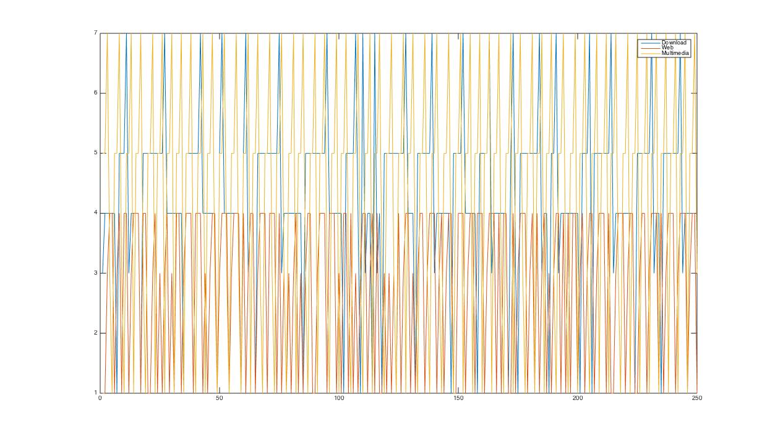
All Together
Web
Browsing
File
Downloads
Multimedia
Streaming
time

Slide 26
Experimental Metrics
Average and individual node:
Throughput (cumulative and variance)
Idle time (backoff, post-backoff)
Packet transmit probability
Packet loss probability

Slide 27
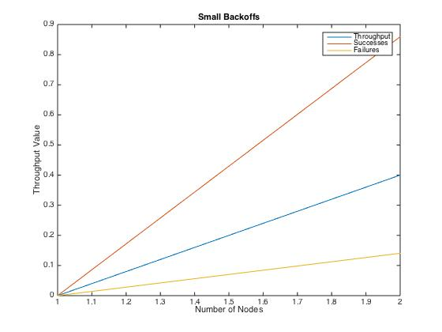
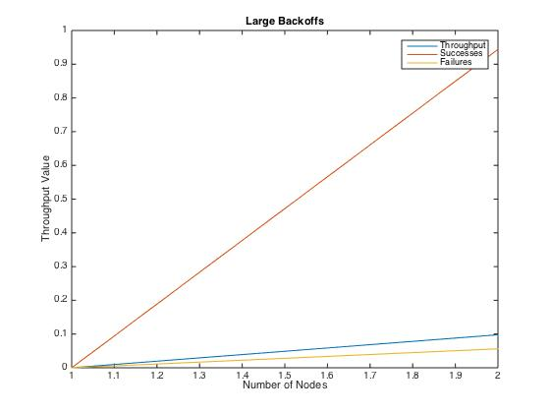
The Case for Small Backoffs
Simulations with large backoff values make metrics less “visible”

Slide 28
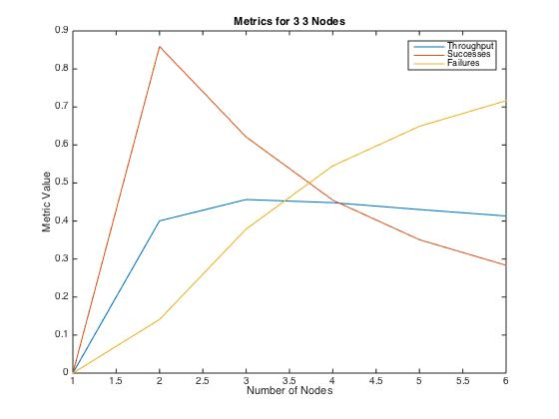
The Case for Few Nodes
Simulations with many nodes obfuscate the effects of traffic parameters

Slide 29
Experimental Setup
Choose one fixed random node
Choose another node of the target traffic type and vary a single parameters,
Interarrival time
Packet size distribution
…

Slide 30
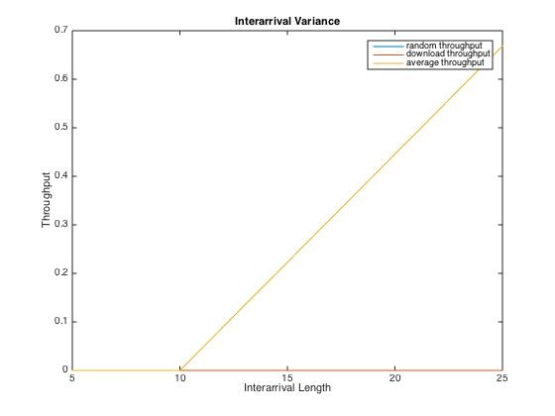
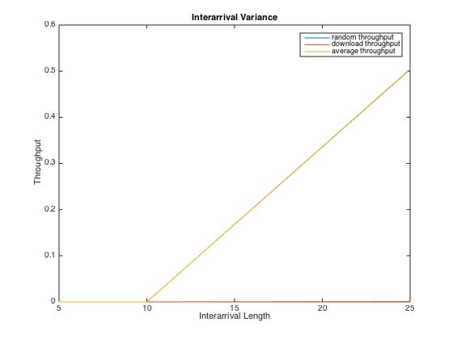
File Downloads: Varying Interarrival Time
Packet Size = [1]
Packet Size = [1,2,3,4,5]

Slide 31
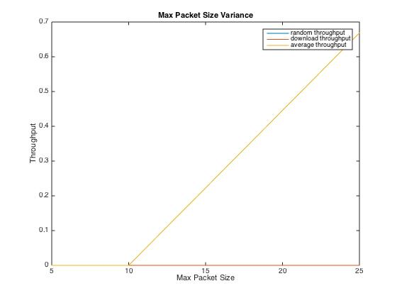
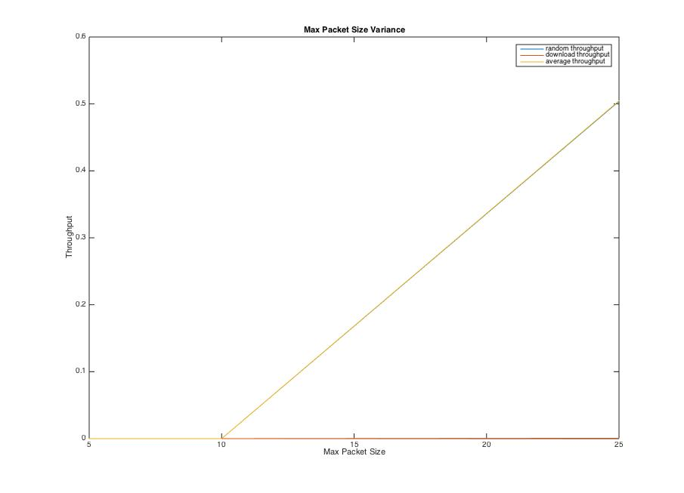
File Downloads: Varying Packet Size
Packet Size = [1]
Packet Size = [1,2,3,4,5]

Slide 32
Observations
Average throughput increases as the time between file download bursts of packets increases
Average throughput decreases as the size of packets increases
Download throughput is starved due to increasing packet sizes
Long times between bursts leave more room for other nodes to transmit

Slide 33
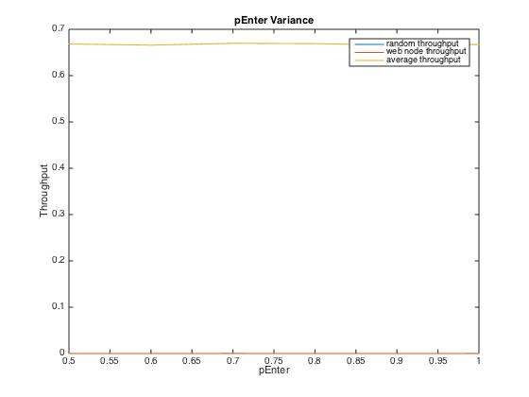
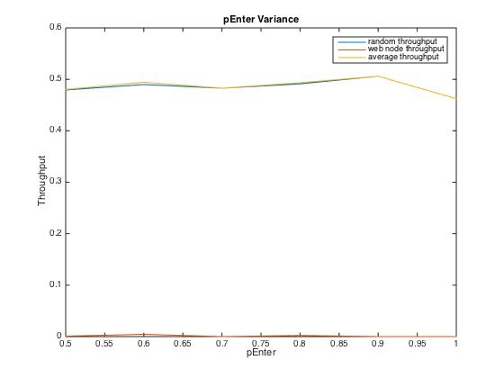
Web Browsing: Probability of Varying Interarrival
Packet Size = [1]
Packet Size = [1,2,3,4,5]

Slide 34
Observations
TODO

Slide 35
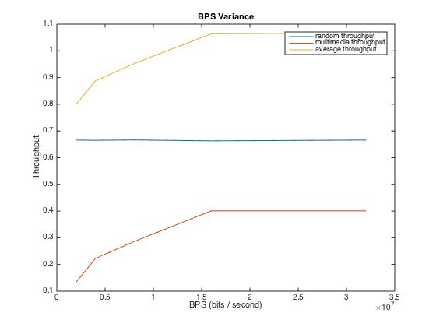
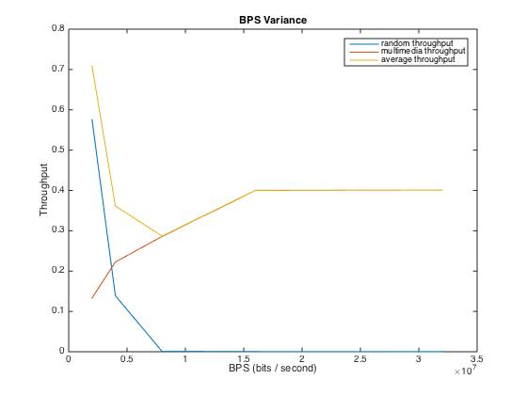
Multimedia: Varying Streaming BPS
Packet Size = [1]
Packet Size = [1,2,3,4,5]

Slide 36
Observations
Higher streaming constraints starve other nodes in the network
Multimedia node throughput increases and random node throughput decreases as a function of streaming quality
Small packet sizes for random nodes aren’t affected by multimedia streaming
Probable cause: streams of traffic are mixed together

Slide 37
Conclusions
The 802.11 DCF function behaves differently depending on the type of traffic being transmitted
Throughput quickly degrades as more than one node is using the channel (higher collision probability)
Application-agnostic random backoffs are perhaps not the best choice for collision avoidance when dealing with non-multimedia streams
Random backoffs serve multimedia traffic quite well in the presence of other nodes

Slide 38
Questions?

