Slide 1
Trust in Information-Centric Networking
From Theory to Practice
Christian Tschudin
University of Basel, Switzerland
christian.tschudin@unibas.ch
Ersin Uzun
Palo Alto Research Center
ersin.uzin@parc.com
Christopher A. Wood
Palo Alto Research Center
christopher.wood@parc.com

Slide 2
Agenda
ICN and CCN overview
Content-Based Security and Trust
Core trust logics for verification/signing
CCNx Trust Engine Design
Conclusion

Slide 3
Information Centric Networks
Aims to evolve away from a host-centric paradigm to a network architecture in which the focal point is “named information”.
Mobility and multi access are the norm and anycast, multicast, broadcast are usually natively supported.
Data is independent from location, application, storage, and means of transportation, enabling in-network caching and replication.

Slide 4
CCN Overview
CCN (and its sister architecture NDN) is one well known example of ICN
Data is obtained via an explicit request for the name with an interest
Consumers issue interests that are routed towards the data producer (using the name)
A content object carries the data back to the consumer

Slide 5
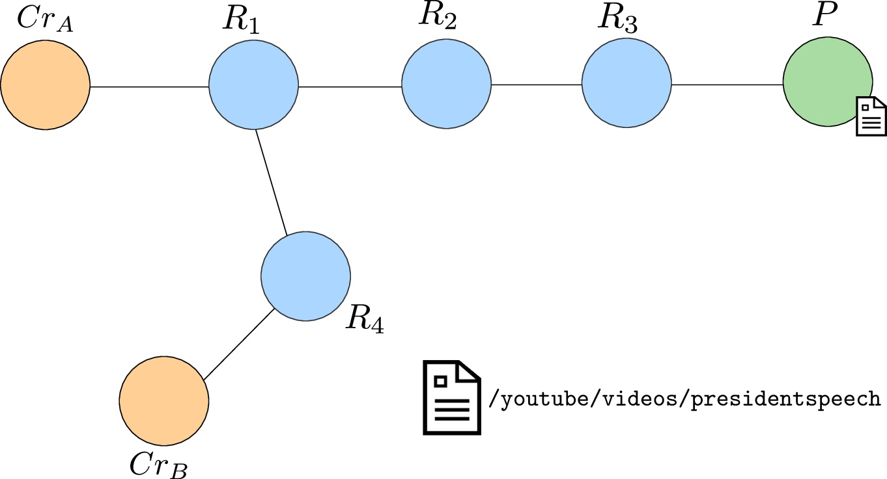
Example

Slide 6
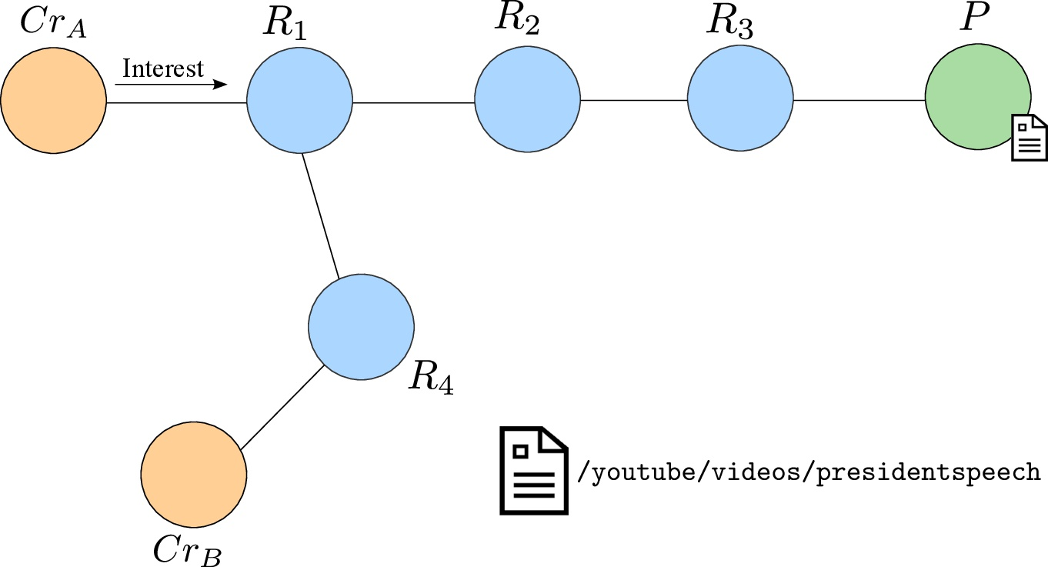
Example

Slide 7
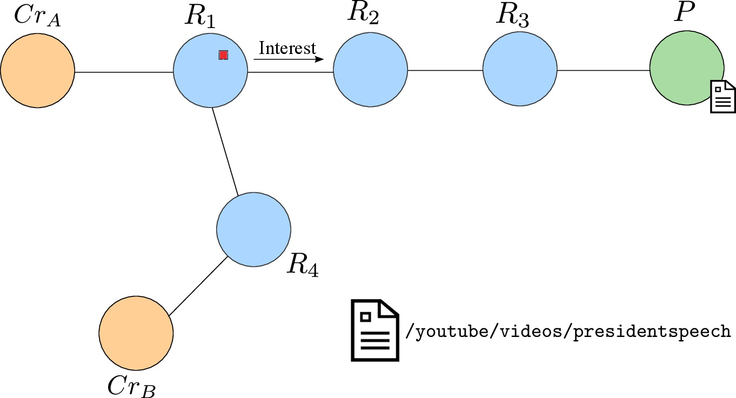
Example

Slide 8
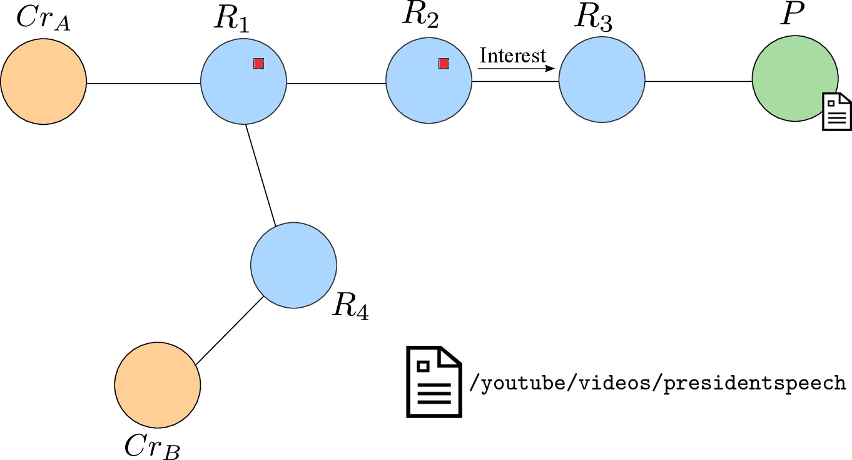
Example

Slide 9
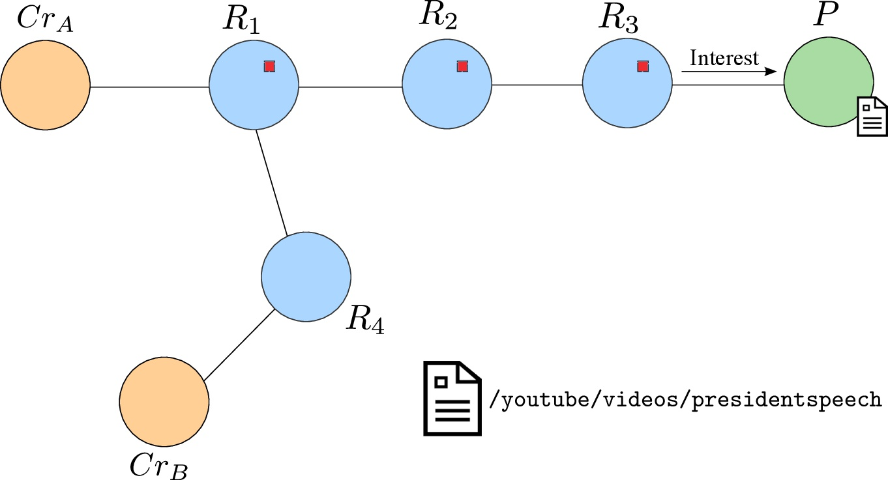
Example

Slide 10
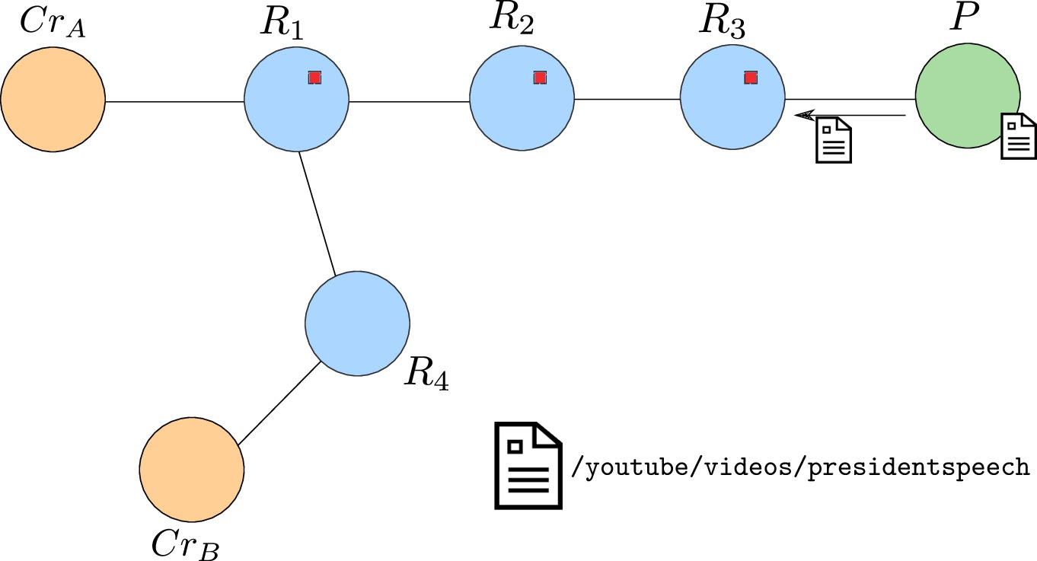
Example

Slide 11
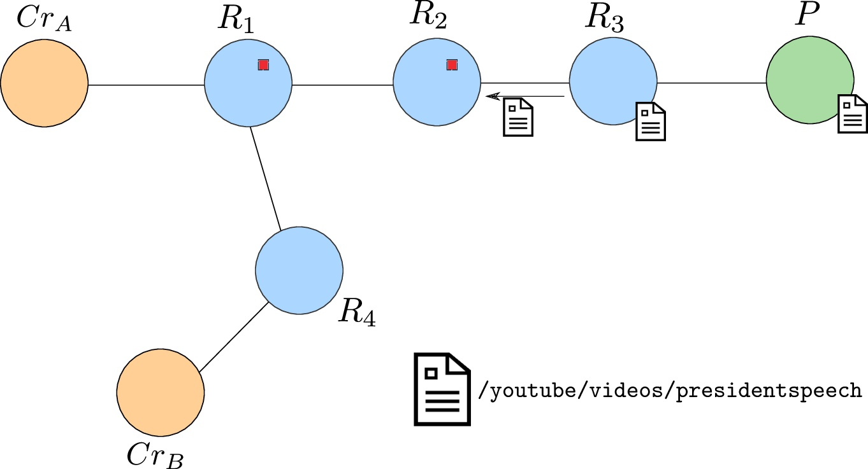
Example

Slide 12
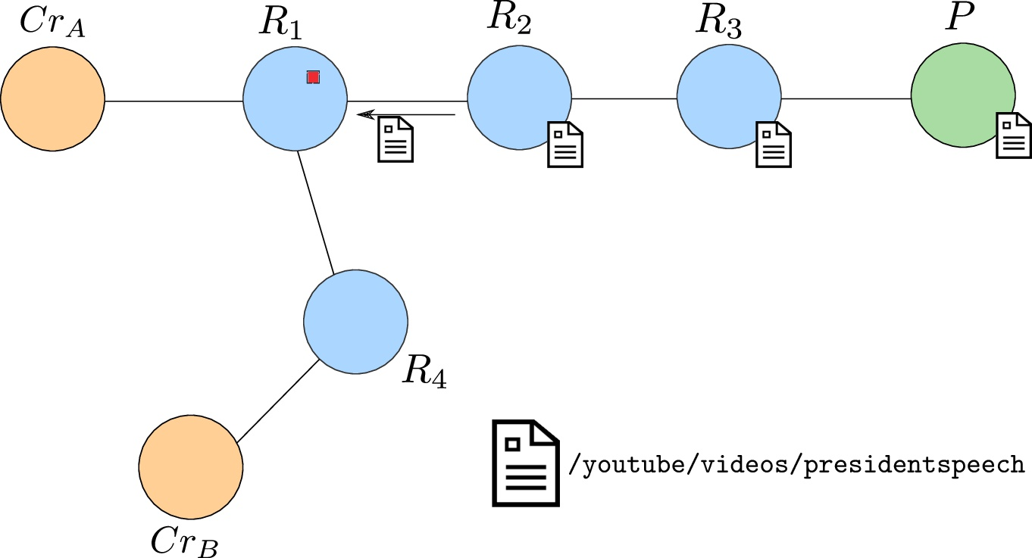
Example

Slide 13
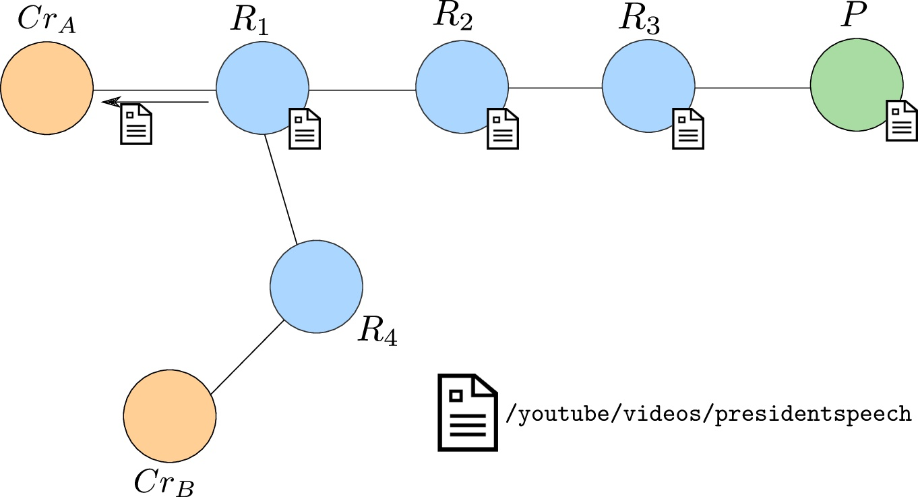
Example

Slide 14
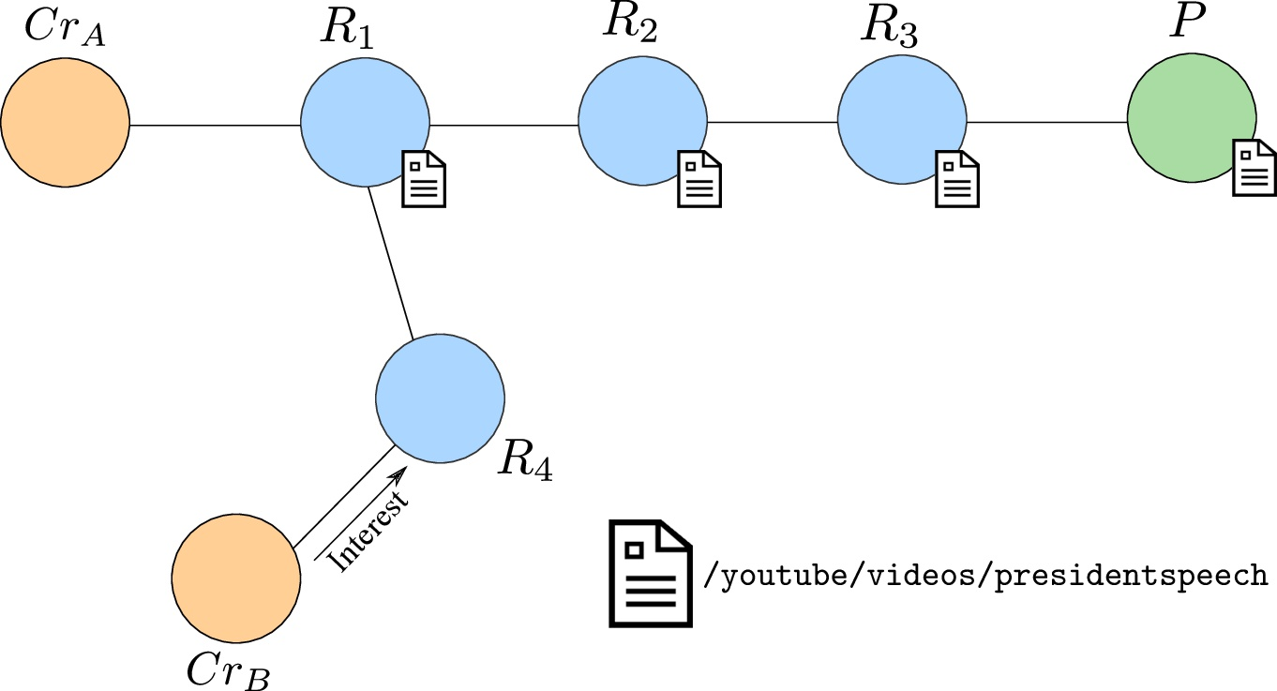
Example

Slide 15
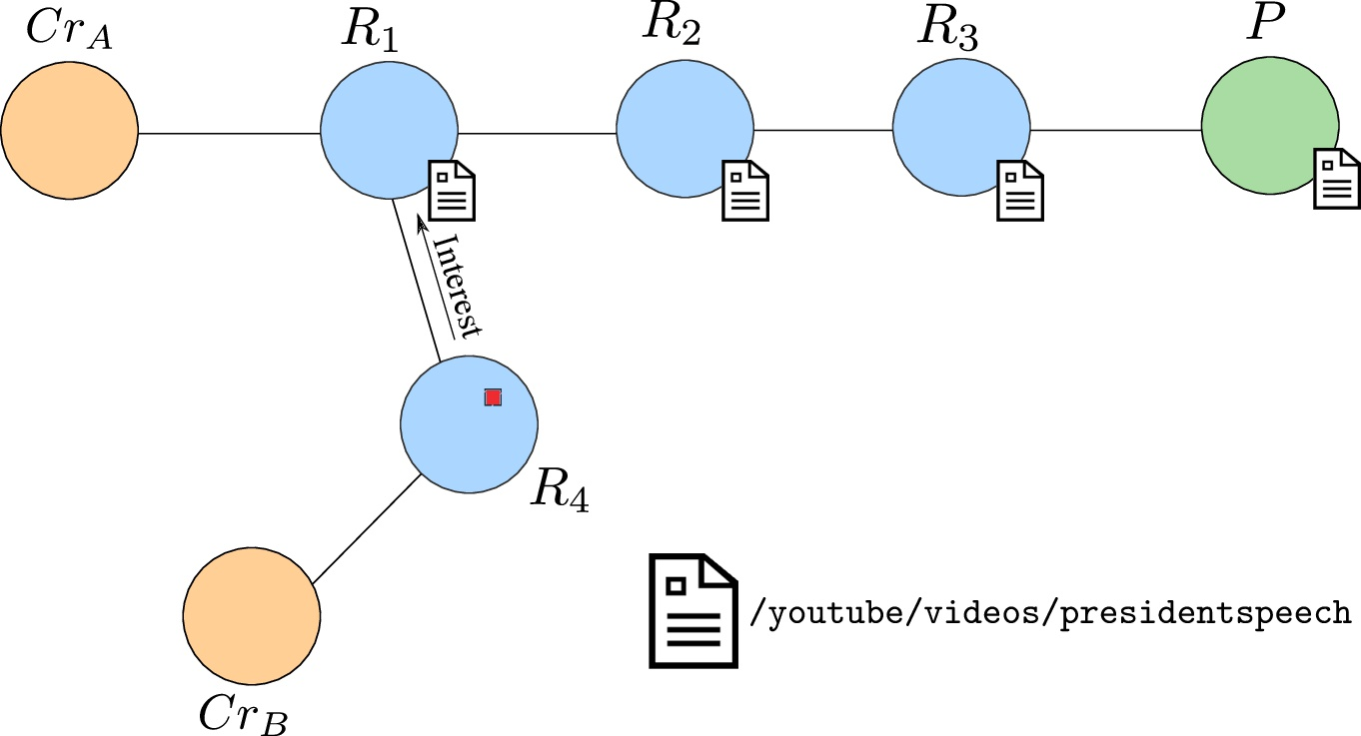
Example

Slide 16
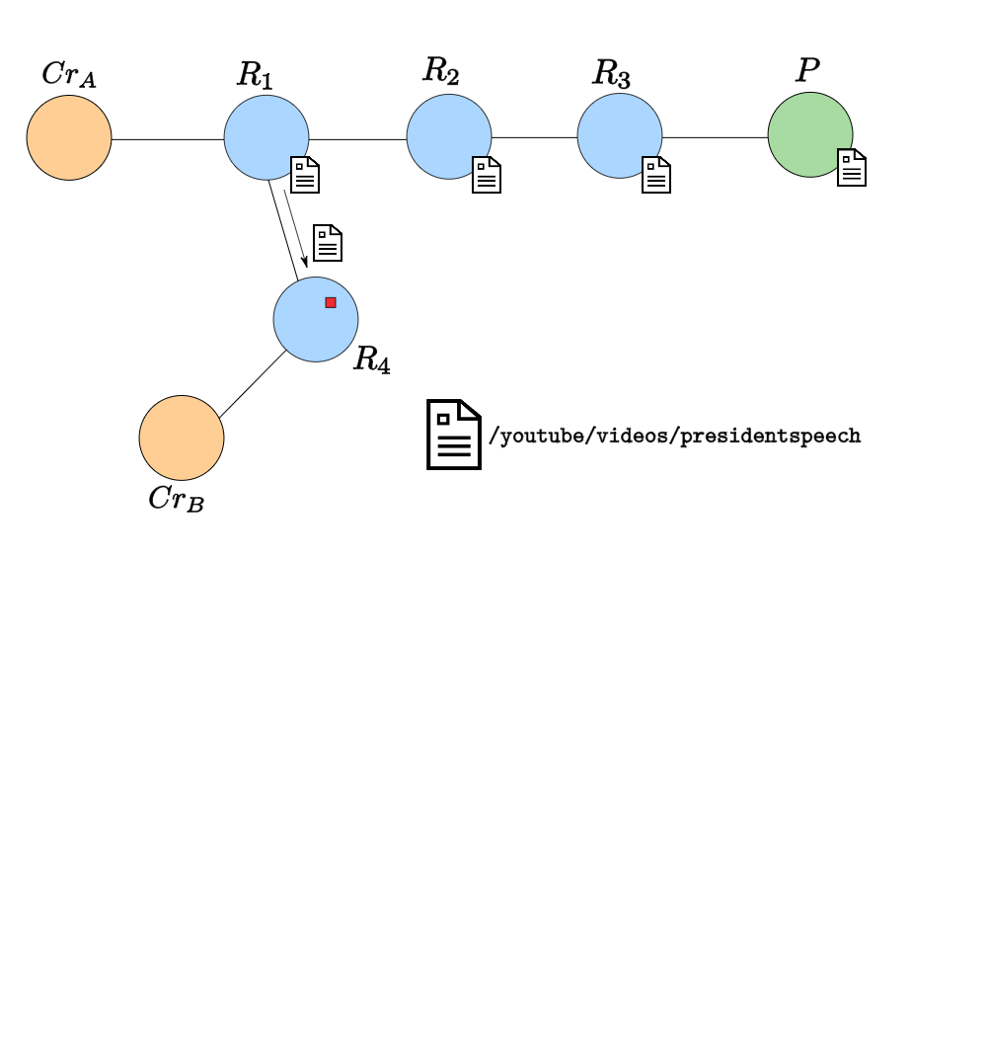
Example

Slide 17
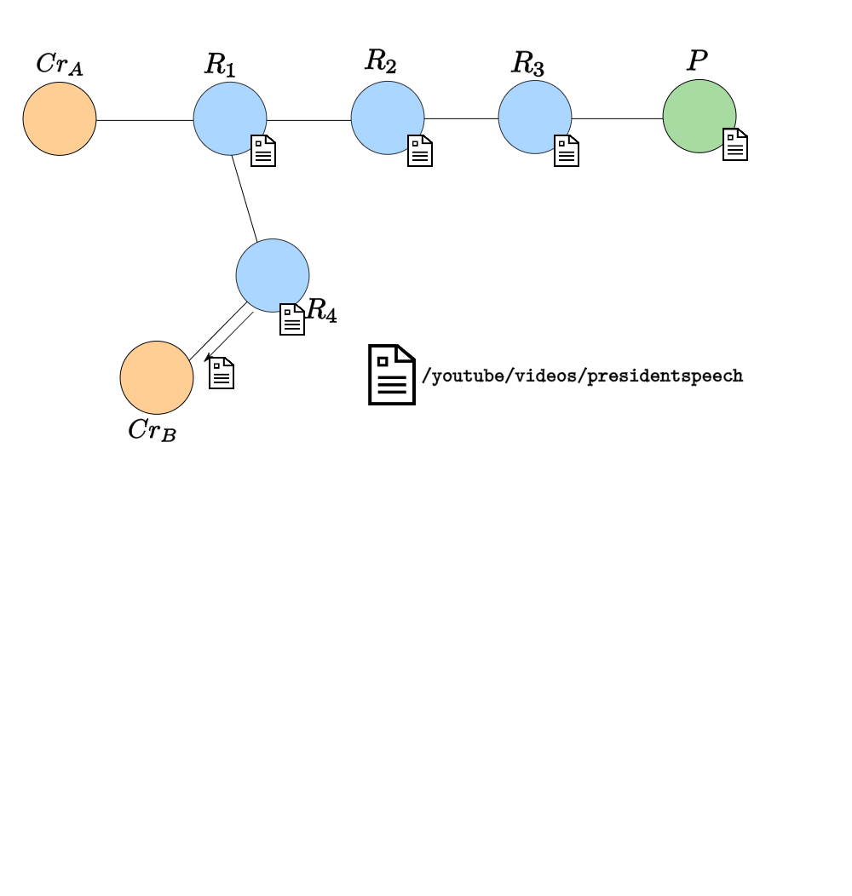
Example

Slide 18
Content-Based Security

Slide 19





Connection-Based Security
Today’s internet secures connections, not content:
https://online.wellsfargo.com/policies.html
DNS
V
online.wellsfargo.com
151.151.13.132
policies.html
13.2.116.61
policies.html
V
= online.wellsfargo.com
13.2.116.62
Certification Authority
(e.g. Verisign)
V
Notes:
https://a248.e.akamai.net/f/248/1856/90m/www.wellsfargo.com/img/hp/logo_62sq.gif
Problems:
all current content access (save certificates themselves) use source to authenticate content; only in non-https case the authentication of source is pretty ad-hoc
Second client has to go back to the source, can’t get content from top with any assurance
First client has no continuing assurance that the content is correct
No semantics: relationships among parts of wellsfargo not visible to client, all trust top-down from CAs
Security limited to the weakest of the all-powerful CAs trusted to sign arbitrary mappings
19

Slide 20
Content-Based Security
Secure the content, wherever it travels…
…get it from anyone who has a copy.
online.wellsfargo.com/policies.html
online.wellsfargo.com
online.wellsfargo.com/policies.html
online.wellsfargo.com/policies.html
online.wellsfargo.com/policies.html
online.wellsfargo.com/policies.html
online.wellsfargo.com/policies.html
Notes:
https://a248.e.akamai.net/f/248/1856/90m/www.wellsfargo.com/img/hp/logo_62sq.gif
Problems:
Second client has to go back to the source, can’t get content from top with any assurance
First client has no continuing assurance that the content is correct
No semantics: relationships among parts of wellsfargo not visible to client, all trust top-down from CAs
Security limited to the weakest of the all-powerful CAs trusted to sign arbitrary mappings
20

Slide 21
Securing Content in CCN
Content Packet = 〈 name, data, signature 〉
In theory, any consumer can verify:
Integrity: is data intact and complete?
Origin: who asserts this data is an answer?
Correctness: is this an answer to my question?

Slide 22
Trust in Application-Layer
How does a consumer application determine which content is trusted?
A valid digital signatures doesn’t mean content is authentic or trustworthy
Trust decisions can only be made within a particular and potentially complex trust context (e.g., given set of trust anchors, rules and exceptions).

Slide 23
Trust in Network-Layer
How network-layer machinery can enforce trust context of applications?
How do routers determine what content they should/can use to respond to requests
How the network stack can request/deliver content that the application would trust

Slide 24
Sample Trust Models
Pre-shared keys
Massage Authentication Codes
PKI
Traditional
Constrained
e.g., Yu et. al., Schematizing trust in NDN
Web-of-Trust
PGP

Slide 25
Theory to Practice
Architectural design that enables efficient representation and enforcement of trust preferences at the network-layer
CCNx requests can have either of content hash or publisher Key ID restrictions
A design/implementation of a machinery that can translate any application-layer trust semantics to network-layer mechanics and enforce them during content publishing/consumption.
In this paper, we show the design logic and an instance implementation of such a machinery in CCNx.

Slide 26
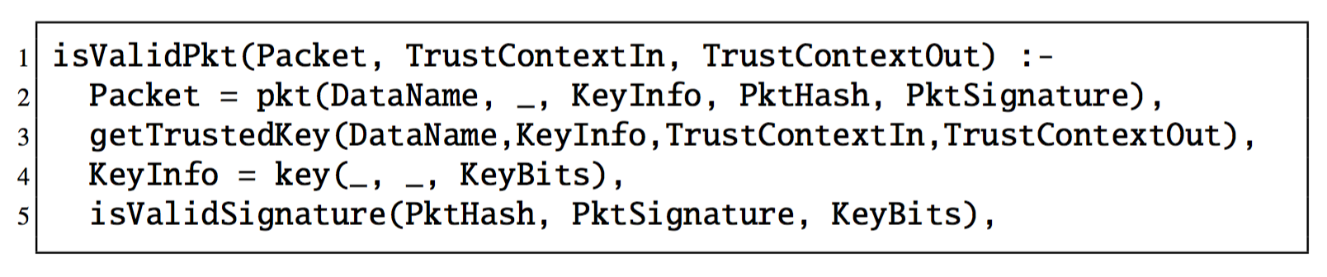
Core Validation Logic
System tries to satisfy the isValidPkt() predicate by getting a trusted key and validating the packet’s signature.
A packet has a name, the information regarding which key was used to sign, the hash value (and the signature value.
KeyInfo usually has key’s name, ID, and always the key value
Underscore is used to leave some fields optional

Slide 27
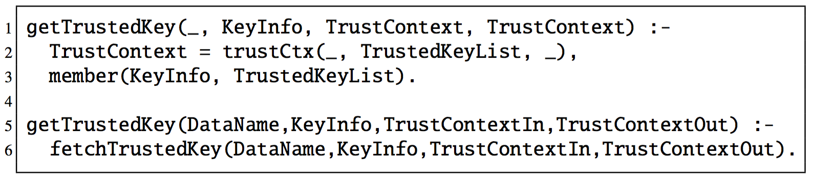
Core Validation Logic
In our trust context
… or not
All differences among the trust models are now isolated to the getTrustedKey() predicate

Slide 28
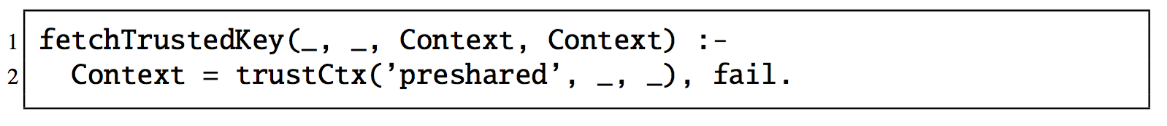
Model-Specific Variations: MAC
In the simplest trust model, symmetric session keys are pre-shared
Consequently, the fetchTrustedKey() is a failing action if the key is not already known

Slide 29
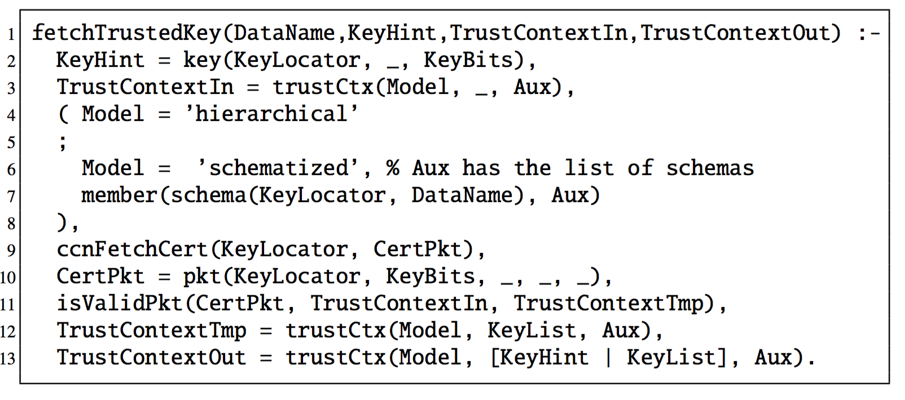
Model-Specific Variations: Hierarchical/Schematized
Basic hierarchical model: fetch certificate chain until a trusted certificate is found…
Schematized model: make sure additional constraints on data and key names and explicit authorizations are satisfied.

Slide 30
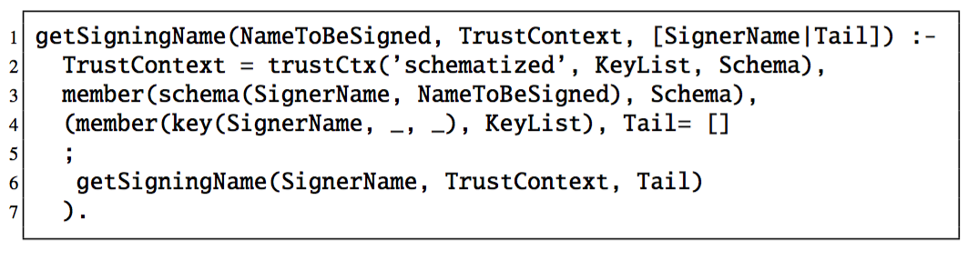
Signing Logic
Relatively straightforward as applications usually know their identity and key
Example logic below consists of find a suitable schema, picking a viable certification path, and signing using the corresponding key

Slide 31
Theory to Practice: The CCNx Trust Engine Implementation
The trust engine is composed of three functions:
InspectPacket: pull out packet info
FetchTrustedKey: obtain the trusted verification key (and update the trust context).
VerifySignature: verify the signature using the trusted key

Slide 32
CCN Trust Engine Overview

Slide 33
Conclusion
In ICNs, network needs to deliver content that consumer applications would trust –otherwise it is non-functional!
This paper demonstrates how to design and implement a machinery that
translates trust context/model of applications to network-layer mechanics that can enforce them
can handle variety of potentially complex trust models with simple unified logics for easy understanding/implementation
provides easy checks for potential pitfalls such as verification loops and weak certification links
is instantiated by a full working implementation on CCNx codebase.

Slide 34
Thanks!
Any question?
You can contact christopher.wood@parc.com for all prolog predicates, TR version of the paper and the CCNx implementation

