Slide 1
Secure Fragmentation for Content-Centric Networks
Cesar Ghali, Ashok Narayanan, David Oran,
Gene Tsudik, Christopher A. Wood
IEEE NCA 2015 – Boston, MA

Slide 2
CCN/NDN Overview
Current Internet is designed:
For point-to-point
Not content distribution
Need new Internet architectures
e.g. XIA Nebula, MobilityFirst, CCNx/NDN
Security and privacy by design (not incremental retrofit)

Slide 3
CCN/NDN Overview
CCNx:
PARC-led effort since 2009
NDN:
Branched out of CCNx around 2012
Funded by NSF as part of FIA program
Participants > 10 institutions

Slide 4
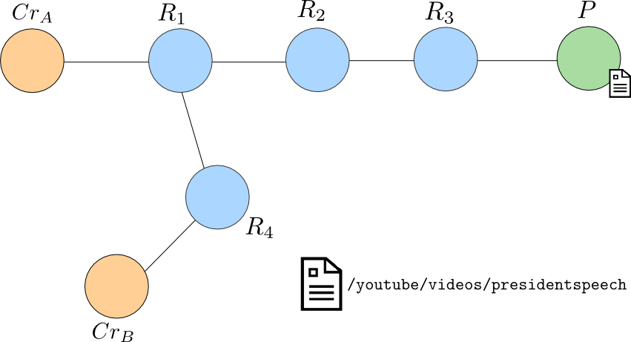
CCN/NDN Overview

Slide 5
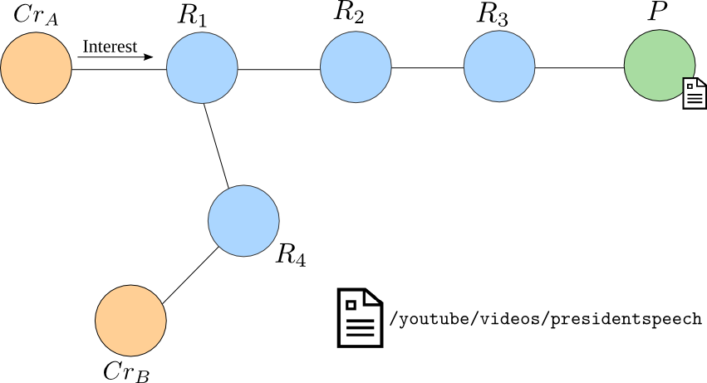
CCN/NDN Overview

Slide 6
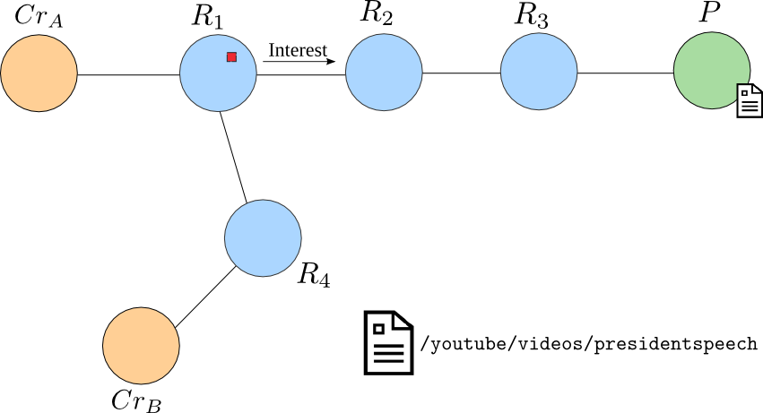
CCN/NDN Overview

Slide 7
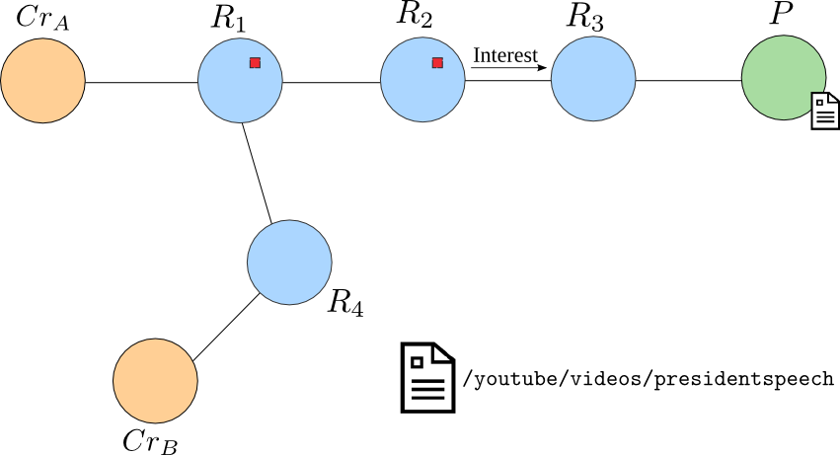
CCN/NDN Overview

Slide 8
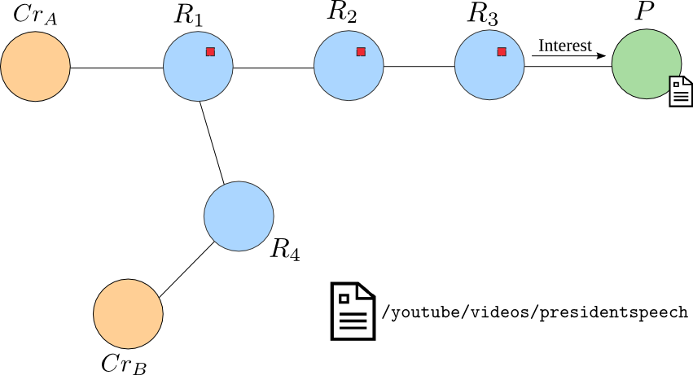
CCN/NDN Overview

Slide 9
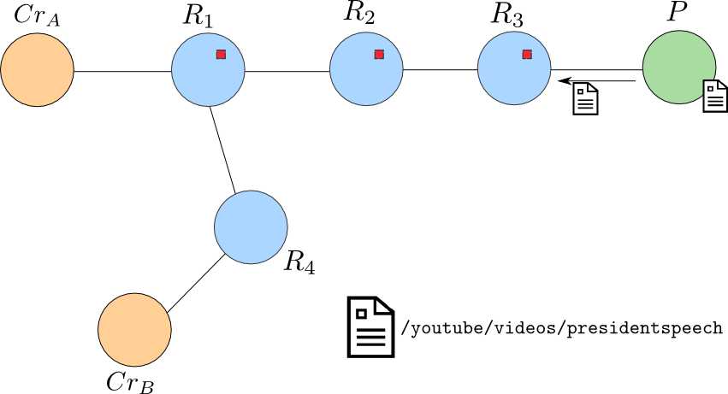
CCN/NDN Overview

Slide 10
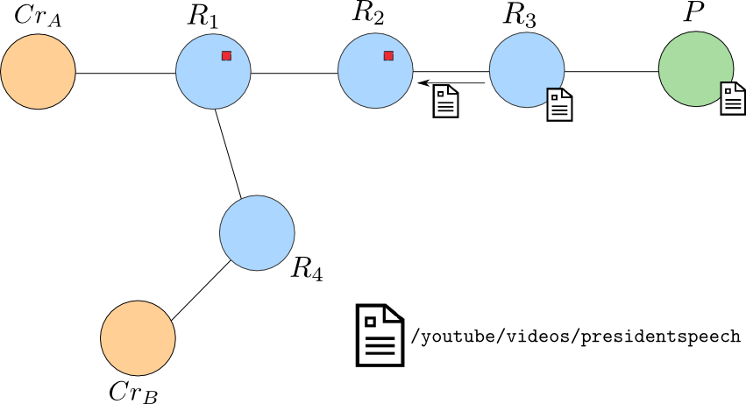
CCN/NDN Overview

Slide 11
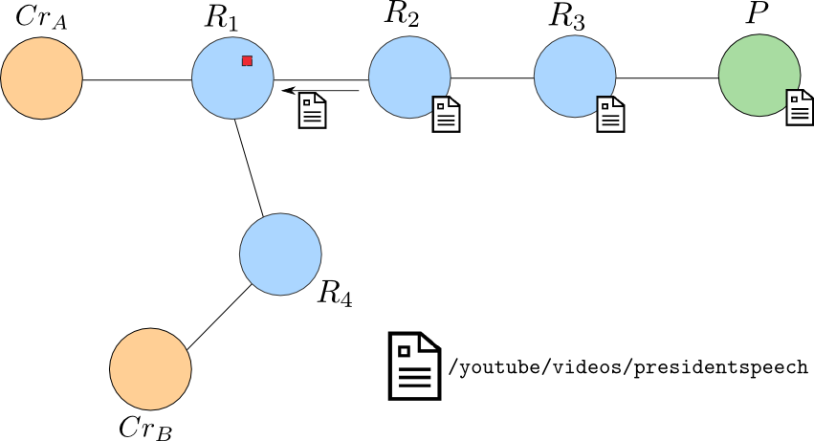
CCN/NDN Overview

Slide 12
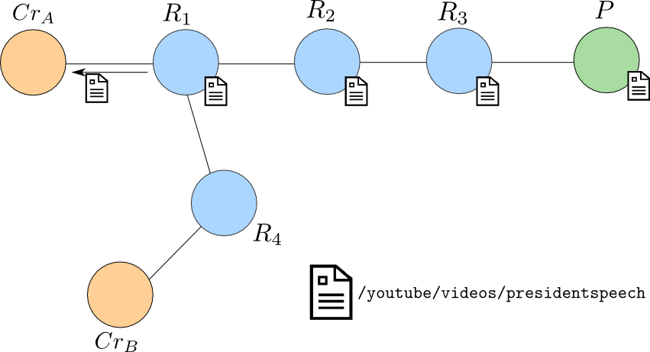
CCN/NDN Overview

Slide 13
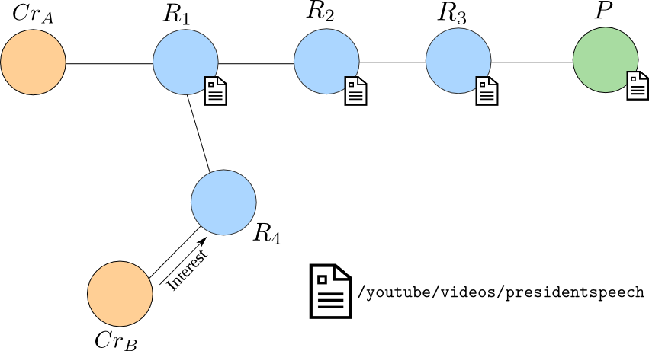
CCN/NDN Overview

Slide 14
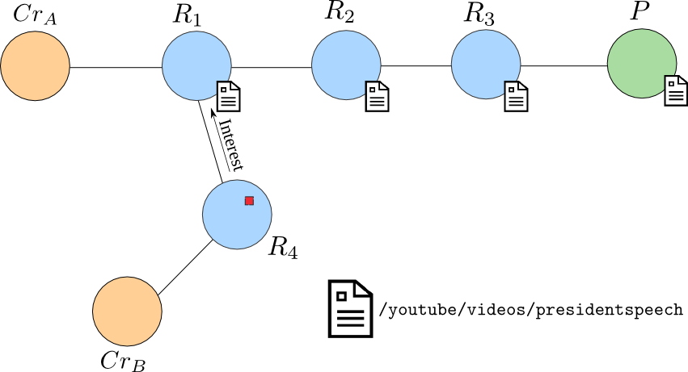
CCN/NDN Overview

Slide 15
Fragmentation
Internet connects heterogeneous devices over heterogeneous links, with different:
Physical layers (copper, fiber, radio, laser)
MAC layers
Maximum Transmission Unit (MTUs)
Determined by MAC layer

Slide 16
Fragmentation
Fragmentation: splitting a packet into fragments that fit into outgoing link MTU
Fragment header encodes ordering of related fragments
Re-fragmentation can occur if smaller MTU is encountered

Slide 17
Fragmentation – IPv4
Src IP | Dst IP | Len=4000 | ID=x | MF=0 | Offset=0 | Data
Src IP | Dst IP | Len=1500 | ID=x | MF=1 | Offset=0 | Data
Src IP | Dst IP | Len=1500 | ID=x | MF=1 | Offset=185 | Data
Src IP | Dst IP | Len=1040 | ID=x | MF=0 | Offset=370 | Data

Slide 18
Fragmentation – IPv4
Issues:
Several attacks
Ping of death
Tiny fragment
Router overhead and code complexity
Results:
Deprecated in IPv6 and limited to source-based fragmentation
C. Kent and J. Mogul, Fragmentation considered harmful, SIGCOMM 1987.

Slide 19
Fragmentation – NDN/CCN
Two messages types:
Interest message
Content object
Name
Data
Signature
Signature Info
Name
Payload (CCN)
Other fields
Interest
Content

Slide 20
Interest Fragmentation
Recall that NDN interests are processed using referenced name
Names can be of arbitrary size
Longest-prefix match on a name requires the entire name before performing a search
Intermediate fragmentation & reassembly for interests is unavoidable

Slide 21
Content Segmentation
Segmentation (at source) can avoid fragmentation
Data segmented by application
Signature computed per segment
Segments are numbered
/youtube/dancingcats/s0
/youtube/dancingcats/s1

Slide 22
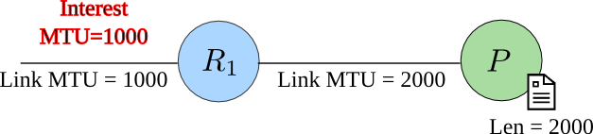
Content Segmentation
Use path MTU discovery
Mark interests with smallest transmit MTU in a path

Slide 23
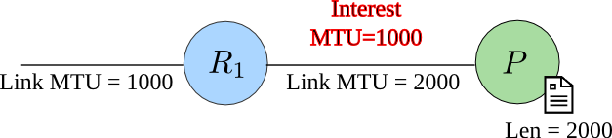
Content Segmentation
Use path MTU discovery
Mark interests with smallest transmit MTU in a path

Slide 24
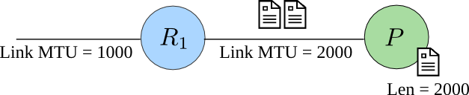
Content Segmentation
Use path MTU discovery
Mark interests with smallest transmit MTU in a path

Slide 25
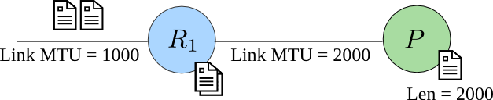
Content Segmentation
Use path MTU discovery
Mark interests with smallest transmit MTU in a path

Slide 26
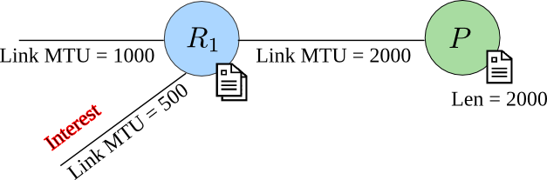
Content Segmentation
Use path MTU discovery
Mark interests with smallest transmit MTU in a path

Slide 27
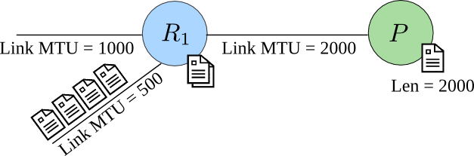
Content Segmentation
Use path MTU discovery
Mark interests with smallest transmit MTU in a path

Slide 28
Content Segmentation
Problems
No access to signing keys
Producer cannot segment for all MTUs

Slide 29
Content Segmentation
Problems
No access to signing keys
Producer cannot segment for all MTUs
Content Intermediate re-fragmentation is unavoidable

Slide 30
Content Segmentation
In CCN/NDN:
Routers are not required to verify signatures
But… they might

Slide 31
Content Segmentation
In CCN/NDN:
Routers are not required to verify signatures
But… they might
Provide content authentication without intermediate reassembly

Slide 32
Content Fragmentation
In today’s Internet
Packet fragments might not follow same path
In CCN/NDN:
All content fragments follow the same path
But… out of order delivery is possible, even between adjacent routers
Parallel links with different speeds and/or loss/error rates

Slide 33
Content Fragmentation
FIGOA: Fragmentation with Integrity Guarantees and Optional Authentication

Slide 34
Content Fragmentation
FIGOA supports:
Cut-through switching & optional intermediate reassembly
Security via Delayed Authentication
Also supports integrity with optional authenticity

Slide 35
Content Fragmentation
FIGOA supports:
Cut-through switching & optional intermediate reassembly
Security via Delayed Authentication
Also supports integrity with optional authenticity
Not CCN/NDN-specific
Works with any network architecture with path consistency guarantees

Slide 36
Content Fragmentation
Make use of hash-and-sign
Content Object
Hash (e.g., SHA256)
Signature Algorithm (e.g., RSA)
Signature

Slide 37

Content Fragmentation
& Merkle-Damgard construction
m₁
m₂
m₃
m₄
m_{k}
pad
H⁰
f
f
f
f
f
H¹
H²
H³
H⁴
H
Hash Value

Slide 38
Content Fragmentation
& Merkle-Damgard construction
m₁
m₂
m₃
m₄
m_{k}
pad
H⁰
f
f
f
f
f
H¹
H²
H³
H⁴
H
Hash Value

Slide 39
Content Fragmentation
Signature (on H)
F₁ Fragment-Info
Name
IntState = H⁰
Signed-Info
… Data …
Data
ContentObjectSize
F₂ Fragment-Info
FragmentOffset
IntState = H¹
FragmentSize
… Data …
SignatureInfo
Signature
F₃ Fragment-Info
IntState = H²
… Data …

Slide 40
Content Fragmentation
F₁
H⁰

Slide 41
Content Fragmentation
m₁
f
H⁰
H¹
F₁
H⁰
F₁

Slide 42
Content Fragmentation
H¹
F₂
H¹
F₁

Slide 43
Content Fragmentation
m₂
f
H¹
H²
F₂
H¹
F₁
F₂

Slide 44
Content Fragmentation
H²
F₃
H²
F₁
F₂

Slide 45
Content Fragmentation
m₃
f
H²
H³
F₁
F₂
F₃
Verify signature (contained in F₃) using H³

Slide 46
Content Fragmentation
F₃
H²
F₁
F₂
F₃
Success

Slide 47
Content Fragmentation
F₁
F₂
F₃
Fail

Slide 48
Content Fragmentation
Hash is computed gradually
FIGOA works with out-of-order fragments
F₁ is received → calculate H¹
F₃ is received → calculate H³
F₂ is received → calculate H²
Ensure calculated IntState = received ones
Verify signature

Slide 49
Content Fragmentation
If content is cached:
Routers store fragments info including data
Content can be cached fragmented or assembled
If content is not cached, routers store:
Fragments offset
Intermediate states

Slide 50
Conclusion
Fragmentation is a must in CCN/NDN
Interest
Content
Segmentation does not avoid fragmentation
MTU discovery does not either
FIGOA: Fragmentation with Integrity Guarantees and Optional Authentication

Slide 51
Thank you!
Questions?

