Slide 1
BEAD: Best Effort Autonomous Deletion in Content-Centric Networking
Cesar Ghali, Gene Tsudik, Christopher A. Wood
University of California Irvine
{cghali, gene.tsudik, woodc1}@uci.edu
IFIP Networking 2016
May 18, 2016
Vienna, Austria

Slide 2
Agenda
CCN overview and types of content
On-demand deletion
Authenticated deletion requests
Distributing deletion requests
Analysis
Experiments
Conclusion

Slide 3
CCN Overview
CCN is a type of network architectures for transferring named data
Data is obtained via an explicit request for the name with an interest
Consumers issue interests that are routed towards the data producer (using the name)
A content object carries the data back to the consumer

Slide 4
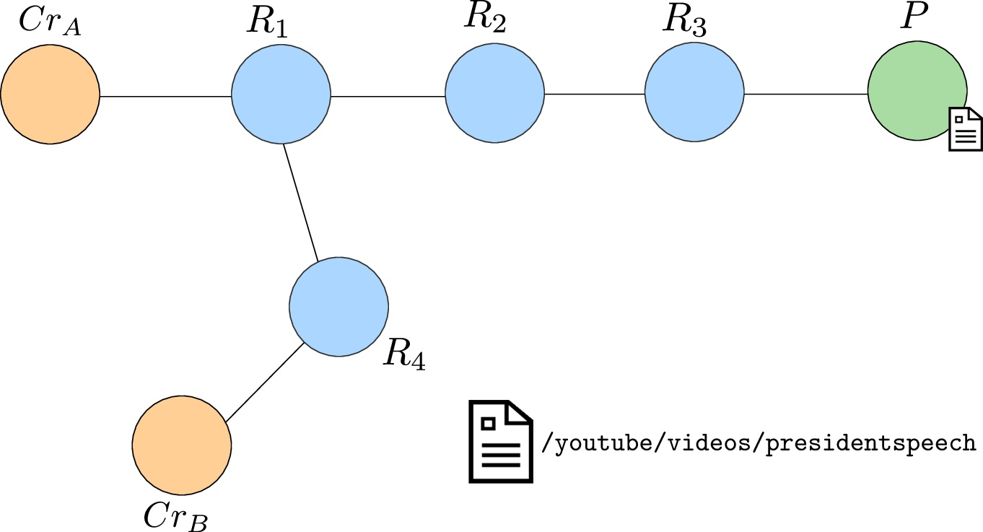
Example

Slide 5
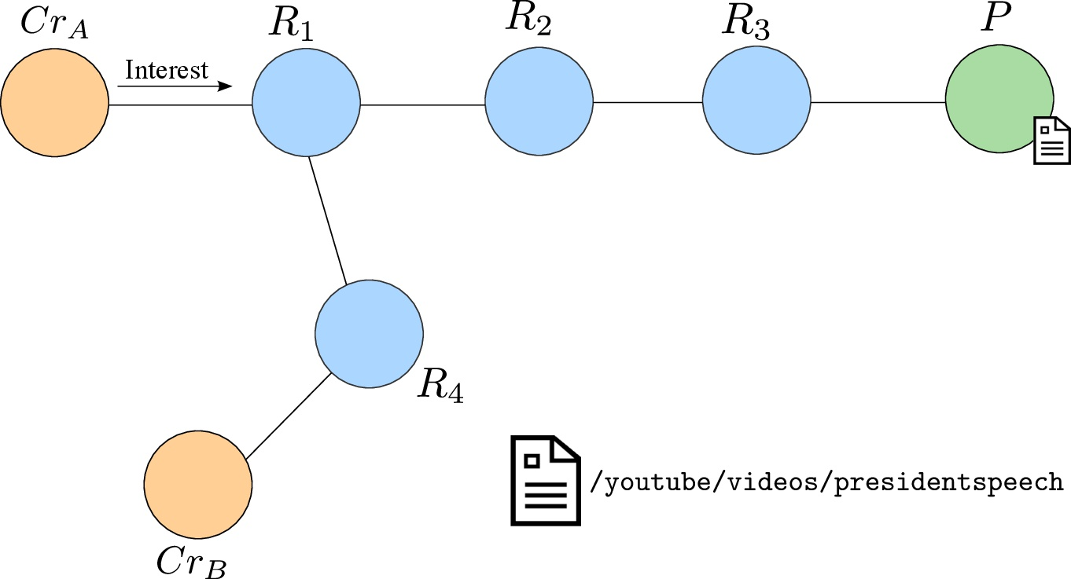
Example

Slide 6
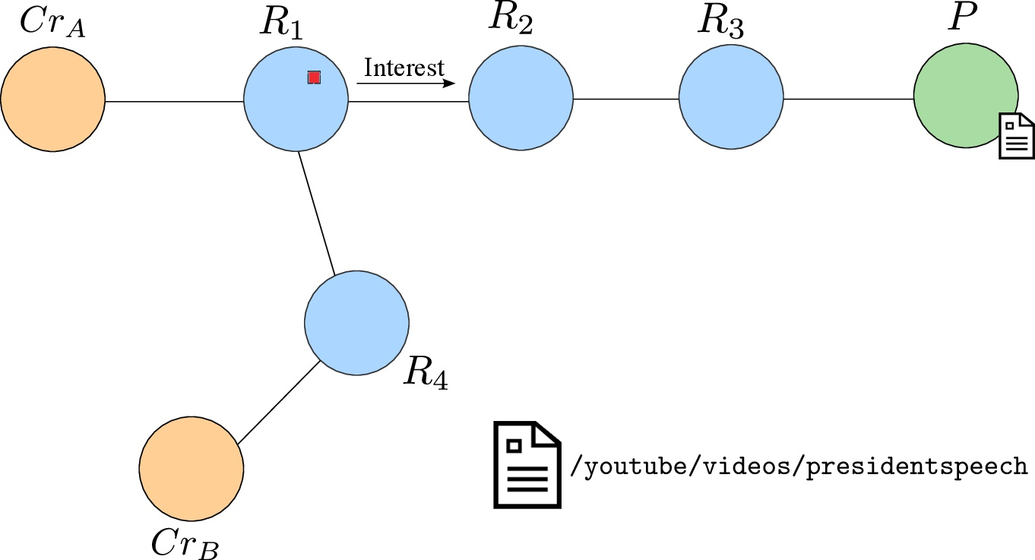
Example

Slide 7
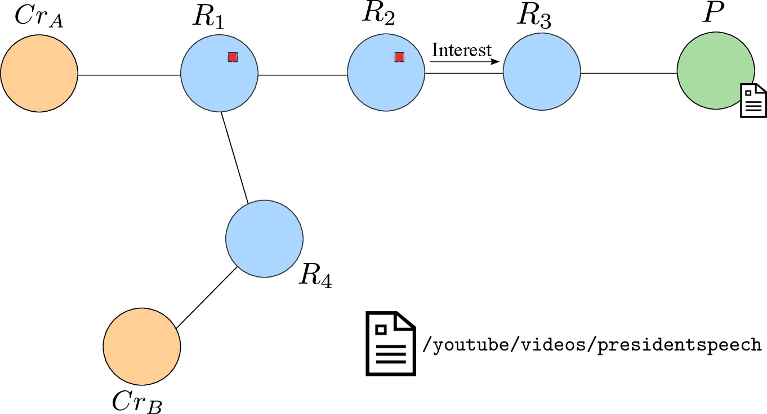
Example

Slide 8
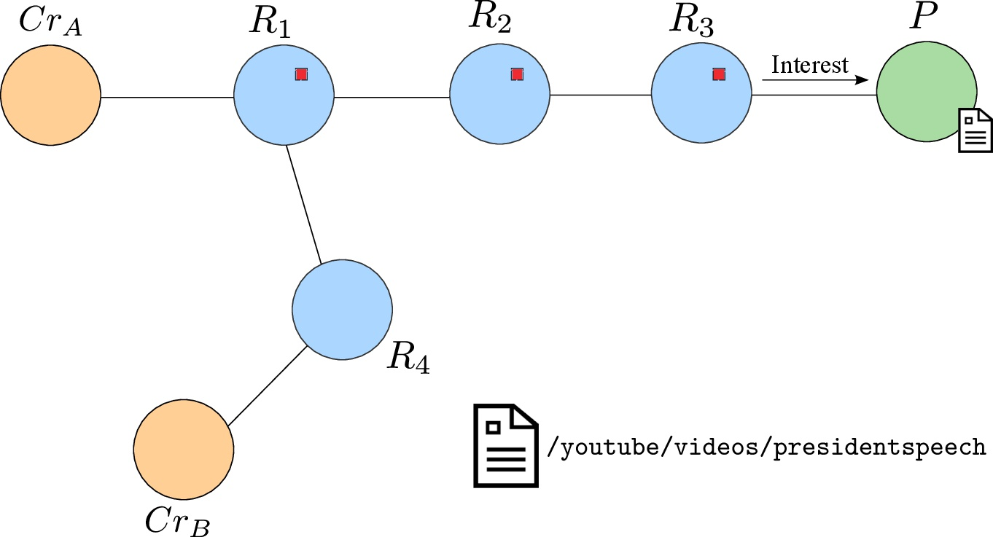
Example

Slide 9
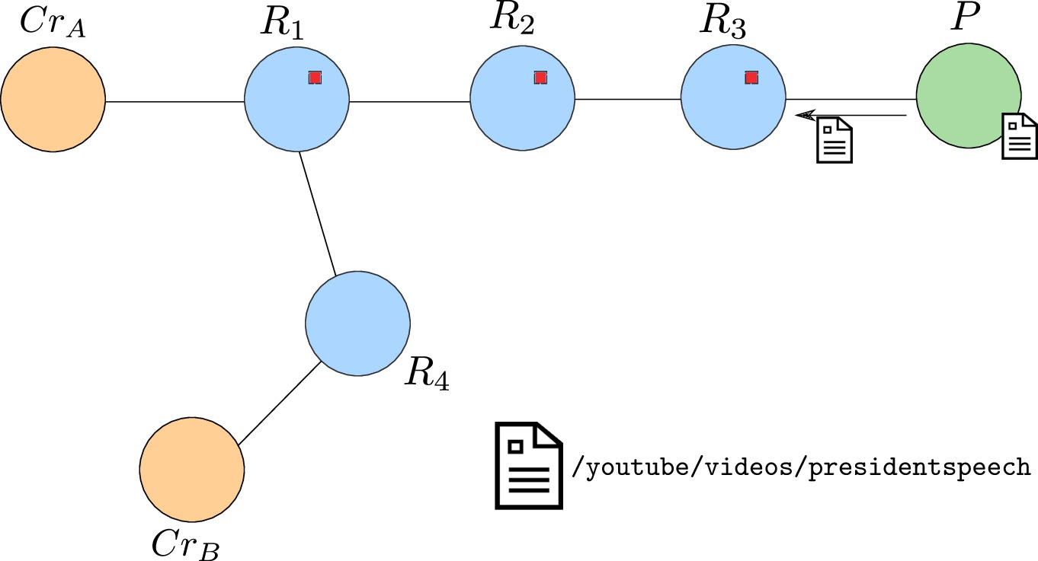
Example

Slide 10
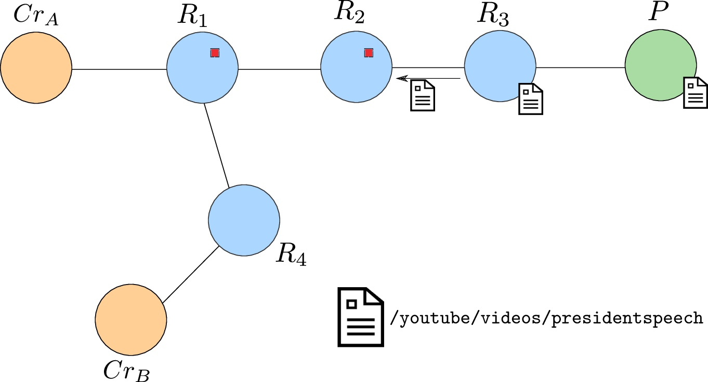
Example

Slide 11
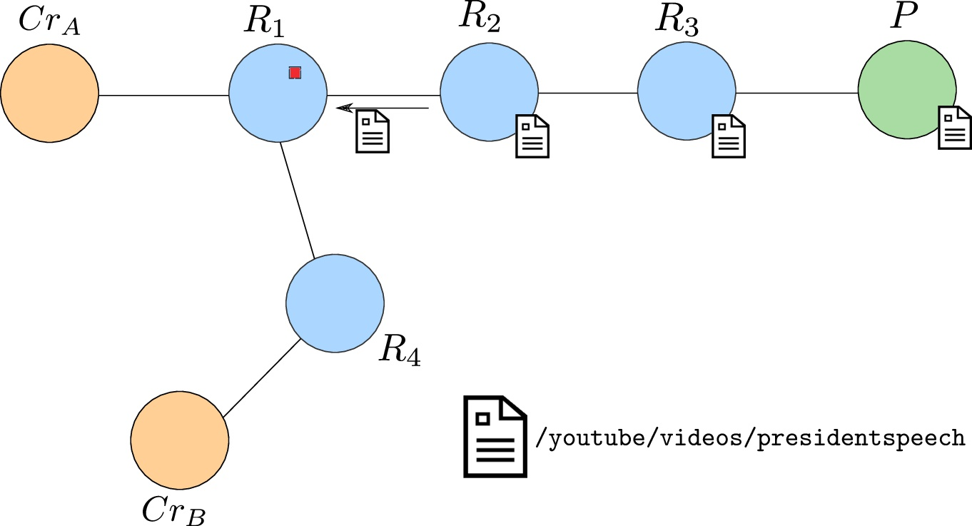
Example

Slide 12
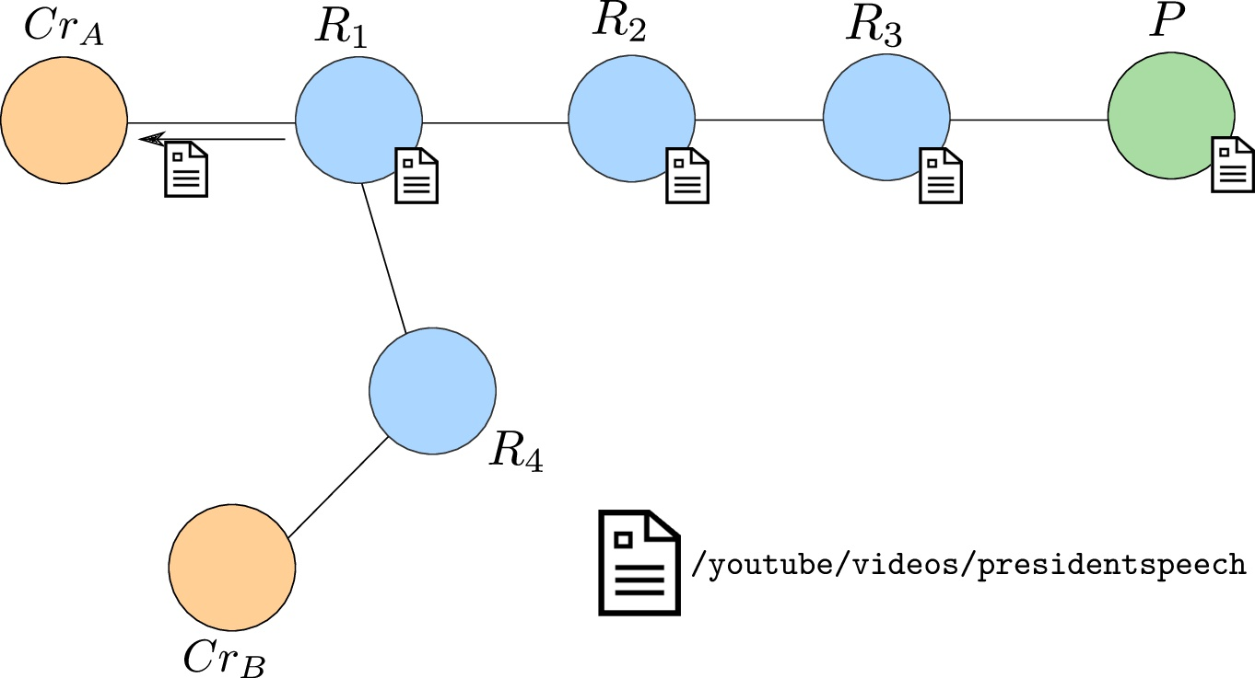
Example

Slide 13
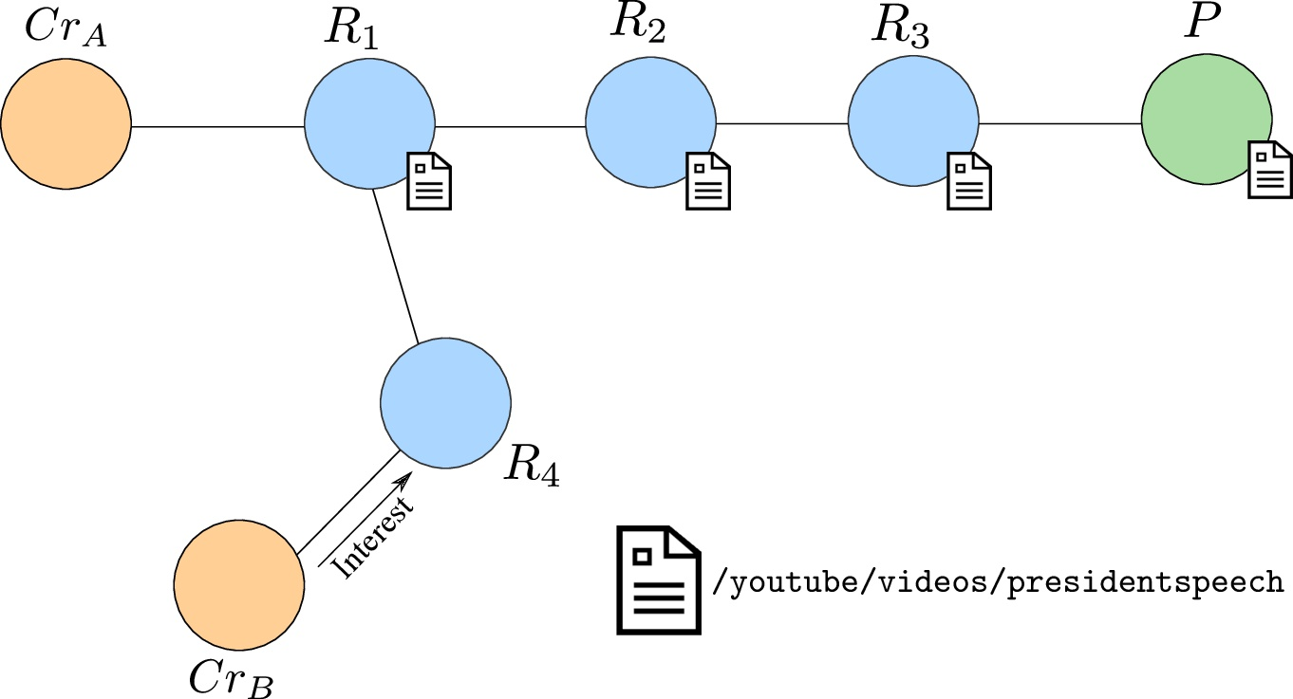
Example

Slide 14
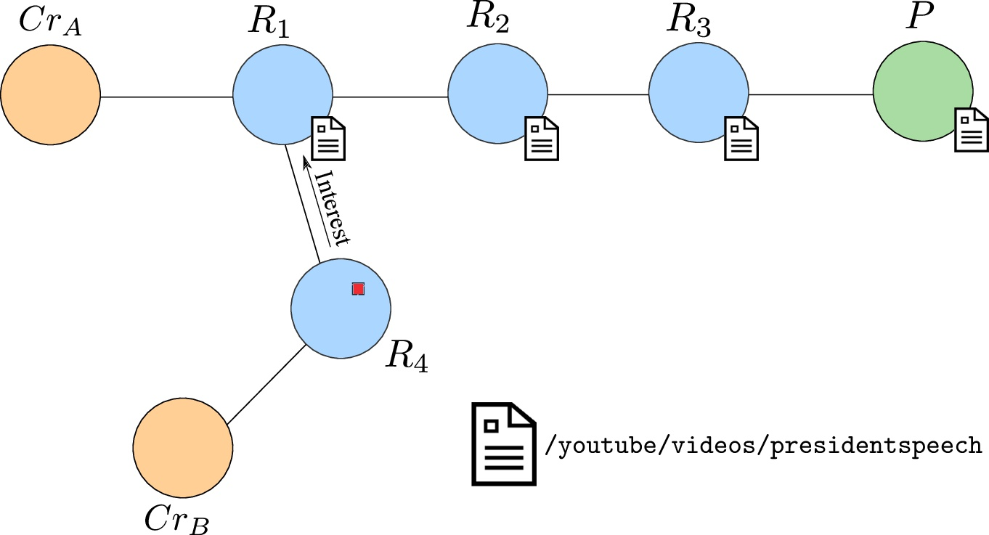
Example

Slide 15
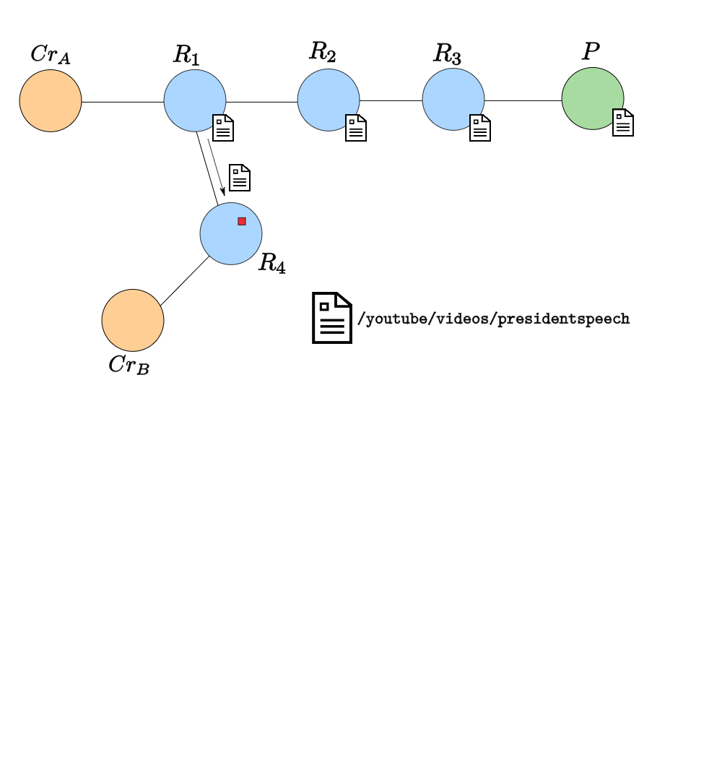
Example

Slide 16
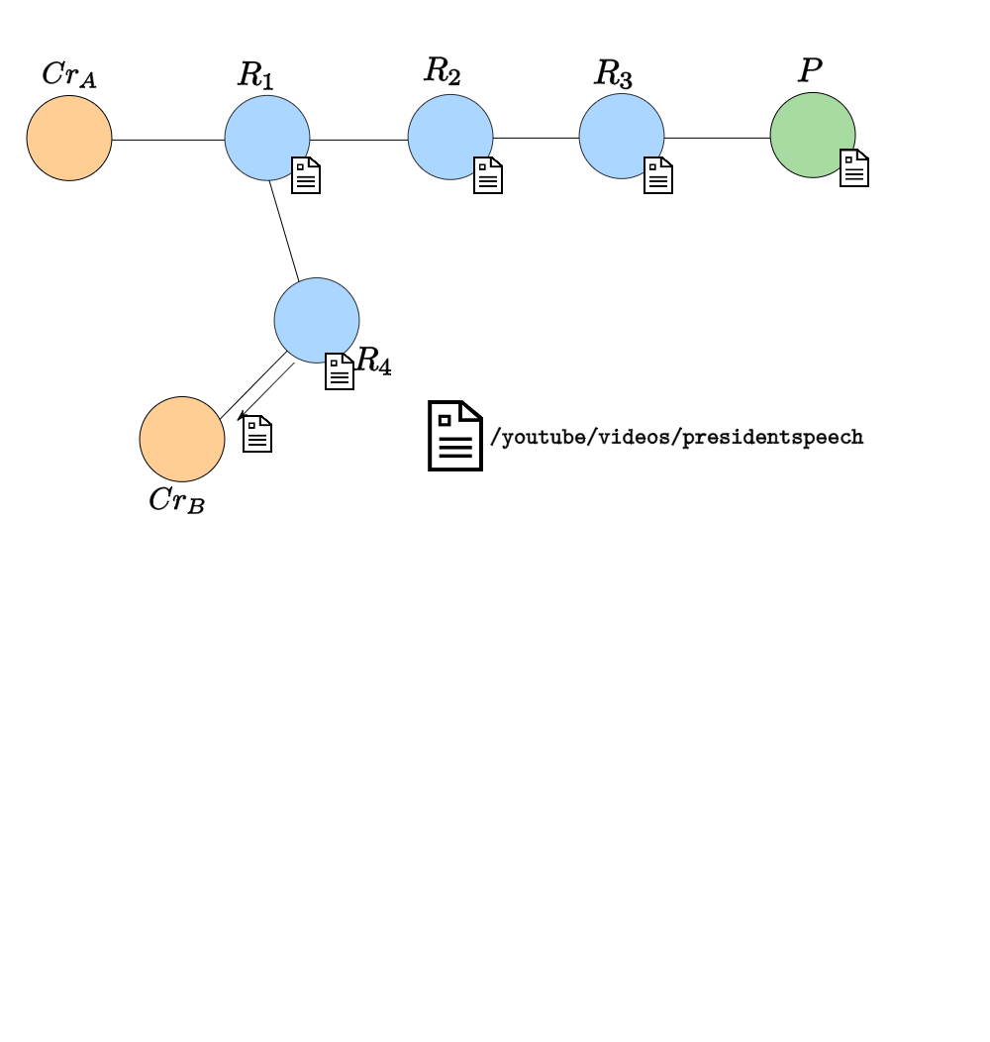
Example

Slide 17
Data Decoupling
Data is decoupled from its origin
Routers may cache content to satisfy future duplicate requests
Benefits:
Upstream congestion and bandwidth utilization is reduced via caching
Consumer latency is reduced
QoS improves (theoretically)
Drawbacks:
Content must be digitally signed (or verified by some other means) to ensure authenticity
Producers have no knowledge about where content is cached

Slide 18
Types of Content
Type | Example | Cacheable? | Rate of Change?
Static | Media file | Yes | Infrequent
Dynamic | VoIP traffic | No (except for retransmissions) | Frequent
Event-driven | Breaking news | Yes | Unpredictable

Slide 19
Main Question
How can we cache event-driven content while preventing consumers from obtaining stale (out-of-date) content?

Slide 20
Related Work*
Dynamically reduce the cache lifetime of content as it spreads further away from the producer
Helps, but doesn’t mitigate the problem
Proactive content sharing between peering routers
No discussion of deletion or expiration of content
Revoke consumer access from content via online OCSP-like protocols
Revocation != deletion
*References are contained in the paper.

Slide 21
Our Answer
We need a way to flush or erase content from router caches on demand

Slide 22
Erasure Requirements
Erase messages must be authenticated
Erase messages must be distributed to all routers which may have potentially cached the content

Slide 23
Erasure Requirements
Erase messages must be authenticated (easy)
Erase messages must be distributed to all routers which may have potentially cached the content (hard)

Slide 24
Authenticating Erase Messages
Several things to consider:
Authentication should not cause a DoS on routers
Deletion is an idempotent operation

Slide 25
Authenticating Erase Messages
Several things to consider:
Authentication should not cause a DoS on routers
Deletion is an idempotent operation
Solution: use pre-image resistant hash functions
Generate
Compute
Distribute with published content
Publish with a erase message to prove ownership of content
If then the producer must have issued the request

Slide 26
Erase Message Format
Fixed Header
256B
Optional Headers
Name (N)
Average(|N|) = 60B*
Content Object Hash Digest (d)
32B
Content Pre-image (Y)
32B
Notation: E(N,d)
*Based on unibas dataset from http://www.icn-names.net/

Slide 27
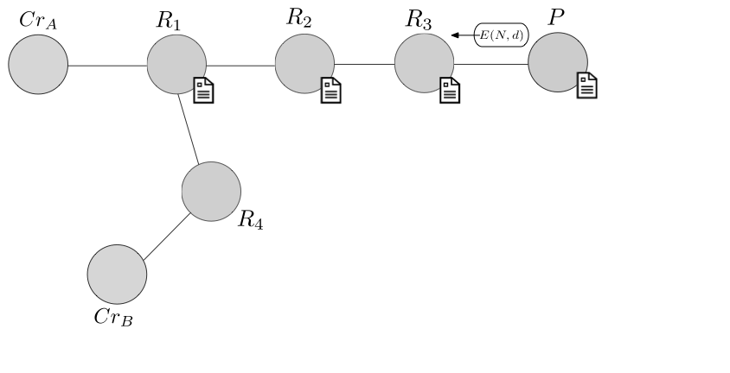
Distributing Erase Messages

Slide 28
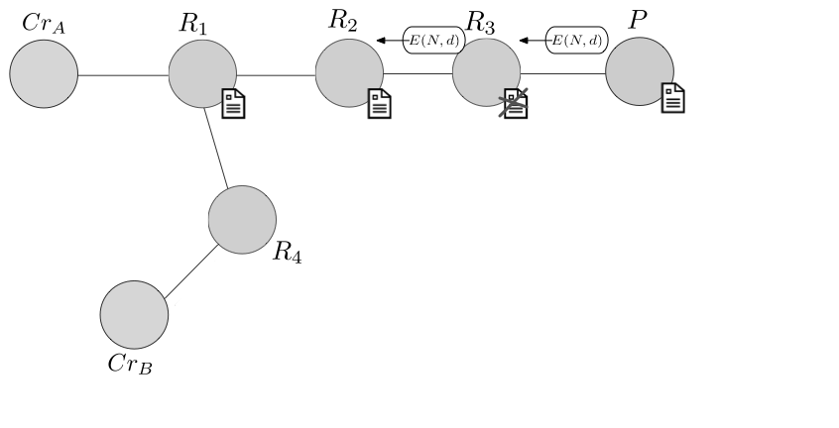
Distributing Erase Messages

Slide 29
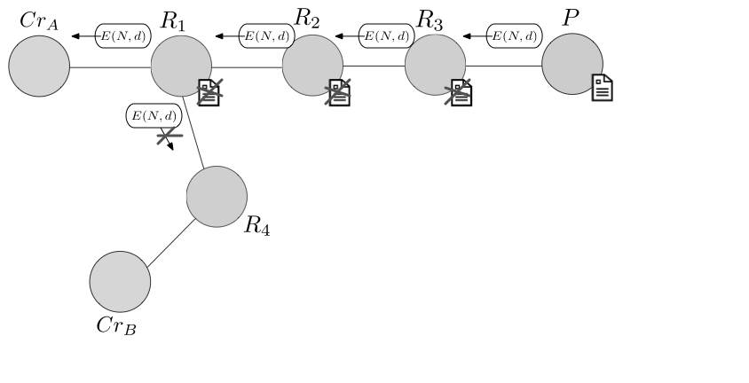
Distributing Erase Messages

Slide 30
Distributing Erase Messages
Several things to consider:
Producers have no knowledge about where content may be stored
Not all routers may cache content

Slide 31
Distributing Erase Messages
Several things to consider:
Producers have no knowledge about where content may be stored
Not all routers may cache content
Our approach: a hierarchy of distribution mechanisms
Mark Interests (see the paper)
Maintain lossless forwarding histories
Maintain lossy forwarding histories
Broadcast (reverse flood) erase messages
more network costs
more storage costs

Slide 32
2) Lossless Histories
Idea: remember where content was forwarded
Implementation:
Caches maintain records of interfaces to which content was sent
When flushed, forwarding history is written to a log
Protocol:
When E(N,d) arrives, search the cache for the content with digest d
If present, forward E(n,d) to recorded interfaces and flush the match
Else, search the log for d
If present, forward E(n,d) to the recorded interfaces
Else, drop E(n,d)

Slide 33
2) Lossless Histories
Idea: remember where content was forwarded
Implementation:
Caches maintain records of interfaces to which content was sent
When flushed, forwarding history is written to a log
Protocol:
When E(N,d) arrives, search the cache for the content with digest d
If present, forward E(n,d) to recorded interfaces and flush the match
Else, search the log for d
If present, forward E(n,d) to the recorded interfaces
Else, drop E(n,d)
Observation: if all routers have lossless histories, this gives complete DFS coverage

Slide 34
Lossless History Analysis
Consumer-facing router:
4GB of history storage
100Mbps forwarding rate (3’200 Cps*)
Saturation in ~12 hours
Core router:
1TB of flash history storage
10Tbps forwarding rate (335 MCps)
Saturation in ~102s (ouch!)
*assuming content objects are 4KB in size

Slide 35
3) Lossy Histories
Idea: remember where content was forwarded without storing the content
Implementation:
Caches maintain records of interfaces to which content was sent
Maintain a Bloom Filter for each outgoing interface
Whenever a content is flushed, add its hash digest to each interface filter to which it was forwarded
Protocol:
When E(N,d) arrives, search the cache for the content with digest d
If present, forward E(n,d) to recorded interfaces and flush the match
Check each interface filter for d
For each match, forward E(n,d) to the interface

Slide 36
3) Lossy Histories
Idea: remember where content was forwarded without storing the content
Implementation:
Caches maintain records of interfaces to which content was sent
Maintain a Bloom Filter for each outgoing interface
Whenever a content is flushed, add its hash digest to each interface filter to which it was forwarded
Protocol:
When E(N,d) arrives, search the cache for the content with digest d
If present, forward E(n,d) to recorded interfaces and flush the match
Check each interface filter for d
For each match, forward E(n,d) to the interface
Observation: enables correct DFS coverage but can induce excess traffic due to false positive nature of BF

Slide 37
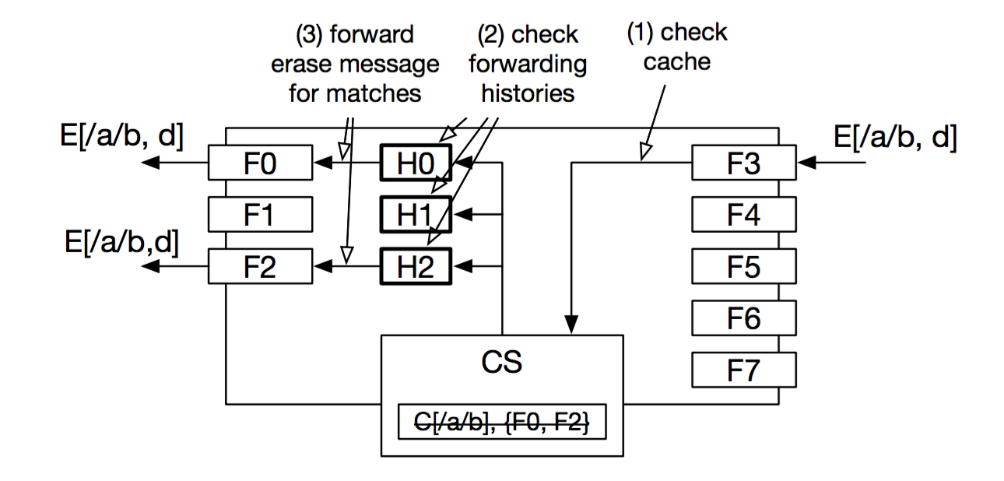

Slide 38
Lossy History Analysis
Consumer-facing router:
False probability ceiling of 10⁻³² → at most 2x10⁸ entries
K = 128 distinct hash functions must be used
Saturation in ~1 day
Core router:
False probability ceiling of 10⁻³² → at most 5.7x10⁸ entries
K = 107 hash functions must be used
Saturation in ~245s (ouch!)

Slide 39
4) Broadcast
Implementation:
Nothing.
Protocol:
If neither of the previous approaches are supported, and if the AS allows it, flood E(n,d) to all interfaces

Slide 40
4) Broadcast
Implementation:
Nothing.
Protocol:
If neither of the previous approaches are supported, and if the AS allows it, flood E(n,d) to all interfaces
Observation: use when there is no cache and in controlled ASs

Slide 41
Overall Recommendations
If interest marking is supported, use it.
If not, and the content is cached, forward based on the cache entry interface list.
If the content is not cached but there is a history, forward based on the history.
Otherwise, flood erase messages.*
*Justification: on-demand deletion can be seen as a feature that allowed producers must pay for

Slide 42
Experiment
Goal: determine the router and network overhead
Setup:
Consumers requesting at 10 interest/second
Producers deleting a random 50% of their (previously sent) content
Topology: large DFN and ATT topologies

Slide 43
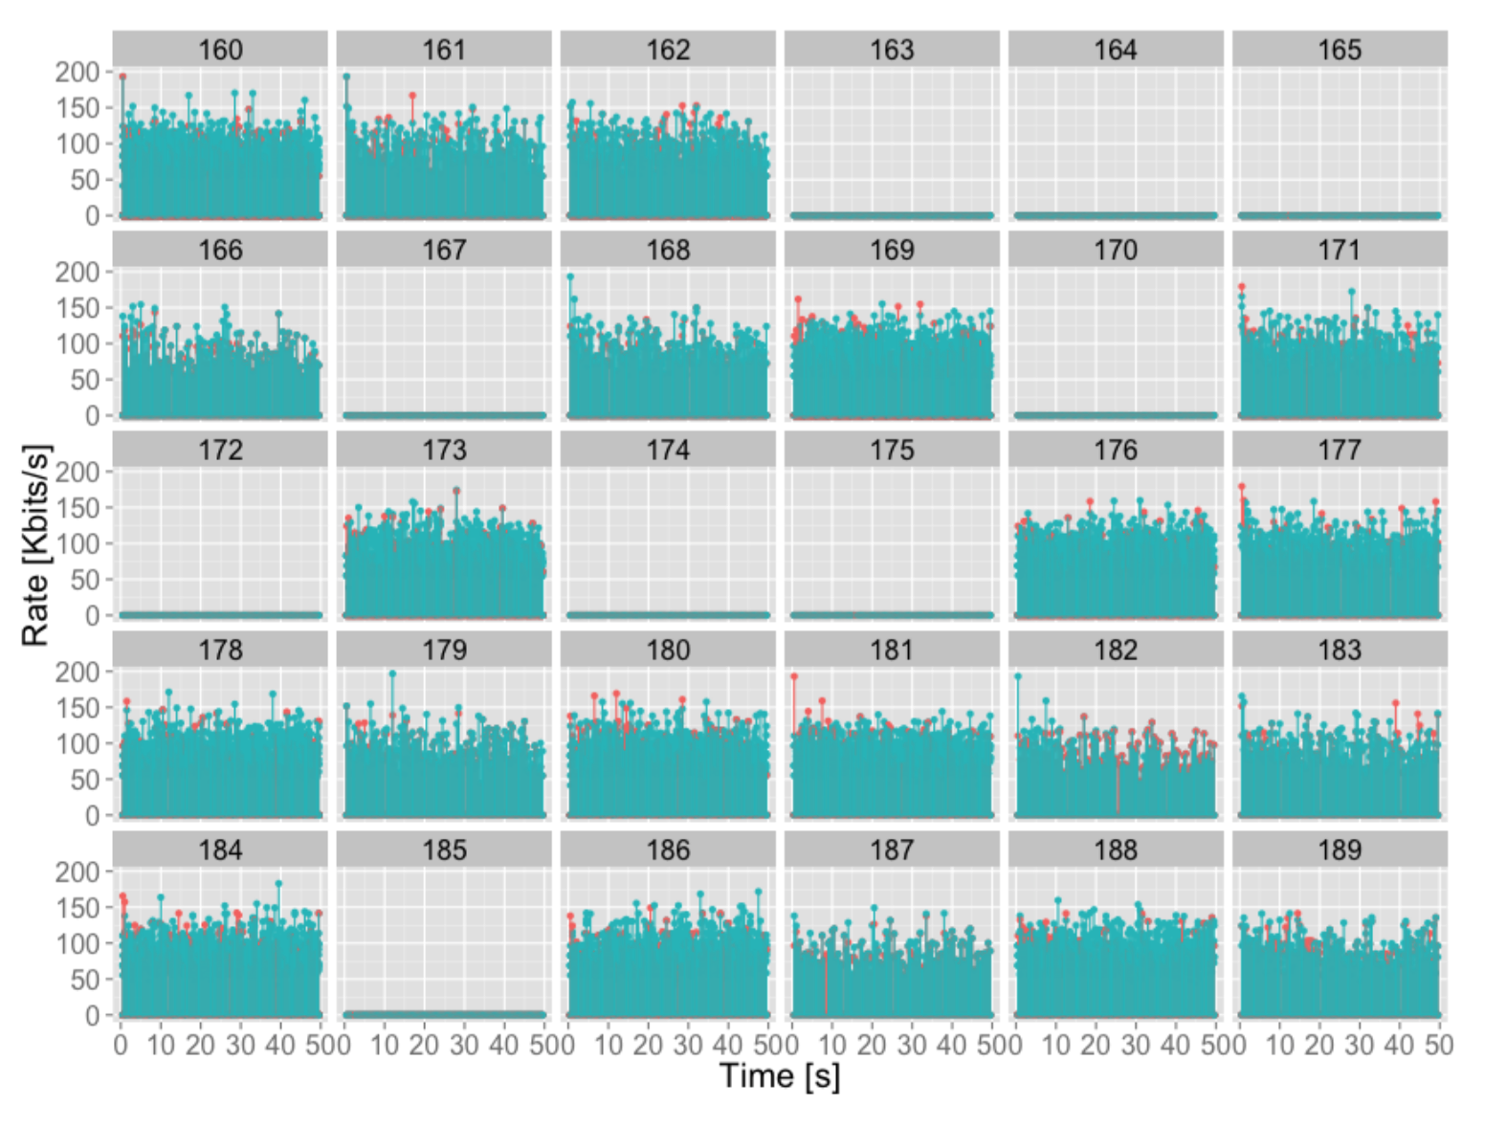
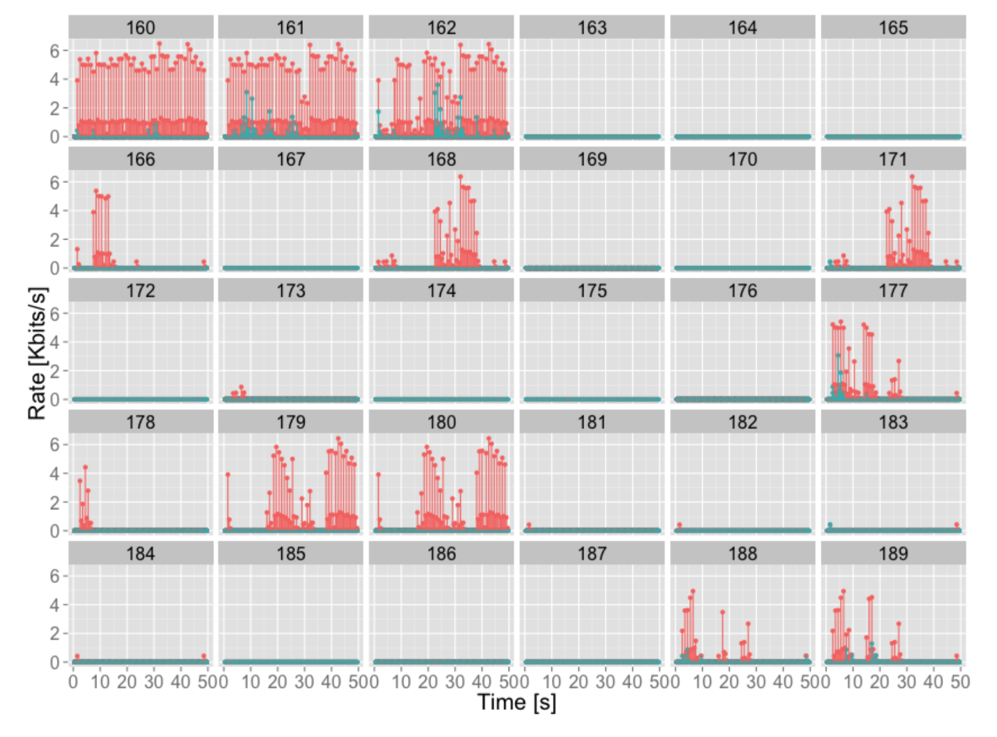
Results (snippet)
Routers under heavy content load
Each cell is a router
X-axis is simulation time
Y-axis is forwarding rate
Notes:
Cells are individual routers
Deletion rate unclear
Lossless unclear

Slide 44
Results (snippet)
Routers forwarding erase
messages (lower output
throughput*)
*Producers may send duplicate BEADs
(which are dropped at routers)
Notes:
Cells are individual routers
Deletion rate unclear
Lossless unclear

Slide 45
Conclusion
Showed how to support on-demand deletion of content in CCN by…
Authenticating erase messages
Distributing erase messages to candidate routers
Analyzed the overhead and efficacy of each distribution mechanism
Experimentally assessed the best-case scenario

Slide 46
Future Work
Continue the experimental assessment of BEAD
Improve the interest marking mechanism so that it’s private
Combine BEAD with a secure accounting protocol for “premium CDN overlays in CCN”

