Slide 1
Cryptographic Algorithms and Security Protocols for ICN
Christopher A. Wood
UC Irvine, PARC
woodc1@uci.edu, cwood@parc.com

Slide 2
ICN Network Stack
An ICN Network Stack
(ICN) App
ICN
ICN
native
TCP/UDP
overlay
IP
Link
PHY

Slide 3
Security Services
An ICN Network Stack
Security Services
(ICN) App
Confidentiality
?
ICN
ICN
?
Integrity and Authenticity
TCP/UDP
?
IP
Anonymity
?
Link
Availability
?
PHY
Privacy

Slide 4
Security Services
An ICN Network Stack
Security Services
(ICN) App
Confidentiality
?
ICN
ICN
?
Integrity and Authenticity
TCP/UDP
?
IP
Anonymity
?
Link
Availability
?
PHY
Privacy
Q: What crypto and security techniques can enable these core services?
Notes:
Be mindful of the state of the art to make informed design decisions

Slide 5
Selection Criteria
Goal: Crypto that can enables essential network services
What’s essential?
Integrity and authenticity
Privacy (e.g., as per RFC 6973)
Availability
What’s non essential?
Anonymity
Confidentiality (application-layer concern)

Slide 6
Topic Breakdown
Included
Integrity and authenticity
Hash-based signatures
Privacy
Encrypted Deep Packet Inspection (DPI)
Password-Authenticated and Non-Interactive Key Exchange (PAKE and NIKE)
Private Information Retrieval (PIR)
Randomizable public-key encryption
Secure searchable encryption and predicate encryption (SSE and PE)
Availability
Authenticated Denial of Existence (DoE)
Omitted
Oblivious and onion routing
Oblivious RAM
Fully and partially homomorphic encryption
General confidentiality techniques
Notes:
Anonymity: TOR and Hornet

Slide 7
Integrity and Authentication

Slide 8
Hash-Based Signatures
Traditional signature schemes are based on trapdoor functions
RSA, DSA, ECDSA, etc.
PQ-secure?
Hash-based signatures are quantum-secure, e.g., they don’t fall to Shor’s algorithm
Based on one-time signatures (OTSs)
A key pair can be used only once

Slide 9
Lamport OTS Idea
x
y
Private key: (x, y)
H
H
H(x)
H(y)
Public key: (H(x), H(y))
Notes:
Lamport, Leslie. Constructing digital signatures from a one-way function. Vol. 238. Palo Alto: Technical Report CSL-98, SRI International, 1979.

Slide 10
Lamport OTS Idea
x
y
Private key: (x, y)
H
H
H(x)
H(y)
Public key: (H(x), H(y))
To sign a ‘0’: release x
To sign a ‘1’: release y

Slide 11
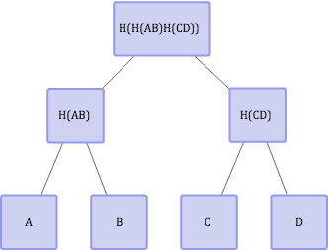
Merkle Tree Idea
Public key
Parts of the public key
k_{A}
k_{B}
k_{C}
k_{D}

Slide 12
Merkle Tree Idea
Public key
Parts of the public key
k_{A}
k_{B}
k_{C}
k_{D}
To sign the first message m1: provide (A, B, H(CD), sign_{kA}(m1))
Notes:
TODO: circle the adjacent path

Slide 13
Merkle Tree Idea
Public key
Parts of the public key
k_{A}
k_{B}
k_{C}
k_{D}
To sign the third message m3: provide (H(AB), C, D, sign_{kA}(m3))
Notes:
TODO: circle the adjacent path
https://sphincs.cr.yp.to/slides-sphincs-20150428.pdf

Slide 14
Merkle Trees
The tree dimensions determine the number of messages that can be signed
Other drawbacks:
It is secure in the Random Oracle model
The length is proportional to the number of messages that are signed
It is stateful
Store the index and intermediate tree results
Notes:
Merkle, Ralph C.: Secrecy, Authentication, And Public Key Systems. Ph.D. thesis, Stanford University (1979)

Slide 15
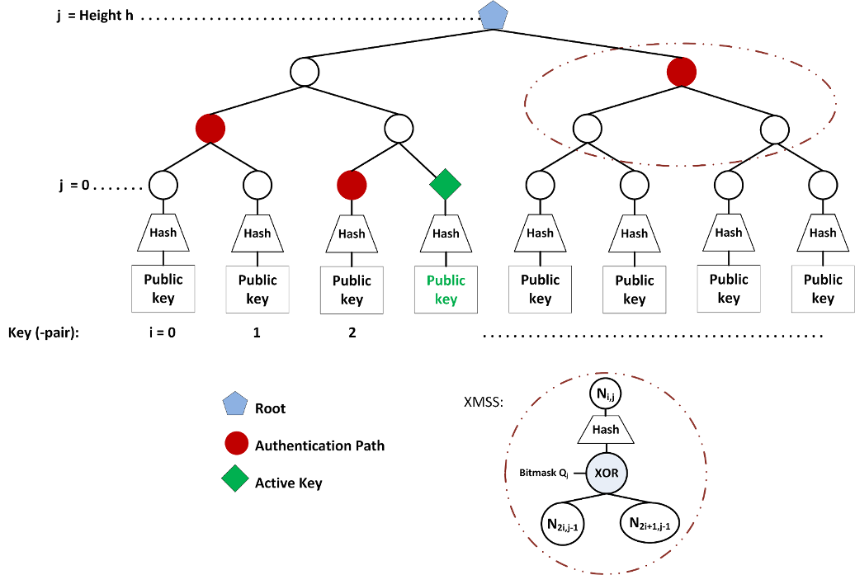
XMSS Tree (Buchmann et al.)
Borrowed from:
http://www.square-up.org/index/hbs.html
Notes:
http://www.square-up.org/index/hbs.html
The main construction looks like a Merkle tree, excepts a few things. The XMSS tree has a mask XORed to the child nodes before getting hashed in their parents node. It’s a different mask for every node:
Leaves are roots of L-trees, which are similar to XMSS trees and embed the public keys
Per-node masks are important for the security proof

Slide 16
Stateless Hash-Based Signature
Similar to Merkle trees but the “index” is chosen at random
Requires huge trees to avoid collisions
For security parameter λ=128 we require 2^{2λ} leaves (by birthday paradox)
OTS secret keys are generated pseudorandomly
Notes:
https://cr.yp.to/talks/2015.04.02/slides-djb-20150402-4x3.pdf
https://sphincs.cr.yp.to/slides-sphincs-20150428.pdf

Slide 17
SPINCS (Bernstein et al.)
Stateless hash-based signature with 2¹²⁸ security
Inspired by Goldreich stateless hash-based scheme
Dramatically reduces signature and tree size
Signatures are down to 41KB
Public and private keys are 1KB
Replace one-time leaves with “few-time leaves”
Use XMSS-like per-node masks
Notes:
[X] Oded Goldreich. Foundations of Cryptography: Volume 2, Basic Applications. Cambridge University Press, Cambridge, UK, 2004.
[Y] Bernstein, Daniel J., et al. "SPHINCS: practical stateless hash-based signatures." Advances in Cryptology--EUROCRYPT 2015. Springer Berlin Heidelberg, 2015. 368-397.
https://eprint.iacr.org/2014/795.pdf
http://link.springer.com/chapter/10.1007%2F3-540-47721-7_8

Slide 18
Hash-Based Signature Recap
Useful for long-term integrity in a post-quantum world
Will ICN data packets live forever?
SPHINCS can be used as a drop-in replacement for current ICN signatures
Notes:
Andreas Hülsing. “W-OTS+-Shorter Signatures for Hash-Based Signature Schemes.” Pages 173-188 in: Amr Youssef, Abderrahmane Nitaj, Aboul Ella Hassanien (editors). Progress in Cryptology – AFRICACRYPT 2013,
6th International Conference on Cryptology in Africa, Cairo, Egypt, June 22-24, 2013, proceedings. Lecture Notes in Computer Science 7918. Springer. ISBN: 978-3-642-38552-0.
https://eprint.iacr.org/2014/795.pdf
https://www.cs.umd.edu/~jkatz/papers/HashBasedSigs.pdf
https://en.wikipedia.org/wiki/Merkle_signature_scheme
https://eprint.iacr.org/2011/484.pdf

Slide 19
Privacy

Slide 20
Encrypted DPI
Goal: perform deep-packet-inspection (DPI) on encrypted packet payloads
e.g., to determine when a packet contains an encrypted version of a specific keyword
Different measures of privacy
Exact-match privacy: only discover bytes that match target keywords
Probable cause privacy: decrypt a flow (entire packet) only if a keyword match is detected
Notes:
https://eprint.iacr.org/2015/264.pdf

Slide 21
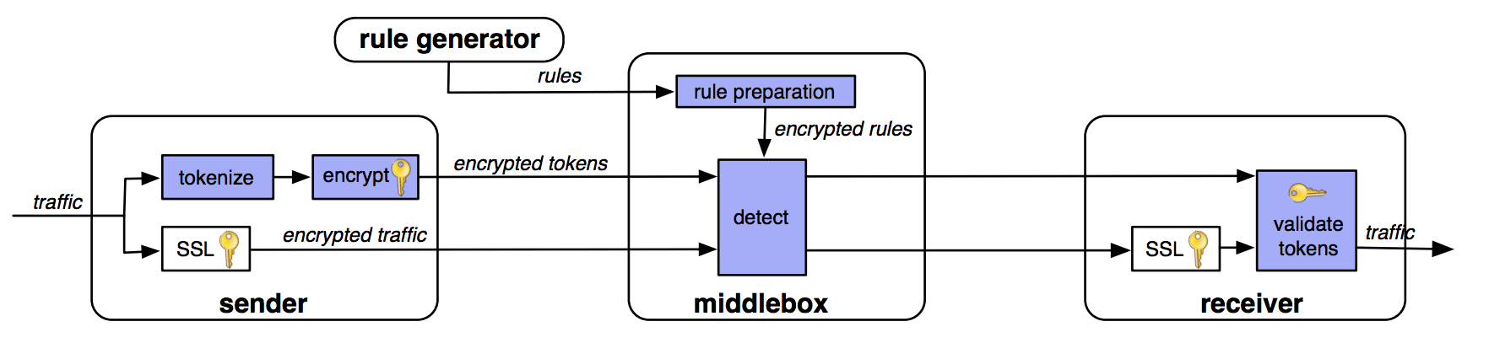
BlindBox (Sheery et al.)
Notes:
https://eprint.iacr.org/2015/264.pdf

Slide 22
BlindBox Details
Packets are tokenized into tokens t1,…,tk
For each token t, encrypt as follows
salt, AES_{AES-k(t)}(salt)
To detect a token t, precompute salt and token combinations
Speedup: use a single salt per token and then derive subsequent token encryptions based on a counter
ensures
randomness
of identical
tokens

Slide 23
Probable Cause Decryption
Idea: embed message encryption key Dk in the encryption of each token
salt, (AES_{AES-k(t)}(salt) XOR Dk)

Slide 24
BlindBox Rule Preparation
The middlebox must learn AES-k(t) without revealing the encryption key k
Solution: Garbled circuit to compute
AES-k(t)
for each token t

Slide 25
Encrypted DPI Recap
ICN packets reveal information about producers and consumers
Signatures, names, etc.
Carrying ICN packets in secure contexts can protect this information
But how do we route on encrypted packets?

Slide 26
Privacy: Key Exchange

Slide 27
Password AKE
Goal: create ephemeral keys from shared secrets – passwords (read: name) – in a way that is:
Not susceptible to offline dictionary attacks
Forward secure
Varying number of rounds
Most are multi-round, e.g., J-PAKE (Hao et al.)
Some work in a single round without sacrificing forward secrecy (Benhamouda et al.)
Notes:
https://eprint.iacr.org/2010/190.pdf
https://www.normalesup.org/~fbenhamo/files/publications/SP_AbdBenMac15.pdf
https://www.researchgate.net/profile/Siamak_Shahandashti/publication/277634814_The_Fairy-Ring_Dance_Password_Authenticated_Key_Exchange_in_a_Group/links/556ee7c508aefcb861dc05be.pdf
https://tools.ietf.org/html/rfc7664
https://eprint.iacr.org/2010/190.pdf
http://eprint.iacr.org/2015/188.pdf

Slide 28
Non-Interactive Key Exchange (NIKE)
Goal: Two parties with knowledge of each other’s public keys agree on a shared secret without requiring any interaction
Alice: x, g^{x}
Bob: y, g^{y}
Shared key: H(“Alice”, “Bob”, g^{xy})
Use case: WSN shared key derivation
Fun fact: public-key encryption follows from NIKE
Notes:
http://www.isg.rhul.ac.uk/esvfreire/slides/NIKE_PKC2013_Eduarda_Freire_Slides.pdf
https://eprint.iacr.org/2012/732.pdf
http://www.di.ens.fr/users/pointche/Documents/Papers/2014_scn.pdf
Diffie, W., Hellman, M.E.: New directions in cryptography. IEEE Transactions on Information Theory 22(6) (1976).

Slide 29
NIKE Protocols
Setup: generate system parameters
KeyGen: generate a private and public key pair for a given identity
SharedKey: given (1) an identity, (2) its public key, (3) another identity, (4) and its secret key, compute and output a shared key

Slide 30
NIKE Protocols
Setup: generate system parameters
KeyGen: generate a private and public key pair for a given identity
SharedKey: given (1) an identity, (2) its public key, (3) another identity, (4) and its secret key, compute and output a shared key
What’s in an ICN certificate?...

Slide 31
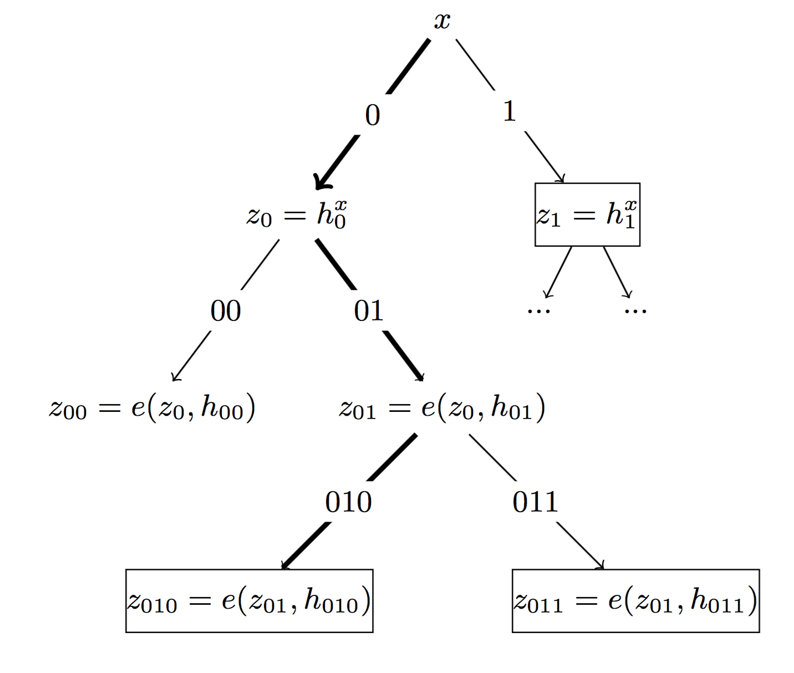
Forward Secure NIKE?
Yes – it’s possible: evolve the public keys (Pointcheval et al.)
Use multilinear maps and the tree-based key derivation technique
Add an Update function to the scheme:
Move the secret key forward in time and space
Notes:
Lee, Young Kyung, and Dong Hoon Lee. "Forward Secure Non-Interactive Key Exchange from Indistinguishability Obfuscation." IT Convergence and Security (ICITCS), 2015 5th International Conference on. IEEE, 2015.
Pointcheval, David, and Olivier Sanders. "Forward secure non-interactive key exchange." Security and Cryptography for Networks. Springer International Publishing, 2014. 21-39.

Slide 32
KE Recap
End-to-end sessions break the ICN model
NIKE lets us create group “sessions” without any exchanges
ICN entities (prefixes) have identities

Slide 33
Privacy: PIR

Slide 34
Private Information Retrieval
A protocol to hide client requests to a server (e.g., a database)
Two variants: computational (CPIR) and information-theoretic (ITPIR)
CPIR (Stern and others)
Require only a single server
Much more computationally expensive
ITPIR (Chor et al.)
Require at least two non-colluding servers
XOR-based computation but requires more communication
Notes:
http://research.microsoft.com/pubs/260105/popcorn.pdf

Slide 35
ITPIR
1) query
3) decode
2) answer
1) query
2) answer

Slide 36
ITPIR
Replica
1) query
Consumer
3) decode
2) answer
1) query
Replica
2) answer
C. Tschudin, Private Information Retrieval over ICN,
INFOCOM 2016 NOM Workshop, April, 2016. [more later]

Slide 37
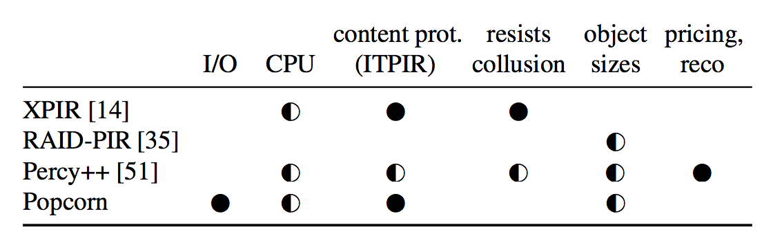
Recent Work
Borrowed from:
http://research.microsoft.com/pubs/260105/popcorn.pdf

Slide 38
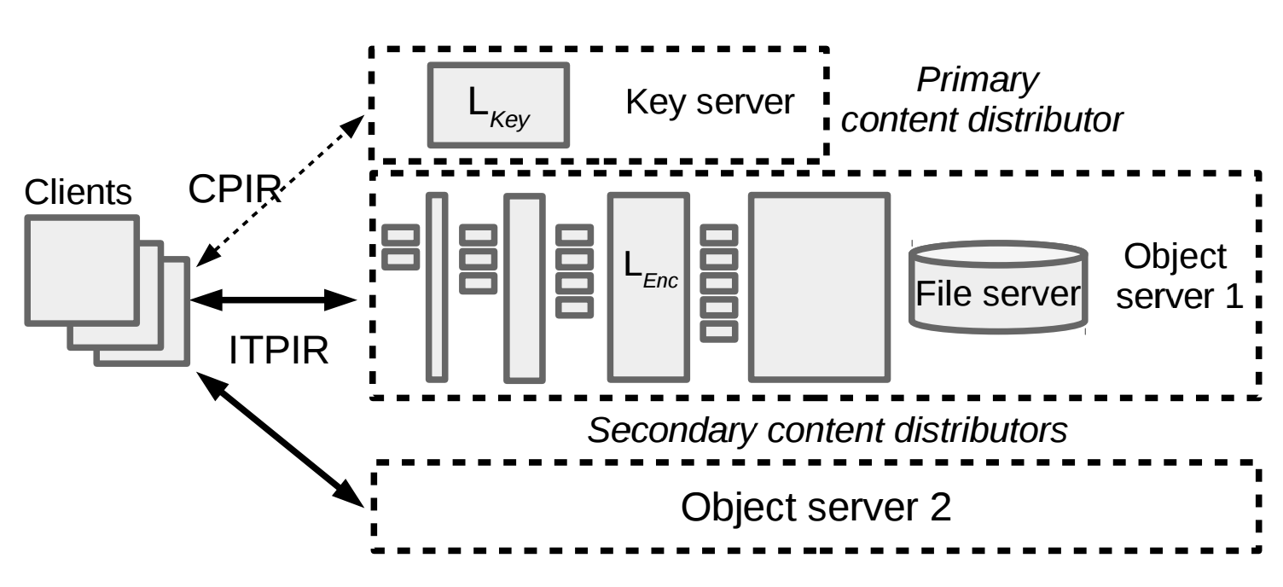
CPIR+ITPIR (Gupta et al.)

Slide 39
Privacy: Randomizable Encryption

Slide 40
Forward-Secure Public Key Encryption
In plain English, “key-evolving public key encryption”
Consists of four algorithms:
Key generation
Key update
Encrypt
Decrypt
Based on binary tree encryption
Notes:
https://www.cs.umd.edu/~jkatz/papers/forward-enc-full.pdf

Slide 41
Binary Tree Encryption (Canetti et al.)
Root key pair: PK, SK_{ε}
0
SK₀
1
SK₁
2
SK₂
3
4
5
6
SK₃
SK₄
SK₅
SK₆

Slide 42
Binary Tree Encryption (Canetti et al.)
Encrypt with the
public key
Root key pair: PK, SK_{ε}
0
SK₀
1
SK₁
2
SK₂
3
4
5
6
SK₃
SK₄
SK₅
SK₆

Slide 43
Binary Tree Encryption (Canetti et al.)
Encrypt with the
public key
Root key pair: PK, SK_{ε}
0
SK₀
derive
SK₂ derived from SK₀
and PK
1
SK₁
2
SK₂
3
4
5
6
SK₃
SK₄
SK₅
SK₆

Slide 44
Binary Tree Encryption (Canetti et al.)
Encrypt with the
public key
Root key pair: PK, SK_{ε}
0
SK₀
SK₂ derived from SK₀
and PK
1
SK₁
2
SK₂
decrypt
Decrypt with SK₂
3
4
5
6
SK₃
SK₄
SK₅
SK₆

Slide 45
Binary Tree Encryption (Canetti et al.)
Encrypt with the
public key
Root key pair: PK, SK_{ε}
0
SK₀
SK₂ derived from SK₀
and PK
1
SK₁
2
SK₂
Decrypt with SK₂
3
4
5
6
SK₃
SK₄
SK₅
SK₆
evolve secret keys in time (and space)

Slide 46
Randomizable Public-Key Encryption
Many encryption schemes can be re-randomized, e.g., ElGamal, BGN, etc.
How can we maintain integrity after randomizing ciphertext?
Randomizable signatures
Notes:
http://www.blazy.eu/Papers/2011_pkc.pdf
https://crypto.stanford.edu/~pgolle/papers/univrenc.pdf

Slide 47
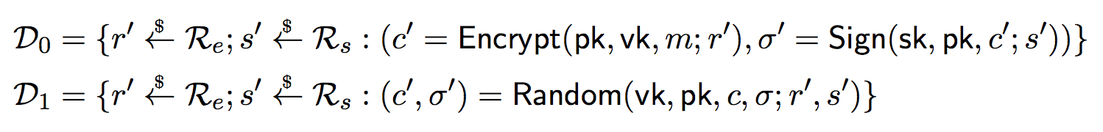
Randomizable Signatures (Blazy et al.)
Given a ciphertext, anyone can re-randomize the ciphertext and adapt the signature the new encryption, i.e.,
are statistically indistinguishable
Notes:
http://www.blazy.eu/Papers/2011_pkc.pdf

Slide 48
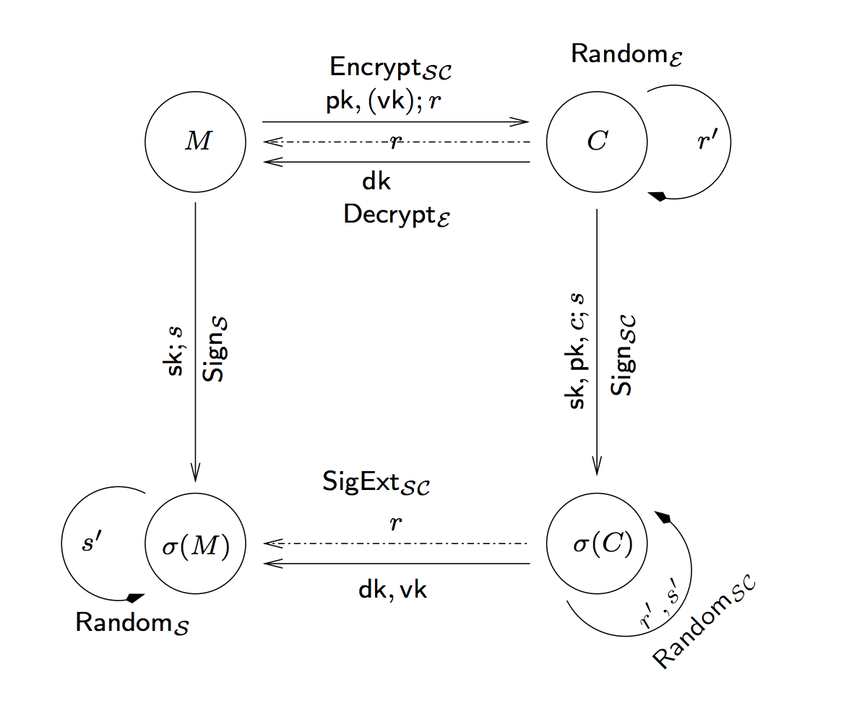
Extractable Signatures

Slide 49
Mixing in Motion
M
M
Mixer
Mixer
encrypt and sign
decrypt and verify
C³,σ³
C²,σ²
C¹,σ¹
V
(randomize)
(randomize)
S

Slide 50
Mixing in Motion
M
M
Replica
Replica
encrypt and sign
decrypt and verify
C³,σ³
C²,σ²
C¹,σ¹
V
(randomize)
(randomize)
S

Slide 51
Privacy: SSE and PE

Slide 52
Searchable Symmetric Encryption
Goal: search over encrypted data using symmetric-key cryptography
Given a database of (encrypted) documents and list of keywords, identify the documents that contain keywords

Slide 53
Searchable Symmetric Encryption
Goal: search over encrypted data using symmetric-key cryptography
Given a database of (encrypted) documents and list of keywords, identify the documents that contain keywords
Many variants:
Interactive and non-interactive
Response-revealing and response-hiding

Slide 54
SSE Overview
Client possess document list D₁,…,D_{n}
Client builds an index (DB) that maps keywords w to documents – DB[w]
Protocol mechanics:
Setup: return key k and encrypted DB (eDB)
Token: on input w and k, return token t
Search: on input eDB and t, the server returns the identifiers in DB[w]
Complexity: search is at best sub-linear in the number of documents and linear in those containing the keyword (optimal)
Notes:
https://eprint.iacr.org/2006/210.pdf
http://diyhpl.us/~bryan/papers2/security/advances-in-cryptology/Advances%20in%20Cryptology%20-%20CRYPTO%202007,%2027%20conf.(LNCS4622,%20Springer,%202007)(ISBN%209783540741428)(642s)_CsLn_.pdf#page=546
https://outsourcedbits.org/2014/08/21/how-to-search-on-encrypted-data-searchable-symmetric-encryption-part-5/

Slide 55
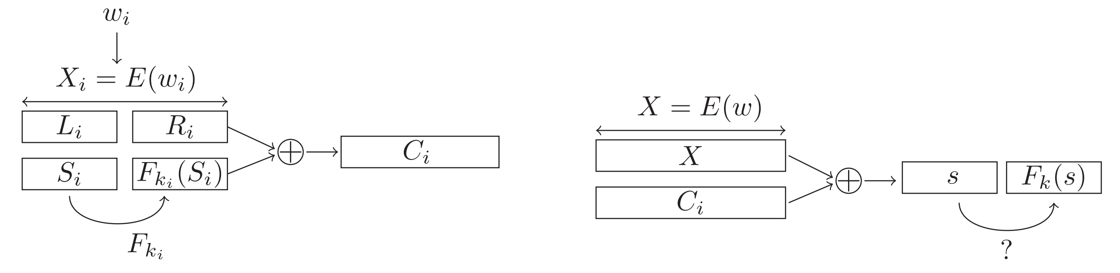
Efficient SSE (Song et al.)
pseudorandom value
Borrowed from:
http://eprints.eemcs.utwente.nl/24788/01/a18-bosch.pdf

Slide 56
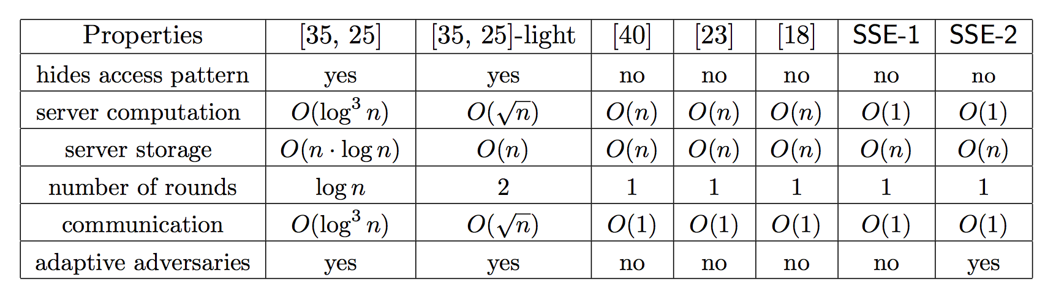
Other SSE Solutions
Borrowed from:
http://research.microsoft.com/pubs/147148/sse.pdf
Notes:
http://research.microsoft.com/pubs/147148/sse.pdf

Slide 57
Other SSE Solutions
…but the search complexity is always linear in the number of matching documents
Borrowed from:
http://research.microsoft.com/pubs/147148/sse.pdf
Notes:
http://research.microsoft.com/pubs/147148/sse.pdf

Slide 58
Alternatives to SSE
Property-Preserving Encryption (PPE) and Predicate Encryption (PE)
Data is encrypted
Users learn plaintext if the predicate evaluates true on the ciphertext
Types of predicates
Inner-products over integer vectors (Nieto et al.)
Subspace membership (Boneh et al.)
Notes:
[31] -- http://elaineshi.com/docs/sympredenc.pdf
https://eprint.iacr.org/2013/830.pdf

Slide 59
Non-Symmetric Encrypted Search
Two variants: Practical and “not so much”
Practical: CryptDB and Arx (CryptDB v2)
Deployed at scale
Theoretical: Based on Oblivious RAM
Seek to hide everything except the result size
Often multi-round, stateful, and have heavy communication costs
Notes:
https://eprint.iacr.org/2014/185.pdf
https://eprint.iacr.org/2016/591.pdf

Slide 60
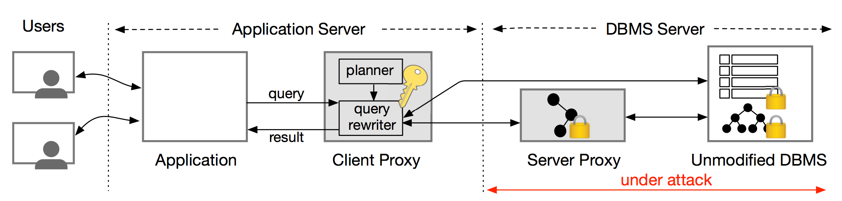
Arx (Poddar et al.)

Slide 61
Availability

Slide 62
Authenticated DoE
Goal: cryptographically prove that a named resource does not exist
DNSSEC
Prevent forging or modifying DNS records
Allow the DNS to prove that a query answer does not exist
Current version allows for zone enumeration

Slide 63
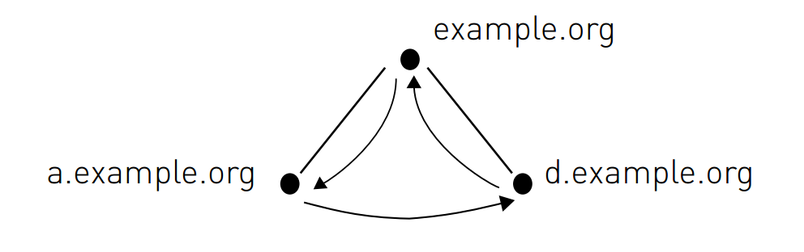
DNSSEC NSEC
Notes:
https://www.sidnlabs.nl/downloads/wp-2011-0x01-v2.pdf

Slide 64
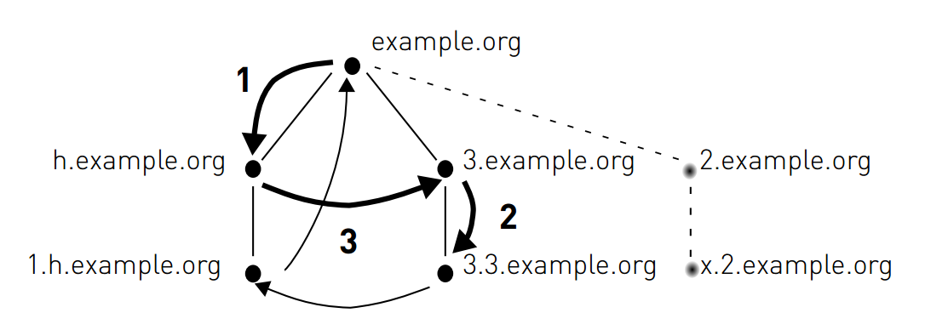
DNSSEC NSEC3
Notes:
https://www.sidnlabs.nl/downloads/wp-2011-0x01-v2.pdf

Slide 65
NSEC5: Preventing Zone Enumeration (Goldberg et al.)
Main result: public-key operations are necessary to keep responses fresh and prevent zone enumeration
Idea: replace the hash in NSEC3 with a keyed hash

Slide 66
Signed Records
Secondary keys: (PK_{S} = e, SK_{S} = d)
For each record x,
S(x) = (h₁(x))^{d} mod N
F(x) = h₂(S(x))
For hash functions h₁ and h₂

Slide 67
Proving Non-Existence
On query q
- Compute S(q) and F(q)
- Respond with S(q) and all hashes after F(q)
To verify a response
1. Check that (S(q))^{e} = h₁(q)
2. Verify the response with PK_{S}
3. Check that F(q) = h₂(S(q)) is before all hashes
Notes:
https://www.cs.bu.edu/~goldbe/papers/nsec5.pdf
https://www.sidnlabs.nl/downloads/wp-2011-0x01-v2.pdf

