Slide 1
Cryptographic Algorithms and Security Protocols for ICN
Christopher A. Wood
UC Irvine, PARC
woodc1@uci.edu, cwood@parc.com

Slide 2
Background
Security was not a goal of the IP protocol
Added after the fact via IPSec, SSL/TLS, etc.
Existing IP security solutions are:
Rooted in old (long-standing) security solutions
Change and adapt very slowly
Only now starting to look ahead (PFS, PQ algorithms and protocols, etc.)

Slide 3
Looking Forward
ICN architectures are:
Built on a clean slate
Can use new and modern crypto

Slide 4
ICN Network Stack
An ICN Network Stack
(ICN) App
ICN
ICN
native
TCP/UDP
overlay
IP
Link
PHY

Slide 5
ICN Network Services
An ICN Network Stack
ICN Network Services
(ICN) App
Confidentiality
?
ICN
ICN
?
Integrity and Authenticity
TCP/UDP
?
IP
Anonymity
?
Link
Availability
?
PHY
Privacy

Slide 6
ICN Network Services
An ICN Network Stack
ICN Network Services
(ICN) App
Confidentiality
?
ICN
ICN
?
Integrity and Authenticity
TCP/UDP
?
IP
Anonymity
?
Link
Availability
?
PHY
Privacy
Q: What crypto and security techniques can enable these core services?
Notes:
Be mindful of the state of the art to make informed design decisions

Slide 7
Selection Criteria
Goal: Crypto that can enables essential network services
What’s essential?
Integrity and authenticity
Privacy (e.g., as per RFC 6973)
Availability
What’s non essential?
Anonymity
Confidentiality (application-layer concern)

Slide 8
Topic Breakdown
Integrity and authenticity
Hash-based signatures
Availability
Authenticated Denial of Existence (DoE)
Privacy
Encrypted Deep Packet Inspection (DPI)
Password-Authenticated and Non-Interactive Key Exchange (PAKE and NIKE)
Private Information Retrieval (PIR)
Randomizable public-key encryption
Secure searchable encryption and predicate encryption (SSE and PE)
Oblivious data structures
Notes:
Anonymity: TOR and Hornet

Slide 9
Integrity and Authentication

Slide 10
Hash-Based Signatures
Traditional signature schemes are based on trapdoor functions
RSA, DSA, ECDSA, etc.
PQ-secure?
Hash-based signatures are quantum-secure, e.g., they don’t fall to Shor’s algorithm
Based on one-time signatures (OTSs)
A key pair can be used only once

Slide 11
Lamport OTS Idea [x]
x
y
Private key: (x, y)
H
H
H(x)
H(y)
Public key: (H(x), H(y))
Notes:
Lamport, Leslie. Constructing digital signatures from a one-way function. Vol. 238. Palo Alto: Technical Report CSL-98, SRI International, 1979.

Slide 12
Lamport OTS Idea
x
y
Private key: (x, y)
H
H
H(x)
H(y)
Public key: (H(x), H(y))
To sign a ‘0’: release x
To sign a ‘1’: release y

Slide 13
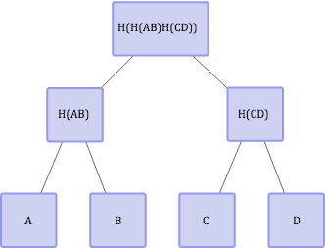
Merkle Tree Idea
Public key
Parts of the public key
k_{A}
k_{B}
k_{C}
k_{D}

Slide 14
Merkle Tree Idea
Public key
Parts of the public key
k_{A}
k_{B}
k_{C}
k_{D}
To sign the first message m1: provide (A, B, H(CD), sign_{kA}(m1))
Notes:
TODO: circle the adjacent path

Slide 15
Merkle Tree Idea
Public key
Parts of the public key
k_{A}
k_{B}
k_{C}
k_{D}
To sign the third message m3: provide (H(AB), C, D, sign_{kA}(m3))
Notes:
TODO: circle the adjacent path
https://sphincs.cr.yp.to/slides-sphincs-20150428.pdf

Slide 16
Merkle Trees [x]
The tree dimensions determine the number of messages that can be signed
Other drawbacks:
It is secure in the Random Oracle model
The length is proportional to the number of messages that are signed
It is stateful
Store the index and intermediate tree results
Notes:
Merkle, Ralph C.: Secrecy, Authentication, And Public Key Systems. Ph.D. thesis, Stanford University (1979)

Slide 17
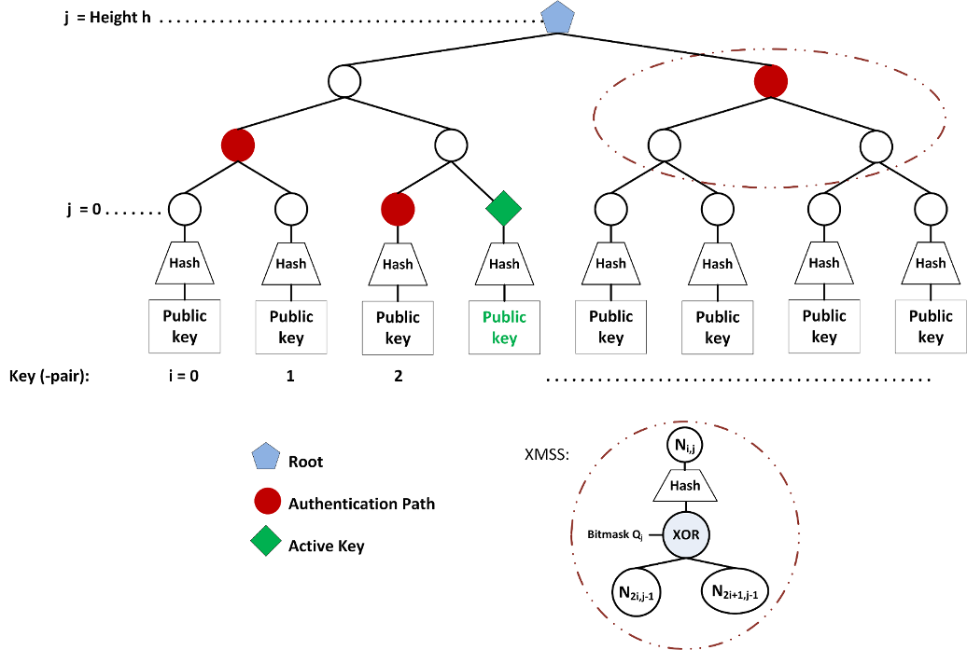
XMSS Tree (Buchmann et al.)
Borrowed from:
http://www.square-up.org/index/hbs.html
Notes:
http://www.square-up.org/index/hbs.html
The main construction looks like a Merkle tree, excepts a few things. The XMSS tree has a mask XORed to the child nodes before getting hashed in their parents node. It’s a different mask for every node:
Leaves are roots of L-trees, which are similar to XMSS trees and embed the public keys
Per-node masks are important for the security proof

Slide 18
Stateless Hash-Based Signature
Similar to Merkle trees but the “index” is chosen at random
Requires huge trees to avoid collisions
For security parameter λ=128 we require 2^{2λ} leaves (by birthday paradox)
OTS secret keys are generated pseudorandomly
Notes:
https://cr.yp.to/talks/2015.04.02/slides-djb-20150402-4x3.pdf
https://sphincs.cr.yp.to/slides-sphincs-20150428.pdf

Slide 19
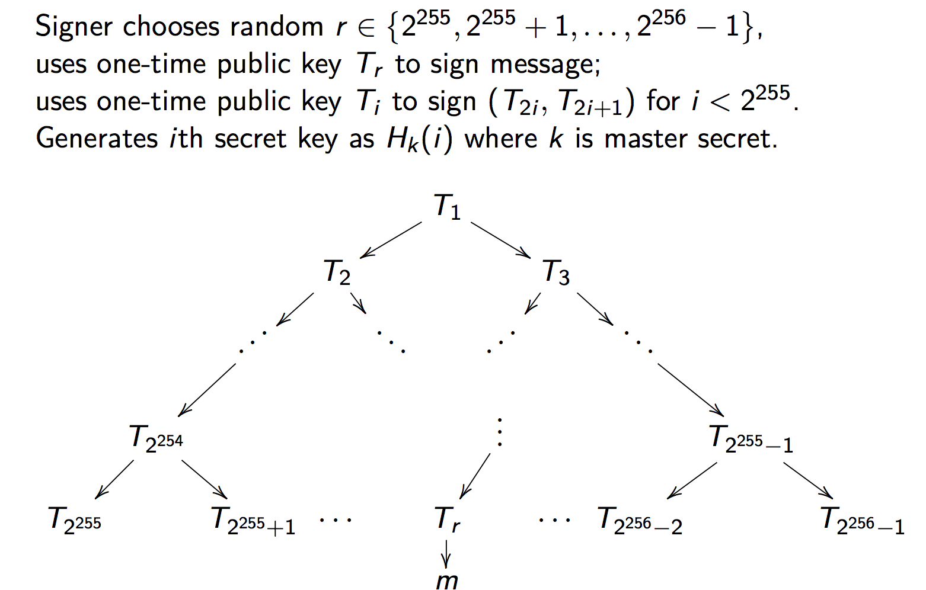
Overview

Slide 20
SPINCS (Bernstein et al.)
Stateless hash-based signature with 2¹²⁸ security
Inspired by Goldreich stateless hash-based scheme
Dramatically reduces signature and tree size
Signatures are down to 41KB
Public and private keys are 1KB
Replace one-time leaves with “few-time leaves”
Use XMSS-like per-node masks
Notes:
[X] Oded Goldreich. Foundations of Cryptography: Volume 2, Basic Applications. Cambridge University Press, Cambridge, UK, 2004.
[Y] Bernstein, Daniel J., et al. "SPHINCS: practical stateless hash-based signatures." Advances in Cryptology--EUROCRYPT 2015. Springer Berlin Heidelberg, 2015. 368-397.
https://eprint.iacr.org/2014/795.pdf
http://link.springer.com/chapter/10.1007%2F3-540-47721-7_8

Slide 21
Hash-Based Signature Recap
Useful for long-term integrity in a post-quantum world
Will ICN data packets live forever?
SPHINCS can be used as a drop-in replacement for current ICN signatures
Notes:
Andreas Hülsing. “W-OTS+-Shorter Signatures for Hash-Based Signature Schemes.” Pages 173-188 in: Amr Youssef, Abderrahmane Nitaj, Aboul Ella Hassanien (editors). Progress in Cryptology – AFRICACRYPT 2013,
6th International Conference on Cryptology in Africa, Cairo, Egypt, June 22-24, 2013, proceedings. Lecture Notes in Computer Science 7918. Springer. ISBN: 978-3-642-38552-0.
https://eprint.iacr.org/2014/795.pdf
https://www.cs.umd.edu/~jkatz/papers/HashBasedSigs.pdf
https://en.wikipedia.org/wiki/Merkle_signature_scheme
https://eprint.iacr.org/2011/484.pdf

Slide 22
Anonymity

Slide 23
Onion Routing
Based on Chaum’s mixnets
TOR (The Onion Router) is the most ubiquitous variant
Not provably secure
Performance could be improved

Slide 24
Sphinx Protocol [x]
Provably secure mix protocol
Mixture of public- and symmetric-key cryptography for each packet
Derive per-packet MAC and encryption keys for each anonymizer
Onion-encrypt the payload with a large-block-size block cipher
Compute the MAC carefully
Wrap the derivation seed using key encapsulation
Notes:
[x] Danezis, George, and Ian Goldberg. "Sphinx: A compact and provably secure mix format." Security and Privacy, 2009 30th IEEE Symposium on. IEEE, 2009.

Slide 25
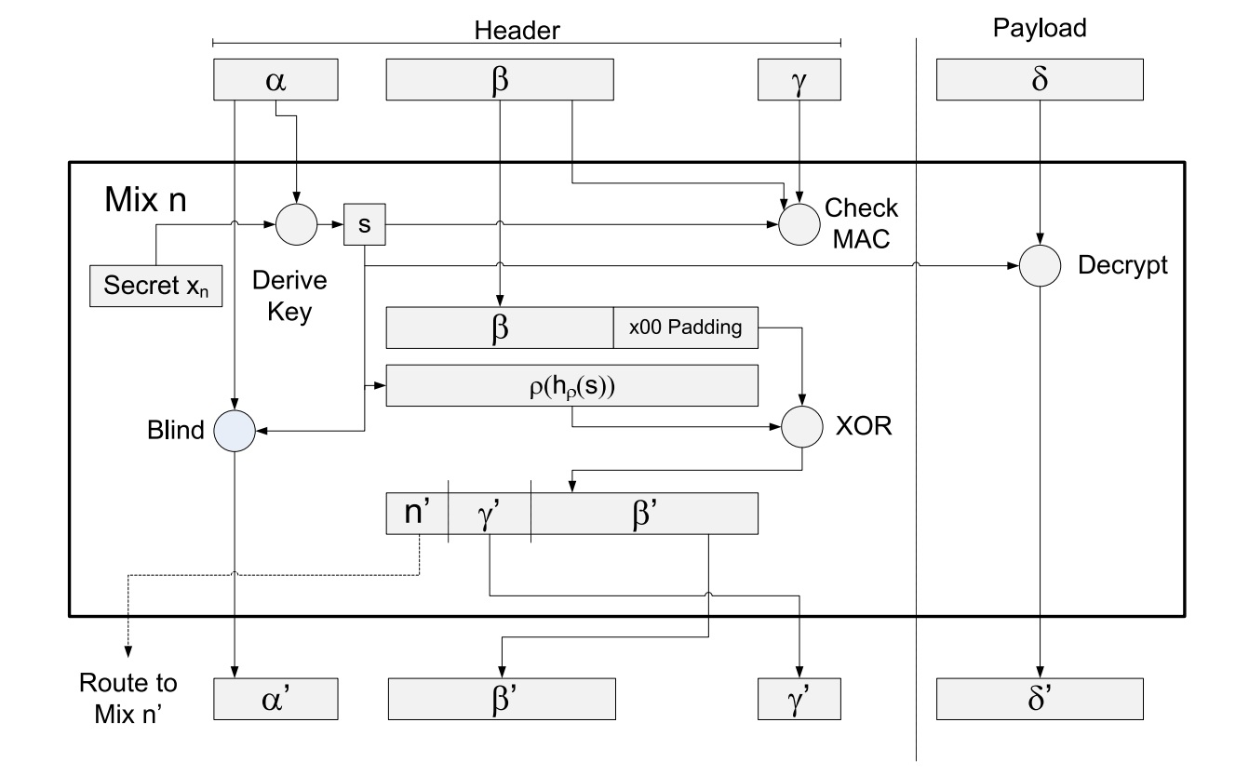
Sphinx Protocol

Slide 26
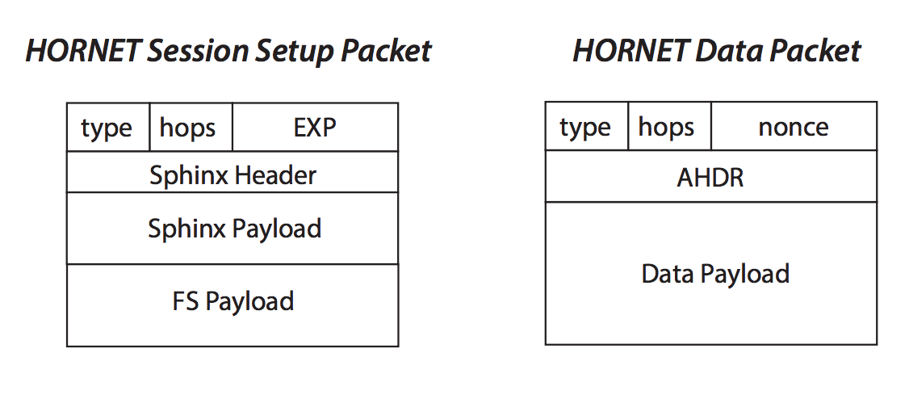
HORNET Protocol [x]
Built on Sphinx to establish symmetric keys with each anonymizer
Extended to include per-hop “forwarding segments” used to process packets in a circuit
Data packets are created with onion-encrypted payloads and anonymous headers (ADHR)
Notes:
Chen, Chen, et al. "HORNET: high-speed onion routing at the network layer." Proceedings of the 22nd ACM SIGSAC Conference on Computer and Communications Security. ACM, 2015.

Slide 27
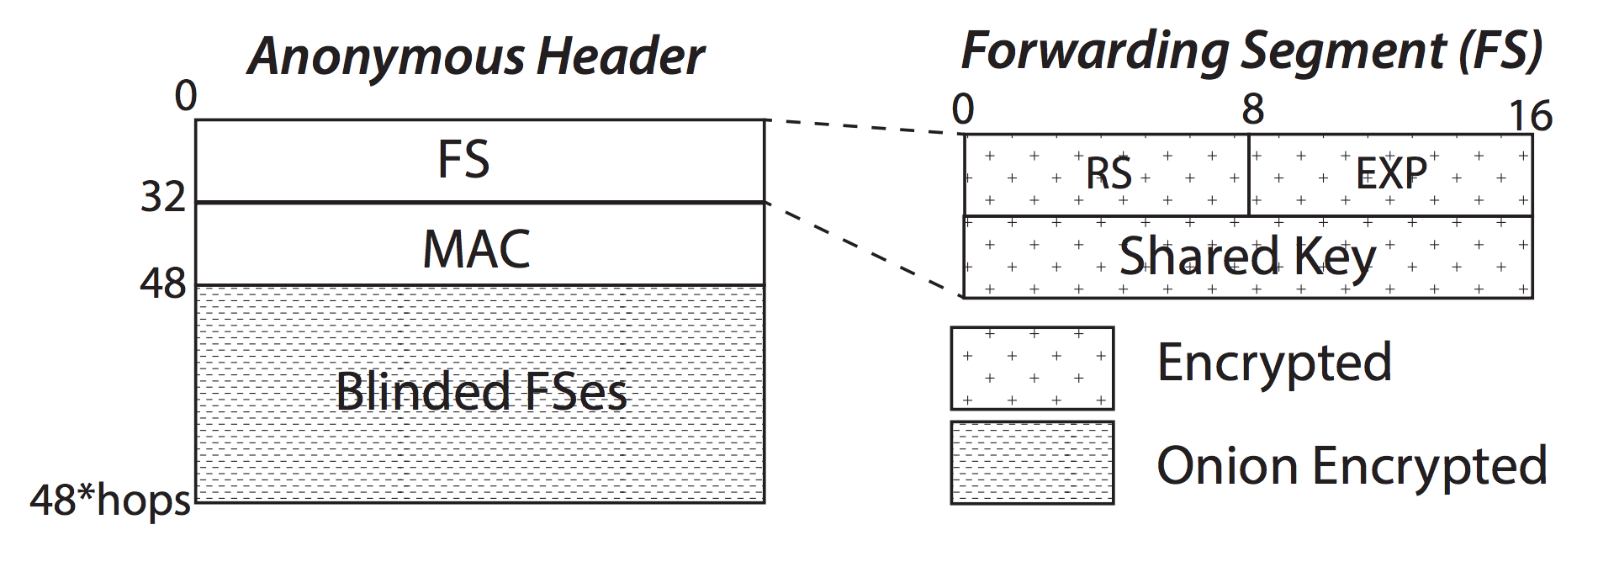
HORNET Data Packet Internals

Slide 28
Onion Routing Recap
ICN names reveal too much
Use onion routing to onion-encrypt individual packets
G. Tsudik, E. Uzun, and C. A. Wood, AC3N: An API and Service for Anonymous Communication in Content-Centric Networking, in the Proceedings of CCNC 2016, Las Vegas, NV, USA, 2016.
S. DiBenedetto, P. Gasti, G. Tsudik and E. Uzun, ANDaNA: Anonymous Named Data Networking Application, the 19th Annual Network and Distributed System Security Symposium (NDSS), San Diego, CA, 2012.
… but do it right as a network service
Notes:
http://arxiv.org/pdf/1507.05724v1.pdf
https://www.infsec.cs.uni-saarland.de/~mohammadi/paper/owake.pdf

Slide 29
Privacy

Slide 30
Encrypted DPI
Goal: perform deep-packet-inspection (DPI) on encrypted packet payloads
e.g., to determine when a packet contains an encrypted version of a specific keyword
Different measures of privacy
Exact-match privacy: only discover bytes that match target keywords
Probable cause privacy: decrypt a flow (entire packet) only if a keyword match is detected
Notes:
https://eprint.iacr.org/2015/264.pdf

Slide 31
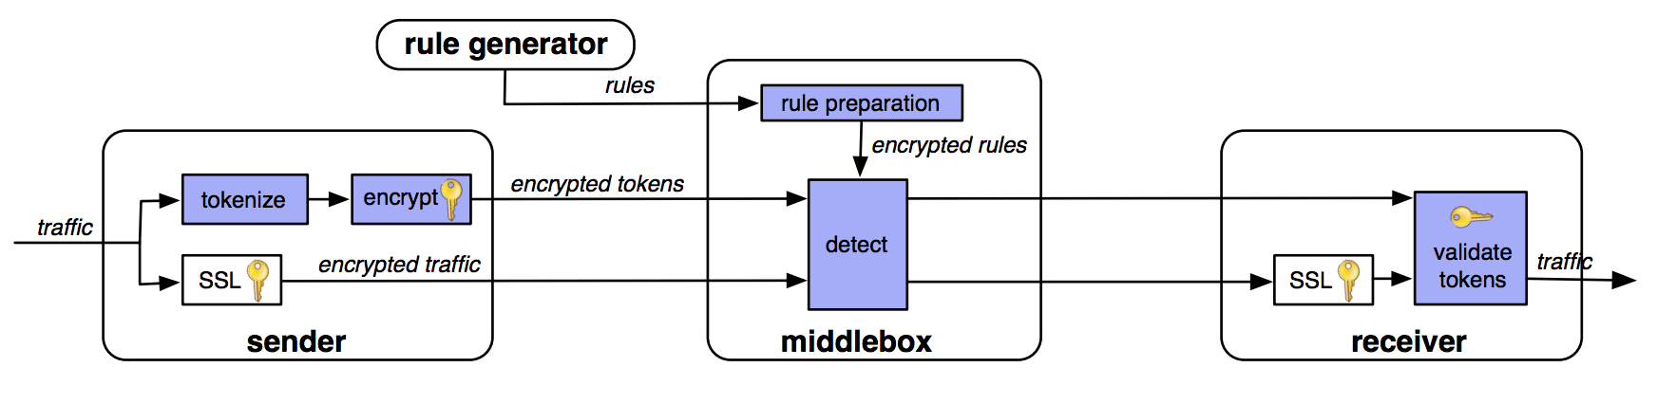
BlindBox
Notes:
https://eprint.iacr.org/2015/264.pdf

Slide 32
BlindBox Details
Packets are tokenized into tokens t1,…,tk
For each token t, encrypt as follows
salt, AES_{AES-k(t)}(salt)
To detect a token t, precompute salt and token combinations
Speedup: use a single salt per token and then derive subsequent token encryptions based on a counter
ensures
randomness
of identical
tokens

Slide 33
Probable Cause Decryption
Idea: embed message encryption key Dk in the encryption of each token
salt, (AES_{AES-k(t)}(salt) XOR Dk)

Slide 34
BlindBox Rule Preparation
The middlebox must learn AES-k(t) without revealing the encryption key k
Solution: Garbled circuit to compute
AES-k(t)
for each token t

Slide 35
Privacy: Key Exchange

Slide 36
Group AKE
https://eprint.iacr.org/2010/190.pdf
http://web.cs.ucla.edu/~dakshita/Dakshita_Khurana_Home_files/KRS-15.pdf
Notes:
https://eprint.iacr.org/2010/190.pdf

Slide 37
Password AKE
Goal: create ephemeral keys from shared secrets – passwords (read: name) – in a way that is:
Not susceptible to offline dictionary attacks
Forward secure
Varying number of rounds
Most protocols are multi-round, e.g., J-PAKE
Some work in a single round without sacrificing forward secrecy
Notes:
https://eprint.iacr.org/2010/190.pdf
https://www.normalesup.org/~fbenhamo/files/publications/SP_AbdBenMac15.pdf
https://www.researchgate.net/profile/Siamak_Shahandashti/publication/277634814_The_Fairy-Ring_Dance_Password_Authenticated_Key_Exchange_in_a_Group/links/556ee7c508aefcb861dc05be.pdf
https://tools.ietf.org/html/rfc7664
https://eprint.iacr.org/2010/190.pdf
http://eprint.iacr.org/2015/188.pdf

Slide 38
Non-Interactive Key Exchange (NIKE)
Goal: Two parties with knowledge of each other’s public keys agree on a shared secret without requiring any interaction [1]
Alice: x, g^{x}
Bob: y, g^{y}
Shared key: H(“Alice”, “Bob”, g^{xy})
Use case: WSN shared key derivation
Public-key encryption follows from NIKE
Notes:
http://www.isg.rhul.ac.uk/esvfreire/slides/NIKE_PKC2013_Eduarda_Freire_Slides.pdf
https://eprint.iacr.org/2012/732.pdf
http://www.di.ens.fr/users/pointche/Documents/Papers/2014_scn.pdf
Diffie, W., Hellman, M.E.: New directions in cryptography. IEEE Transactions on Information Theory 22(6) (1976).

Slide 39
NIKE Protocols
Setup: generate system parameters
KeyGen: generate a private and public key pair for a given identity
SharedKey: given (1) an identity, (2) its public key, (3) another identity, (4) and its secret key, compute and output a shared key

Slide 40
NIKE Protocols
Setup: generate system parameters
KeyGen: generate a private and public key pair for a given identity
SharedKey: given (1) an identity, (2) its public key, (3) another identity, (4) and its secret key, compute and output a shared key
What’s in an ICN certificate?...

Slide 41
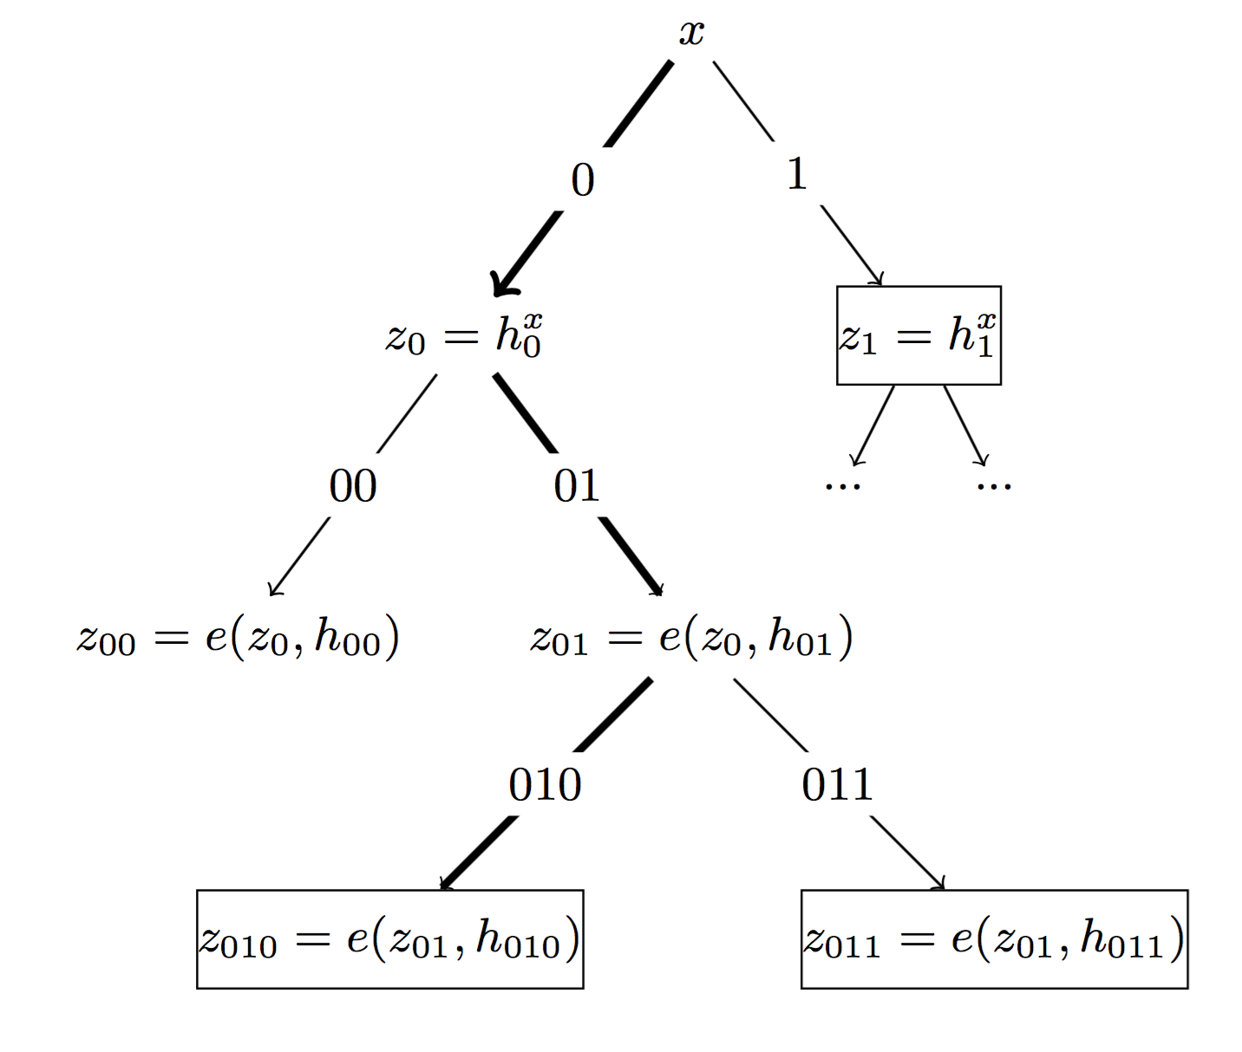
Forward Secrecy NIKE?
Yes – it’s possible: evolve the public keys.
Use multilinear maps and the tree-based key derivation technique
Add an Update function to the scheme:
Move the secret key forward in time and space
Notes:
Lee, Young Kyung, and Dong Hoon Lee. "Forward Secure Non-Interactive Key Exchange from Indistinguishability Obfuscation." IT Convergence and Security (ICITCS), 2015 5th International Conference on. IEEE, 2015.
Pointcheval, David, and Olivier Sanders. "Forward secure non-interactive key exchange." Security and Cryptography for Networks. Springer International Publishing, 2014. 21-39.

Slide 42
Privacy: PIR

Slide 43
Private Information Retrieval
A protocol to hide client requests to a server (e.g., a database)
Two variants: computational (CPIR) and information-theoretic (IPIR)
CPIR
Require only a single server
Much more computationally expensive
IPIR
Require at least two non-colluding servers
More efficient but requires more communication
Notes:
http://research.microsoft.com/pubs/260105/popcorn.pdf

Slide 44
IPIR
1) query
3) decode
2) answer
1) query
2) answer

Slide 45
IPIR
Replica
1) query
Consumer
3) decode
2) answer
1) query
Replica
2) answer
C. Tschudin, Private Information Retrieval over ICN,
INFOCOM 2016 NOM Workshop, April, 2016. [more later]

Slide 46
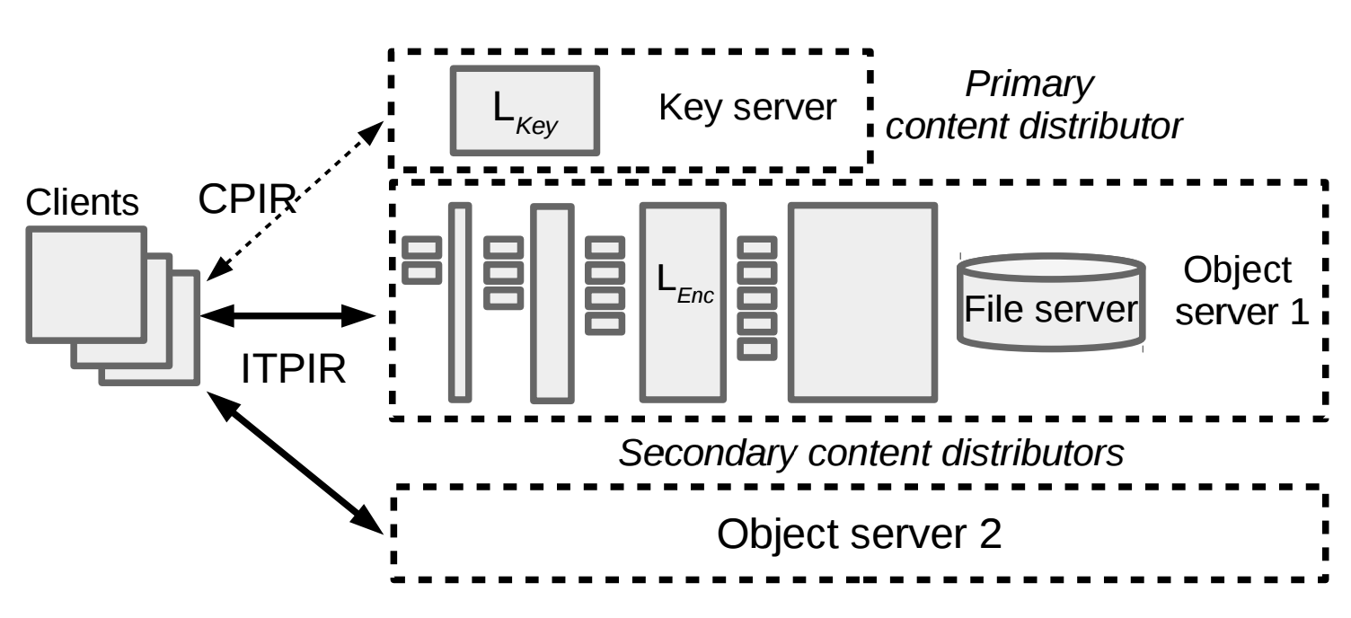
Popcorn: CPIR+IPIR

Slide 47
Privacy: Randomizable Encryption

Slide 48
Forward-Secure Public Key Encryption
In plain English, “key-evolving public key encryption”
Consists of four algorithms:
Key generation
Key update
Encrypt
Decrypt
Based on binary tree encryption
Notes:
https://www.cs.umd.edu/~jkatz/papers/forward-enc-full.pdf

Slide 49
Binary Tree Encryption
Root key pair: PK, SK_{ε}
0
SK₀
1
SK₁
2
SK₂
3
4
5
6
SK₃
SK₄
SK₅
SK₆

Slide 50
Binary Tree Encryption
Encrypt with the
public key
Root key pair: PK, SK_{ε}
0
SK₀
1
SK₁
2
SK₂
3
4
5
6
SK₃
SK₄
SK₅
SK₆

Slide 51
Binary Tree Encryption
Encrypt with the
public key
Root key pair: PK, SK_{ε}
0
SK₀
derive
SK₂ derived from SK₀
and PK
1
SK₁
2
SK₂
3
4
5
6
SK₃
SK₄
SK₅
SK₆

Slide 52
Binary Tree Encryption
Encrypt with the
public key
Root key pair: PK, SK_{ε}
0
SK₀
SK₂ derived from SK₀
and PK
1
SK₁
2
SK₂
decrypt
Decrypt with SK₂
3
4
5
6
SK₃
SK₄
SK₅
SK₆

Slide 53
Binary Tree Encryption
Encrypt with the
public key
Root key pair: PK, SK_{ε}
0
SK₀
SK₂ derived from SK₀
and PK
1
SK₁
2
SK₂
Decrypt with SK₂
3
4
5
6
SK₃
SK₄
SK₅
SK₆
evolve secret keys in time (and space)

Slide 54
Randomizable Public-Key Encryption
Many encryption schemes can be re-randomized, e.g., ElGamal, BGN, etc.
How can we maintain integrity after randomizing ciphertext?
Randomizable signatures
Notes:
http://www.blazy.eu/Papers/2011_pkc.pdf
https://crypto.stanford.edu/~pgolle/papers/univrenc.pdf

Slide 55
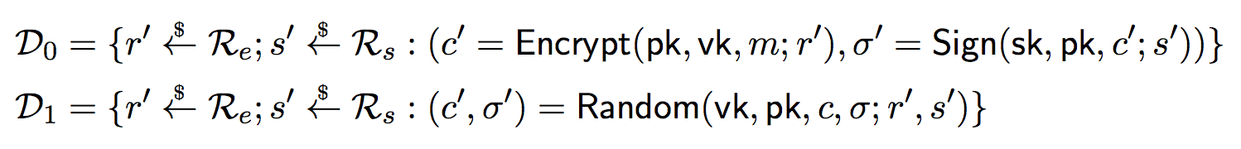
Randomizable Signatures
Given a ciphertext, anyone can re-randomize the ciphertext and adapt the signature the new encryption, i.e.,
are statistically indistinguishable
Notes:
http://www.blazy.eu/Papers/2011_pkc.pdf

Slide 56
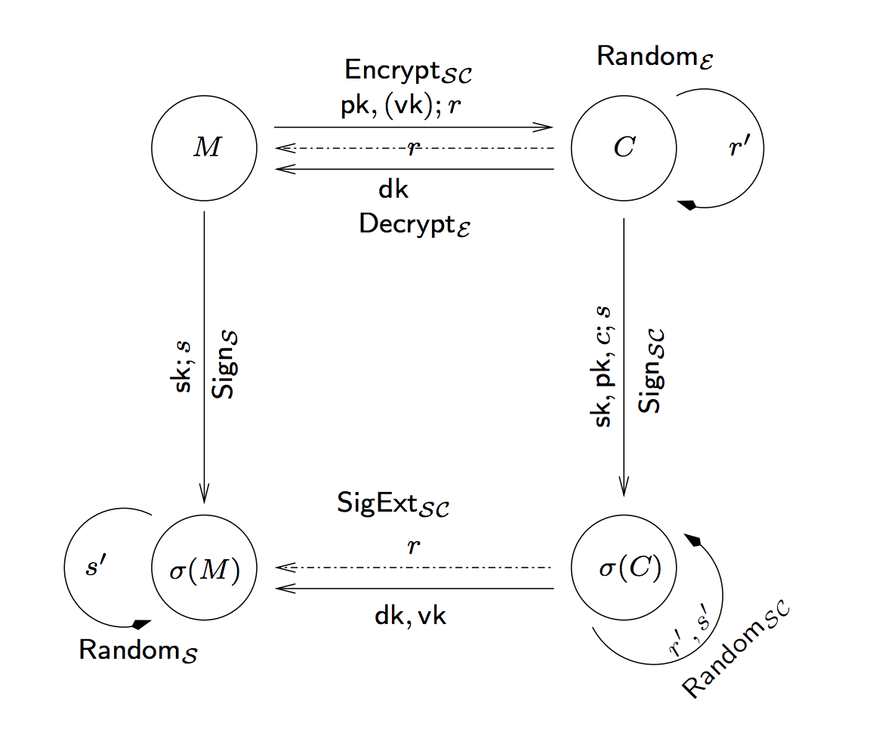
Extractable Signatures

Slide 57
Mixing in Motion
M
M
Mixer
Mixer
encrypt and sign
decrypt and verify
C³,σ³
C²,σ²
C¹,σ¹
V
(randomize)
(randomize)
S

Slide 58
Mixing in Motion
M
M
Replica
Replica
encrypt and sign
decrypt and verify
C³,σ³
C²,σ²
C¹,σ¹
V
(randomize)
(randomize)
S

Slide 59
Privacy: SSE and PE

Slide 60
Searchable Symmetric Encryption
Goal: search over encrypted data using symmetric-key cryptography
Given a database of (encrypted) documents and list of keywords, identify the documents that contain keywords

Slide 61
Searchable Symmetric Encryption
Goal: search over encrypted data using symmetric-key cryptography
Given a database of (encrypted) documents and list of keywords, identify the documents that contain keywords
Many variants:
Interactive and non-interactive
Response-revealing and response-hiding

Slide 62
SSE Overview
Client possess document list D₁,…,D_{n}
Client builds an index (DB) that maps keywords w to documents – DB[w]
Protocol mechanics:
Setup: return key k and encrypted DB (eDB)
Token: on input w and k, return token t
Search: on input eDB and t, the server returns the identifiers in DB[w]
Complexity: search is at best sub-linear in the number of documents and linear in those containing the keyword (optimal)
Notes:
https://eprint.iacr.org/2006/210.pdf
http://diyhpl.us/~bryan/papers2/security/advances-in-cryptology/Advances%20in%20Cryptology%20-%20CRYPTO%202007,%2027%20conf.(LNCS4622,%20Springer,%202007)(ISBN%209783540741428)(642s)_CsLn_.pdf#page=546
https://outsourcedbits.org/2014/08/21/how-to-search-on-encrypted-data-searchable-symmetric-encryption-part-5/

Slide 63
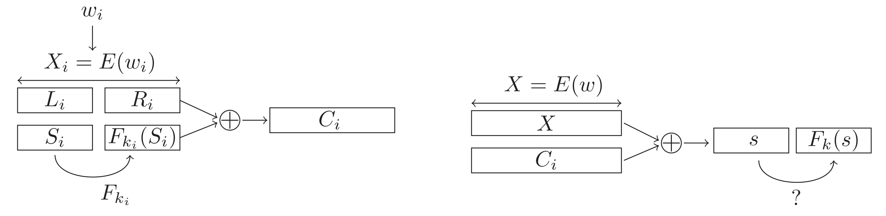
Efficient SSE
pseudorandom value
Borrowed from:
http://eprints.eemcs.utwente.nl/24788/01/a18-bosch.pdf

Slide 64
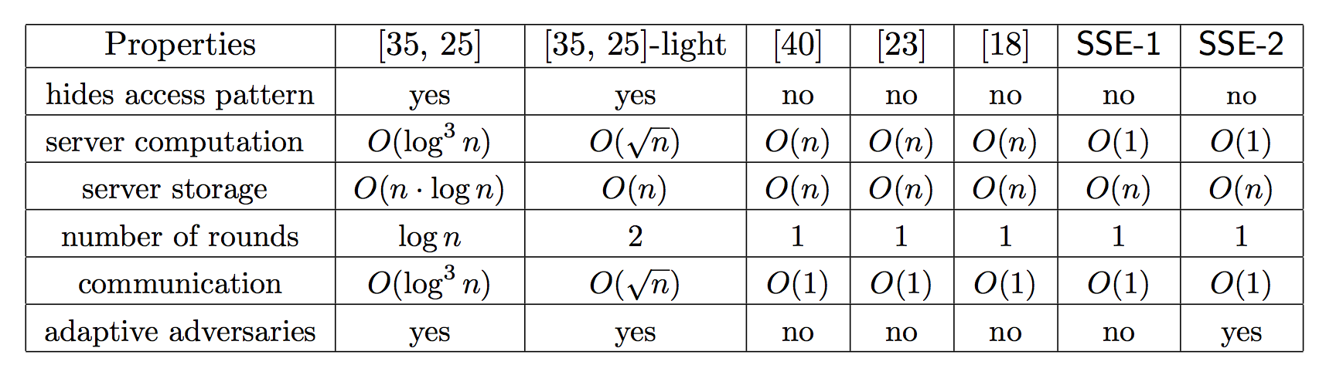
Other SSE Solutions
Borrowed from:
http://research.microsoft.com/pubs/147148/sse.pdf
Notes:
http://research.microsoft.com/pubs/147148/sse.pdf

Slide 65
Other SSE Solutions
…but the search complexity is always linear in the number of matching documents
Notes:
http://research.microsoft.com/pubs/147148/sse.pdf

Slide 66
Alternatives to SSE
Property-Preserving Encryption (PPE) and Predicate-Private Encryption (PE)
Data is encrypted
Users learn functions (predicates) of the encrypted ciphertext
Types of predicates
Inner-products over integer vectors
Subspace membership
Notes:
[31] -- http://elaineshi.com/docs/sympredenc.pdf
https://eprint.iacr.org/2013/830.pdf

Slide 67
Privacy: Oblivious Data Structures
Notes:
https://www.sidnlabs.nl/downloads/wp-2011-0x01-v2.pdf

Slide 68
Non-Symmetric Encrypted Search
Two variants: Practical and “not so much”
Practical: CryptDB and Arx (CryptDB v2)
These are deployed at scale
Theoretical: Based on Oblivious RAM
Seek to hide everything except the result size
Often multi-round, stateful, and have heavy communication costs
Notes:
https://eprint.iacr.org/2014/185.pdf
https://eprint.iacr.org/2016/591.pdf

Slide 69
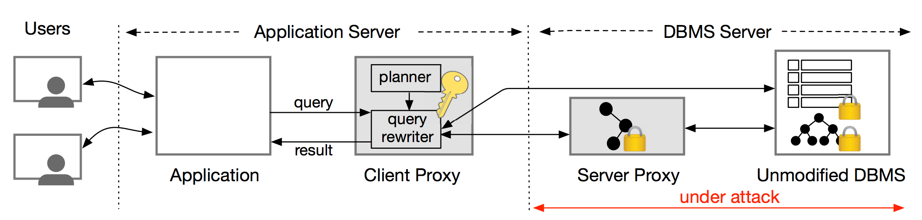
Arx

Slide 70
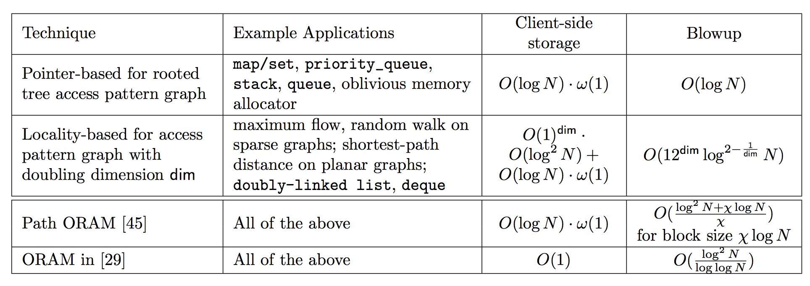
ORAM
Borrowed from:
https://eprint.iacr.org/2014/185.pdf

Slide 71
Availability

Slide 72
Authenticated DoE
DNSSEC
Prevent forging or modifying DNS records
Allow the DNS to prove that a query answer does not exist
Current version allows for zone enumeration

Slide 73
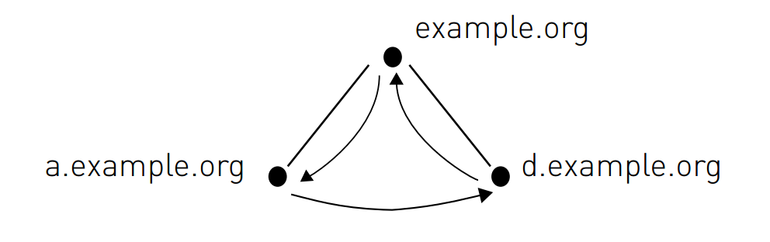
DNSSEC NSEC
Notes:
https://www.sidnlabs.nl/downloads/wp-2011-0x01-v2.pdf

Slide 74
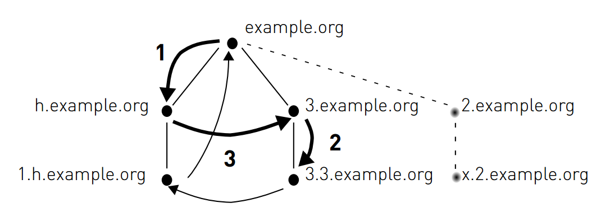
DNSSEC NSEC3
Notes:
https://www.sidnlabs.nl/downloads/wp-2011-0x01-v2.pdf

Slide 75
NSEC5: Preventing Zone Enumeration
Main result: public-key operations are necessary to keep responses fresh and prevent zone enumeration
Idea: replace the hash in NSEC3 with a keyed hash

Slide 76
Signed Records
Secondary keys: (PK_{S} = e, SK_{S} = d)
For each record x,
S(x) = (h₁(x))^{d} mod N
F(x) = h₂(S(x))
For hash functions h₁ and h₂

Slide 77
Proving Non-Existence
On query q
- Compute S(q) and F(q)
- Respond with S(q) and all hashes after F(q)
To verify a response
1. Check that (S(q))^{e} = h₁(q)
2. Verify the response with PK_{S}
3. Check that F(q) = h₂(S(q)) is before all hashes
Notes:
https://www.cs.bu.edu/~goldbe/papers/nsec5.pdf
https://www.sidnlabs.nl/downloads/wp-2011-0x01-v2.pdf

Slide 78
Comments on Confidentiality
There’s a tremendous number of papers on confidentiality in ICN
All of them solve the problem at the application layer
This problem is important, but not yet a core network service

