Slide 1
A Study of Privacy and Anonymity in the DNS
Cesar Ghali, Gene Tsudik, Christopher A. Wood
University of California Irvine DNS OARC – Dallas 2016

Slide 2
Pitiful Privacy in the DNS
Encryption only protects the query contents [1,2,3]
Side channels are prevalent in the protocol [2]:
Timing
Frequency
Response sizes
Resolution chains
[1] Bernstein, Daniel J. "DNSCurve: Usable security for DNS." dnscurve. org (2009).
[2] Shulman, Haya. "Pretty bad privacy: Pitfalls of DNS encryption." Proceedings of the 13th Workshop on Privacy in the Electronic Society. ACM, 2014.
[3] DNS-over-HTTPS, Google. https://developers.google.com/speed/public-dns/docs/dns-over-https

Slide 3
Practical Approaches to Plug DNS Privacy Holes
Message padding [size side]
Query chaffing(?) [frequency]
Query splitting/partitioning [resolution chains]
Message interleaving [resolution chains]
Artificial resolver delays [timing]

Slide 4
But Wait… There’s More
For privacy, we want to protect the contents of a query from Adv (resolver or anchor)
What about the sources of the queries?
Can queries reveal information about the origin?

Slide 5
Agenda
DNS privacy mitigations
Message padding [size side]
Query splitting/partitioning [resolution chains]
(Omitted for time)
Message interleaving [resolution chains]
Artificial resolver delays [timing]
DNS client anonymity
Analysis
Query chaffing countermeasure [frequency]

Slide 6
PRIVACY

Slide 7
Adversarial Model
S₁
QUERY .com
QUERY www.example.com
C
R
QUERY example.com
S₂

Slide 8

Adversarial Model
S₁
QUERY .com
QUERY www.example.com
C
R
QUERY example.com
snoop
query
snoop
S₂

Slide 9
Adversarial Model
S₁
QUERY .com
QUERY www.example.com
C
R
What’s inside this query?
QUERY example.com
snoop
query
snoop
S₂

Slide 10
Message Padding
Ideal requirements:
Must fit within UDP packet (or TLS record).
What if a request or response exceeds the MTU?
Must not be more than what’s necessary.
What’s the maximum padding length?

Slide 11
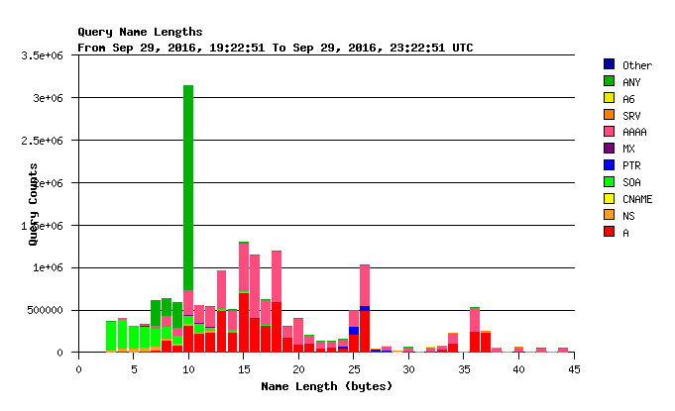
Maximum QNAME Size

Slide 12
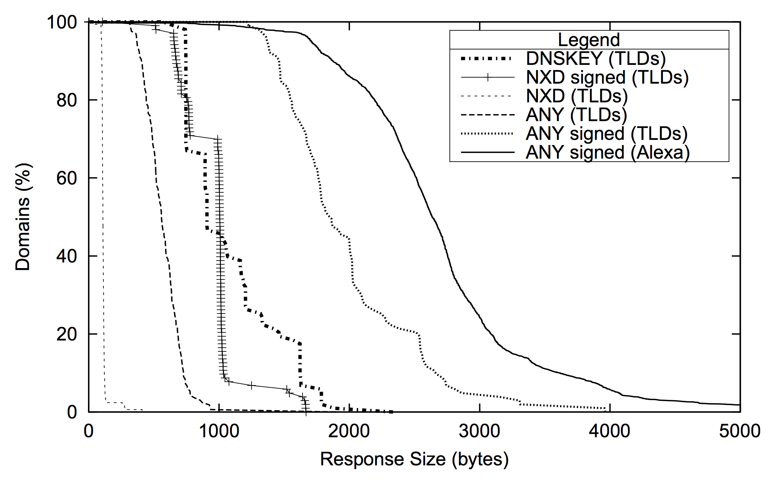
Maximum Response Size
Standard MTU

Slide 13
Maximum Response Size
Standard MTU
Where’s the end?

Slide 14
Multiple Packets
Everything must be sent with multiple packets
... that’s not good
Tradeoff: break responses into ”sized tiers”
Size ∈ [0,1500] => Tier 1
Size ∈ [1501,4096] => Tier 2
…
Size > X => Tier N
Ideally: distribution of tiers is uniform

Slide 15
Padding Tiers

Slide 16
Side Effects and Questions
How can tier boundaries be selected such that privacy is increased while overhead is decreased?
Fewer tiers => more privacy, more overhead
More tiers => less privacy, less overhead

Slide 17
Message Interleaving
Requirements: mask query order by interleaving messages
Cannot interleave unless we batch queries
Want to minimize query delays while maximizing interleaving
Approach:
Batch for RTT* seconds
Shuffle queries, issue in sequence, repeat
Responses are added to batch
*Average RTT to resolve a single query

Slide 18
Message Interleaving Overview
Stub
Client
Q1
Client
Q2
Resolver
(mixer)
Stub
Q3
Client
Q3
Q2
Q1
Stub

Slide 19
Message Interleaving Overview
Stub
Client
Q1
Client
Q2
Resolver
(mixer)
Stub
Q3
Client
Q3
Q2
Q1
shuffle
Stub

Slide 20
Message Interleaving Overview
Stub
Client
Q1
Q1
Client
Q2
Resolver
(mixer)
Stub
Q3
Client
Q2
Q3
Q1
Stub

Slide 21
Message Interleaving Overview
Stub
Client
Q1
Client
Q2
Resolver
(mixer)
Q3
Stub
Q3
Client
Q2
Q3
Q1
Stub

Slide 22
Message Interleaving Overview
Stub
Client
Q1
Client
Q2
Resolver
(mixer)
Stub
Q3
Q2
Client
Q2
Q3
Q1
Stub

Slide 23
Results

Slide 24
Results

Slide 25
Results
Batching has no useful effect on average query resolution time

Slide 26
Artificial Resolver Delays
Requirements: introduce artificial delays are resolvers to mask timing side channels (even with RANSes)
Approach:
If data not cached, resolve the request and record the RTT
Else, wait for the previously recorded RTT before returning the response

Slide 27
Delay Effects

Slide 28
Side Effects and Questions
Worst-case latency for clients
Is < 0.1s noticeable?
Per-record query delays can reveal information about different resolution strategies
Should the delay always be the worst case across all records?

Slide 29
Query Partitioning/Splitting
Requirements: perform multiple queries in parallel

Slide 30
Anonymity

Slide 31
Adversarial Model
S₁
C₁
QUERY .com
QUERY www.example.com
R
C₂
QUERY example.com
S₂

Slide 32
Adversarial Model
S₁
C₁
QUERY .com
QUERY www.example.com
R
C₂
QUERY example.com
S₂

Slide 33
Adversarial Model
S₁
C₁
QUERY .com
QUERY www.example.com
Who generated this query?
R
C₂
QUERY example.com
S₂

Slide 34
De-Anonymizing Attack
Goal: use information in queries to link them to specific clients
Select features:
Query length
Query resolution time
Query target name
Query frequency (windowed)
Source target frequency (windowed)
Query target address
Source query single component differences
Source query entropy
Other possibilities:
Resolution chain (not visible to single adversary)

Slide 35
Classifiers
We need sampled a number of different classification algorithms:
SVM
Logistic Regression
SGD
Linear Regression
Decision Tree
… For each combination of features

Slide 36
Results

Slide 37
Query Chaffing
Requirements:
Chaffing should look similar to existing queries
Rate should resemble legitimate traffic
Approach:
Using DNS packet traces, build a weighted directed graph of domain relationships
Sample chaff traffic from neighbors of past queries

Slide 38
Domain Graphs
G = (V,E) such that
V is the set of domains (QNAMEs)
(u∈V, v∈V)∈E iff v is queried after u

