Slide 1
Face Recognition
source

Slide 2
outline
Import Package
Preprocess data
Use pre-trained model
Data augmentation
Train the model
Model Evaluation
Visualize the result
Save back to the file

Slide 3
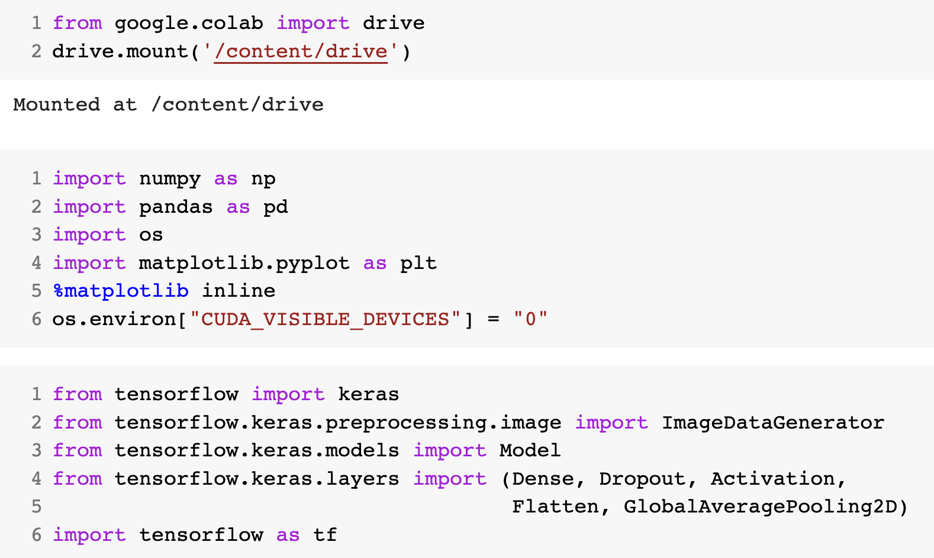
Import Package
Mount the drive
Import basic package
Check the GUP support
Import deep learning package

Slide 4
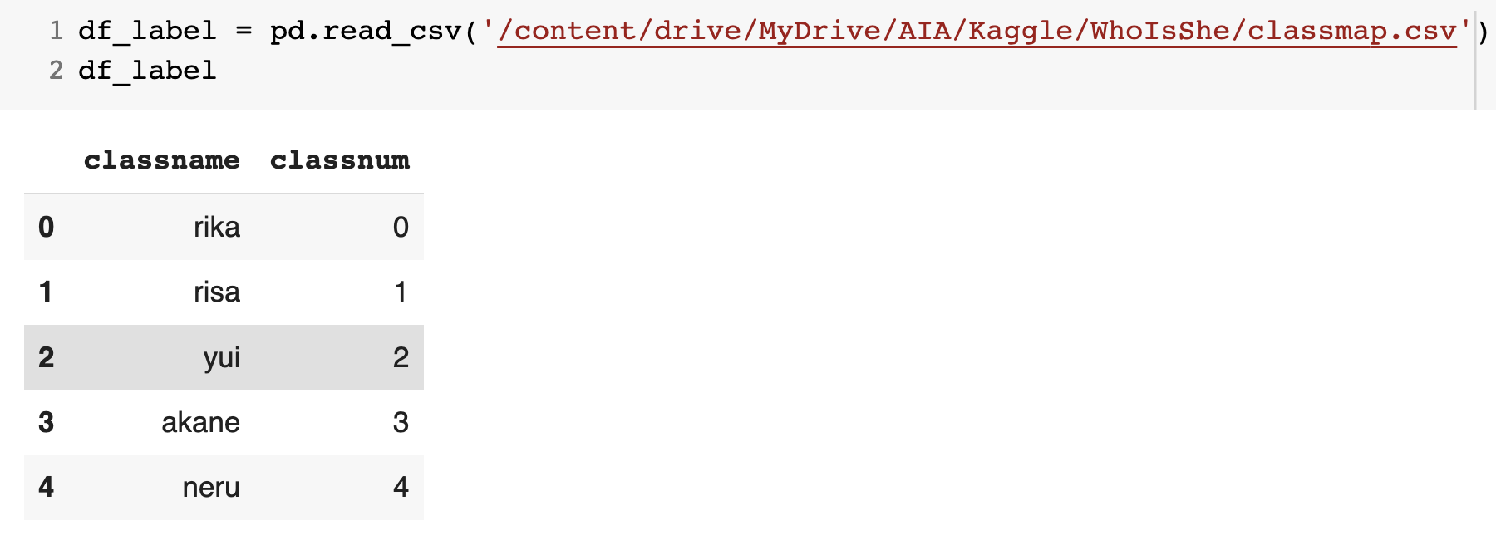
Preprocess data(format Frame)
DataFrame

Slide 5
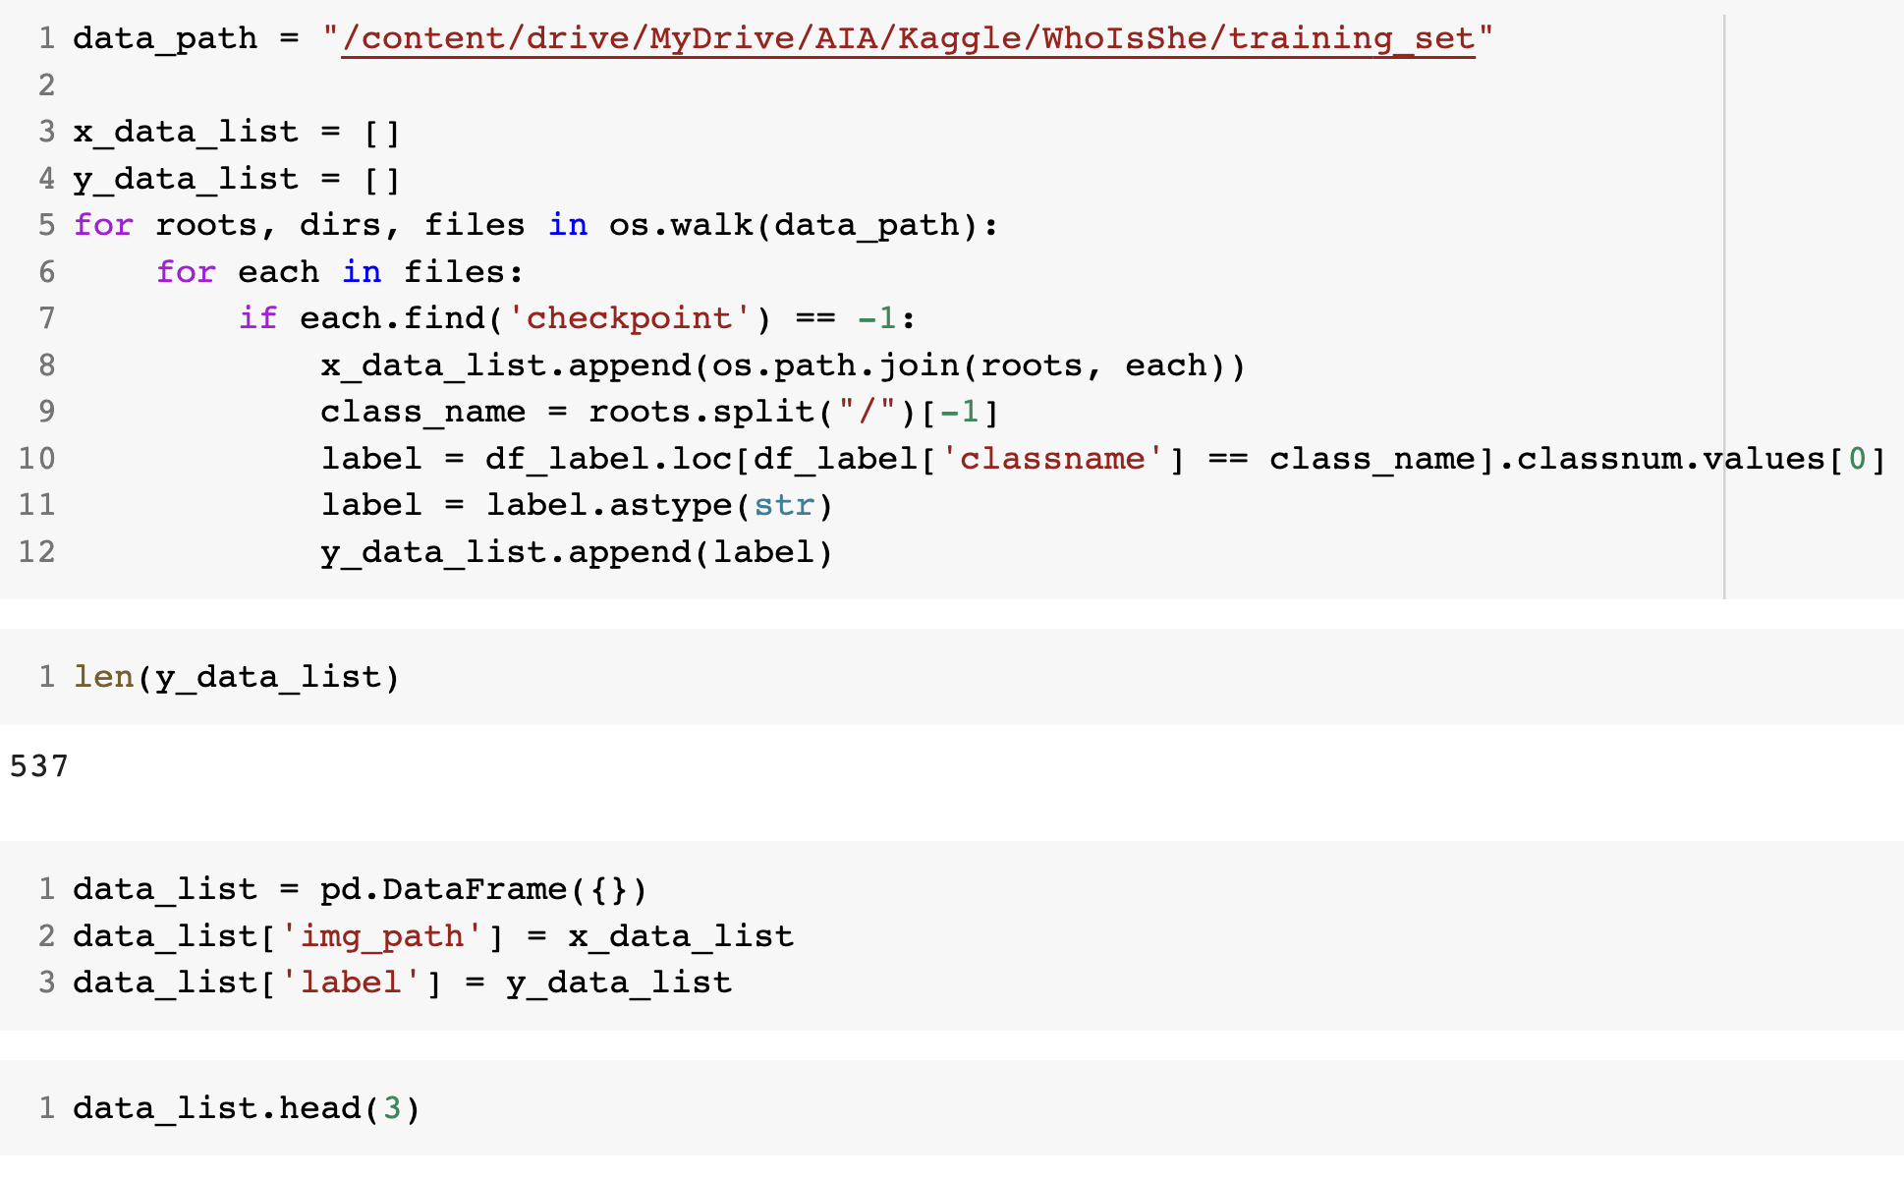
Preprocess data(Training Data)
x_data_list store image path
y_data_list store label

Slide 6
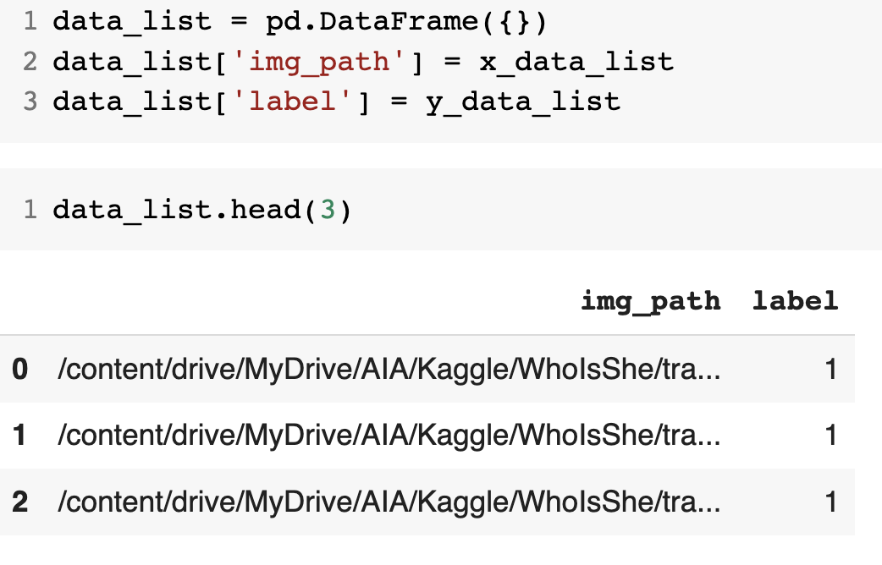
Preprocess data(training Data)
Use data list as Data Frame

Slide 7
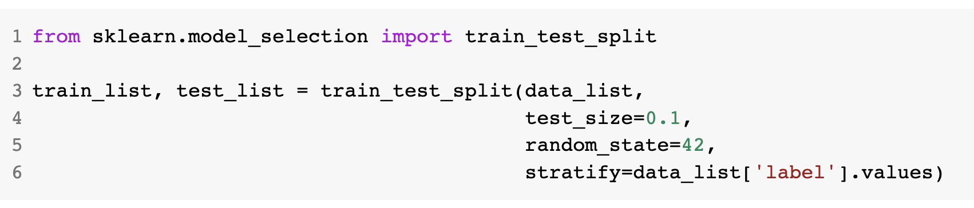
Preprocess data(training data)
Split the data as train set and test set
Mark label by parameter: stratify

Slide 8
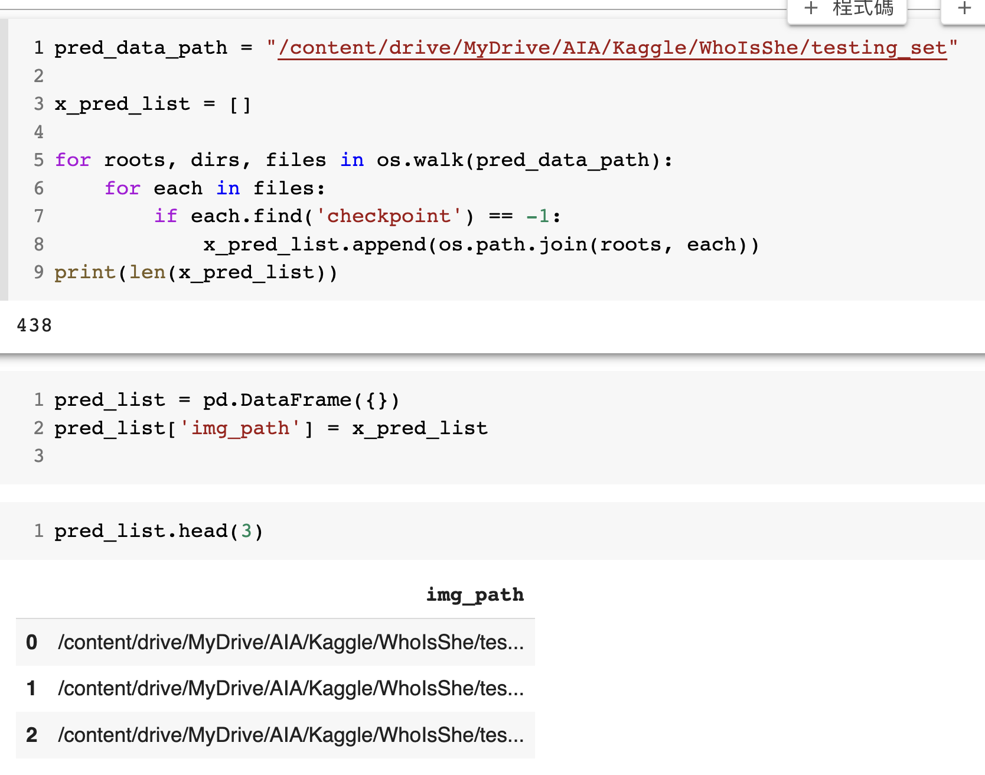
Preprocess data(testing data)
Skipp checkpoint file

Slide 9
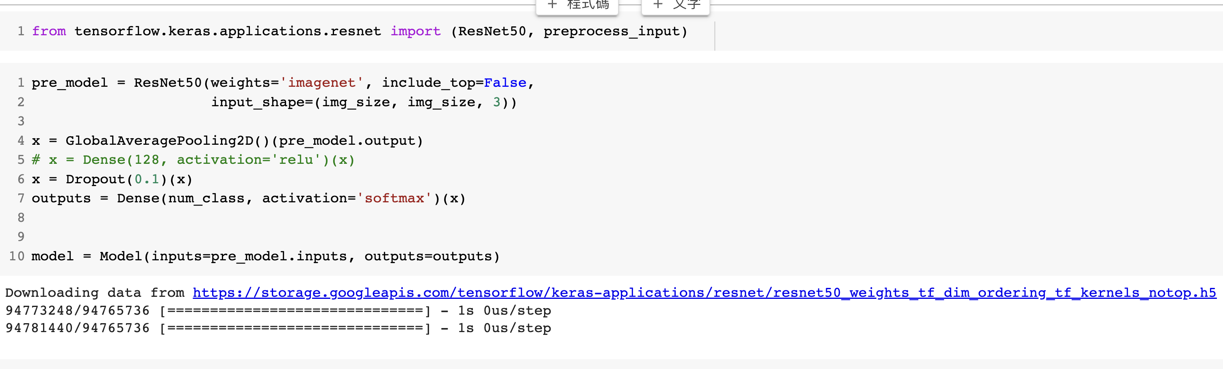
Use pre-trained model

Slide 10
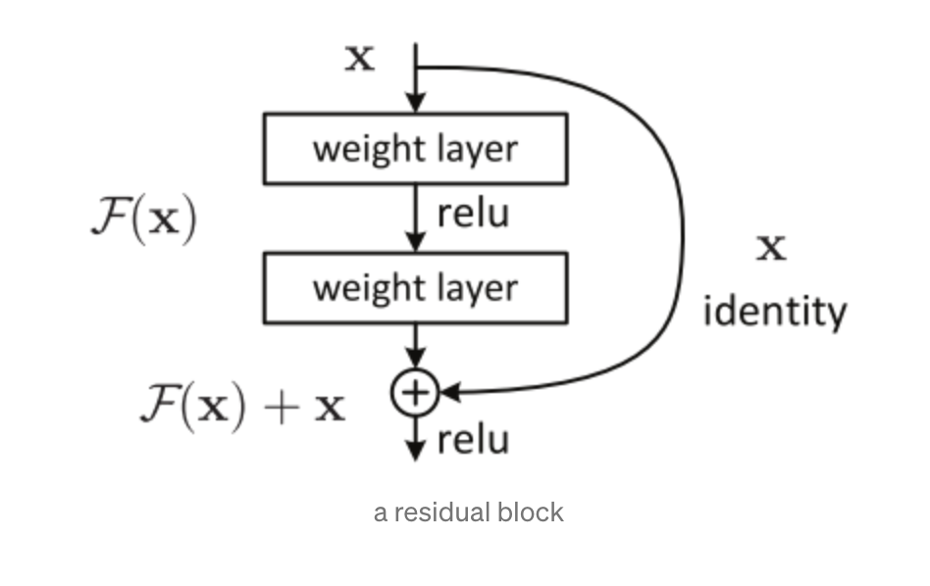
Use pre-trained model(resnet50)
F(x) is residual
Residual learning makes the training go faster, since learning a completely new representation is omitted.

Slide 11
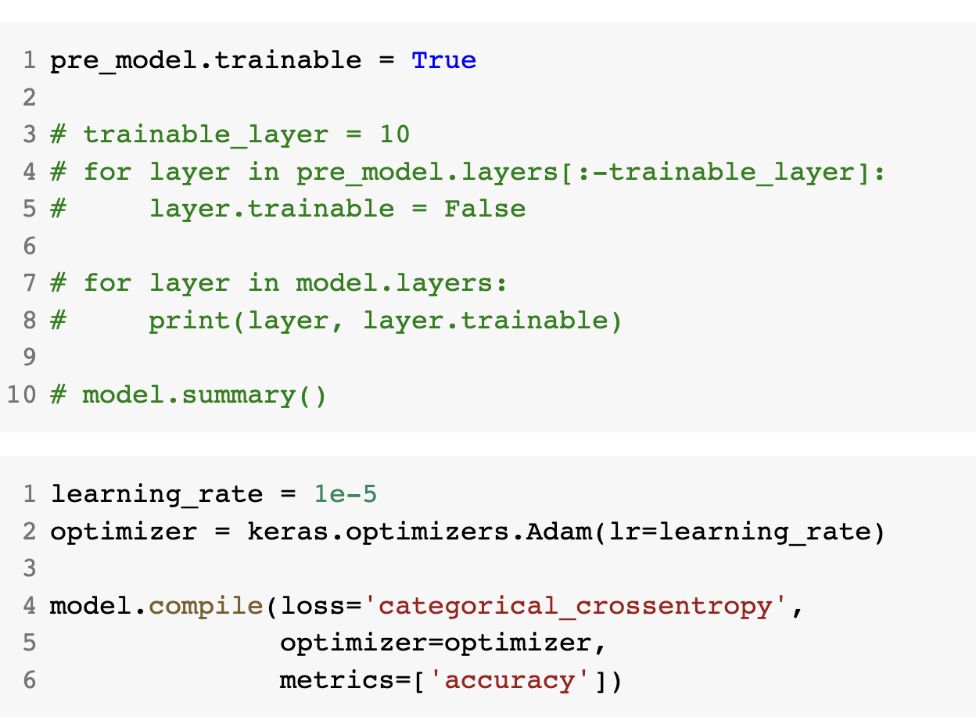
Use pre-trained model(Fine tune)

Slide 12
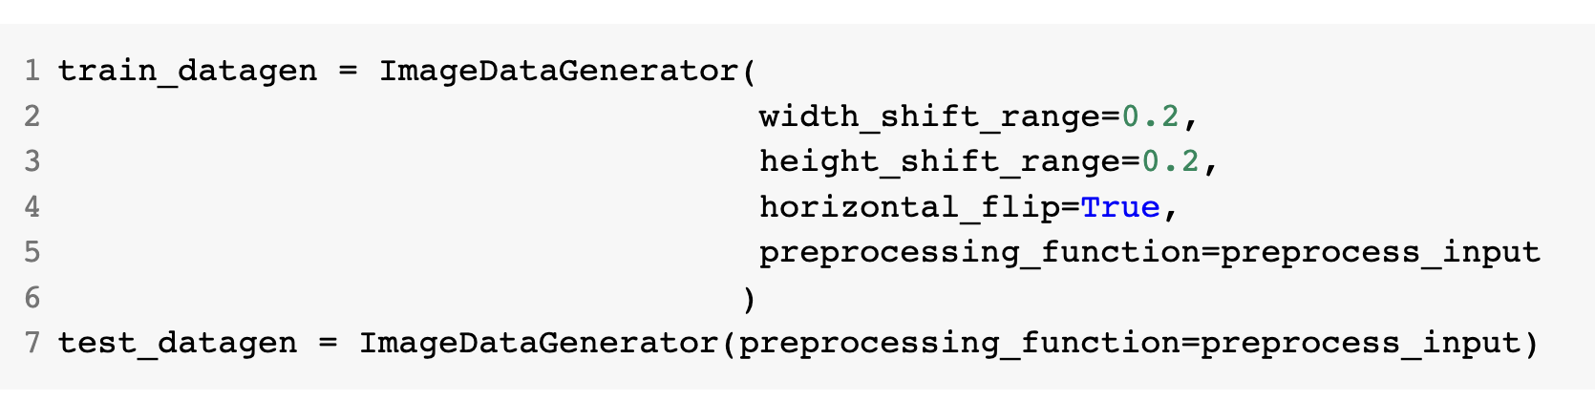
Data augmentation
Setting ImageDataGenerator Object

Slide 13
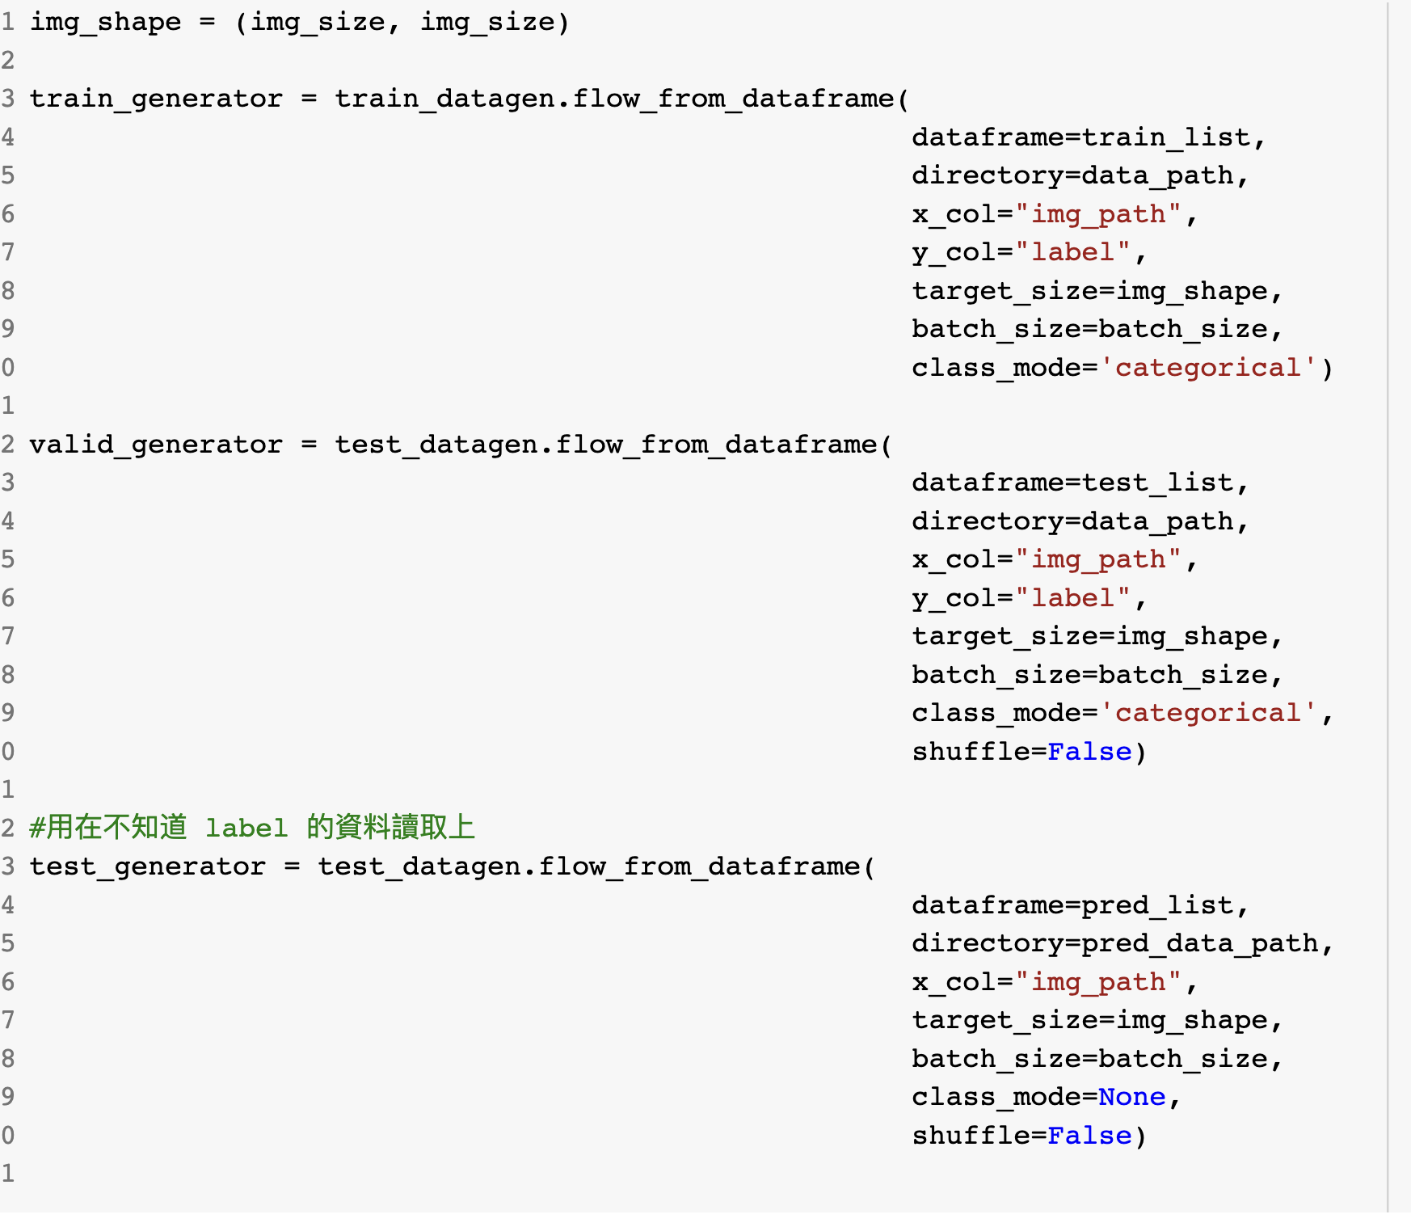
Data augmentation

Slide 14
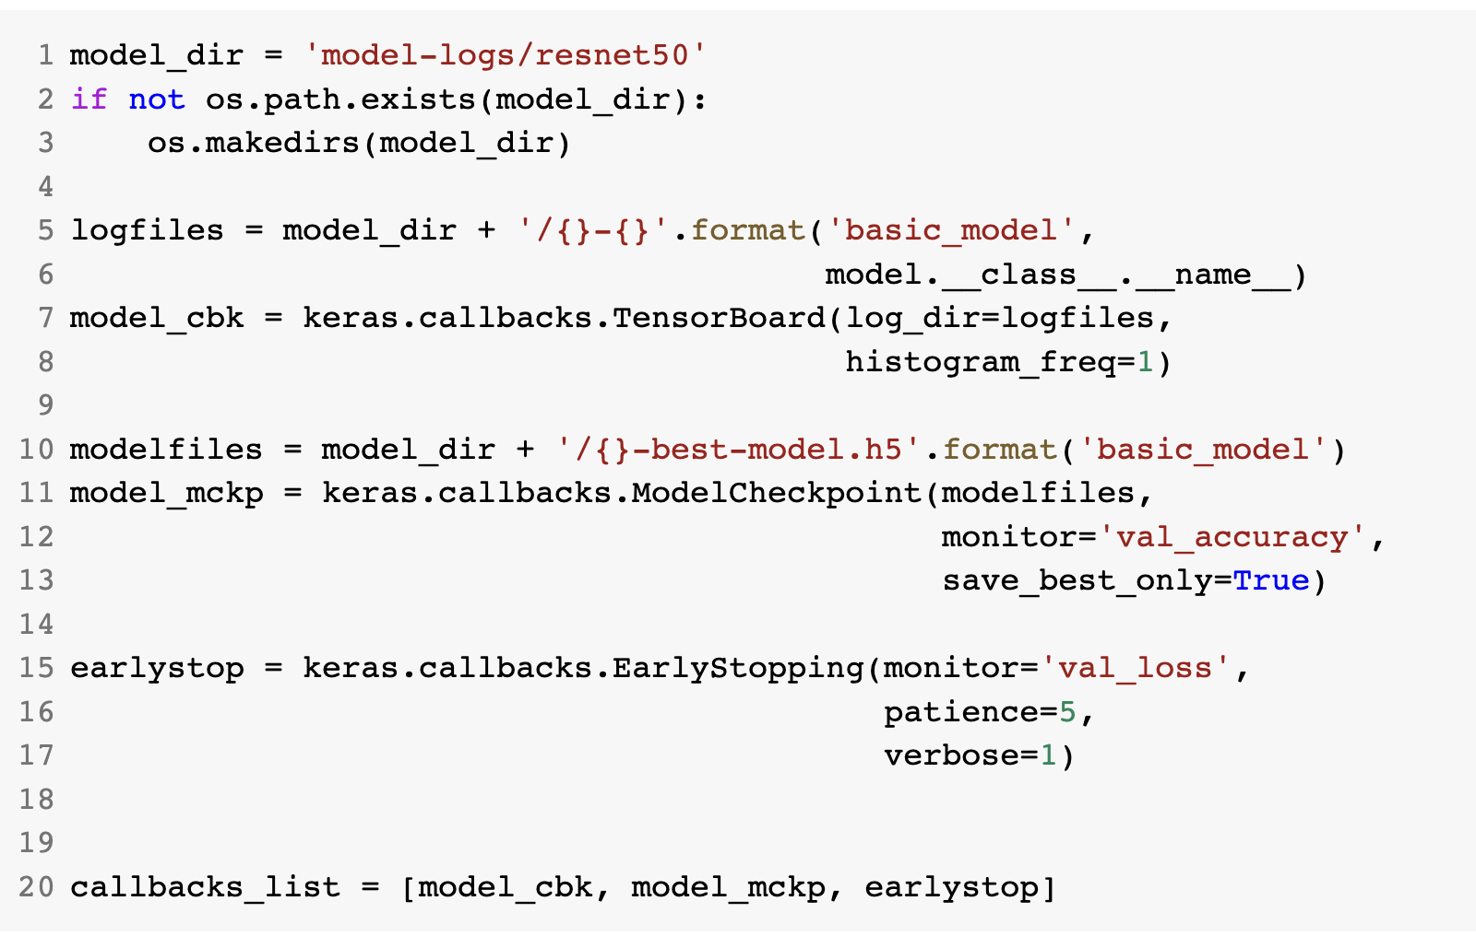
Train the model(Monitor)
Keras callback:
TensorBoard(model_cbk)
ModelCheckpoint(model_mckp)
EarlyStopping(earlystop)
Link:https://medium.com/towards-data-science/a-practical-introduction-to-keras-callbacks-in-tensorflow-2-705d0c584966

Slide 15
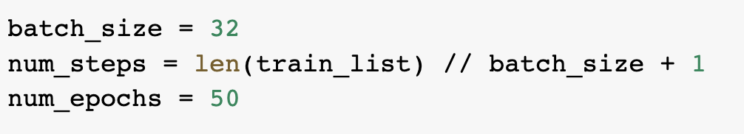
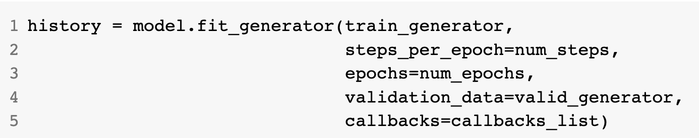
Train the model(fitting)

Slide 16
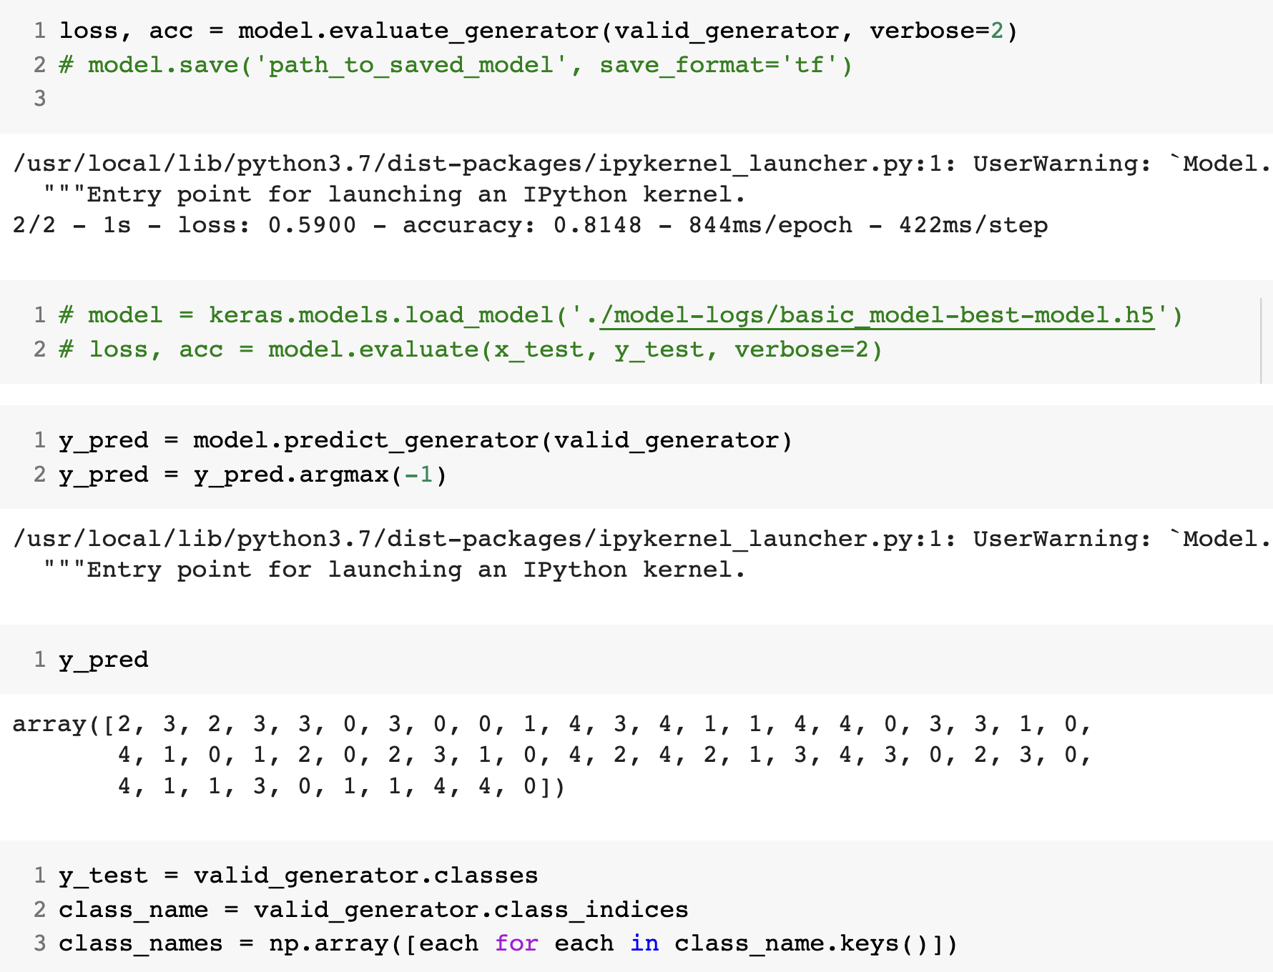
Model evaluation

Slide 17
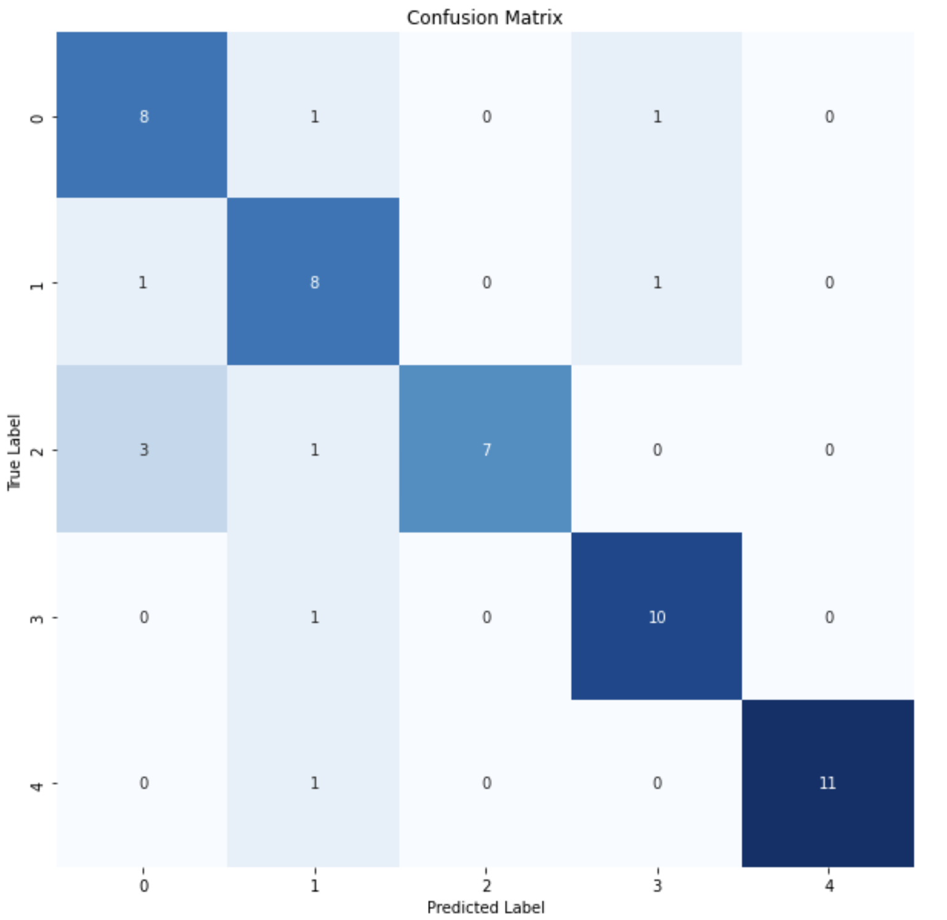
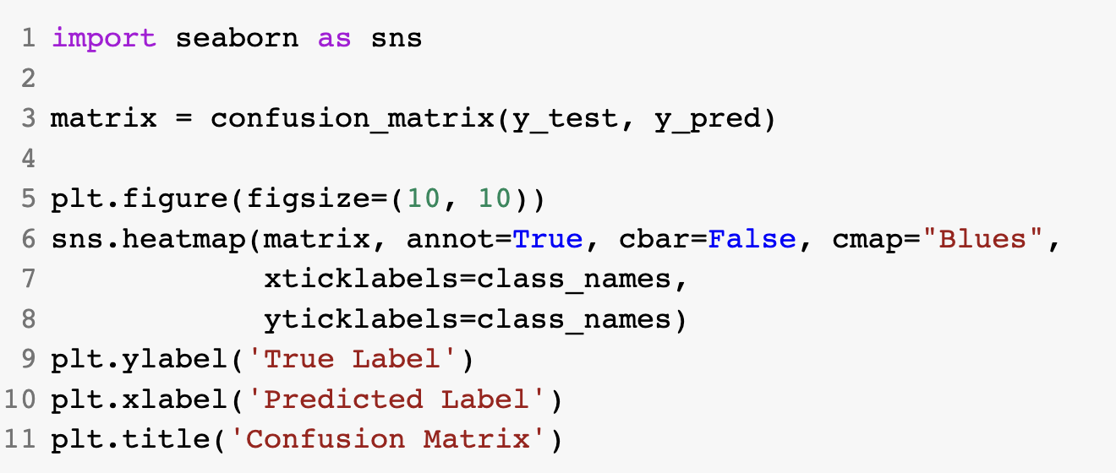
Visualize the result

Slide 18
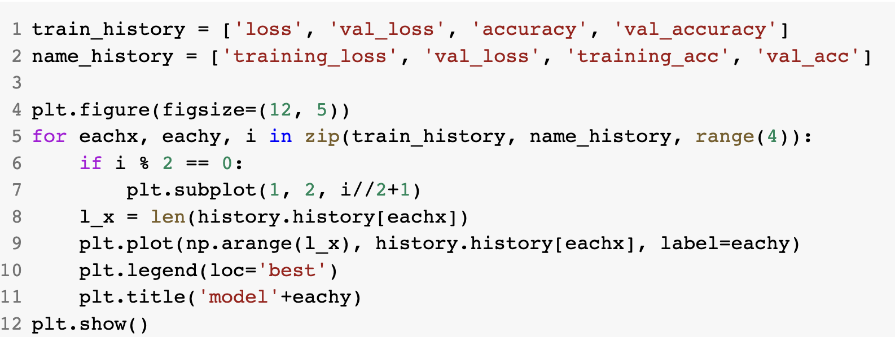
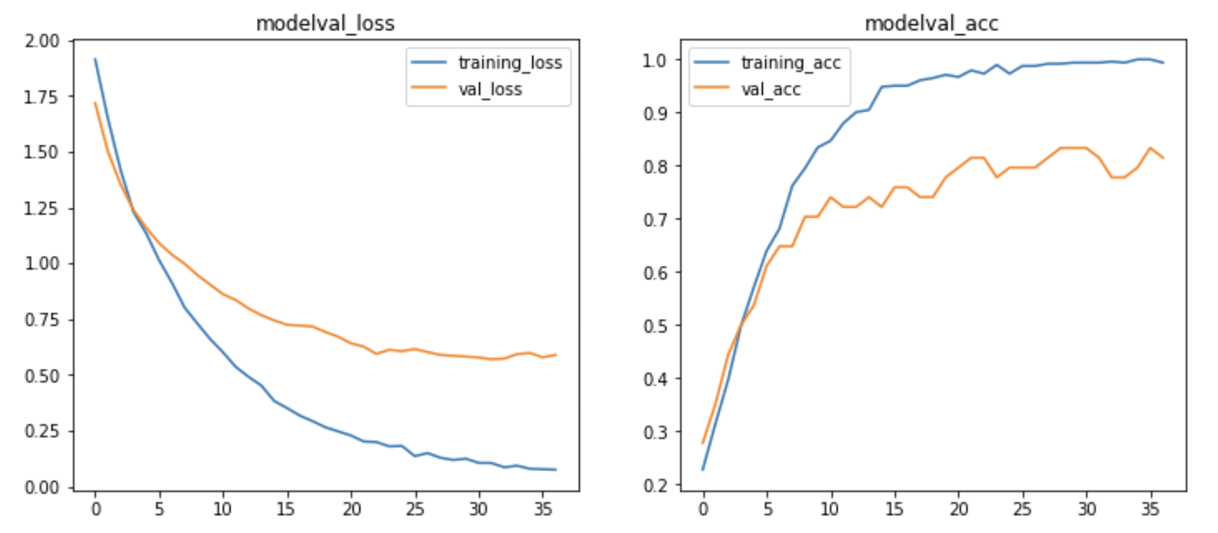
Visualize the result

Slide 19
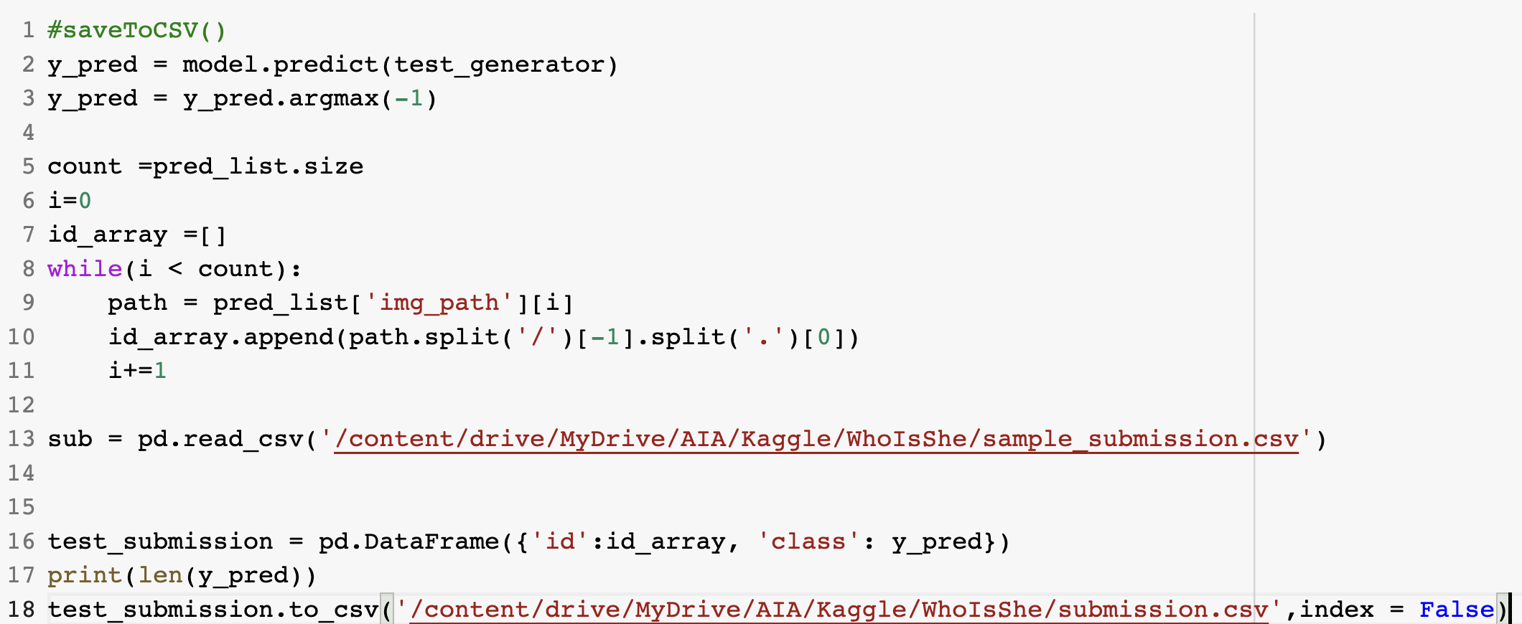
Save back to the file

