Slide 1

Team Work C# part 2
Just Frog
Team: Bishop
Telerik Software Academy
academy.telerik.com

Slide 2
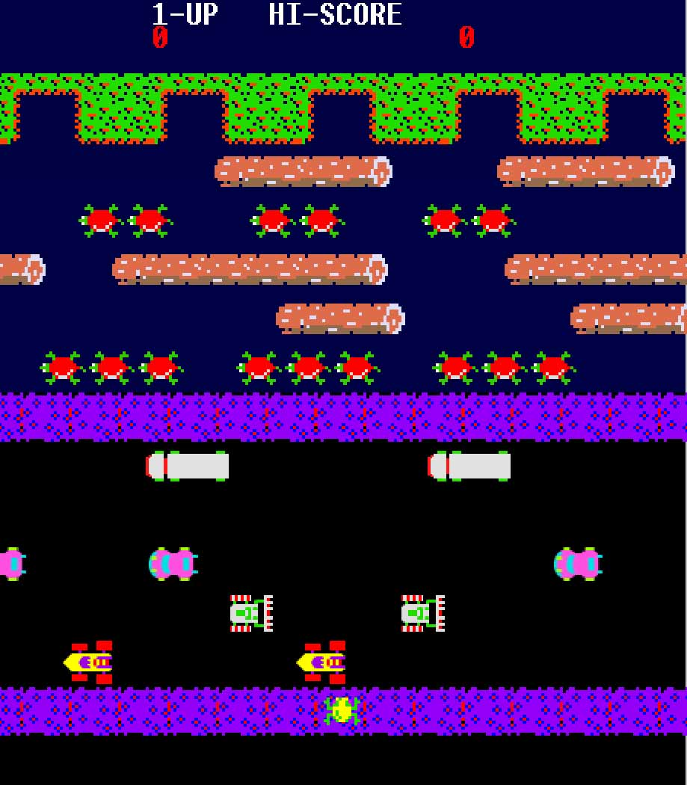
1981 “Frogger” by Konami Co.

Slide 3
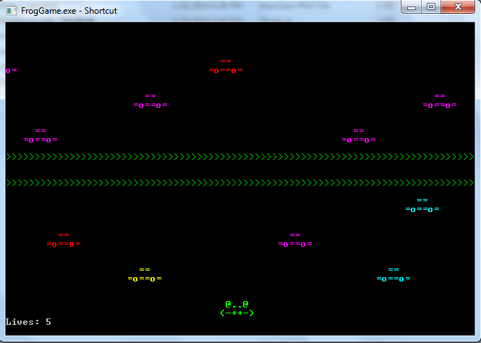
2014 “JustFrog” by Team Bishop

Slide 4

Demo
Please, keep the Frog alive… =)

Slide 5
class FrogMain |  | class Car
Frog frog |  | Direction direction
Lane[] allLanes |  | char[,] parts
CreateLanes() |  | Car(row, col, color, direction)
RefreshConsole() |  | Move()
StartNewGame(int lives) |  | Redraw()
bool ValidateCursorPosition(col, row) |  | CheckIsFrogHere()
class Lane |  | class Frog
Direction dir; |  | char[,] parts
List<Car> cars = new List<Car>() |  | Frog()
Lane(row, direction, speed) |  | Move(ConsoleKey pressedKey)
GenerateCar() |  | Redraw()
UpdateCarPositions() |  | DrawRoadKill()
DrawCars() |  | DrawRoadKill()

Slide 6
TFS and documentation…
TFS repository URL:
https://justfrog.codeplex.com/

Slide 7
How it’s made…
classes -> Cars; Frog; Lane; FrogMain;
methods -> ReDraw(); Move(); StartNewGame();
SetConsole(); RoadKill(); Success();
lane.DrawCars(); frog.Redraw(); etc.
one-dimensional and two-dimensional arrays
.NET classes -> Console, Random, List, Stopwatch
animated welcome screen -> read from external text file

Slide 8
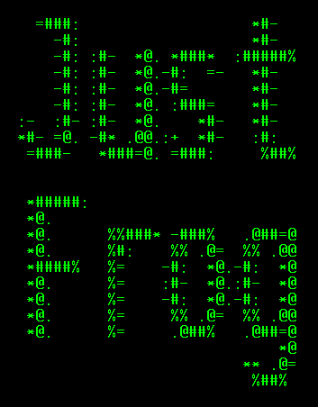
How to play…
Press SPACE to start the game
Use the keyboard arrows Left, Right, Up and Down to navigate the Frog and help it cross the highway!

