Slide 1
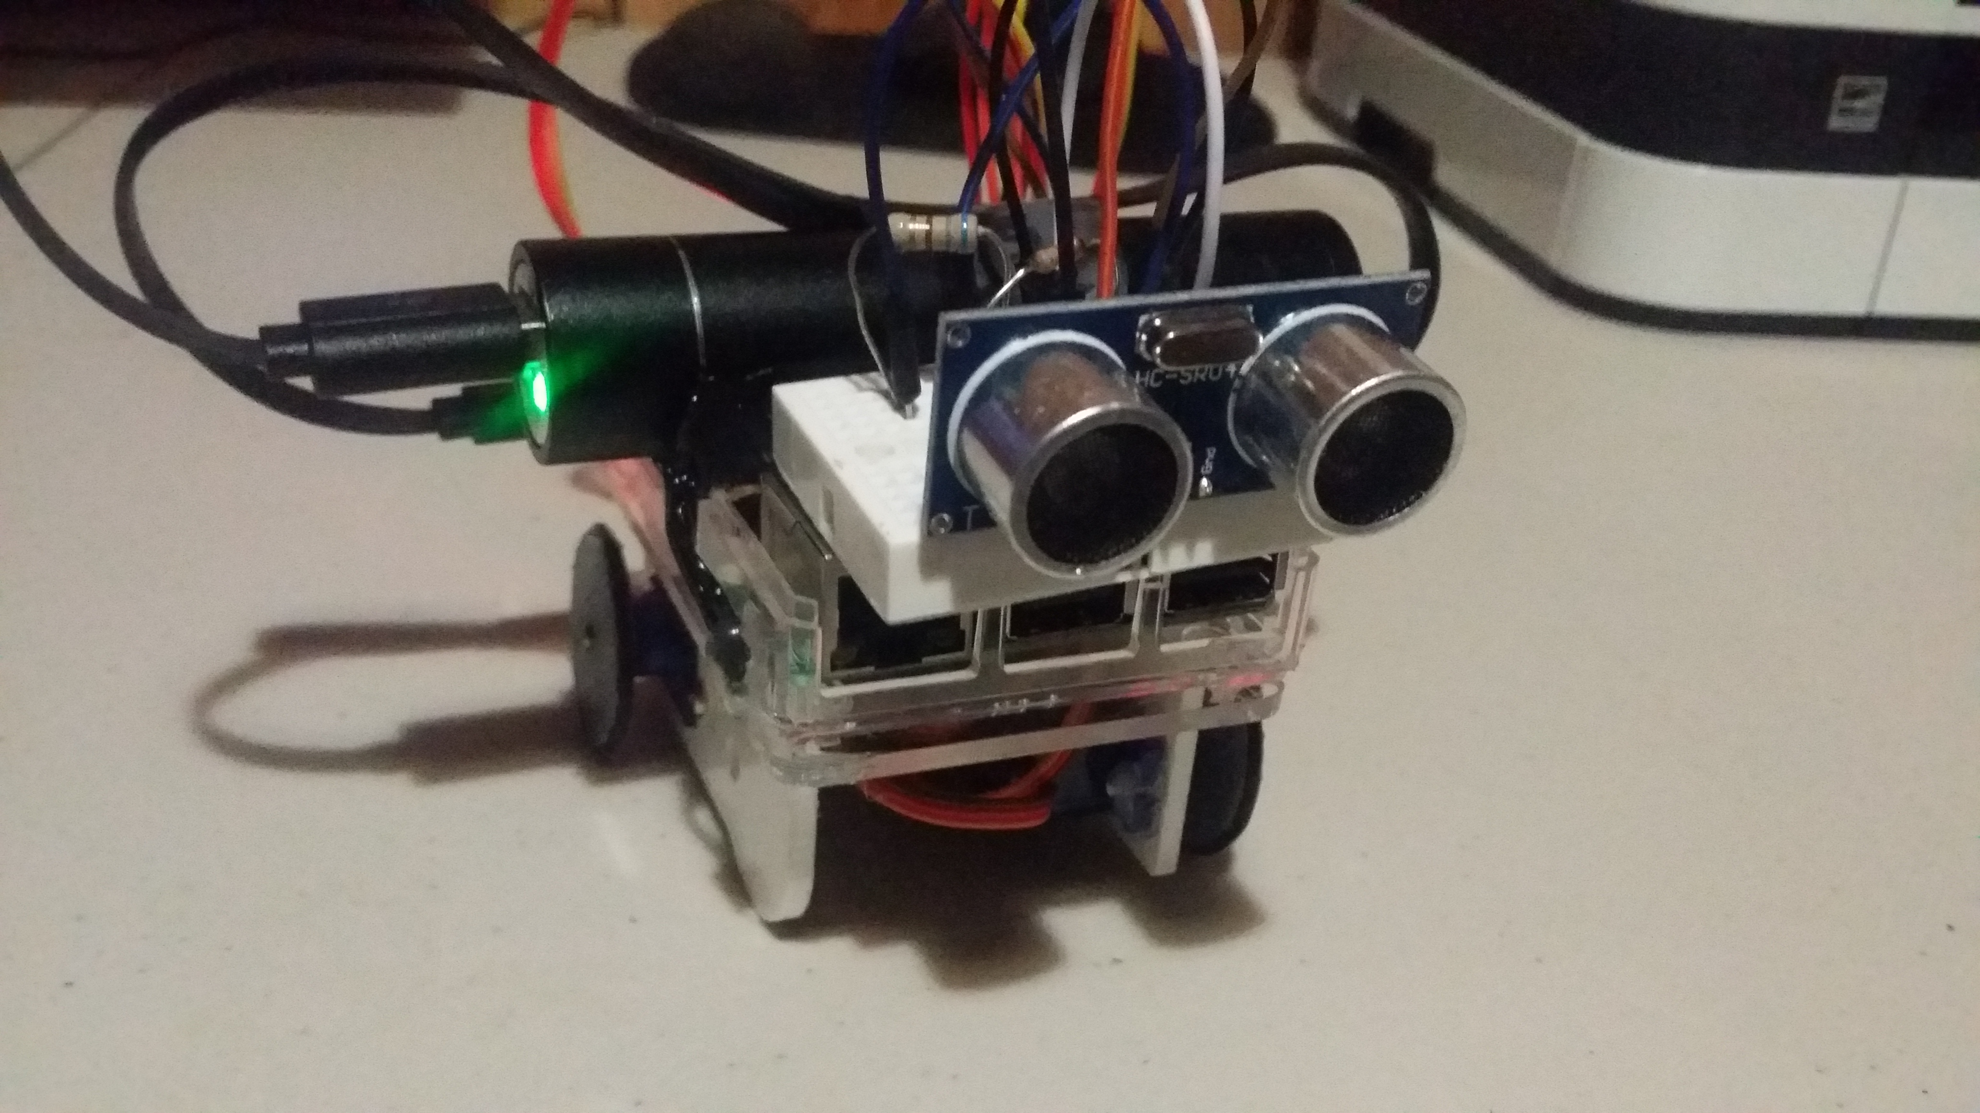
PiRover
RaspberryPi rover

Slide 2
Introduction
PiRover is a rover controlled by a raspberry pi. It is integrated with Bluetooth connection using an Android app called “PiRover”. This project can be used for emergency purposes and any exploration activities. The PiRover can be controlled manually and automatically.

Slide 3
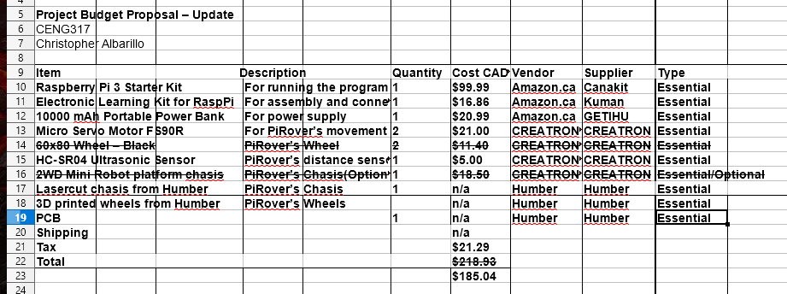
Budget (saved $33.79)

Slide 4
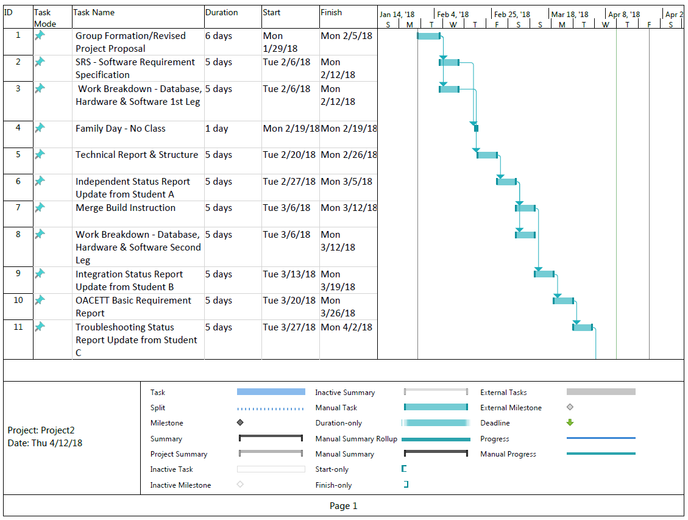
Schedule

Slide 5
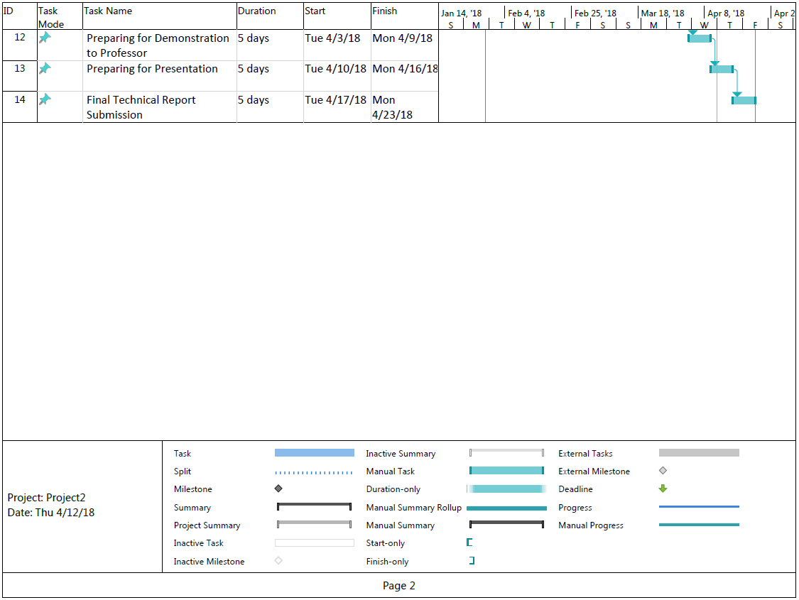
Schedule

Slide 6
Backup Demo
PiRover Demo video link
https://www.youtube.com/watch?v=DTNT1y5OaBA
PiRover Build video link
https://www.youtube.com/watch?v=hWkuDr1-n2Y

Slide 7
Course Knowledge utilized from previous courses
Technical C
Electric Circuit
Java Programming
Internet Programming
Database with Java

