Slide 1
Research Topics

Slide 2
Smart Cities
- Big data analytics can be used by cities to monitor and manage traffic flows effectively.
Data Collection
Sensors and IoT devices at intersections and roadways
Mobile Applications
Data Processing and Analysis
Big data analytics can be used to process a vast amount of traffic data
Machine Learning Models may be used to develop predictive models to forecast traffic and optimize stop light timings for better traffic flow

Slide 3
Studies and Implementation
Google’s Green Light project:
Google has deployed AI-driven systems in 14 cities to create "green waves," optimizing traffic light sequences to reduce stop-and-go traffic by up to 30%. This approach utilizes data from connected vehicles and navigation apps, allowing municipalities to adjust traffic light timings without the need for new hardware
Cavnue's Smart Infrastructure:
In Michigan, Cavnue has developed a smart infrastructure system on a three-mile section of Interstate 94, installing sensors every 200 meters to monitor and analyze road conditions in real time. This system provides valuable insights to help government agencies improve and repair roadways more efficiently.

Slide 4
Literature Review
“Smart city re-imagined: City planning and GeoAI in the age of big data" by Reza Mortaheb and Piotr Jankowski
This paper critiques the techno-centric notion of smart cities and argues for the integration of city planning with GeoAI (Geospatial Artificial Intelligence) to achieve sustainable, equitable, and efficient urban development. It introduces a human-centered city planning framework that leverages GeoAI, Big Data, and GIScience to achieve four overarching goals:
Enhance efficiency in urban services.
Improve quality of life for urban citizens.
Address socio-environmental and economic challenges.
Generate spatial data and knowledge on urban dynamics.
“SmartAirQ: A Big Data Governance Framework for Urban Air Quality Management in Smart Cities”
This study proposes the SmartAirQ framework, which integrates advanced technologies (AI, IoT, Big Data, and Cloud Computing) for urban air quality management (UAQM) in smart cities. Its goal is to tackle air quality issues using various data-collection methods and AI.
Acquire massive amounts of data using sensors, AI, and existing big data platforms.
More of a discussion than action

Slide 5
Literature Review cont.
“The Role of Big Data in Smart Cities”
This paper explores the potential impact of data collection techniques and the applications that could be employed using this data. It emphasizes Internet of Things (IoT) technologies and the deployment of sensors as primary data sources.
Smart Grid: Enhances energy efficiency based on real time needs using big data capabilities.
Smart Transportation: Aimed at reducing traffic congestion using optimized routes and patter analysis.
Smart Governance: Support future policy formulation
Key Concepts to Research Further
Internet of Things (IoT)
Recurs in almost every paper on Smart City.
Best means of data collection
Big Data
Massive amounts of data will be generated using the suggested collection techniques.
Big data makes it possible to work in real time.
AI
Useful for pattern prediction

Slide 6
Possible Data Sources
Kaggle Datasets
Various datasets on participating smart cities
SensorThings API
Unified framework for interconnected IoT devices
pNEUMA
Large-scale dataset of vehicle trajectories collected through drone experiments in Athens, Greece
Open Traffic
Open Traffic is a global data platform to process anonymous positions of vehicles and smartphones into real-time and historical traffic statistics
Aimsun
Various papers and software on urban mobility
Smart City website
Data catalogs, participating city information, etc. Great source for general information.

Slide 7
Data.gov
Massive wide range US government data catalog
1. Traffic Volume Counts
Metadata Updated: September 2, 2023
New York City Department of Transportation (NYC DOT) uses Automated Traffic Recorders (ATR) to collect traffic sample volume counts at bridge crossings and roadways. These counts do not cover the entire year, and the number of days counted per location may vary from year to year. Also see Automated Traffic Volume Counts: https://data.cityofnewyork.us/Transportation/Automated-Traffic-Volume-Counts/7ym2-wayt
- CSV File
2. Transportation Services Index and Seasonally-Adjusted Transportation Data
Metadata Updated: August 16, 2024
The Transportation Services Index (TSI), created by the U.S. Department of Transportation (DOT), Bureau of Transportation Statistics (BTS), measures the movement of freight and passengers.
- CSV File

Slide 8
Data.gov cont.
3. MTA Monthly Ridership / Traffic Data: Beginning January 2008
Metadata Updated: November 29, 2024
This dataset provides systemwide ridership and traffic estimates for subways (including the Staten Island Railway), NYCT bus, MTA Bus, Long Island Rail Road, Metro-North Railroad, Access-A-Ride, Bridges and Tunnels and Staten Island Railway on a monthly basis.
- CSV File
4. 2022 Traffic Volume (DoC)
Metadata Updated: September 17, 2024
Traffic volume of Roadway Blocks. The dataset contains traffic volume data, created as part of the District of Columbia, Department of Transportation (DDOT) Roads and Highways database. A database provided by the District of Columbia, Department of Transportation identified traffic volume. Count data is collected (both direction) at pre-selected locations on Highway Performance Monitoring System (HPMS) Sections on a three-year cycle. These counts are converted to Annual Average Daily Traffic (AADT).
-CSV File

Slide 9
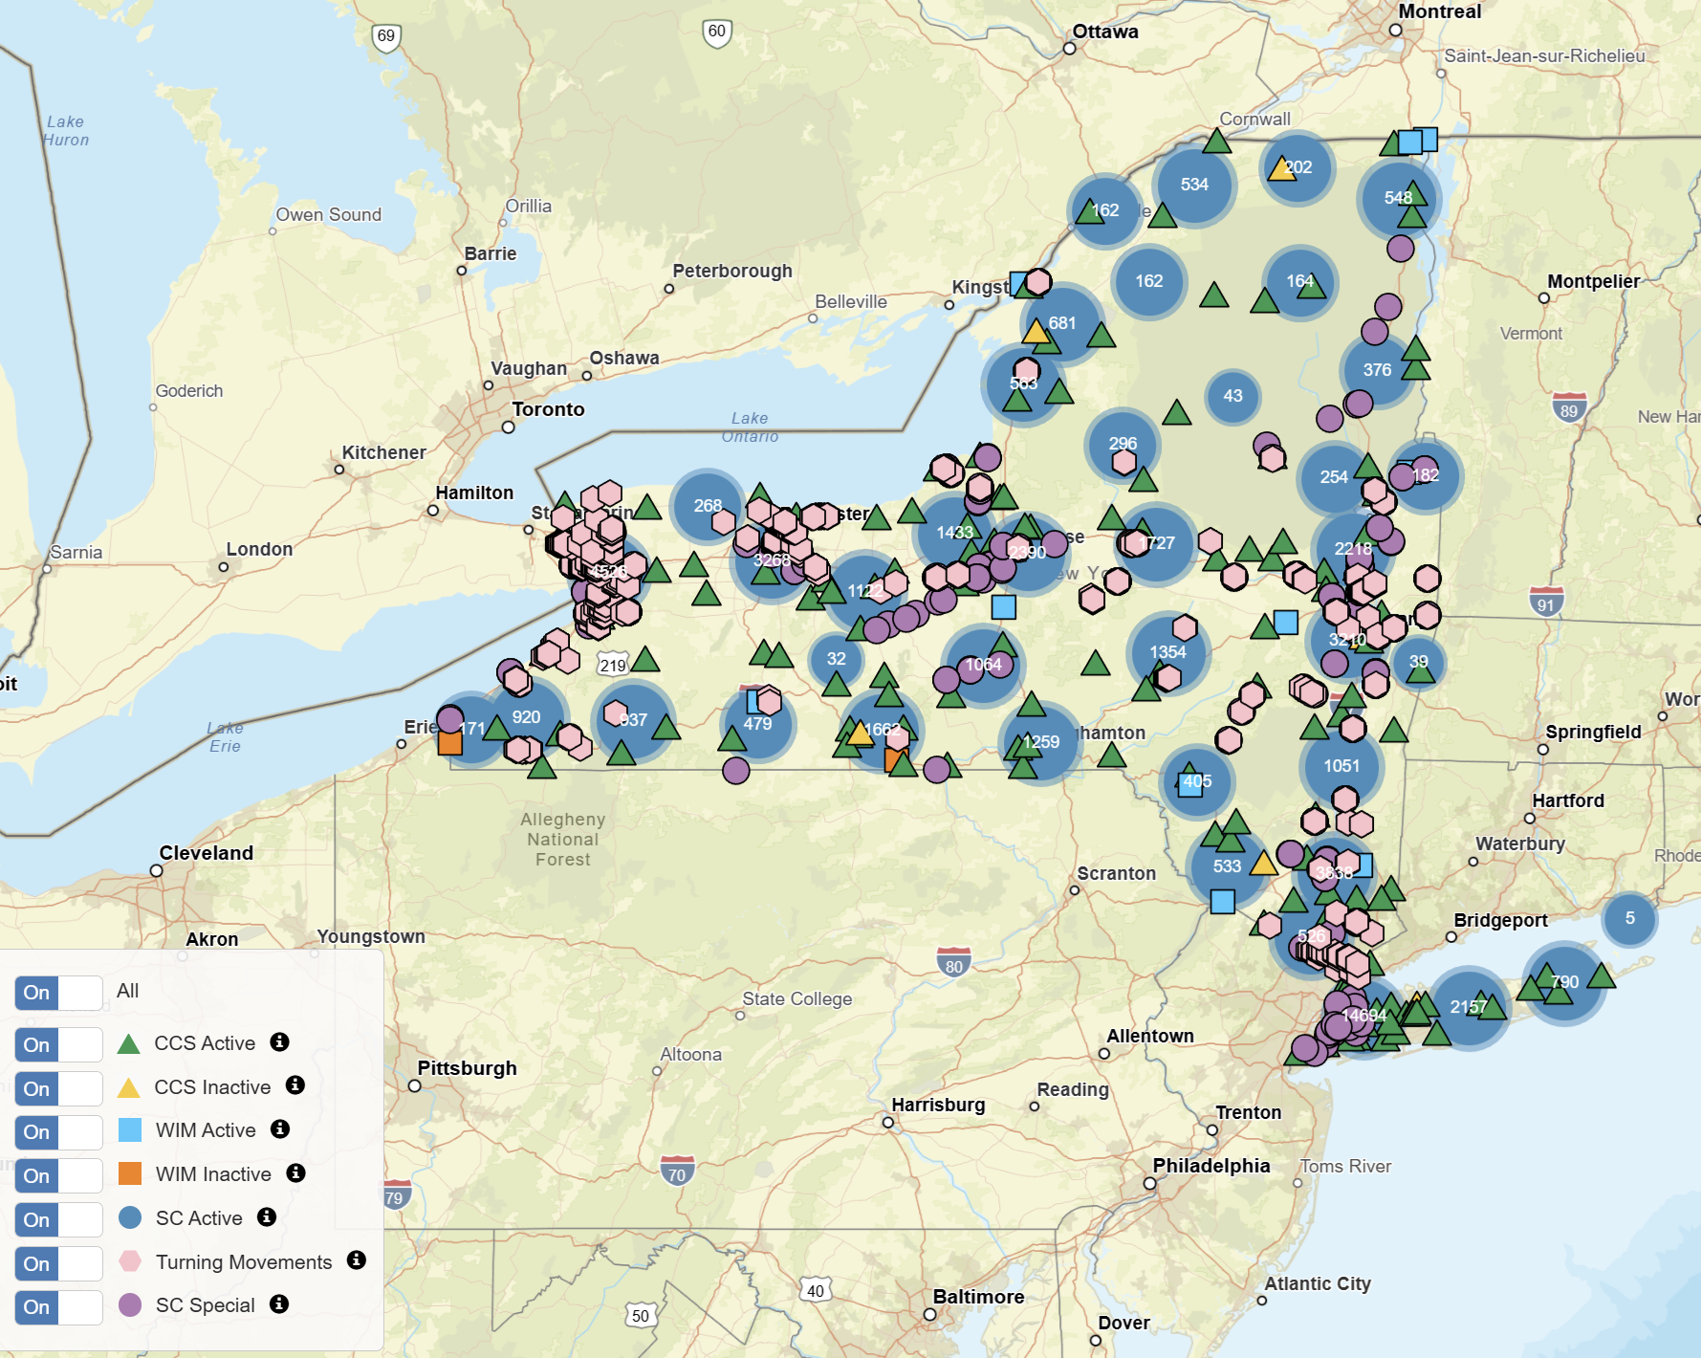
New York Dept. of Transportation
dot.ny.gov
- New York has lots of traffic data on its department of
transportation website.
Traffic Viewer
- Live traffic trends map
Extensive traffic data catalogued over the last decade
1. Estimates of Vehicle Miles of Travel (VMT) and system
length stratified by functional class, urban area, and county.
- CSV File
2. Count Statistics
- Labeled dataset containing vehicle counts labeled by county ID and an
ID for specific road segments.
- Several years worth of data
- CSV File

Slide 10
Goal
Analyze the Annual Average Daily Traffic (AADT) data in New York to identify trends in traffic volume across different regions or counties. Investigate how traffic volume correlates with road characteristics such as speed limits or functional classifications. Use this to assess congestion and propose traffic management strategies.

Slide 11
Dataset
Roughly 150,000 rows by 91 columns of traffic data per year from the New York Department of Transportation.
- Contains thousands of “Count stations” that have an aadt value
- Stations are grouped by region (11) and county
- Addition information on traffic speeds
- Some information on traffic directionality
- Updated to 2022 spanning several years prior
- Excel and CSV format

Slide 12
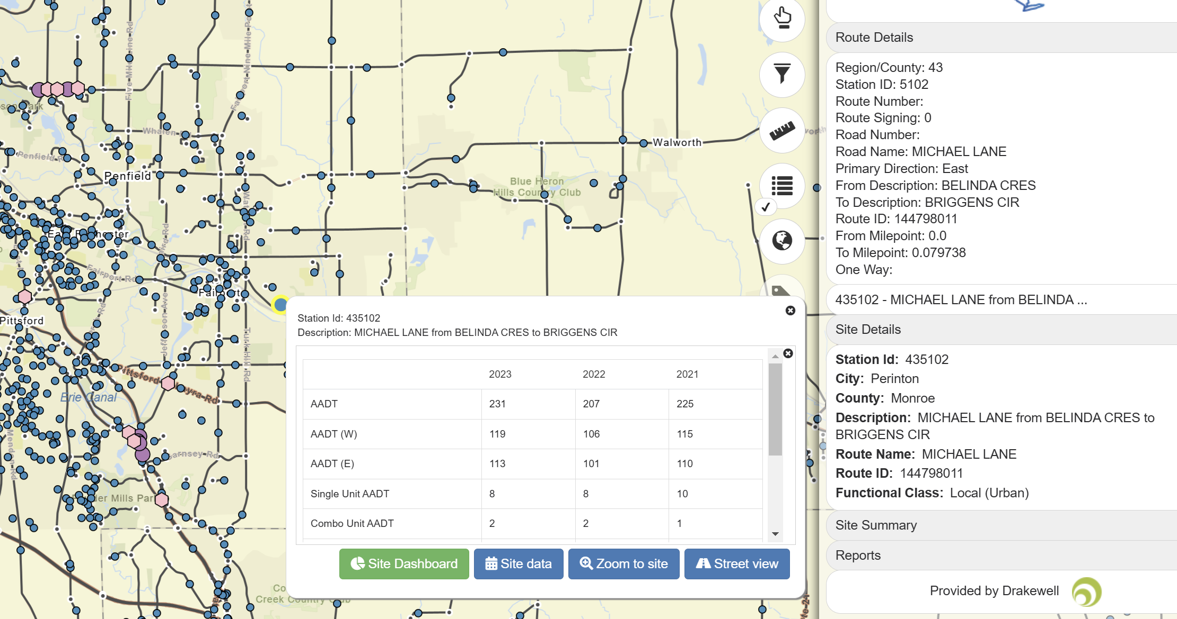
New York Traffic Data Viewer
https://nysdottrafficdata.drakewell.com/publicmultinodemap.asp
- This map contains updated traffic data in a visual map
- Selecting a station gives its AADT count
- Helpful for cross checking traffic volume numbers and
getting bearings for location

Slide 13
Methods
Jupyter Notebook
- Cohesive platform for writing code and visualizing data
Python
- Pandas (data manipulation)
- Matplotlib (visualization)
SQLite
- Allows the creation an in-memory database that can be used to execute SQL commands on

Slide 14
Cleaning Data

Slide 15
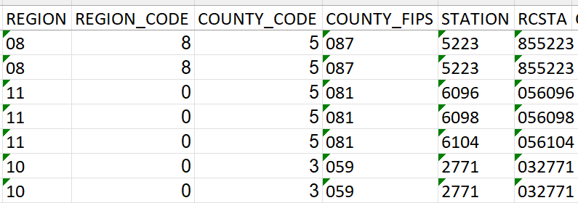
Region, Station, County Codes
Currently 5 Columns to represent this information:
RCSTA contains region, county, and station numbers in one code.
This allows these columns to be removed.

Slide 16
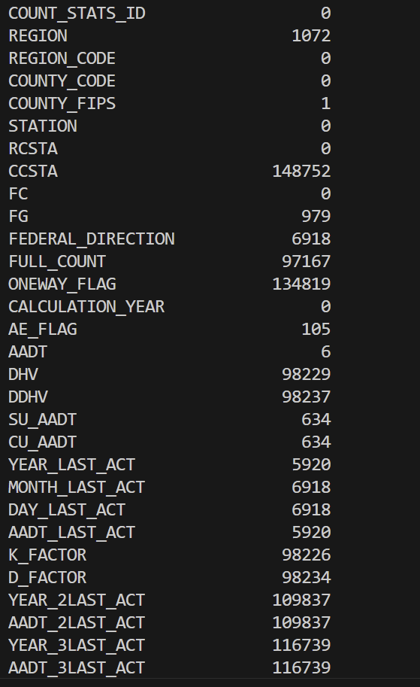
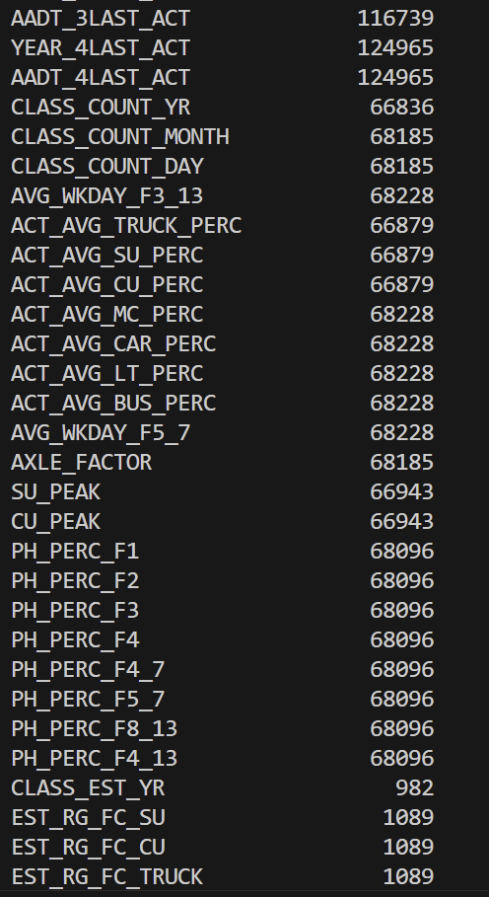
Lots of Empty Data
Mainly traffic count percentage with reference vehicle class
Data within a similar category (i.e. speed, percentages, aadt) have similar numbers of empty cells
Some empty data is explained by incomplete categorical records.
All data using Y/N, 1/0, 30/50/70/90 etc. are empty if false. This can
be fixed by filling empty space accordingly, but caution needs to be
taken to avoid real empty data.

Slide 17
Likely Columns to be Removed
REGION (Redundant)
REGION_CODE (Redundant)
COUNTY_CODE (Redundant)
STATION (Redundant)
CCSTA (Mostly Empty)
AXLE_FACTOR (Irrelevant)
EST_FC_AXLE_FACTR (Irrelevant)
EST_RG_FC_AXLE_FACTR (Irrelevant)
Any date data (Irrelevant)
AVG_K_FACTOR (Redundant)
AVG_D_FACTOR (Redundant)

Slide 18
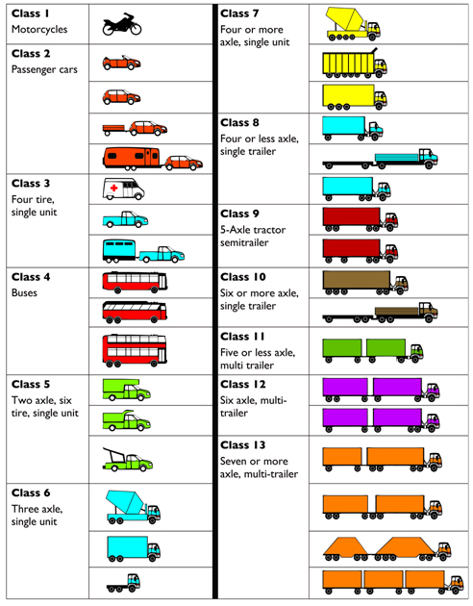
Merging Vehicle Count Percentages
The federal department of transportation groups vehicle
types using a functional class.
The original dataset contained dozens of columns pertaining
To the percentages of vehicles counted per class.
Much of this data can be trimmed/merged for simplicity.

Slide 19
Merging Vehicle Count Percentages
Everyday Roadway Vehicles (Class F1 - F7)
Common Vehicle Percentage. The percentage of the total vehicles in classes
F1 through F7 based on the average weekday distribution of vehicle classes from the
most recent vehicle classification count for the segment
Large/Heavyweight Vehicles (Class F8 - F13)
Truck percentage or Heavy Vehicle Percentage. The percentage of the total vehicles in
classes F8 through F13 based on the average weekday distribution of vehicle classes
from the most recent vehicle classification count for the segment.
Dataset contains percentages for F1, F2, F3, F4 -7, and F4-13
individually. This means there is overlap that needs to be
removed before separation.

Slide 20
After Trimming
68 Total Columns removed
Redundant information
Irrelevant date data
Excess Count Percentages
Old Column Total: 94
New Column Total: 29
Other cleaning needed:
Empty data

Slide 21
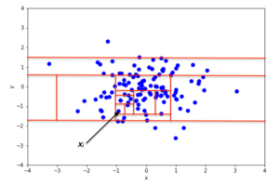
Analysis Methods Research
Machine Learning Algorithms
Isolation Forest
Identify Anomalies
Regression Models to Predict Traffic
Random Forest
Linear Regression
Clustering Techniques
K-Means Clustering
Partition roads or regions into groups based on traffic features.
Isolation Forest

Slide 22
Empty Data
Empty Data is a detriment when using AI models
While the core information of the dataset (Annual Count Averages and Location) is complete,
supplemental information such as speeds and vehicle type are often half empty.
This data exists in the same format for several years back, so it may be possible to
supplement a lack of data using prior years recordings.

