Slide 1

图书管理系统
项目汇报
Report of System of Library Management
汇报组：第七组

Slide 2
01
02
03
04
05
CONTENTS
成员组成
项目意义
技术路线
项目创新
结果展示

Slide 3
01
成员
组成
Members In Group

Slide 4
01
成员分工
Division of Work
姓 名 | 分 工 | 备 注
马宁
白谦
李登 |  | 组长
郑刘鑫
王崇智
武逸飞 |  | 转专业

Slide 5
02
项目
意义
Significance of Project

Slide 6


02
设计背景
Background of Design
时代背景
其优势：
随着科学技术的不断提高,计算机科学日渐成熟,其强大的功能已为人们深刻认识,它已进入人类社会的各个领域并发挥着越来越重要的作用。作为计算机应用的一部分,使用计算机对图书信息进行管理,具有手工管理所无法比拟的优点。
检索迅速、查找方便、可靠性高、存储量大、保密性好、寿命长、
成本低等等

Slide 7
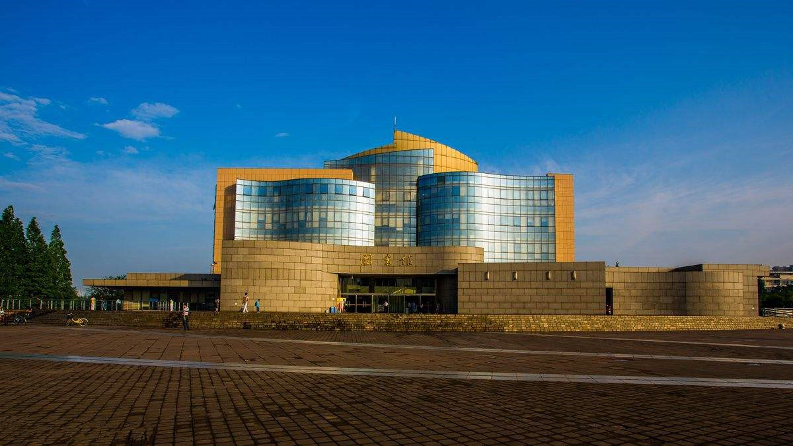
02
系统使用场景
Situation of use of system
图书管理系统，是集先进的关系和文档数据库技术、多媒体技术于一身的信息管理系统。适用于需要自助查询书籍信息，管理借阅信息的信息化图书馆，如学校图书馆，单位图书馆等等。

Slide 8

02
预期使用人群
People who will use the system
学生
图书管理员
（1）查找书籍
（2）更改密码
（3）查看已借书籍
（4）借书[<=10本]
（5）还书
（6）评价书籍
在教师功能的基础上，增加功能：
（7）添加新书
（8）修改书籍信息
（9）删除书籍信息
（10）查找借书人
教师
系统管理员
在学生功能的基础上，增加最多借书数量到30本
在教师功能的基础上，增加功能：
（11）添加新用户
（12）修改用户信息及密码（13）删除用户

Slide 9
03
技术
路线
Way of Techniques

Slide 10

03
开发工具
Develop Tool
标题文字添加
The user can demonstrate on a projector or computer, or print the presentation and make it into a film to be used in a wider field. Using PowerPoint,
标题文字添加
The user can demonstrate on a projector or computer, or print the presentation and make it into a film to be used in a wider field. Using PowerPoint,
标题文字添加
The user can demonstrate on a projector or computer, or print the presentation and make it into a film to be used in a wider field. Using PowerPoint,

Slide 11

02
开发语言
Develop Language
标题文字添加
标题文本预设
标题文本预设
标题文字添加
The user can demonstrate on a projector or computer, or presentation and make it film to be used in a wider field
The user can demonstrate on a projector or computer, or presentation and make it film to be used in a wider field
标题文字添加
标题文字添加
The user can demonstrate on a projector or computer, or presentation and make it film to be used in a wider field
The user can demonstrate on a projector or computer, or presentation and make it film to be used in a wider field
标题文本预设
标题文本预设

Slide 12
03
重点步骤
Important Step
2018
标题文字添加
2017
The user can demonstrate on a projector or computer, or print the presentation and make it into a film to be used
标题文字添加
2016
The user can demonstrate on a projector or computer, or print the presentation and make it into a film to be used
标题文字添加
2015
The user can demonstrate on a projector or computer, or print the presentation and make it into a film to be used
标题文字添加
The user can demonstrate on a projector or computer, or print the presentation and make it into a film to be used

Slide 13
03
发展规划
The user can demonstrate on a projector or computer
The user can demonstrate on a projector or computer, or print the presentation and make it into a film to be used in a wider field. Using PowerPoint, The user can demonstrate on a projector or computer, or print the presentation and make it into a film to be used in a wider field. Using PowerPoint, The user can demonstrate on a projector or computer, or print the presentation and make it into a film to be used in a wider field. Using PowerPoint, The user can demonstrate on a projector or computer, or print the presentation
标题文字添加
标题文字添加
标题文字添加
标题文字添加
标题文字添加
标题文字添加
标题文字添加
标题文字添加
标题文字添加
标题文字添加
标题文字添加
标题文字添加

Slide 14
04
项目
创新
Innovation of Project

Slide 15
04
项目创新点
Innovative Point
标题文字添加
标题文字添加
标题文字添加
标题文字添加
The user can demonstrate on a projector or computer, or presentation and make it film to be used in a wider field
The user can demonstrate on a projector or computer, or presentation and make it film to be used in a wider field
The user can demonstrate on a projector or computer, or presentation and make it film to be used in a wider field
The user can demonstrate on a projector or computer, or presentation and make it film to be used in a wider field

Slide 16
05
结果
展示
Presentation of Consequence

Slide 17

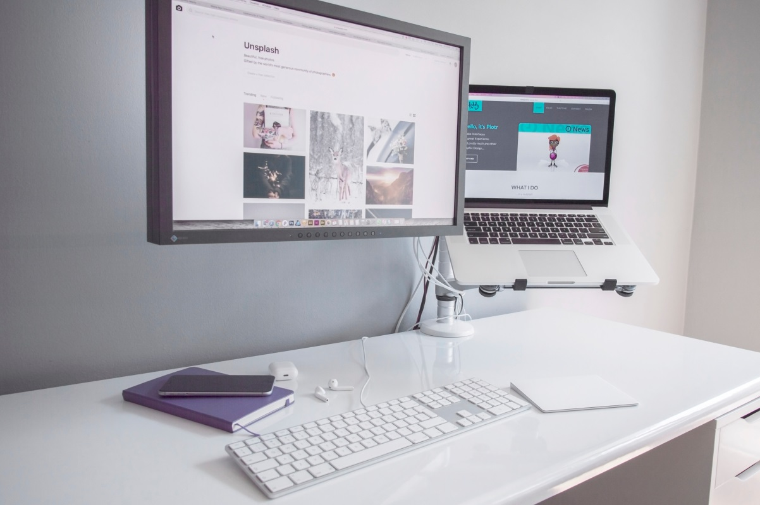

05
系统界面
Interface of System
标题文字添加
标题文字添加
The user can demonstrate on a projector or computer, or print the presentation and make it into a film to be used in a wider field
The user can demonstrate on a projector or computer, or print the presentation and make it into a film to be used in a wider field
01
03
02
标题文字添加
The user can demonstrate on a projector or computer, or print the presentation and make it into a film to be used in a wider field

Slide 18




05
运行效果
Result after Running
标题文字添加
标题文字添加
标题文字添加
标题文字添加
The user can demonstrate on a projector or computer
The user can demonstrate on a projector or computer
The user can demonstrate on a projector or computer
The user can demonstrate on a projector or computer
标题文字添加
标题文字添加
标题文字添加
标题文字添加
The user can demonstrate on a projector or computer
The user can demonstrate on a projector or computer
The user can demonstrate on a projector or computer
The user can demonstrate on a projector or computer

Slide 19
Thanks for watching！
谢谢观看
There’s wish to let the system become more available.
汇报组：第七组

