Slide 1

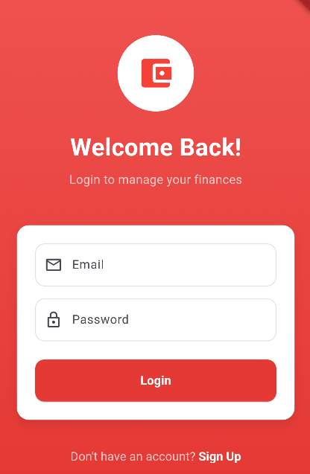
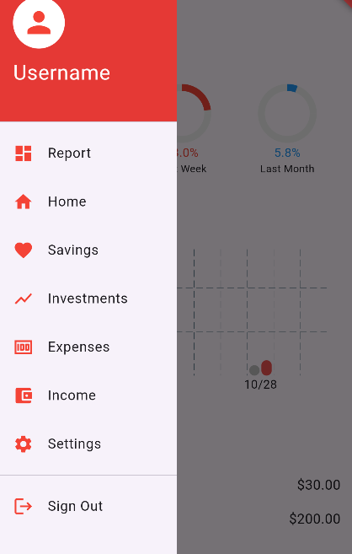
Creative Finance Devs
Team Name: FlutterPros
Team Members: Chris Baez & Sar Vashisht

Slide 2
Problem Statement
Users Struggle with tracking finances efficiently including income, expenses, budget, and investments.

Slide 3
Requirements
App features need to include:
Comprehensive reports
Able to add income, expenses, and investments
Store user specific income, investment, and expenses using databases and accounts.

Slide 4
Input/Output
Input:
Login information
Add Income
Add Expenses
Add investments
Output:
Comprehensive reports
Categorized Expense Tracking
Investment Performance.

Slide 5
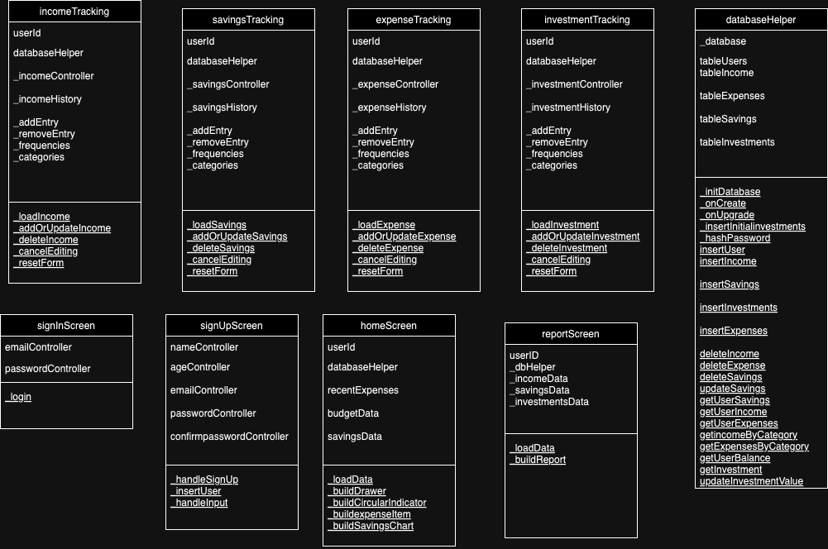
UML Diagram

Slide 6
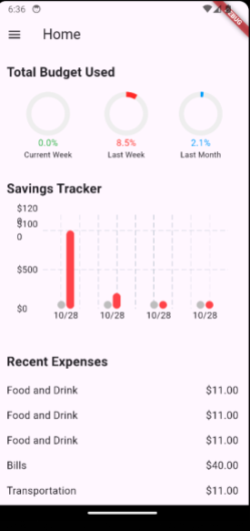
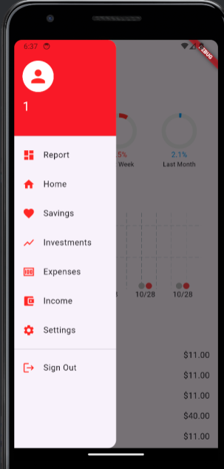
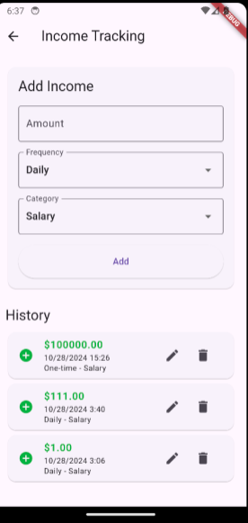
Design Overview

Slide 7
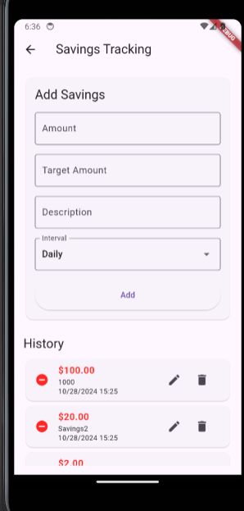
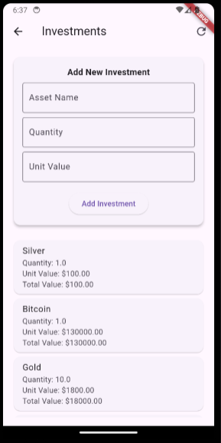
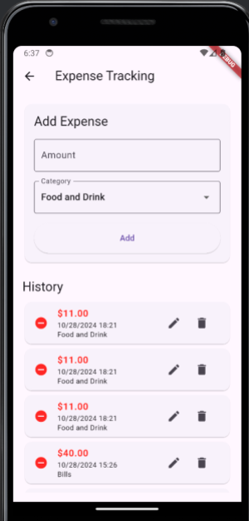
DESIGN OVERVIEW

Slide 8

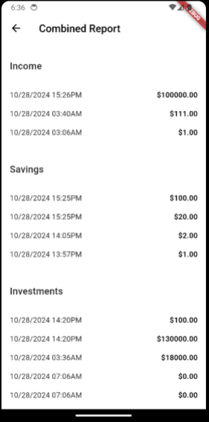
DESIGN OVERVIEW

Slide 9
Testing
The plan for testing was straightforward, pretend a child is using the app, putting letters where they shouldn’t be, pressing random buttons, henceforth so many error statements. We tried to make the database as robust as possible, with error statements for wrong type, wrong input, to prevent any wrong information from slipping through the cracks and breaking the database on us.

Slide 10
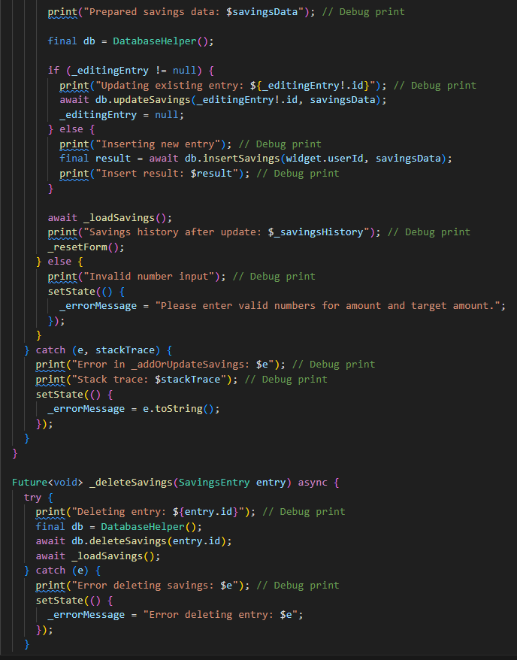
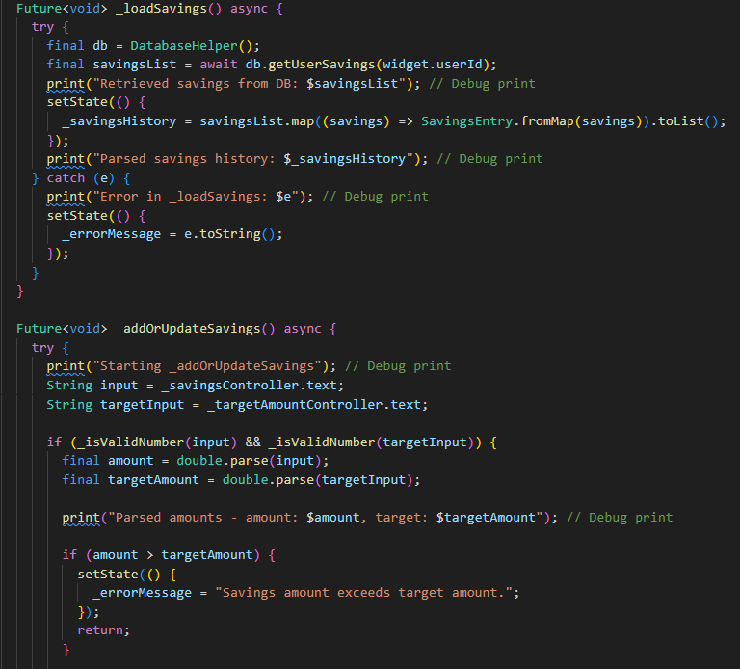
Testing

Slide 11
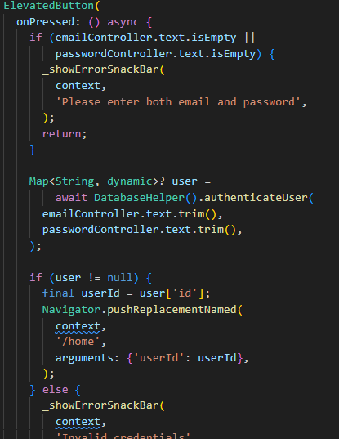
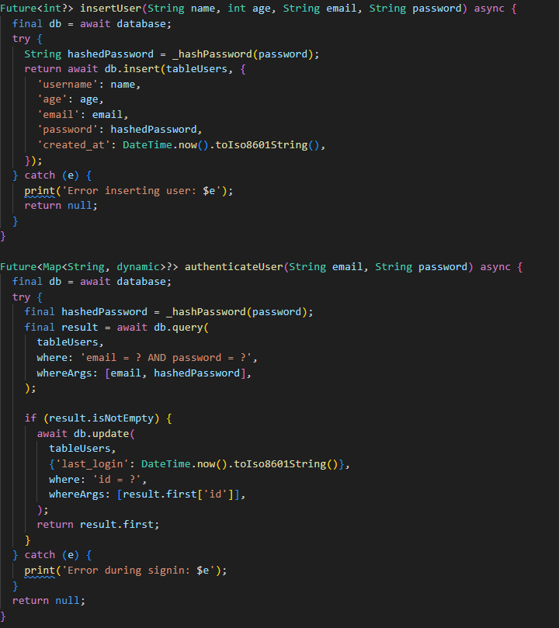
Login Logic

Slide 12
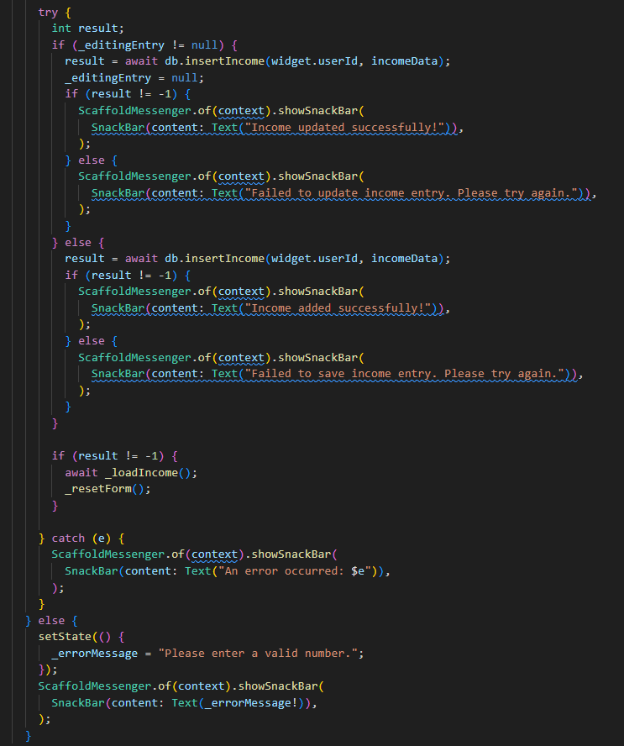
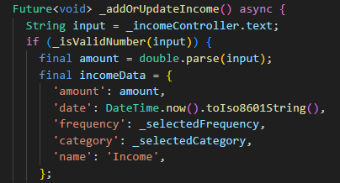
Income Logic

Slide 13
The other pages
Add income and expense use similar logic as they take user input and save it into the database, the screens have functions for adding, updating, and deleting, as well as error catching that we found along the way, such as being able to add $a0 as income, and many other type differences between int or double and so on.

Slide 14
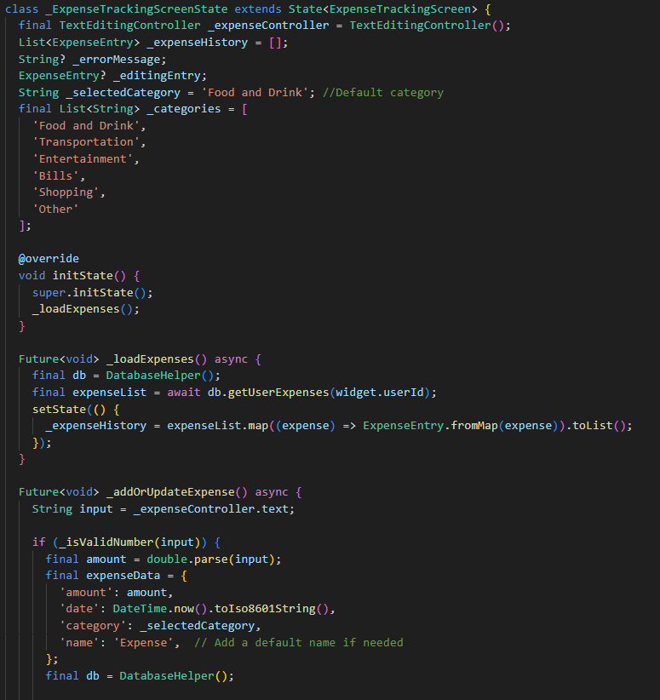
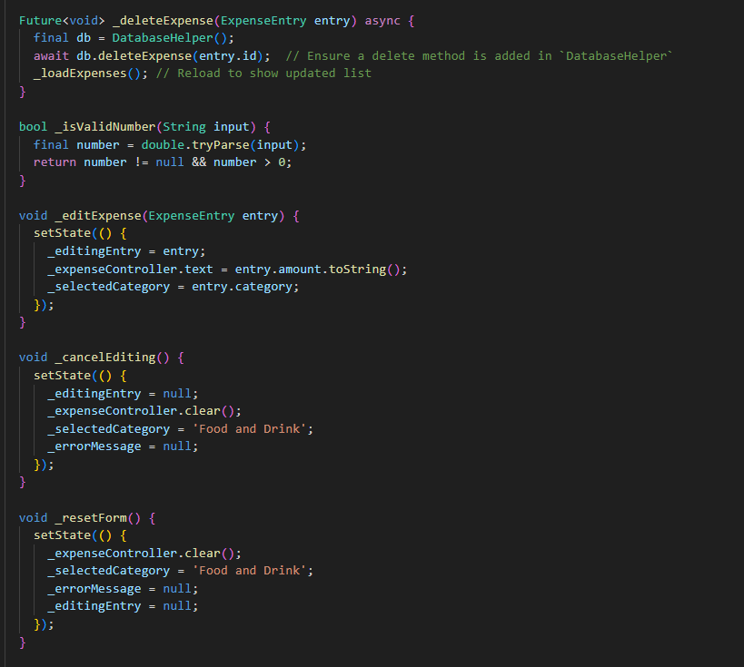
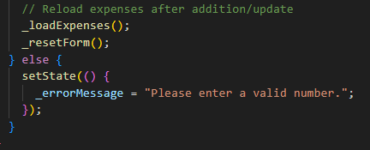
Snippets from Add Expense.

Slide 15
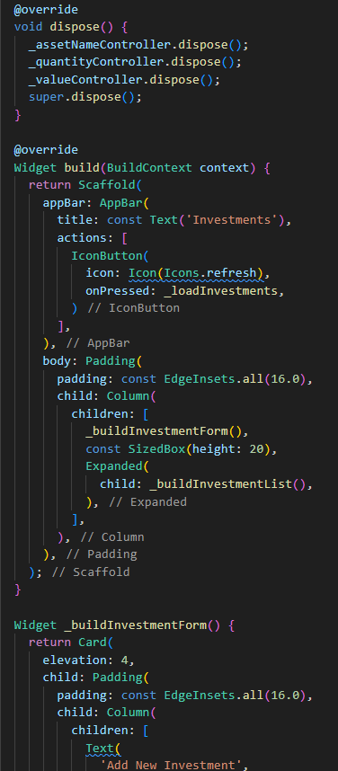
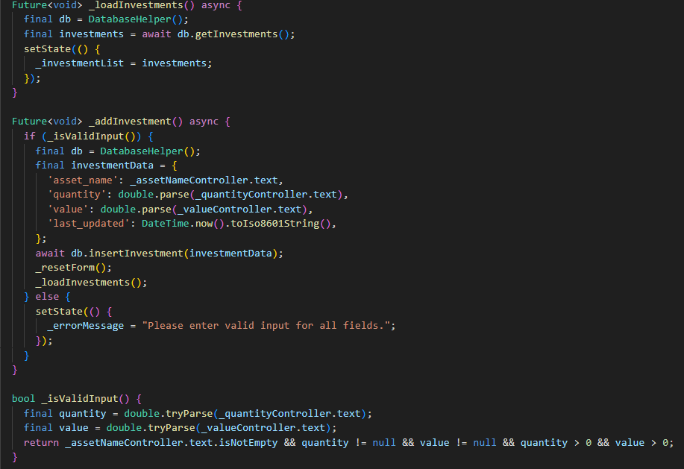
Investment Logic

Slide 16
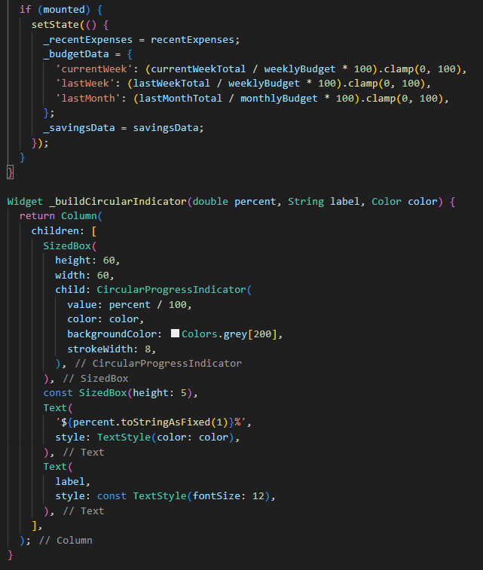
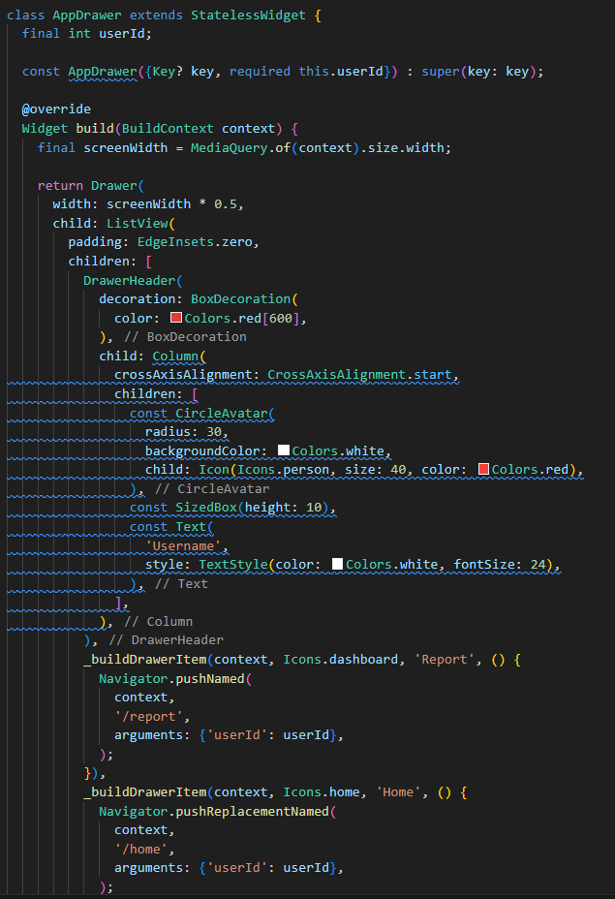
Snippets for Home Screen
Code for Navigation Drawer
Code for Circular Indicators

Slide 17
Issues Encountered
Database Integration with the code, working with a database this big almost always caused errors as the code is very dependent on the data present in the database.
Working through int and double and type mismatch errors as we worked through the code was a bit frustrating.
Chart integration was very new to us, so we had to learn along the way, and we saw no other way to beautify the home screen other than charts as it is a finance application.
Database retrieval, and the methods being used to retrieve the database often encountered errors and had to be changed fixed constantly as new methods were added.
Importing, and the dependencies of different imports on different screens got old after a little bit, but we worked around it

Slide 18
Helpful sources
Existing Githubs
Class content for database use
Stack Overflow
Existing Reddit Threads

Slide 19
Future Development
Fixing Minor Bugs and giving app that furnished look.
Fixing any errors that may arise with normal use, we accounted for MOST errors, and our testing strategy was to pretend a new user is using it, going here and there, and not allowing for letters where letters shouldn’t be.
A more secure user login, possibly a more robust database that can handle more information at the same time.
Firebase authentication as we learn, and more user security with more authentication methods.

Slide 20
LIVE DEMO

