Slide 1
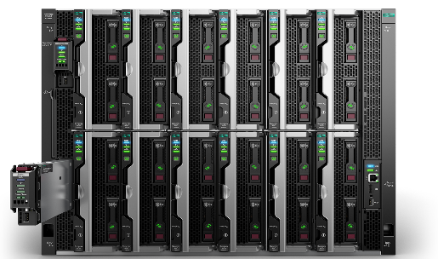

3x HPE Synergy 12000
3 Frame High Availability solution
Docker Infrastructure
3x Docker UCP
3x Docker DTR
1x UCP Load balancer
1x DTR load balancer
1x Swarm Worker VM load balancer
1x Logging server
1x NFS server
Docker Worker Nodes
3x Linux worker nodes
3x Windows worker nodes (optional)
Notes:
Infrastructure nodes run Registry, load balancer, router, monitoring and logging.
These can be scheduled to run regular applications or excluded from scheduling (with a scheduling flag)

Slide 2
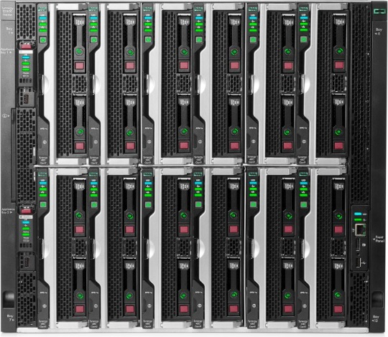
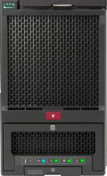
Docker on HPE Synergy
2X HPE Synergy Composer
6x HPE Synergy 480 Gen10
Compute Module
2X HPE Synergy
Image Streamer

Slide 3
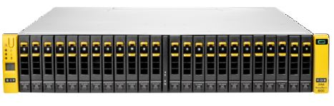
HPE Synergy solution: Docker on virtual machines
2X HPE Synergy Composer
Fiber Channel Direct Attach SAN Manager
6x HPE Synergy 480 Gen10
Compute Module
VMware ESXi 6.5
Controller 1
Controller 2
2X HPE Synergy
Image Streamer
HPE 3PAR StoreServ 8200 All Flash array with
8x 480GB SSD

Slide 4
HPE Synergy solution: Docker on virtual machines
2X HPE Synergy Composer
Fiber Channel Direct Attach SAN Manager
6x HPE Synergy 480 Gen10
Compute Module
Controller 1
Controller 2
2X HPE Synergy
Image Streamer
HPE 3PAR StoreServ 8200 All Flash array with
8x 480GB SSD

