Slide 1
Using Random Forest Modelling to Predict Star Type
Christopher Seven

Slide 2
Research Question
Question – Using random forest modelling, can we predict the luminosity class of stars based on predictor variables and limited information?

Slide 3
Significance of project
Through the construction of a random forest model, only a limited amount of astronomical data can be used to predict star type. As such, this project could potentially increase the speed of identifying and classifying stars at a great distance using easily accessible data.

Slide 4
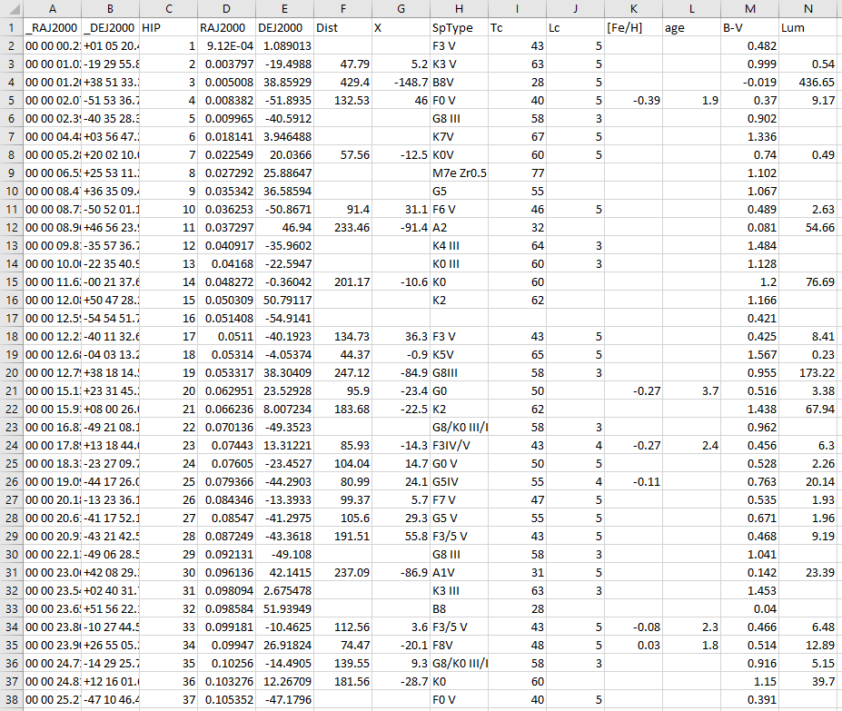
Datasets used
https://vizier.u-strasbg.fr/viz-bin/VizieR-4
Pulled from the University of Strasbourg astronomical catalogue using data from the CDS (Center of Astronomical Studies)

Slide 5
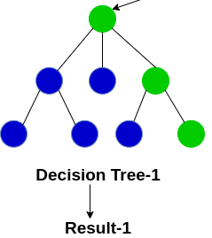
Decision Trees
Sequential question order results in “decisions” being made
Typically result in “overfitting” of the data
The greater the depth of the tree (more questions being asked) results in greater variance
https://www.google.com/url?sa=i&url=https%3A%2F%2Fwww.analyticsvidhya.com%2Fblog%2F2020%2F05%2Fdecision-tree-vs-random-forest-algorithm%2F&psig=AOvVaw1vF-neFbFt0euu8FG6K1A5&ust=1622695306966000&source=images&cd=vfe&ved=0CAIQjRxqFwoTCNDms8mR-PACFQAAAAAdAAAAABAD

Slide 6
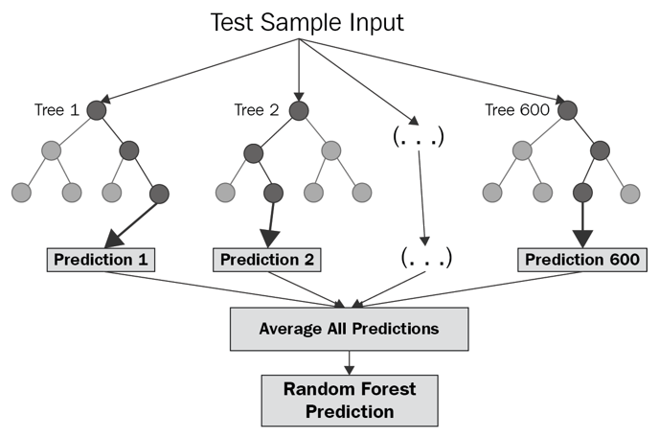
Random Forest Implementation
Works through averaging decision trees
Results in a reduction in variance and bias, and an increase in accuracy
“Bagging”, or bootstrap aggregating, is used to create data samples for decision trees
https://www.google.com/url?sa=i&url=https%3A%2F%2Fcorporatefinanceinstitute.com%2Fresources%2Fknowledge%2Fother%2Frandom-forest%2F&psig=AOvVaw03DKUq72Jg50tJkCmPZRrp&ust=1622743320563000&source=images&cd=vfe&ved=0CAIQjRxqFwoTCLDE-LfE-fACFQAAAAAdAAAAABAu

Slide 7
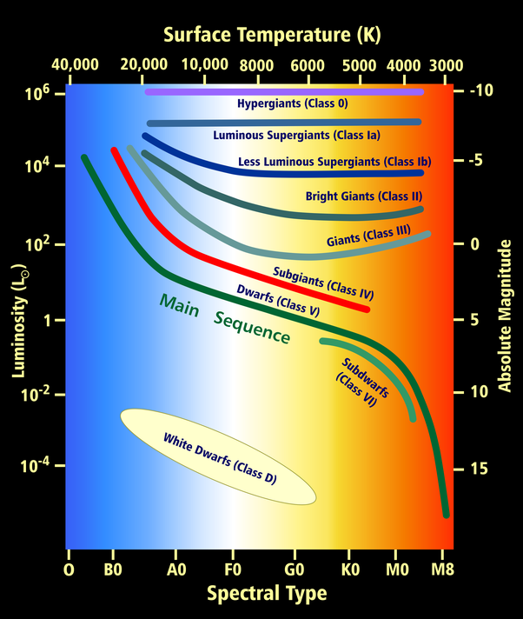
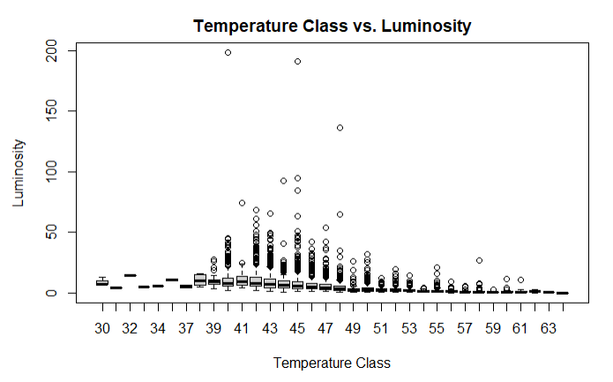
Hertzsprung-Russell Diagram
https://qph.fs.quoracdn.net/main-qimg-bccc0cdb891aca1c92dd205d595318ab

Slide 8
Data Overview
Luminosity Classes – Supergiants (I), Bright Giants (II), Giants (III), Subgiants (IV), Dwarfs (V), Subdwarfs (VI)
Spectral Type in increasing temperature – M, K, G, F, A, B, O
Right Ascension and Declination – Used for star location
Heliocentric Distance – Distance from the sun, measured in parsecs
Galactic Distance – Distance from galaxy center, measured in parsecs
Iron – Iron abundance, logarithm of ratio of iron to hydrogen with difference from the sun
B-V Color – The hotter the star, the lower the index (and the bluer the star)
Luminosity – Measure of energy output of star compared to sun
Age – Billions of years
Temperature Class – O (10-19), B (20-29), A (30-39), F (40-49), G(50-59), K (60-69), M (70-79), L (80-89), etc.

Slide 9
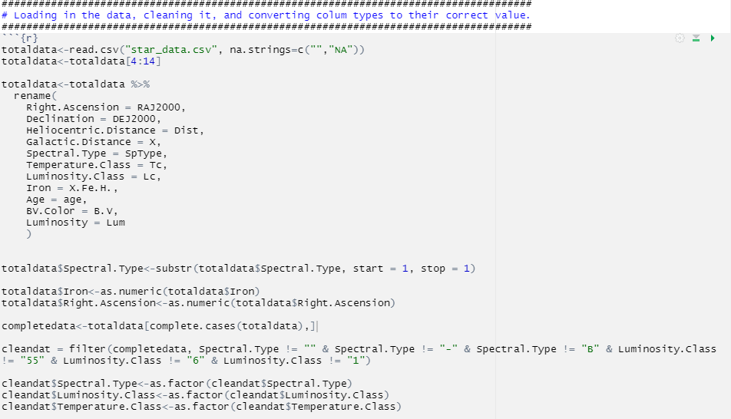
Data Preparation
Initially reading the data in as csv
Replacing missing values with NA
Renaming the columns
Changing data types to appropriate values
Filtering out unnecessary values
Split into test and train datasets

Slide 10
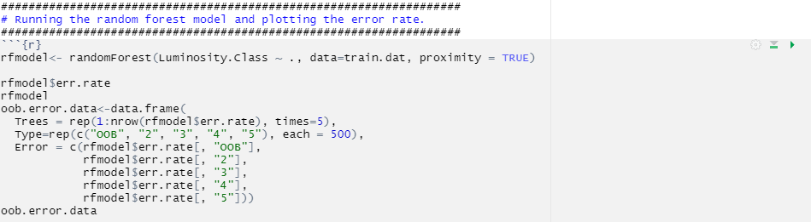
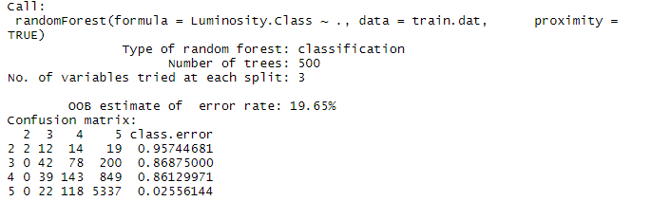
Random Forest Model Construction
Initial random forest construction on the training data
Calculating error rate and storing in a data frame
OOB estimate of error rate is 19.65%
Low error rate for category 5, very high for other categories

Slide 11
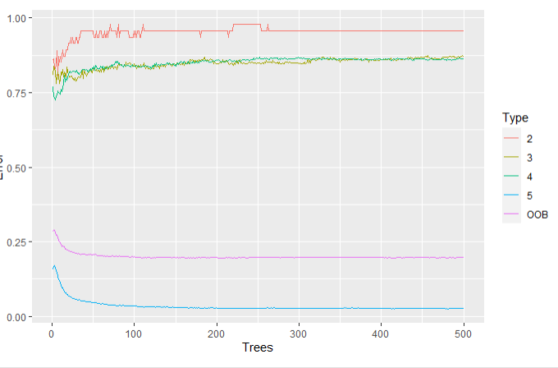
Plotting Error Rate
Visual representation of error data frame
Confirms that luminosity class 5 has a very low error rate
Since class 5 is the most common, overall OOB error rate is still low

Slide 12
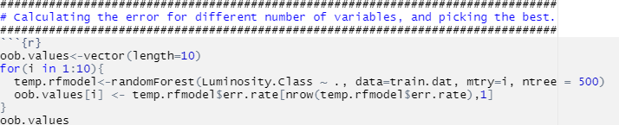
Model Comparison – Optimal Selection
For loop used to determine optimal number of variables at each node
Only examining from 1 to 10
Resulting vector will yield best model
OOB Values –
Optimal model appears to try 2 variables at each node

Slide 13
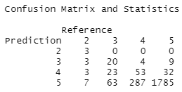
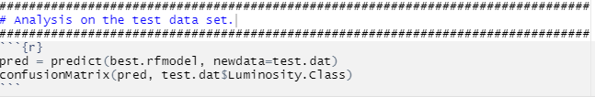
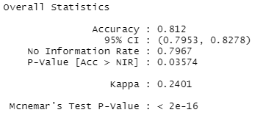
Analysis on Test Data
Confusion matrix and overall accuracy reveal that model is working well
P-value of [Acc>NIR] is significant
Mcnemar’s Test P-value is significant
Error for prediction and reference are different

Slide 14
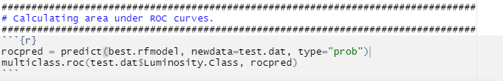

ROC Curve and AUC
Receiver Operating Characteristics (ROC) curves are a measure of performance
AUC of .7405 indicates a 74.05% chance for model to distinguish between class levels
Indicates overlap in true negatives and true positives

Slide 15
Conclusions
The best random forest model outperformed the No Information Rate (NIR)
Relatively decent AUC indicates positive model performance
Appears the best random forest model can be used to predict luminosity class from limited information

