Slide 1

1. 目標
Notes:
https://pixabay.com/videos/woman-musician-violin-music-melody-225546/

Slide 2
2. 阻礙
Notes:
https://pixabay.com/videos/time-moon-clock-time-machine-6358/

Slide 3
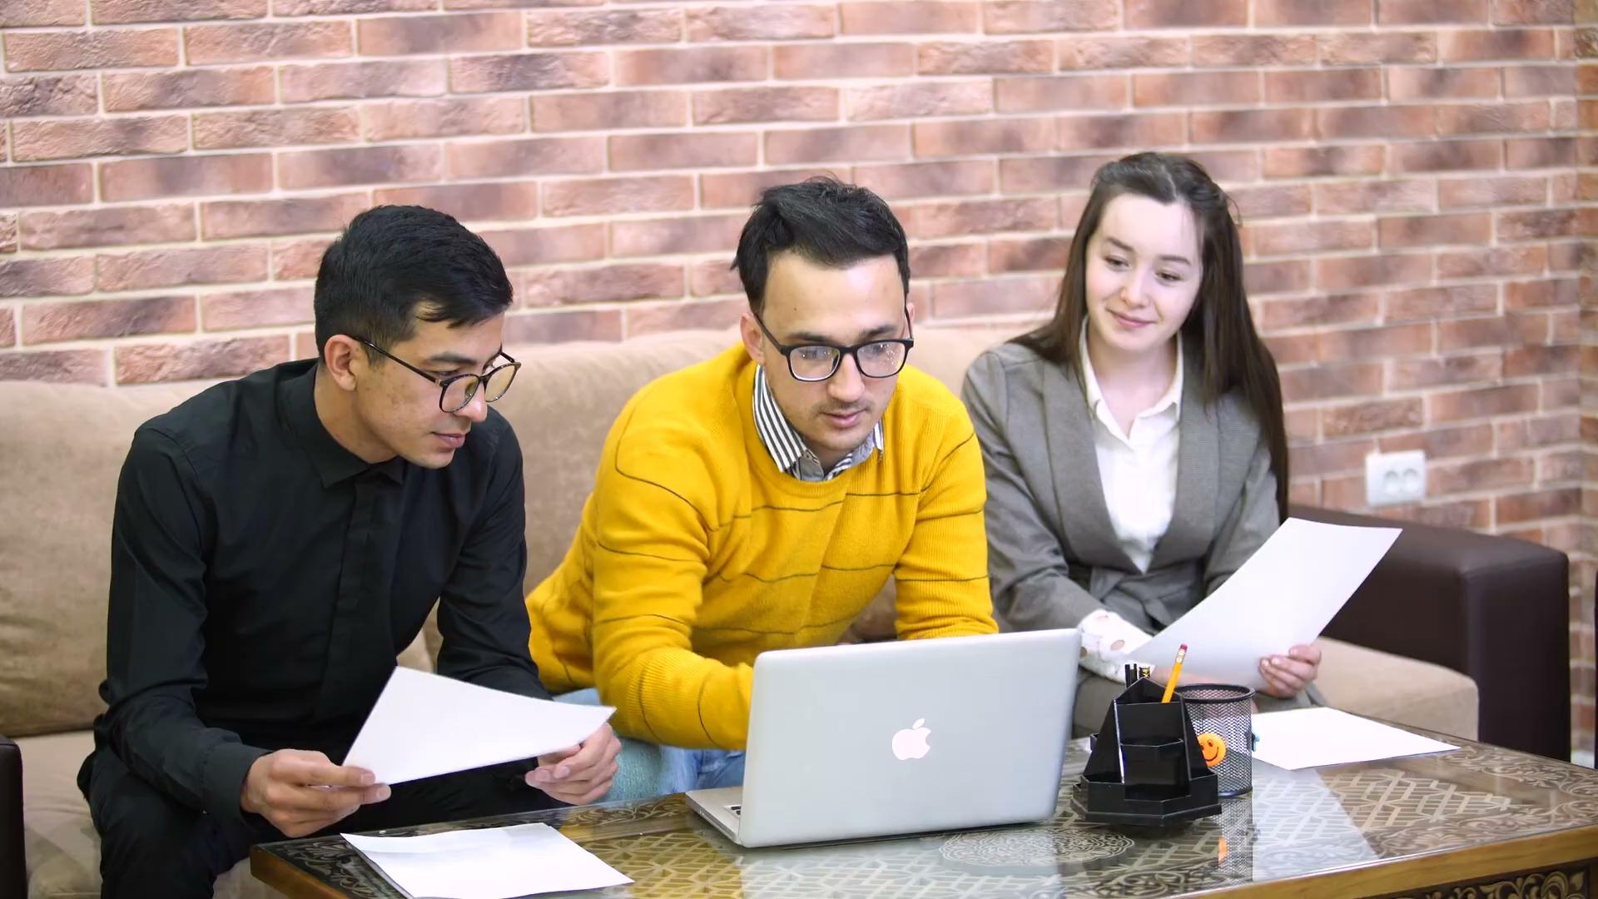
2. 阻礙
Notes:
https://pixabay.com/videos/work-office-people-working-87593/

Slide 4
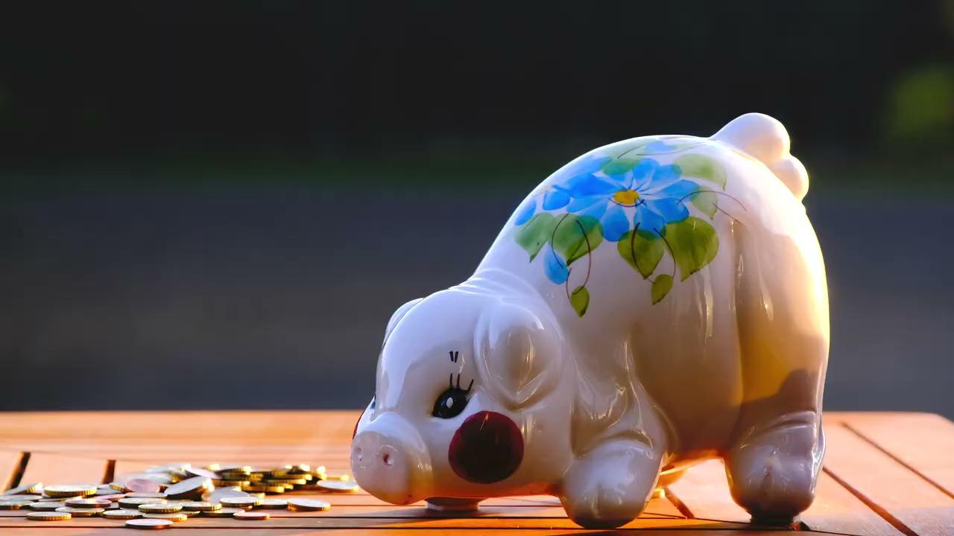
3. 努力
Notes:
https://pixabay.com/videos/piggy-bank-world-savings-day-coins-93550/

Slide 5

3. 努力
Notes:
https://pixabay.com/videos/people-laptop-team-friend-sitting-202134/

Slide 6
4.結果
Notes:
https://pixabay.com/videos/dog-puppy-human-high-5-smart-135025/

Slide 7
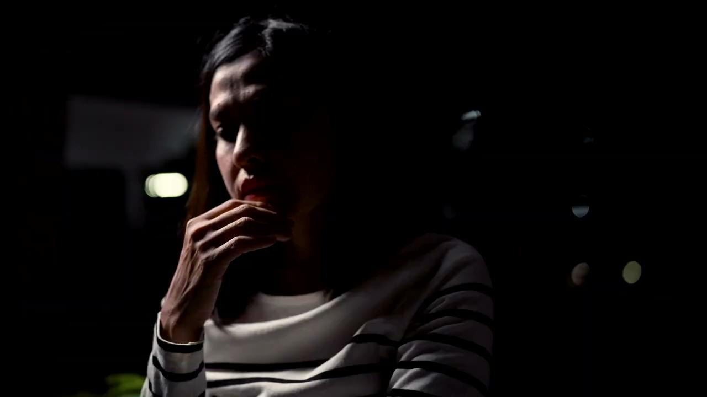
5.意外
Notes:
https://pixabay.com/videos/heartbroken-upset-sorrow-187521/

Slide 8
6. 轉彎
Notes:
https://pixabay.com/videos/brain-mind-knowledge-think-206173/

Slide 9

7.結局
Notes:
https://pixabay.com/videos/fireworks-pyrotechnics-celebration-201955/

