Slide 1
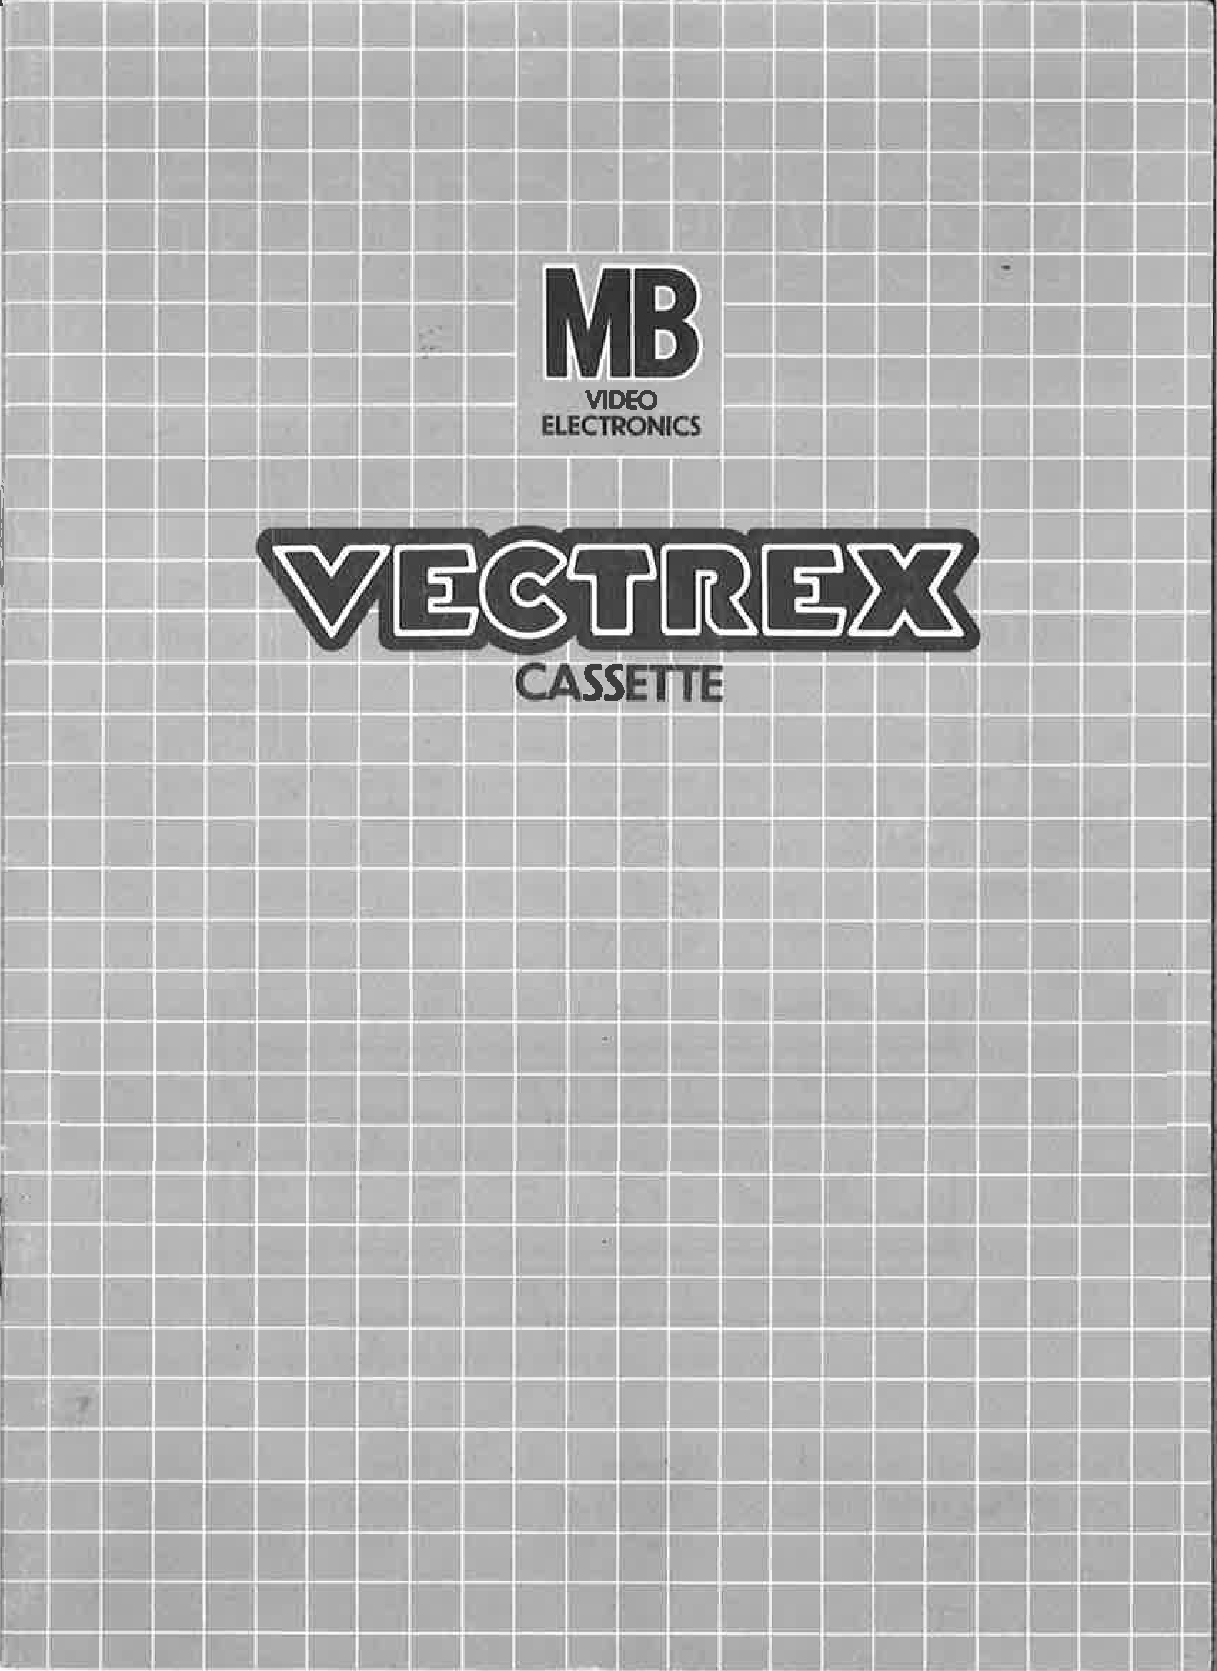
CLIMB IT

Slide 2
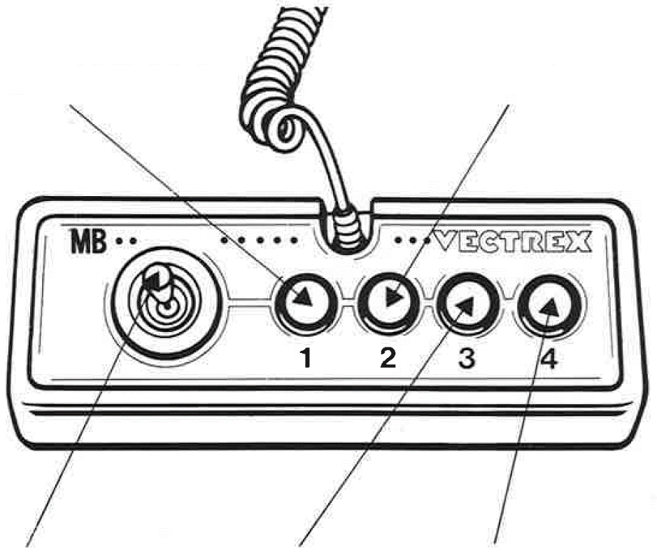
CLIMB IT
GAME CONTROLS
CLIMB IT is designed to be played with the built-in control panel only. The functions of the controls are:
Button 1
not used
Button 2
not used
Joystick
not used
Button 3
not used
Button 4
Starts the game and let the player jump over obstacles

Slide 3
HOW TO PLAY
PLAYER SELECTION
This game is played by one player at the time. So only controller 1 is needed. After one finished his round, he can give the controller to the next person. You can compare your high scores with your friends and see who is the best.
GAME PLAY
Jump over every obstacle on your way up the mountain and win if you're on top or compete against your high score. Your score is incremented by five every time you jumped over an obstacle. The maximum score is 1.275.

Slide 4
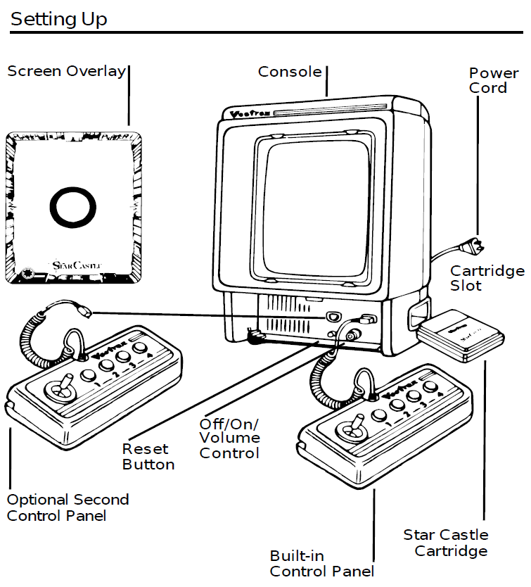
SETTING UP
CREDITS
This game was developed by Christian Fröhlecke and programmed in C and MC6809 assembly language. It is the outcome of a student project which was part of the elective course “Advanced hardware-oriented C and Assembly Language Programming” at Pforzheim University, Germany, in spring term 2020, supervised and tutored by Prof. Dr. rer. nat. Peer Johannsen.

Slide 5


